Slide 1



Public Hearing
AUGUST 29, 2023

Slide 2

Agenda
Review purpose of public hearing
Purpose & Need overview
Project alternatives
Proposed project
Environmental process
Project timeline

Slide 3

Public Hearing Process
Requirement of the National Environmental Policy Act (NEPA)
Impacts described in the project's environmental document
Environmental document released July 20, 2023:
Project Website (available at the end of this presentation)
INDOT District Office in Greenfield
City of Lawrence, City Hall

Slide 4
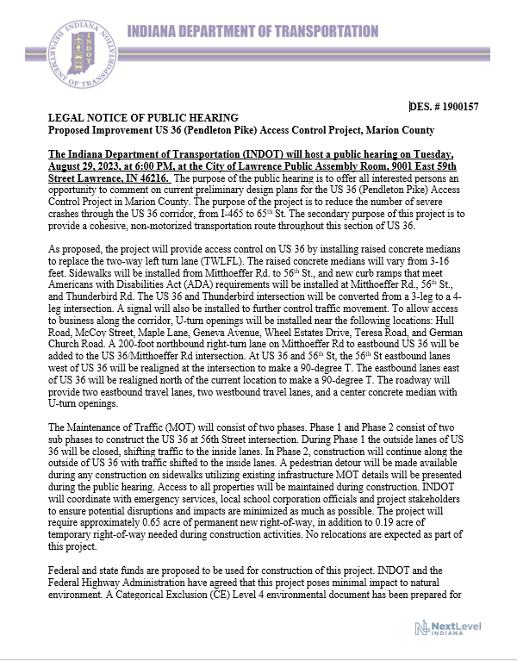
Notice of Public Hearing
Legal Notice of Public Hearing
Advertised in the Indianapolis Star
August 15, 2023 and August 22, 2023
Advertised in La Voz
August 11, 2023 and August 25, 2023
Notice mailed to adjacent property owners
August 15, 2023

Slide 5
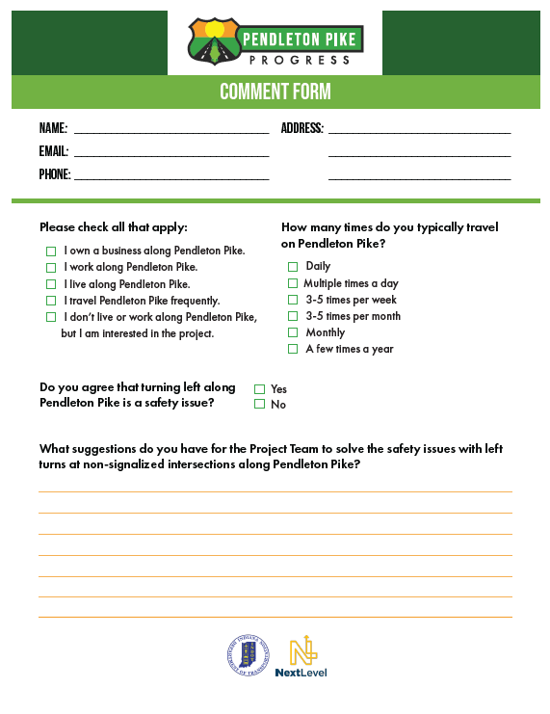
Public Comment Process
In Person
Statement made tonight during the public comment session
Complete comment sheet and leave in the comment box
After the Hearing
Mail, email or faxed to CHA
Contact information at end of presentation
Deadline: September 12, 2023

Slide 6
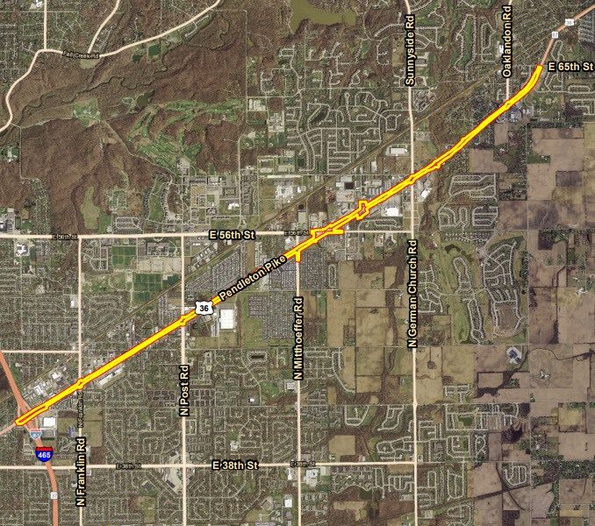
Project location

Slide 7
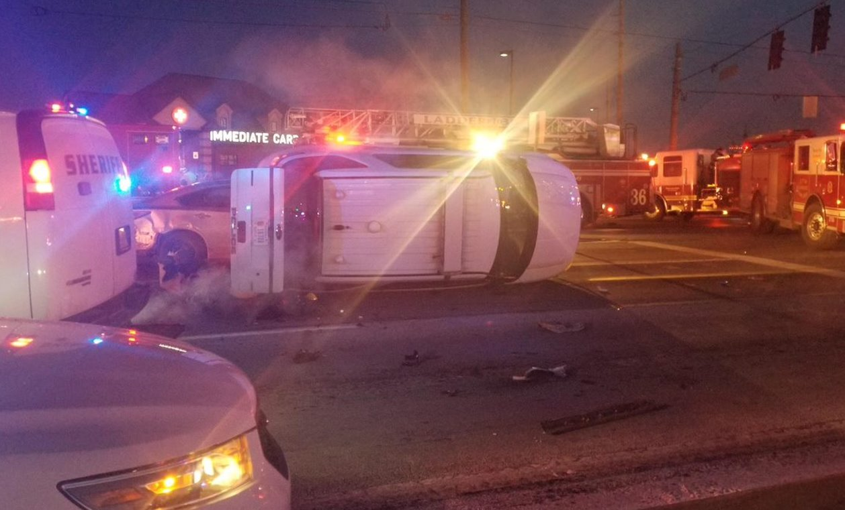
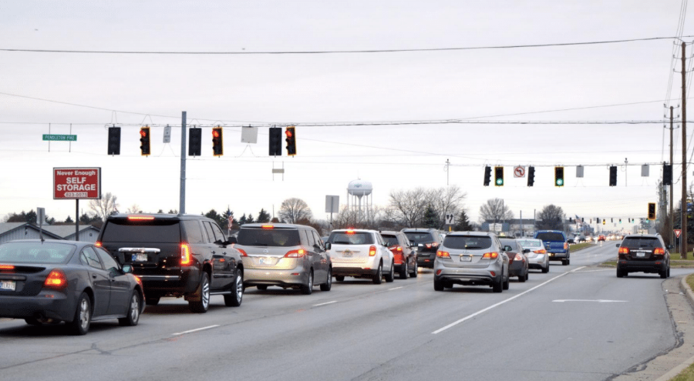
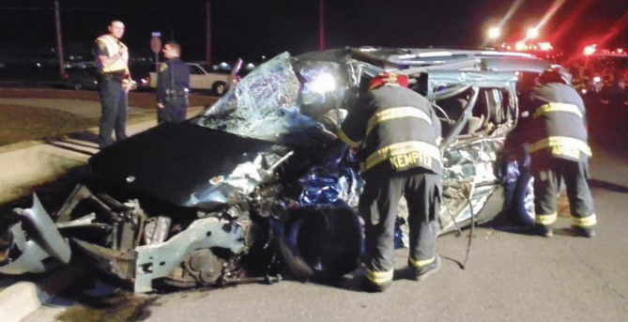
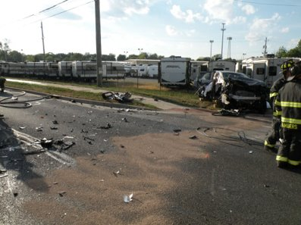
Purpose and Need
High frequency of injury crashes
Reduce congestion at 56th Street intersection
Pedestrian connectivity near 56th Street

Slide 8
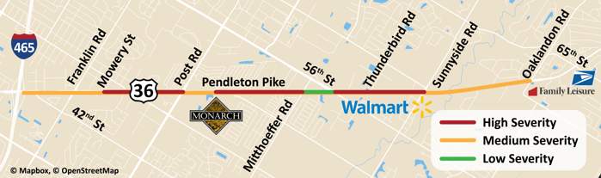
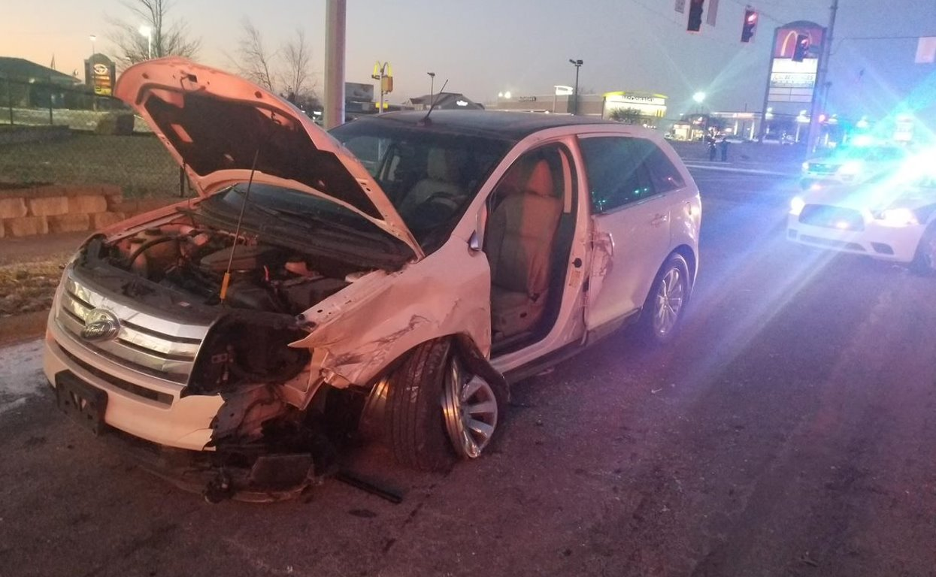
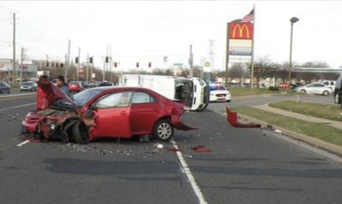
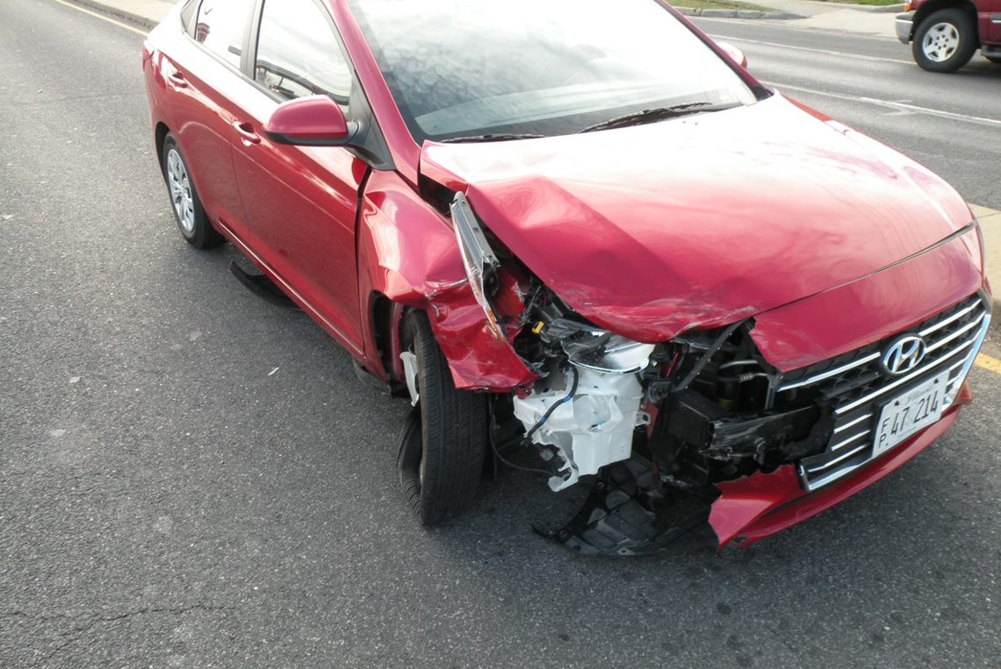
Crash Frequency and Severity
18 crashes
27 crashes
71 crashes
62 crashes
73 crashes
114 crashes
3 crashes

Slide 9
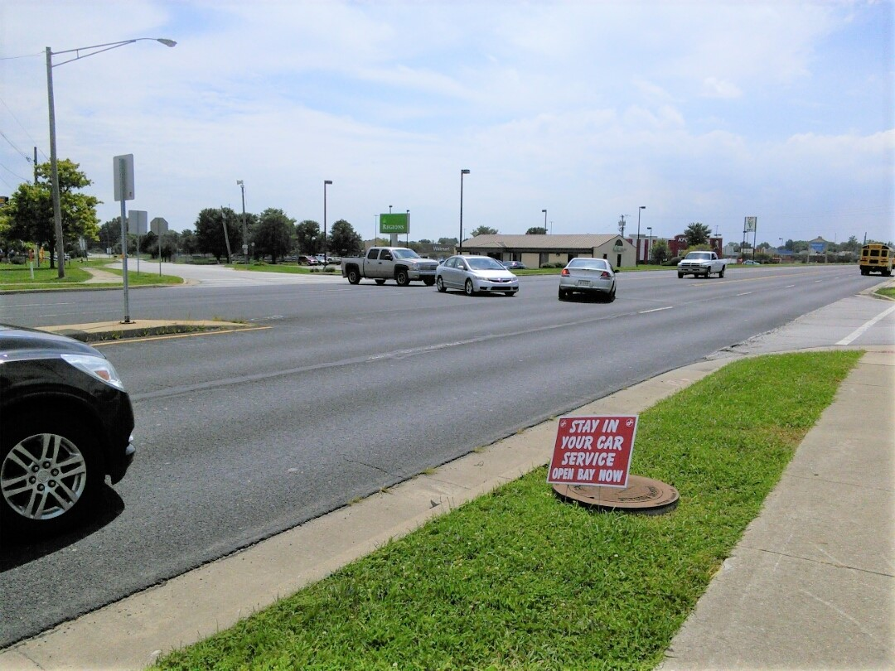
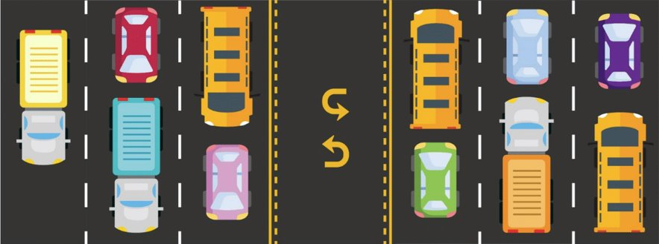
What's Causing Crashes?
Pendleton Pike carries 45,000 vehicles per day
Driveways must cross 3+ lanes to turn left
Difficulties turning left
Aggressive driving

Slide 10
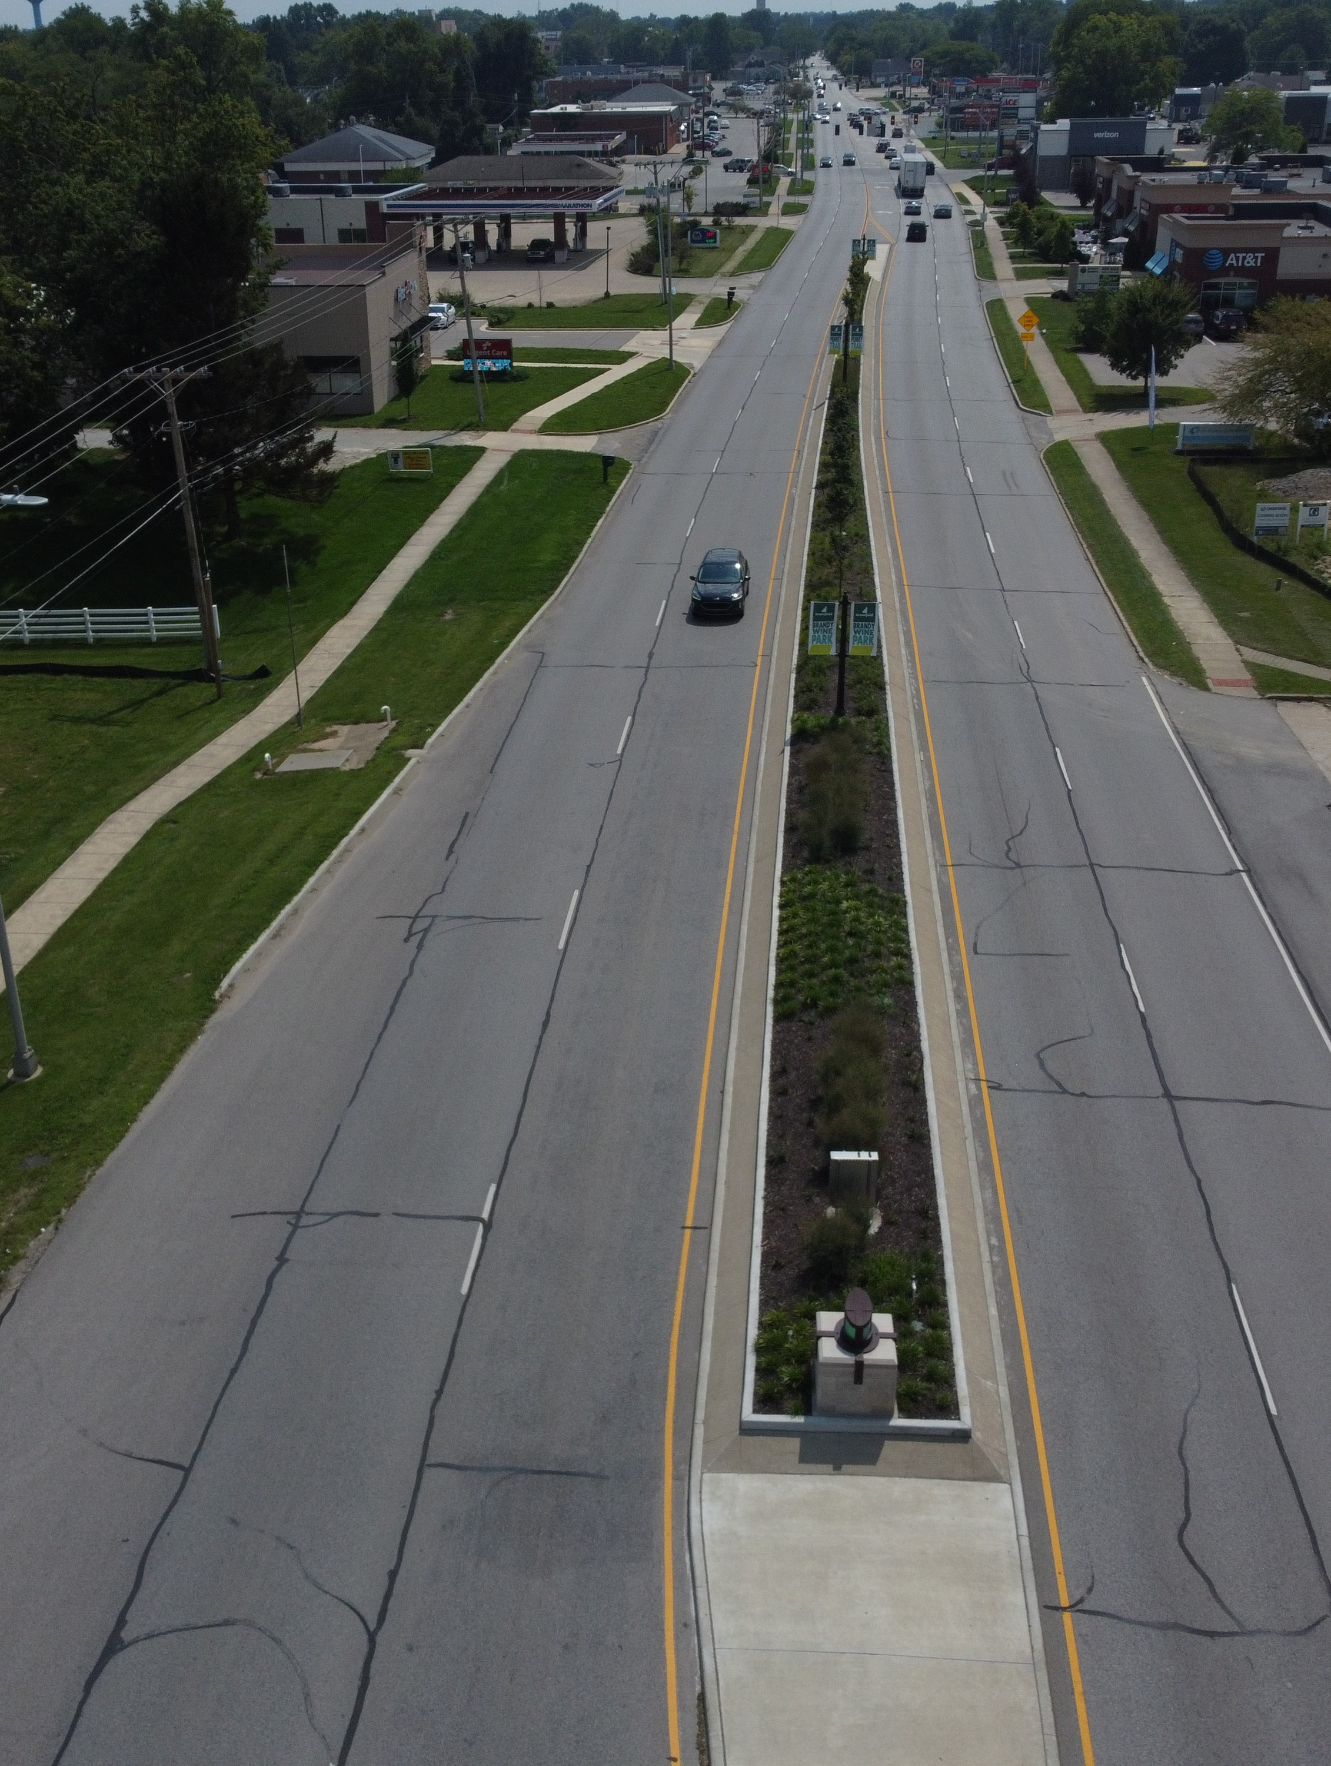
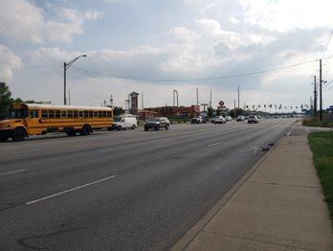
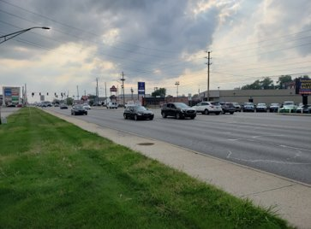
Project Alternatives
No Build: leave the corridor as is
Does not address the purpose and need.
Median U-Turn Corridor:
Does not address crashes between the signals.
Raised Medians with Loons:
Safety concern for pedestrians at U-Turn locations.
Already have favorable street connectivity.
Raised Medians:
Addresses the purpose and needs of the corridor.

Slide 11
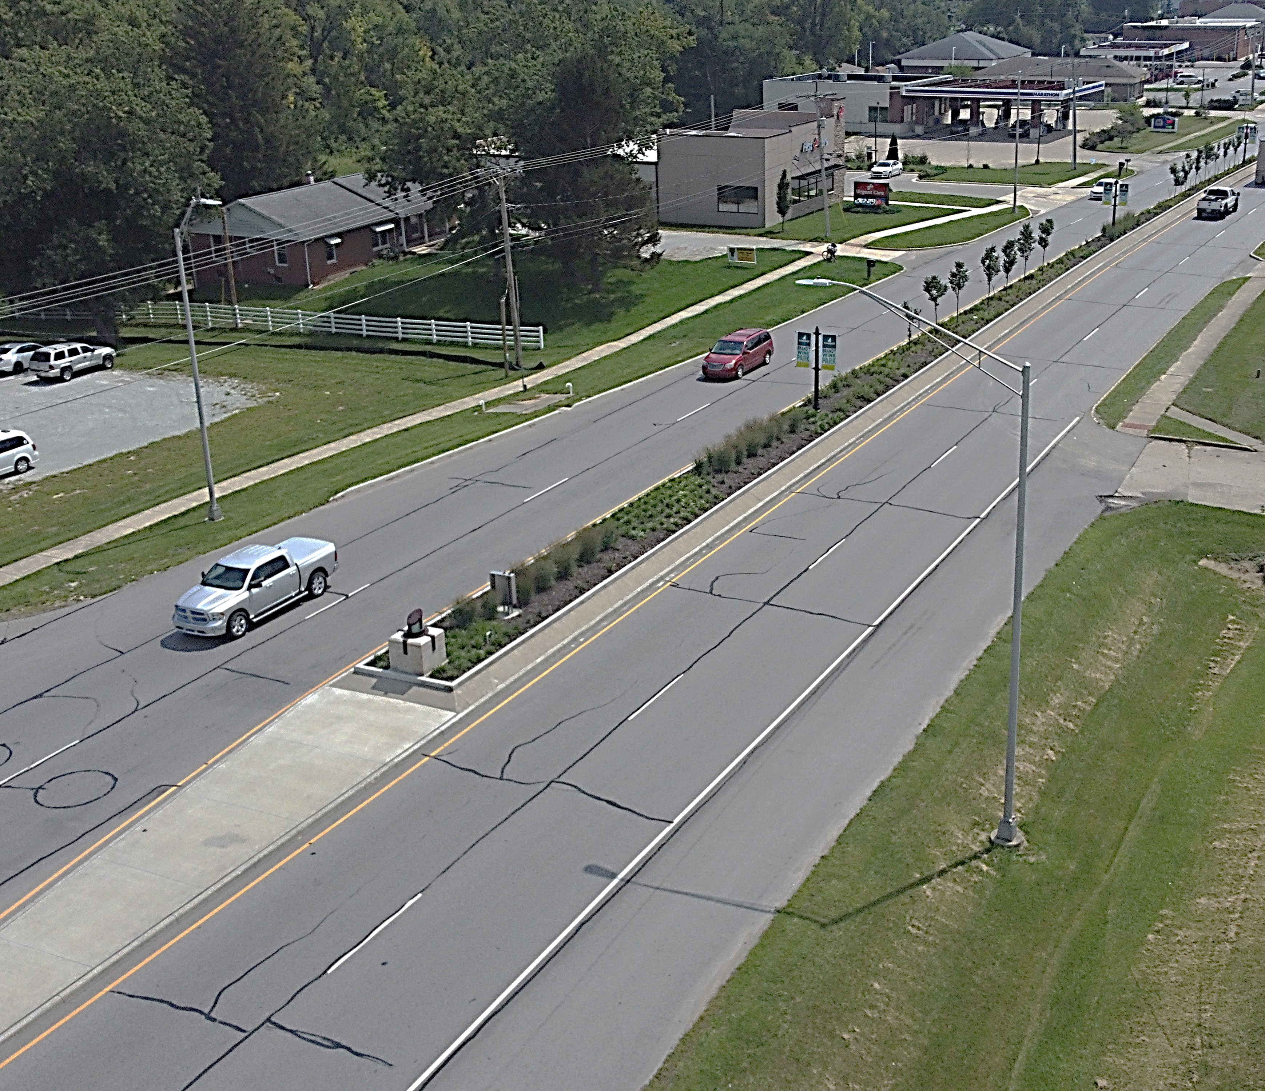
Proposed Solution
Median Benefits
Eliminate angle crashes between intersections
Improve traffic flow
More consistent speeds
Promote safer driving
Coordinating with city on landscaping raised medians.

Slide 12
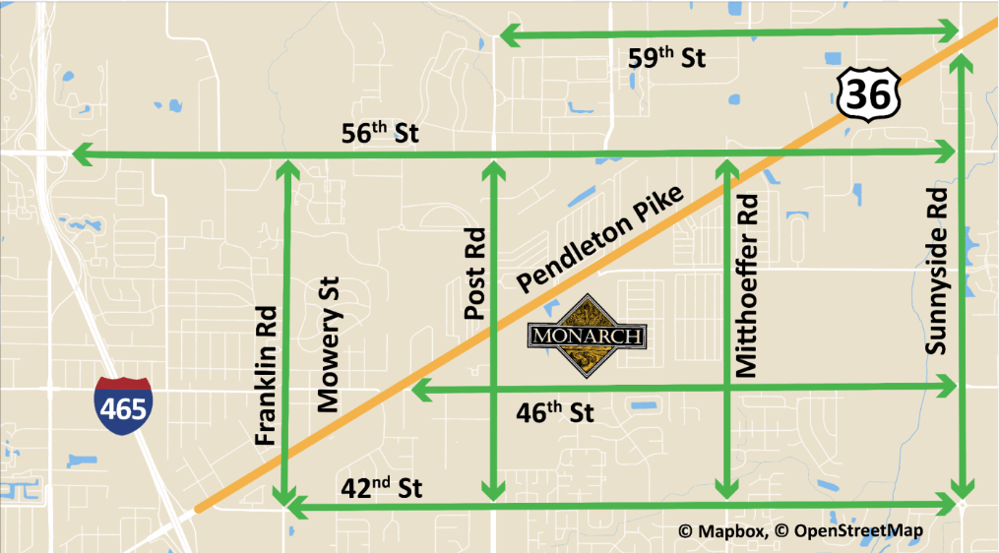
Left Turns for Cross Traffic
Left turns and U-turns will be allowed at signalized intersections
Large trucks can use the road network as shown

Slide 13
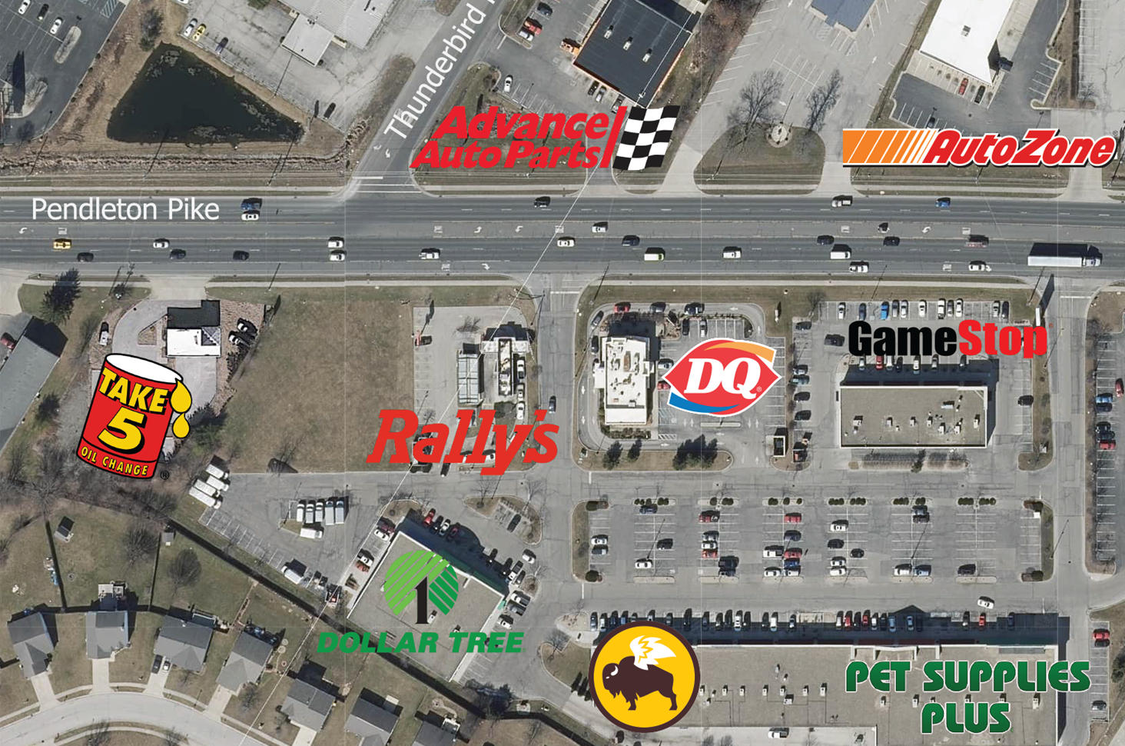
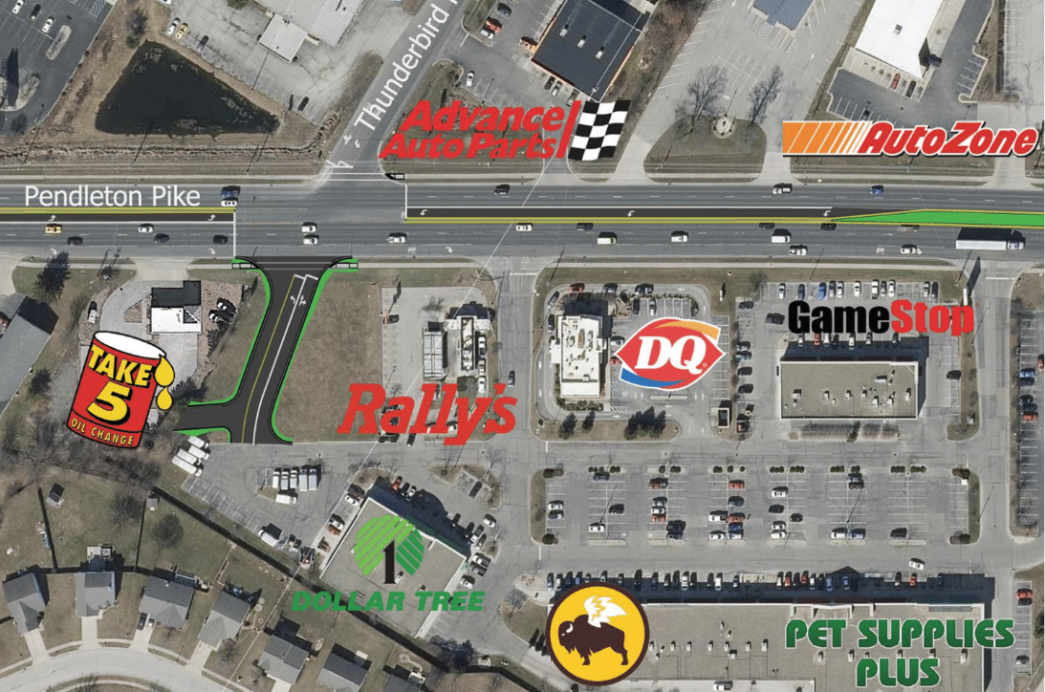
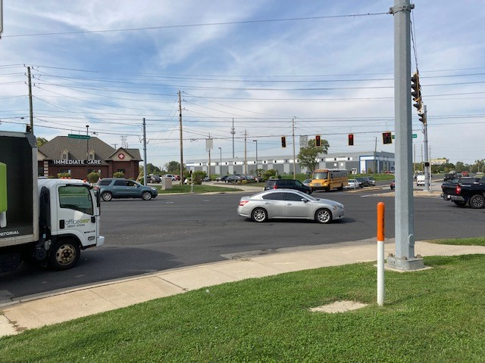
Thunderbird Road Intersection

Slide 14
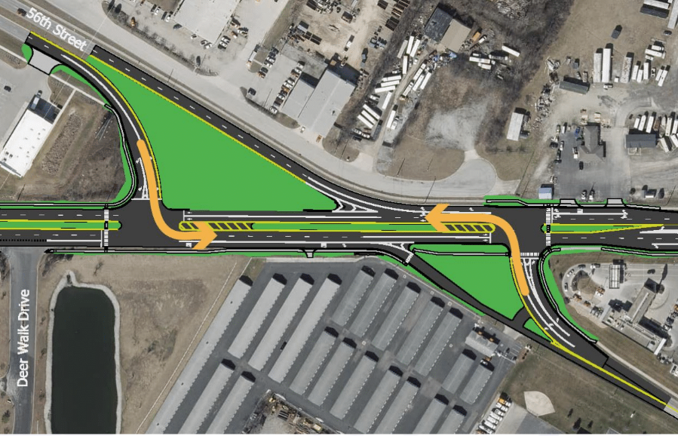
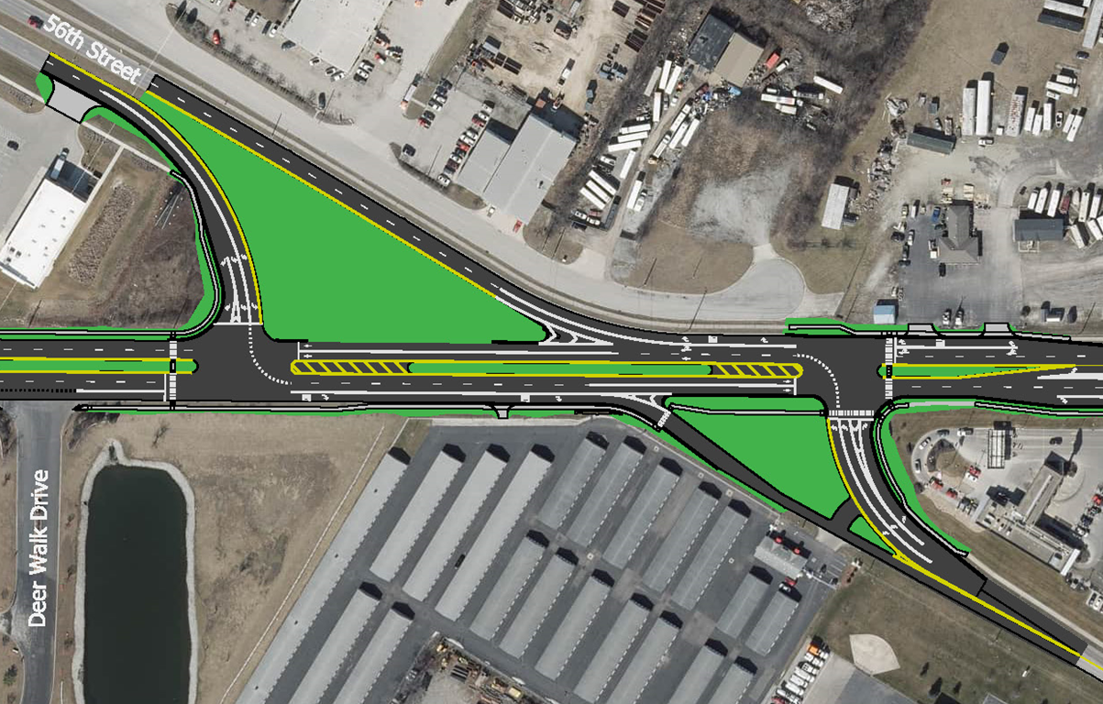
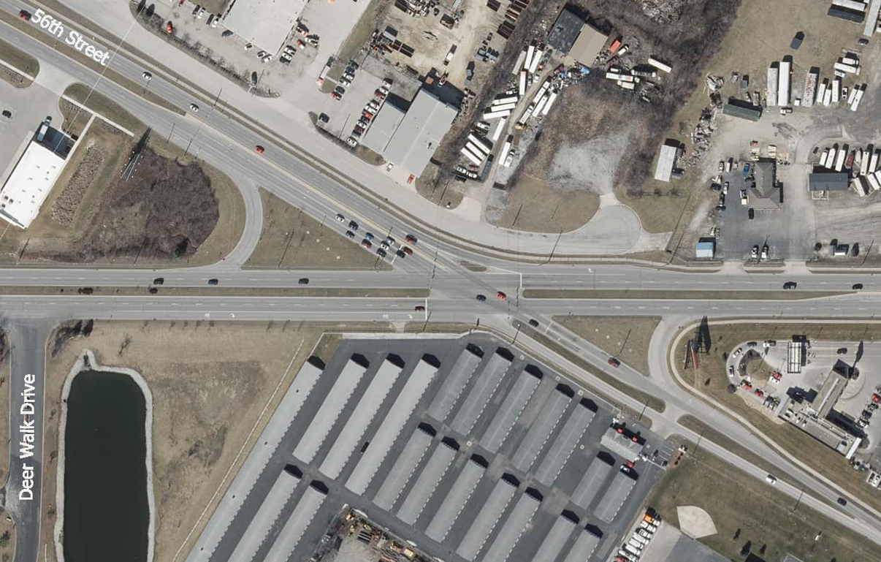
56th Street Intersection
Benefits
Turns get green at same time
Less time stopped at redlights and less congestion
Improved sight distance
Reduces rear-end crashes

Slide 15
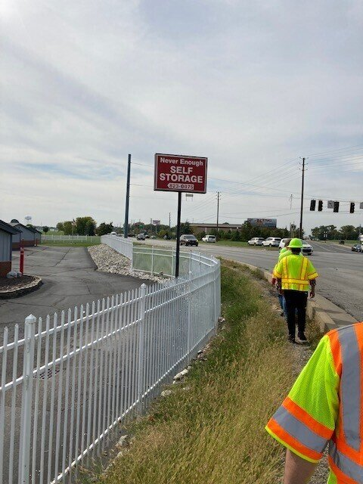
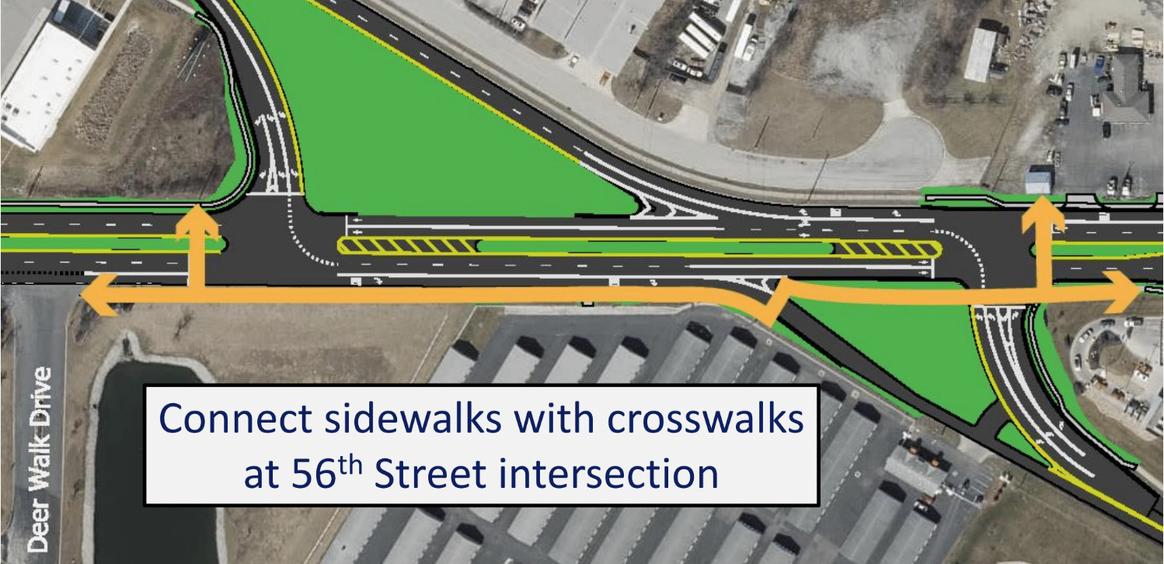
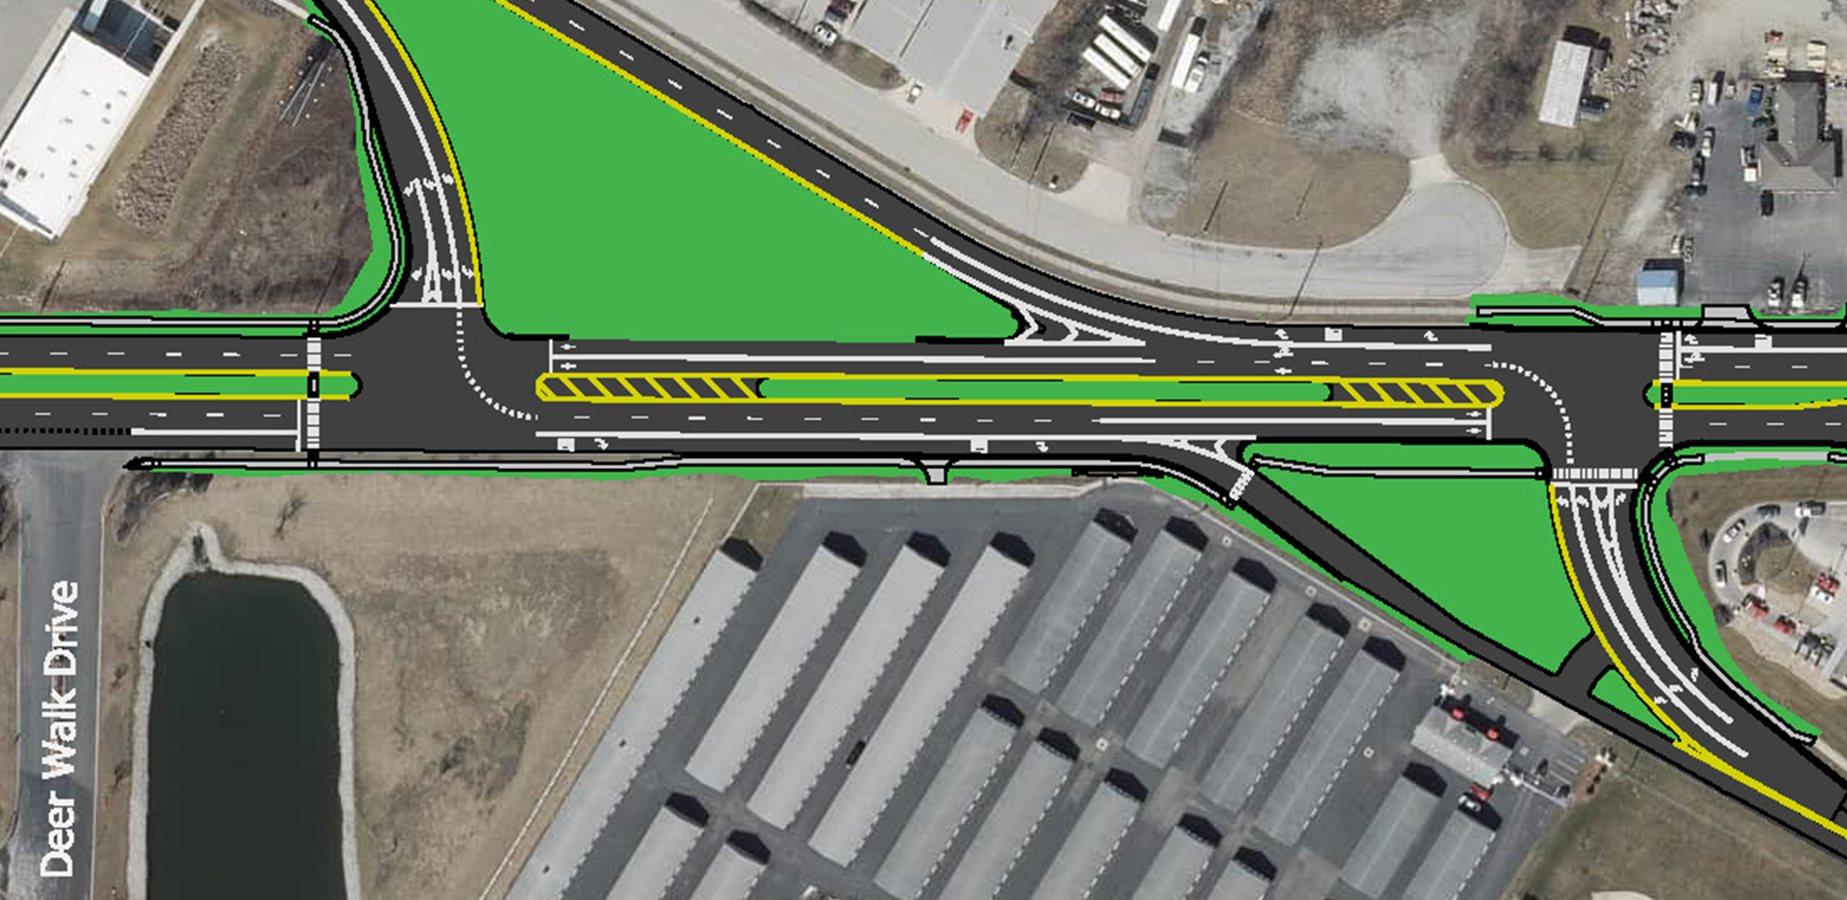
Pedestrian Connections

Slide 16
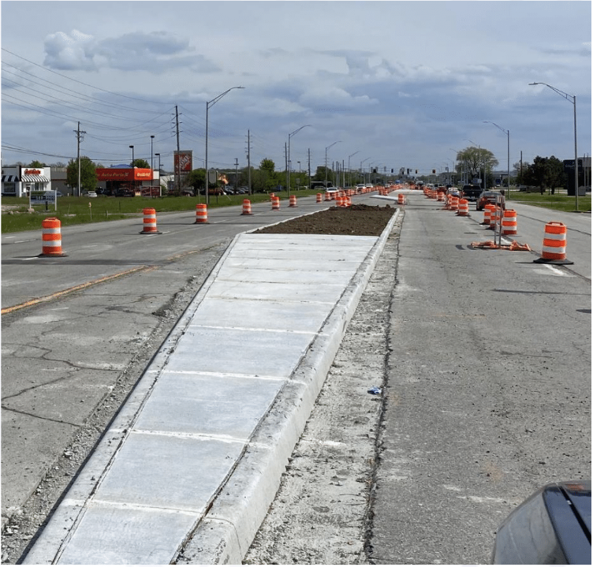
Traffic During Construction
Built in segments
Expected combination of day and night work
Coordination with emergency responders, schools

Slide 17

National Environmental
Policy Act (NEPA)
Environmental analysis and documentation is required for
all federally-funded projects
Evaluates alternatives, including “no build”
Considers and addresses public comments
Incorporates socio-economic and ecological considerations in the decision-making process
What are the impacts?
How can they be avoided or mitigated?

Slide 18
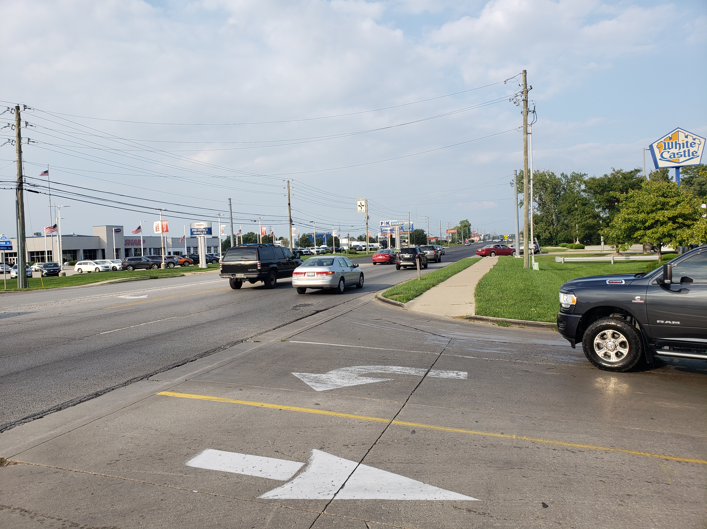
Environmental Impacts
Right-of-way
Cultural Resources
Environmental Justice
Hazardous Material Concerns

Slide 19
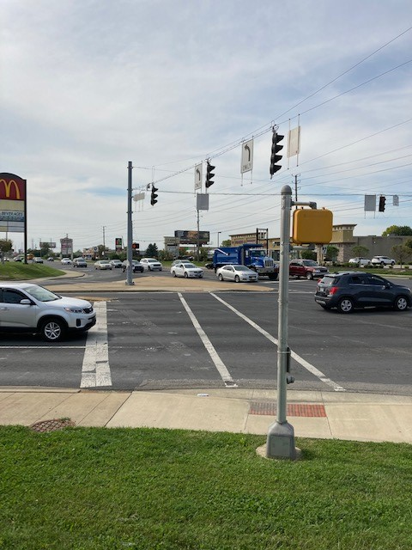
Environmental Impacts
Right-of-Way
Permanent right-of-way: 0.65 acre
Temporary right-of-way: 0.19 acre
No relocations
Cultural Resources
No impact on cultural resources
Section 106 Minor Projects Programmatic Agreement Types B-1, B-2, and B-3

Slide 20
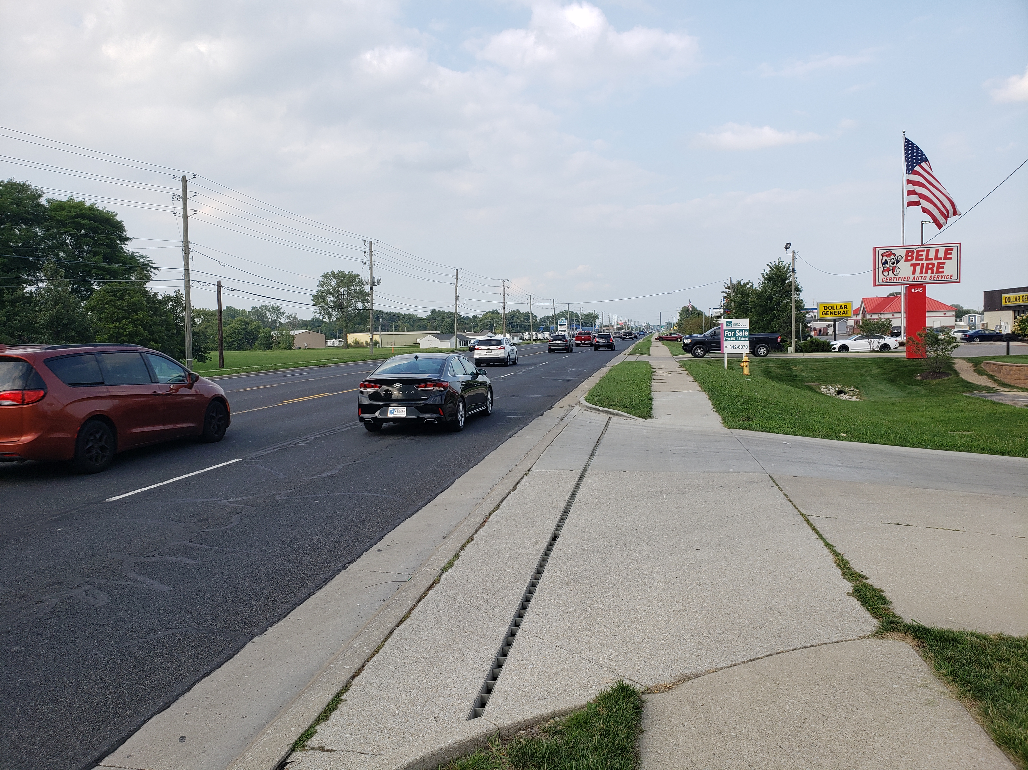
Environmental Impacts
Environmental Justice
Part of FHWA Order 6640.23A
Ensures activities don't have a disproportionately high and adverse effect to minority or low-income populations
Population of low-income concern and minority concern
Everyone benefits from improved safety and pedestrian facilities
All property owners retain access to property during construction
Project will not result in a disproportionately high and adverse effect to environmental justice populations.

Slide 21
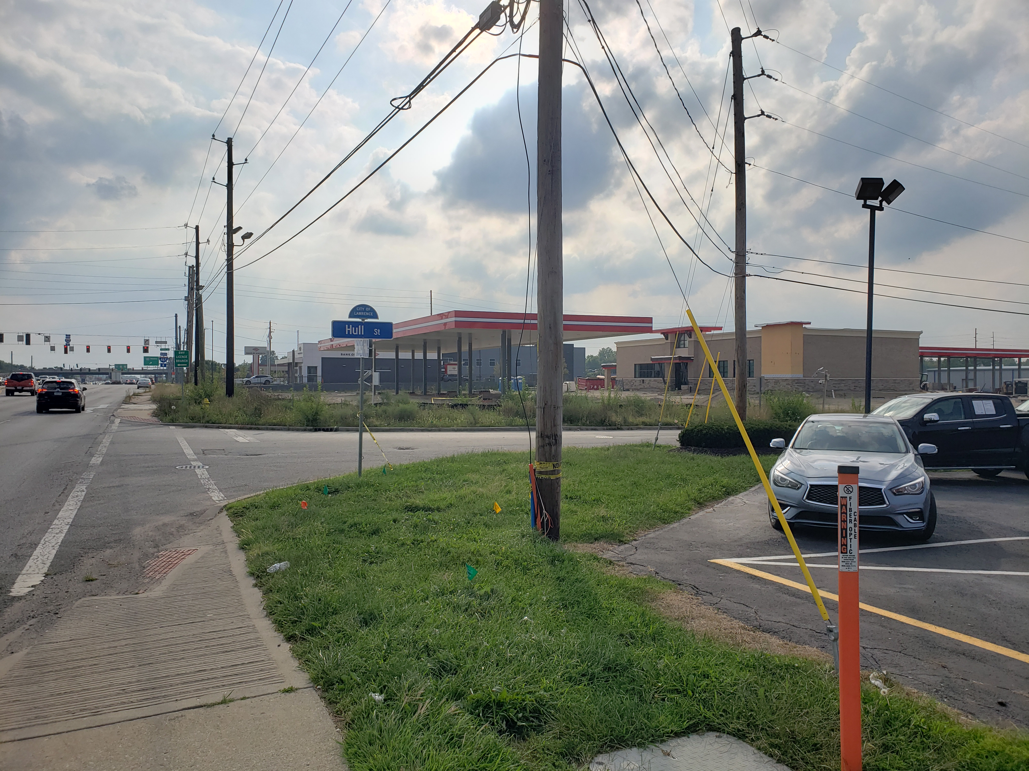
Environmental Impacts
Hazardous Material Concerns
Multiple locations with hazardous material concerns or sites with regulated substances
INDOT determined that no locations would need additional studies
Commitments are in place to minimize impacts to environment and public should hazardous materials be found

Slide 22
Anticipated Timeline
Summer 2023
Fall 2023
Late 2023
Summer 2024
Draft environmental document for public review and
comment
Finalize environmental document
Finalize project design
Start
construction

Slide 23
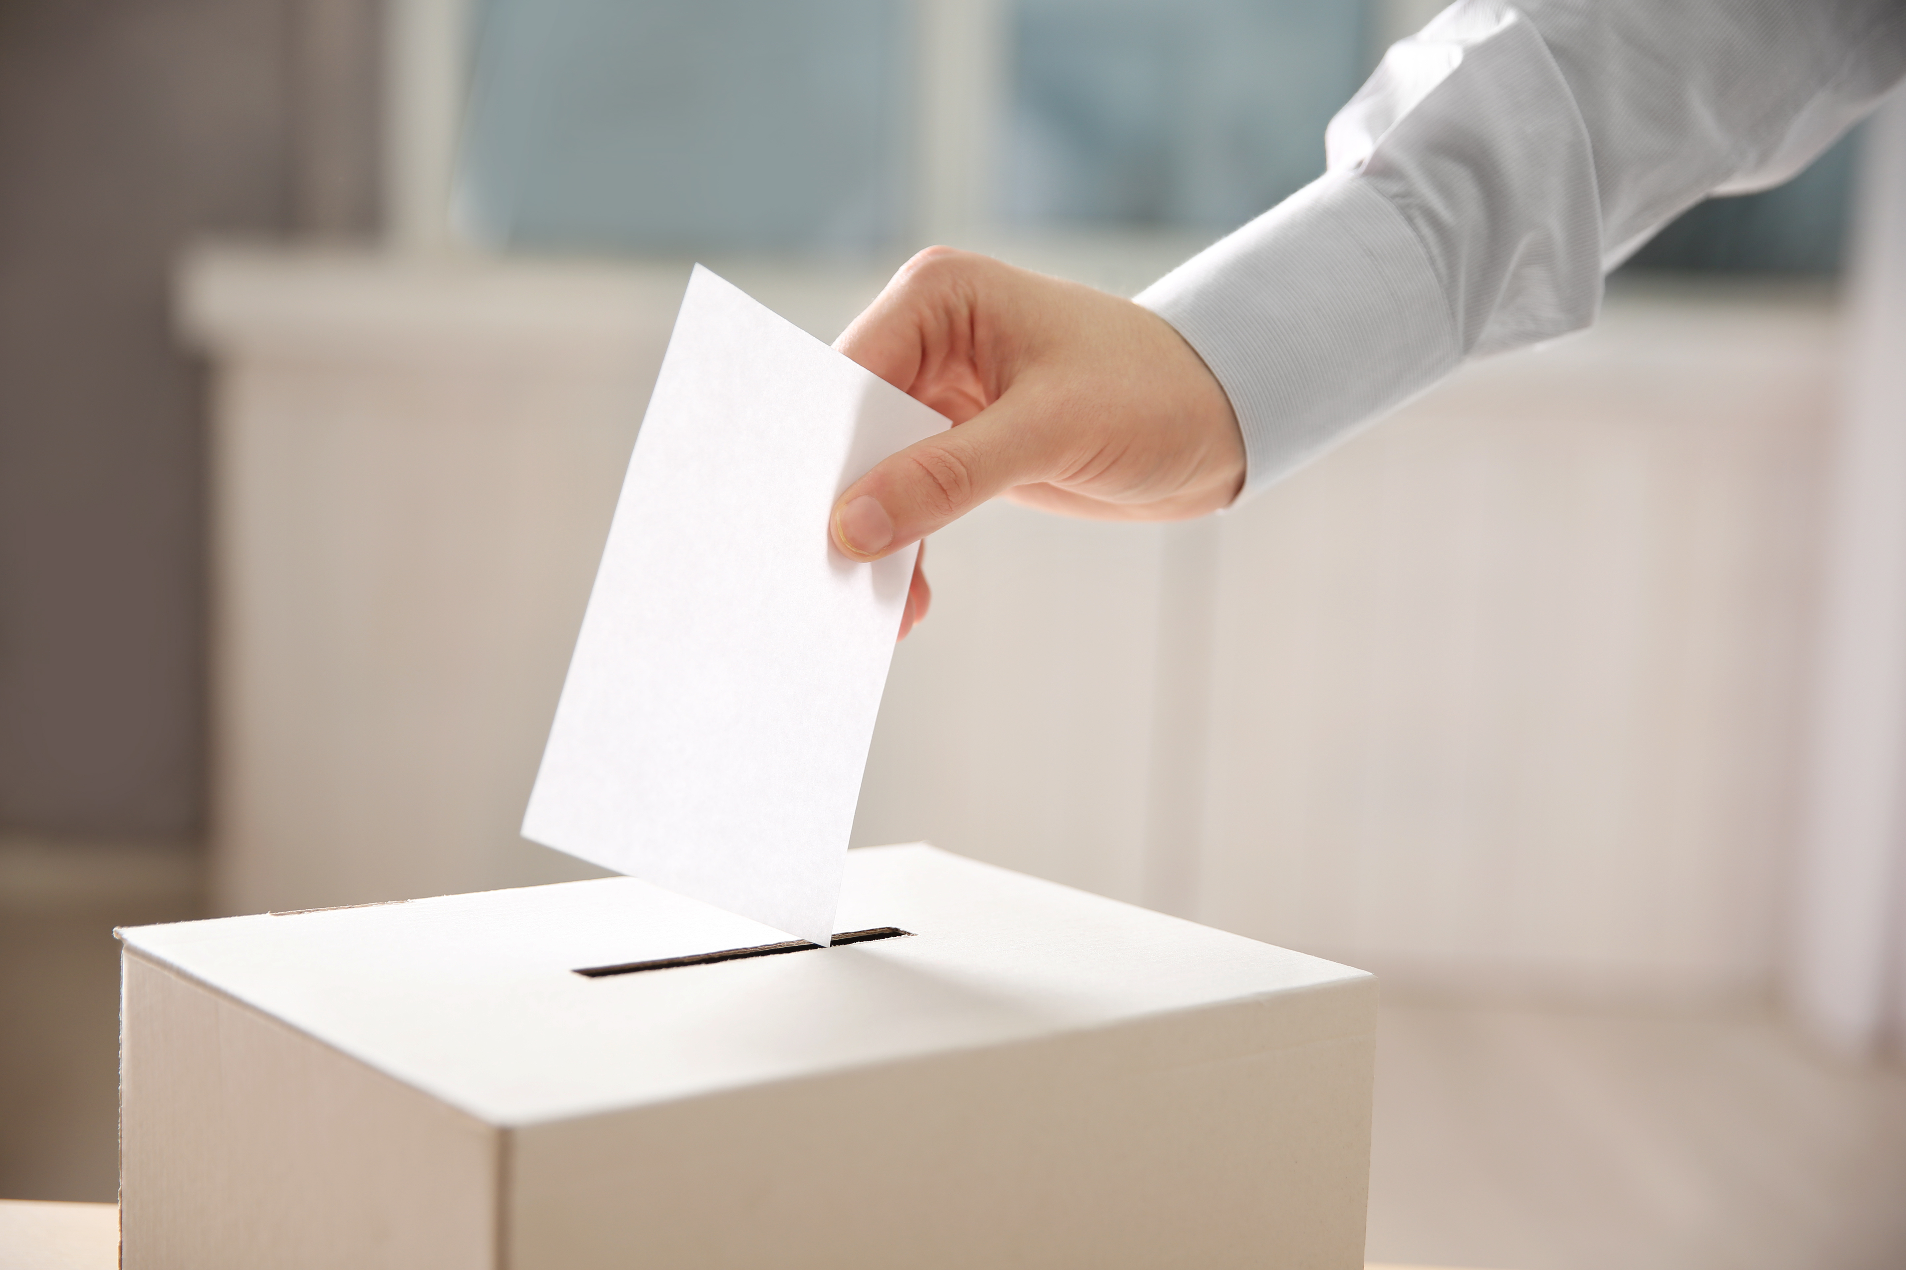
Public Comment Process
Tonight
Statement made during the public comment session
Complete comment sheet and leave in the comment box
After the Hearing
Mail, email or fax to CHA
Leigh Montano, CHA Consulting, Inc.
201 N. Illinois St., Suite 800
Indianapolis, IN 46204
lmontano@chacompanies.com
Deadline: September 12, 2023

Slide 24

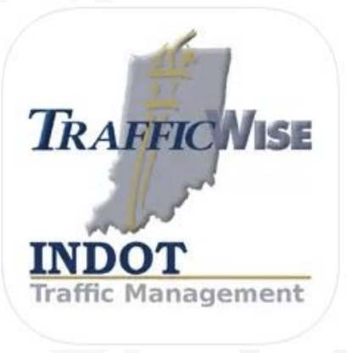
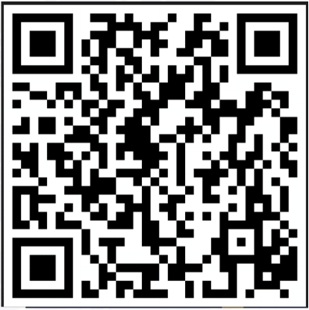
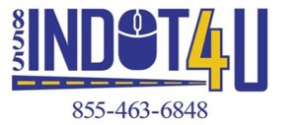
Stay Informed
INDOT East Central on Facebook & @INDOTEast on Twitter
GovDelivery Email & Text Alerts
INDOT4U.com
855-INDOT-4U
511in.org
Available for download on Apple and Android.

Slide 25
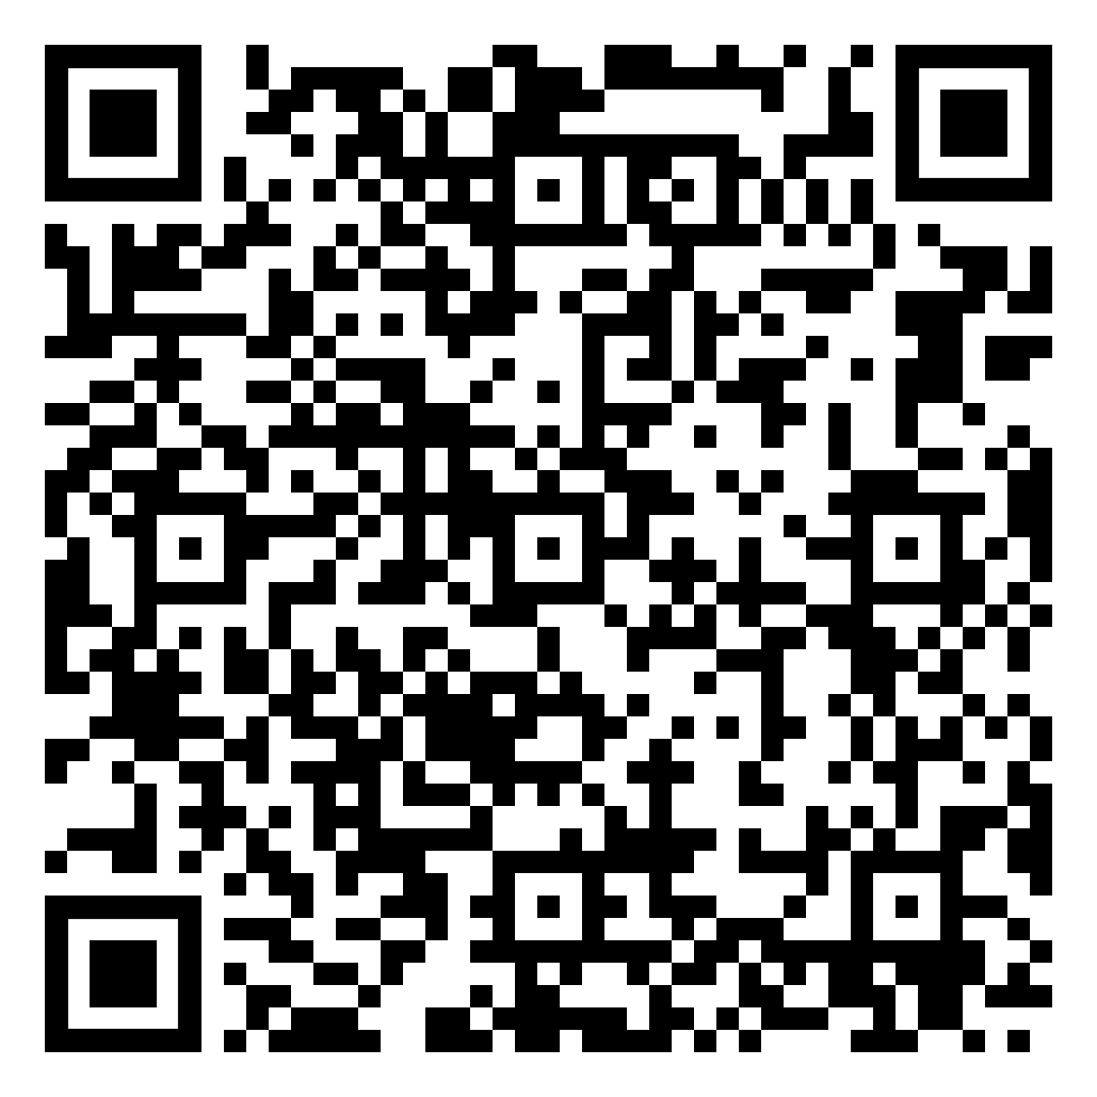
Project Webpage

