Slide 1
S.R. 9 at S.R. 234 Intersection Improvement INDOT DES 2000154
Hancock County
Indiana Department of Transportation

Slide 2

Agenda
Project Overview
Proposed Improvements
What to Expect During Construction
We Want Your Feedback!

Slide 3
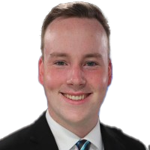
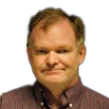

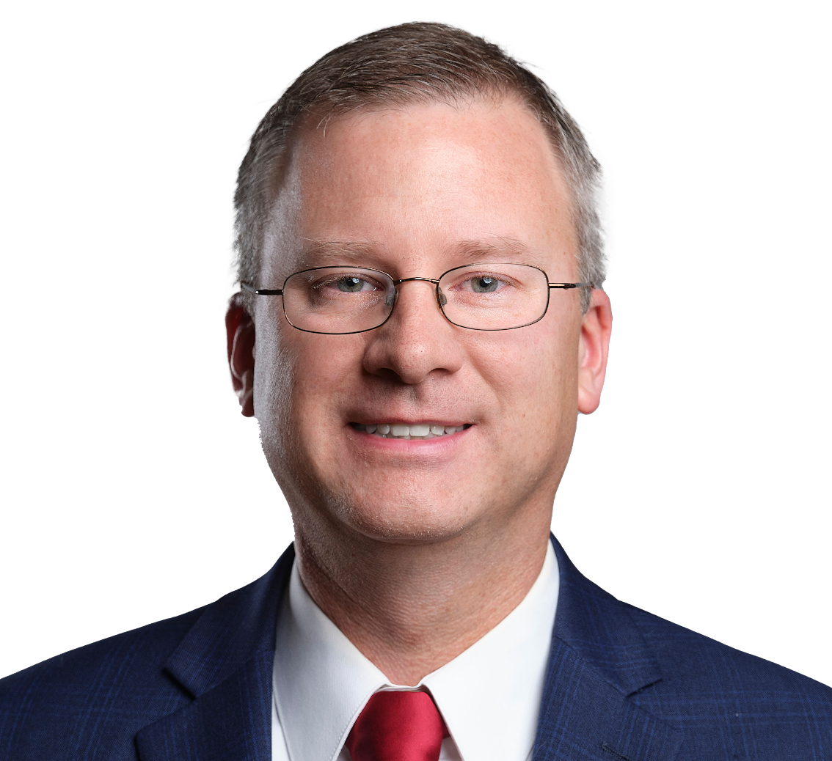
Introductions
Jordan Yaney
Don McGhghy
Michael MacNeil
Nick Batta, PE
Public Relations Director
INDOT
Project Manager
INDOT
District Traffic
INDOT
Design Lead
CMT Engineers and Consultants

Slide 4


Introductions
Introduction of INDOT and CMT Project Team
Greenfield District – INDOT Regional Office
Project management
Public involvement
Engineering and design
Environmental analysis team
Real estate

Slide 5
Public Meeting Advertisements
A public meeting invitation was mailed to known property owners in the project area.
An announcement of this meeting was posted to INDOT’s website and social media channels.
Legal noticed published in the Greenfield newspaper
A presentation and project documentation copy is available online via INDOT’s website.
Be sure to sign-in at attendance table to be added to project mailing list
More information at bit.ly/SR9SR234Roundabout

Slide 6
Project Stakeholders
Indiana Department of Transportation
Indiana Division Federal Highway Administration
Green Township and Hancock County local officials
Residents and citizens
Businesses
Emergency services
Greenfield-Central Schools
Churches
Community organizations

Slide 7
Project Development
Identify preferred alternative
Preliminary design phase
Provide environmental document for public viewing
Data Collection
Need and purpose
Develop alternatives
Screen alternatives
Additional work to finalize project design
Real estate acquisition
Project selection
Early coordination
Construction
We Are Here

Slide 8
Environmental Document
National Environmental Policy Act (NEPA)
Requires INDOT to analyze and evaluate the impacts of a proposed project to the natural and socio-economic environments
NEPA is a decision-making process
Purpose and Need
Alternatives Screening
Preferred Alternative
Impacts Are Analyzed, Evaluated, and Described in an Environmental Document
What are the impacts this project might have on the community?
How can impacts be avoided?
Can impacts be minimized?
Mitigation for impacts?

Slide 9
Examples of Items Evaluated
Right-of-way
Streams, wetlands, and other waters
Floodplains
Endangered species
Cultural resources (historic/archaeological)
Parks and recreational lands (trails)
Community impacts
Environmental justice
Hazardous materials
Permits
Mitigation
Public involvement

Slide 10
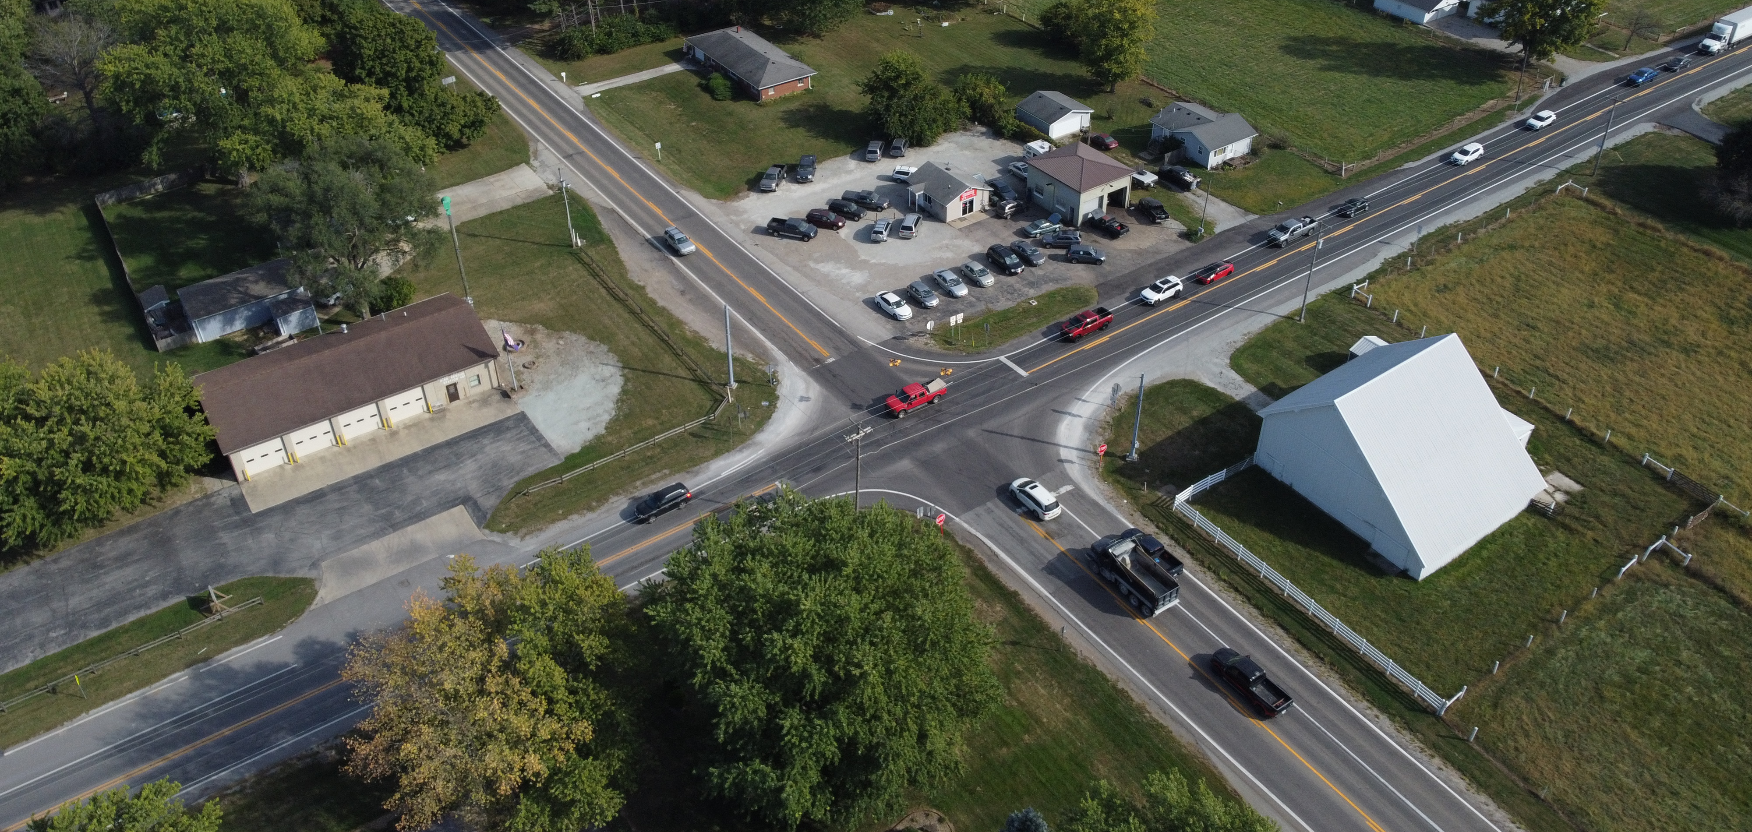

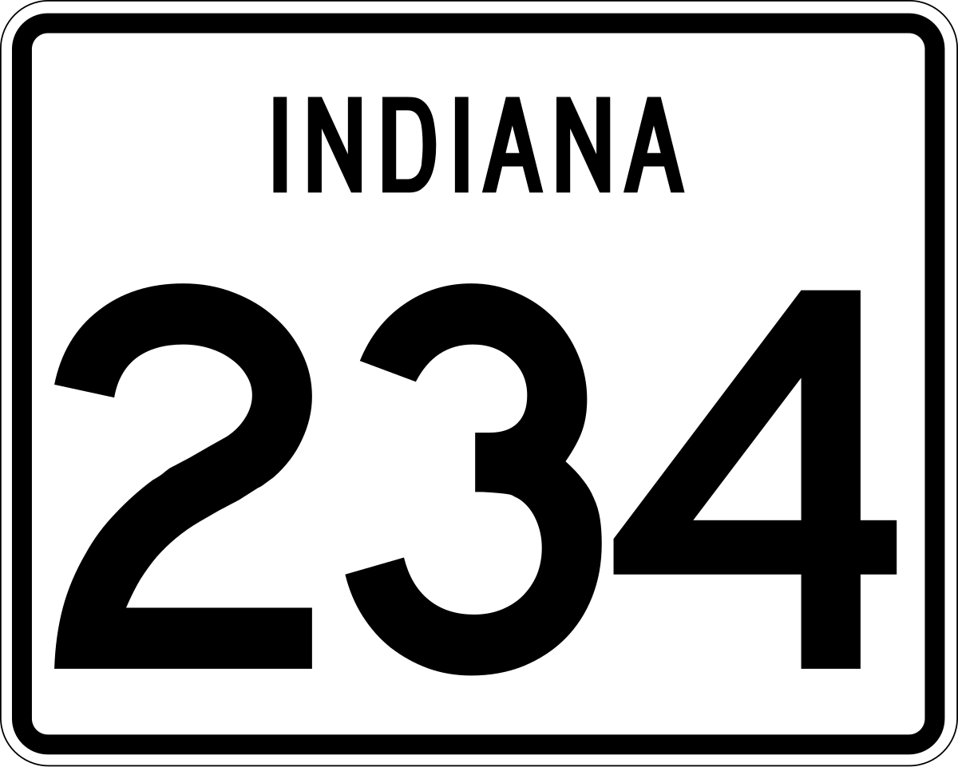

Project Location
N

Slide 11

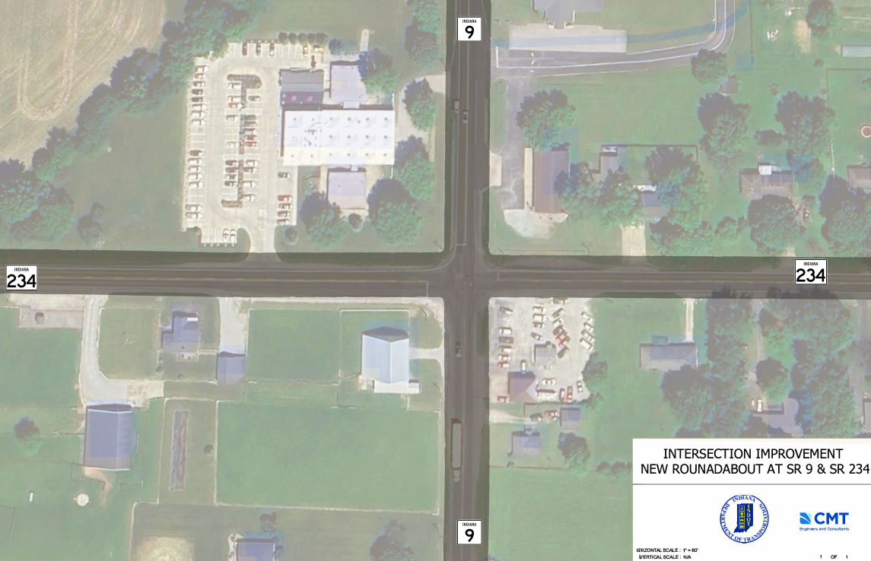
Need and Purpose
Need
24
Over
3 of 4
70%
N
Intersection legs are
congested in PM
crashes in 2022-2024
more frequent crashes compared to similar intersections
In the design year, the morning peak hour will have 2 of the 4 legs also operating at congested levels of service.
Purpose
All four intersection legs operate at acceptable levels to the 2045 design year and reduction in number of crashes.

Slide 12



Alternatives Considered
No-Build Alternative
No improvements to the intersection
Crash frequency and traffic congestion to continue and perhaps get worse
Traffic Signal
Install traffic signal
Add left turn lanes to all four approaches
Improve traffic congestion to acceptable levels
2.81 acres of new right of way would be required
New Roundabout
Install single-lane roundabout
Improve traffic congestion to acceptable levels
Reduce conflict points at intersection from 32 to 8
Requires less new right of way compared to traffic signal with more turn lanes

Slide 13
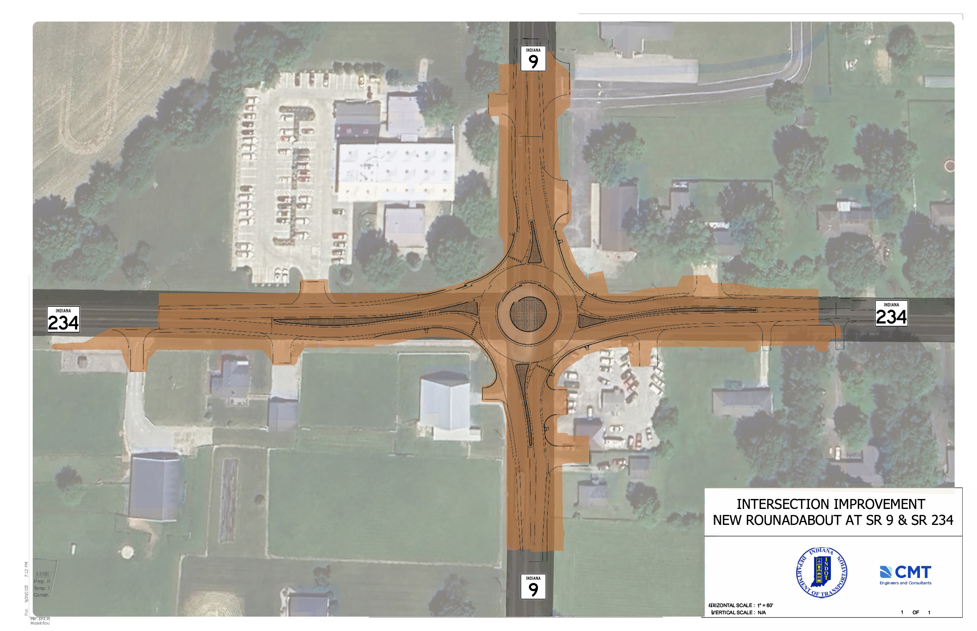
Project Overview

Slide 14




Special Traffic Considerations
Property Owner Access
Fire and EMS Response
School Drop-Off and Pick-Up
Commuter Traffic

Slide 15
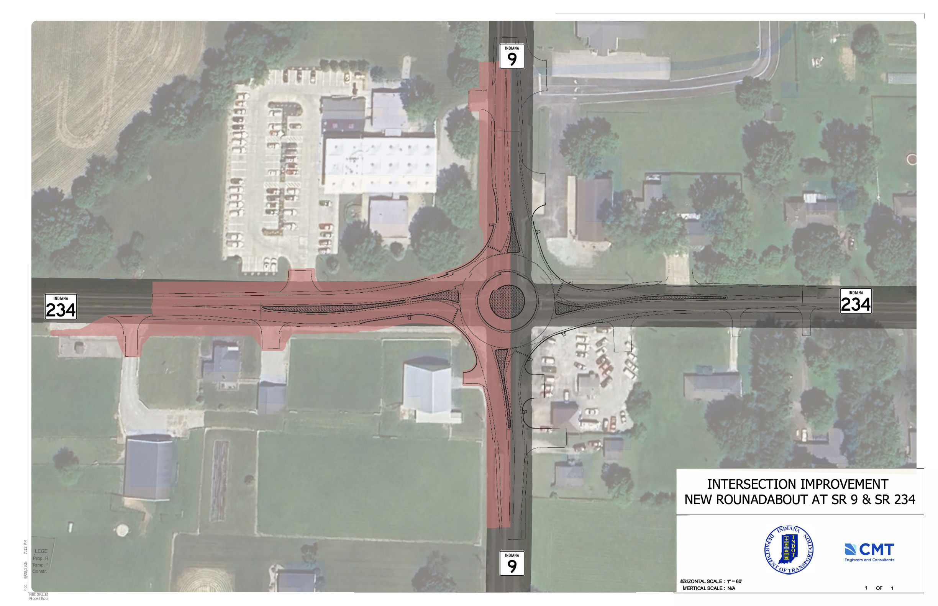
Construction Stages & Timeline
STAGE 1
West Half
SR 9 traffic shifted to use northbound lane only
Construct west half of roundabout
Construct west leg of SR 234
Access to fire station and school provided via existing driveways

Slide 16
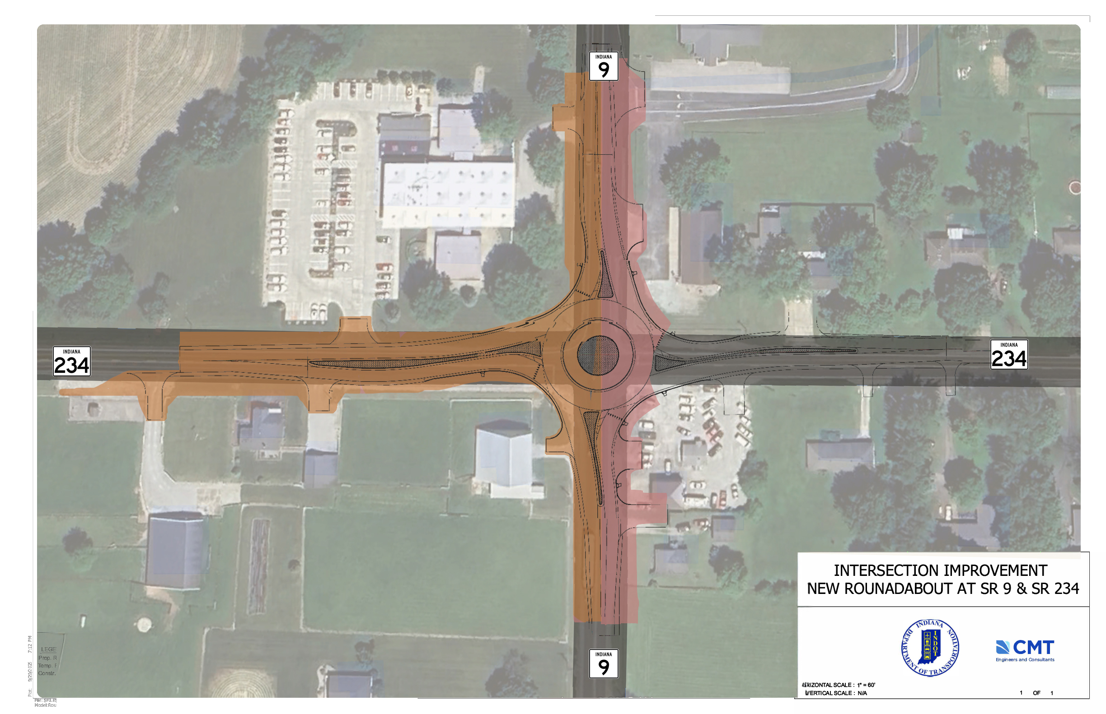
Construction Stages & Timeline
STAGE 2
East Half of SR 9
SR 9 traffic to use new southbound lane
SR 234 remains closed and detoured to through traffic
Fire station access provided via temporary driveway off SR 234
School access to use northern-most driveway

Slide 17
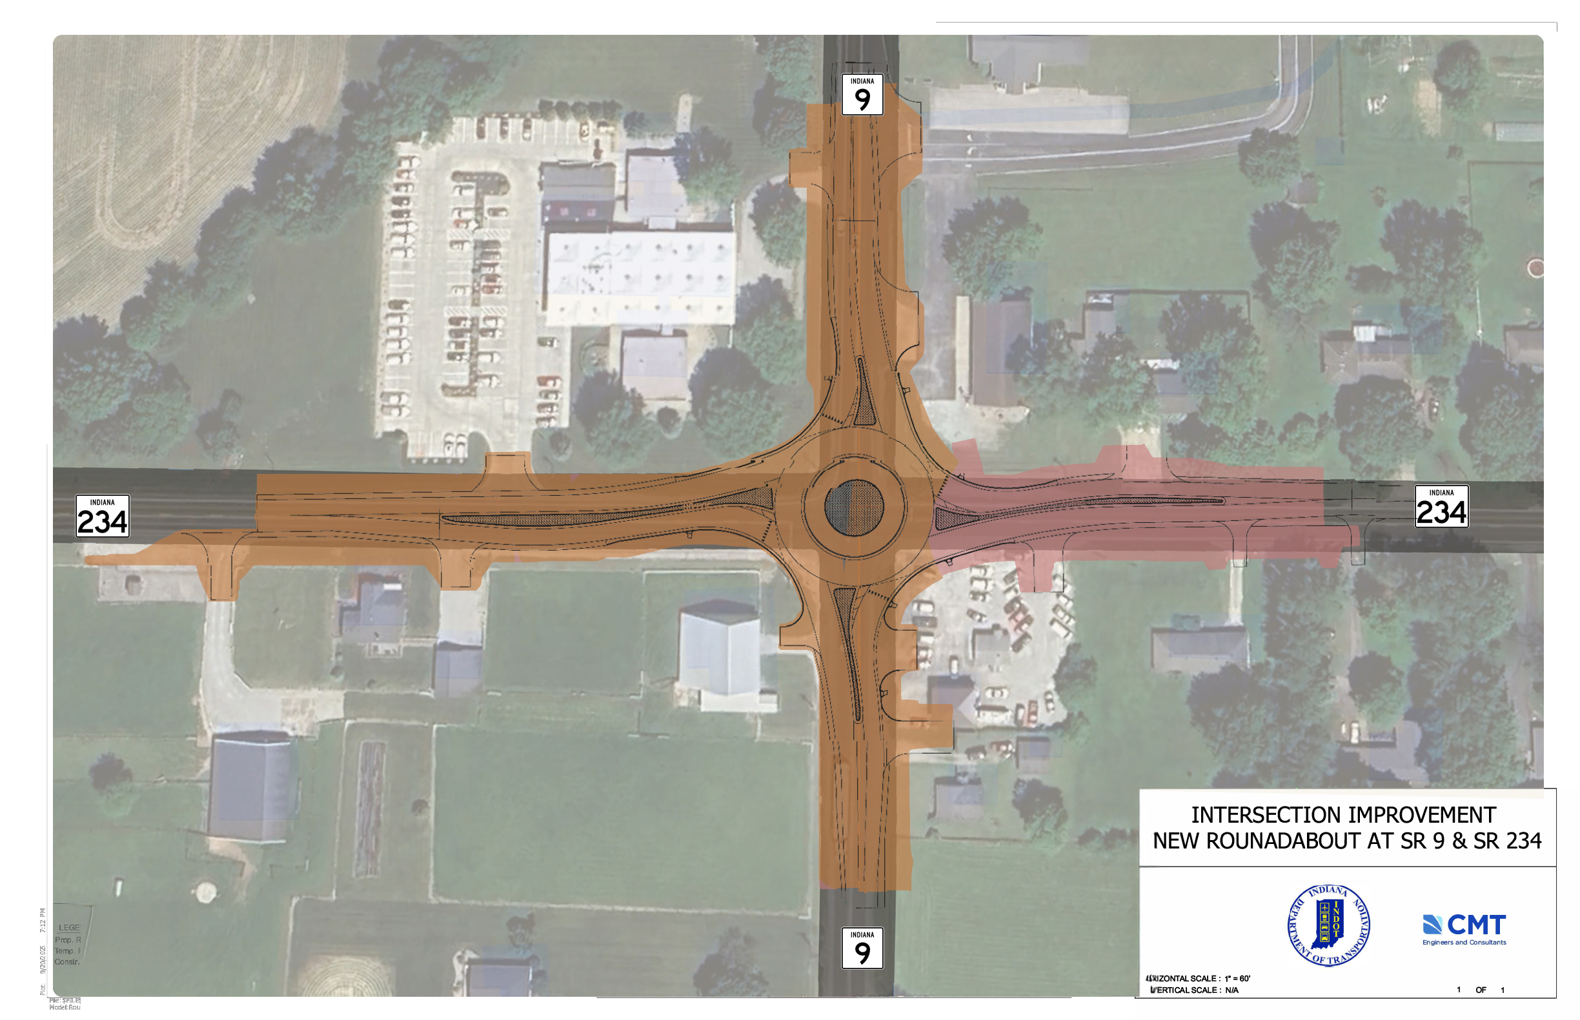
Construction Stages & Timeline
STAGE 3
East Half of SR 234
Each lane of SR 9 is now open to traffic
Construct east leg of SR 234
Fire station access via northern-most school entrance

Slide 18
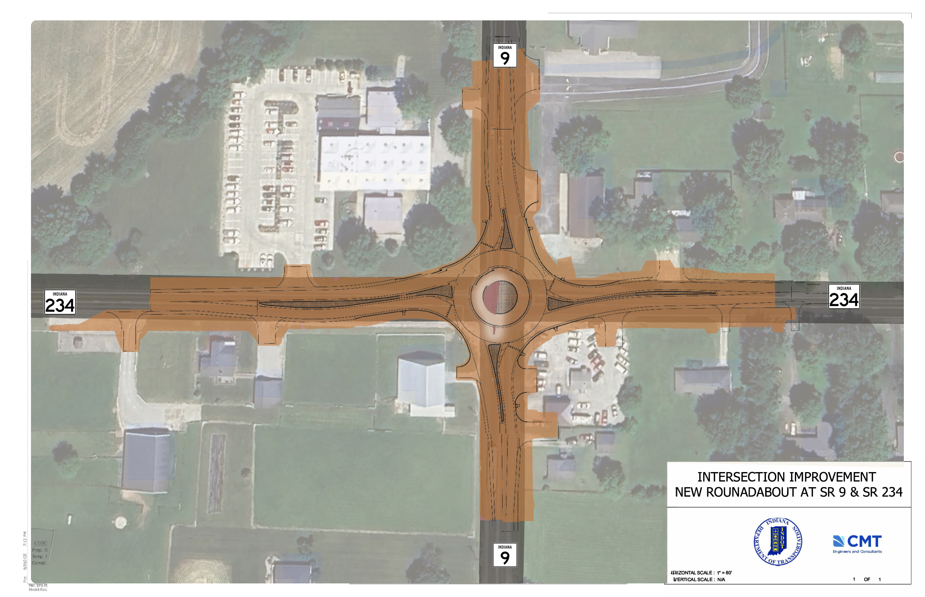
Construction Stages & Timeline
STAGE 4
Roundabout Open
All four legs of roundabout open to traffic
Construct center island and medians
Notes:
.

Slide 19
Environmental Impacts
No impact on streams or wetlands
Irving Materials, Inc. building was found to be eligible for the National Register for Historic Places due to example of Modern/Late Modern architecture
Project will require 0.32 acre of new permanent right of way from parcel
Determined to be a No Adverse Effect

Slide 20
Land Acquisition
1.89 acres of new permanent right of way from 13 parcels
0.24 acre of new temporary right of way from 9 parcels
Appraising is ongoing
Offers expected to be extended early 2026
See Real Estate table for more information

Slide 21
Construction Schedule & Project Cost
Utility Relocations Summer & Fall 2026
Final Design
Fall/Winter 2025
2025
2026
2027
Land Acquisition
Spring 2026
Construction Summer 2027
Phase | Cost
Construction | $2,333,360

Slide 22

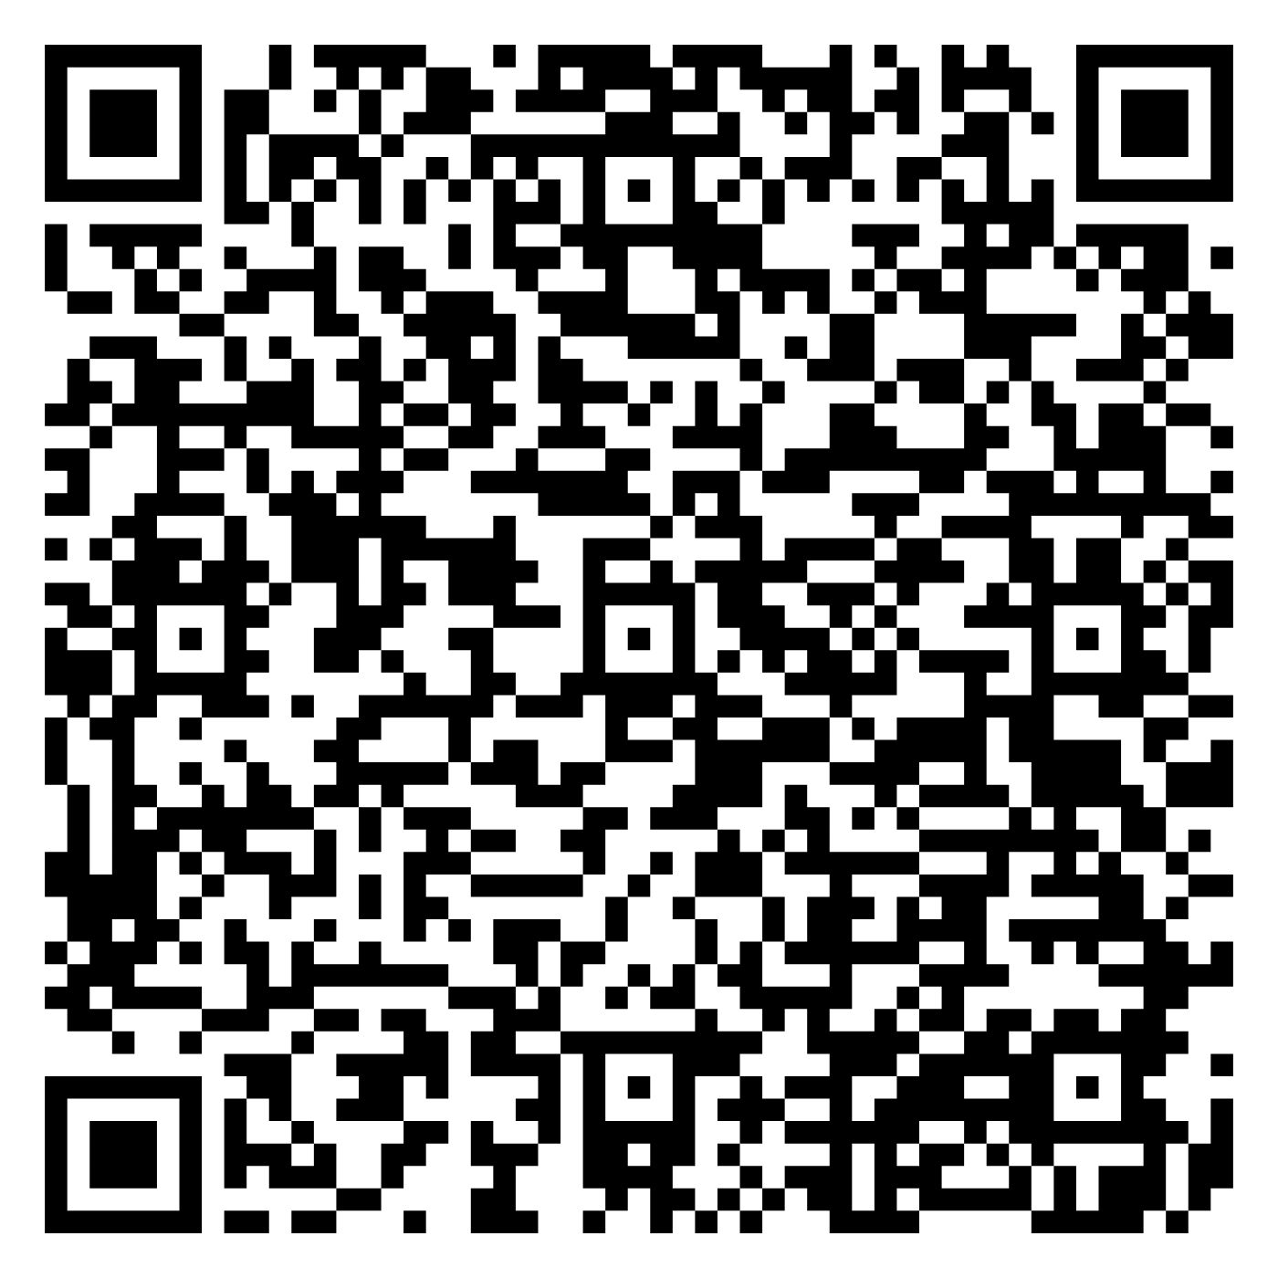
Project Resources
Transportation Services Call Center
Provides citizens and business customers with a single point of contact to request transportation services, obtain information, or provide feedback through multiple channels of communication.
855-463-6848 • INDOT4U.com • INDOT@indot.in.gov
Project Website
bit.ly/SR9SR234Roundabout

Slide 23
Verbal Comment Period
Welcome to approach microphone
Please write name on sign-in sheet
Comments will be transcribed and added to the project file
No response will be provided tonight
Please keep comment to 2 minutes or less
Alternatively, written comments also accepted tonight and until November 28th.

Slide 24
Next Steps
Project Open House
Project maps, displays, real estate acquisition table, INDOT project team, and informal Q&A until 7PM tonight .
Public and project stakeholder input
Submit comments via options described in the project handout.
INDOT review and evaluation
All comments are given full consideration during the decision-making process.
Comments due NOVMEBER 28th to Nick Batta at nbatta@cmtengr.com or 8790 Purdue Road, Indianapolis, IN 46268
Questions? Contact the Public Involvement Team.

Slide 25
S.R. 9 and S.R. 234 Intersection Improvement
Comments due Nov. 28th Nick Batta nbatta@cmtengr.com 8790 Purdue Road, Indianapolis, IN 46268
Questions? Contact the Public Involvement Team.
Project Website
bit.ly/SR9SR234Roundabout

