Slide 1

IN - BEAD Permitting Roundtable
August 6, 2026
Notes:
Good afternoon, everyone. Thank you all for taking the time to join us for our first BEAD Permitting Roundtable. RSM will be hosting these periodically throughout the BEAD process as a way to share updates, walk through key permitting topics, and provide an opportunity for questions and discussion.
Adam and I will be presenting on behalf of RSM today. Megan and the IBO team are also on the call and will be providing an update as well. We are also joined by several partner agencies who will be sharing information with you all. I will now pass it over to Megan to give a quick welcome introduction

Slide 2


Permitting Roundtable
Agenda
 | Welcome
 | Permitting Roundtable Purpose
 | IBO BEAD Program Overview Roles and Responsibilities Partner Agencies Question and Answer
August 6, 2026

Slide 3
Purpose of the Permitting Roundtable
To share information and meet NTIA requirements
Drive Alignment
Advance Projects
Enable stakeholders to stay informed, aligned, and focused on successful project outcomes.
Share program updates
Monitor project progress
Identify high-priority issues
Create a collaborative forum for involved parties to keep projects moving forward, address challenges, and support successful BEAD implementation
Resolve issues proactively
Reduce impact to project schedules
Encourage consistent permitting decisions
Notes:
Initial meeting is to go over the purpose of these meetings, make sure everyone understands the roles and responsibilities of the subgrantee, RSM, and IBO, and familiarize subgrantees with some of the permitting partner agencies and stakeholders. Meetings will be held on a bi-monthly basis (every other month)

Slide 4
IBO BEAD Program Update
August 15th – Federal contract signing deadline
After contract execution, no work can begin until a project receives its NEPA decision memo
Immediate focuses post-contract signing:
  Work with RSM to move through state Section 106 processes and federal NEPA submission
  Work with RSM to review clash analysis and need for state-level permits
  Review plans and determine local permitting and pole attachment needs
  Communicate with IBO often about permitting challenges and help needed
Pole Attachment Reporting – report to IBO:
  When a process management agreement is reached
  When pole attachment requests are made
  When attachment requests are granted

Slide 5
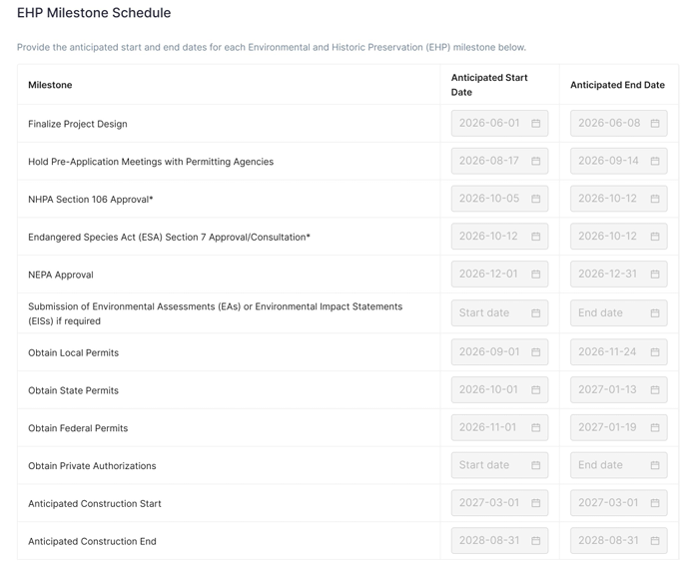
Indiana Broadband Grant Portal Updates
Milestone Schedule
Now available in the Indiana Broadband Grant Portal
Project management tool required by NTIA for tracking Environmental and Historic Preservation (EHP) review deadlines before construction begins
The schedule lists dates for:
  Completion of required consultations (Section 106, Tribal, Endangered Species Act Section 7, NEPA)
  Submission of Environmental Assessments (EAs) or Environmental Impact Statements (EISs) if required)
  Submission of relevant local, state, and federal permits
Required prior to 1:1 Technical Assistance meeting with RSM or submitting an ESAPTT Questionnaire

Slide 6
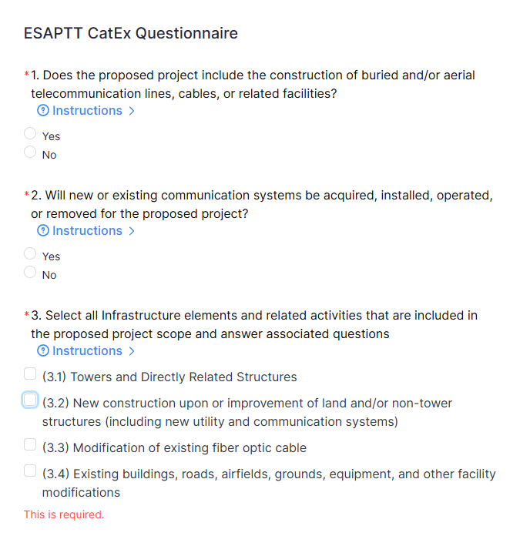
Indiana Broadband Grant Portal Updates
Environmental Screening and Permitting Tracking Tool Questionnaire
Now available in the Indiana Broadband Grant Portal
The questionnaire asks the subgrantee a series of questions that seek to identify Categorical Exclusions and Extraordinary Circumstances related to the BEAD deployment project
Should not be completed until all supporting documentation is prepared
Required documentation for ESAPTT:
  Project summary
  Detailed project description
  Project map
  Endangered Species Act Section 7 review documentation
  Section 106 of the National Historic Preservation Act review documentation
  National Wetlands Inventory Map
  FEMA Flood Map (optional)

Slide 7
RSM Role in Permitting Review
Processes & Tracking
Technical Assistance
ESAPTT
Permit review processes to comply with NTIA guidance
Communication with subgrantees
Resources for identifying required permits and reviews
Templates to secure uniform documentation across all projects
1:1 Technical Assistance meetings
Coordination with State Agencies
If needed, coordination with federal and local agencies
Identification of project information that will be needed by more than one review Agency
Streamlining of review processes as appropriate
Uniform data collection
Review of all materials required for ESAPTT records
Communication with subgrantees
Entry of all ESAPTT records
Prepare ESAPTT record for IBO review and submission
Review and approval of Milestone Schedules

Slide 8

What’s Next?
Technical Assistance & ESAPTT Questionnaire
Over the next few weeks, as GIS data is submitted, each subgrantee will have a 1:1 Technical Assistance meeting with RSM
Within the Indiana Broadband Grant Portal, subgrantees will complete an EHP milestone schedule that lists key events, deadlines, or deliverables along a project timeline
The Environmental Screening and Permitting Tracking Tool (ESAPTT) questionnaire is now available in the Indiana Broadband Grant Portal for subgrantees to complete
RSM will review submitted questionnaires and supporting documentation and will complete the corresponding entries within NTIA's ESAPTT system on behalf of IBO for NEPA approval

Slide 9
Partner Agencies

Slide 10
Indiana Cable & Broadband Association

Slide 11

The Indiana Cable and Broadband Association (ICBA) represents Indiana’s largest and fastest broadband providers with networks reaching over 2 million Hoosier homes, offering gig speeds in urban and rural communities. Our members work every day to expand broadband access for unserved Hoosiers and we are committed to closing the digital divide by offering resources that help Hoosier families overcome barriers to adoption. ICBA has a strong history of public-private partnerships in Indiana. ICBA is proud to be a strategic partner to the Indiana Broadband Office and is excited to play a key role in transforming the state of Indiana and ensuring that all residents are connected to the world.
Joseph Dant
Executive Director
jdant@broadbandig.org
Jenny Knox
Operations & Member Relations Manager
jknox@broadbandig.org
www.inbroadband.org

Slide 12
Indiana Utility Regulatory Commission

Slide 13



IURC & OED Roles
  The IURC grants Certificates of Territorial Authority for Communication Service Providers (including broadband providers) to operate statewide.
  The IURC’s Pipeline Safety Division helps enforce Indiana’s 811 “Call Before You Dig” Law and pipeline safety laws.
  Contact Point Person
    Sally Getz, Communications Division Director
    SGetz@urc.IN.gov
  317-234-1543
  Contact Point Person
    Miranda Chandler, Pipeline Safety Division Director
    MiChandler@urc.in.gov
    317-502-2966
INDIANA OFFICE OF ENERGY DEVELOPMENT & INDIANA UTILITY REGULATORY COMMISSION

Slide 14
IURC & OED Roles
  The Indiana Office of Energy Development (OED) provides:
    Policy guidance to elected officials
    Administers several energy grant programs
    Provides public education on energy-related subjects
  OED’s primary way of assisting broadband providers is through connecting providers with points of contact in electric and gas utilities.
  Contact Point Person
    Jon Ford, Executive Director
    jonathanford@oed.in.gov
    463-265-4987
  Contact Point Person
    Luke Wilson, Chief Policy Officer
    LukWilson@oed.in.gov
  317-719-0227
INDIANA OFFICE OF ENERGY DEVELOPMENT & INDIANA UTILITY REGULATORY COMMISSION

Slide 15
Department of Natural Resources

Slide 16
Intro
The Environmental Unit is in the Indiana Department of Natural Resources, Division of Fish, Wildlife, and Nature Preserves.
Matt Buffington is the Environmental Unit Supervisor.
The Unit is composed of 8 biologists that provide technical assistance through review of permit applications and early coordination requests.
We review about 1500 projects a year.
Contact info:
  mbuffington@dnr.IN.gov
  317-233-4666

Slide 17
Floodway and Public Freshwater Lake permits include a review by the Environmental Unit for unreasonably detrimental effects upon fish, wildlife, and botanical resources.
Impacts to non-wetland floodway forest are the main impacts that require mitigation by DNR through the restoration of similar habitat.
Prefer directional drilling under streams and other avoidance measures.
If working in or around a waterway, best to contact DNR, IDEM, and US Army Corps of Engineers.
  www.in.gov/waterways/ for DNR and IDEM permit info
  Water_inquiry@dnr.IN.gov for DNR Division of Water
  WetlandsProgram@idem.IN.gov for IDEM wetlands/401 program

Slide 18
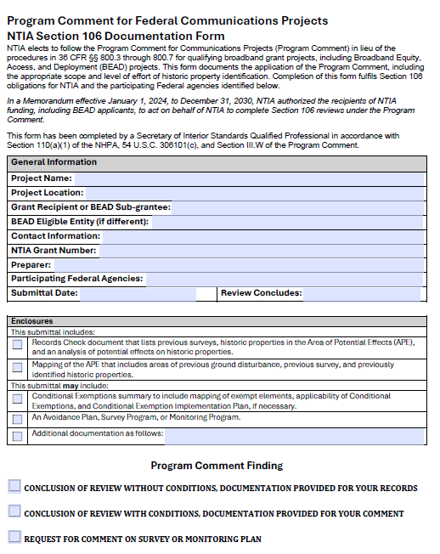
The Indiana Division of Historic Preservation & Archaeology (DHPA) promotes the conservation of Indiana’s cultural resources through public education efforts, financial incentives including several grant and tax credit programs, and the administration of state and federally mandated legislation.
The Environmental Review Section of DHPA reviews and comments on the potential effects of federal and state undertakings on historic and archaeological resources.
Section 106 of the National Historic Preservation Act (54 U.S.C. § 306108)
  The head of any Federal agency having direct or indirect jurisdiction over a proposed Federal or federally assisted undertaking shall take into account the effect of the undertaking on any historic property
  Implementing Regulations: 36 CFR 800
NTIA Program Comment for Federal Communications Projects in lieu of standard Section 106 documentation.
DHPA Review Request Submittal Form and additional information at https://www.in.gov/dnr/historic-preservation/review-and-compliance/
If you have any questions regarding this information, please contact Chad Slider, Assistant Director for Environmental Review, at cslider@dnr.ing.gov or 317-234-5366.

Slide 19

Flood Control Act
DNR Division of Water Permitting Requirements
Markita Shepherdson, CFM, Senior Environmental Manager
Central Basin Team Leader
Division of Water

Slide 20
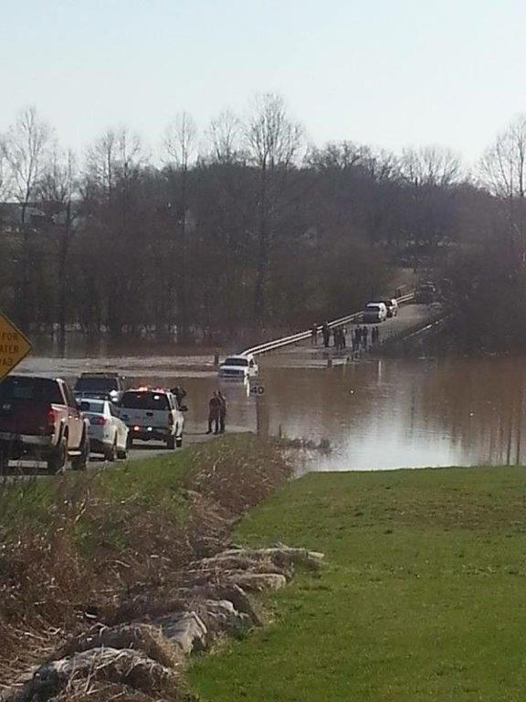
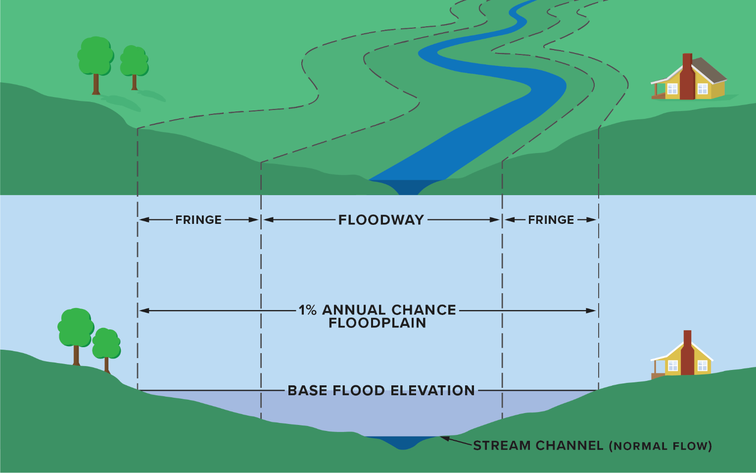

Contact Us
Under the Flood Control Act (IC-14-28-1), construction in streams and floodways require a permit from the DNR Division of Water.
A permit exemption exists for utility lines crossing a stream. Details at:
dnr.IN.gov/water/regulatory-permit-programs/exemptions/#Utility_Line
Web: dnr.IN.gov/water/
Email: water_inquiry@dnr.IN.gov
Phone: (317) 232-4160
Indiana Floodplain Information Portal: infip.dnr.IN.gov
Not sure if a permit is required?
Submit an inquiry at www.waterways.IN.gov for permitting information from both DNR Division of Water and IDEM.
Notes:
The DNR Division of Water oversees several water-related statutes; we are focusing on the Flood Control Act today.

Slide 21
Indiana Department of Transportation

Slide 22
Indiana Department of Transportation
Our Role:
Administers and reviews all Broadband Access permits via EPS.
  Permit applications are flagged for BEAD Projects
Ensures bonding compliance for right-of-way work.
  Compliance for Right of Way, MOT, Construction Plans, Planned INDOT Projects, As-Builts etc.
Provide timely application feedback and processing updates.
Act as a critical gatekeeper for broadband infrastructure on state-controlled routes.
Assist with contributing BEAD implementation efforts across local, county, and state levels.

Slide 23
Indiana Department of Transportation
FAQ :
Broadband permits categorized by:
  Broadband Corridor
    All Interstate R/W
    US 30 R/W
    US 31 (excludes I-465 S to Ohio River)
    Toll Ways, Bridges or Roads
  Executed Broadband Access agreement required prior to permit issuance.
    Processed by Broadband Corridor Team then permit is issued by District Permit Manager.
  Nonbroadband Corridor
    All US Highways (except US 30, US 31)
    All State Routes
  Processed by District Permits Team
  No agreement is required

Slide 24
Indiana Department of Transportation
Support:
Broadband Corridors Team:
Sam Anderson,
Director of Utility, Rail & Broadband Corridors
saanderson@indot.in.gov
Andrew Brelage,
Assistant Director of Broadband Corridors
abrelage@indot.in.gov
Shirin Baygani-Vakily,
Broadband Corridor Program Administrator
sbayganivakily@indot.in.gov
INDOT Permits:
Monica Hartke,
Director of Permits
Victor Grimes,
Assistant Director of Permits
vgrimes@indot.in.gov
Department Email & Website,
permits@indot.in.gov
https://www.in.gov/indot/doing-business-with-indot/permits/
District Permits Staff Map
Useful Links:
INDOT Website: https://www.in.gov/indot
Broadband Corridors Map: https://experience.arcgis.com/experience/a08cabeabb414ad49367642a638e840a/?org=indot
INDOT Broadband
Broadband Access Policy (BAP)
Broadband Permit Guide
INDOT Construction Map: https://entapps.indot.in.gov/dotmaps/nlri/

Slide 25
Question and Answer

