Slide 1
SOAR (SSI/SSDI Outreach, Access, and Recovery) for Adults
Substance Abuse and Mental Health Services Administration
(SAMHSA) SOAR Technical Assistance Center
Policy Research Associates, Inc.
February 20, 2019

Slide 2
Disclaimer
The views, opinions, and content expressed in this presentation do not necessarily reflect the views, opinions, or policies of the Center for Mental Health Services (CMHS), the Substance Abuse and Mental Health Services Administration (SAMHSA), or the U.S. Department of Health and Human Services (HHS).

Slide 3
Purpose and Objectives
Share the importance of Supplemental Security Income (SSI) and Social Security Disability Insurance (SSDI) benefits
  Including income, health insurance, education and employment supports, and housing stability
Offer opportunities for community members to get involved with SOAR
  Connecting to local SOAR efforts, the SOAR Online Course, and the SOAR Online Application Tracking (OAT) program

Slide 4
What is SOAR?
A model for assisting eligible individuals to apply for Social Security Administration (SSA) disability benefits
For individuals who are experiencing or at risk of homelessness and have a serious mental illness, co-occurring substance use disorder, or other physical disabilities
Sponsored by SAMHSA in collaboration with the Social Security Administration (SSA) since 2005
All 50 states and Washington, DC currently participate

Slide 5
SSI and SSDI: The Basics
Supplemental Security Income (SSI)
Social Security Disability Insurance (SSDI)
Date of eligibility based on Protective Filing Date/Application Date
Health insurance: Medicaid
Monthly amount based on Federal Benefit Rate: $771/month (2019)*
Eligibility based on need: low income and resources; living arrangement
Monthly amount based on earnings history
Date of eligibility based on “date of onset” of disability, 5 month waiting period
Health insurance: Medicare
Eligibility based on insured status (FICA payments)
*https://www.ssa.gov/ssi/text-general-ussi.htm
Notes:
Comparison of SSI and SSDI
People often confuse the two types of disability benefits offered by the Social Security Administration
SSI and SSDI are separate disability benefits with significant differences, but some similarities!
SSA Benefits are a tool- a means of helping a person stabilize his or her life
SSI
SSI benefit rate for 2019 is $771 per month, changes annually
If your state has a state supplement, then reference amount, and enter onto slide
Eligibility may be established with a Protective Filing date- which is discussed in greater detail in the course.
Since SSI is based on need, the nonmedical information required for the application is detailed to determine the person’s current income and resources
To determine eligibility for SSI, SSA needs a complete picture of not only income, but also living arrangement and assets/resources
SSI has limits on personal resources, $2,000 for individuals, $3,000 for couples
Living arrangements affect one’s benefit amount
Date applicant or case manager contacts SSA to indicate intent to file application- PFD (Protective Filing Date)
Medicaid is the associated health insurance program
Medicaid can be as beneficial to a person as the income from SSI
Retroactive benefits back to eligibility date, e.g.) PFD, date of application
SSDI
Monthly amount based on earnings history (different for every individual)
Personal resources and living arrangements don’t affect one’s benefits amount
Medicare is usually provided after 2 years of eligibility for benefits
Uses the “date of onset” of disability, determined by DDS
Eligibility begins five months after date of onset
Retroactive benefits go back no further than 12 months

Slide 6


SSI/SSDI Eligibility: Definition of Disability for Adults
SSA’s Definition of Disability
Medical Condition(s)
Functional Impairment(s)
  Diagnosis
  Documentation
  Duration
  Severity
  Work
  SGA
Notes:
SSA’s Definition of Disability
The inability to engage in substantial gainful activity (SGA) - 1,220/month (2019)
Because of medically determinable physical or mental impairment(s)
That have lasted or are expected to last for a continuous period of at least 12 months OR result in death.

Slide 7
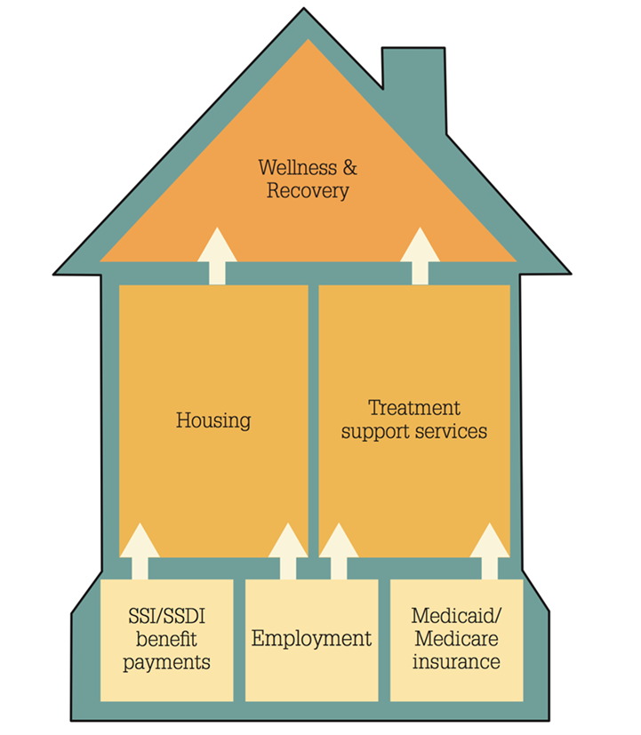
A Foundation for Recovery and Resiliency
More Than Income
SSI/SSDI: One Brick in Foundation
Access to health care and housing
Increased education and employment opportunities
Decrease in incarcerations and hospitalizations

Slide 8
How do States and Communities Benefit?
SSI and Medicaid bring federal dollars into states, localities, and community programs:
Health providers can recoup cost of uncompensated care.
States and localities can recoup the cost of public assistance.
Cash benefits and back payments received by individuals is spent in the local community (2018: $406 million*).
* https://soarworks.prainc.com/article/soar-outcomes-and-impact

Slide 9
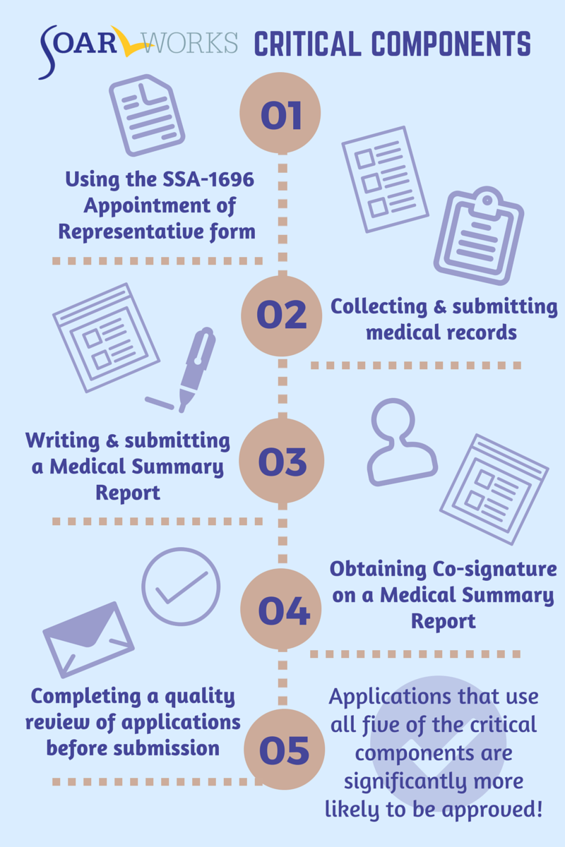

What Makes SOAR Unique?
SOAR-trained case workers are the heroes!

Slide 10
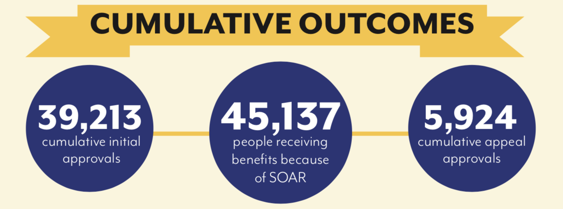
SOAR Works!
*National SOAR outcomes as of June 30, 2018
https://soarworks.prainc.com/article/soar-outcomes-and-impact

Slide 11
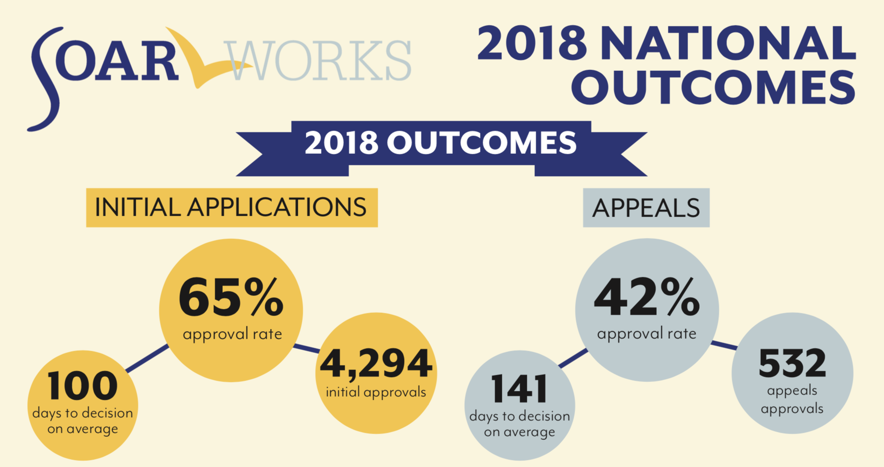
2018 National Outcomes
*As compared to a 29% approval rate for all SSI/SSDI applicants nationwide
SSI Annual Statistical Report, 2017. Table 70. SSA Pub. No. 13-11827. Washington, D.C.: SSA, September 2018

Slide 12
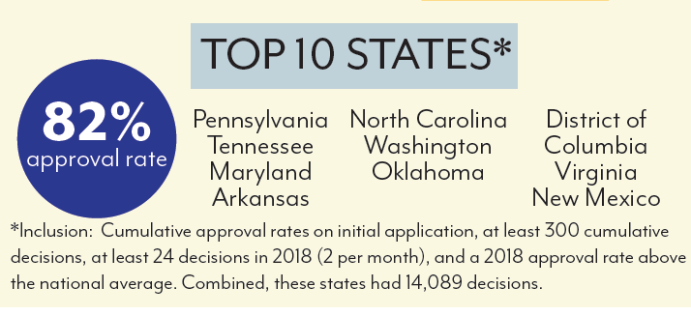
SOAR Super Stars!

Slide 13







Community Collaborations
Notes:
SOAR cannot and does not function in a vacuum. We rely heavily on our community partners.
First and foremost, the Social Security Administration (SSA) is an essential collaborator. SSA is the federal agency that administers SSI and SSDI. Because SSA is federal, their eligibility rules are the same in every state. SSA makes the non-medical decision on the claim.
Every state has a Disability Determination Services (DDS) that works in partnership with SSA to make the medical or disability determination. The DDS is often an unknown player in the process, but with SOAR they are absolutely key.
Medical and treatment providers are also extremely important. You will need access to assessments, evaluations and the corresponding medical records that support the claim.
Involving partners from criminal justice organizations, Veterans Affairs, employment programs, housing providers and others helps to ensure that individuals served by SOAR are receiving comprehensive services and supports and that your SOAR program is not operating in a silo.

Slide 14
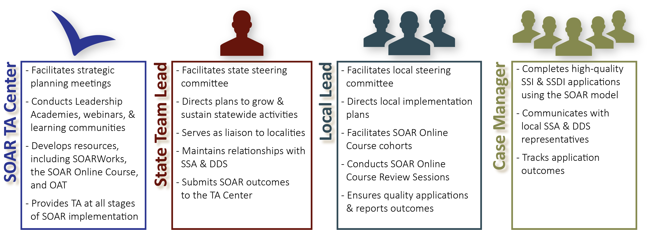
SOAR Leadership Structure
*OAT: Online Application Tracking Program
*DDS: Disability Determination Services
*TA: Technical Assistance
Notes:
Be sure to mention that case managers might have an agency lead that uses OAT and helps supervise multiple case managers
All these players are ambassadors for SOAR Initiative – united in ending homelessness for individuals with disabling conditions

Slide 15
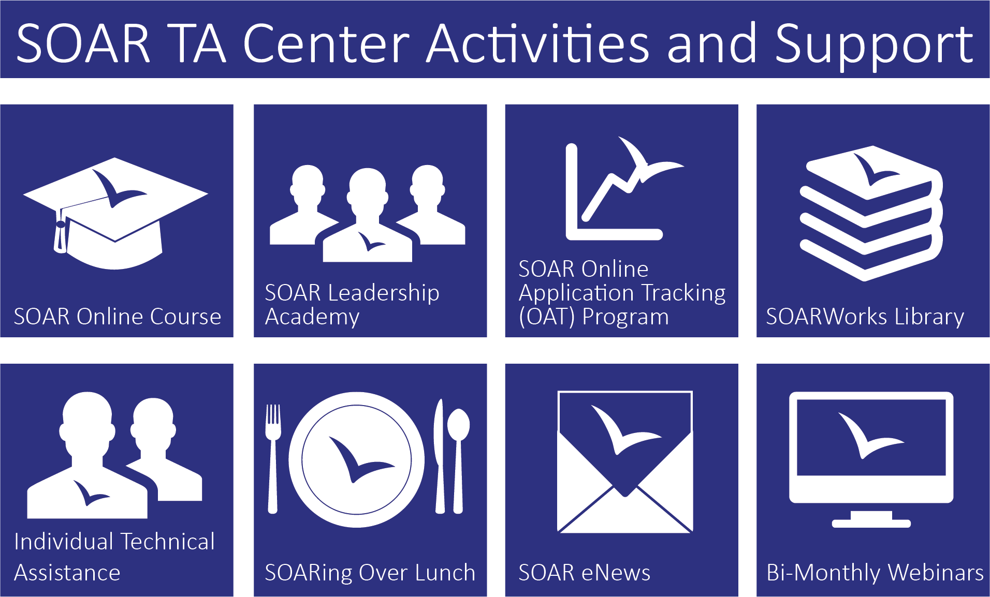
Oh, the support you will receive!
15

Slide 16

Benefits of the SOAR Online Course
Standardized training provided across all geographic areas
SOAR Leaders can coordinate follow-up training and support
Course is FREE, web-based, and self-guided
20 CEUs from National Association of Social Workers (NASW)

Slide 17
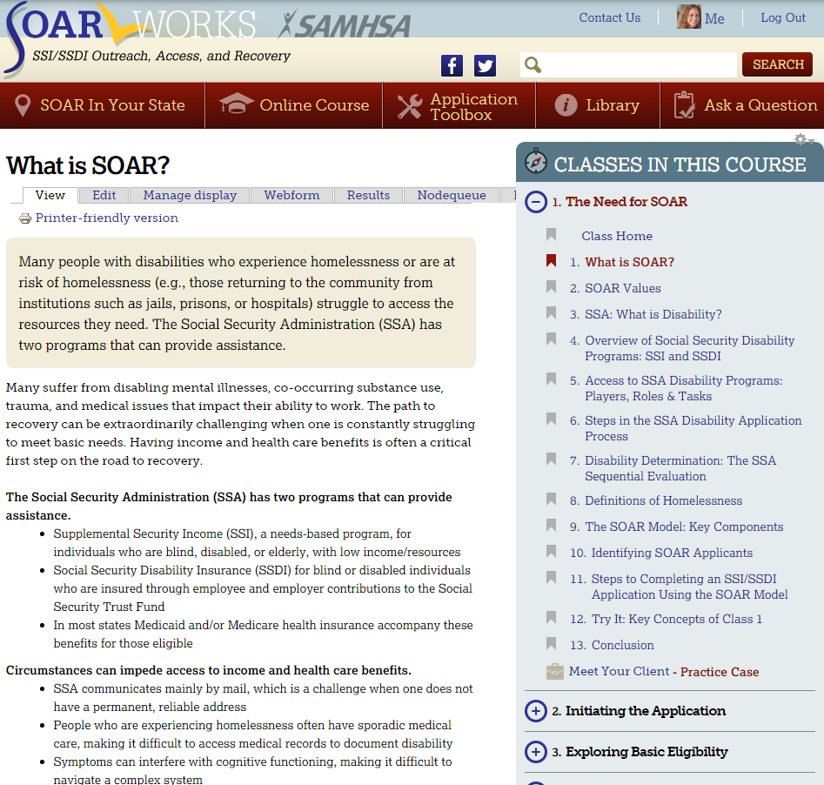
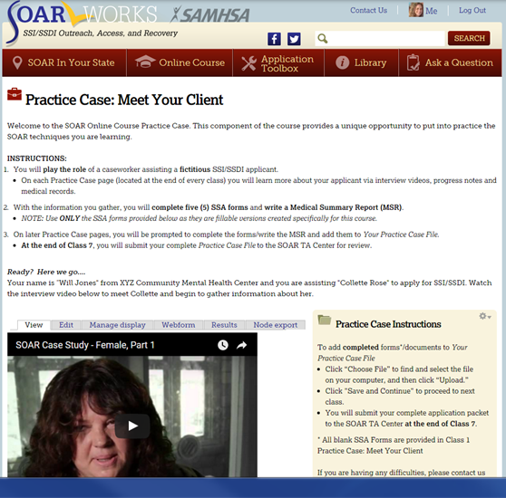
SOAR Online Course: Articles and Practice Case
Articles and Content
Practice Case
Notes:
Articles v Practice Case files
7 Classes that cover everything from the basics of SSI/SSDI and SOAR to Work Incentives
Unique Practice Case Component – trainees complete an SSI/SSDI application packet for a fictional applicant

Slide 18
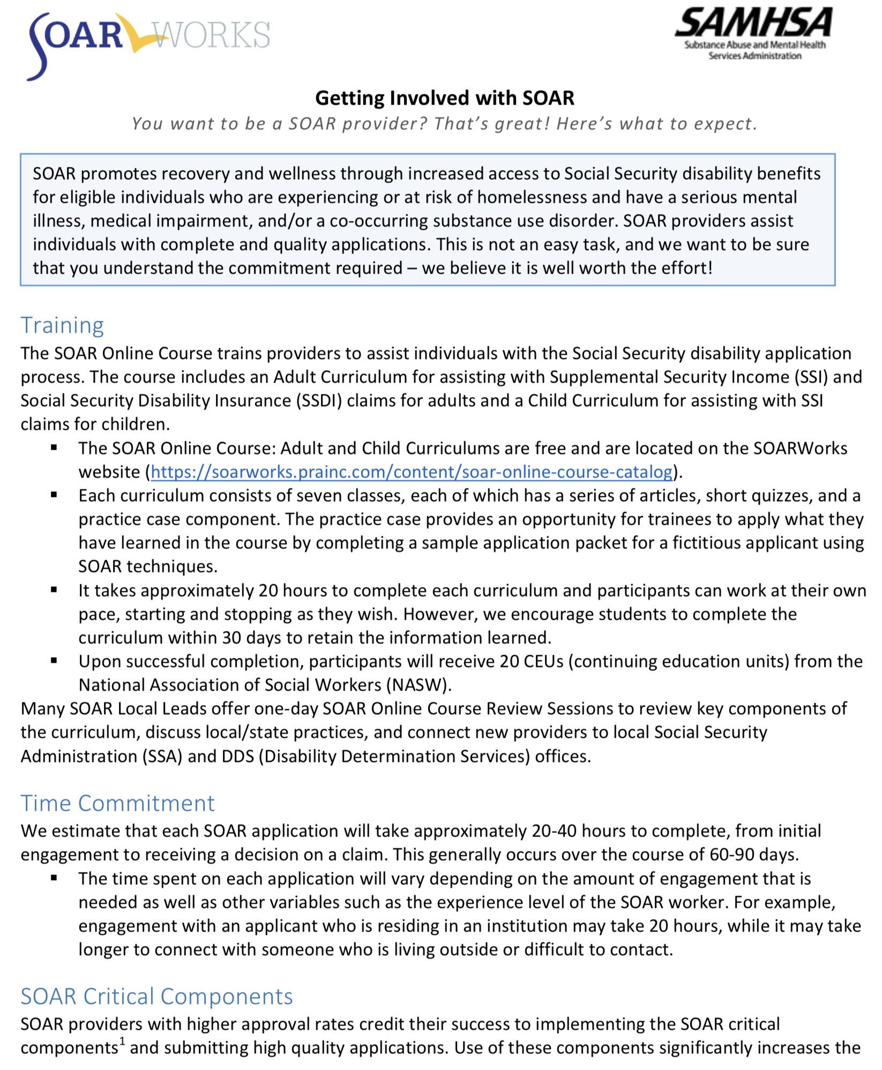
Getting Involved: Time Commitment
Training: 20 hours
20-40 hours per complete application
SOAR Critical Components
Outcome Tracking
Benefit to Your Agency and the Individuals You Serve

Slide 19

Online Application Tracking (OAT)
Web based
User friendly
HIPAA compliant
Monitors quality
Takes only 3-5 minutes
It’s FREE!
All the reasons OAT is awesome!
https://soartrack.prainc.com

Slide 20
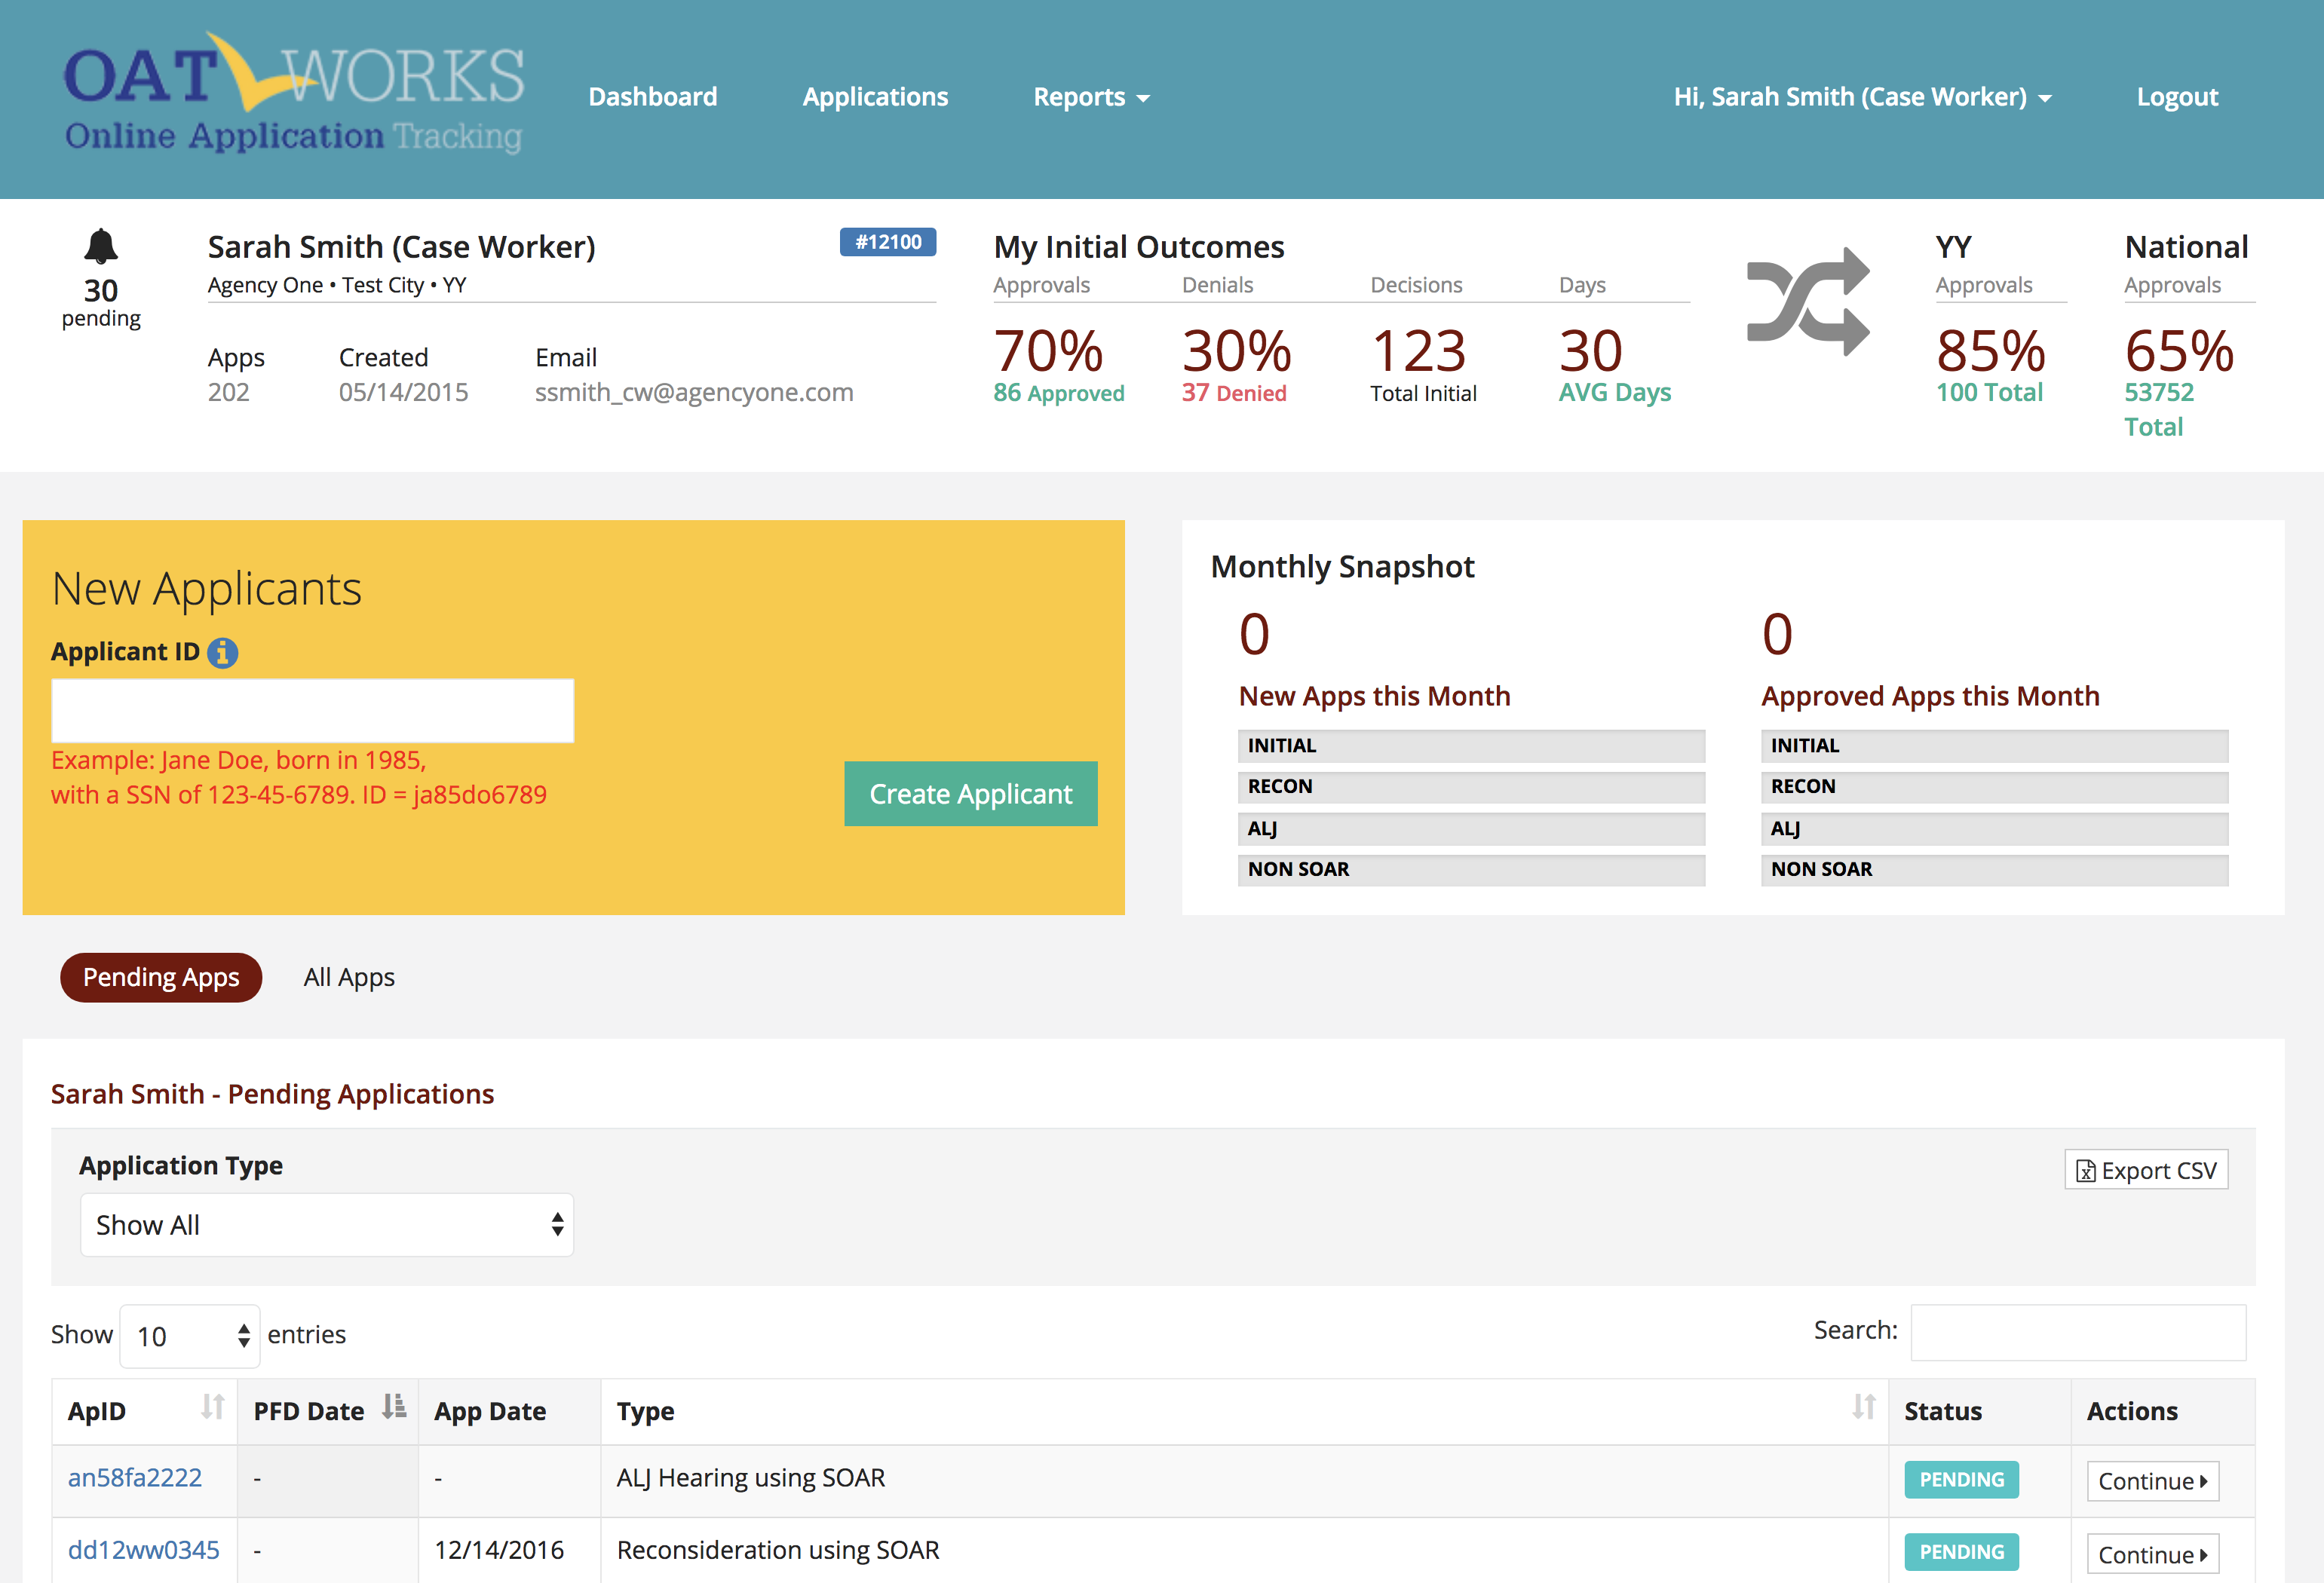
OAT Case Worker Dashboard

Slide 21
Next Steps
Learn more about SOAR
Get in touch with your SAMHSA SOAR TA Center Liaison
Reach out to your local or state SOAR leads
Register for the SOAR Online Course

Slide 22
Additional Resources
SOAR Works Website and Online Course: https://soarworks.prainc.com/
SOAR Outcomes Tracking: https://soartrack.prainc.com/
SSA Disability Information: https://www.ssa.gov/benefits/disability/
SSA Employment Supports: https://choosework.ssa.gov/

Slide 23
Thank You
https://soarworks.prainc.com
soar@prainc.com

