Slide 1
EAP PROGRAM PERFORMANCE & INTEGRITY 2019 INCAA CONFERENCE
© IHCDA 2018

Slide 2
PROGRAM PERFORMANCE AND INTEGRITY
The program performance and integrity process ensures that each Local Service Provider (LSP) has developed Internal Controls unique to their agency and follows the established EAP guidelines that will protect EAP funds from waste, fraud and abuse.

Slide 3
INTERNAL CONTROLS
In Summary
It plays an important role in providing guidance for detecting and preventing fraud and protecting the LSPs and EAPs integrity

Slide 4
INTERNAL CONTROLS Whistleblower policy
Each LSP should have this policy as part of the Employee Handbook.
Whistleblower Policy is intended to encourage employees and others to make good faith reports of suspected fraud, corruption, or other improper activity. It also protects an employee who reports such activity.
The policy will also outline the proper communication method. Some LSPs encourage reporting to their immediate supervisor or the Human Resource Director. Some LSPs also have an anonymous telephone number to call.

Slide 5
Internal controls conflict of interest (COI) policy
Each LSP should have this statement or policy as part of the Employee Handbook.
COI Policy is designed to help employees identify situations where there is competing interest or loyalties and the correct process to follow to remove the appearance of impropriety.
Define who is considered family
Describes internal procedures when a COI exist (i.e. intake worker processes application of family member)

Slide 6
INTERNAL CONTROLS PROCESSING INTERNAL APPLICANTS
Use the guidelines outlined in the EAP Manual when developing you specific procedures
Ensure that the appropriate checks and balances are in place, and utilized
Train staff on this process because they are likely to experience it at some point during the season
FYI- If the Supervisor or Program Manager is related to the individual receiving the benefits, then the review should be pushed up and conducted by their immediate Supervisor.

Slide 7
INTERNAL CONTROLS QUALITY ASSURANCE REVIEWS
Reviews of no less than ten percent (10%) of all EAP applications;
all LSPs must conduct a review within forty-five (45) days of the date of eligibility determination.
The ten percent (10%) should be maintained through the end of the program year.

Slide 8
INTERNAL CONTROLS Employee Offboarding Checklist
Offboarding is the process of managing all aspects of an employee’s exit from your organization.
Information Technology Specific
Deactivating permissions and account status in the EAP statewide database
Close LSP accounts, logins, and email, etc..
Change passwords

Slide 9
Internal controls fraud investigation guidelines
Each LSP should have procedures as part its Internal Controls or agency Fraud Policy
Proper Prior Planning is essential to effectively documenting the investigation process. The last thing you want to do is build the boat in the middle of the storm.
Be prepared and develop your procedures before they are needed!

Slide 10
Purpose of investigating fraud, waste and abuse
Ensure Benefits are allotted in correct amounts and only to those individuals who are eligible
Recover EAP Funds obtained by participants through fraudulent activities, unintentional participant error, administrative error or non-compliance
Deter future occurrences of fraud or non-compliance within all programs to help maintain program integrity
© IHCDA 2018

Slide 11
investigation
Investigation: detailed examination or search to determine if an individual has committed an act of non-compliance or fraud and/or received benefits to which they were not entitled.
© IHCDA 2018

Slide 12
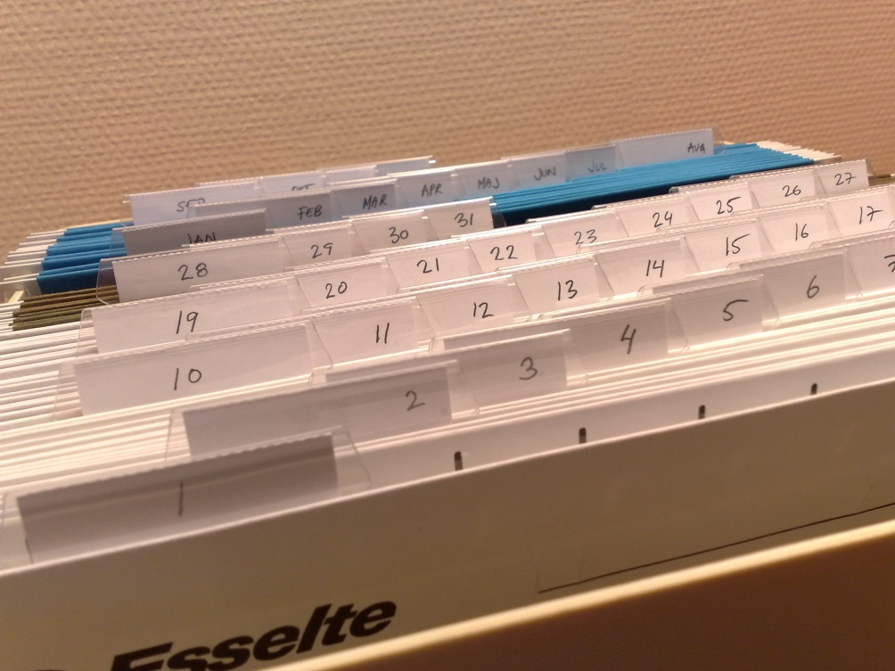
documentation
Document each step taken in the course of the investigation in chronological order
Include investigator notes as well as copies of relevant documents
Important not just for agency records, but for situations where law enforcement will also be involved
© IHCDA 2018

Slide 13
documentation
Six basic questions to consider while collecting information during the course of any investigation:
© IHCDA 2018

Slide 14
Potential sources to assist with an investigation
© IHCDA 2018

Slide 15
Potential sources LSP attorney

Slide 16
Potential sources Ihcda-legal team
BRIGITTE COLLIER
Compliance Attorney
Indiana Housing and Community Development Authority
PHONE 317-234-6982 OR 800-872-0371
EMAIL bcollier1@ihcda.in.gov
DAVID W. STEWART General Counsel Indiana Housing and Community Development Authority PHONE 317-234-6980 OR 800-872-0371 EMAIL dstewart2@ihcda.in.gov

Slide 17
Potential sources Sheriff or police department
© IHCDA 2018

Slide 18
confidentiality
The more people who know about an investigation, the greater the chances of the subject finding out.
© IHCDA 2018

Slide 19
Final steps
After violation has been corroborated, action needs to be taken.
Action needs to be taken against participant’s application or against benefits if they have already been distributed if the fraud was by a participant
Action needs to be taken against staff if the fraud was by a employee
Or Both, depending on the situation
Case can also be submitted to Federal Officials if the situation warrants.

Slide 20
IHCDA involvement
IHCDA Program Staff and Compliance Attorney are available to assist during any phase of investigation.
Be sure to make IHCDA Program Staff aware of all substantiated acts of fraud, waste and abuse as soon as you become aware of a potential issue.
IHCDA Program Staff will then contact the IHCDA Compliance Attorney if situation warrants.
© IHCDA 2018

Slide 21
REPORT FRAUD, WASTE AND ABUSE
Please help us ensure the integrity of our programs by reporting suspected fraud, waste, abuse or gross mismanagement of programs.
If you believe that you have information regarding possible fraudulent activities, please let us know by completing this online form: http://form.jotform.com/IHCDA/fraud
A link to the online form can also be found on both the IHCDA partner and consumer websites.
© IHCDA 2018

Slide 22
QUESTIONS…
© IHCDA 2018

