Slide 1
PY2023 IHCDA EAP Operations and Policy Changes
Thomas Hartnett-Russell
Community Programs Manager
July 25, 2022

Slide 2
agenda
Operations Updates
Policy Changes
Changes to Forms

Slide 3


Operations updates

Slide 4
Program Operations TIMELINE
Official start of federal program year is October 01, 2022.
LSPs may distribute applications to their at-risk households beginning Tuesday, September 06, 2022.
LSPs may evaluate at-risk household applications for completeness and prepare to enter data into the statewide database from September 06-September 18, 2022.
LSPs may begin to enter data into statewide database beginning Monday, September 19, 2022.
LSPs may distribute applications to any non-at-risk households beginning Monday, October 03, 2022.
The online application portal will open to all applicants on Monday, October 03, 2022.
LSPs who conduct in-person appointments may start setting those appointments beginning October 03, 2022, provided the appointments are set for no earlier than November 01, 2022.
LSPs may begin issuing incomplete letters only to applicants with incomplete applications beginning Monday, October 03, 2022.

Slide 5
Program Operations TIMELINE
The official start of the statewide Energy Assistance Program is Tuesday, November 01, 2022.
  LSPs may start conducting in-person appointments or taking walk-in crisis.
  LSPs may begin issuing benefit approval and/or denial notification letters to applicants.
  LSPs may begin making verbal or written pledges to utility vendors or fuel providers.
  LSPs may begin sending transmittals to utility vendors or fuel providers.
  LSPs may begin issuing crisis checks in-house to biofuel households in crisis and/or wood vouchers for households purchasing biofuel from a vendor with whom the LSP has an MOA.
  LSPs may begin submitting executed transmittals to IHCDA Fiscal for payment.

Slide 6
Program Operations TIMELINE
Statewide utility shutoff moratorium begins Thursday, December 01, 2022.
  Applicants are granted protection from utility disconnect by non-bulk fuel utility vendors upon successful submission of an application for energy assistance, until such time as household eligibility has been determined.
  LSPs must notify utility vendors of a household’s application if they are aware that a household is facing an imminent disconnection and they are not able to immediately determine eligibility.
  Documentation of such notification in a client file will count as crisis mitigation.
  Notifying the vendor does not relieve the LSP of the responsibility to prioritize eligibility determination of households that are presenting with an energy crisis.
  Unless service is already disconnected and the benefit is insufficient to restore service, LSPs must waive the requirement for a client contribution during moratorium, because continued service is guaranteed by moratorium protection. LSPs may, however, encourage a client contribution.
  Vendors who indicate they do not intend to observe moratorium protection should be reminded of their legislative requirement to do so. If a vendor continues to indicate it will not observe moratorium, please escalate to IHCDA.

Slide 7
Program Operations TIMELINE
Statewide utility shutoff moratorium ends at 11:59pm on Wednesday, March 15, 2023.
  Utility vendors may disconnect households regardless of eligibility status, including households who were previously approved and who are now in arrears.
  LSPs may issue additional crisis to already-approved households who are now facing disconnect, pending availability of crisis funding.
  LSPs may require client contributions for new applicants if the eligible benefit is insufficient to provide continuing service.
Application deadline is 5:00pm Eastern time on Monday, May 15, 2023.
  EAPConnect will no longer accept application submissions after this time.
  Applicants may submit incomplete applications, but will have a hard deadline of returning missing documentation of May 30, 2023.

Slide 8
Program Operations TIMELINE
All outstanding applications must have final eligibility determined and in either approved or denied status by Tuesday, May 30, 2023 due to the Memorial Day holiday.*
All outstanding transmittals must be submitted to IHCDA Fiscal by Monday, June 12, 2023.*
All vendors must be fully reconciled by Monday, June 26, 2023.*
The official closing date of federal program year 2022 is September 30, 2023.
* - please note that these dates may be different than in the distributed version of the manual. I will make changes in the posted version of the manual to reflect these updates. You may note these changes in your own manual or download the updated version when it is posted.

Slide 9
EAPConnect
EAPConnect is Roeing’s web-based interface. RIAA has officially been retired/decommissioned. All eligibility determination and client tracking must now be performed in EAPConnect.
IHCDA is working with Roeing to roll out some large-scale enhancements for EAPConnect in order to improve efficiency, user-friendliness, and functionality. Roeing will train on these enhancements at a later date.

Slide 10
Online Applications
Applicants will continue to be able to apply 24 hours a day, 7 days a week, from any computer or internet-connected mobile device through the online portal.
LSPs will be responsible to regularly monitor the online application portal for new applications, particularly for households in crisis, and to develop internal procedures to work online applications into their intake workflow.
Online applicants are subject to the same rights and responsibilities as households who apply via any other method.
All LSPs must provide a link to the online application portal on their website to facilitate equity of access. This link should lead applicants to https://eap.ihcda.in.gov.

Slide 11
Telephonic Applications
IHCDA will continue to partner with contractors working with the state’s 2-1-1 service in order to provide telephonic access to submit an application.
The 2-1-1 contractors will submit an electronic applications through the portal on behalf of the applicant. Because of the telephonic nature of the application, 2-1-1 contractors will not have access to an applicant’s documents in order to upload them.
2-1-1 contractors will have a script instructing them to inform the applicant of their responsibility to submit documents to the LSP within 14 days. The LSP must follow up with a formal incomplete letter, as would be required with an incomplete application submitted via any other method.
Telephonic applicants, like online applicants, are subject to the same rights and responsibilities as households who apply via any other method.

Slide 12
Subgrantee agreements
We are currently projecting being able to issue subgrantee agreements using carryover funds and Improving Infrastructure and Jobs Act (IIJA) funds in September of 2022. Therefore, you should be able to submit grantee payment claims and transmittals immediately upon the beginning of the program year.
We currently have no insight into when we might expect the first release of PY2023 funds, nor what the amount of our award might be this year.

Slide 13
Vendor moas
This is not an MOA year for EAP; however, we are aware that there may be some new vendors or already existing vendors who have not entered into an MOA with IHCDA.
  If you are aware of a vendor in your area that has not signed an MOA with us, please have them contact liheap@ihcda.in.gov in order to have an MOA sent to them. We are trying to eliminate paper MOAs.
  Effective PY2020, IHCDA no longer enters into MOAs with wood vendors or other biofuel providers. LSPs may develop their own MOAs in order to pay biofuel vendors directly using a voucher system.

Slide 14
Transmittals
IHCDA asks that transmittals sent to vendors electronically. Avoid using regular mail to send transmittals, unless this is the only way a vendor can receive them. Please ensure that you are notifying IHCDA of these exceptions.
All claims must be transmitted to vendors within 14 calendar days of claim approval.
All transmittals must be corrected and sent to IHCDA Fiscal within 7 calendar days of receipt of approval from vendor.
IHCDA strongly encourages all LSPs to adhere to a weekly schedule at minimum for both transmittals and submission of signed transmittals to IHCDA Fiscal.

Slide 15
Lsp email
Agencies are strongly encouraged to have a generic email where they can accept documents, applications, and questions or requests for information.
ihcda email
There is a generic email for EAP. Agencies should use the IHCDA mailbox for general correspondence, questions about guidance, sending back budget modifications, questions, etc., rather than e-mailing the manager or analyst directly.
  LIHEAp@ihcda.in.gov

Slide 16
Statewide application
New application forms will be made available to LSPs shortly. There will be minimal changes from last year’s forms.
IHCDA encourages fillable EAP applications to be made available.
We will allow LSPs to fill out applications over the phone without obtaining a client signature, but notes must be made in the Statewide database.
Must have the subgrantee’s logo and contact information at the top. At a minimum, this must include address and phone number. An e-mail address is strongly urged.

Slide 17
DATEs
The LSP must make a timely and accurate determination of the household's eligibility for benefits within the timeline below:
For appointments: Fourteen (14) calendar days of the application's completion.
For mail-ins: Fifty-five (55) calendar days of received date. The time frame starts November 1. Any application received before November 1, 2022 would have to be processed within 55 calendar days of November 1, or December 26.
Dates are defined as follows:
Received date: The date an application is received by the LSP. LSPs must date stamp all incoming mail-in applications when received. These applications should be processed on a first-received, first-serve basis, crisis notwithstanding.

Slide 18
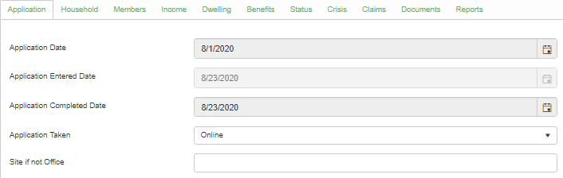
Dates in EAPCONNECT
Application Date: the date stamp of the application.
Application Entered: the day that the application was entered into the database.
Completion date: The day that the application was completed. This will be mandatory when the client has a claim pending.

Slide 19
Closed accounts
An EAP benefit can be applied to a closed account if the client received the pledge or benefit before the account was closed.
An EAP benefit cannot be applied if the funds are pledged or transmitted to the vendor after the client has closed the account.
Vendors may not apply EAP benefits to closed accounts with an outstanding balance.
Benefits may only be award to accounts that are indicated to be scheduled for closure or in “final bill” status if such a benefit will result in the account being reinstated and service continued at the address of record.

Slide 20
Example
Ex: A client closed an electric account and declared bankruptcy after submitting a mail-in application. The LSP transmitted a benefit 5 days after the account was closed. The electric company didn’t catch that the account was closed when checking the transmittal and the transmittal was approved. When the funds were paid to the electric company, the company applied the funds to the outstanding balance.
The company should have rejected the benefit on the transmittal. If it got through the transmittal process and was paid out, the vendor will have to send the entire benefit back to IHCDA.

Slide 21
Individual Checks
LSPs should make every effort to have clients who receive a direct payment benefit sign up for ACH/Direct Deposit.
IHCDA will continue to print and mail the checks and initiate direct deposits.
If a biofuel client is in crisis and needs an immediate benefit, and the LSP does not enter into MOAs with biofuel vendors, the LSP should issue the client an immediate crisis benefit and submit a claim for reimbursement. The LSP must include a list of clients who received a crisis benefit with the claim submission.
For clients who have utilities included in their rent, the threshold of monthly rent paid required in order to be eligible for a benefit has been lowered to $1.00.

Slide 22
Household eligibility vs. benefit eligibility
Intake staff must take care to distinguish between household eligibility and benefit eligibility.
If a household has a circumstance that is preventing the awarding of a benefit (e.g., inoperable equipment, outstanding deposit on account, etc.), this does not impact the determination of overall household eligibility.
Household eligibility may be used to determine eligibility for other resources and can qualify households for moratorium protection.
When household resolves issues preventing benefit payment, household eligibility must not be redetermined.
Households must not be denied on the basis of not submitting utility bill documentation.

Slide 23
LSP administration
The Administrative line item in LSP budgets is unchanged from last year’s level of 7.5%.
For PY2023, the Outreach and Eligibility Determination line item is unchanged from last year’s level of 4.5% of total award.
These will be reviewed in greater detail in another module.

Slide 24
Water program
The Low Income Home Water Assistance Program (LIHWAP) will continue to run parallel to and integrated with EAP. Additional LIHWAP-related training will be conducted on Wednesday.

Slide 25
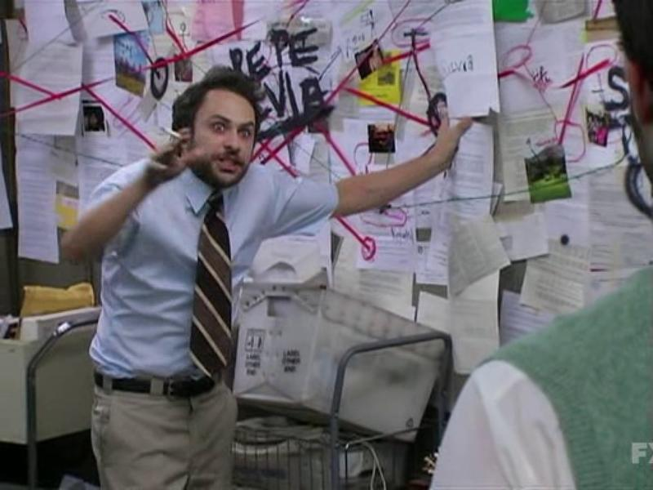
Policy changes

Slide 26
Regular benefit changes
Electric adder has increased from $125 per household to $150 household.
Matrix points for heating fuel have been bumped up by 1, except for households with heat included in rent.
  Electric or gas heating – 3 points
  Propane, fuel oil, biofuel – 12 points
Taken together, these two changes increase the benefit for a typical household, as well as the maximum benefit, by $50.
Note that households with heating included in rent will continue to receive 0 matrix points for heating fuel.

Slide 27
Crisis benefit changes
Beginning in PY2023, when determining benefit for an approved applicant who is in crisis, the LSP is to consider the disconnection or reconnection amount and award crisis first to that amount, up to a maximum of $500 per utility. This is an increase from last year’s maximum of $250.
  Heating and electric utilities are each eligible for up to $500 in crisis benefits, for a total of $1,000. Unused crisis from one utility may not be waived to the other.
  Clients who heat with electric are eligible for crisis of $1,000 ($500 to the base electric, $500 to the portion of electric that provides heating fuel).
  Crisis for bulk fuels and biofuels should be given up front to assist with delivery and reduce administrative burden, regardless of presence of actual crisis.
  Clients may come back once after initial application approval to use any crisis funding not used at the time of approval.

Slide 28
Matrix changes

Slide 29
Income calculation and eligibility
Income Eligibility Period is defined as the most recent three complete months prior to an application date, or the most recent thirteen weeks prior to an application date.
LSPs may no longer count the current month as part of the income eligibility period, unless all adult household members receive income on a regular schedule and there are no additional pay dates for the remainder of the month. These exceptions must be documented in the client file and should be invoked only to avoid the burden of requesting additional documentation from the household.
Example: A household applies on November 18th. One household member receives Social Security and SSI at the beginning of every month, but the other household member is employed. Household member #2 presents pay stub for November 12 with a two-week pay period. Because they will be receiving additional pay on November 26, November is not a complete month. Intake must consider income for August, September, and October.

Slide 30
Income calculation and eligibility
IHCDA is providing a worksheet to streamline and automate calculation of the 13-week calculation method with the entry of just a few pieces of data from the most recent paystub.
Fixed income issued on a monthly schedule (e.g., SSA-administered benefits) can continue to be calculated by multiplying the most recent benefit amount received by three. The exception is if an applicant applies in the first three months of 2023 and presents a letter from SSA outlining a COLA that increases their monthly benefit. As long as the letter shows both the pre-COLA and post-COLA benefits, the intake is to count the appropriate amount of benefit for the appropriate months of the eligibility period.

Slide 31
Income calculation and eligibility
This year, income eligibility will be continue to be based on 60% of State Median Income only. We will not switch over to 150% of Federal Poverty Guidelines once FPG outpaces SMI.
The most recent SMI for a household of four is $89,193.

Slide 32
Application of benefits
With the expiration of ARPA benefits, the order of application of benefits is reverting to its previous order this year:
  Crisis (if eligible)
  Regular
  Second crisis (if available and meets requirements)
Local funding/utility programs may be awarded before or after Regular funding depending on its own rules on guidelines, but shall not be applied before Crisis.

Slide 33
Wood and biofuels
  Wood and other biofuels receive 12 points, and are eligible for $500 crisis.
  Crisis should be given at the time of eligibility determination, and may not be waived to the electric utility.
  IHCDA is not entering into agreements with wood vendors this year. All wood clients will receive a check or an ACH deposit which they will use to purchase their wood on the market. LSPs are strongly encouraged to enter into agreements with local wood vendors.
  If a client is in immediate need of wood, the LSP may issue a check in the amount of $500 to satisfy the immediate need with the crisis benefit. These claims are to be submitted to IHCDA for reimbursement. All regular benefits will be paid by IHCDA, unless LSP has entered into MOA with local vendors.

Slide 34
ERR Changes
  ERR per-household benefit cap has been increased from $5,000 to $7,000 in order to better address rising costs and reduced purchasing power of the dollar.
  Agencies may continue to opt to either operate under a strict $7,000 per-household cap, or to use an Average Cost per Unit (ACPU) method.
  ERR may not be performed on a dwelling if the home is in foreclosure.
  Applicants who are awarded ERR may not decline Weatherization services; if the client consents to ERR, they are also consenting to Weatherization.

Slide 35

Changes to forms

Slide 36
Appendices vs. forms
Renamed and redefined appendices and forms for increased clarity.
Appendices are informational in nature and are intended to supplement the content of the manual.
Forms are interactive and for documentation purposes.
All forms have been edited to indicate when they were last changed so that LSPs may ensure they always have the most current version. Therefore, all LSPs should destroy any existing hard copies of forms they have on hand, and archive any electronic versions they may be maintaining of previous versions.

Slide 37
List of appendices
Appendix A List of Manual Changes
Appendix B Local Service Providers (LSPs)
Appendix C IHCDA Community Programs Contacts
Appendix D Federal LIHEAP Statute
Appendix E Indiana Moratorium Legislation
Appendix F Income Calculation Quick Reference Chart

Slide 38
List of forms
Form ABS-2023 Declaration of Absent Household Members
Form ADDR-2023 Address Change Form
Form APPL-2023 EAP and Water Program Application Form
Form APPLESP-2023 EAP and Water Program Application Form – Spanish
Form APPLLP-20223 EAP and Water Program Application Form – Large Print
Form DBPE-2023 Direct Benefit Payment Election Form
Form DIS-2023 Disability Medical Statement
Form DWD-2023 Department of Workforce Development Release of Information
Form EARN-2023 Request for Earnings Information
Form EBTR-2023 Energy Benefit Transfer Request
Form ERRCHECK-2023 Emergency Repair and Replace Checklist
Form ERRCON-2023 Emergency Repair and Replace Consent/Release of Liability Form
Form IVA-2023 Income Verification Affidavit
Form LLA-2023 Landlord Affidavit
Form MTRX-2023 EAP Benefit Matrix Form
Form RECERT-2023 Simplified Recertification Tool
Form UTIL-2023 Utility Affidavit

Slide 39
Changes/Updates to forms
All forms and appendices will be updated and renamed, and will be distributed with the final version of the 2023 manual in August.
All LSPs should be sure to remove previous versions of forms and appendices from their websites and internal archives, and recycle any existing hard copies of these forms. Please ensure only 2023 forms are being used this year.
Generally speaking, no major changes are anticipated, although we will try to incorporate water information onto utility forms and may make other adjustments to make the forms easier to use for LSPs and applicants.

