Slide 1
Lessons Learned from the Field:
Building Authentic Relationships and Radical Self-Care
Kate Kimmer, MA
May 12, 2022

Slide 3
How do you define ‘success’ in your role?

Slide 4
How do you define ‘wellness’
How do you know when you are well?

Slide 5
What is violence?
Structural Violence
Taxonomy of Violence
Direct Violence
Cultural Violence
Johan Galtung’s Taxonomy of Violence

Slide 6
WHAT’S THE DIFFERENCE?
‘Anti-Racist’ vs. ‘Not Racist’
Structuration
Structure
Agency
Adapted from Sewell (1992)
Notes:
While we often talk about the individual risk factors of trafficking, human trafficking does not occur in a vacuum. Human trafficking is a form of abuse and exploitation so severe that it is equated to modern slavery. Though many victims of this crime are often not kept behind locked doors or in chains, there are micro, mezzo, and macro levels of exploitation, marginalization, oppression and abuse that make some people not only more vulnerable to experiencing trafficking, but less likely to self-identify as a victim of a violent crime, and also less likely to seek help or cooperate with law enforcement.
Though it is easier to discuss individual risk factors and risky behaviors, particularly in the context of DMST, in reality, as a society, we all play a role excusing, perpetuating, and at times, even exacerbating this violent crime.
When as a anti-trafficking professionals, we become survivor centered in our work—whether it is for the purpose of preventing, intervening in, providing short term and long term services to trafficking survivors, or successfully prosecuting cases of human trafficking, what are the macro, mezzo, and micro aspects of oppression, marginalization, abuse, and exploitation do we need to unpack?

Slide 7
Previous exposure to and engagement in violence
Experiential * Biological * Neurological * Cultural
0
100
Violence Continuum
What dictates ‘normal’ in the context of violence?
When and why is violence used?

Slide 8
Transformative Justice
Transformative Justice (TJ) is a framework and approach for responding to violence, harm and abuse; (…) it seeks to respond to violence without creating more violence and/or engaging in harm reduction to lessen the violence.
TJ actively cultivates the things we know prevent violence such as healing, accountability, resilience, and safety for all involved.
Transformharm.org

Slide 9
In TJ interventions, we work to actively practice healing and accountability for everyone involved, not only for the survivor and the person who committed the violence. TJ responses are an opportunity for us to not only address incidences of violence, harm and abuse, but to also take stock of and collectively build the kinds of relationships and communities that could intervene in instances of violence, as well as prevent violence. Transformharm.org

Slide 10
Complex PTSD: The Brain, the Body, and the Impact of Complex Trauma
Individual * Community * Historic
Behavioral
Psychological
Physical
Social/Relational
Economic
Long-term Consequences

Slide 11
What is dissociation? Trauma Geek

Slide 12
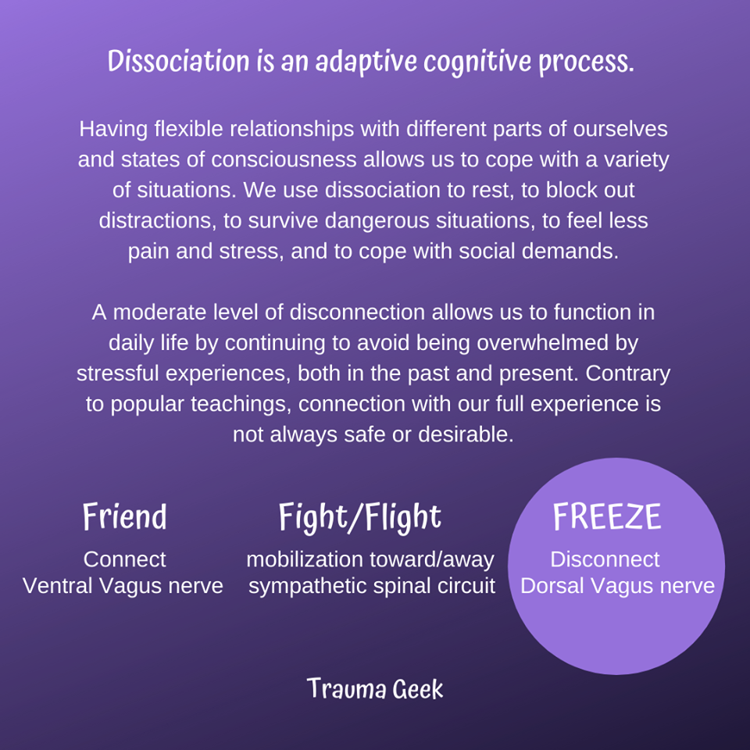
Dissociation is an adaptive cognitive process Trauma Geek

Slide 13
Dissociation is normal Trauma Geek

Slide 14
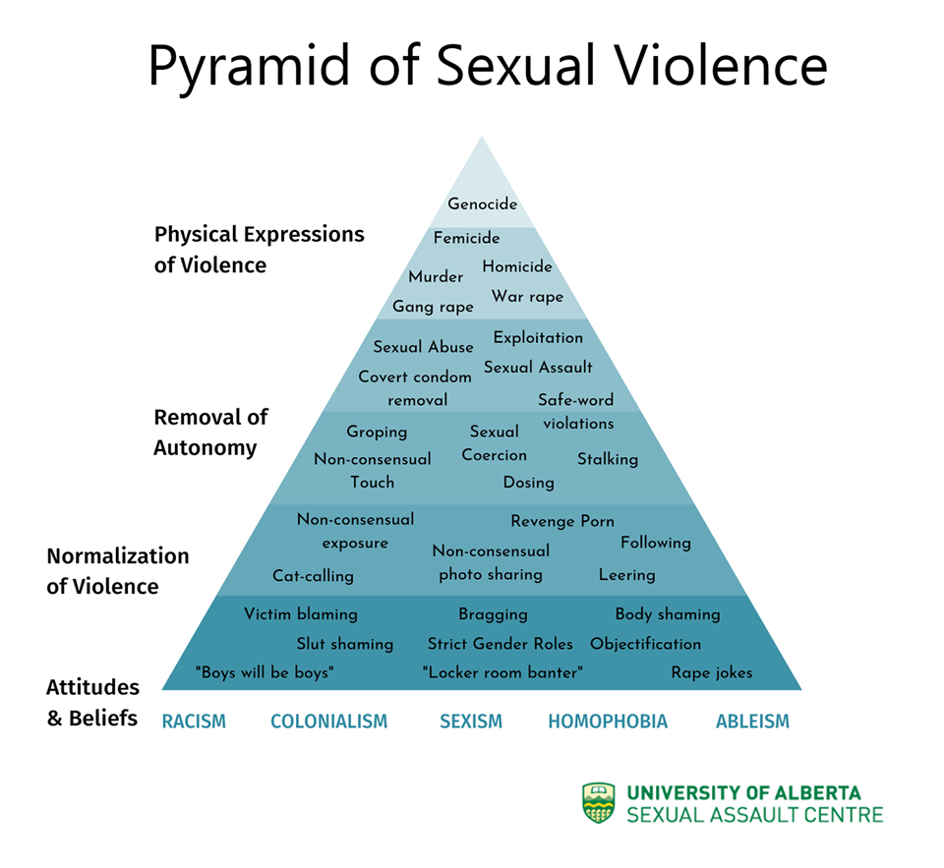
How do we remain present for and unwavering in the work we do while still prioritizing and maintaining our mental health?

Slide 15
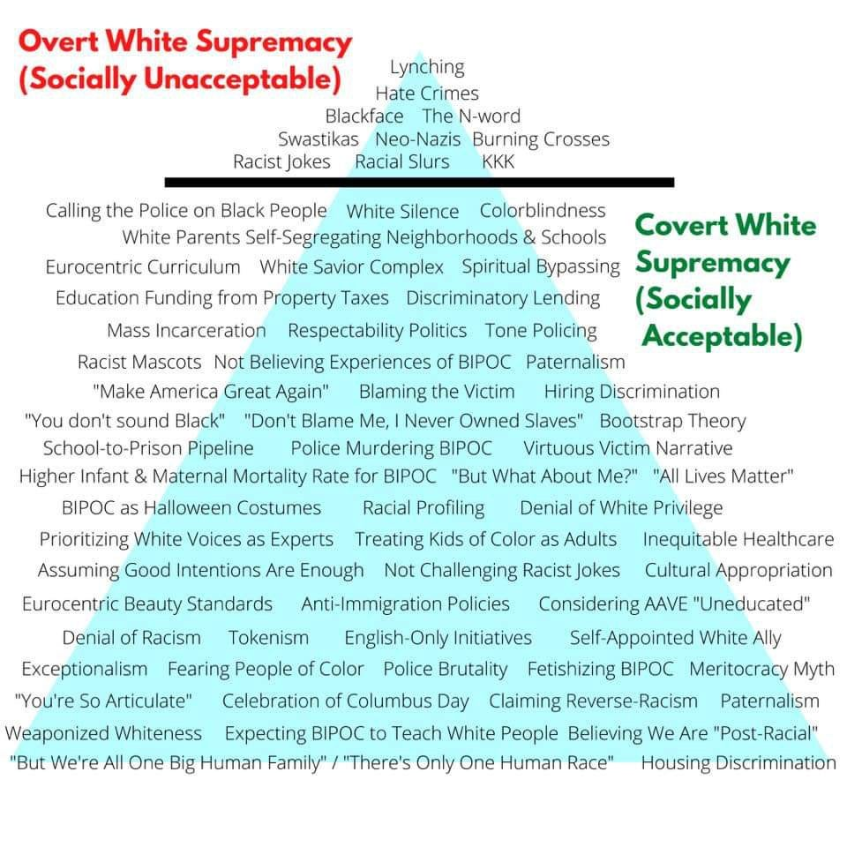
How do you feel when you look at the trajectory of the work we have to do…

Slide 16
As survivors of violence, as professionals in the anti-violence field, as social justice warriors, as change makers… what does dissociation mean for us? When is it adaptive? How is it helpful? When is it harmful? How do we ground during a pandemic and a revolution pushing to dismantle systems of oppression?

Slide 17
Affirmations
affirming our inalienable value as humans

Slide 18
Window of Tolerance
Are you operating within you Window of Tolerance? What happens when you’re not?

Slide 19
How do you prioritize rest and rejuvenation? What grounds you? What fills your cup?

Slide 20
Have you made yourself crisis plans?
How do you know when you are not well?
Who are your people/supports?

Slide 21
Culture and Structuration
Culture consists of the beliefs, behaviors, objects, and other characteristics common to the members of a particular group or society.
Through culture, people and groups define themselves, conform to society's shared values, and contribute to society.
Culture includes many societal aspects: language, customs, values, norms, mores, rules, tools, technologies, products, organizations, and institutions.

Slide 22
How could your agency support your wellness? How could leadership foster radical self-care? How could your agency foster authentic relationship and communication among staff?

Slide 23
Thank you!

