Slide 1
IHCDA HOME Homebuyer Program Selling the Unit – Part I: Choosing the buyer and evaluating the lender Session 4
Samantha Spergel
Director of Real Estate Strategic Initiatives and Engagement
Indiana Housing & Community Development Authority

Slide 2
IHCDA’s Mission and Vision
Our Mission
To provide housing opportunities, promote self-sufficiency, and strengthen communities.
Our Vision
An Indiana with a sustainable quality of life for all Hoosiers in the community of their choice.

Slide 3
CONGRATS!
You’ve made it. You are ready to sell your HOME Homebuyer Unit.
Now what?

Slide 4
Agenda
Pre-Closing Timeline
Eligible Beneficiaries
Homebuyer Counseling
Setting the Purchase Price
Evaluation of Buyer Expenses, Cash Contribution and Cash Savings
Lending Standards
Filling out the Buyer Closing Analysis

Slide 5
Pre-Closing Timeline

Slide 6
IHCDA Closing Manual
IHCDA will be releasing a final version of the Closing Manual by the end of this month.
This is a guide to assist with the various requirements and regulations pertaining to the actual selling of a HOME-assisted Homebuyer unit.
Please note that the Manual does not cover Project Compliance.

Slide 7
End of Construction
The final inspection of the unit must be completed prior to moving forward on selling the unit. The Final Inspection must be scheduled within 30 days of construction completion and the issuance of the certificate of occupancy.
Final forms may include:
Lead Form
Certified HERS rating Form
Final Inspection Form
Universal Design Features, Green Building Techniques and Design Features as noted in your application must be met.
Dave Pugh will issue the inspection clearance letter. Reminder – this begins the 9-month requirement to have a purchase agreement with an eligible buyer.

Slide 8
Pre-Closing Documentation
Pre-closing documentation must be submitted to IHCDA 3-4 weeks prior to closing.
Closing Manual includes a list of those documents. Those may include:
Part 5 income verification
Certificate of Housing Counseling
Final Appraisal
Closing Disclosure
Final Closing Proforma (per unit)
Mortgage
Buyer Expenses
Buyer Bank Statements
Written explanation of assets
Development Sources
Other Buyer Assistance

Slide 9
Pre-Closing Documentation
All pre-closing documents must be submitted on a per-unit basis
IHCDA must approve the closing based on these documents and cannot guarantee approval if documents are submitted late.
If you are submitting more than one unit at a time, please reach out to IHCDA to set up a OneDrive folder.

Slide 10
Eligible Beneficiaries

Slide 11
Eligible Beneficiaries
All homebuyers must be at or below 80% of the HUD Area Median Income at time of purchase.
IHCDA provides this information on a per-county basis through the release of RED notices. 2023’s income limits are posted in RED Notice 23-26.
IHCDA follows the Part 5 Income Verification Process. The requirements can be found under Chapter 14 – Income Verification of the CDBG-HOME-HTF Program Manual.

Slide 12
Verifying Income
IHCDA’s Compliance Division will verify that the household meets the HUD income requirements prior to closing.
New process is to ensure the household is at or below 80% AMI prior to closing – otherwise, the unit is considered a failed HOME unit and the developer must repay all funds to IHCDA.
IHCDA will require income documents to be submitted 4 weeks prior to any closing.

Slide 13
Verifying Income
At a minimum, IHCDA will require:
Form 23 (Income Certification Questionnaire)
Form 47 (OOR and Homeowner Income Certification)
Supporting documentation of income
IHCDA may also require Form 24 if an adult member of the household has no source of income (this is a self-certification)
Developers are encouraged to use Form 42 (Employment Verification Income Calculation Worksheet) to assist in ensuring income is calculated per the HUD regulations.
Additional Forms can be found in the list of Exhibits under Chapter 14 on the IHCDA Compliance webpage.

Slide 14
Verifying Income
Verification of all sources of earned and unearned income and of all asset sources on both the Eligibility Questionnaire and Income Certification must be included.
Third-party verifications are the preferred method of income verification.
When utilizing paystubs as support documentation for verifying and anticipating income from wages of household member whose job provides steady employment (i.e. 40 hour a week, 52 weeks/year) you must obtain the number of paystubs that cover two consecutive months of payments.
For those jobs providing employment that is less stable or does not confirm to a 12-month schedule, income documentation should be obtain that covers the entire previous 12-month period.

Slide 15
Verifying Income
If utilizing tax returns as income verification, you must obtain a certified copy by completing IRS form 4506 “Request for Copy of Tax Form”.
Any other documentation verifying the beneficiaries’ eligibility (joint custody of a child documentation etc.).
Program Manual provides information on how income is to be counted, whose income is to be counted, whose income does not need to be counted, income inclusions, income exclusions and how to treat assets.

Slide 16
Common Mistakes
Compliance Form #47 not signed by ALL adult family members.
Supplemental documents do not match forms.
Assets are not clearly documented.
Third-party verification missing.

Slide 17
Housing Counseling

Slide 18
Housing Counseling Rule
All homebuyers MUST receive Housing Counseling.
HUD Housing Counseling Rule effective 2021
All adult household members who will hold title and be a party to the senior loan are required to complete homebuyer housing counseling.
All homebuyers assisted under HOME must receive housing counseling that is performed by:
Certified Housing Counselor who has passed the HUD certification exam AND
Who is employed by a HUD-approved housing counseling agency.

Slide 19
HUD Housing Counseling Agencies
Private or public non-profit organizations who have been approved by HUD to provide housing counseling
Experience
Community Base
Resources to implement counseling plan
Agencies will have HUD-Certified Housing Counselors on staff
These counselors have passed an intensive exam to be certified
Counselors are experts on pre-and post-purchase, fair housing, financial literacy.
Roughly 1300 certified counselors nationwide!

Slide 20
HUD Housing Counselors
HUD has a tool to find HUD participating housing counseling agencies! This can be accessed at:
https://hudgov-answers.force.com/housingcounseling/s/?language=en_US
Can search by geography, type of services needed or counseling method

Slide 21
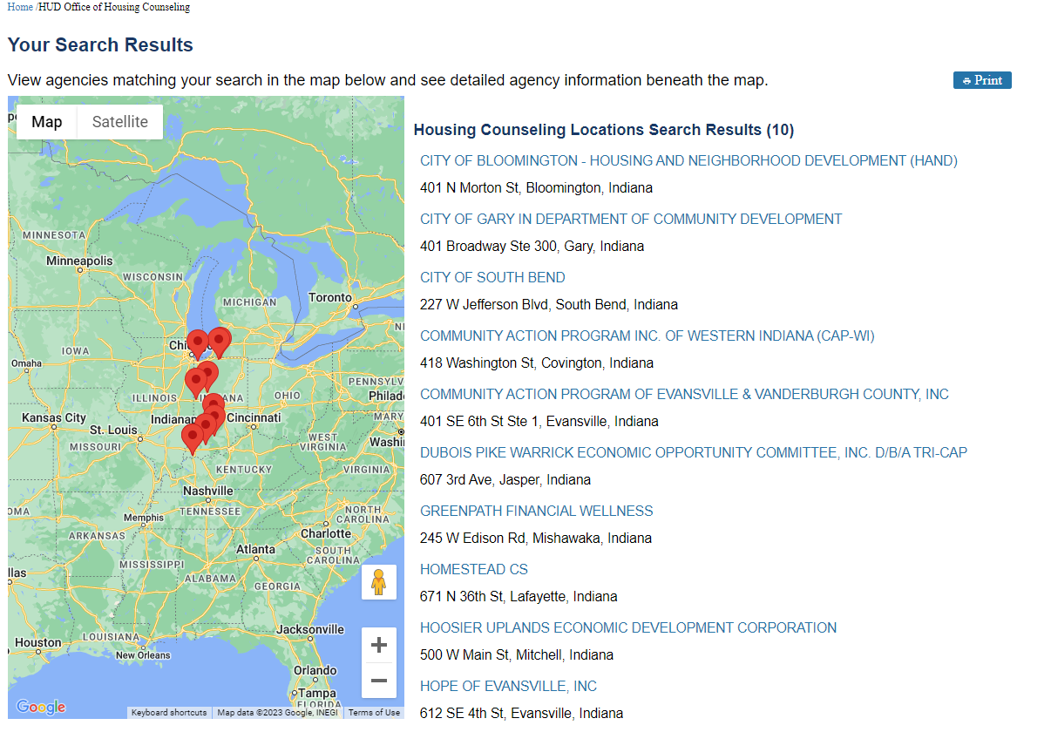
Indiana Housing Counseling Agencies
Includes:
Contact
Counseling Method
Counseling Services
Languages
Currently, HUD lists 24 Housing Counseling Agencies
Please note that certain areas of the state may not have a certified housing counseling agency

Slide 22
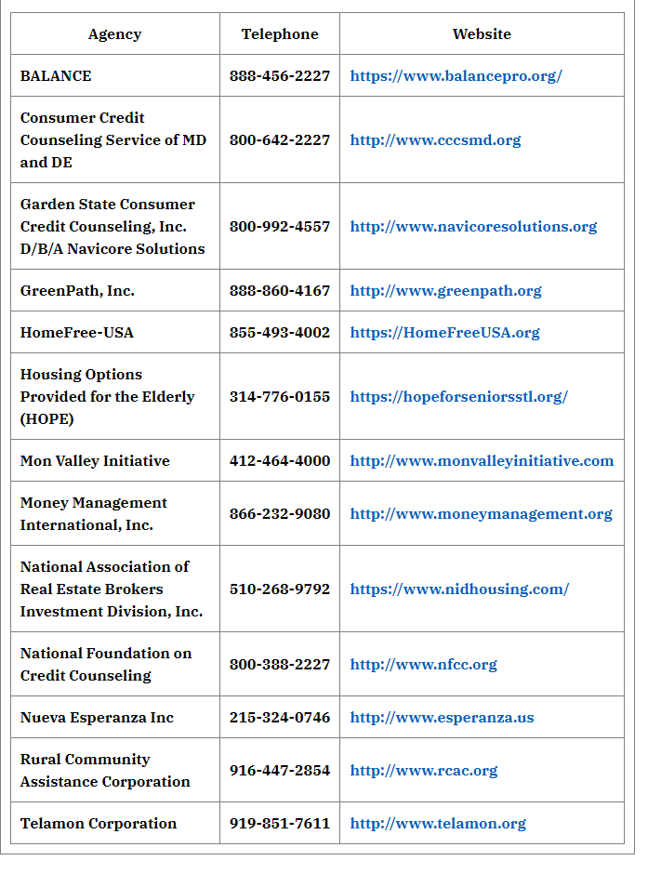
National Housing Counseling Agencies
List of HUD-approved agencies can be found here:
https://www.hud.gov/program_offices/housing/nationally_hud_approved_housing_counseling_agenciesdirectory

Slide 23
Housing Counseling Approval
Identification of the Housing Counseling Agency is recommended with application.
Use of additional housing counseling (i.e., through Habitat affiliate) not prohibited but must also use certified Housing Counseling Agency. Failure to meet this requirement will prompt full repayment of HOME award to IHCDA.
Can include cost of housing counseling as soft costs per HOME regulations if unit is sold. Donated counseling can count as HOME match.
NOTE: cannot be a part of the Recapture Lien.

Slide 24
What is housing counseling?
Must be independent, expert advice customized to the need of the homebuyer to address the homebuyer’s housing barriers and to help achieve their housing goals. It must at a minimum include:
Intake
Financial and housing affordability analysis
An Action Plan
Reasonable effort to have follow up communication when possible
The counseling must be individualized to the specific homebuyer. The counseling must address all topics relevant to the homebuyer, including:
The decision to purchase a home;
The selection and purchase of a home;
Issues arising and affecting the period of ownership of a home (including financial, refinancing, default and foreclosure);
The sale of other disposition of a home.

Slide 25
What is housing counseling?
The counselor must communicate on the importance of obtaining an independent home inspections.
The Developer must ensure that each homebuyer signs a receipt acknowledging they were given the “For your protection: get a Home Inspection” and “Ten important questions to ask your Home Inspection”. Most may be found on the HUD Exchange.
IHCDA requires pre-purchase counseling
Minimum of 8 hours of counseling
Certificate of pre-purchase counseling is valid for one-year
Points for post-purchase counseling

Slide 26
What is housing counseling?
The delivery method may be flexible (in-person, phone, internet, or combination) but again, must be individualized.
The developer may not charge servicing, origination, processing, inspection or other fees for the costs of providing counseling.
Three weeks prior to close out, IHCDA must receive:
Certificate of completion of the housing counseling
Documentation that the housing counseling agency is a HUD-approved housing counseling agency
Other documentation as requested by IHCDA

Slide 27
Setting the Purchase Price

Slide 28
Appraisals
Developers will be required to provide either an “after rehab” or “construction value” appraisal from a licensed appraiser, either at time of application or three weeks prior to closing.
If submitting at time of application, developer can use appraisal as final sales price.
If the developer opts for CMA with application, then appraisal must be submitted with closeout.
The unit should sell at appraised value – sales price should reflect market.
Discounted sales price hurt the market and may result in windfall on resale.

Slide 29
Limits on Sales Price
HUD does have maximum limits on sales price – if the home comes in above the HUD limit, HOME cannot be used to subsize and must be returned to IHCDA, even if other funds cover the excess.
Limits are based on construction type. Both are calculated by HUD based on the 95% of the median purchase price, based on FHA single-family mortgage data.
HUD releases limits annually; the limits remain in affect until HUD issues new limits.
Limits may be accessed HERE from HUD exchange. Current limits effective 7/1/2023.

Slide 30
Important considerations
While HUD has maximum limits, the amount may not be affordable to a potential HOME Homebuyer.
IHCDA will underwrite the buyer and may deny the final sales contract if the purchase price even reduced is more than the homebuyer may safely afford.
The amount of the sales price must be entered into the Final Proforma Closing Tab.

Slide 31
Evaluation of Buyer Expenses, Cash Contribution and Cash Savings

Slide 32
What is homebuyer affordability?
IHCDA uses front-end and back-end ratios to determine affordability.
Front-end ratio is used at time of application. This includes an analysis of the principal payment, insurance, taxes, insurance (PITI) + utilities to a projected income.
Limit is set at 29%. See previous trainings on exceptions.
Back-end ratio is used at time of closing. The back-end ratio includes both PITI + utilities and existing non-housing consumer debt.
IHCDA has set this at 41%.
Habitat affiliates may go up to 43%.
The back-end ratio may also limit the loan amount from a primary lender.

Slide 33
Determining non-housing debt
IHCDA will evaluate the homebuyer’s reoccurring monthly expenses. The Developer must submit documentation of:
Utility cost projections (may use utility model)
Transportation costs
Monthly Debt Obligations (credit card, auto loan, student loans, other installment and revolving debt that may appear on a credit report such as alimony, child support etc.)
Dependent care expenses (child/elder care) which the homebuyer must have to allow the head of household to work more than 15% of gross income
Court order child support or alimony payments more than 20% gross income
Out of pocket health insurance premiums more than 10% gross income
Certain debts which may be repaid in full within several years of closing may not have to be considered for the back-end ratio.

Slide 34
Cash Contributions & Savings
Buyers are required to contribute a minimum of $250 toward the purchase of the unit. This cannot be waived.
There may be cases in which the homebuyer has significant assets to purchase the home. This may include proceeds gained from the sale of a previous home. If the buyer has liquid assets that exceed $25,000, the buyer must invest at least 5% of those funds in the purchase.
Liquid assets are those readily convertible to cash including cash, savings accounts, checking accounts and other bank accounts.
IHCDA will review Part 5 income documents to assess assets. IHCDA may require written explanations from the homebuyer of any unexplained large expenditures or large deposits.

Slide 35
Cash Reserves
The homebuyer must have adequate case reserves to pay for unanticipated emergencies.
IHCDA requires 2-4 months of cash reserves. The reserves would then equate last least two times the total PITI + utilities needed per month.
These may be from savings, checking, money market or other non-retirement accounts.
If Part 5 documentation does not provide information on the reserves, IHCDA will require additional documentation.

Slide 36
Waivers
IHCDA may consider waivers on the following:
Front End Ratio
Back-End Ratio
Reoccurring monthly expense
Cash Reserves

Slide 37
Uniform Assistance (don’t do this)
The developer may not provide a uniform amount of assistance to each homebuyer irrespective of income, assets or other circumstances.
Each household must be independently evaluated.
IHCDA must finalize an approval of a homebuyer purchasing a home prior to closing.

Slide 38
Lending & Mortgage Standards

Slide 39
Reviewing the Mortgage
IHCDA is required to review each primary mortgage to ensure the loan is sustainable. Homebuyers must be protected from risky mortgage features that may threaten the long-term sustainable of the mortgage.
The Developer must provide, at a minimum, the closing disclosure to IHCDA at least 3 weeks prior to closing.
If there is additional buyer assistance, documentation of that assistance must also be included as part of the pre-closing package.
If the Developer can supply a draft of the mortgage prior to closing, that would also be preferrable. The mortgage may be submitted after closing – however, it if contains any language that conflicts with the HUD regulations then the funds must be repaid to IHCDA.

Slide 40
Qualified Mortgages
The Primary mortgage must be a “Qualified Mortgage” (QM) under the requirements of the Consumer Protection Finical Bureau (CFPB).
QMs limit total points and lender fees to reasonable levels. They also strictly limit pre-payment penalties and contain other features intended to protect consumers.
With QMs, certain risky loan features are not permitted, such as:
An “interest-only” period, when you pay only the interest without paying down the principal, which is the amount of money you borrowed.
"Negative amortization,” which can allow your loan principal to increase over time, even though you’re making payments.
"Balloon payments,” which are larger-than-usual payments at the end of a loan term. The loan term is the length of time over which your loan should be paid back. Note that balloon payments are allowed under certain conditions for loans made by small lenders.
Loan terms that are longer than 30 years.

Slide 41
Mortgage Exemptions
Mortgages provided by the following entities are exempt from the QM requirement:
Habitat Affiliates
Community Development Financial Institutions
USDA Section 502 Loans

Slide 42
Lending Standards
Cannot exceed a 30-year term (can be as low as 20-year term).
Exception: USDA loans
Must require periodic payments (Balloon payments not allowed).
Cannot have a first mortgage interest rate more than 1.5% above the average prime offer rate, reported by the Federal Financial Institutions Examinations Council.
Must be a fixed rate – adjustable-rate mortgages are not allowed under this policy.

Slide 43
Lending Standards
The purchaser must be qualified by the lender to spend at least 20% of their monthly gross income on housing.
Buyer’s who qualify at payments levels below 20% of income usually have higher consumer debt which increases both subsidy costs, and the likelihood for foreclosure later.
Mortgage cannot contain any right of first refusal – only PJs are allowed to hold any right of first refusal during POA. When sold, it must be sold in fee simple.
Lenders are not permitted to charge fees for HOME funding.
IHCDA has a recommended Loan-to-Value ceiling of 97% and required floor of 80%.
Be mindful of lender’s LTV standards.

Slide 44
Common Lender Questions
HOME may be used with a variety of mortgage types – conventional, FHA, VA, USDA.
IHCDA DPA (First Home, Next Home) may also be used in conjunction.
HOME would then fall to 3rd position
Closing Statement will show Buyer Subsidy as a debit to the Seller, and a Credit to the Buyer.
Refinancing is allowed (more on this in Session 6)
IHCDA Buyer Subsidy is forgiven on pro-rated basis with 100% forgiven at end of POA.

Slide 45
Buyer Underwriting

Slide 46
Buyer Analysis
IHCDA will underwrite each buyer to determine that the mortgage, and lending terms are affordable and not risk to the homebuyer. IHCDA will review the first and if applicable, second mortgage.
The Developer must include a contingency within the sales contract with their perspective buyer that IHCDA must approve the buyer and the level of buyer subsidy prior to closing.
Amounts listed in the Buyer Analysis must match terms and financial figures as identified in both the final Closing Disclosure and Mortgage.
If change occur and the final proforma is not submitted and approved by IHCDA, a new lien may need to be issued.

Slide 47
Cash needed to buy unit
Sales price set by appraisal.
Final closing costs or pre-paids needed. Closing costs may include:
Lender fees (origination)
Lender costs (appraisal, title)
Recording fees, transfer taxes, closing fees
Initial escrow deposits
These may be HOME eligible and should be included in TDC (closing prorations are not HOME eligible but can be included in TDC)
Pro-Forma will then calculate total cash needed.

Slide 48
Buyer’s cash and mortgage
Buyer’s Cash investment (minimum $250 required).
Buyer investment paid outside of closing items: If the buyer had any items which lowered the mortgage (i.e. sweat equity).
Other adjustments/credits: prorations.
Final Mortgage Amount: this will be less than appraised value – we will next determine the appropriate amount of HOME buyer subsidy.

Slide 49
Buyer Assistance
Total Buyer Assistance needed is the gap between the total cash needed and the buyer’s cash investment + the mortgage.
Other assistance would be other sources of DPA/Closing Cost assistance not coming from HOME.
The Proforma will then calculate the total amount of HOME assistance.
Up to $60k if under 50% AMI
Up to $50k if over 50% AMI
Cannot over more subsidy than needed

Slide 50
Mortgage Terms
Interest rate is the annual interest rate for the first mortgage.
Mortgage Insurance rate (yellow cell) and the annual payment (orange) should be included.
Mortgage term in number of years.
The proforma will then calculate the principal and interest payments and PMI/MIP.
Amounts must match Closing Disclosure.

Slide 51
Other housing costs
Proforma request annual costs of taxes, insurance and associate fees.
Projected taxes and insurance must be used. Taxes must be estimated at a minimum of $50/month. If developers have data supporting a higher tax need, please supply that documentation.
Utilities to be added to proforma.
Proforma will calculate the total escrow and total payment needed (PITI+ utilities).

Slide 52
Determining buyer affordability
Use annual income from Part 5 analysis.
Include existing non-housing consumer debt.
Proforma will then calculate the front-end ratio (housing ratio) and the back-end ratio (total debt ratio). This helps us determine if the mortgage is affordable.
Proforma will calculate the LTV and include information on the buyer cash investment.

Slide 53
Evaluating Liquid Assets
Add in starting liquid assets
Pro-forma will pull the cash investment toward purchase.
Proforma then calculates the assets after closing and determines the remaining assets.
Include existing non-housing consumer debt.

Slide 54
Implications of Underwriting Policy
Not all potential homebuyers that may be income eligible are going to qualify
May need more buyer subsidy than allowable under policy
May not have sufficient assets
May not qualify for a responsible mortgage
Be mindful of lenders who may want to “overleverage” the buyer or offer a subprime loan

Slide 55
Upcoming Training –
Monday, September 18th
9:30am

Slide 56
Selling the Unit Part 2 -
Putting the numbers together
Development Budget
Development Sources
Understanding Proceeds
Program Income
CHDO Proceeds
CHDO reuse agreement

Slide 57
Any Questions?
Samantha Spergel, Director of Real Estate Strategic Initiatives and Engagement
sspergel@ihcda.in.gov

