Slide 1
Community Housing
Development Organizations
(CHDOs)

Slide 2

IHCDA’s Mission and Vision
Our Mission
To provide housing opportunities, promote self-sufficiency, and strengthen communities.
Our Vision
An Indiana with a sustainable quality of life for all Hoosiers in the community of their choice.

Slide 3
Agenda
CHDO Benefits and Definitions
Preparing to Submit CHDO Application
CHDO Workbook and Related Policies
CHDO Board Composition Tools
Questions and Contact
This presentation should not be considered a complete guide to the Community Housing Development Organization certification requirements or the HOME Investment Partnership Program (HOME). The responsibility for compliance with federal program regulations lies with the recipient.

Slide 4

Interested in HOME?
The purpose of the HOME program is to provide subsidies in the form of grants or loans for the rehabilitation, and/or new construction of housing for low-income households.
Review the IHCDA HOME Investment Partnerships Program Page's resources and request technical assistance from your regional analyst to gain a greater understanding about the requirements and limitations of the HOME program.
For instance, both HOME Rental and HOME Homebuyer programs require:
Applications meet minimum documentation and scoring criteria to be considered for funding.
Affordability Periods determined by the amount of HOME funds committed to the assisted units.

Slide 5

The Benefits of Being an IHCDA-Certified CHDO
A minimum of 15% of IHCDA’s yearly allocation of HOME funds must go to CHDOs.
CHDOs may apply for up to $1,500,000 in HOME funds for construction awards.
CHDOs have exclusive access to project Seed Money and/or Site Control Loans up to $30,000.
CHDOs may apply for CHDO Operating Supplement funds up to $50,000.
IHCDA policy allows additional operating funding for CHDOs in the second year of construction of an eligible HOME project.
For more information on CHDOs, please go to IHCDA’s CHDO page or contact your regional analyst.

Slide 6

Community Housing Development Organizations (CHDO)
CHDOs are private, non-profit, community-based organizations that have qualified staff dedicated specifically to developing affordable housing within their targeted service areas.
The organization must meet the following criteria set forth in 24 CFR 92.2.
Legal Status
Be organized under State or local laws
Have tax exempt ruling: 501(c)3 or 501(c)4
Not allow net earnings to benefit any member, founder, contributor, or individual
Have the purpose of providing decent housing affordable to low-income individuals within its charter, articles of incorporation, or by-laws

Slide 7
Community Housing Development Organizations (CHDO)
The organization must meet the following criteria set forth in 24 CFR 92.2
Capacity
Organization's standards of financial accountability conform to 2 CFR 200.302 and 2 CFR 200.303
Have paid employees with housing development experience who will work on HOME funded projects
Have at least one paid key employee with housing development experience
Have a clearly defined geographic service area
Have a history of serving the community in which affordable housing is to be located
Organizational Structure
Cannot be or be controlled by a governmental entity
Cannot be for-profit organization
Accountable to low-income community residents:
At least 1/3rd of board members are low-income community residents (see CHDO Board Composition section)
Formal advisory process for low-income beneficiaries to contribute to development's decision-making

Slide 8
CHDO Roles
OWNER | DEVELOPER | SPONSOR
Holds valid legal title in fee simple absolute or has a long-term ground lease during both the development and the affordability period. If not responsible for the development activity, still must provide effective oversight to the contracted project manager/developer Must own the rental housing during development and at least the entire period of affordability | As developer, must be in sole charge of all aspects of development process: Obtaining zoning Securing funding Selecting contractors Overseeing progress Determining cost reasonableness Etc. Must own the rental housing during development and at least the entire period of affordability For HOME Homebuyer projects, CHDO may ONLY be a Developer | Property is solely owned and developed by the CHDO which agrees to convey ownership to a second non-profit organization at a predetermined time after project completion -OR- If also using LIHTC, property is “owned” or “developed” by: wholly owned subsidiary of the CHDO, limited partnership (CHDO is sole partner) limited liability company (CHDO is sole managing member)

Slide 9
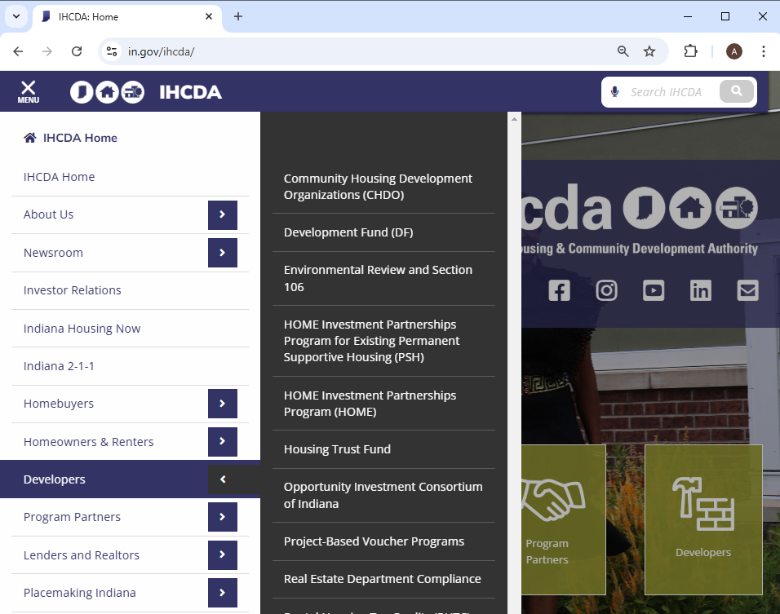
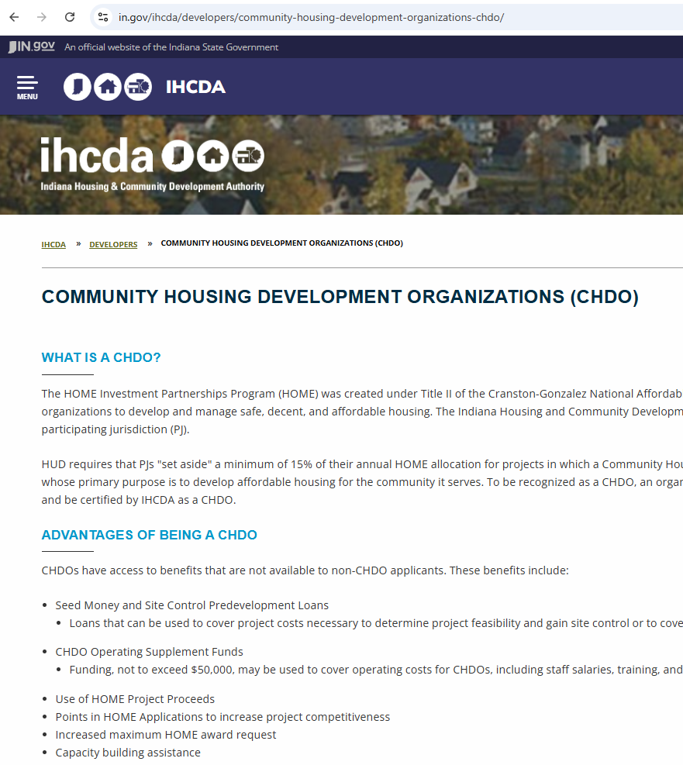

IHCDA CHDO Resources
https://www.in.gov/ihcda/developers/community-housing-development-organizations-chdo/

Slide 10




Reference Materials
CHDO Workbook | HOME Rental Policy | HOME Manual | Federal Regulations
Denoted by this icon: | Denoted by this icon: *HOME Homebuyer Policy may have slight nuances specific to homebuyer awards. | Denoted by this icon: | Denoted by this icon:

Slide 11
Preparing to Submit
CHDO Application

Slide 12
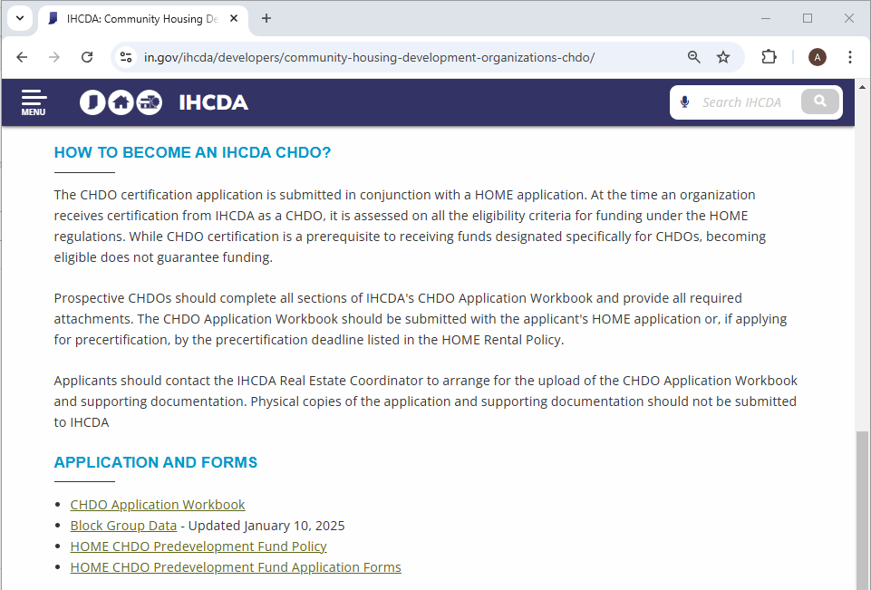
CHDO Application
Go to: https://www.in.gov/ihcda/developers/community-housing-development-organizations-chdo/
Scroll Down

Slide 13

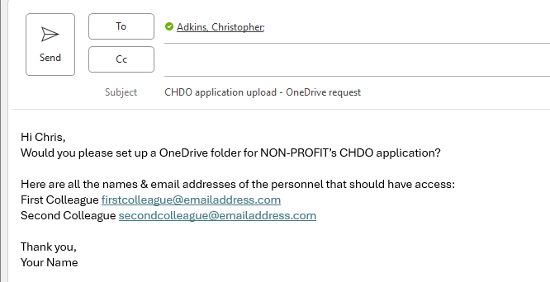
Real Estate Coordinator
Chris Adkins
Real Estate Coordinator
cadkins@ihcda.in.gov
Please include the email addresses of all personnel that require access to the upload folder!

Slide 14
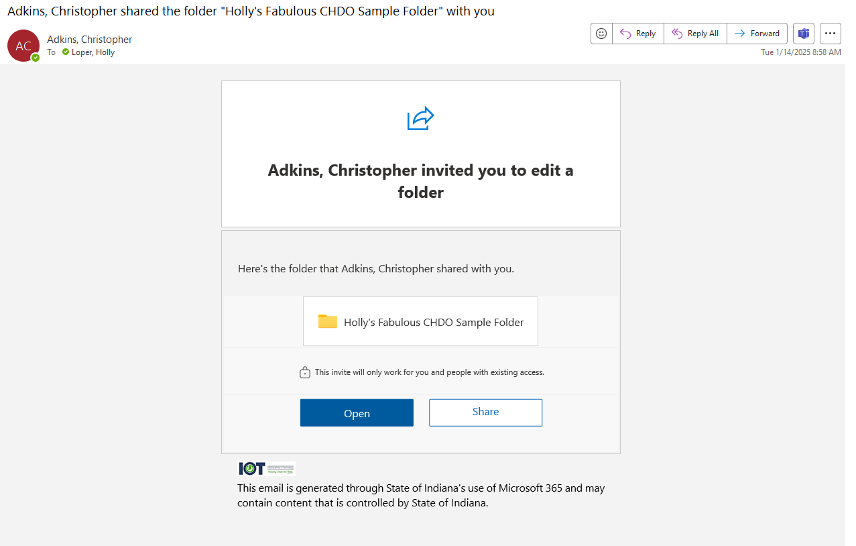
OneDrive Folder Invite

Slide 15
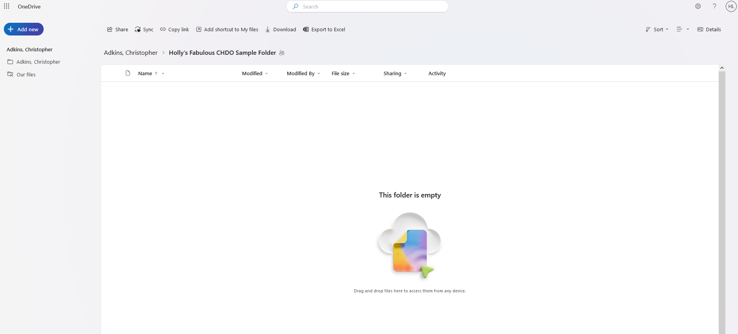
OneDrive Folder - Empty
https://ingov-my.sharepoint.com/ […]
Drag and Drop files!

Slide 16
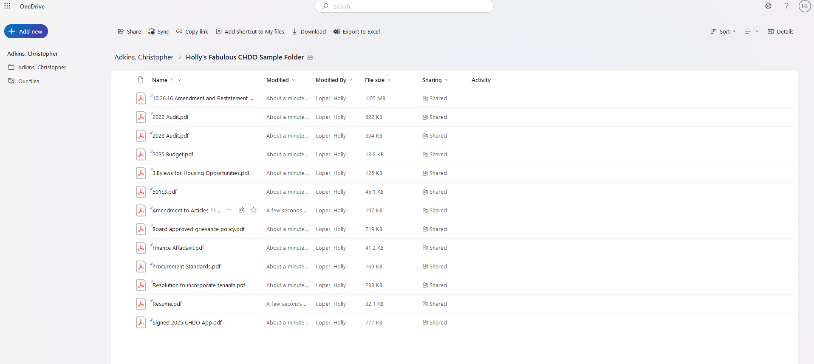
OneDrive Folder – Files Uploaded
*If applying for HOME Homebuyer or a Non-Competitive round, please inform Coordinator when all documents are uploaded.

Slide 17
CHDO Workbook and Policy

Slide 18
CHDO Application Workbook Location
Go to: https://www.in.gov/ihcda/developers/community-housing-development-organizations-chdo/
Scroll Down

Slide 19
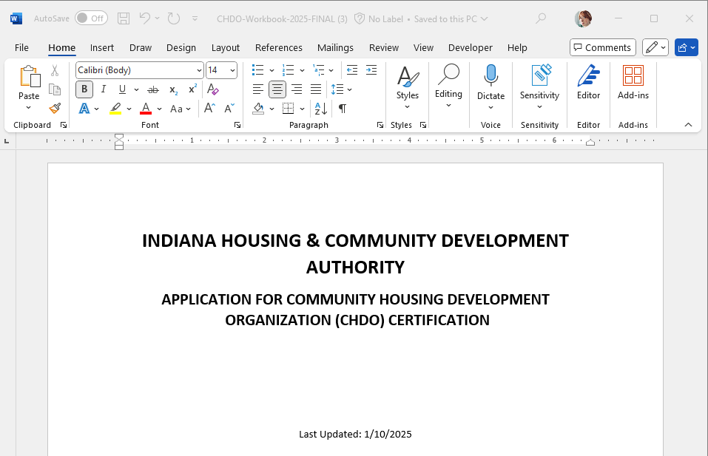
CHDO Application Workbook
Microsoft Word Document
Use the most recent version

Slide 20
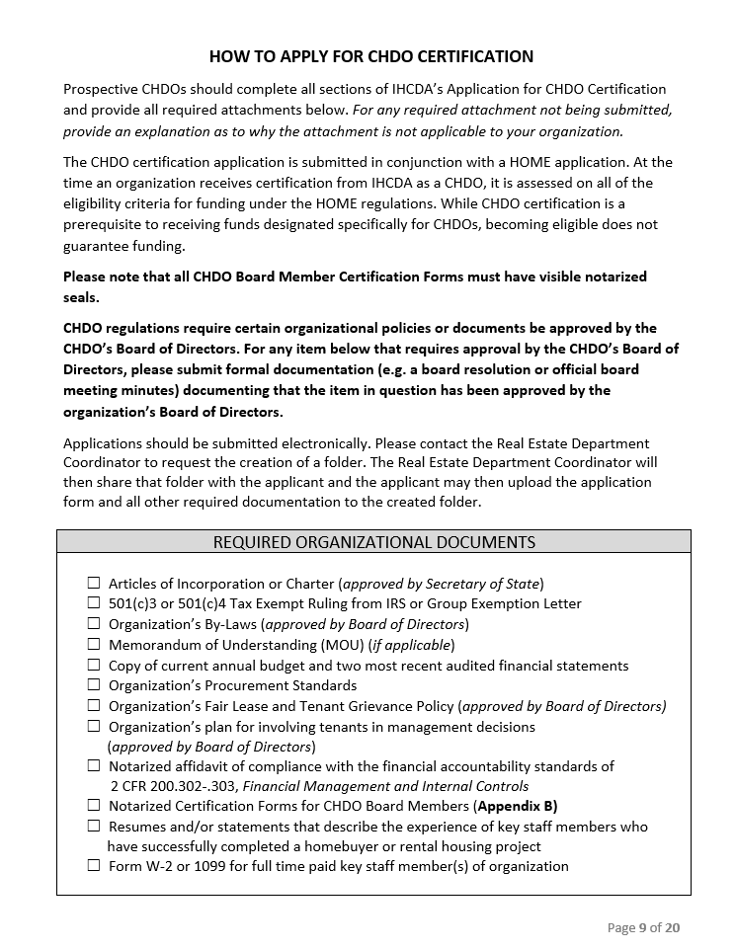
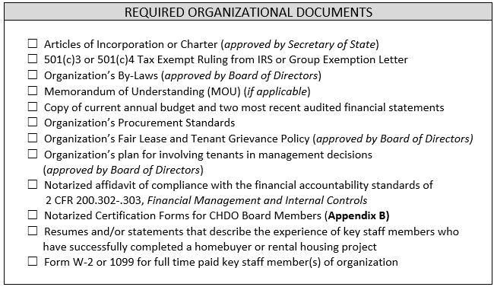
Required Documents

Slide 21

Documenting Legal Status
CHDO
Workbook
Page 2
HOME Manual
Page 11
Articles of Incorporation or Charter
Must be organized under state law in Indiana
IRS Exemption Letter
Must declare organization has been ruled tax exempt under section 501(c)3 or 501(c)4
Organization's By-Laws
Must be approved by Board of Directors
Must include purpose to provision affordable housing to low-income households
Memorandum of Understanding
Applicable if CHDO is sponsored or created by a for-profit entity

Slide 22
Documenting Capacity - Financial
CHDO
Workbook
Page 3
HOME Manual
Budget and Financial Statements
Demonstrate effective control over and accountability for all funds, property, and assets
Demonstrate fiscal capacity to maintain project through period of affordability
Notarized Affidavit of Compliance
Needs to be signed by CPA
Needs to be notarized
Page 12
Federal Regulations
2 CFR 200.302
2 CFR 200.303

Slide 23
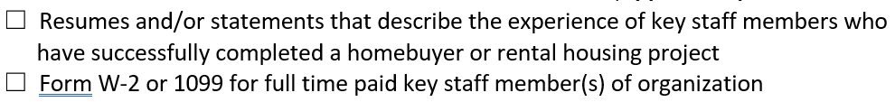
Documenting Capacity - Experience
CHDO
Workbook
Page 3
Resumes and/or statements describing experience
Demonstrates employees' experience successfully completing housing project(s) similar to those to be assisted with HOME funds
Form W-2 or 1099 for full time key staff member
Evidences at least one experienced paid employee is on staff
Cannot be employed by parent organization
HOME Manual
Page 12-13

Slide 24
Procurement Standards
CHDO
Workbook
Page 4
Procurement Standards
Must provide evidence the organization has established procurement standards to determine cost reasonableness
HOME Manual
Page 145-146
Federal Regulations
2 CFR 200.318

Slide 25

Community Accountability
Fair Lease and Tenant Grievance Policy
Must be Board Approved
Must include:
How grievances are submitted
Who reviews them
Timeframe for review
Appeal process
*Homebuyer grievance policies must be Homebuyer specific
Involving Tenants in Management Decisions
Evidences existence of a formal advisory process allowing program beneficiaries to contribute to development decisions
HOME Policy
Page 35
CHDO
Workbook
Page 4 & 16

Slide 26
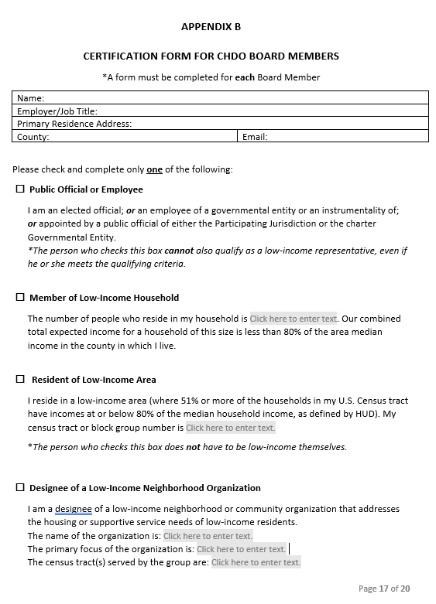
Organizational Structure
CHDO
Workbook
Pages 17 - 18
Certification Forms for Board Members
Must be notarized
Additional instructions for determining Board Members' status to follow in CHDO Board Composition section

Slide 27
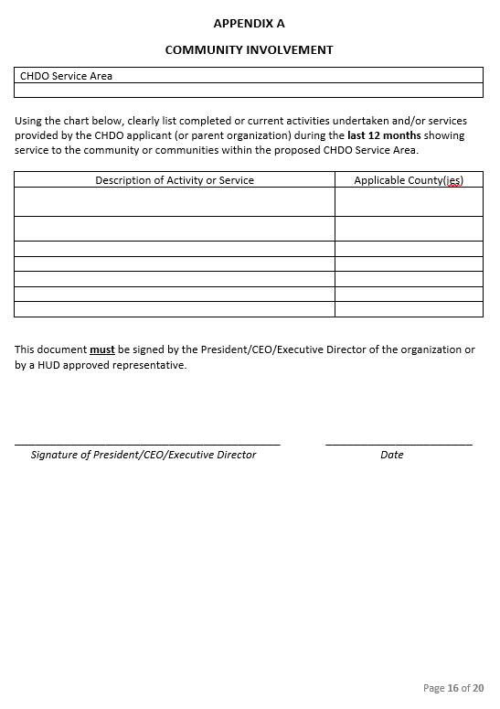
Serving the Community
CHDO
Workbook
Page16
Used to support federal requirement that low-income beneficiaries contribute to project decision making

Slide 28
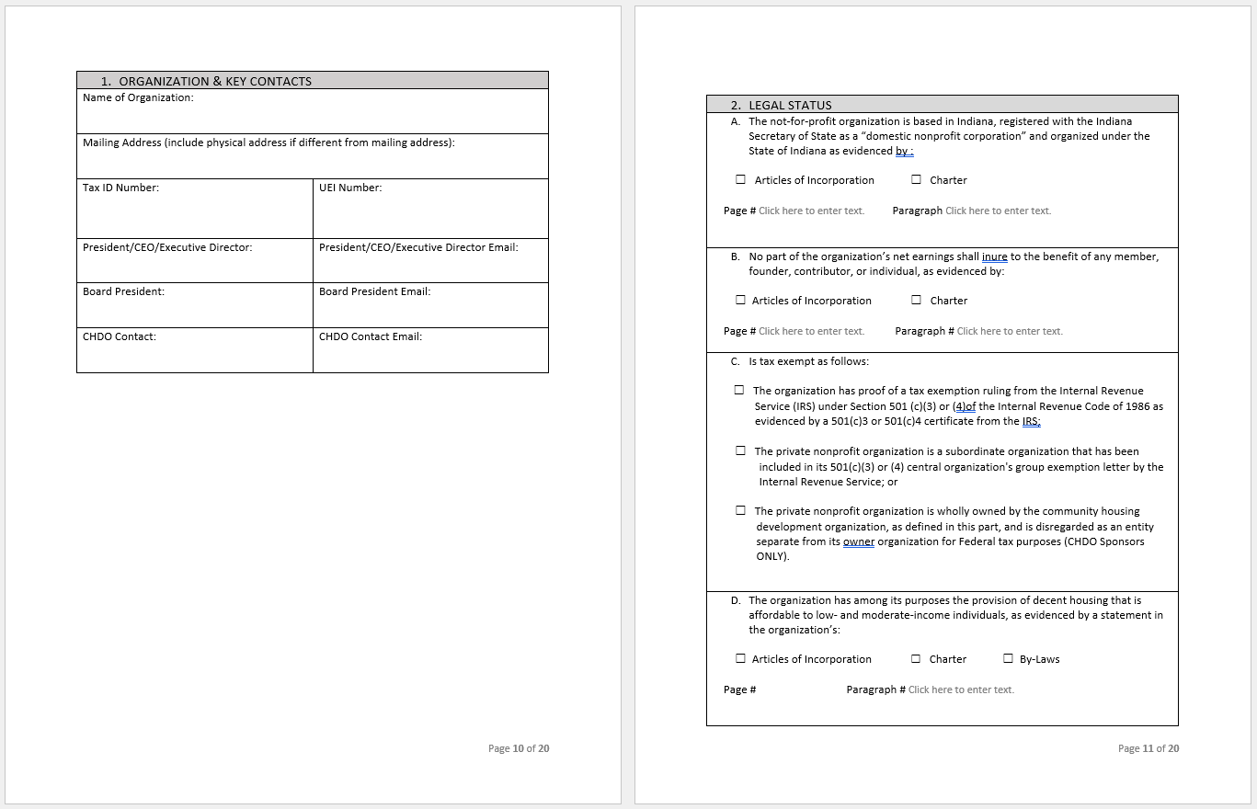
Application Pages 10-11
Please fill out all sections of the workbook in their entirety.
Please make sure to complete the prompts for Page # and Paragraph #.
If your organization’s documents are organized into named sections, please use “Article #, Section #” when possible.

Slide 29
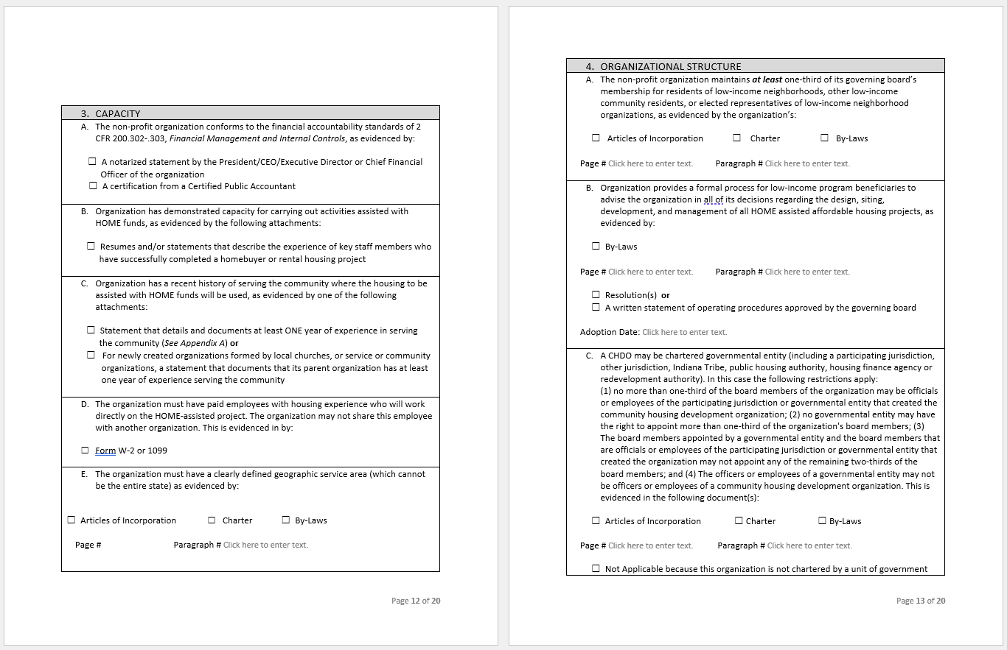
Application Pages 12-13

Slide 30
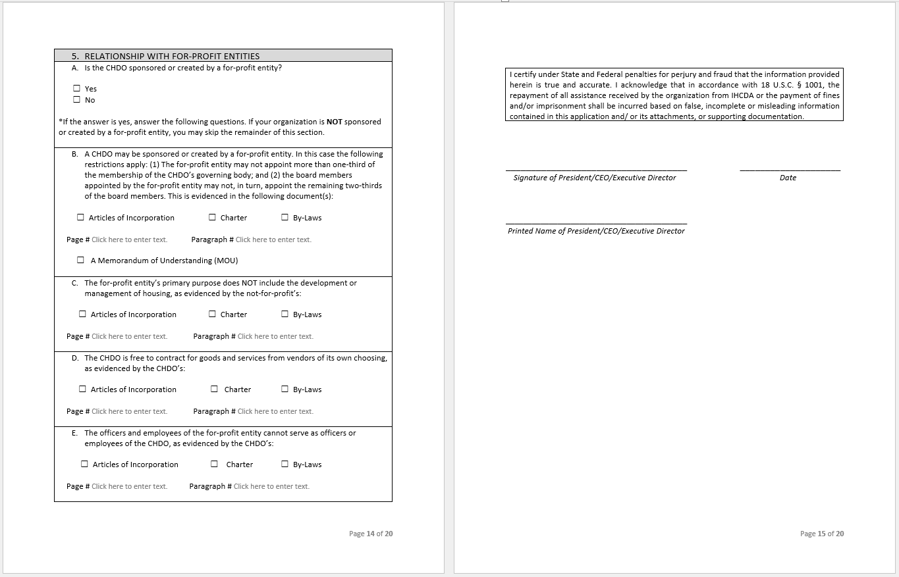
Application Pages 14-15
*Note: For-profit involvement is rare, most of the items for Section 5 will likely be ‘not applicable.’​

Slide 31
CHDO Board Composition

Slide 32
Organizational Structure
CHDO
Workbook
Pages 17 - 18
*Note: Additional instructions located in CHDO Workbook
CHDO
Workbook
Page 6-8
The following slides will illustrate how to determine if board members are residents of low-income areas.

Slide 33
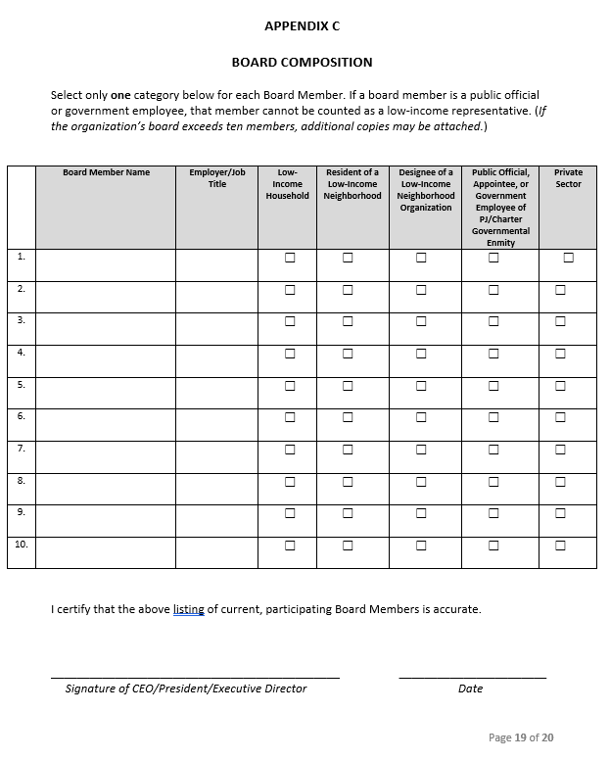
Accountability to the Community
CHDO
Workbook
Page 19
Once Appendix B is completed for each board member, summarize the composition information on the chart in Appendix C.

Slide 34
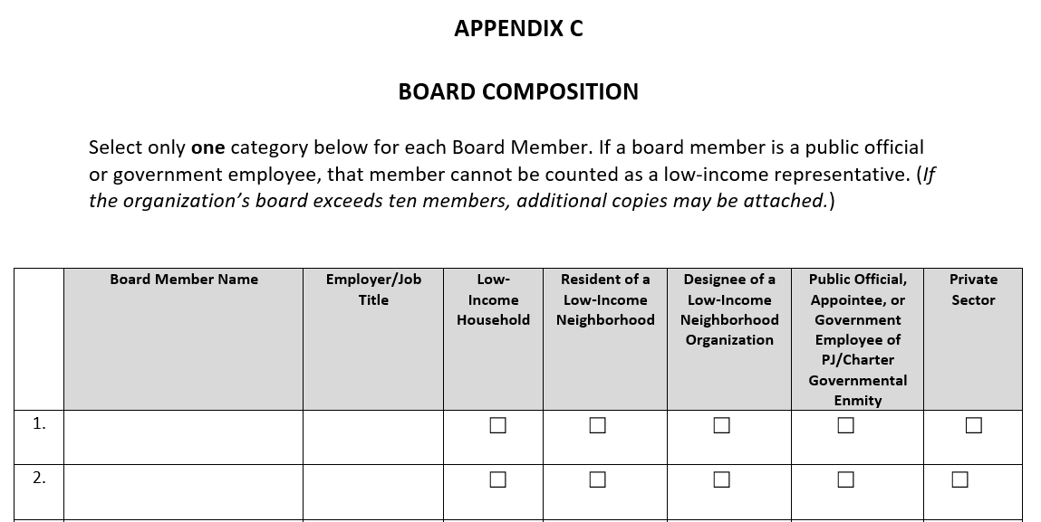
Board Composition
CHDO’s must maintain at least one-third of its governing board’s membership for residents of low-income neighborhoods, other low-income community residents, designees of low-income neighborhood organizations, or low-income beneficiaries of HUD programs.

Slide 35
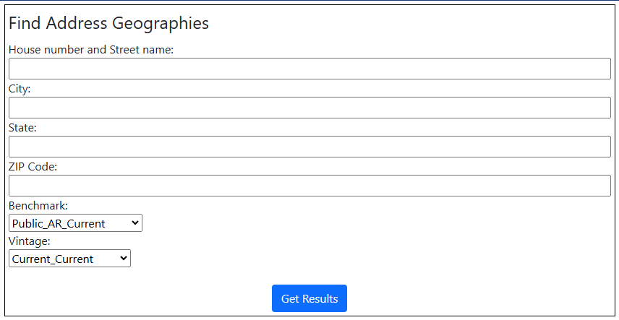
Determine Low-Income Neighborhood
Low-income neighborhoods can be determined based on census tract or block group. To locate your census tract / block group:
Go to: https://geocoding.geo.census.gov/geocoder/geographies/address?form
Enter the board member's address, city, state, and zip code.
Do not modify the “Benchmark” or
“Vintage” selections.

Slide 36
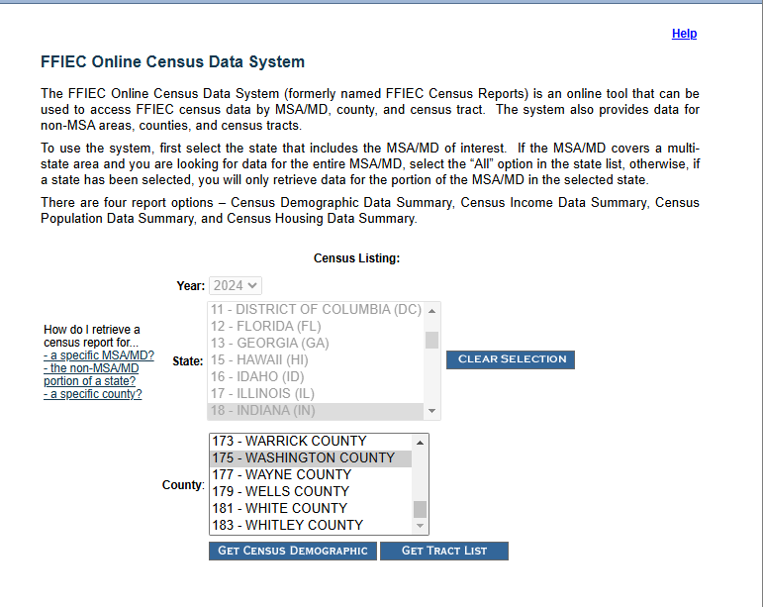
Does Census Tract Qualify?
To determine if your census tract qualifies:
Go to: https://www.ffiec.gov/census/default.aspx
Select Indiana, and click “Retrieve by County” or “MSA/MD”, whichever is applicable
Select the county or MSA in which the Board Member lives and click “Get Census Demographic”

Slide 37
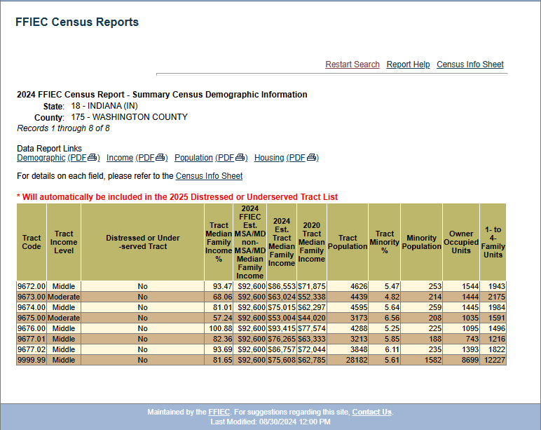
Does Census Tract Qualify?
To determine if your census tract qualifies (cont'd):
Look up the census tract under “Tract Code” to determine Tract Income Level
To qualify, the census tract must be low or moderate under “Tract Income Level”

Slide 38
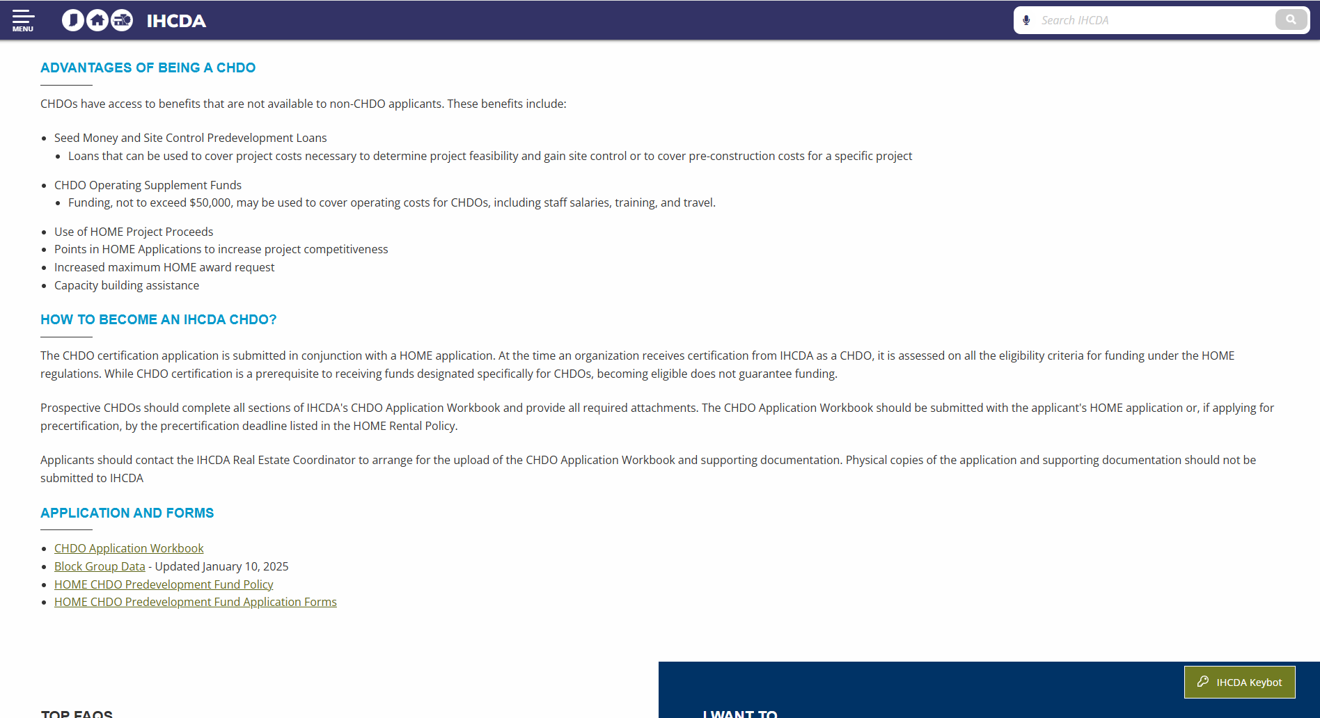
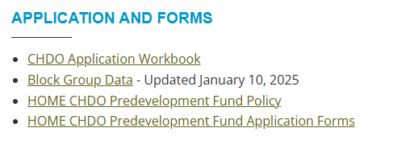
Does Block Group Qualify?
To determine if your block group qualifies:
Go to: IHCDA's CHDO Page
Scroll down to the “Block Group Data” link and open the file

Slide 39
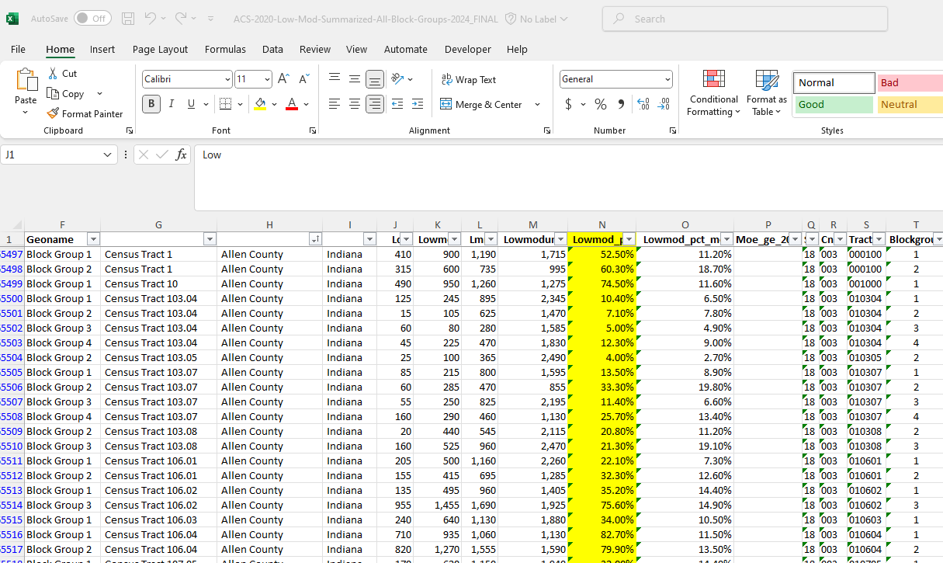
Does Block Group Qualify?
To determine if your block group qualifies (cont'd):
Filter by the County column (column H)
Look up the Census Tract (column G) and Block Group Number (column F).
Block Group column (column N) is highlighted in yellow.
If the “% of Low/Mod Income Persons” is at or above 51% the Block Group qualifies.

Slide 40
Ready to Submit?
https://ingov-my.sharepoint.com/ […]
Drag and Drop files!

Slide 41
Files Uploaded
*If applying for HOME Homebuyer or a Non-Competitive round, please inform Coordinator when all documents are uploaded.

Slide 42
Questions?
Contact Us!

Slide 43


Real Estate Allocation Analysts
Holly Loper
Real Estate Allocation Analyst North Region
hloper@ihcda.in.gov
James Wells
Real Estate Allocation Analyst
South Region
jwells3@ihcda.in.gov

Slide 44
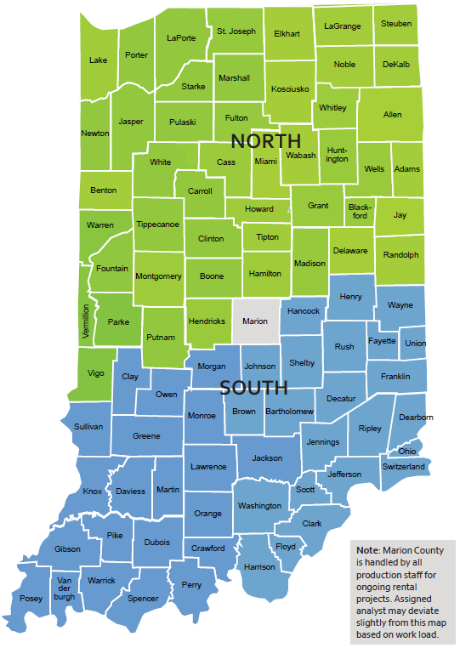
North Region:
Adams, Allen, Benton, Blackford, Boone, Carroll, Cass, Clinton, DeKalb, Delaware, Elkhart, Fountain, Fulton, Grant, Hamilton, Hendricks, Howard, Huntington, Jasper, Jay, Kosciusko, LaGrange, Lake, LaPorte, Madison, Marshall, Miami, Montgomery, Newton, Noble, Parke, Porter, Pulaski, Putnam, Randolph, St. Joseph, Starke, Steuben, Tipton, Tippecanoe, Vermillion, Vigo, Wabash, Warren, Wells, White, Whitley
South Region:
Bartholomew, Brown, Clark, Clay, Crawford, Daviess, Dearborn, Decatur, Dubois, Fayette, Floyd, Franklin, Gibson, Greene, Hancock, Harrison, Henry, Jackson, Jefferson, Jennings, Johnson, Knox, Lawrence, Martin, Monroe, Morgan, Ohio, Orange, Owen, Perry, Pike, Posey, Ripley, Rush, Scott, Shelby, Spencer, Sullivan, Switzerland, Union
Questions about Marion County projects can go to both Regional Analysts.

Slide 45


Real Estate Management
Andrea Lynch
HOME and HTF Manager
andlynch@ihcda.in.gov
Sam Spergel
Director of Real Estate Strategic Initiatives and Engagement
sspergel@ihcda.in.gov

