Slide 1
Section 811 PRA
Property Onboarding Training

Slide 2
Agenda
811 PRA Overview & Definitions
Leases, Rents, Deposits, & Fees
Household Eligibility, Tenant Selection, & Occupancy Standards
Tenant Files
Next Steps

Slide 3
811 PRA Overview & Definitions

Slide 4
811 PRA Overview
Project Rental Assistance Program of Section 811 Supportive Housing for Persons with Disabilities
Purpose of 811 PRA
  “To identify, stimulate, and support innovative state-level strategies that will transform and increase housing for extremely low-income persons with disabilities while also making available appropriate support and services”
IHCDA was funded under the Fiscal Year 2019 and 2023 Notices of Funding Availability (“NOFA”)
  There are no final regulations for 811 PRA
  Projects are subject to the compliance requirements of:
    Section 811 of the Cranston Gonzalez National Affordable Housing Act, as amended by the Frank Melville Supportive Housing Act of 2010
    2019 or 2023 811 PRA NOFA and related FAQ documents
    All terms of the Rental Assistance Contract (“RAC”), Use Agreement, and 811 Model Lease (HUD Form 90106)
    IHCDA’s 811 PRA “Leases, Rents, Deposits, & Fees Policy”
    IHCDA’s 811 PRA “Tenant Selection & Occupancy Standards Policy”

Slide 5
811 PRA OVERVIEW- KEY TERMS PER NOFA
ELIGIBLE MULTIFAMILY PROPERTY
“Any new or existing property owned by a non-profit or a private entity with at least 5 housing units”
Cannot have an existing use restriction for persons with disabilities or a 62+ age restriction
Cannot duplicate or supplant other project-based rental assistance
ELIGIBLE TENANTS
“Extremely low-income households where at least one person must be an individual with a disability, 18 years of age or older and less than 62 years of age at time of admission into the property.”
“The person with the disability must be eligible for community-based, long-term services as provided through Medicaid waivers, Medicaid state plan options, state funded services, or other appropriate services related to the target population under the Inter-Agency Partnership Agreement.”
EXTREMELY LOW-INCOME
A household “whose annual income does not exceed 30 percent of the median income for the area.”
Income is determined based on the Part 5 definition (24 CFR 5.609, Section 8 Methodology)

Slide 6
811 PRA OVERVIEW- KEY TERMS PER NOFA
DISABILITY
42 USC 9013(k)(2)
• A physical, mental, or emotional impairment which (A) is expected to be long-continued and indefinite duration, (B) substantially impedes his or her ability to live independently, and (C) is of such a nature that such ability could be improved by more suitable housing conditions.
FY19 811 PRA NOFA – Additional Definitions
• A person who has developmental disability as defined in section 102 of the Development Disabilities Assistance and Bill of Rights Act
• A person with a chronic mental illness, i.e., a severe and persistent mental or emotional impairment that seriously limits his or her ability to live independently, and which impairment could be improved by more suitable housing conditions.

Slide 7
811 PRA OVERVIEW
Project Limitations Per NOFA
No more than 25% of the total units can:
  Be used for supportive housing for persons with disabilities under 811 PRA or any other federal or state program
  Have any occupancy preference for persons with disabilities
  However, owner agents may not prohibit persons with disabilities from applying for residency in non-811 PRA units
Units must be dispersed throughout the property and must not be segregated into one floor, building, wing, etc.
Specific units are not pre-designated as 811 PRA units
  Owner will select unit types to designate (e.g., 6 one-bedroom units & 2 two-bedroom units)
Must have a 30-year use restriction for extremely low-income persons with disabilities
  However, use restriction can be terminated earlier if 811 PRA funding is no longer appropriated

Slide 8
811 PRA Overview
The Rental Assistance Contract (RAC)
The RAC sets forth the rights and obligations of the property owner and IHCDA
• Collectively includes HUD Forms 92235 and 92237 and exhibits
• Contract term is for 20 years
Identifies the project, number of contract units, and contract terms
Outlines tenant protections
Exhibits
1. Rent and unit schedule, shows number of assisted units by size and their applicable rents
2. iREMS Data Record = IHCDA Responsibility, not viewable by owners
3. Affirmative Fair Housing Marketing Plan (HUD Form 92243-PRA)
4. 30-Year Use Agreement (HUD Form 92238-PRA)
5. PRA Model Lease (HUD form 92236-PRA)
6. Definitions
7. Program Guidelines

Slide 9
811 PRA Overview
IHCDA Compliance Monitoring
811 PRA projects are subject to HUD’s National Standards for the Physical Inspection of Real Estate (“NSPIRE”) standards
IHCDA will use the triennial LIHTC inspection to cover its 811 PRA physical inspection
811 file monitoring procedures and timeline TBD
Owner must annually certify compliance with terms of the Use Agreement and RAC (IHCDA will utilize the Annual Owner Certification of Compliance) for these purposes
All monitoring efforts must include confirmation the owner has displayed Fair Housing posters and the Affirmative Fair Housing Marketing Plan in the leasing office

Slide 10
Leases, Rents, Deposits, & Fees

Slide 11
Lease Terms
Leases must be for at least a 1-year term and must use HUD Model Lease (Form 92236-PRA)
Termination (eviction or non-renewal) is only permitted for the following *per Model Lease 8(b)(1)*
  Material noncompliance with the lease- Model Lease 8(d)
    1 substantial violation
    Repeated minor violations which disrupt livability or adversely affect health and safety
    Failure to timely certify/recertify or knowingly providing incomplete or inaccurate information
    Nonpayment of rent
  Criminal activity that threatens health or safety, including drug related criminal activity on or near the premises– Model Lease Part 8(i)
  Other good cause with prior notice that conduct constitutes grounds for termination- Model Lease 8(e)
Termination requires 30-day written notice specifying grounds for such action- Model Lease 8(h)
811 PRA projects are subject to nondiscrimination requirements of Fair Housing, Section 504 of the Rehabilitation Act, HUD’s Equal Access Rule, and VAWA

Slide 12
Initial rents & Rent Increases
Initial rent is set at 100% of HUD published Fair Market Rent (FMR)
Owner agent may request an annual rent increase at least 90 days prior to the anniversary date of the effective date of the RAC
Previous rent will be adjusted by the current HUD Operating Cost Adjustment Factor (OCAF)
IHCDA will review the request and provide written approval
New rent schedule will be sent to property for execution

Slide 13
Tenant Rent & Deposits
Eligible tenant pays tenant contribution to rent equal to the greater of (1) 30% of adjusted monthly income or (2) 10% of monthly gross income
  Owner agent cannot establish a minimum tenant rent
Must provide 30-day written notice of adjustment of rent amount – Model Lease Part 10
Security deposit required- capped at the greater of one month’s total tenant payment or $50
IHCDA mandates owner-paid utilities (0 utility allowance)

Slide 14
Allowable Fees
Allowable Fees
  Damages exceeding normal wear and tear
Unallowable Fees
  Application processing fees / screening fees
  Late rent fees or fees for checks returned for insufficient funds
  Ongoing pet fees (deposits ok- not to exceed $300, max $50 at admission, $10 per month until paid)
  Fees for “bad behavior” – however, such behavior could become grounds for termination
  Other fees not explicitly allowed
  Fees to turn a unit

Slide 15
Household Eligibility, Tenant Selection, & Occupancy Standards

Slide 16
Tenant Selection / Eligibility Overview
Must meet federal eligibility requirements of the FY19 811 PRA NOFA
Extremely low-income (< 30% AMI)
One household member has a long-term disability and is age 18 or older but less than 62 at time of admission
Person with disability must be eligible for long-term, community-based services- e.g., Medicaid
Student status requirements (see next slide)
Must also meet IHCDA eligibility requirements per IHCDA’s HUD-approved 811 PRA program policy/design
At time of admission, tenants must belong to at least 1 of 3 target populations. Each 811 project will have an assigned target population.
  Persons experiencing homelessness- referred through Coordinated Entry
  Persons with intellectual or developmental disabilities- referred through disability service provider
  Persons living in institutional settings- referred through service provider

Slide 17
Tenant Selection / Eligibility
Income Calculation
Household must be at or below 30% AMI at time of admission
Use the “Section 8 methodology” of income and asset verification per 24 CFR 5.609 and HUD Handbook 4350.3.
Income eligibility is based on gross household income
Tenant rent contribution is based on adjusted household income
811 PRA rental assistance is not counted as a source of income

Slide 18
Tenant Selection / Eligibility
Student Status
Eligibility of Students for Other Assistance Programs
Owners must determine a student’s eligibility for assistance at move-in, initial or annual recertification, and at the time of an interim recertification if one of the changes reported is that a household member is enrolled as a student, at an institution of higher education.
The student must meet all of the following criteria to be eligible:
Be of legal contract age under state law;
Have established a household separate from parents or legal guardians for at least one year prior to application for occupancy or meet the U.S. Department of Education’s definition of an independent student
Not be claimed as a dependent by parents or legal guardians pursuant to IRS regulations; and
Owner agent must obtain a certification of the amount of financial assistance that will be provided by parents, signed by the individual providing the support. This certification is required even if no assistance will be provided.

Slide 19
Tenant Selection / Eligibility
Citizenship & SSN
HUD’s noncitizen rule does not apply to 811 PRA and owner agents may not impose a citizenship requirement on 811 PRA units
Owner agents must obtain Social Security Numbers for all household members, with the following exceptions:
Individuals who do not contend eligible immigration status; or
A child under the age of 6 who does not yet have a Social Security Number assigned and who was added to the applicant household six months or less from the move-in date. The owner agent must give the household 90 days from the effective date of their move-in certification to provide documentation of the SSN for the child. An additional 90-day period may be granted by the owner agent if failure to provide documentation of a SSN is due to circumstances that are outside the control of the household, such as delayed processing by the Social Security Administration, natural disaster, fire, death in the family, etc. During this time period, the child is to be included as part of the household. The penalty associated with the failure to disclose and provide verification of a household member’s SSN is termination of tenancy. The owner must terminate if the SSN disclosure and verification requirements are not met in the specified timeframe.

Slide 20
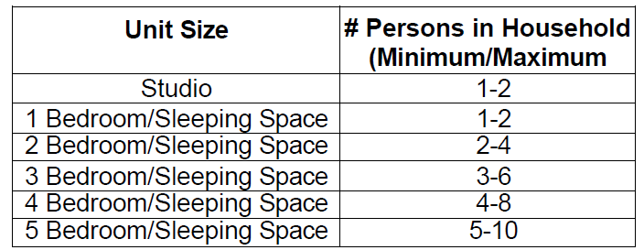
Tenant Selection / Eligibility
Occupancy Standards
Exceptions:
Adults of opposite sex who are not spouses/domestic partners are allocated separate bedrooms
Children age 5 or older of opposite sex are allocated separate bedrooms
Pregnant women with no other dependents are allocated two bedrooms
Live-in aides allocated a separate bedroom
Other exceptions if required for Fair Housing reasonable accommodation

Slide 21
Tenant Selection Plan
The RAC requires the property use an IHCDA approved TSP template and receive IHCDA approval for any proposed changes to the TSP
TSP must include all 811 PRA requirements as well as the following information:
Any additional screening criteria implemented by the owner agent- may not impose minimum income or credit screening
Outline of application process, including process for denials and appeals
Transfer policies implemented by the owner agent
Eligibility requirements imposed by other funding programs tied to the project, such as LIHTC or HOME
Description of the EIV Existing Tenant Search and that it will be used prior to move-in
Policies and procedures to abide by Fair Housing Act and VAWA protection
Owner agent may not restrict occupancy for 811 PRA units to subpopulations, such as veterans
However, may implement a preference if such preference is nondiscriminatory and approved by IHCDA
TSP may not required participation in supportive services for admission or continued occupancy

Slide 22
Tenant Files

Slide 23
Referral packet
Recommend that the referral packet include everything required for property management to determine initial eligibility:
  Property rental application (if owner will require it)
  Income and asset verification (paystubs, bank statements, benefit award letters, etc.)
  Deduction documentation (medical expenses)
  Student Verification (if applicable)
  ROI and consent for 3rd party verification, (HUD 9887 and HUD 9887A)
  Disability verification signed by applicant and referral provider (HUD 90102)
  Verification of age (Birth certificate or other government document)
  Verification of Social Security Number
  Supplement to Application for Federally Assisted Housing (alternate contact form, HUD 92006)

Slide 24
Briefing
Schedule briefing, lease signing, move-in inspection, move-in
Briefing
  Provide and go over following documents with all adult household members:
    EIV and You brochure
    Tenant Consent to Disclose EIV Income Information
      One for each adult, signed by adult and property representative
    Resident Rights & Responsibilities brochure
    Fact Sheet for HUD Assisted Residents: How Your Rent is Determined
    Notice of Occupancy Rights under VAWA (HUD Form 5380)
    Certification of Domestic Violence, Dating Violence, Sexual Assault, or Stalking (HUD Form 5382)
Each household must sign IHCDA Compliance Form 9E- “Lease Addendum for Section 811 PRA Units: Receipt of Required Forms & Brochures” to acknowledge receipt of the required forms and brochures

Slide 25
Lease signing and Unit move-in Inspection
Must use HUD Model Lease (HUD-92236-PRA)
HUD Attachments
  Owner’s Certification of Compliance with HUD’s Tenant Eligibility and Rent Procedures (HUD 50059)
  Move-In Inspection Form (HUD 90106)
  HUD VAWA Notification Forms (HUD 5380 and 5382)
  HUD VAWA Lease Addendum
IHCDA Mandated Attachments (confirmed as allowable addenda to HUD Model Lease)
  Lease Addendum for Section 42 LIHTC Units (Form 9A)- if applicable
  Lease Addendum for Section 811 PRA Units – Receipt of Required Forms & Brochures (Form 9E)
Property Attachments
  House Rules
  Pet Rules

Slide 26
HUD Form 50059
Serves as the Tenant Income Certification for 811 PRA
Completed and submitted to IN Quadel through property management software
Complete Sections B through F and then complete Section A and have tenant sign

Slide 27
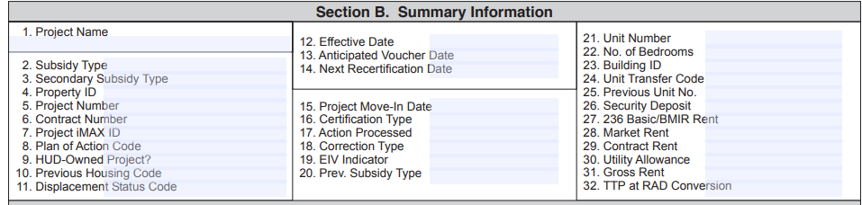
HUD Form 50059, Section B
Insert project name
6- 811 PRA Demo
Leave Blank
Will be assigned in iREMS (IHCDA will notify you once a Property ID is assigned)
IN36RDD1901
Will be assigned by HUD- IN36RDDXXXX (IHCDA will notify you when a number is assigned)
Will be assigned by HUD starts with “TRACM”
Leave Blank
“N”

Slide 28
HUD Form 50059, Section B (Cont.)
10. For move-ins only, select code that best describes household’s previous housing:
1- Substandard
3- Standard
4- Conventional Public Housing
5- Lacked a Fixed Nighttime Residence
6- Fleeing/Attempting to Flee Violence
11. For move-ins only, Select code that describes reason family was displaced
1- Government Action
2- Natural Disaster
3- Private Action
4- Not Displaced
12. Effective date of action (MMDDYYYY)
13. Anticipated Voucher Date (MMDDYYYY), For move-in on the first of a month it will be the following month, for move-in any other day it will be two months later

Slide 29
HUD Form 50059, Section B (Cont.)
14. Next recertification date, first of the current month plus one year
15. Project Move-in Date, should match effective date (12) for move-in actions
16. Certification type:
MI- Move-in
AR- Annual Recertification
IR- Interim Recertification
IC- Initial Certification (in-place tenant begins receiving subsidy)
17. Action Processed, 1 for a correction to a prior 50059 (e.g., correct unreported income), otherwise leave blank
18. Correction Type
1- Administrative Resubmission (i.e., minor clerical/data entry issues)
2-Corrects owner/agent certification errors (i.e., owner agent miscalculated income)
3. Corrects Tenant Misreporting
19. EIV Indicator, 1 if 50059 is being created or corrected as a result of a discovery in EIV, leave blank otherwise

Slide 30
HUD Form 50059, Section B (Cont.)
20. Previous Subsidy Type, leave blank
21. Unit Number
22. No. of bedrooms
23. Building ID- leave blank
24. Unit Transfer Code- Y if existing household is transferring units
25. Previous Unit Number – Only complete if 24 is Y
26. Security Deposit – enter amount listed on lease
27. Leave Blank
28. Leave Blank
29. Contract Rent – Rent listed on lease
30. Utility Allowance – Enter Zero (all utilities included in rent)
31. Gross Rent – Line 29 minus line 30
32. Leave Blank

Slide 31
HUD Form 50059, Section C-F
60-65. Complete if HoH has been removed from household
63. Eff. Date of last TRACS Submission
64. SSN of removed HoH
83. – HUD passbook rate
90-95. Leave Blank
96- “N”
108- Total Tenant Payment – Greater of 30% monthly adjusted income or 10% monthly gross income
109. Leave Blank
110. Equal to 108 when property pays all utilities
112. Line 31 minus line 108
113. Enter Zero
114-117. Leave Blank
118- Use only if tenant has not signed certification (reach out for guidance in this situation

Slide 32
Enterprise Income Verification (EIV)
Anyone conducting income certification will need access, email IHCDA to request access and we will work with you on completing application and requesting access from HUD
At time of referral use EIV to conduct “Existing tenant search”- Must complete before move-in
-If EIV identifies the tenant as already receiving assistance at another property they must be exited from that program before or at the same time as move-in
Property management must verify tenant income in EIV within 90 days of submission of a move-in certification to TRACs and at the time of certification thereafter.
If discrepancy is identified the property must investigate the discrepancy. The tenant may be required to pay-back assistance if the discrepancy is due to unreported income.

Slide 33
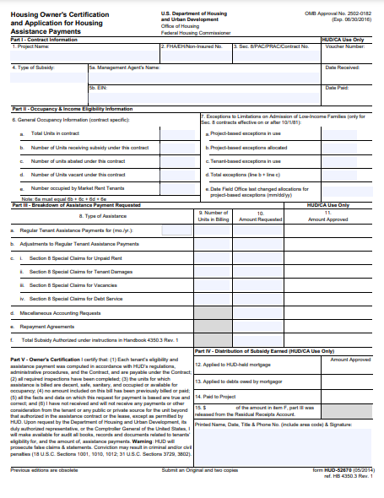
HUD Form 52670 - Vouchering
Form 52670 – This is the “voucher” and is submitted monthly to HUD through TRACS. Payment cannot be made until the voucher is submitted. Will be generated and submitted by software system (e.g., Yardi) to Quadel who will then submit to HUD.
Additional training on this process will be conducted by Quadel prior to your first voucher submission

Slide 34
File Checklist
HUD Model Lease (HUD 92336- PRA)
Unit Inspection Report (HUD-90106)
IHCDA Mandated Lease Addenda (IHCDA Form 9A & 9E)
HUD Form 50059
VAWA Lease Addendum
VAWA Notification Forms (HUD-5280 & HUD-5282)
Tax Credit Tenant Income Certification (IHCDA Form 22)
Income Questionnaire
Income and Asset Verifications
EIV Documentation - *MUST BE KEPT SEPARATE FROM TAX CREDIT FILE*
All referral packet items (see slide 20)- application, verification of age, disability verification, verification of SSN, referral, etc.
  These are the items sent by the referral provider to the management agent to make a referral to a PRA unit

Slide 35
Next Steps

Slide 36
NEXT Steps- PREPARING FOR RAC
Approval of AFHMP & TSP- IHCDA will provide templates. Must be approved by IHCDA prior to RAC execution.
Owner must register through HUD Multifamily Business Partner Registration if not already registered
IHCDA will prepare the RAC
AFHMP & TSP must be finalized and approved as they are attached to the RAC
Must confirm Business Partner Registration
Project must be placed-in-service and pass IHCDA NSPIRE inspection
Owner executes RAC and IHCDA submits to HUD for system setup. Expect delay from lease-up to first payment due to HUD systems. You will receive backpay once first vouchering is submitted.

Slide 37
NEXT Steps- PREPARING FOR LEASE-Up
Prior to lease-up:
Receive certificate of occupancy and submit to IHCDA
IHCDA conducts NSPIRE inspection and owner corrects any issues
Lease-up can begin when RAC is executed AND inspection is cleared

