Slide 1
Lender training
(for virtual meetings) winter 2021
Homeownership Products:
Next Home
First Place
Mortgage Credit Certificate

Slide 2
The homeownership team
Homeownership Director
Kim Harris @ kiharris@ihcda.in.gov 317-233-5367
Operations Manager
Tom Pearson @ tpearson1@ihcda.in.gov 317-232-0210
Underwriters
Katryna Rice-Krause @ krice-krause@ihcda.in.gov 317-232-2023
Marianne Fraps @ mfraps@ihcda.in.gov 317-232-7023
Operations
Dolores Scisney @ dscisney@ihcda.in.gov 317-234-3706
Account Managers
Brienn White @ bwhite@ihcda.in.gov 463-203-7108
Mark Doud @ mdoud@ihcda.in.gov 317-447-8156
US Bank Customer Care Specialists 800-562-5165, option 1
hfacustomercare@usbank.com

Slide 3
Is your borrower eligible

Slide 4

Ihcda homebuyer eligibility
Fico Credit Score minimums
640
With a DTI ratio of 45% or less
680
With a DTI ratio between 46 – 50%

Slide 5
Ihcda Homebuyer eligibility Income Limits (varies by county)
Marion County and most doughnut counties:
$82,000 / $94,300
(1-2 person) / (3+ persons)
Except Shelby County:
$98,400 / $114,800
(1-2 person) / (3+ persons)

Slide 6
Key features

Slide 7
BROAD PROGRAM FEATURES
FHA
30-Yr. Conforming Loan
Sold into the Secondary Market
Reservation Fee - $100
Stand-alone MCC - $800
Owner Occupancy Required
Follow Ginnie Underwriting Guidelines

Slide 8
Income
Link to: https://www.in.gov/ihcda/4119.htm

Slide 9
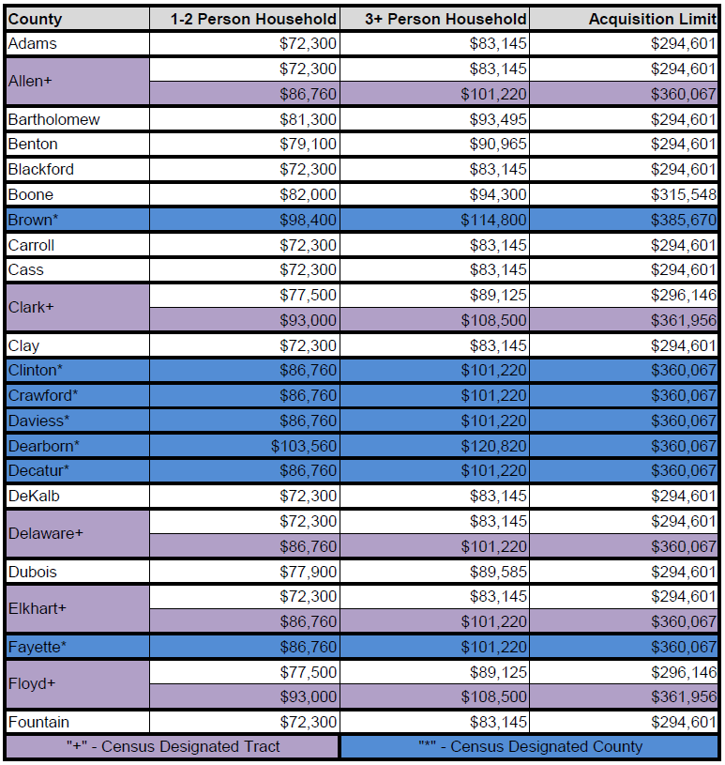
county income limits – Adams to Fountain

Slide 10
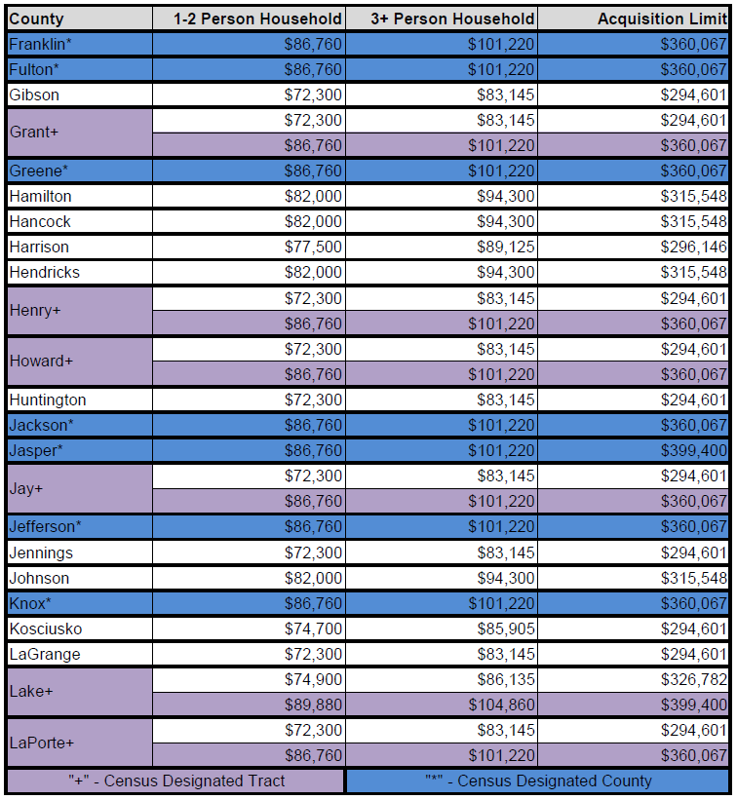
County Income Limits – Franklin to LaPorte

Slide 11
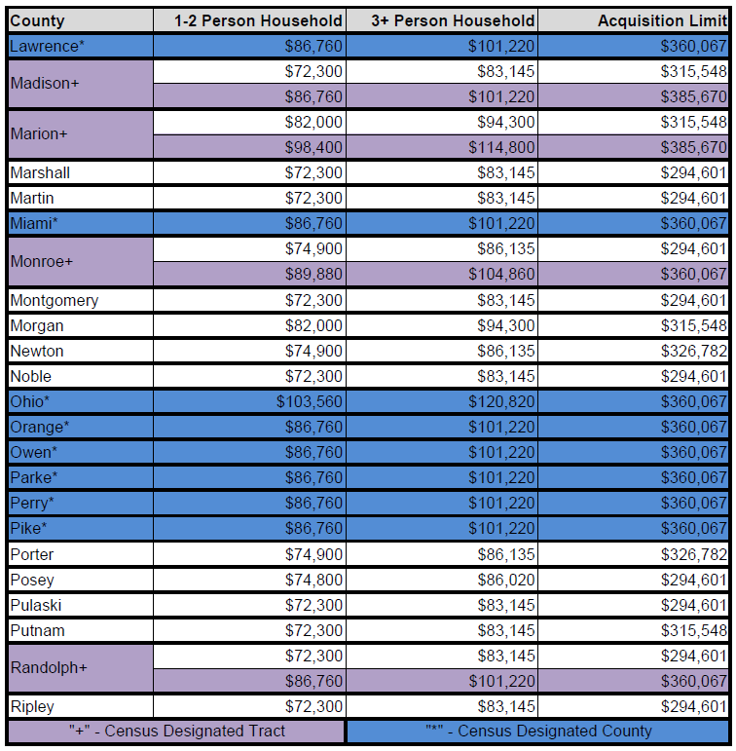
County Income Limits – Lawrence to Ripley

Slide 12
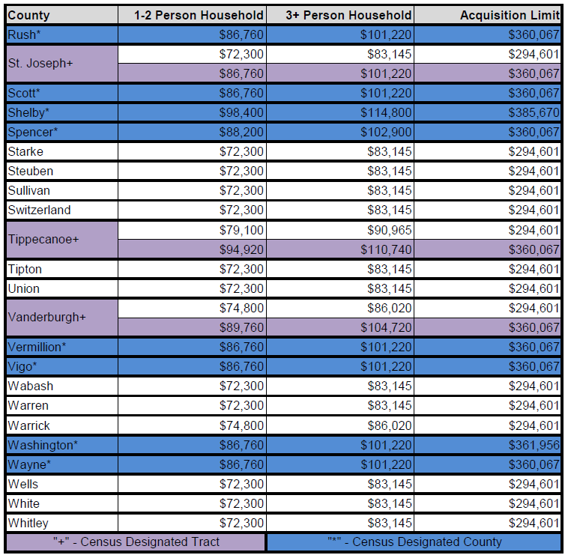
County Income Limits – Rush to Whitley

Slide 13
Qualified Income
On the 1003,“Qualified Income” needs to includes sources of income that meet the GSE definition of income and could be used to qualify the borrower.
Either the Borrower’s income alone or the Borrower/Co-Borrower’s income may be used.
Co-signor, non-occupant borrowers allowed

Slide 14
Gross annual Income
Gross Wages & Salary from employment including:
  Part-time earnings
  Seasonal earnings
  Sporadic earnings
  Shift differential
  Overtime pay
  Commission earnings
  Fees
  Tips
  Bonuses
This list is also included in Section 2 of the Program Guides
(https://www.in.gov/ihcda/4117.htm)

Slide 15
Gross annual Income
Additional sources of income can include:
  Child support
  Alimony
  Periodic payments from: trusts, annuities, inheritances, insurance policies, pensions, retirement funds, lotteries
  Public assistance (excluding Medicaid & food stamps)
  Interests & dividends
  Payments in lieu of earnings: social security, unemployment benefits, workers comp, severance pay, disability benefits, death benefits
  Income from partnerships
  Rental Income
  All Armed Forces pay (except special pay for hostile fire service)
This list is also included in Section 2 of the Program Guides
(https://www.in.gov/ihcda/4117.htm)

Slide 16
Homeownership products

Slide 17
Down Payment Assistance (Most popular)
Next Home Reservation Fee: $100
Main Features for Borrower
First-Time Homebuyer AND non-1st Time Homebuyer
DPA of 3.5% of the lower of appraised value or purchase price
DPA forgiven in 3 years, secured via 2nd mortgage
Standard FHA financing, underwrite to Ginnie guidelines
All Conventional loan products are currently “paused” by IHCDA
MCC can be added, if FTHB, eligible military veteran, or property is located in a targeted area
Lender Features to Know
Lender must provide CD on 2nd in accordance with the TRID rules
Tax transcripts not needed, unless an MCC is added
Acquisition and normal income requirements apply

Slide 18
Down Payment assistance +
First Place (FHA Loan) Reservation Fee: $100
Main Features
Offers 6% of purchase price (cannot exceed the appraised value), which can be applied toward the down payment, closing costs or prepaids
1st homebuyers only, unless purchasing in a targeted area, go to: www.in.gov/ihcda/4440.htm to determine if property is in a targeted area.
“Affordability period” (forgiveness period) is 9 years
Acquisition and normal program income limits apply
Recapture tax provisions could apply if loan is sold or refinanced
Lender Features to Know
Silent 2nd mortgage & IHCDA promissory note, no payments/no interest
Participating lender can charge 1% origination fee and up to $1,200 in usual and customary lender fees.
MCC cannot be added

Slide 19
Federal Tax credit
Mortgage Credit Certificate (MCC) Reservation Fee: $800 / $100
Main Feature for Borrower
Offers a Homeowner up to $2,000 per year of a dollar-for-dollar Income Tax credit against their federal tax liability for as long as the home remains their primary residence.
Lender Features to Know
For 1st Time Homebuyers* (not on title for last 3 years)
Transferable to a new mortgage, in most cases
Permanent credit rate of 25%, annual amount the borrower receives will change as the mortgage loan amount decreases each year
Recapture Tax may apply (determined by a tax professional when home is sold)
Normal county income and acquisition limits apply
*Unless in Targeted Area or military veteran

Slide 20
Recapture Tax – know thy borrower
The law mandates a “recapture” of some of the benefits of the program if a Mortgagor meets all 3 of the following criteria:
  the property ceases to be the principal residence in the first full nine (9) years after the date that the mortgage loan is closed;
  there is a profit on the sale of the home; and,
  the household income is more than that year’s adjusted qualifying income for the Mortgagor’s family size in the year the home is sold. This income amount is provided in the MCC documentation the borrower receives once the loan is sold into the secondary market.
If the Federal Recapture Tax must be repaid, it will never exceed the lesser of 6.25% of the original loan amount or ½ of the gain on the sale of the home
For more details see: http://www.in.gov/myihcda/files/MCC_PROGRAM_GUIDE_2016_.pdf

Slide 21
MCC Federal tax benefit for the homebuyer
Simply calculation:
MTG Amount x Interest Rate x MCC Rate = Tax Credit
$120,000 x 4% x 25% = $1,200
$150,000 x 4% x 25% = $1,500
$175,000 x 4% x 25% = $1,750
$200,000 x 4% x 25% = $2,000
$250,000 x 4% x 25% = $2,500
$2,000 Limit
Increase W-4 Withholdings to Distribute into Paycheck
Monthly Bi-Weekly Weekly
$100 $50 $25
$125 $56 $28
$146 $66 $33
$167 $83 $38
$167 $83 $38

Slide 22
DPA & Mcc (Tax benefit)
Next Home/MCC Combo Reservation Fee: $100
Main Features
DPA of 3.5 of appraised value or purchase price, whichever is less
DPA Forgiven in 3 years, provided at Closing table
Available for 1st Time Homebuyers or Existing Homeowners
Tax transcripts not needed
Lender provided CD on 2nd
MCC may be added
When Combo’d with a MCC the comparative differences are:
First-Time Homebuyer* and non-1st Time Homebuyer
Tax transcripts (3 years)* not needed in the closing package
Due to the MCC, a Recapture Tax may apply when property is sold. (Borrower will need to consult w/ tax professional to determine if recapture tax would apply at time of sale)
*Unless in Targeted Area or the borrower is a veteran

Slide 23
resources

Slide 24
Homeownership team
Homeownership Director
Kim Harris @ kiharris@ihcda.in.gov 317-233-5367
Operations:
Tom Pearson @ tpearson1@ihcda.in.gov 317-232-0210
Dolores Scisney @ dscisney@ihcda.in.gov 317-234-3706
Underwriters:
Marianne Fraps @ mfraps@ihcda.in.gov 317-232-7023 Katryn Rice-Krause @ krice-Krause@ihcda.in.gov 317-232-2582
Account Manager
Bre White @ Bwhite@ihcda.in.gov 463-203-7108
Mark Doud @ mdoud@ihcda.in.gov 317-447-8156
US Bank Help Desk 800-562-5165

Slide 25
Marketing & outreach opportunities
On-Demand, customizable program flyers
Marketing brochures (to be ordered)
Availability to partner w/special promotional events*
  Realtor Lunch & Learns or other realtor forums
  Builder programs
  Community based 1st Time Homeownership programs
  Smart Money Week (April)
  National Homeownership Month (June)
  Civic groups (i.e. Rotary, Chamber of Commerce, etc…)
  Vendor/Exhibit/Virtual opportunities
Website: homeownership.in.gov or in.gov/ihcda
*When COVID-19 travel restrictions are lifted, 2021 at earliest

Slide 26
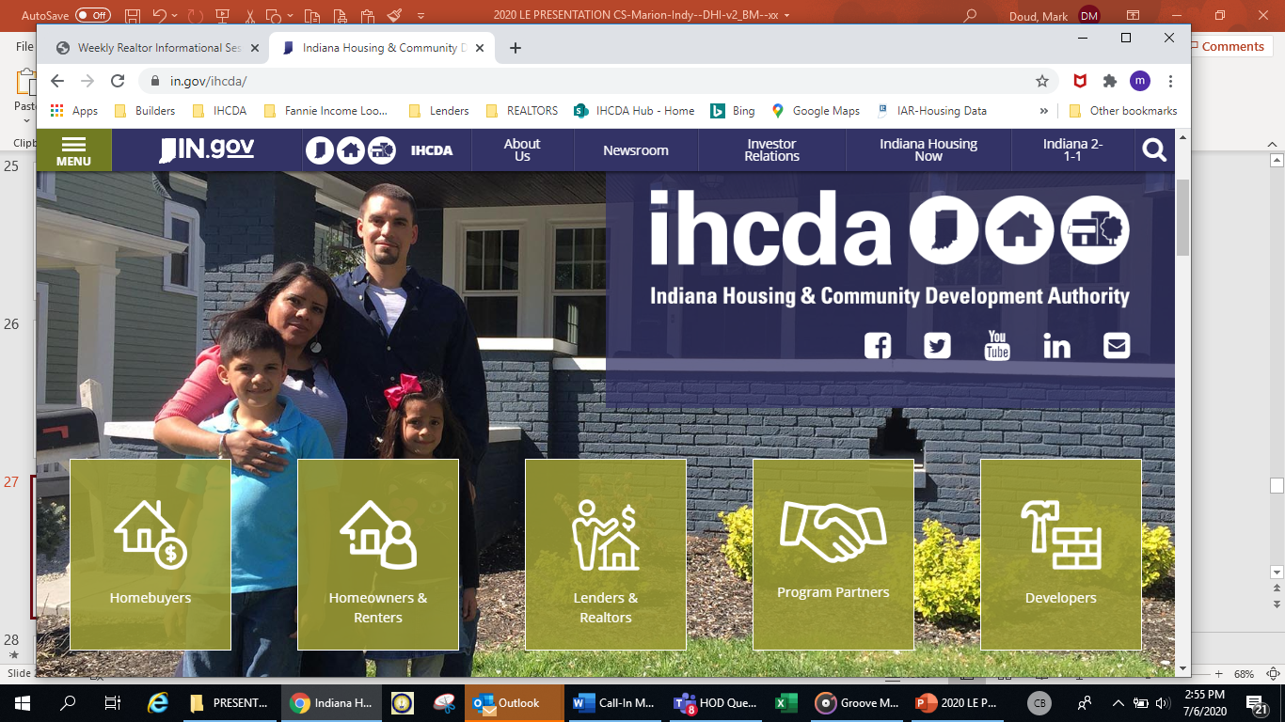

Slide 27
Marketing suggestions
What marketing approaches or materials can we offer to you and your realtor partners to get the word out to potential homebuyers that these homeowenership programs are available?
Generally, 60-70% of homes listings are homes that the borrower, if credit score and income eligible, would be able to use IHCDA’s down payment assistance to purchase

Slide 29
Program summary
4 Eligibility Factors
1) Income - Regional Ranges
$72,300 to $120,820
2) Credit Scores
640 w/ DTI of 45% <
680 w/ DTI b/t 46-50%
3) Reservation Fee:
$100 or $800*
4) USB Overlay: 1-month PITIA & 6 month on the job if FICO is b/t 640 & 659
*MCC Stand-alone
Benefits for the Borrower
  Down Payment either:
  > 3.5% on an FHA loan
  Federal Tax Credit
  Extra cash loan options
  > to assist w/ closing costs, prepaids

Slide 30
loan ORIGINATOR Questions?
Account managers
Mark Doud Bre White
317-447-8156 463-203-7108 mdoud@ihcda.in.gov Bwhite@ihcda.in.gov
HOMEOWNERSHIP.IN.GOV

Slide 31
General process & additional important information

Slide 32
Ihcda: products & process
IHCDA Loan Products currently offers:
  MCC
  Next Home
  First Place
Process/System*
Placing Reservation
Reservation Fee
Submitting Affidavit
DPA Wire (if applicable)
Closing Packet
*Note: An On-Demand DMS training video
is under development and will soon
be available.
Link:

Slide 33
Dms System access
Access to the DMS is granted by each lender’s DMS Administrator(s)
The Administrator grants access level to each user:
  Lender – Allows LO to check daily rates, check loan status and initiate loan reservations
  Lender Documents – Access to printable documents
  DPA Wire & Closing – Ordering of DPA wire/upload closing docs
  Administrator – Set-up/deactivate users; assign access levels
Log-in link: https://online.ihcda.in.gov/DMSOnline

Slide 34
OVERALL PROCESS
60 - Days
1. Initiate & Submit Loan Reservation using DMS Online
(Stage 1)
2. Complete and Upload Homeownership Affidavit & Upload Appraisal
(Stage 3)
3. Order DPA Wire for Closing (if applicable)
(Stage 5)
4. Submit Closing Packet for Review and final Approval
(Stage 7)

Slide 35
Summary of submittal process
Front End
Homeownership Affidavit – A summary review of all aspects of the file that must be evident for the file to maintain tax compliance. Much of the document is pre-filled with data from the reservation. Lender signs/dates the affidavit verifying its accuracy.
  Turn-time: Approves are issued within 24 - 48 business hours (often sooner)
Middle (if applicable)
DPA Wire Order - Within the DMS Online system lender orders the DPA Wire for the Closing Table, 48 – 72 business hours prior to closing date. The system will not permit a wire to be ordered until the Affidavit and Appraisal have been approved.
Back End
Closing Packets - Loan must have final approval from IHCDA AND be purchased by US Bank before commitment expiration date. (60-days)

Slide 36
Paperless application package
Step 1: Lender makes reservation in the DMS Online—60 day clock begins
Step 2: Lender submits reservation fee via:
    ACH (ACH account number and routing number is given to Lender only after a signed MOSA is approved)
    Mails Certified check/Lender check/money order to IHCDA. If sending checks/money orders you must
    submit the IHCDA Invoice along with the fee and include the 5-digit reservation number in the memo section of
    the check or money order. The IHCDA Invoice is located in the Loan Documents section of the DMS system (personal checks are not accepted). Electronic transfer for Reservation Fees can be
    set-up if lender prefers (Point one above).
    **Due to remote working arrangements, files are being allowed to progress without first receiving the reservation fee. Under normal work environments, this fee must be received before a file will be reviewed. Files are currently conditioned at the Closing Package Review for reservation fee payment; stand-alone MCC’s reservation fees must be received prior to the Closing Package approval.
Step 3: Lender completes and uploads the IHCDA Homeownership Affidavit and, the Property Appraisal
Step 4: Lender checks Enhanced IHSF system for status of loan within 24 business hours (or sooner)
Step 5: Upon “Committed Approval” status (Stage 4), the Enhanced IHSF system allows the lender to order the DPA funds to be wired (if applicable)
NOTE: Requests should be made no more than 5 business days before closing but must allow at least
48 business hours for wire to be received
Step 6: Lender closes the loan (Signings occur)
Step 7: Lender sends Closing packet to IHCDA and a Closing packet to
US Bank and monitors each system for any further
Conditions. If no conditions are issued or when all conditions are
cleared, loan is sold into secondary market, U.S. Bank remits SRP
to originating lender and the process is complete.

Slide 37
Operations & processing
(for virtual meetings) winter 2021
Topics:
Fees
Program Locks
Tax Transcripts
Cancellations
Transfers & Changes

Slide 38
Reservation fees
Reservation fees can be paid via;
  ACH – preferred (details on next slide)
  Lender Check, Cashiers Check or Money Order
    No personal checks and/or credit cards are accepted
All DPA Programs
$100.00 – NON-REFUNDABLE
MCC Only
$800.00 – REFUNDABLE if cancelled
IHCDA refunds 75% ($600) & retains 25% ($200), if the file has been reviewed
Refund is paid to the lender for the lender to refund the borrower

Slide 39
fees
Made payable by ACH, lender check, cashiers check or money order
$100.00
Next Home (NH)
First Place and
Next Home/MCC Combo loan
$800.00
MCC stand-alone
Extension Fees
Reservation Fees
MCC stand-alone
**Due if the commitment date expires prior to the loan receiving final approval from IHCDA
30-day extension only, .25% of the final loan amount made payable to IHCDA (this fee cannot be paid by the borrower)
Next Home, Next Home w/MCC Combo and First Place
**Extension must be requested if the commitment date expires prior to the loan being purchased by US Bank
Extension options: ExtensionRequests@ihcda.in.gov

Slide 40
ACH account information
The below account information should be used when sending the reservation fee via ACH Wire to IHCDA
THIS ACCOUNT SHOULD NOT BE SHARED WITH ANY BORROWERS – The ACH Wire is to ONLY come from an IHCDA participating lender.
REMINDER: The 5-digit IHCDA reservation number must be input as a reference for IHCDA to be able to apply the fee to the correct loan
J.P. Morgan Chase
1 East Ohio Street
Indianapolis, IN 46277
Routing: 074000010
Account: 687725080

Slide 41
PROGRAM locks
NEXT Home & next home/mcc combo, & First place
Once reserved, loan receives a lock of 60 days with IHCDA
Relocks occur if;
    a lock expires**
    if there is a property change**
    if Mortgagor changes lender**
    if a cancellation occurs and loan is outside of original 60 day lock period**
Extensions must be requested at ExtensionRequests@ihcda.in.gov
  NOTE: US Bank will only allow ONE (1) additional 30-day extension once the closing package is submitted for review. This applies on all loans that are aged past the commitment expiration date.
** ALL RELOCKS ARE AT WORST CASE PRICING **

Slide 42
Extension fees
Must be requested via email if the commitment date expires prior to the loan being purchased by US Bank - Paid to US Bank through SRP except MCC-stand alone
MCC-stand alone fees must not be passed on to the borrower and need to be paid directly to IHCDA by the lender.
ExtensionRequests@ihcda.in.gov
Email must state the reservation number and the choice of days to extend. Choices can be singular or any combination. Extension options;
US Bank will only allow ONE (1) additional 30-day extension once the closing package is submitted for review. This applies on all loans that are aged past the commitment expiration date.
Rate Lock Extension Extension Fee
15 days .12500
30 days .25000

Slide 43
MCC Stand Alone
ADDITIONAL FEES and COMMITMENT DATES
MCC FEES
COMMITMENT DATES/LOCKS
Late Submission: .25%
Cancellation/Reinstatement:
  Tier 1: $500
  Tier 2: $1,000 plus reservation fee
  Tier 3: $1,500 plus reservation fee
Re-Issuance: $200
Existing – 90 days
New Construction – 180 days
ALL FEES ARE BASED OFF OF THE FINAL LOAN AMOUNT AND DUE PRIOR TO FINAL APPROVAL

Slide 44
Exception code / file Rescinds
Pre-lock or Post-lock: If a file has been reserved (submitted, i.e. locked), and a change needs to be made, contact an IHCDA Homeownership staffer and they will rescind the file back to Stage 1 (or any other Stage level where the change needs to be made) and the data can be re-typed back correctly.
If a file cannot be rescinded, then an exception code will need to be issued and a new reservation begun. When the new reservation is initiated the system will request an exception code in order to continue

Slide 45
Reservation CHANGES
If changes need to be made to the file prior to the Affidavit upload (ex: purchase price, loan amt., etc…), include the changes on the Affidavit and the Underwriter will make the changes during their compliance review process.

Slide 46
Loan reservation CANCELLATIONS
Pre-locked: If your file has not yet been locked and you wish to cancel, it is your responsibility to do so.
Post-locked: Once your file has been locked, the cancellation would need to be completed by IHCDA. Please use the Cancellation email address to request these changes. HomeownTerminations@ihcda.IN.gov
Once the loan is cancelled, the reservation fee is non-transferable.
Similarly, if you have submitted the reservation fee and the loan is to be cancelled, without re-reserving, under all programs except MCC Stand Alone the reservation fee is NON-REFUNDABLE.
MCC Stand Alone will refund the full $800 if the loan has not been submitted or reviewed by an IHCDA Underwriter OR a portion of the reservation fee will be refunded, 75% ($600) of the $800, if the loan is in Stage 4 Application Review or after.
If the cancellation occurs after the DPA has been wired out, the DPA will need to be returned to IHCDA immediately.

Slide 47
The closing package
You are ready to close once the file has reached Committed Stage 5 and your DPA has been requested, wired and received by the title company, if applicable. You will find this confirmation on the Summary page under Loan Progress.
You will find docs required by IHCDA under the GENERATE FILLED DOCS on the bottom right of the Documents tab. The docs required will be listed under closing upload identified as IHCDA with a check mark next to it. Only the documents pertaining to your chosen program will be listed.
Once your file has closed, you are ready to upload the complete closing package.
When a complete file has been uploaded, your underwriter will be notified via email that it is ready for review.
Watch your pipeline for approval or any open conditions that need to be addressed.
*For faster approvals, upload these to the “Add Conditions Document” section of the Status Tab*

Slide 48
IHCDA Turn-times
TURN-AROUND TIMES
All files (application or closing) – 24 to 48 business hours
DPA disbursement – 48-72 business hours
Conditions (if uploaded as “Add Conditions Document” on Status Screen) – 24-72 business hours

Slide 49
UNDERWRITING
Processes and Procedures

Slide 50
What underwriting criteria does IHCDA use?
  1. Qualifying Income – All income that meets the GSE standards. The breakdown of eligible income can be found in the Program Guides under Section 2 – Mortgagor Eligibility, Letter C.
  2. Program Income Limits.
  3. Program Acquisition/Purchase Price Limits, when applicable.
  4. First-time homebuyer guideline, when applicable.
  Purchase Price cannot exceed appraised value, except on MCC stand- alone program.
  Dwelling must be one (1) parcel under all programs.
  All land must be required for the livability of the property and so noted within the Appraisal.

Slide 51
HIGHLIGHTS
Using Qualifying Income based off of the 1003 FOR MORTGAGOR/CO-MORTGAGOR ONLY
  Paystubs are not required
    - May be requested if there is a discrepancy
  - Qualifying Income – ALL income that meets GSE standards. The breakdown of eligible income can be found in all Program Guides under Section 2 – Mortgagor Eligibility, Letter A
3-Years Tax Transcripts are only required on MCC, Next Home/MCC Combo, and First Place
  Tax Transcripts are not required on the stand-alone Next Home.
Accessory Units are acceptable with a Notarized Auxiliary Unit Affidavit

Slide 52
TAX TRANSCRIPTS & GUIDELINES
IRS Tax Compliance Laws require applicable program loans to be documented by 3-years of tax transcripts
  MCC
  Next Home/MCC
  First Place
3 yrs. of IRS Tax Transcripts are required on mortgagor/co-mortgagor and must be submitted with the closing package on applicable IHCDA programs
If a borrower did not file a tax return for all 3 years and/or any of the past years tax returns, they must complete the ‘INCOME TAX AFFIDAVIT’ section of the IHCDA Borrower Information Certificate

Slide 53
The homeownership team
Homeownership Director
Kim Harris @ kiharris@ihcda.in.gov 317-233-5367
Operations Manager
Tom Pearson @ tpearson1@ihcda.in.gov 317-232-0210
Underwriters
Katryna Rice-Krause @ krice-krause@ihcda.in.gov 317-232-2023
Marianne Fraps @ mfraps@ihcda.in.gov 317-232-7023
Operations
Dolores Scisney @ dscisney@ihcda.in.gov 317-234-3706
Account Managers
Brienn White @ bwhite@ihcda.in.gov 463-203-7108
Mark Doud @ mdoud@ihcda.in.gov 317-447-8156
US Bank Customer Care Specialists 800-562-5165, option 1
hfacustomercare@usbank.com

Slide 54
IHCDA DMS Online
System Training

Slide 55
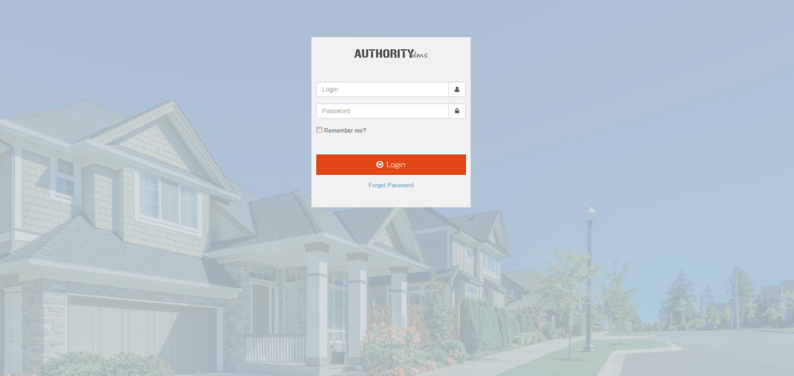
Web link
IHCDA Online is a web-based application, no downloaded software, that is supported by the most recent versions of major browsers like;
  Google Chrome
  Firefox
https://online.ihcda.in.gov/DMSOnline

Slide 56
Home Screen Navigation

Slide 57
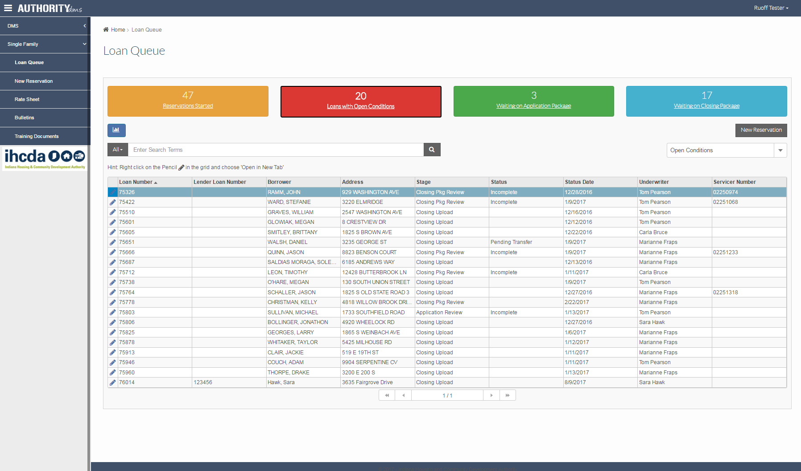
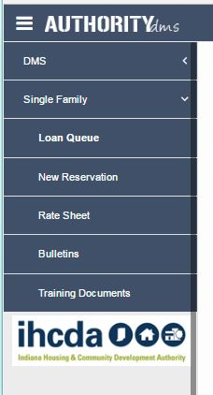
Reservations Started = Reservations started but not yet submitted as a live/locked loan
Loans with Open Conditions = Incomplete loans for both Application & Closing status loans
Waiting on Application Package = Live reservations with the reservation fee submitted waiting for the Homeownership Affidavit to be uploaded for review
Waiting on Closing Package = Loans that have been wired by IHCDA waiting on closing documents to be uploaded

Slide 58
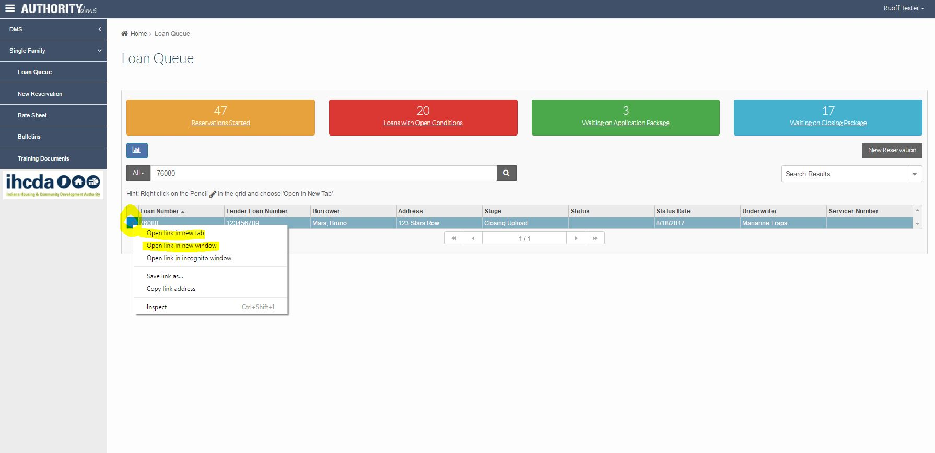
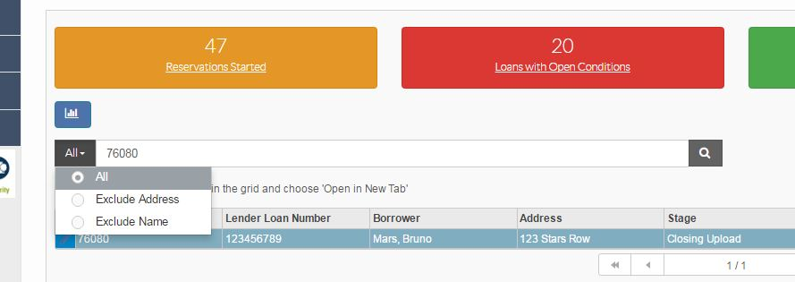
Search fields can also be limited to exclude certain criteria by clicking “All” and selecting what you DO NOT want to be included.
Searching for loans;
Borrower Name
Loan Number (Lender or IHCDA)
Address
The search box is similar to Google. Input what you are looking for with as little or as much information as you have. To separate your search criteria, the word “AND” must be used.
Example: You wanted to search Smith at Maple Street. Your search would be; Smith and “Maple Street”
HINT: using “ ” encloses the phrase you are searching
HINT: Once your loan is found or opening a loan at all, you can click on that line item but that will open the loan in the current window. In order to toggle between your home screen and different loans, right click the “Pencil” next to the loan and select either;
Open link in a new tab OR
Open link in a new window

Slide 59
Inputting Reservations

Slide 60
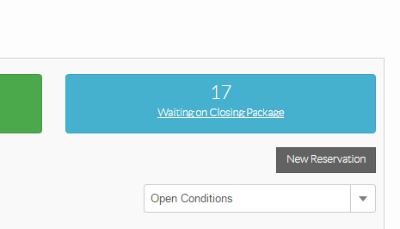
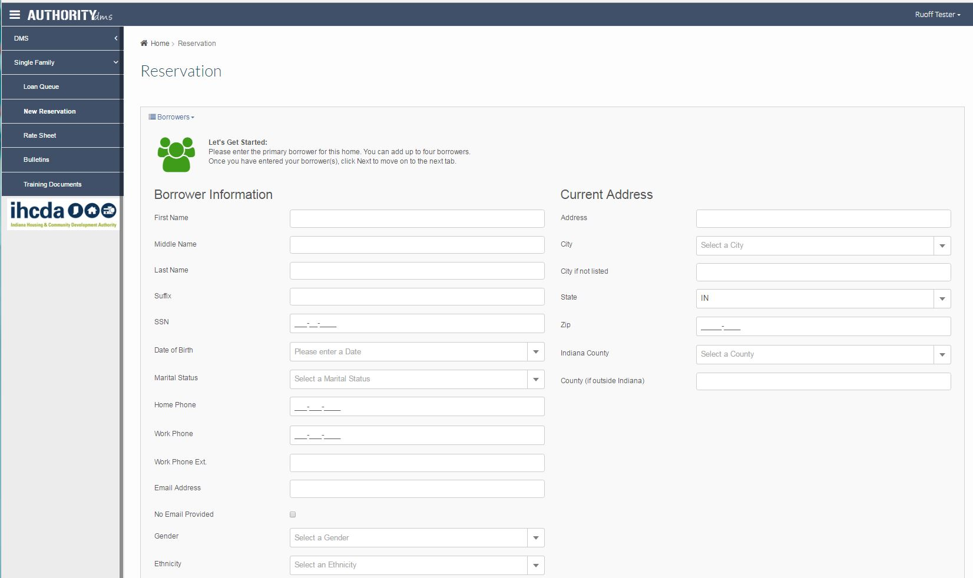

Slide 61
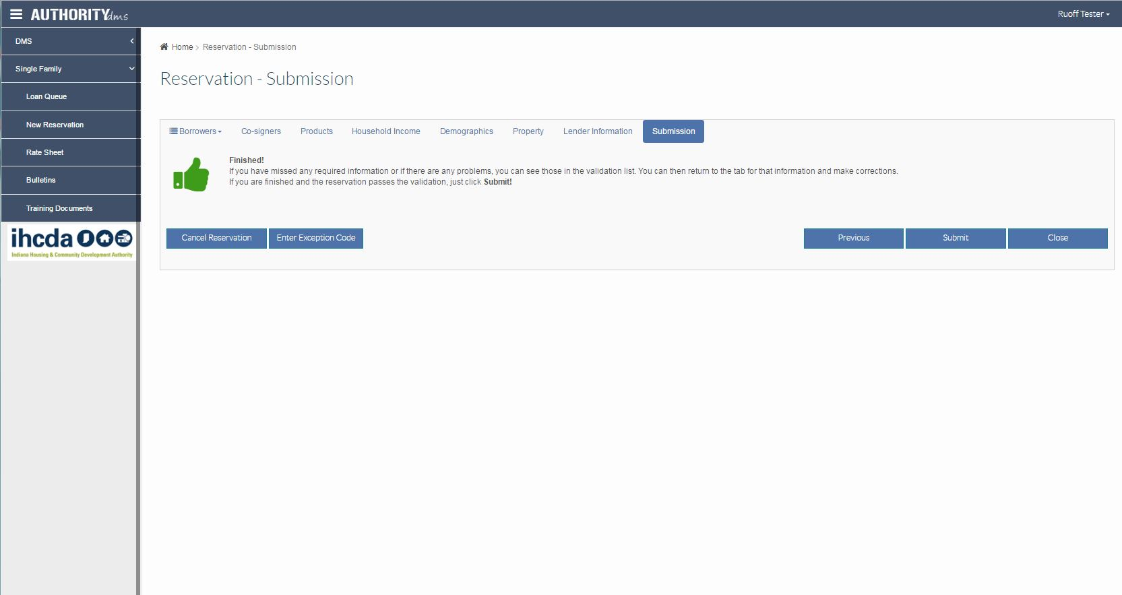
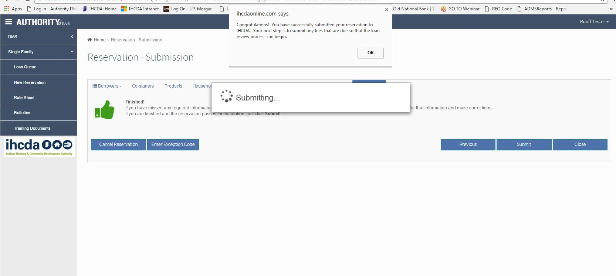
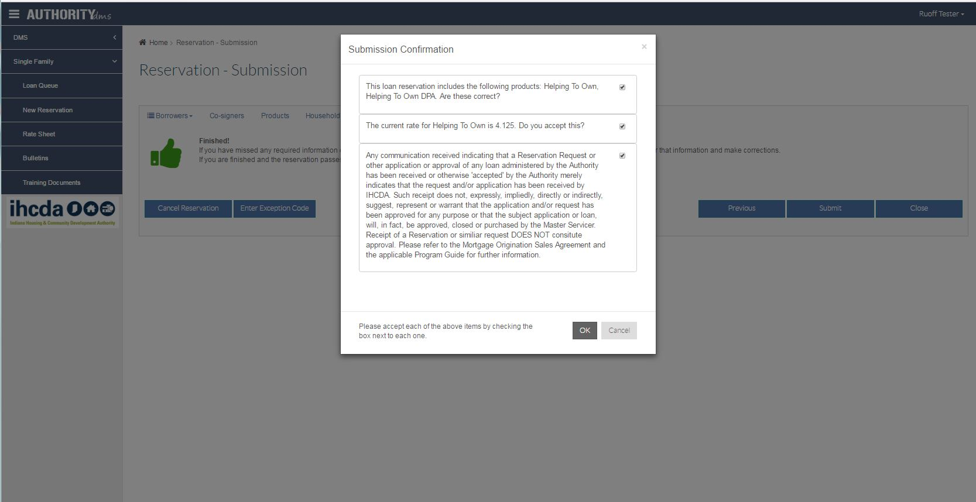

Slide 62
Application Upload

Slide 63
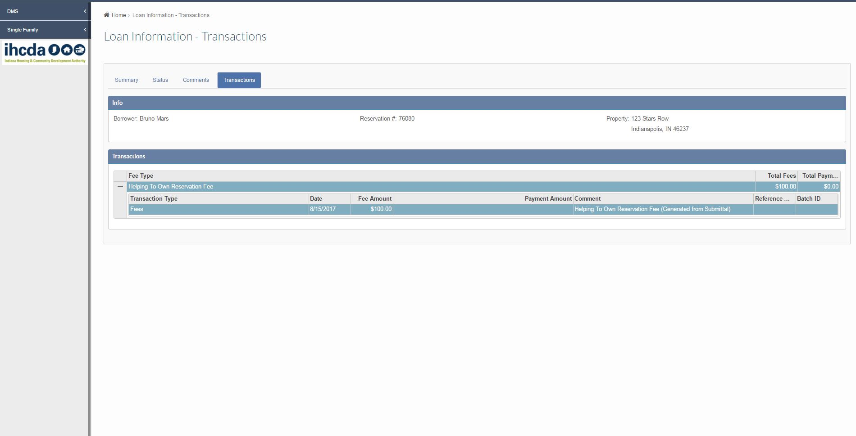
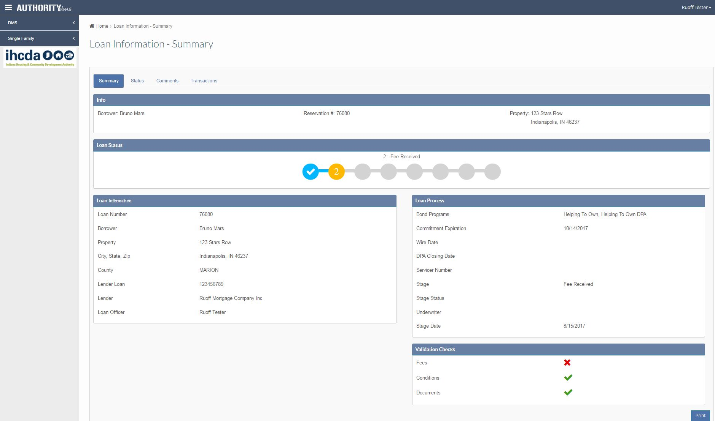
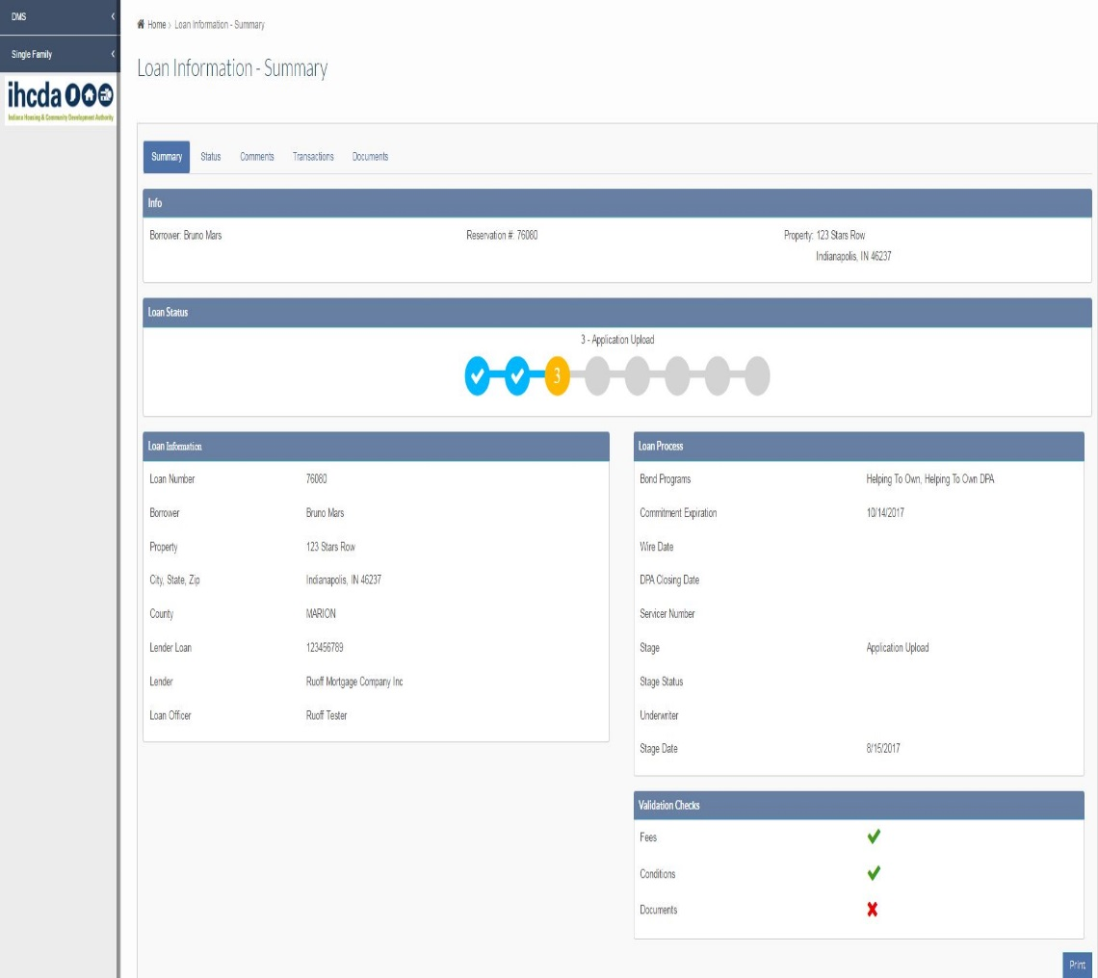
Stage 2 – fee received
Step 3:
Yellow @ 3
Upload Ready
Step 2:
ACH/Money Order/Cashiers Check to IHCDA
Step 1:
Yellow @ 2
Fee Required
Note: Stage 2 “Fee Received – Assigned” does not reflect payment received by IHCDA.

Slide 64
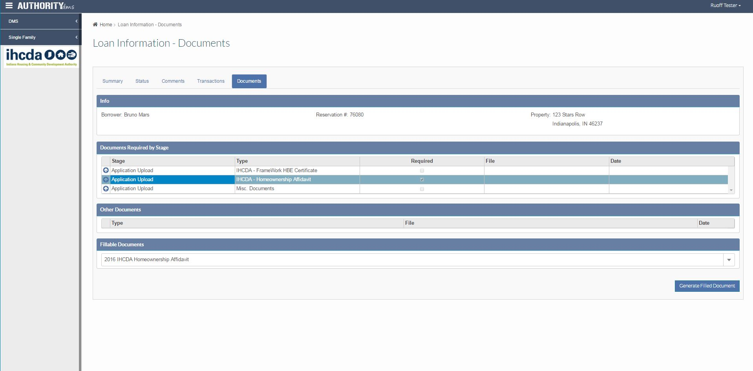
Stage 3 – application upload

Slide 65
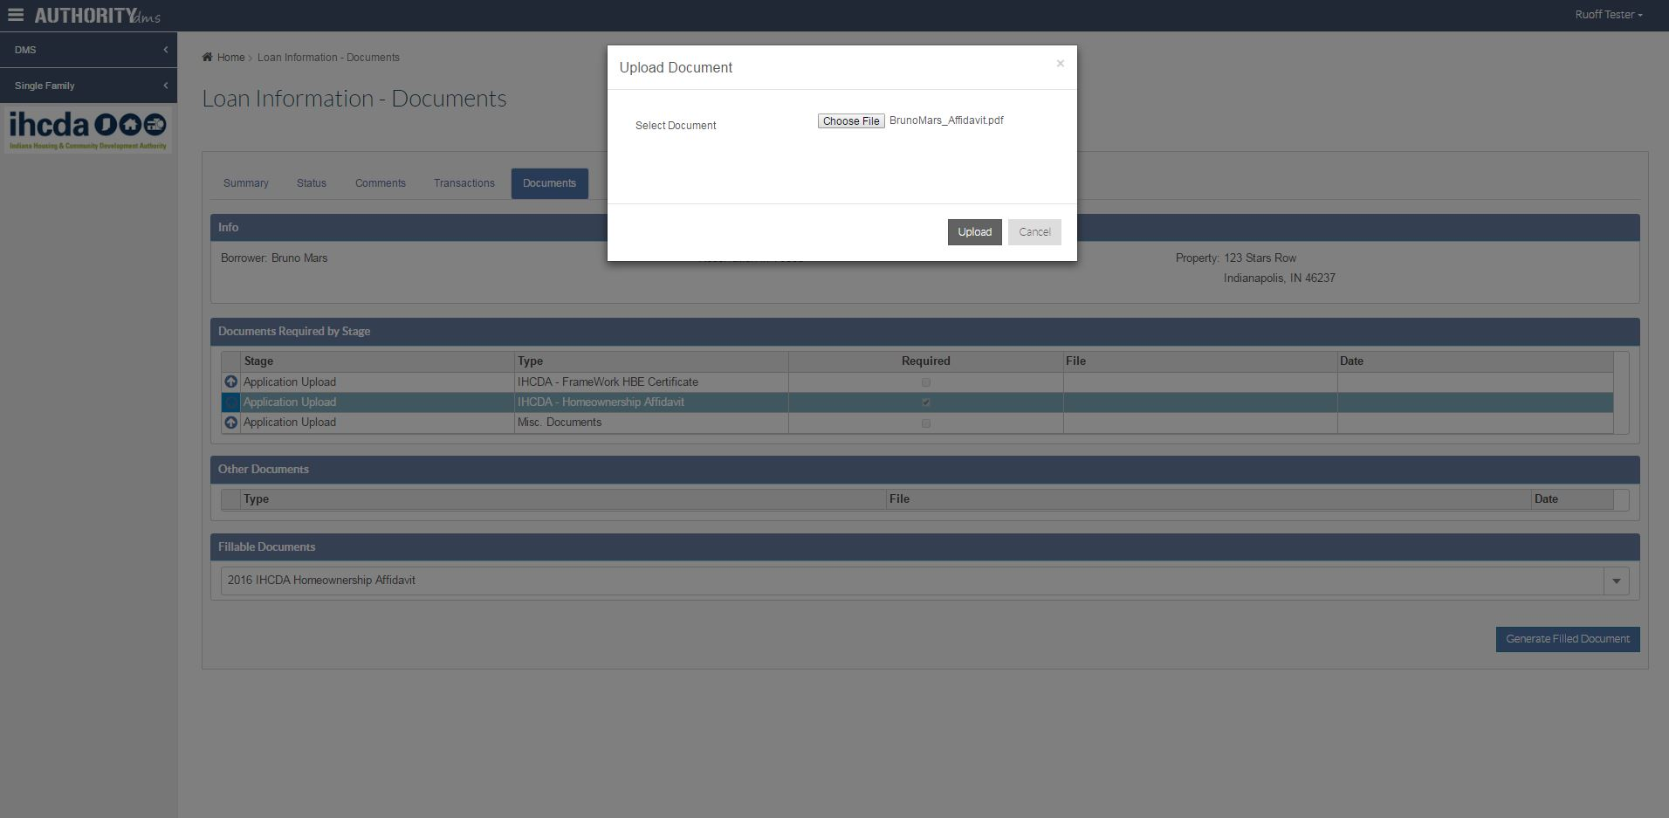
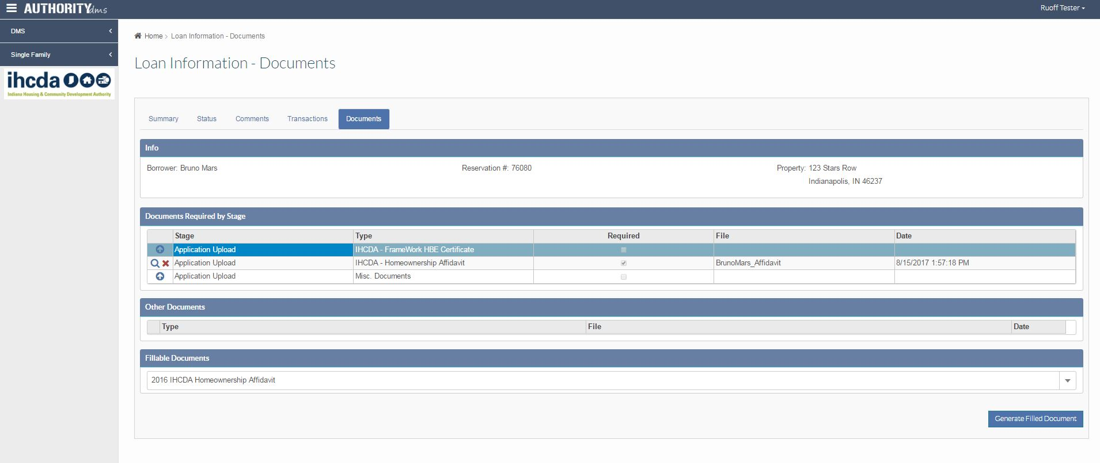
Stage 3 – application upload
Chose the saved file from your computer and select “Upload”
To find/fill an IHCDA required document locate the “Fillable Documents” section, use the drop down arrow to locate which document to prefill and select “Generate Filled Document”.
Once the document is uploaded the “upload arrow” turns into a magnifying glass along with the ability to delete the document if an error was made during the uploading process.

Slide 66
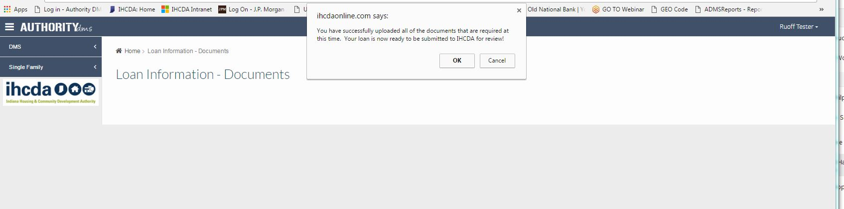

Once all “required” documents are uploaded a submission box appears asking if you are ready to submit the file to IHCDA for review.
NOTE: If there are additional non-required documents you want to upload you can select “Cancel” to continuing uploading. You will receive the submission box after each upload until you select “OK” to submit the file to IHCDA.
Once the documents are uploaded and submitted for IHCDA review, the validation checks turn green and the loan summary line moves to a yellow @ Stage 4 of “Application Review” awaiting an IHCDA Underwriter’s review of the uploaded file.

Slide 67
Application Review - Incomplete

Slide 68
UNDERSTANDING CONDITIONS
Our goal as underwriters is to always try to make all conditions clear and understandable
  If you do not understand a noted condition, please contact the assigned underwriter as we are always willing to explain what is being asked for and why
Reminders
  Allow 24-48 hours for conditions to be reviewed
  Conditions must be uploaded correctly
  All open conditions must be satisfied prior to IHCDA underwriter review

Slide 69
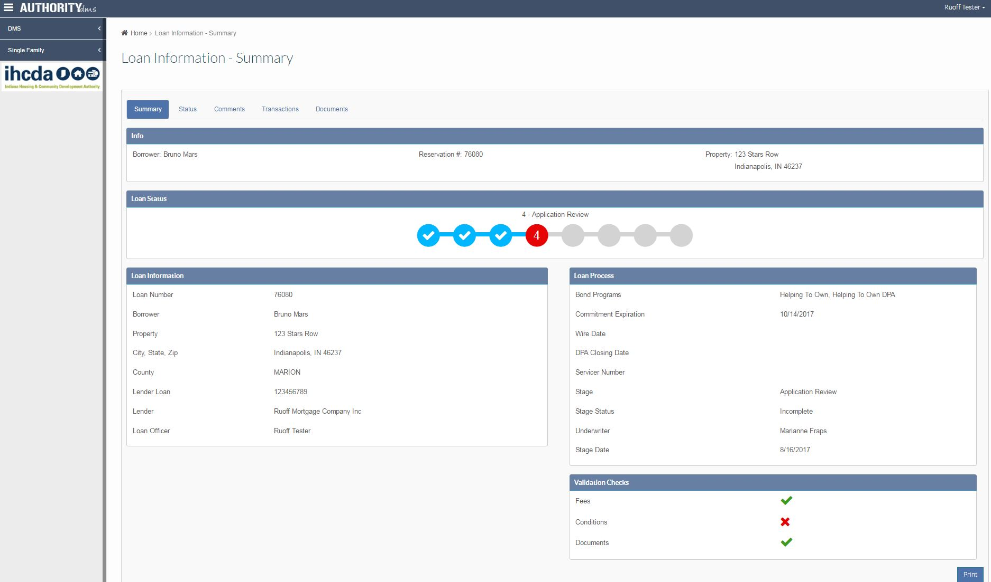
If you’ve received an “Incomplete” review, the bubble will turn Red @ Stage 4 as well as the validation checks shows an “X” meaning open conditions. At this point, you will need to upload the required open conditions for an IHCDA re-review.

Slide 70
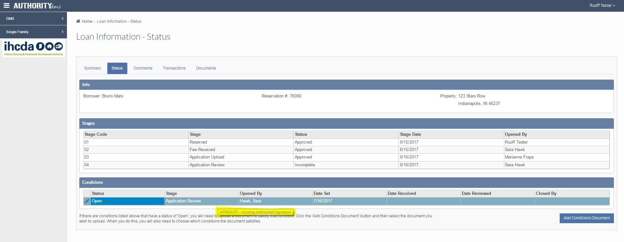
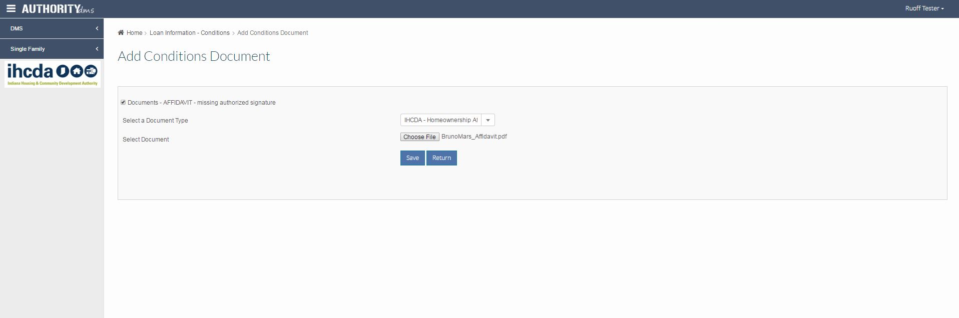
Step 1: Review all “Open” conditions needed to be uploaded for approval.
Step 2: Click “Add Conditions Document” to upload required item(s).
Step 6: Hit “Save” to actually load the document for that specific open condition.
Step 7: Select “Return” to go back to the Status tab.
Step 3: Select which condition the document you are uploading will satisfy.
Step 4: Choose the document label from the drop down box.
Step 5: Browse your computer and select the applicable document.

Slide 71
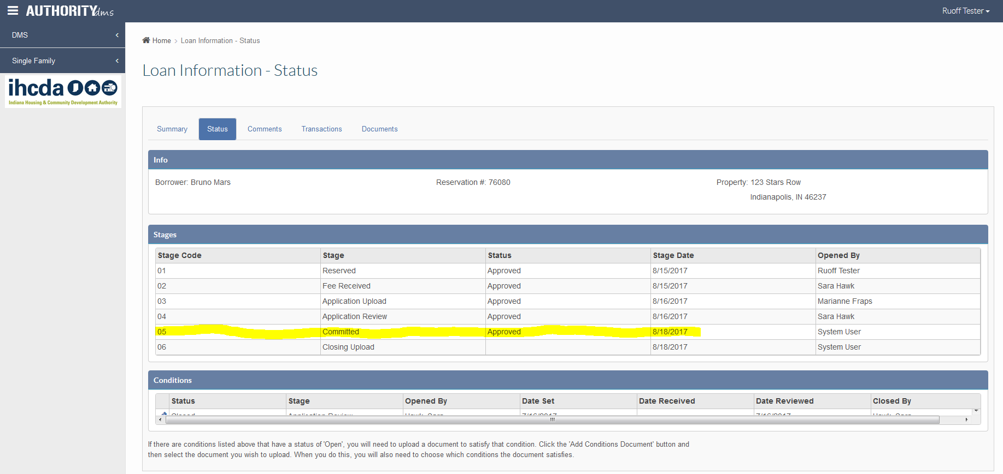
Committed – approved (stage 5)

Slide 72
Inputting a DPA Wire Request

Slide 73
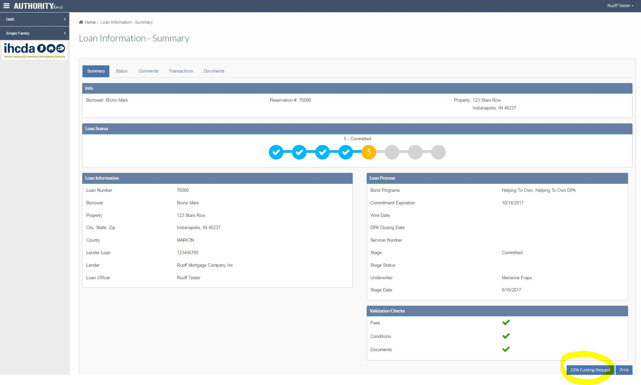

Committed & ordering dpa wire
Once a loan is “Committed – Approved” the ‘DPA Funding Request’ button will appear for the wire to be ordered.

Slide 74
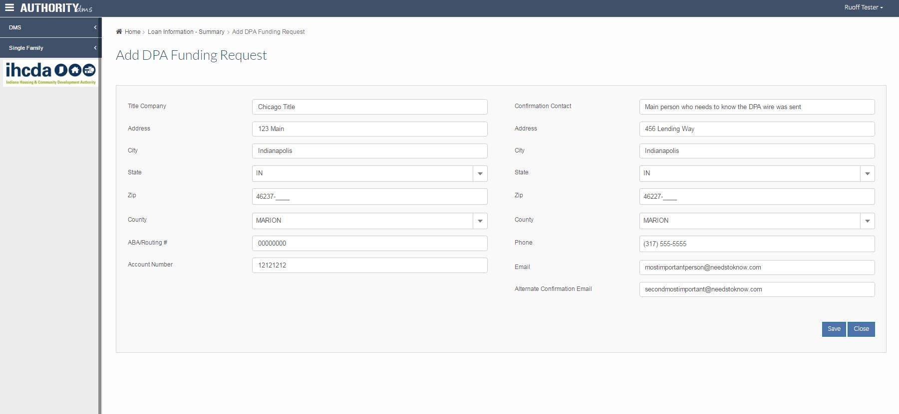
Inputting wiring instructions
@ Confirmation Contact input “Lender” information and at least one email address of the one individual that needs to know the wire has been sent. There is now the ability to add another email address, if applicable.

Slide 75
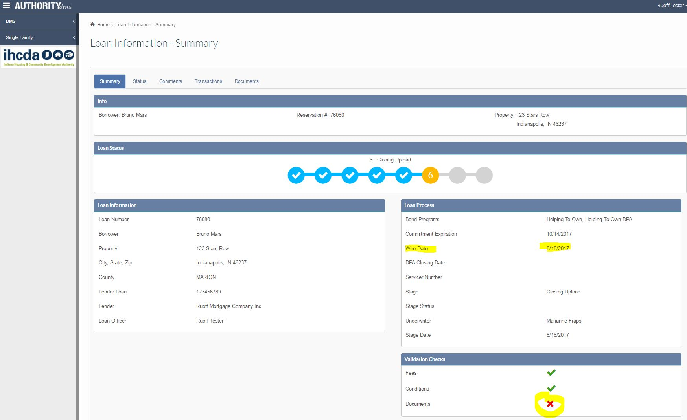
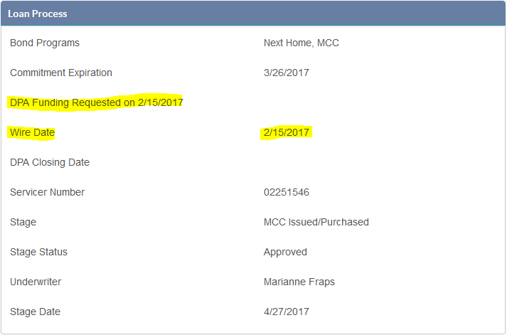
dpa wired – confirmation
You will be able to see the funding request has been submitted. Once the loan has been wired and a wire date has been input by IHCDA the ability to upload the closing package “unlocks” and becomes available.

Slide 76
Additional dpa wire information
INTERMEDIARY DISBURSEMENTS:
IHCDA Online is not set up to enter more than one (1) financial institution. If there is an intermediary bank involved, please contact IHCDA’s Homeownership Operations Team.
Dolores Scisney: dscisney@ihcda.in.gov

Slide 77
Closing Upload

Slide 78
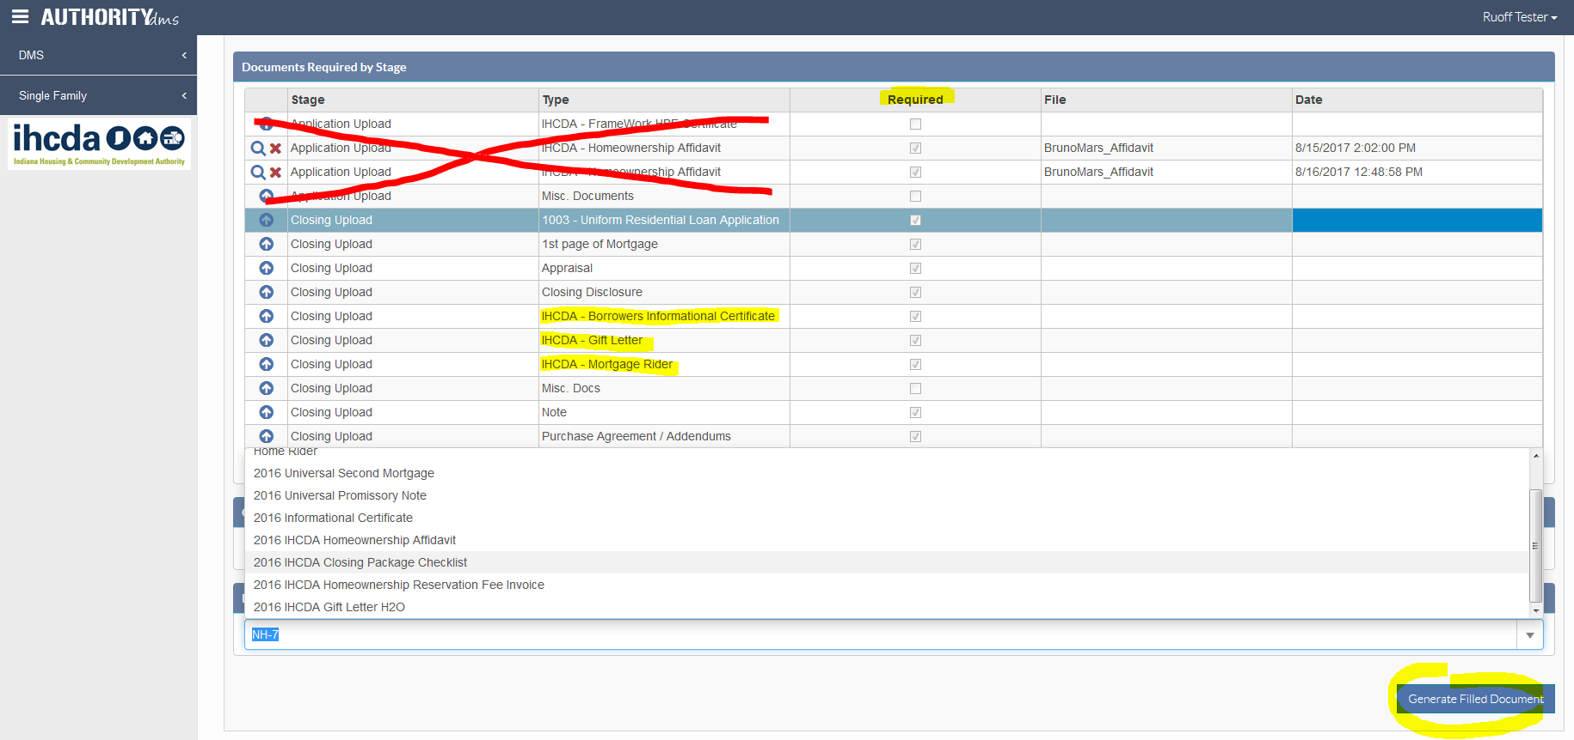
Stage 6 – closing upload
Upload all “Required” closing documents, following the same process as the application upload.
Reminder: To find/fill an IHCDA required document locate the “Fillable Documents” section, use the drop down arrow to locate which document to prefill and select “Generate Filled Document”.

Slide 79
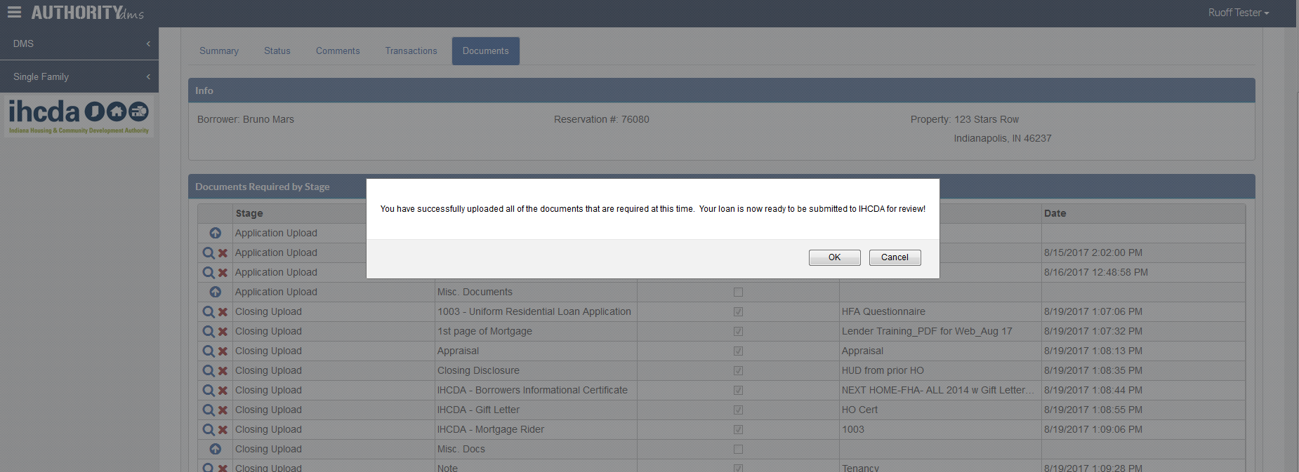
Stage 6 – Closing upload
Chose the saved file(s) from your computer and select “Upload” on all required documents.
Once all “required” documents are uploaded a submission box appears asking if you are ready to submit the file to IHCDA for review.
REMINDER: If there are additional non-required documents you want to upload you can select “Cancel” to continuing uploading. You will receive the submission box after each upload until you select “OK” to submit the file to IHCDA.

Slide 80
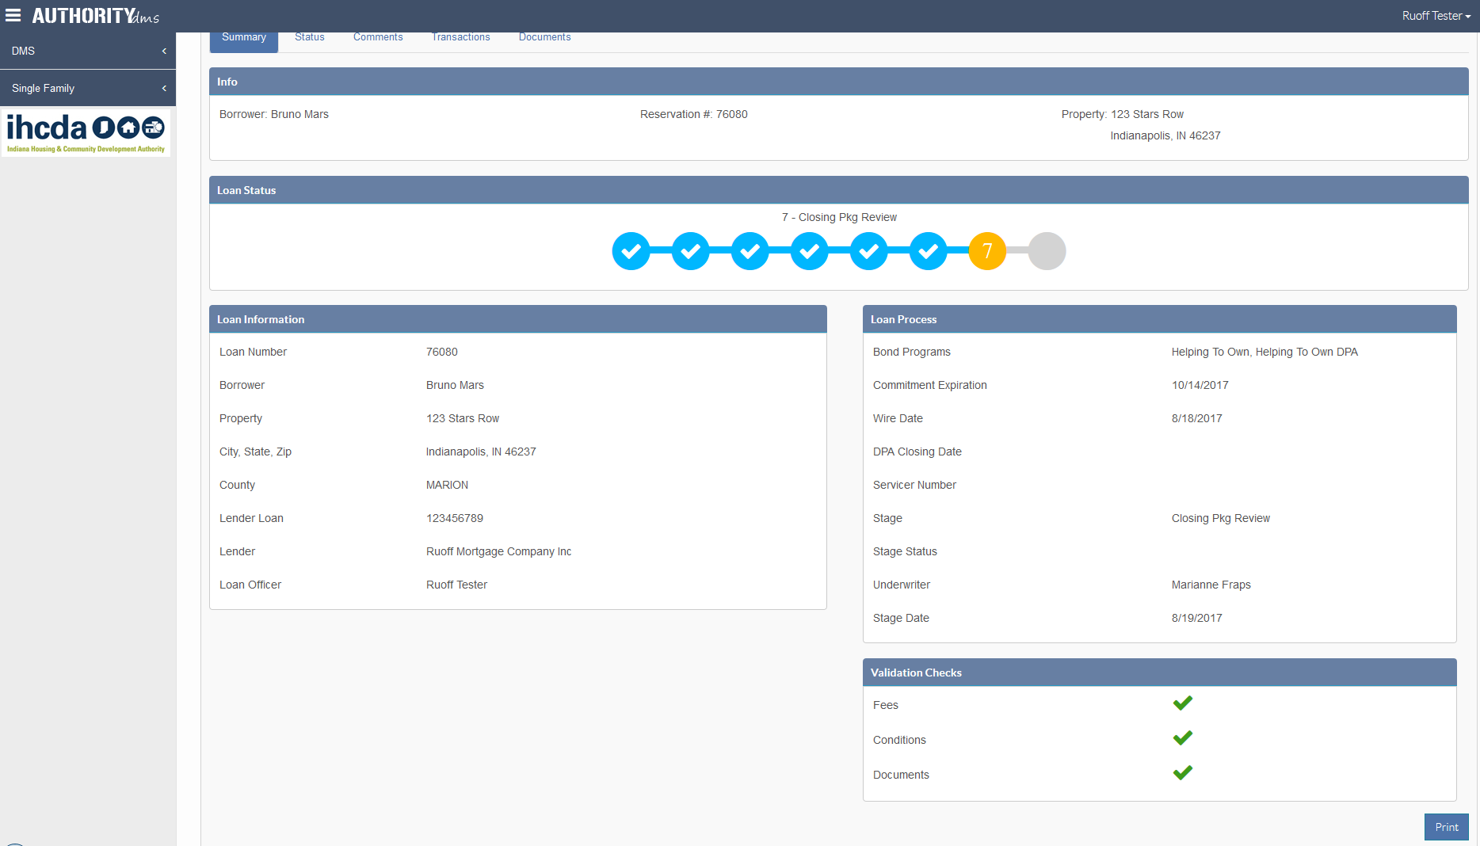
Once the documents are uploaded and submitted for IHCDA review, the validation checks turn green and the loan summary line moves to a yellow @ Stage 7 of “Closing Pkg Review” awaiting an IHCDA Underwriter’s review of the uploaded file.

Slide 81
Closing Pkg Review - Incomplete

Slide 82
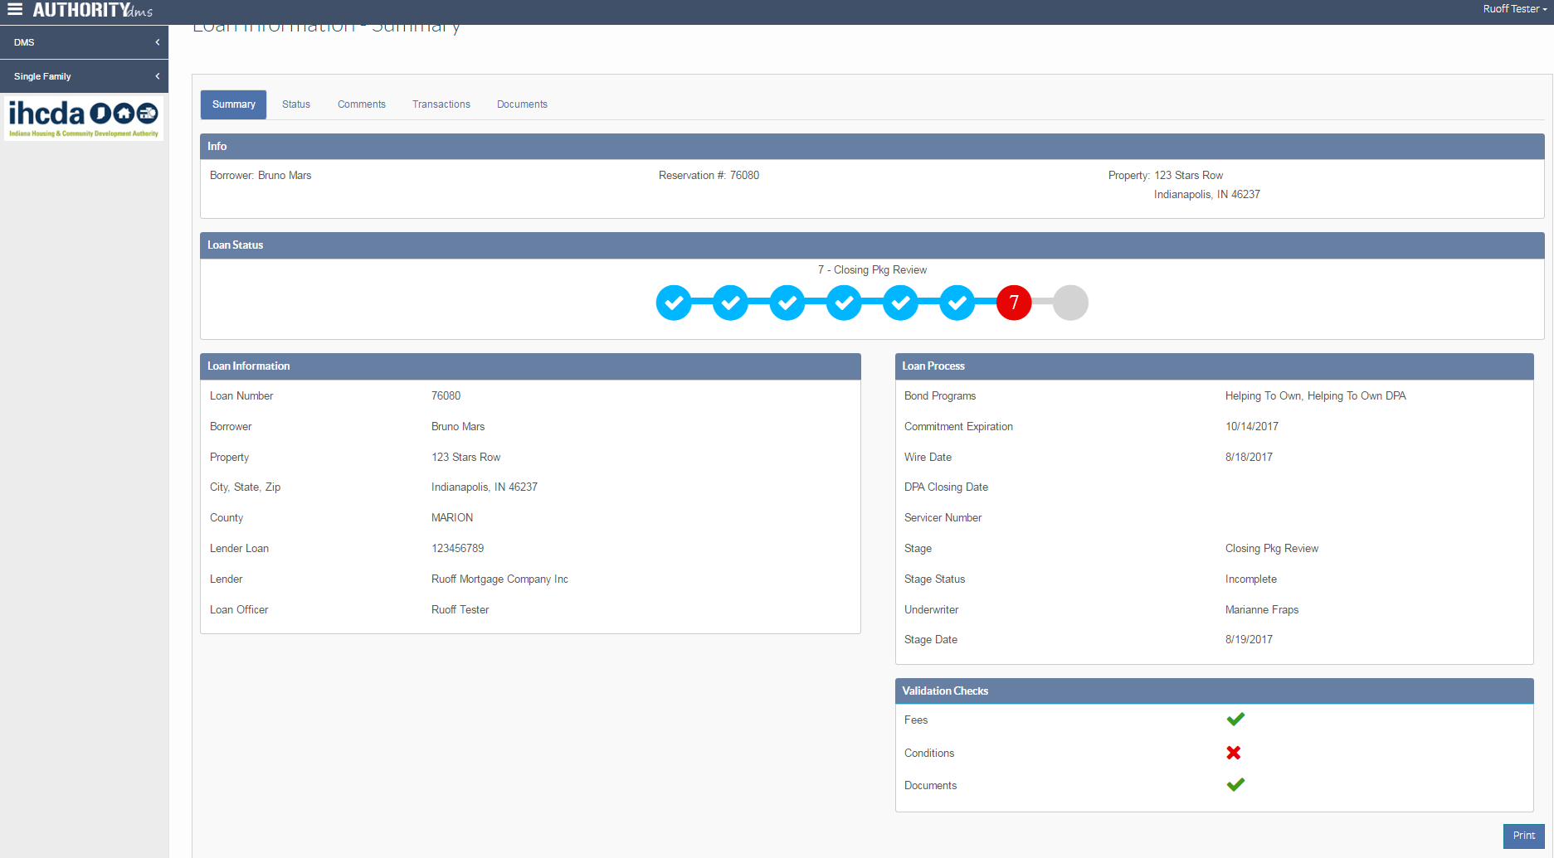
If you’ve received an “Incomplete” review, the bubble will turn Red @ Stage 7 as well as the validation checks shows an “X” meaning open conditions. At this point, you will need to upload the required open conditions for an IHCDA re-review.

Slide 83
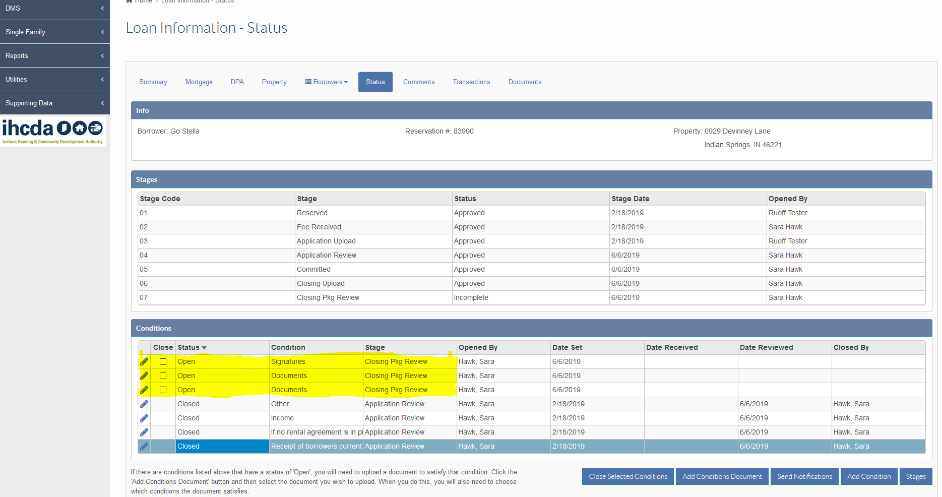
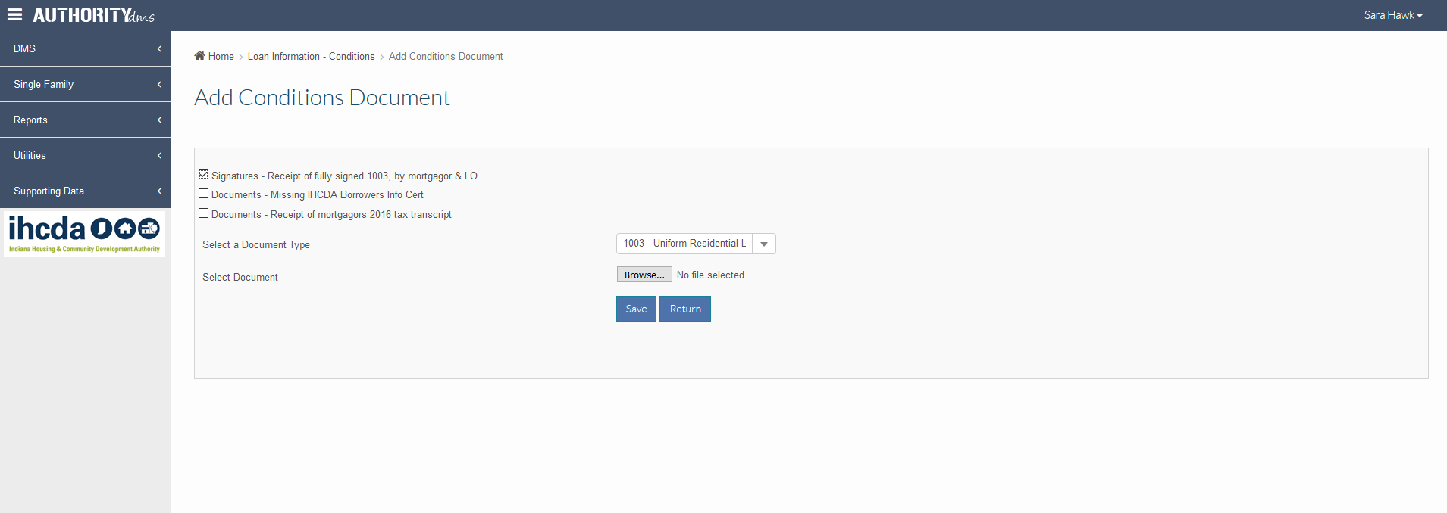
Step 1: Review all “Open” conditions needed to be uploaded for approval.
Step 2: Click “Add Conditions Document” to upload required item(s).
Step 6: Hit “Save” to actually load the document for that specific open condition.
Step 7: Select “Return” to go back to the Status tab.
Step 3: Select which condition the document you are uploading will satisfy.
Step 4: Choose the document label from the drop down box.
Step 5: Browse your computer and select the applicable document.

Slide 84
UPLOADING CONDITIONS
REMINDER
Please make sure you upload condition documents correctly otherwise IHCDA underwriter is never notified of the loan to be reviewed.
Incomplete Condition Uploading Process
Under the “Status” tab by selecting ‘Add Conditions Document’
Select what condition(s) you are satisfying.
Select a Document Type to match the condition document you are uploading
“Choose File” to browse your computer
Hit “Save” and then “Return”
Once you’ve uploaded the condition(s) correctly, on the “Status” tab, the ‘Open’ condition will turn into ‘Lender Submitted’ and then the “Date Received” column will show the date of the upload.
Once all open conditions are changed to "Lender Submitted", the IHCDA underwriter will get a notification to review the file. This is the only way the assigned underwriter will be notified. If any condition reflects ‘Open’ the file and all uploaded documents will not be reviewed.

Slide 85
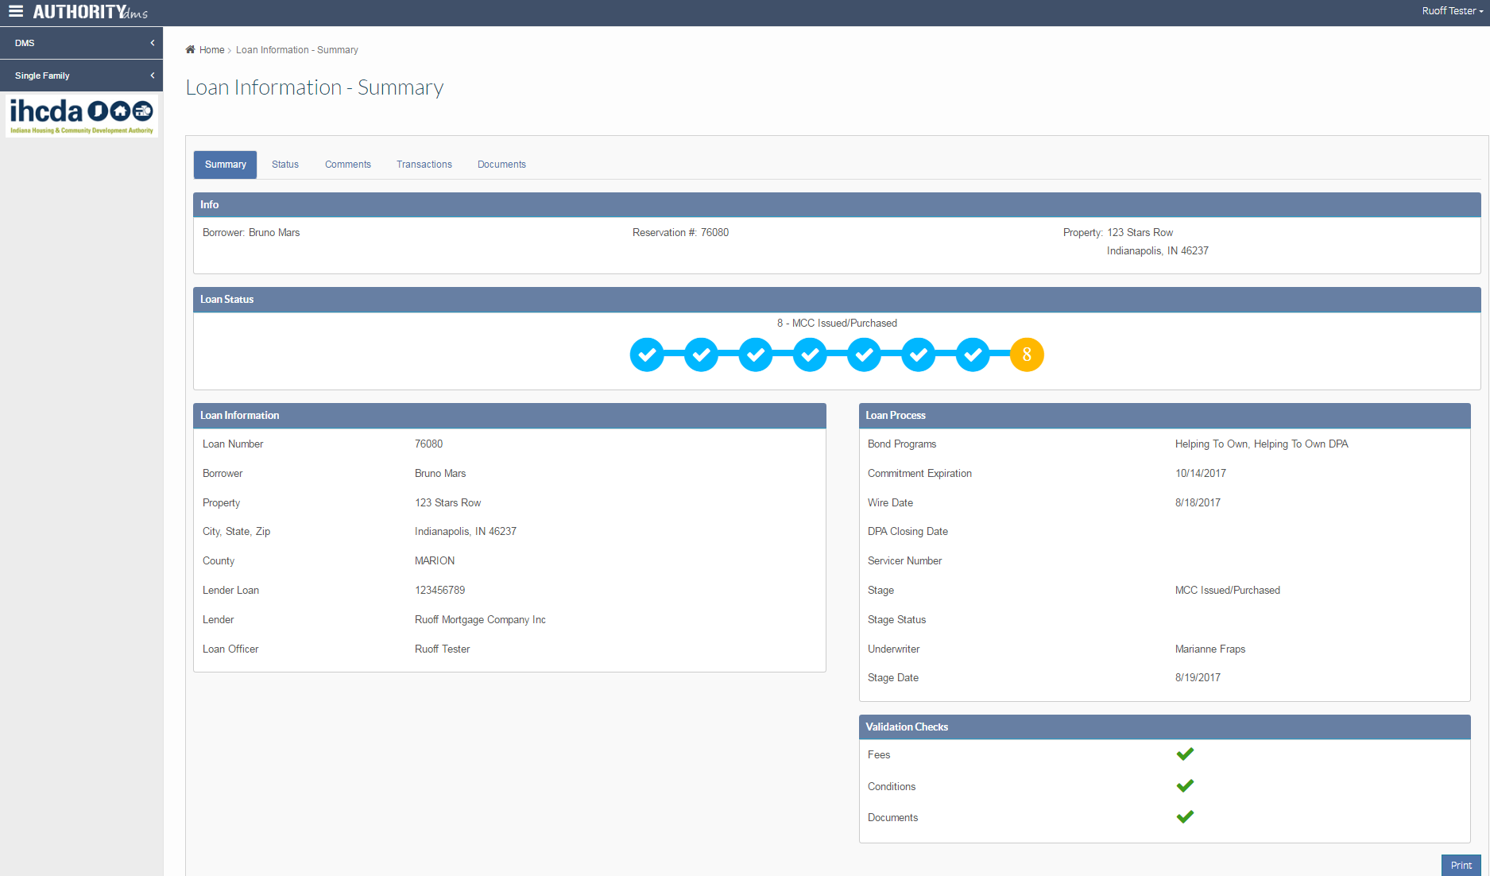
Closing pkg review – final approval
Stage 7 as a blue checked bubble shows that IHCDA has provided “Final Approval” on the loan.

Slide 86
HOMEOWNERSHIP Websites
https://www.in.gov/ihcda
LENDER INFORMATION
Become a Participating Lender (MOSA info & IRS 8329 Reporting)
Contact Information
Homeownership Web Application & Training (Log-on link & Training Info)
Program Guides (Bullet point info & links to each program’s Program Guide)
Loan Status (Quick access to check on the status of a loan)
Mortgage Credit Certificate Re-issuance Affidavit
Servicer Overlays
Income/Acquisition limits
Targeted Areas
IHCDA ONLINE
https://online.ihcda.in.gov/DMSOnline

Slide 87
PROCESS / UW / system Questions?
Tax compliance underwriter
Marianne Fraps
317-232-7023 mfaps@ihcda.in.gov
DMS System / IT
Katryna rice-Krause
317-232-2023 krice-krause@ihcda.in.gov
HOMEOWNERSHIP.IN.GOV

Slide 88
Addendum slides

Slide 89
Reservation fee refundS
If the reservation fee has been paid and you want to transfer the fee to a new reservation, this must be requested prior to cancellation. Once the loan is cancelled, the reservation fee is non-transferable. and a new reservation fee will need to be submitted. ??
If you have submitted the reservation fee and the loan is to be cancelled, without re-reserving, under all programs except MCC Stand Alone the reservation fee is NON-REFUNDABLE.
MCC Stand Alone will refund the full $800 if the loan has not been submitted or reviewed by an IHCDA Underwriter OR a portion of the reservation fee will be refunded, 75% ($600) of the $800, if the loan is in Stage 4 Application Review or after.

Slide 90
RECAPTURE TAX
(MCC, NH/MCC combo, First Place)
Recapture tax is in accordance with Section 143(m) of the Internal Revenue Code for mortgages that are Federally Subsidized
A “Notice to Borrower(s) of Maximum Recapture Tax and Method to compute Recapture Tax in Disposition of Home” is sent to each borrower once the loan has received final approval with IHCDA
    IHCDA will not calculate the Recapture Tax amount, if any, upon sale of the home. If the borrower needs assistance, they would need to consult their tax advisor or the IRS
  Borrowers must pay “Recapture Tax” when the following THREE conditions occur:
    Property is sold within the first 9-years
    A net profit on the sale of the property is made
    The household income is above the current income
    limit at the time of sale of the property

Slide 91
The Application package
Reservation
Fees
Lender downloads and completes the IHCDA Homeownership Affidavit (found under the “Documents” tab in IHCDA Online) and uploads the completed and signed affidavit and appraisal for IHCDA compliance review
  Any changes to income, purchase price, or mortgagor status, update them on the homeownership affidavit for IHCDA to change in the system.
Lender to check IHCDA Online for status of loan within 24 business hours
Upon “Committed Approval” status
  Lender requests DPA funds to be wired (if applicable)
  Requests should be made no more than 3 business days before closing but must allow 48 business hours for wire to be received
6. Lender will generate required IHCDA documents from the borrower’s Documents tab.
7. Lender closes the loan
NOTE: All loans, regardless of the program, cannot close until
IHCDA has provided a ‘Stage 5 – Committed Approval’ status

Slide 92
SUBMISSION PROCESS
APPLICATION
Lender uploads the completed and signed Homeownership Affidavit and the Appraisal.
Once the loan has been reserved AND the $100 reservation fee is paid for an approval to close from IHCDA.
  The affidavit must be uploaded into the specific ‘Application Upload’ spot for the affidavit to be submitted for underwriter review
  The appraisal must be submitted with the application
DPA
Requested after Affidavit approval
After the DPA has been requested you will generate your IHCDA required closing documents found under the documents tab.
CLOSING
Lender uploads the full closing package, after the loan has closed, with all required documents completed and signed for final approval from IHCDA
  Each document must be uploaded into the specific ‘Closing Upload’ spots for a full package to be submitted for underwriter review
T

