Slide 1
IHCDA 2021 HOME Round Policy Webinar March 17th, 2022
Notes:
CN

Slide 2
Real Estate Staff
Peter Nelson
HOME & HTF Manager
Debra Swinson
Funds Management & Reporting Specialist
Dave Pugh
Lead Grant Manager
Emma Oesterle
Real Estate Coordinator
Regional Analysts
Holly Lester – Northern Indiana
hlester@ihcda.in.gov or (317) 233-3895
Vacant– Southern Indiana
Notes:
CN

Slide 3
2021 IHCDA HOME Round
This webinar is meant to provide a brief overview of the 2021 HOME Investment Partnerships round.
All applicants must also read and adhere to the 2021 HOME Round Policy and CDBG, HOME & Housing Trust Fund Program Manual.
2021 HOME Rental Policy
https://www.in.gov/ihcda/files/2021-Final-HOME-Rental-Policy.pdf
2021 CHDO Webinar, Application, and Forms
https://www.in.gov/ihcda/developers/community-housing-development-organizations-chdo/
CDBG, HOME & HTF Program Manual 4th Edition
https://www.in.gov/ihcda/files/CDBG,-HOME,-HTF-Program-Manual-4thEdition.pdf
Notes:
ET

Slide 4
2021 HOME Round Timeline
Event | Date
2021 HOME Rental Round policy and application posted on IHCDA website. Application round begins. | March 8th, 2022
HOME Application webinar | March 17th, 2022
CHDO Certifications due | March 28th, 2022 at 5pm EST
HOME Rental application due date | May 9th, 2022 at 5pm EST
HOME Rental awards announced | August 25th, 2022
Notes:
ET

Slide 5
HOME Eligible Activities
Rental Specific Eligible Activities
New construction of rental units
Rehabilitation of existing rental units
The acquisition* of property and new construction of rental units or
The acquisition* and rehabilitation of rental units
*The stand-alone acquisition of property is ineligible for HOME funding. Applicants intending to use a portion of HOME funds for acquisition are now required to submit an appraisal.
Notes:
ET

Slide 6
Eligible For HOME
Possible HOME funding applicants include:
Cities, towns, or counties that are located within Indiana but outside of participating jurisdictions (right)
Community Housing Development Organizations (CHDOs)
501(c)3 and 501(c)4 Not-for Profit Organizations and PHAs
Joint Venture Partnerships
IHCDA HOME Ineligible Participating Jurisdictions
Bloomington | Lake County
Evansville | Lafayette**
Fort Wayne | Muncie
Gary | South Bend***
Indianapolis*
* Excluding cities of Beech Grove, Lawrence, Speedway, and Southport
**Cities of Lafayette, West Lafayette, and the unincorporated areas of Tipp. Co.
*** Cities of South Bend, Mishawaka, and the unincorporated areas of St. Joe. Co.
Notes:
ET

Slide 7
Eligible For HOME
Eligible CHDO Applicants Proposing Projects in Selected Participating Jurisdictions:
Nonprofits that certify as CHDO’s can apply for up to $1,000,000 in funding if the project is in a participating jurisdiction that receives less than $500,000 of HOME funding within IHCDA’s HOME Program Year. These include:
Anderson
East Chicago
Hammond
Terre Haute
To be eligible, applicant must have received a preliminary commitment of HOME funds from the PJ where the project is located.
Notes:
ET

Slide 8
Maximum Funding Request
Amount varies depending on CHDO status:
An IHCDA certified CHDO may request up to $1,500,000 in HOME funds per application.
Any Non-CHDOs or CHDOs that did not certify prior to the application due date may request $1,000,000 in HOME funds per application.
Please note that any applicant that requests more than their applicable maximum request will be given a technical correction and one week to revise and resubmit their application. If the application is not corrected or returned within the allotted week, the applicant will be disqualified.
Notes:
CN

Slide 9

Community housing Development Organizations (CHDOS)
Notes:
RH

Slide 10
Community Housing Development Organizations (CHDOs)
CHDOs are private, non-profit, community-based organizations, that have staff with a capacity to develop affordable housing for the communities they serve.
In order to qualify for certification as an IHCDA CHDO, an organization must meet certain HUD specified criteria pertaining to their legal status, board make-up, capacity, and experience.
Notes:
RH

Slide 11
CHDO Roles
Owner – the CHDO owns the property fee simple throughout the affordability period and hires a developer for the project
Developer – the CHDO is the sole developer AND owns the property fee simple throughout the affordability period
Sponsor – the CHDO sponsors the project by either:
The project is developed by a CHDO affiliate, defined as a CHDO’s wholly owned subsidiary, which is in sole charge of the development process or,
The CHDO develops rental housing on behalf of another non-profit organization. The sponsoring CHDO must own the property during the development period, be in sole charge of the development process, and then transfer the project to the partnering non-profit upon completion.
Notes:
RH

Slide 12
Benefits of being a certified CHDO
IHCDA is required to reserve a minimum of 15% of annual allocation of HOME funds for CHDOs.
As previously mentioned, CHDOs are eligible to request up to $1,500,000 in HOME funds vs. a max request of $1,000,000 for non-CHDOs.
CHDOs will have their HOME application fee refunded.
CHDOs are eligible to receive three additional application points.
CHDOs are eligible to apply for Seed Money/Pre-Development Loans of up to $30,000 per project.
Notes:
RH

Slide 13
Benefits of being a certified CHDO
CHDOs are eligible to request a $50,000 Operating Supplement with their application.
Also, CHDOs that have been awarded funding for rental projects may be eligible for an additional $25,000 operating supplement grant* in year two of their project if they meet the following criteria:
They have begun construction of their project within the first 12 months after the executed agreement.
They have drawn a minimum of 25% of their rental/homebuyer award.
They have drawn 100% of any previously awarded CHDO Operating Supplements.
The 25% match requirement is temporarily waived. Eligible match can still count towards an applicant’s total banked match.
*CHDOs receiving a second year of CHDO Operating Supplement may receive funds in an amount not to exceed $50,000 per project and $75,000 total within one program year. CHDO Operating Supplement cannot exceed
the greater of $50,000 or 50% of the CHDO’s total annual operating
expenses within one program year. Program year is defined as beginning in July and ending in June.
Notes:
RH

Slide 14
CHDO Certification
CHDOs must (re)certify with each HOME activity. The CHDO Application Workbook is available for download on the IHCDA website.
If a partner wishes to be certified as a CHDO so that it may apply for the additional $500,000 in HOME funds, it must submit its CHDO certification to IHCDA by March 28, 2022.
CHDO documentation should be uploaded to the folder on OneDrive that will also be used for the applicant’s HOME application. Please contact Emma Oesterle before the CHDO deadline for assistance in creating this folder.
Notes:
CN

Slide 15
CHDO Certification
CHDOs must (re)certify with each HOME activity.
IHCDA staff will review the applicant’s certification materials and notify the applicant if any clarification is required.
Applicants will have one week to respond – special exceptions can be made on a case-by-case basis if additional time is needed for a specific clarification.
Notes:
CN

Slide 16
IHCDA Certified CHDOs
More information can be found on the benefits of and requirements for being an IHCDA CHDO on our CHDO webpage.
Additionally, our CHDO webpage features the 2018 CHDO Webinar, which provides further explanation of:
HUD requirements for CHDO board member composition
The capacity requirements for certification
More detail about the different CHDO roles
Notes:
RH

Slide 17
IHCDA home program requirements
Notes:
DM/ET

Slide 18
HOME Program Requirements
All other development funding must be committed prior to submitting an application for HOME funding.
Applicants must demonstrate adequate market demand for the proposed development via the application’s narrative section.
The applicant must submit matching funds in the amount of 25% of their total HOME request amount, minus administration and environmental review costs.*
This can include grants, tax abatements, donated materials and/or labor, etc.
All match must be committed by the time that closeout documentation is submitted.
Labor, property, or funds donated by the applicant or principal investor is ineligible for match.
*For the 2021 HOME Rental Round, the 25% match
requirement is temporarily waived. Eligible match can
still count towards the applicant’s total banked match.
Notes:
DM/ET

Slide 19
HOME Program Requirements (cont.)
Environmental Review Record (ERR) and Section 106 Review are due at time of application.
Submit electronically at time of application. No hard copies required.
A hard copy of original signatures pages will be requested if awarded IHCDA funding.
An updated ERR Guidebook can be found on our website here: https://www.in.gov/ihcda/4083.htm
Davis Bacon requirements will apply for developments containing 12 or more HOME assisted units.
Capital Needs Assessments (CNA) are required for rehab activities with 26 or more total units.
Notes:
DM/ET

Slide 20
HOME Program Requirements (cont.)
The project must meet applicable HUD approved rent and income limits.
RED Notice 21-33: 2021 Federal Program Income and Rent Limits
Rental housing must assist households at or below 60% AMI.
Projects with five or more HOME-assisted units must set aside 20% of units for households below 50% AMI.
Tenant events for rental developments must be entered at https://online.ihcda.in.gov/ for ongoing HOME rental compliance.
Any vacant HOME assisted units must be registered on the affordable housing database at http://indianahousingnow.org.
Notes:
DM/ET

Slide 21
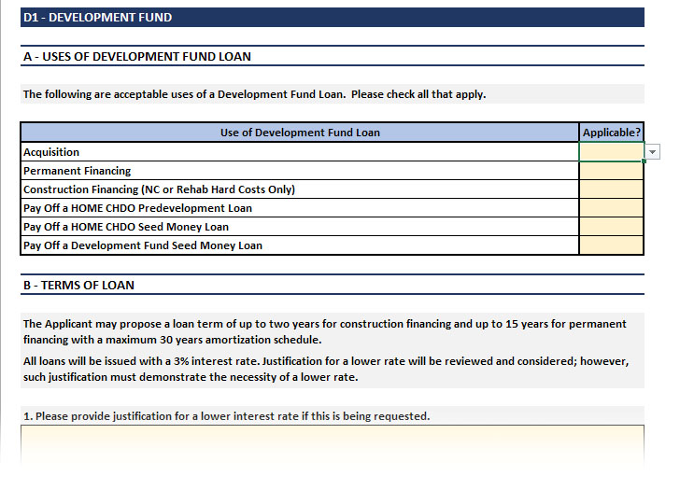
Additional Funding Available
Applicants may also apply for Development Fund
Each applicant must provide documentation and explanation on alternative sources of funding if the Development Fund is denied or funding is unavailable.
Applicants must also submit the Development Fund tab, not the separate Development Fund application.
There is no guarantee Development Fund will be available – each applicant anticipating Development Fund must also have an alternate funding plan if it is not available.
Notes:
DM/CN

Slide 22
2021 HOME Rental policy
Notes:
RH

Slide 23
HOME Rental Policy
Application Submission Process
No hard copies of any documents should be sent to IHCDA at the time of initial application.
All application signatures must be scanned digital copies of signed originals (no digital signatures).
Applicants will need to reach out to IHCDA to set up their OneDrive folder(s) in advance of CHDO certification and/or HOME application due dates for submission of required documents.
Notes:
CN

Slide 24
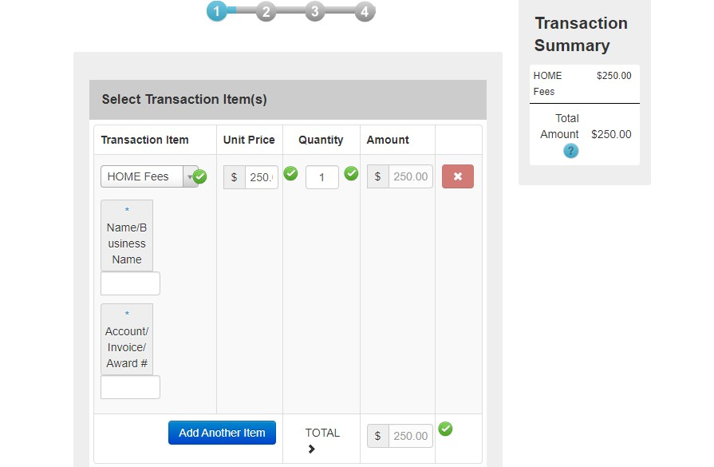
HOME Rental Policy
All payments to IHCDA for HOME Applications must be submitted through the IHCDA Online Payment Portal.
The “Transaction Name” selection should be “HOME Fees”. Please include the name of your organization in the box below.
For questions, please contact your Regional Analyst.
Notes:
CN

Slide 25
HOME Threshold
Environmental Review
Added additional Environmental Review requirements related to floodways, flood plains, and wetlands. (Policy p. 13-14)
Debarment Requirement
A new Debarment lookup website link has been added, which can be found here.
Notes:
CN

Slide 26
HOME Scoring
Existing Structures or Infill New Construction
Applicants are only eligible for points in this category if at least 50% of the HOME assisted units utilize existing structures or are new construction. The two categories are mutually exclusive—a single project may not receive points in both categories.
Updated Smoke-Free Housing Policy Requirement
Applicants are no longer required to have separate policy and lease addendum – only a lease addendum is required. Addendum must address all required items and include electronic cigarettes and vaping.
Sources for Leveraging
Tax abatements and exemptions are eligible sources for leveraging. Permanent loans must have below market rate interest rates and have a submitted lender letter acknowledging such.
Notes:
CN

Slide 27
HOME Scoring
Contractor Solicitation Category
Applicants may now earn points in two ways. One point to applicants who solicit a minimum of 5 Indiana contractors (with one being a certified MBE/WBE/DBE/VOSB/SDVOSB). Two points will be awarded if an Indiana certified MBE/WBE/DBE/VOSB/SDVOSB entity is serving as a formal member of the project’s development team.
Additional Clarifications:
Clarified when design features must apply to all units and buildings.
Clarified that the term “Administrator” encompasses both administrators and consultants.
Clarified that administrators/consultants are eligible for points in the non-IHCDA experience category.
Notes:
CN

Slide 28
CHDO Predevelopment Loan
Predevelopment Loan in Predevelopment Activities Scoring Category
New requirements include:
CHDO PD Loan must have been approved by IHCDA Board of Directors at least 30 days prior to the HOME application due date.
The applicant may not have more than five currently open or pending CHDO Predevelopment loans, including all loans submitted as part of the current HOME funding round.
If the applicant received points in this category in the most recent HOME funding round prior to the current round, the applicant must have expended at least 25% of each CHDO PD Loan that qualified for points in that round.
Notes:
CN

Slide 29
Application process for 2021 home round
Notes:
RH

Slide 30
Application Process
Technical assistance by IHCDA staff is available to you at your request but are not required for application.
Please contact your regional analyst as early as possible if you:
Are encountering any issues with the application workbook
Have questions about CHDO certification
Have any questions about capacity certifications
Have questions about ERR or Section 106 reviews
Would like guidance on producing any imagery required by the HOME policy
Notes:
DM/CN

Slide 31
Application Process
There is a $250 fee per application. If the applicant applies and is certified as a CHDO, the fee will be refunded.
All applications will be reviewed for:
Completeness
Threshold
Scoring
HOME Rental applications must score a minimum of 68 points to be considered for funding.
Unfunded applications will not roll over to be considered in later HOME application rounds.
Notes:
DM/CN

Slide 32
OneDrive
You will need OneDrive access to submit an application.
To set up your access, please email Emma Oesterle at eoesterle@ihcda.in.gov.
In your email to Emma, please include:
Your Contact(s) information, your project Location(s) and your Project Name
Technical Issues
Applicants that encounter issues with the application forms, supporting documentation, or submitting the application via OneDrive should inform their regional analyst ASAP so that issues can be resolved prior to the application deadline.
Notes:
DM/CN

Slide 33
Submitting an Application
All required application items must be uploaded to OneDrive and USB drives delivered to IHCDA no later than 5:00 p.m. Eastern time on Monday, May 9th, 2022.
The USB drive containing all required application documentation should be sent to:
Indiana Housing and Community Development Authority
ATTN: Real Estate Department Coordinator
RE: HOME Application
30 South Meridian Street, Suite 900
Indianapolis, IN 46204
Notes:
DM/CN

Slide 34
2021 HOME Homebuyer & Annual Action Plan Update March 8th, 2022
Notes:
CN

Slide 35
Application process
Notes:
RH

Slide 36
Application Process
IHCDA will be accepting applications on a rolling basis.
Maximum award requested cannot exceed $500,000
There is a $250 fee per application. If the applicant applies and is certified as a CHDO, the check will be refunded.
All applications will be reviewed for:
Completeness
Threshold
Scoring
HOME Homebuyer applications must score a minimum of 47 points to be considered for funding.
Notes:
ET

Slide 37
Eligible For HOME
Possible HOME funding applicants include:
Cities, towns, or counties that are located within Indiana but outside of participating jurisdictions (right)
Community Housing Development Organizations (CHDOs)
501(c)3 and 501(c)4 Not-for Profit Organizations and PHAs
Joint Venture Partnerships
IHCDA HOME Ineligible Participating Jurisdictions
Bloomington | Indianapolis*
Evansville | Lake County
Fort Wayne | Lafayette**
Gary | South Bend***
* Excluding cities of Beech Grove, Lawrence, Speedway, and Southport
**Cities of Lafayette, West Lafayette, and the unincorporated areas of Tipp. Co.
*** Cities of South Bend, Mishawaka, and the unincorporated areas of St. Joe. Co.
Notes:
ET

Slide 38
Eligible For HOME
Eligible CHDO Applicants Proposing Projects in Selected Participating Jurisdictions:
Nonprofits that certify as CHDO’s can apply if the project is in a participating jurisdiction that receives less than $500,000 of HOME funding within IHCDA’s HOME Program Year. These include:
Anderson
East Chicago
Hammond
Muncie
Terre Haute
To be eligible, applicant must have received a preliminary commitment of HOME funds from the PJ where the project is located.
Notes:
ET

Slide 39
Project requirements
Notes:
RH

Slide 40
Eligible Beneficiaries
Each household must have an annual income equal to or less than 80% of the area median family income (adjusted for household size) at the time the contract to purchase the home is signed.
The Part 5 definition of household income applies. See the CDBG, HOME and HTF Program Manual for instructions on calculating and verifying household income.
The purchasing household must be low-income at either:
In the case of a contract to purchase existing housing, at the time of purchase; or
In the case of a contract to purchase housing to be constructed, at the time the contract is signed.
Recipients are required to identify and prequalify homebuyers prior to acquiring and beginning construction on the HOME-assisted units; however, HOME-assisted units are not considered completed until occupied by an income eligible homebuyer.
IHCDA will hold 25% of the developer fee.
Notes:
DM/ET

Slide 41
Homebuyer Identification & Market
All homebuyers must be identified prior to application. Completion of homebuyer counseling is not required at time of application. Potential homebuyers are encouraged to be pre-qualified at time of application.
Applicant must submit the Pro-Forma by address.
A market study is not required.
Narratives on the following (in the application form) should be included:
Community Conditions
Market Area
Socioeconomic profiles and trends
Pool of eligible buyers
Capture rate and absorption period
Other Housing Opportunities
Development Site Description
Notes:
DM/ET

Slide 42
Homebuyer Financing
All other development funding, including AHP funds, must be committed prior to submitting an application for HOME funding to IHCDA. Please complete the sources and uses tab in the application.
If the project is utilizing funding committed more than one year prior to the application due date please provide a letter confirming that the funds are still available and accessible to the applicant.
Submit signed letters of commitment for all funding sources with funding terms and amounts. This includes Deferred Developer Fee.
Full Pro-Forma and Financial Commitment tab must be completed.
Notes:
DM/ET

Slide 43
Underwriting Standards
Applicants must evaluate housing debt and overall debt of the family, the appropriateness of the HOME assistance, the monthly expenses of the family, the assets available to acquire the housing and the financial resources to sustain ownership.
Applicants must complete the Homebuyer Commitment of the tool for each household applying for HOME financing. An updated tool must be resubmitted if there is a change to the targeted household.
The applicant may not provide a uniform amount of assistance to each homebuyer irrespective of income, assets or other circumstances. Each household must be independently evaluated. IHCDA must finalize an approval of an eligible household purchasing a HOME unit prior to the signing of the ratified sales contract.
Notes:
DM/ET

Slide 44
Housing Counseling
In a final rule published by HUD’s Office of Housing Counseling, HUD established housing counseling certification requirements provided in connection with a HUD program. All adult household members who will hold title and be a party to the senior loan are required to complete homebuyer counseling.
Under the rule, all homebuyers assisted under the HOME program must receiving housing counseling that is performed by a certified housing counselor who has passed the HUD certification examination and is employed by a HUD-approved housing counseling agency.
Notes:
DM/ET

Slide 45
Other Threshold Items
Sam Registration/ Debarment
Grievance Procedures
Non-for-Profit Applicant Documentation
Market Need (narrative)
Audited Financial Statements & Current Year to Date
Site Map and Phots
Board Resolution
Title Search
Construction Cost Estimate
Site Control
Unit Plans
ERR
Appraisal (if requesting HOME for acquisition)
Housing Counseling Narrative
Universal Design Features Form
Notes:
DM/ET

Slide 46
CHDO Provisions
If applying as a CHDO, please include the CHDO certification with the application.
Certified CHDOs are eligible for up to $50,000 in Operating Support.
CHDOs may also apply through the Site-Control and Seed Money Loan programs for pre-development assistance.
Notes:
RH

Slide 47
Scoring
Applications must score at least 47 points to be eligible.
Scoring Category | Points Possible
Development Characteristics | 22
Development Features | 25
Readiness | 8
Capacity | 27
Leveraging of Other Sources | 6
Bonus | 5
Total Possible Points | 93
Notes:
DM/ET

Slide 48
2022 Annual Action Plan
Notes:
RH

Slide 49
Tentative Annual Action Plan update
Annual Action Plan covers policies over the State’s:
Community Development Block Grant (CDBG)
HOME Investment Partnerships Program (HOME)
National Housing Trust Fund (NHTF)
Emergency Solutions Grant (ESG)
Housing Opportunities for Persons with AIDS (HOPWA)
IHCDA and OCRA will accept public comments March 7-May 13, 2022.
Two public hearings to be held virtually on March 21st, 2022:
10:00am EST
5:00pm EST
Further detail on the Action Plan and access to the hearings can be found in RED Notice 22-13
Notes:
CN

Slide 50
Thank you for attending the 2021 HOME Round Policy Webinar! Are there any questions?

