Slide 1
IHCDA Lead based paint technical assistance webinar October 2017 presented by: Dave Pugh

Slide 2
Presentation today
Overview and history of lead
Rules and Regulations
Licensing requirements
Lead form
Questions
Notes:
Please mute your phones

Slide 3
Lead: The original artificial sweetener
https://www.youtube.com/watch?v=CM1u29BeqC0

Slide 4
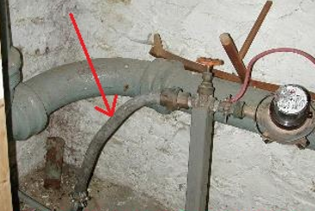
History of lead
Chemical element assigned the symbol Pb (Latin plumbum)
Soft, malleable, low melting point, corrosion resistant, high denisty
Used in paint, ceramics, pipes, gasoline, solders, batteries, cosmetics, etc.
Lead used in paint to speed up drying time, increase durability, maintain a fresh appearance, resist moisture that causes corrosion, and because it adhered better than other types of paint
3000 BC- significant production began (Romans first to use widely)
1786- Ben Franklin writes letter detailing the effects of lead
1840- France discourages the use of lead pigment
1887- Us Medical authorities diagnose childhood lead poisoning
1904- Child lead poisoning linked to LBP
1909- France, Belgium, Austria ban white lead interior paint
1921- A national lead company admits lead is a poison
1922- League of Nations bans white-lead interior paint- the
U.S. declines not to adopt
1943- Report concludes eating lead paint chips causes
physical and neurological disorders
1971- Lead-based Paint Poisoning Prevention Act passed
1978- Residential lead-based painted banned
Notes:
1971 LBP content max 1%; 1978 .006% (600 ppm); 2008 reduced to .009% (90 ppm)

Slide 5
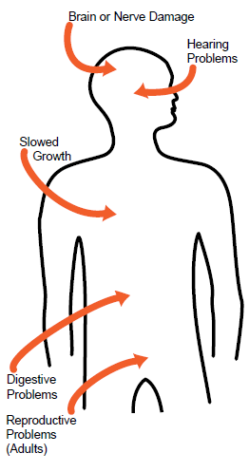
Most at Risk and health effects
Children age 6 and under:
Nervous system and kidney damage
Learning disabilities, attention deficit disorder, lower IQ
Speech, language, and behavior issues
Poor muscle coordination, decreased muscle and bone growth
Hearing damage
Pregnant women:
Increased chance of illness during pregnancy
Harm to a fetus, including brain damage or death
Fertility problems
High blood pressure
Digestive problems
Nerve disorders
Memory and concentration problems
Muscle and joint pain
Notes:
Children under the age of 6 are more susceptible because the blood brain barrier isn’t fully developed; therefore, the brain and nervous system is more sensitive to the effects of lead. Their growing bodies adsorb more lead. Babies and young children often put their hands and objects in their mouths which may have lead dust. Kids are typically on the floor and ingest Lead dust by way of hand to mouth. Ingestion is the fastest way pathway. Poor nutrition- calcium/iron

Slide 6
HUD’s Lead Safe Housing Rule (LSHR)
24 CFR Part 35
Covers all Federally-assisted or owned target housing
Effective September 15, 2000
Requirements depend on type and amount of federal housing assistance
https://www.hud.gov/program_offices/healthy_homes/enforcement/lshr
Notes:
Sub-part J covers rehab

Slide 7
Exemptions to the LSHR
Any rehabilitation that does not disturb a painted surface
Residential property for which construction was completed on or after Jan 1, 1978
Zero-bedroom units, including single room occupancy (SRO) units
Housing exclusively for elderly or disabled (see HUD definition) in §35.110
Property evaluated as free of lead-based paint (LBP) or where LBP was removed
Property or part of property that is not used for human residential habitation
* Historic Preservation exemption- listed as eligible, or contributes to a
historic district
Notes:
Break it down. Historic exemption- State Historic Preservation Officer may request Interim Controls rather than abatement (windows).

Slide 8
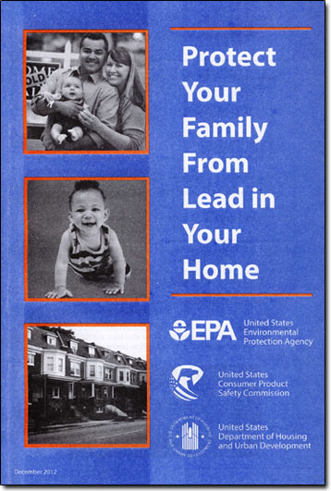
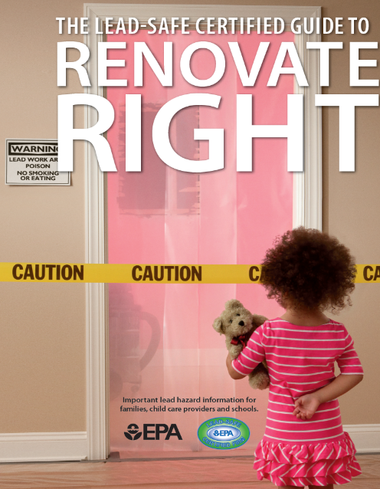
Notice Requirements
EPA (“blue”) Pamphlet- Protect Your Family from Lead in Your Home
Renovate Right- renovators must distribute to each family
Notice of evaluation or presumption- within 15 days of
receipt of report
Notice of hazard reduction- within 15 days of completion
Notes:
Must give owner and tenants copy of this pamphlet, Risk Assessment, and Clearance reports. This pamphlet is very good at describing what lead is, the effects, and how to protect your family

Slide 9
Other required information
Notes:
Lead Paint Safety- given to every contractor. Call to order at 800-424-5323. Runs better unleaded poster displayed at LUG, Sub-recipient, administrator, other organizations involved.

Slide 10
Subpart J: Rehabilitation
Up to $5,000 per unit hard costs
Paint testing and repair
Use Lead Safe Work Practices (LSWP)
Clearance
$5,000 up to $25,000
Risk assessment
Interim Controls
Clearance
Over $25,000 per unit
Paint testing & Risk Assessment
Abatement of all identified LBP Hazards (Not all LBP)
Clearance
Notes:
Paint test areas being disturbed.
Full risk assessment- not just the areas you’re working in.

Slide 11
Licensing requirements
The Indiana State Department of Health requires the following to be licensed:
Risk Assessors
Lead Inspectors
Project Supervisor license (Abatement)
Contractors (Abatement)
Project Designer (Abatement)
Worker License (Abatement)
Clearance Examiner
* RRP (renovate, repair, paint) required by EPA for all contractors
https://www.in.gov/isdh/19153.htm
I-Lead- managed by the ISDH
https://gatewayp.isdh.in.gov/Gateway/SignIn.aspx
Notes:
I lead requires all Risk Assessments to be entered into the portal. A certificate will be generated and is required to be submitted during setup to completion.

Slide 12
Three Basic Requirements
Evaluation
Lead Hazard Control Plan- this is where de minimis is considered
* Occupant Protection/Containment
3. Clearance

Slide 13
Step #1: Evaluation
Paint testing- Testing lead content of:
Deteriorated paint
Painted surfaces to be disturbed or replaced
Risk assessment – On-site investigation to identify the existence, nature, severity and location of LBP hazards and provision of report
Lead-based paint inspection – Surface-by-surface investigation to determine presence of LBP and provision of report
Notes:
RA- looking for dust, deteriorated paint, and debris

Slide 14
Step #2: Lead Hazard Control Plan
Interim Controls
Designed to temporarily eliminate LBP hazards
Safe Work Practices
Abatement
Intent is to permanently eliminate LBP hazards
Lead-Based Paint Hazards (rehab over $25,000)
Refer to EPA 402 Rule (40 CFR 745) for work practice standards and certification requirements
Safe Work Practices
§745.227 Work practice standards for conducting lead-based paint activities: target housing and child-occupied facilities
https://www.ecfr.gov/cgi-bin/text-idx?SID=4484117eb8d82ca1478eb8b4ea68e2dd&mc=true&node=se40.34.745_1227&rgn=div8
Notes:
Permanent is defined as lasting 20 years

Slide 15
De Minimis Levels
Work which disturbs less than
20 square feet on exterior surfaces
2 square feet in any one interior room or space
10 percent of total surface area of interior or exterior component type with a small area (sills, baseboards, etc.)
Exception to Safe Work Practices and Clearance only
Notes:
Don’t confuse de minimus as an exemption to the lead rules. Cutting through walls for electrical constitutes disturbing a painted surface. Latin definition meaning “about minimal things”

Slide 16
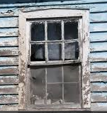
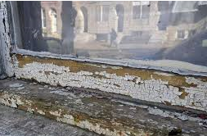
Abatement
Intent is to permanently eliminate LBP or LBP hazard(s)
Licensed contractors
Methods include
Encapsulation, enclosure, component replacement or removal of paint
Paving or removal for soil
Clearance by inspector or risk assessor
https://portalapps.hud.gov/CORVID/HUDLBPAdvisor/info/documents/HUD-EPAabateguidance.pdf
Notes:
Window replacement an abatement job? It depends on the cost allocation. If a window is being replaced to address a lead hazard it’s an abatement activity…If being replaced for other reasons it is a rehabilitation activity. Link to HUD/EPA letter. Windows are on the Rehab Priority List under structural/security.

Slide 17
Step #3 clearance
Two Parts:
Visual Assessment
Dust sampling
Interim Dust Lead standards
Conducted at least one hour after all work is completed
Occupants notified of results within 15 calendar days
Conducted by a licensed:
Inspector
Risk Assessor
Clearance Examiner
Final Payment to Contractor. A minimum of ten percent (10%) of the total contract must be held from the contractor until you receive a clearance report detailing that the levels of lead are within the acceptable range.
Notes:
Exterior repairs are a visual only. Soil hazards equal to or greater than 5,000 mg/g of lead shall be abated. Soil interim control impermanent surface 6”.

Slide 18
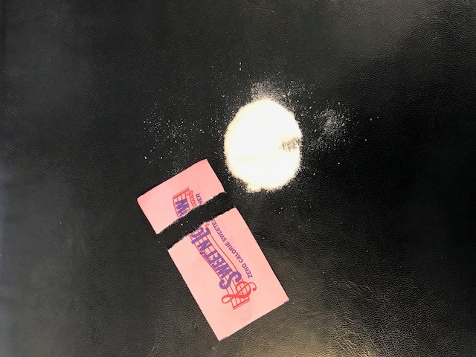
Lead Hazard Criteria for Risk Assessment
Lead in dust (clearance/risk assessment)
Floors 40 μg/ft²
Interior window sills 250 μg/ft²
Window troughs 400 μg/ft² (clearance)
Lead in bare soil (risk assessment)
Play areas 400 ppm
Other soils 1,200 ppm

Slide 19
Risk assessments
Dust samples must be collected in all “living areas” where young children are most likely to come into contact with dust (40 CFR 745.227(d)(5)).
Chapter 5 of HUD’s Guidelines for the Evaluation & Control of Lead-based Paint Hazard in Housing recommend that risk assessors select a minimum of four rooms for dust sampling (except, of course, when the dwelling unit has less than four rooms).
The rooms generally recommended for sampling, in approximate order of importance, are:
the principal play area of young children,
the kitchen,
the bedroom of the youngest child,
the bedroom of the next oldest child,
the bathroom used by the youngest child, and
the living room.
Bare soil areas to be sampled for lead contamination are
Each play area with bare soil, including sandboxes (see definition of play area)
Non-play areas in drip line/foundation areas (see definition)
Non-play areas in the rest of the yard, including, but not limited to vegetable gardens, pet sleeping areas, and bare soil
4. Vegetable gardens (recommended)
HUD Guidelines for the Evaluation & Control of Lead-Based Paint Hazards in Housing
https://www.hud.gov/program_offices/healthy_homes/lbp/hudguidelines
Interpretive Guidance on HUD’s Lead Safe Housing Rule
https://www.hud.gov/sites/documents/DOC_25476.PDF

Slide 20
Prohibited Work Methods
Open flame burning
Machine sanding or grinding without HEPA control
Abrasive blasting or sandblasting without HEPA control
Heat guns over 1,100º F
Dry sanding or scraping (except with heat guns, within 1 foot of electrical outlets or on areas less than 2 sq. ft.)
Hazardous volatile paint strippers (e.g., methylene chloride)
Notes:
Containment during remediation is key

Slide 21
Occupant protection- Relocation
Occupants shall be temporarily relocated before and during hazard reduction activities to a suitable, decent, safe, and similarly accessible dwelling unit that does not have lead-based paint hazards, except if:
Treatment will not disturb lead-based paint hazards or soil-lead hazards;
2. Only the exterior of the dwelling unit is treated, and windows, doors, ventilation intakes and other openings in or near the worksite are sealed during hazard control work and cleaned afterward, and entry free of dust-lead hazards, soil-lead hazards, and debris is provided;
3. Treatment of the interior will be completed within one (1) period of eight (8) daytime hours, the worksite is contained so as to prevent the release of leaded dust and debris into other areas, and treatment does not create other safety, health or environmental hazards
Notes:
LSHR §35.1345

Slide 22
Relocation continued
4. Treatment of the interior will be completed within five (5) calendar days, the worksite is contained so as to prevent the release of leaded dust and debris into other areas, treatment does not create other safety, health, or environmental hazards and, at the end of work on each day, the worksite and the area within at least ten (10) feet (3 meters) of the containment area is cleaned to remove any visible dust or debris, and occupants have safe access to sleeping areas, and bathroom and kitchen facilities.
Notes:
You should be conducting site visits to ensure proper containment and safe work practices are being followed

Slide 23
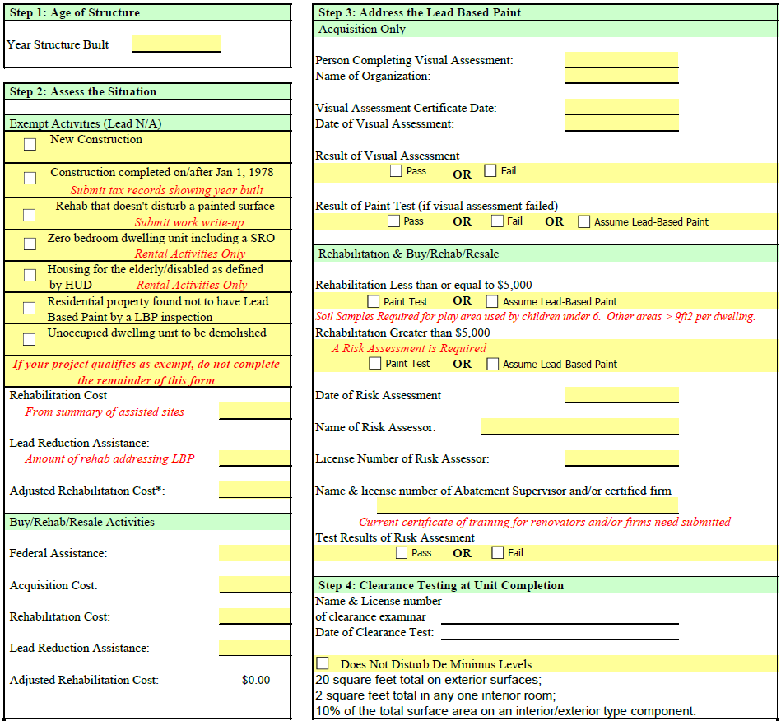

Slide 24
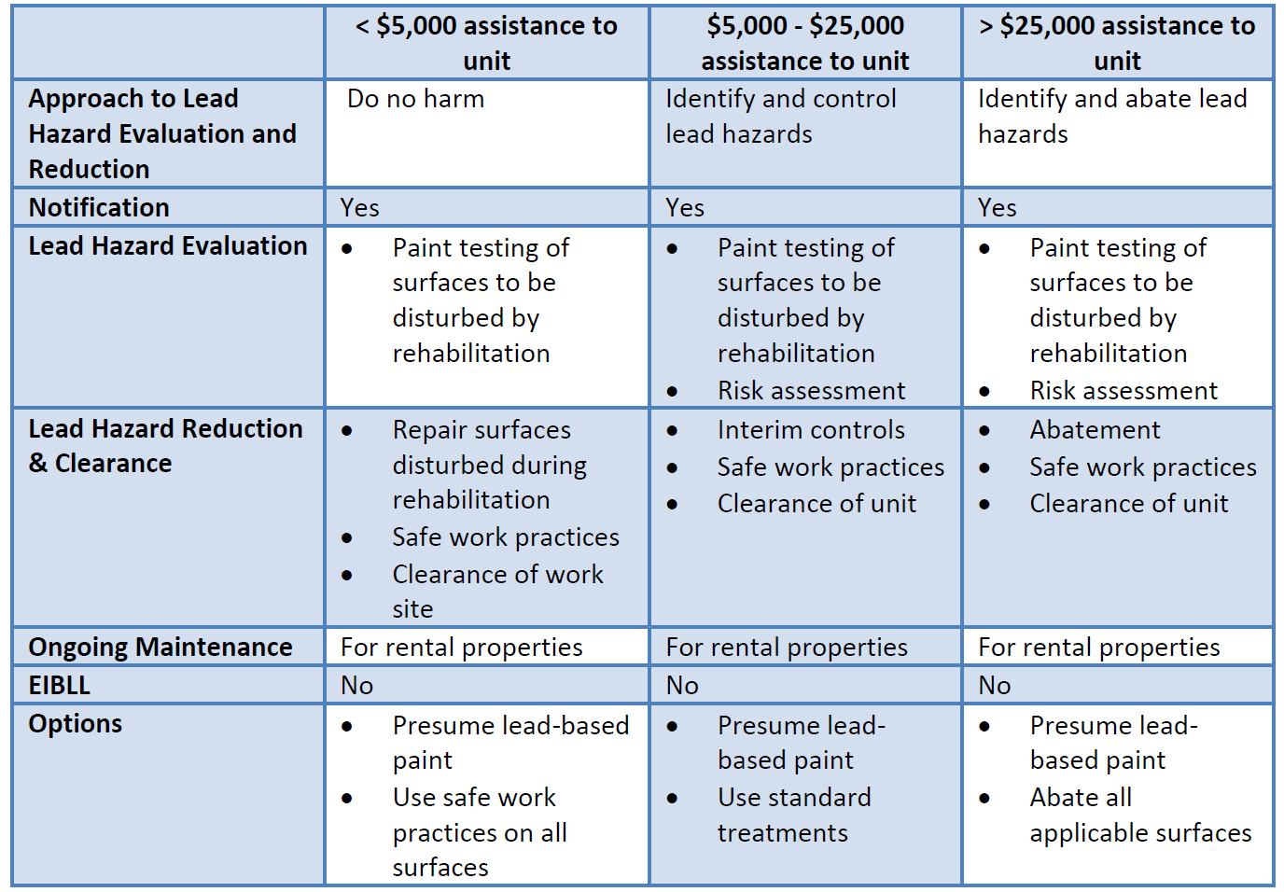

Slide 25
For Further Information
Sign up for our email list for newsletters and notices
If you want an IHCDA contact name for a specific program, let us know
Contact Info:
Dave Pugh
Lead Grant Manager
317-234-6289
dpugh@ihcda.in.gov
IHCDA Contact Info:
317-232-7777
askihcda@ihcda.in.gov

Slide 27
Questions?
Thank you

