Slide 1
WELCOME
INDIANA GAMING COMMISSION
CHARITY GAMING DIVISION
2014 Distributor Seminar
Director Diane Freeman
Executive Director Ernest E. Yelton

Slide 2
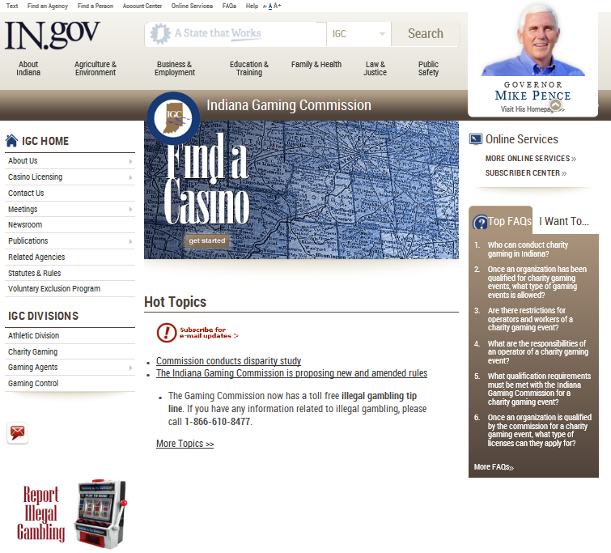

Slide 3
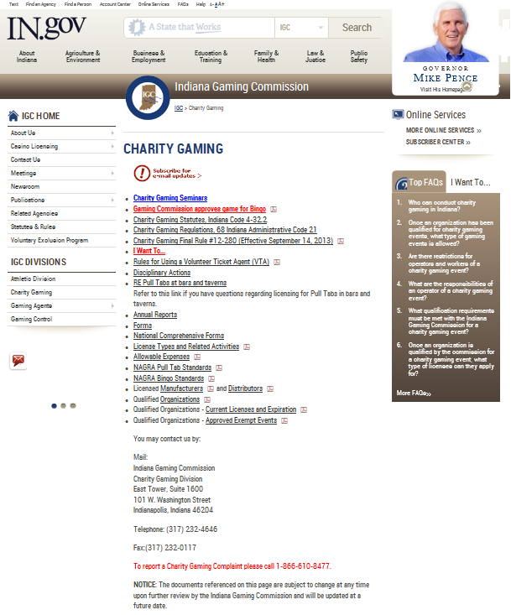

Slide 4
Charity Gaming Basics
Qualified
Raise money for charitable purposes
Using volunteers (can’t pay)
8 types of licenses Singles/Annuals
Single---date, time, location specific
Annual---- up to 3 days a week time and location specific
Exempt Events
Illegal Gaming 3-elements

Slide 5
Types of Events Allowed
Bingo
Charity Game Night
Raffle
Annual PPT
Door Prize
Water Race
Guessing Game
Festival

Slide 6
Bingo
Conduct bingo events
Conduct raffle drawings
Conduct door prize drawings
Sell pull-tabs, punchboards, and tip boards at the allowable event
Payout limitation per bingo game is $1,000.00
Payout limitation per bingo event is $6,000.00
Pull tab game played with bingo blower is allowed, as long as it is sold as a pull tab game, played as a pull tab game and reported as a pull tab game. It is not considered as part of the bingo payout.
A qualified organization may request special permission to increase the bingo prize payout of an event from $6,000 to $10,000 two (2) times per year
The total value of all raffle prizes may not exceed $5,000
A qualified organization may request special permission to increase the total value of a raffle prize payout to $25,000 if conducted at another allowable event one (1) time per year
The total value of all door prizes may not exceed $1,500

Slide 7
Charity Game Night
  Conduct a card game
  Conduct a dice game
  Conduct a roulette wheel
  Conduct a spindle game
  Conduct raffle drawings
  Conduct door prize drawings
  Sell pull-tabs, punchboards, and tip boards
The total value of all raffle prizes may not exceed $5,000
A qualified organization may request special permission to increase the total value of a raffle prize payout to $25,000 if conducted at another allowable event one (1) time per year
The total value of all door prizes may not exceed $1,500

Slide 8
Raffle License
Conduct raffle drawings
Conduct door prize drawings
Sell pull-tabs, punchboards, and tip boards
No limitation to raffle prize pay out
The total prizes awarded for one (1) pull tab, punchboard, or tip board game may not exceed five thousand dollars ($5,000)
A single prize awarded for one (1) winning ticket in a pull tab, punchboard, or tip board game may not exceed five hundred ninety-nine dollars ($599.00)
The selling price for one (1) ticket for a pull tab, punchboard, or tip board game may not exceed one dollar ($1.00)
The total value of all door prizes may not exceed $1,500

Slide 9
Door Prize
  Conduct door prize drawings
  Conduct raffle drawings
  Sell pull-tabs, punchboards, and tip boards
Total value of all door prizes may not exceed $5,000
A qualified organization may receive special permission to increase the total value of all prize payouts not to exceed $20,000.00 per event one (1) time per year
The total value of all raffle prizes may not exceed $5,000
A qualified organization may request special permission to increase the total value of a raffle prize payout to $25,000 if conducted at another allowable event one (1) time per year

Slide 10
Festival
  Conduct a festival event
  Conduct bingo events
  Conduct charity game nights
  Conduct raffle drawings
  Conduct door prize drawings
  Conduct guessing games
  Conduct water races
  Sell pull-tabs, punchboards, and tip boards
Total value of all bingo prize payouts per game can not exceed $1,000 or $6,000 per event
No limitation on raffle prize payout
Total value of all door prize payouts may not exceed $5,000
Only one (1) festival event per calendar year
A qualified organization may conduct one (1) additional festival event during each six (6) months of a calendar year (total of three (3) events per year)
Festival cannot exceed five (5) consecutive days per event

Slide 11
Annual PPT license at club locations
Sell pull-tabs, punchboards and tip boards
Conduct a winner take all drawing and/or qualified drawing where the qualified organization retains no portion of the amount wagered
Everyday event (24/7)
License is effective for one year
The total prizes awarded for one (1) pull tab, punchboard, or tip board game may not exceed five thousand dollars ($5,000)
A single prize awarded for one (1) winning ticket in a pull tab, punchboard, or tip board game may not exceed five hundred ninety-nine dollars ($599.00)
The selling price for one (1) ticket for a pull tab, punchboard, or tip board game may not exceed one dollar ($1.00)
Winner take all and qualified drawing prize awarded not to exceed $300
Not more than one daily drawing each day
Not more than one weekly drawing
Not more than one monthly drawing

Slide 12
Water Race
[
Conduct a water race using qualified personal property.
Each item of the qualified personal property is marked with a number corresponding to the number on a chance purchased in a water race
The winner of the water race is determined by the number of the item of the qualified personal property that crosses a designated finish line on the body of water first
[I1]

Slide 13
Guessing Game
A guessing game license allows an organization to conduct a guessing game.
How many beans in a jar?
How many books in a library?
Golf ball drops.

Slide 14
Event Summary Reports
Bingo – Event Summary Report
Charity Game Night – Event Summary Report
Raffle – Event Summary Report
PPT – Event Summary Report
Door Prize – Event Summary Report
Festival – Event Summary Report
Water Race – Event Summary Report
Guessing Game – Event Summary Report

Slide 15
Guidelines for Distributors and Manufacturers
Must be licensed by IGC
You may have both licenses BUT, you have to apply and pay license fees to obtain both licenses.
Must be registered with IRS and hold a valid FID number.
If required to have Indiana Registered Retail Merchant Certificate you must attach it to application.
Distributor must collect and remit gaming card excise tax to Indiana Department of Revenue for the sale of pull tabs, punchboards or tip boards.

Slide 16
Guidelines continued
You must submit quarterly reports CG-MDQ
Products must meet NAGRA standards for PPT’s and Bingo.
Gaming Card license is not transferable.
Gaming Card license is not valid if altered in any manner.
If you sell your business or there is a change of ownership you are required to notify the commission on form CG-MDNF within 10 business days from the effective date of sale. Records must be maintained for six (6) years. Notification must include location and actual contact information for the records.

Slide 17
Guidelines continued
If any of your business information that appears on your license changes, you are required to amend the license by completing the CG-MDA “Manufacturers and/or Distributors Gaming Card License Amendment Request” and submit a $25.00 amendment fee.

Slide 18
Record Keeping Requirements
Sales Invoices:
You must use a general sales invoice which:
Is numbered consecutively
Is 2 parts, one for customer and one for your invoice file.
Electronic Invoices? Email? Protected? Scanned? PDF?

Slide 19
All Invoices must contain:
Date of sale
Customer Name and business address
Full description of each item sold
Serial number of each item
Quantity and sale price of each item
Customer’s current valid license number, current at the time of sale (invoicing). If an Exempt Event write Exempt Event.
Your current license number
Separately show gaming excise tax collected. (if applicable)

Slide 20
Credit memos
Must be prepared in the same detail as if they were sales invoices….

Slide 21
Sales Journal:
Must keep a monthly sales journal
Date of Sale
Invoice number of sale
Customer name and account number
Total amount of invoice
Total amount of gaming card excise tax by sale. (if applicable)

Slide 22
Other Records
You must keep a complete and current list of persons authorized to represent your company to Indiana customers. They can be members of a qualified organization, but they may not be involved in the gaming in any manner, other than sale of the products.
You must keep purchase records documenting that all purchases made by you of bingo supplies, equipment, pull tabs, punchboards, and tip boards and any other licensed supplies came from a licensed manufacturer or distributor.

Slide 23
Quarterly Reports
Quarterly reporting periods are based on the licensed period of your annual license. You will receive documentation of the required quarterly periods at the time you receive your license.
Quarterly sales reports are due the 20th day of the month following your assigned quarterly periods.
Must be timely, Current valid license number , FID numbers must be correct for each organization.

Slide 24
Restrictions
An employee, officer, or owner of a manufacturer or distributor is prohibited from participating in or affiliating in any manner with the charity gaming operations of a qualified organization of which the employee, officer or owner is a member.
You may not be a worker or operator at any allowable event.

Slide 25
Restrictions-May I be an officer in a qualified organization.
Yes..
The presiding officer of a qualified organization and the owner of the business are responsible to notify the commission in writing (on letterhead) that there is a conflict. The notification must include the position the officer currently holds and who will now be responsible for the oversight of the charity gaming in his or her place.
This must be submitted in writing to the Director of Charity Gaming.

Slide 26
Penalties
The commission can levy civil penalties for violations such as failure to keep accurate records concerning supplies, sales, or committing fraud or deceit.
An additional civil penalty of $100 per day can be added for each day the civil penalty goes unpaid.
You must provide these records within the requested time frame, or you could face charges.

Slide 27
Penalties continued
A person who violates a provision of the law commits a Class B misdemeanor.
A person who enters into a contract with a qualified organization to operate an allowable event commits a Class D felony.

Slide 28
Gaming Card Excise Tax
An excise tax is imposed on the distribution of pull tabs, punchboards, and tip boards.
10% of the wholesale price.
Bingo supplies and equipment are not subject to the tax.

Slide 29
Gaming Card Excise Tax - continued
Licensed distributor supplying pull tabs, punchboards, and tip boards is liable for the gaming card excise tax. Distributor gives a free game to a qualified organization. Distributor is responsible for the excise tax. Organization is responsible to put the game into inventory and report the sale of the game.
Tax is imposed at the time the business is conducted:
Brings or causes the pull tabs, punchboards, or tip boards to be brought into Indiana for distribution.

Slide 30
Gaming Card Excise Tax - continued
Distributor:
Transports Pull tabs, punchboards, or tip boards to qualified organizations in Indiana for resale by those qualified organizations.
Excise Tax/Sales Tax is collected by the Indiana Department of Revenue. Questions may be directed to 317-615-2544

Slide 31
DISCUSSION ITEMS
Cash/Walk-in sales. Can we do them?
Last sale cards. Letter of 2013.
Serial numbers on the invoice required?
Serial numbers on equipment and invoice.
Queen of Hearts-License required-limits.
Progressive Boards---serial numbers required.
Organization closing trade in of products and equipment-refurbish and resell?
Guest in club-Buy PPT’s? play bingo?
Push out bingo sheets
Proposed Raffle board games request our review.

Slide 32
Discussion items continued
Progressive Pull Tab games-Serial number of the games must match any prize board that is associated with the game, maximum payout for a game is $5000.
Serial numbers must be permanently placed on the board by the manufacturer or distributor in a manner that cannot be altered.
Coin boards-pay excise tax? Sales tax?
Prize wheels-what license?
Donating equipment to charity-Lease
Percentage payouts for pull tabs?
Beer tent on property-sell PPT's?
Can charity get a Type II license Excise?

Slide 33
Discussion items continued
Credit memo’s
Failure to maintain accurate records?
Same license number every year-is that possible?
Why can’t they pass the deal for all card games?
When you give an organization a free pull tab game they must include that in their inventory and report the sale of that game. You are required to pay the excise tax on that game.

Slide 34
Discussion items continued
Whom can we purchase from?
Manufacturer to Manufacturer
Manufacturer to Distributor
Distributor to Distributor
Distributor to Organization.
Can they grandfather equipment now?

Slide 35
Discussion items continued
Can we buy equipment from club
Electronic Raffle Sales—Colts.
1 Million dollar duck races
Electronic Gaming for Charities- No…
Can they use someone else's license.
ESR’s how do they use them.. Big Raffles
Pea Shake Houses

Slide 36
Test Your Charity Gaming Knowledge

Slide 37
Who is responsible for submitting excise tax to the Department of Revenue?

Slide 38
Distributor must collect and remit gaming card excise tax to Indiana Department of Revenue for the sale (including free games) of Pull tabs, punchboards or tip boards.

Slide 39
An officer, employee or agent is a member of the American Legion can they be an operator or worker on their gaming license?

Slide 40
No…. An employee, officer or owner of a manufacturer or distributor is prohibited from participating in or affiliating in any way with charity gaming operations of a qualified organization of which the employee, officer or owner is a member. Other than the sale or lease of licensed supplies.

Slide 41
Can an officer, employee or agent of my business be an officer of a qualified organization?

Slide 42
Yes…..But! If their responsibilities include the oversight of gaming then:
the presiding officer of a qualified organization, and the owner of the business is responsible to submit in writing (on letterhead) to the commission including the position currently held and who will now be responsible for the oversight of the charity gaming.
Upon renewal you are required to divulge on line 28 and 29 if any key person, employee or owner is a member of a qualified organization and currently active in their organizations charity gaming activities.

Slide 43
When I sell my business may I transfer my license to the new owners?

Slide 44
Gaming Card license is not transferable.
Gaming Card license is not valid if altered in any manner.
If you sell your business or there is a change of ownership you are required to notify the commission on form CG-MDNF within 10 business days from the effective date of sale. Records must be maintained for six (6) years. Notification must include location and actual contact information for the records.

Slide 45
May I get both a manufacturers and distributor license?

Slide 46
You may have both licenses, BUT you have to apply and pay the appropriate license fees to receive both licenses.

Slide 47
Am I required to have a Retail Merchants Certificate?

Slide 48
You will have to verify with the Department of Revenue if one is needed for your business.
If required to have Indiana Registered Retail Merchant Certificate you must attach it to application.

Slide 49
When do I have to submit my quarterly reports?

Slide 50
Quarterly reporting periods are based on the licensed period of your annual license. You will receive documentation of the required quarterly periods at the time you receive your license.
Quarterly sales reports are due the 20th day of the month following your assigned quarterly periods.
Must be timely, Current valid license number , FID numbers must be correct for each organization.

Slide 51
What is required for a sales invoice?

Slide 52
You must use a general sales invoice which:
Is numbered consecutively
Is 2 parts, one for customer and one for your invoice file.

Slide 53
Can we issue a credit memo and if so what information is required?

Slide 54
Yes……
Must be prepared in the same detail as if they were sales invoices….

Slide 55
What information is required on a sales invoice?

Slide 56
Date of sale
Customer Name and business address
Full description of each item sold
Serial number of each item
Quantity and sale price of each item
Customer’s current valid license number, current at the time of sale (invoicing). If an Exempt Event write Exempt Event.
Your current license number
Separately show gaming excise tax collected. (if applicable)

Slide 57
May we use electronic invoices?
Could we email them?
Must they be protected?

Slide 58
You may provide electronic invoices and credit memo’s as long as they:
Meet all the requirements and contain all of the information for sales invoices and credit memos.
They must be sent in “read only” format that cannot be altered by the receiver.
You must maintain conformation that the invoice was received by the appropriate email address.

Slide 59
Are we required to keep a monthly sales journal? If so what information is required?

Slide 60
Yes…
Date of Sale
Invoice number of sale
Customer name and account number
Total amount of invoice
Total amount of gaming card excise tax by sale. (if applicable)

Slide 61
What other reports are we required to keep?

Slide 62
You must keep a complete and current list of persons authorized to represent your company to Indiana customers. They can be members of a qualified organization, but they may not be involved in the gaming in any manner, other than sale of the products.
You must keep purchase records documenting that all purchases made by you of bingo supplies, equipment, pull tabs, punchboards, and tip boards and any other licensed supplies came from a licensed manufacturer or distributor.

Slide 63
Can we purchase equipment from a club that is no longer doing bingo?

Slide 64
Generally the answer is no.
The commission allows you to accept equipment in trade.
If the organization is closing and owes you money then an exception may be made. BUT…. it will be decided on a case by case basis.
It must be submitted to the Director of
Charity Gaming in writing by the organization outlining the equipment to be returned.
A written response will be sent to the organization and distributor.

Slide 65
Charity Gaming test for organizations
Last year you provided a test for organizations that included answers that I use for research. Where can I get that test?
On our website you will go to the organizational seminars and you will find the PowerPoint for organizations which includes the test. You can download the PowerPoint for your use…

Slide 66
THANK YOU!
Have a Safe trip home.

