Slide 1
Terre Haute comparative analysis and estimated impacts November 2021 Drew Klacik dklacik@iupui.edu
INDIANA UNIVERSITY

Slide 2
Three parts
Casino configuration
Economic impacts
Construction
Operations
Community benefits

Slide 3
Configuration estimates:
2019 pre-pandemic
Used most similar markets
Belterra, Blue Chip, French Lick, Tropicana
3 estimates (lines) using Terre Haute data and
Population is (proportional) average of most similar at 30, 60, 90 and 120 drive time
Income is also average of most similar at 30, 60, 90 and 120 drive time
Average is mean of 4 casino performance (sum casinos / 4)
Compared to Terre Haute applications (bars)

Slide 4
Pre-pandemic configuration estimates:
Based on first full year of operations in permanent facility
Full House will have 6 months of temporary facility
Construction times vary
Long-term perspective for comparison

Slide 8
French Lick 608
Belterra 608
Blue Chip 486
Tropicana 339

Slide 13
Comparison Summary
Based on first full year of operations
Basic performance measures
Mix of measures
Churchill and Full House most similar on gaming and construction
Full House and Hard Rock most similar on total employment
But Hard Rock has lowest employee comp per fte
Depends on criteria

Slide 14
Economic impacts of casino construction
Construction one time event
Area of impact
Vigo, Clay, Parke, Putnam, Sullivan, Vermillion
Direct and total economic contribution, employment and wages estimated using IMPLAN, one of 2 most commonly used input output models and used by PPI for over 20 years of estimating economic and tax benefits of construction and operations
Assumptions based on data provided in casino applications

Slide 18
Economic impacts of casino operations
Operations are an annual on-going impact
Area of impact
Vigo, Clay, Parke, Putnam, Sullivan, Vermillion
Direct and total economic contribution, employment and wages estimated using IMPLAN, one of 2 most commonly used input output models and used by PPI for over 20 years of estimating economic and tax benefits of construction and operations
Assumptions based on data provided in casino applications

Slide 19
Economic impacts of casino operations
Full House proposing a temporary casino to operate during construction
Up to two years
Net revenue of $43m in year one and $47.8 in year two
$147,660,467 at full build out year 1
Payroll and benefits of $10,117,645 compared to $30,429,910 at full build out year 1
$106 million average annual economic impact of temp facility
384 direct and indirect jobs
$14.3 million of direct and indirect employee compensation

Slide 23
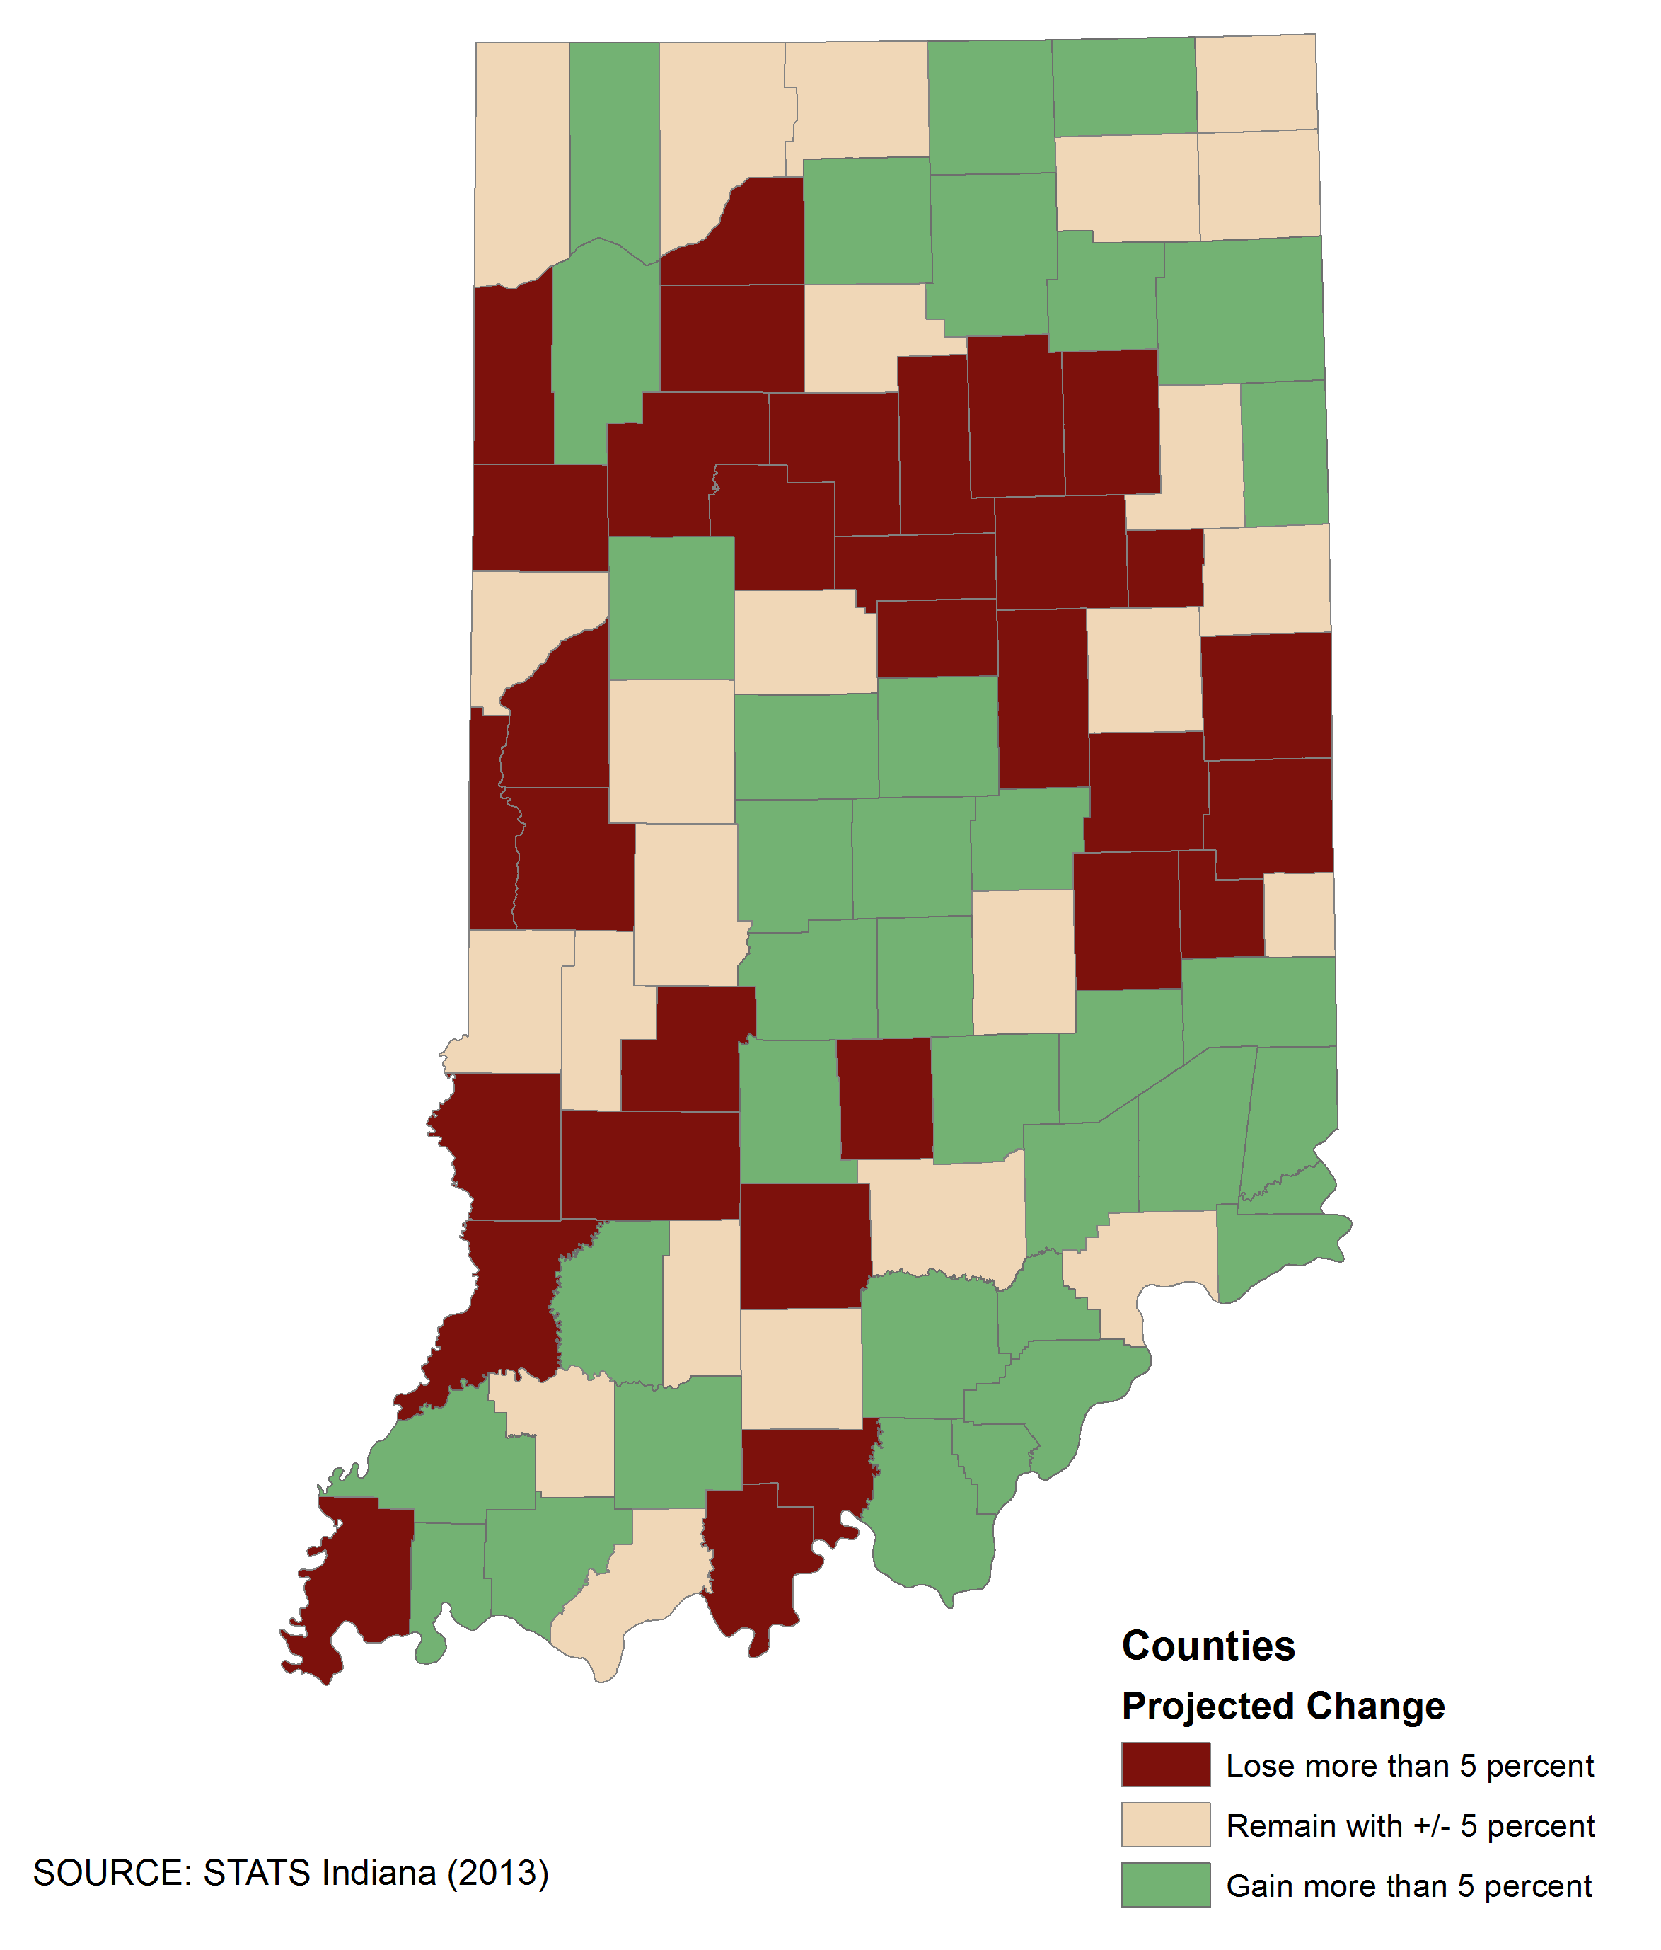
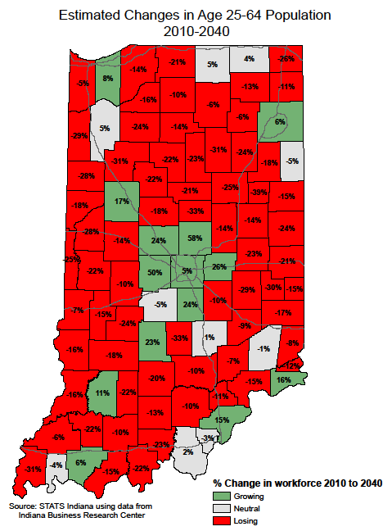
Community Benefits from Full-Time Operations
Midwest, Indiana and Terre Haute Region

Slide 24
Full House Community Benefit
Projected Distribution of Direct, Indirect and Induced New Workers
 | Employees | Income | LOIT
Vigo | 817 | $ 34,429,922.91 | $ 688,597.97
Clay | 32 | $ 1,339,830.50 | $ 31,486.14
Parke | 12 | $ 540,104.57 | $ 14,312.93
Putnam | 3 | $ 111,845.20 | $ 2,349.41
Sullivan | 25 | $ 1,034,427.39 | $ 17,585.94
Vermillion | 23 | $ 954,455.08 | $ 14,317.26
Other | 61 | $ 2,628,662.35
Totals | 973 | $ 41,039,248 | $ 768,650

Slide 25
Hard Rock Community Benefit
Projected Distribution of Direct, Indirect and Induced New Workers
 | Employees | Income | LOIT
Vigo | 809 | $ 28,358,462 | $ 567,169
Clay | 31 | $ 1,103,561 | $ 25,934
Parke | 12 | $ 444,861 | $ 11,789
Putnam | 3 | $ 92,122 | $ 1,935
Sullivan | 25 | $ 852,014 | $ 14,485
Vermillion | 23 | $ 786,144 | $ 11,793
Other | 61 | $ 2,165,117
Totals | 964 | $ 33,802,282 | $ 633,104

Slide 26
Churchill Community Benefit
Projected Distribution of Direct, Indirect and Induced New Workers
 | Employees | Income | LOIT
Vigo | 511 | $ 22,851,047.64 | $ 457,020.63
Clay | 20 | $ 889,241.92 | $ 20,897.26
Parke | 8 | $ 358,465.96 | $ 9,499.45
Putnam | 2 | $ 74,231.36 | $ 1,559.30
Sullivan | 16 | $ 686,546.69 | $ 11,671.74
Vermillion | 14 | $ 633,469.28 | $ 9,502.33
Other | 38 | $ 1,744,636.16
Totals | 609 | $ 27,237,639 | $ 510,151

Slide 27
Premier Community Benefit
Projected Distribution of Direct, Indirect and Induced New Workers
 | Employees | Income | LOIT
Vigo | 484 | $ 21,443,460 | $ 428,869
Clay | 19 | $ 834,466 | $ 19,610
Parke | 7 | $ 336,385 | $ 8,914
Putnam | 2 | $ 69,659 | $ 1,463
Sullivan | 15 | $ 644,257 | $ 10,953
Vermillion | 14 | $ 594,449 | $ 8,917
Other | 36 | $ 1,637,169
Totals | 577 | $ 25,559,844 | $ 478,726

Slide 28
Minimum (577) Community Benefit
Impact on Region’s Employment
 |  |  | Adjusted | Current | Adjusted
 | Labor Force | Unemployed | Unemployed | Rate | Rate
Vigo | 48,734 | 1,946 | 1,462 | 4.0% | 3.0%
Clay | 12,189 | 411 | 392 | 3.4% | 3.2%
Parke | 7,020 | 266 | 259 | 3.8% | 3.7%
Putnam | 16,778 | 543 | 541 | 3.2% | 3.2%
Sullivan | 8,450 | 311 | 296 | 3.7% | 3.5%
Vermillion | 7,045 | 325 | 311 | 4.6% | 4.4%

Slide 29
Maximum (973) Community Benefit
Impact on Region’s Employment
 |  |  | Adjusted | Current | Adjusted
 | Labor Force | Unemployed | Unemployed | Rate | Rate
Vigo | 48,734 | 1,946 | 1,129 | 4.0% | 2.3%
Clay | 12,189 | 411 | 379 | 3.4% | 3.1%
Parke | 7,020 | 266 | 254 | 3.8% | 3.6%
Putnam | 16,778 | 543 | 540 | 3.2% | 3.2%
Sullivan | 8,450 | 311 | 286 | 3.7% | 3.4%
Vermillion | 7,045 | 325 | 302 | 4.6% | 4.3%

Slide 38
Important addition to regional economy
Keys to maximizing economic impact
How local communities spend the new gaming related local revenue
Local spending by casino
Overnight stays
Outside the casino complex spending

Slide 39
Questions?

