Slide 1
RiverLink Industry Forum
Roadside Toll Collection System Replacement
December 14, 2021

Slide 2
INTRODUCTIONS
Amanda Spencer
Innovative Finance Manager
Kentucky Transportation Cabinet
Jonathan Kellogg
Executive Advisor & Engineer
Kentucky Transportation Cabinet
Jerry Hoover
Director of Operations, Ohio River Bridges
Indiana Department of Transportation
Matt Fulkerson
Deputy Director of Tolling, Ohio River Bridges
Indiana Department of Transportation
Rick Herrington
Vice President
HNTB
Brandon Rich
Project Manager
HNTB

Slide 3
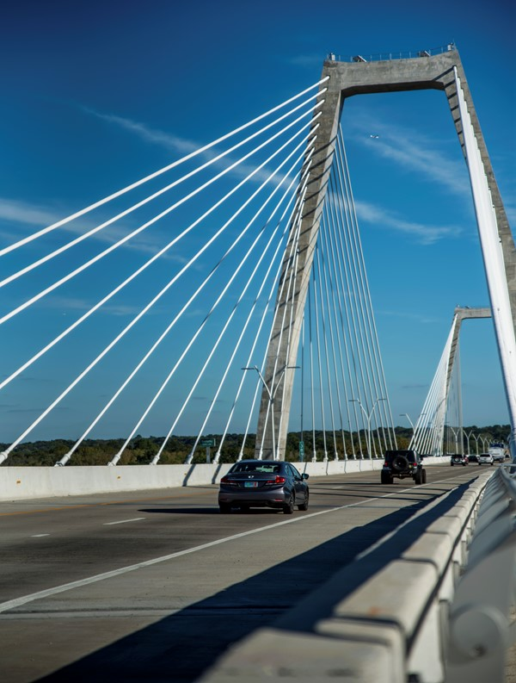
WHAT WE’LL COVER
Overview
Scope
Goals
Procurement Schedule
Project Schedule
Contract Terms

Slide 4
RIVERLINK

Slide 5
EQUIPMENT LANES – DOWNTOWN CROSSING (Facing South)
Court Ave/
6th St. Ramp
Lincoln Bridge I-65 North
Kennedy Bridge I-65 South
4 – 12’ equipment lanes
7 – 12’ equipment lanes
7 – 12’ equipment lanes
1 – 10’ equipment lane
plus gore area

Slide 6
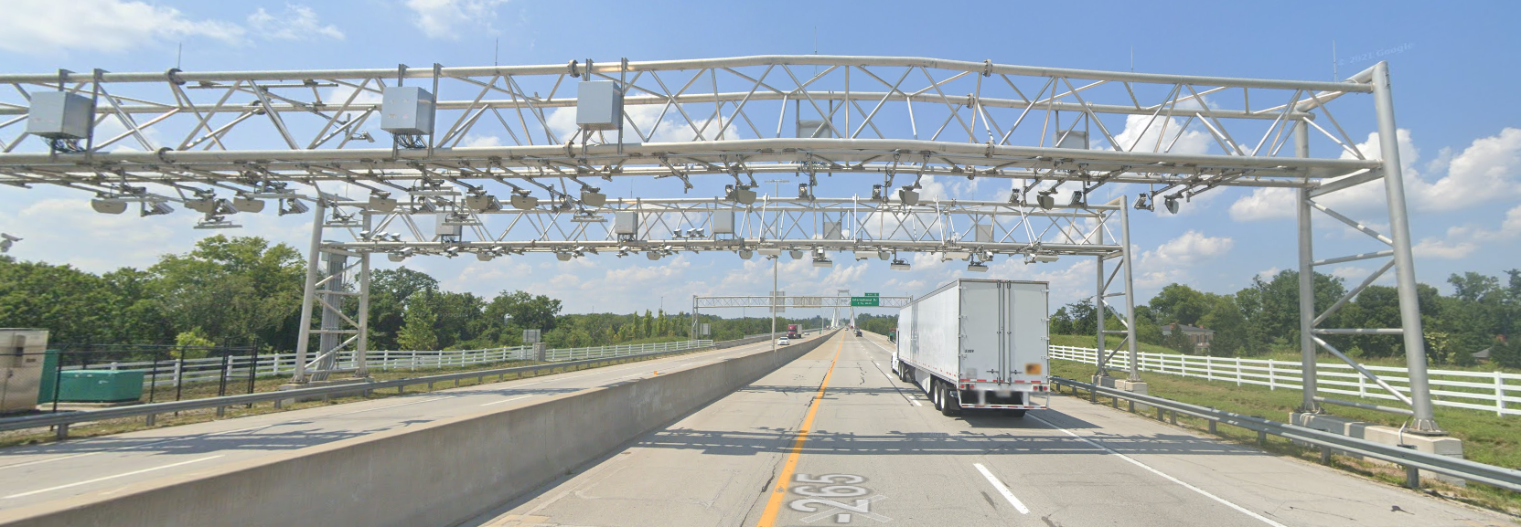
EQUIPMENT LANES – EAST END CROSSING (Facing North)
Lewis and Clark Bridge
SR-265
4 – 12’ equipment lanes (Northbound)
4 – 12’ equipment lanes (Southbound)

Slide 7
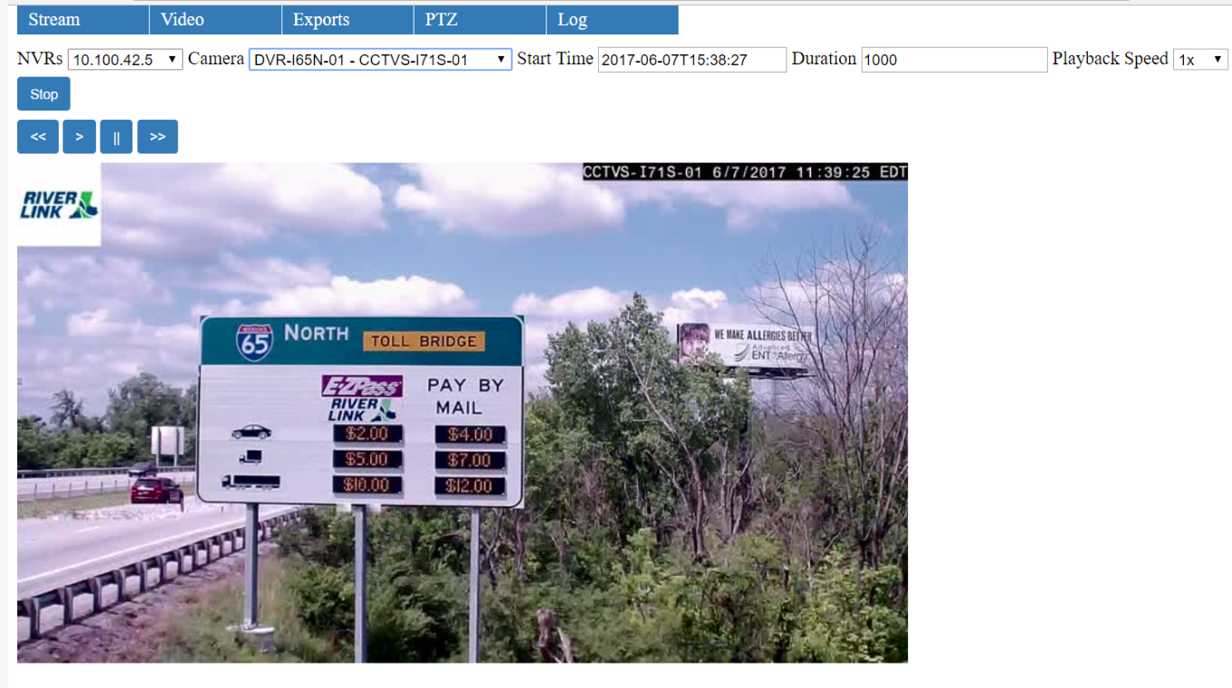
CHANGEABLE MESSAGE TOLL RATE SIGNS
8 changeable message toll rate signs with CCTV cameras

Slide 8
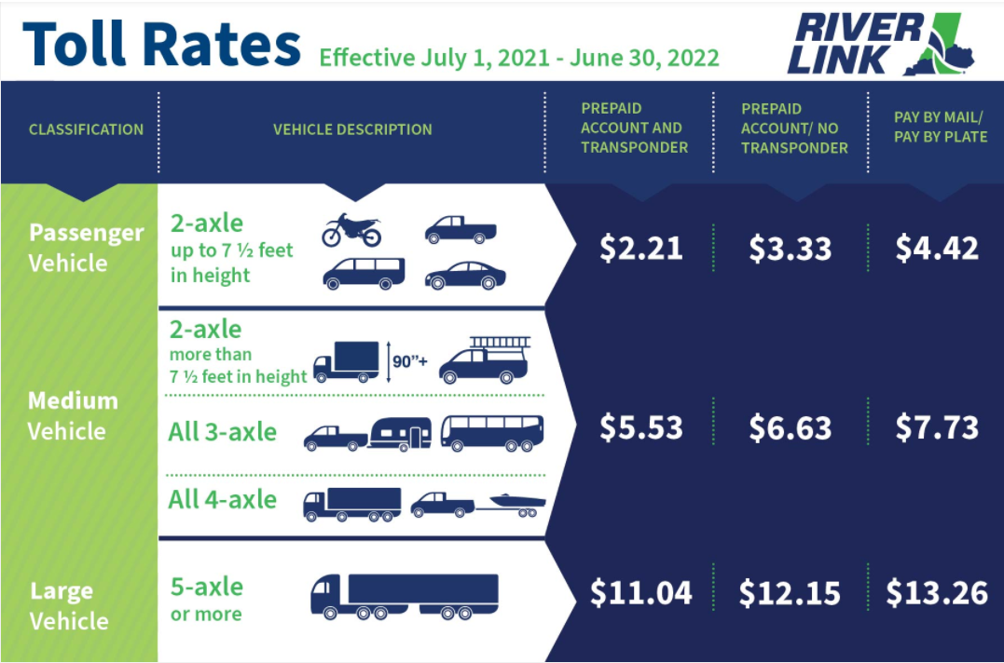
VEHICLE CLASSIFICATIONS

Slide 9
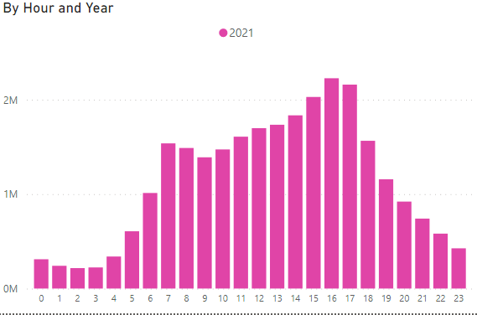
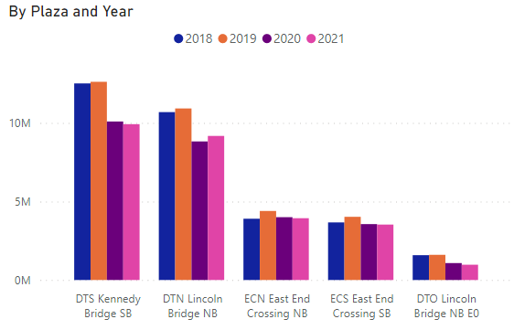
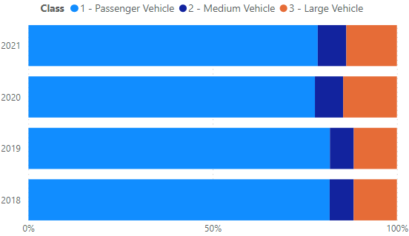
CROSSINGS
by Hour
Year | Total Crossings
2018 | 32.3 M
2019 | 33.6 M
2020 | 27.4 M
2021 (through 11/9) | 27.5 M
by Facility
by Vehicle Class

Slide 10
PROJECT SCOPE
Responsible for all roadside aspects of tolling for RiverLink
Roadside system – readers, cameras, zone controllers, cabinets, vehicle classification, etc.
Toll-related ITS – ITS cameras and changeable toll rate message signs
Communications – LAN, WAN, fiber, power supply, etc.
Toll operations center – daily operations and monitoring of the system
Implement a new roadside system that can handle at least 130K transactions per day
Architecture – complete transactions (including images and all required information) transmitted to BOS

Slide 11
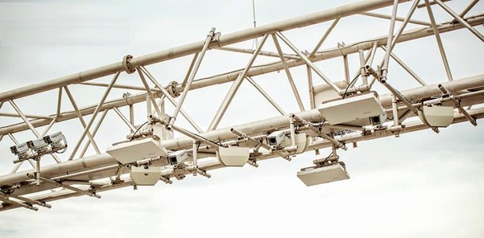
PROJECT GOALS
Procure, furnish, design, install, test, operate and maintain a Roadside Toll Collection System
Minimize risk, revenue loss, and impacts to RiverLink customers and stakeholders during transition

Slide 12
ANTICIPATED PROCUREMENT SCHEDULE
Event | Date
Industry 1-on-1’s | Dec 15-16, 2021
Publish RFP | Jan 7, 2022
Proposal due date | Feb 14, 2022
Notification of short-list | Feb 28, 2022
Interviews | Mar 8, 2022
Best and final offers | Mar 11, 2022
Notification of preferred proposer | Mar 16, 2022

Slide 13
ANTICIPATED PROJECT SCHEDULE
Event | Date
Contract award | April 22, 2022
Factory Acceptance Test | TBD
Full Revenue Service Achieved | TBD
Operational Test and Acceptance | TBD

Slide 14
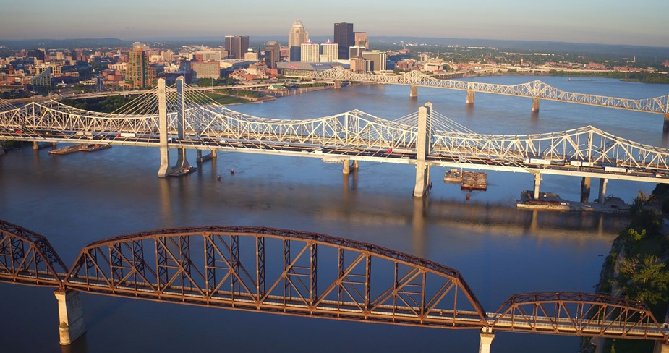
CONTRACT LENGTH
Operations and Maintenance Term (at Full Revenue Service) – 6 years
Potential renewal – Two 2-year renewal options

Slide 15
PAYMENT TERMS
Cost Component | Basis for Payment
Initial costs | fixed price by milestone
Operations and maintenance costs | fixed price per month
Utilities (electric, gas, and internet) | pass through costs

Slide 16
KEY PERFORMANCE INDICATORS
Point system
Examples
Points escalate for each subsequent month requirements are not met
Functional Area | KPI | Compliance Threshold | Points for Non-Compliance | Measurement Frequency
System Availability | RTCS (all systems and sub-systems | All systems available 99.95% of the time excluding scheduled maintenance | 3 pts for each 0.1% below requirement for each lane | Monthly
Operations | Image quality | 0.1% or less of images rejected for reasons under RSP2’s control | 1 pt for each 0.1% above requirement | Monthly

Slide 17
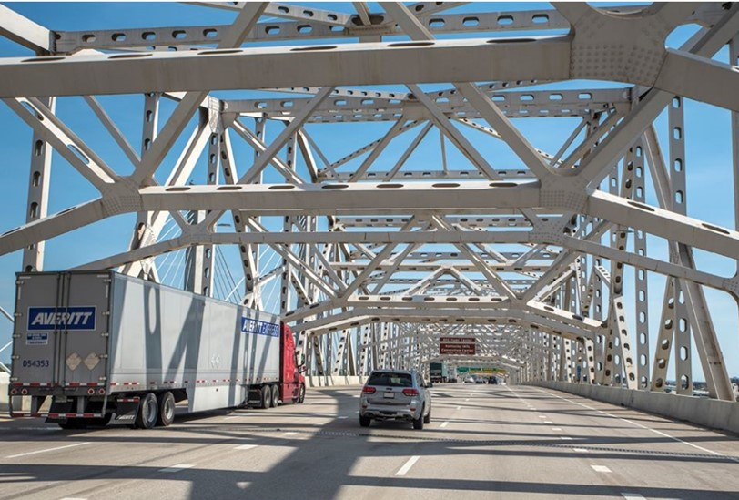
KEY PERFORMANCE INDICATORS
Performance adjustments
Performance Level | Total Non-Compliance Points for the Month | Adjustment to Monthly Invoice
1 | 0-10 | 0%
2 | 11-20 | 5%
3 | 21-30 | 10%
4 | 31-40 | 15%
5 | 41-50 | 20%
6 | >50 | 25%

Slide 18
CONCLUSION
Q&A

Slide 19
Thank You
December 14, 2021

