Slide 1
A DISPASSIONATE UPDATE ON THE STATUS OF FEDERAL AFFORDABLE CARE ACT LITIGATION Indiana Department of Insurance Annual Continuing Legal Education Indianapolis, Indiana September 24, 2019 By William G. Schiffbauer, Esq.

Slide 2
Major Pending Litigation
I. Texas et al v. United States of America et al, U.S. District Court, Northern District of Texas; pending in the U.S. Court of Appeals for the Fifth Circuit.
II. State of New York et al v. United States Department of Labor et al, U.S. District Court, District of Columbia; pending in the U.S. Court of Appeals for the D.C. Circuit.
III. Association for Community Affiliated Plans et al v. United States Department of the Treasury et al, pending in the U.S. District Court, District of Columbia; pending in the U.S. Court of Appeals for the D.C. Circuit.

Slide 3
THE INDIVIDUAL MANDATE CASE
I. Texas et al v. United States of America et al

Slide 4
I. Texas v. US
A. TIMELINE
1. December 22, 2017, Tax Cut and Jobs Act of 2017 is signed into law.
2. February 26, 2018, complaint filed in District Court by 20 Red States.
3. April 9, 2018, petition filed to intervene as Defendants by 17 Blue States and DC.

Slide 5
I. Texas v. US
A. TIMELINE
4. September 5, 2018, oral argument held in District Court.
5. November 6, 2018, Federal Election Day.
6. December 14, 2018, District Court rules for the plaintiffs and issues order and opinion for partial summary judgment.

Slide 6
I. Texas v. US
A. TIMELINE
7. January 3, 2019, U.S. House of Representatives files intervention to join as Defendant.
8. January 7, 2019, Blue States file appeal and case is docketed at Fifth Circuit Court of Appeals.

Slide 7
I. Texas v. US
TIMELINE
March 25, 2019, U.S. DOJ files notice that the Federal Government now agrees with the U.S. District Court and Appellee Red States.
June 26, 2019, Court of Appeals requests parties to address three questions relating to standing.

Slide 8
I. Texas v. US
TIMELINE
11. July 9, 2019, Fifth Circuit held oral arguments before three-judge panel.
12. Fifth Circuit will issue its order and decision in September or October. Is “en banc” request lurking?
13. Parties will file Petition for Certiorari to SCOTUS for review during the October 2019 Term.

Slide 9
I. Texas v. US
B. PLAINTIFF RED STATES’ ARGUMENTS
1. Tax Cut and Jobs Act of 2017 eliminated ACA individual mandate tax penalty.
2. Stand-alone mandate without tax penalty is not supported by the Commerce Clause.

Slide 10
I. Texas v. US
B. PLAINTIFF RED STATES’ ARGUMENTS
3. Community-rating, guaranteed-issue provisions are inseverable from mandate.
4. Injunction must apply to the rest of the ACA “major provisions”.

Slide 11
I. Texas v. US
C. FEDERAL DEFENDANTS’ REPLY
1. The Individual Mandate is Unconstitutional After the Tax Cut and Jobs Act.
2. The Mandate is Not Severable from the Guaranteed Issue and Community Rating Provisions.
3. The Mandate, Guaranteed-Issue, and Community Rating Provisions are Severable from ACA.

Slide 12
I. Texas v. US
C. FEDERAL DEFENDANTS’ REPLY
4. Preliminary Injunctive Relief is Not Warranted but a Declaratory Judgment would be appropriate.
5. Request a holding that the individual mandate will be unconstitutional as of January 1, 2019.

Slide 13
I. Texas v. US
D. BLUE STATE DEFENDANTS’ REPLY
1. Individual mandate penalty remains and production of revenue is not a constitutional requirement.
2. The penalty can be characterized as a tax with a delayed effective date or suspension.
3. Penalty payments will continue to raise revenue because liability for 2018 is not due until April 2019.

Slide 14
I. Texas v. US
D. BLUE STATE DEFENDANTS’ REPLY
4. The Tax Cut and Jobs Act amendment to reduce the penalty to $0 is unconstitutional.
5. If the Individual Mandate as amended is found to be unconstitutional it is severable from the entire ACA.

Slide 15
I. Texas v. US
DISTRICT COURT ORAL ARGUMENT HIGHLIGHTS
1. The District Court appeared to agree with the Plaintiff’s arguments that the mandate is now unconstitutional.
2. The District Court was primarily concerned with the scope of severability and application to all or only the Plaintiff states.

Slide 16
I. Texas v. US
E. DISTRICT COURT ORAL ARGUMENT HIGHLIGHTS
4. Court noted the 111th Congress in 2010 characterized the mandate as integral to guaranteed-issue and community rating.
5. Court noted the 115th Congress in 2017 only repealed the amount of the penalty and left the remainder of the ACA in place.

Slide 17
I. Texas v. US
F. DISTRICT COURT’S OPINION
1. Individual mandate may no longer be upheld under the Tax Power of the Congress or the Commerce Clause.
2. Relies upon CJ Roberts NFIB v. Sebelius that the penalty no longer produces revenue in present tense.
3. Congress did not just suspend or delay the penalty, it eliminated the individual mandate penalty.

Slide 18
I. Texas v. US
F. DISTRICT COURT’S OPINION
4. Individual mandate is “essential” to the ACA and cannot be severed from the ACA’s remaining provisions.
5. Relies upon joint dissent severability rationale of four conservative Justices in NFIB v. Sebelius.
6. Cites six statutory references in ACA text and “findings” stating individual mandate is “essential” to the Act.

Slide 19
I. Texas v. US
F. DISTRICT COURT’S OPINION
7. Court’s attempt to “sever” interdependent provisions would “rewrite” the statute violating Separation of Powers.
8. The 2017 amendment did not mean that Congress wanted the ACA to survive without the mandate.
9. The 2017 amendment did not remove the requirement to purchase insurance or the “findings” that the mandate is “essential” to the Act.

Slide 20
I. Texas v. US
G. FIFTH CIRCUIT COURT OF APPEALS BACKGROUND
1. Maintains a reputation as the most politically conservative circuit court of appeals.
2. Six of the Fifth Circuit’s seventeen judges have been appointed by President Trump.
3. Twelve of the seventeen active judges were appointed by a Republican President.

Slide 21
I. Texas v. US
FIFTH CIRCUIT COURT OF APPEALS
BLUE STATE APPELLANTS’ ARGUMENTS
State-Plaintiff Appellees do not have standing --
District Court did not address fiscal injury.
2. The Coverage Provision is a “condition” or choice with no legal obligation that remains Constitutional.
3. If Unconstitutional the Coverage Mandate is severable from the rest of the ACA.

Slide 22
I. Texas v. US
FIFTH CIRCUIT COURT OF APPEALS
U.S. HOUSE APPELLANTS’ ARGUMENTS
1. NFIB v. Sebelius held that the ACA offered a choice between buying insurance or paying a tax.
2. State-Plaintiff Appellees and Individual Appellees do not have standing.
3. If Unconstitutional the Coverage Mandate is severable from the rest of the ACA.

Slide 23
I. Texas v. US
J. FIFTH CIRCUIT COURT OF APPEALS
RED STATE APPELLEE ARGUMENTS
1. Individual and State Plaintiffs have standing – individuals compelled to purchase insurance; States incur economic costs.
2. Individual Mandate is Unconstitutional – Commerce Clause does not permit Congress to mandate purchase; no tax penalty to save the mandate.

Slide 24
I. Texas v. US
J. FIFTH CIRCUIT COURT OF APPEALS
RED STATE APPELLEE ARGUMENTS
3. Remaining portions of the ACA cannot be severed from the individual mandate – community rating and guaranteed issue provisions are inseverable.
4. Dissent in NFIB v. Sebelius found that both major and minor provisions of ACA are inseverable.

Slide 25
I. Texas v. US
K. FIFTH CIRCUIT COURT OF APPEALS
FEDERAL GOVERNMENT ARGUMENTS
1. Individual Plaintiffs have standing – individuals required to purchase health insurance but standing extends to extent of ACA injury to them.
2. Individual Mandate is Unconstitutional – tax penalty is eliminated and was the basis for saving in NFIB v. Sebelius.

Slide 26
I. Texas v. US
K. FIFTH CIRCUIT COURT OF APPEALS
FEDERAL GOVERNMENT ARGUMENTS
3. Individual Mandate is not severable from guaranteed issue and community-rating provisions, and the rest of the ACA is not severable.

Slide 27
I. Texas v. US
L. FIFTH CIRCUIT COURT OF APPEALS
ORAL ARGUMENTS
1. Oral argument was heard on July 9, 2019, by a three judge panel: Engelhardt (Trump); Elrod (G.W. Bush); and King (Carter).
2. Court’s questions focused mostly on standing issues: states and U.S. House standing; standing in light of federal defendant’s changed position.

Slide 28
I. Texas v. US
L. FIFTH CIRCUIT COURT OF APPEALS
ORAL ARGUMENTS
3. Blue States argued individual plaintiffs had no standing because mandate is a “choice” without penalty and so harm is “self-inflicted”.
4. Court disagreed – law is a command to purchase health insurance and under Blue State theory no one could challenge a law that compels citizens to act.

Slide 29
I. Texas v. US
L. FIFTH CIRCUIT COURT OF APPEALS
ORAL ARGUMENTS
5. Red States argued Blue and Red States have standing but DOJ argued that any ruling applies only to Red State plaintiffs.
6. Both Red States and DOJ argued that U.S. House has no standing. U.S. House argues that Blue States have standing so no need to decide U.S. House standing.

Slide 30
I. Texas v. US
L. FIFTH CIRCUIT COURT OF APPEALS
ORAL ARGUMENTS
7. Court noted that U.S. House is not representing the Congress – Senate did not join suit so not a Separation of Powers or Executive Enforcement controversy.
8. Blue States argued that the tax remains but is set at $0 and the rest of the ACA remains as intended by 2017 Congress.

Slide 31
I. Texas v. US
L. FIFTH CIRCUIT COURT OF APPEALS
ORAL ARGUMENTS
9. Red States argued that ACA’s own findings establish “inseverability” of the mandate and the whole ACA and findings remain in the statute.
10. Court noted that the Congress can fix the issues and it is not the task of the courts to rewrite the ACA – Court is a “taxidermist’ for Congress (Engelhardt).

Slide 32
I. Texas v. US
L. FIFTH CIRCUIT COURT OF APPEALS
ORAL ARGUMENTS
11. DOJ argued that the entire ACA is inseverable from the individual mandate but that the Court should enjoin only provisions directly affecting the plaintiffs and not nationwide.
12. Red and Blue States disagreed with DOJ’s position that the District Court’s ruling was limited and not a nationwide injunction.

Slide 33
I. Texas v. US
M. NOTE ON SEVERABILITY JURISPRUDENCE:
ALASKA AIRLINES v. BROCK (1987)
1. First, court determines if remainder of statute will operate in the manner Congress intended; if not remainder is invalidated?
2. Second, if remainder can operate as intended, would Congress have enacted remainder standing alone and without the invalid provision?

Slide 34
ASSOCIATION HEALTH PLANS CASE
II. State of New York et al v. United States Department of Labor et al

Slide 35
II. New York v. US DOL
A. TIMELINE
1. June 21, 2018, U.S. Department of Labor publishes final rule for Association Health Plans.
July 26, 2018, complaint filed in District Court
by State of New York and 11 other Blue states
3. January 24, 2019, oral arguments held on New York motion for summary judgment.

Slide 36
II. New York v. US DOL
A. TIMELINE
4. March 28, 2019, District Court issues order and opinion granting New York motion.
5. April 2, 2019, DOL posts FAQ on District Court’s ruling and impact on AHPs.
6. May 1, 2019, Federal Defendants filed an appeal with the D.C. Circuit Court of Appeals.

Slide 37
II. New York v. US DOL
TIMELINE
7. May 10, 2019, court order set briefing schedule for all parties.
8. September 11, 2019, D.C. Circuit scheduled oral arguments for November 11, 2019.

Slide 38
II. New York v. US DOL
A. TIMELINE
9. D.C. Circuit will issue order and decision after oral arguments. Could be December 2019 or January 2020.
10. Parties will file Petition for Certiorari to SCOTUS for review during the October 2019 Term.

Slide 39
II. New York v. US DOL
B. BLUE STATES’ ARGUMENTS
1. Final rule unlawfully overrides the Affordable Care Act’s employer-group market structure with the association health plans.
2. Final rule unlawfully expands the ERISA definition of “employer” to include a “working owner”.
3. Final rule is an arbitrary and capricious departure from long-standing interpretations of “bona fide association”.

Slide 40
II. New York v. US DOL
C. FEDERAL DEFENDANTS’ REPLY
1. ERISA statutory term “employer” includes a group or association of employers acting in relation to an employee benefit plan.
2. AHP final rule is a reasonable interpretation of ERISA term “employer” because it is ambiguous and “group or association” is undefined.

Slide 41
II. New York v. US DOL
C. FEDERAL DEFENDANTS’ REPLY
3. Federal agencies may permissibly modify long-held sub-regulatory guidance and not foreclosed by other statutory provisions.
4. Statutory definition of “employer” is silent with respect to number of “employees” and final rule is a “reasonable” interpretation.

Slide 42
II. New York v. US DOL
D. DISTRICT COURT’S OPINION
1. The Final Rule is clearly an end-run around the ACA to avoid the most stringent requirements of the Act.
2. The Final Rule does violence to ERISA’s careful statutory scheme that is based on employment relationships.
3. The Final Rule extends ERISA to cover commercial insurance transactions between unrelated parties.

Slide 43
II. New York v. US DOL
D. DISTRICT COURT’S OPINION
4. The AHP is an entrepreneurial venture selling insurance outside of ERISA’s “employment relationship” scope.
5. The Final Rule has no meaningful limit on associations having a commonality of interest or control to be ERISA “employers”.

Slide 44
II. New York v. US DOL
D. DISTRICT COURT’S OPINION
6. The inclusion of “working owners” in contrary to the text of ERISA that requires an “employment relationship”.
7. ERISA defines an “employee” to be an individual employed by an employer and so anticipates two parties.

Slide 45
II. New York v. US DOL
D. DISTRICT COURT’S OPINION
8. The bona fide association and working owner provisions are unlawful and vacated.
9. The Final Rule includes a “severability” clause and remands the rule to DOL for consideration.
10. Not vacated are the subsections captioned “(a)
In general”, “(d) Nondiscrimination”, “(f) Applicability dates”.

Slide 46
II. New York v. US DOL
U.S. COURT OF APPEALS FOR THE D.C. CIRCUIT – Background
1. Maintains a reputation as the nation’s expert court on administrative law and the Federal Administrative Procedures Act (“APA”).
2. The court has 12 (twelve) active judges – 5 appointed by a Republican President (3 by President Trump), and 7 by a Democrat President (4 by President Obama).

Slide 47
II. New York v. US DOL
U.S. COURT OF APPEALS FOR THE D.C. CIRCUIT – Background
3. Four of the current nine Justices on the Supreme Court are alumni of the court – John Roberts, Clarence Thomas, Ruth Bader Ginsberg, and Brett Kavanaugh.
4. The late Justice Antonin Scalia also served on this court.

Slide 48
SHORT-TERM LIMITED DURATION INSURANCE CASE
III. Association for Community Affiliated Plans et al v. United States Department of the Treasury et al

Slide 49
III. ACAP v. US TREASURY
A. TIMELINE
1. August 3, 2018, ACA Tri-Agencies publish final rule for Short-Term, Limited-Duration Health Insurance.
2. September 14, 2018, complaint filed in District Court by Association for Community Affiliated Plans and 6 other organizations.

Slide 50
III. ACAP v. US TREASURY
A. TIMELINE
4. October 25, 2018, Hearing on Preliminary Injunction; Parties change to Summary Judgement.
5. May 21, 2019, District Court held a second hearing on Motion for Summary Judgment.

Slide 51
III. ACAP v. US TREASURY
A. TIMELINE
7. July 19, 2019, District Court issued its order and ruling denying ACAP motion for Summary Judgment and upholding the final STLDI rule.
8. July 30, 2019, ACAP filed its appeal to the D.C. Circuit Court of Appeals – up to a 1 year process.

Slide 52
III. ACAP v. US TREASURY
B. PLAINTIFF ACAP’S ARGUMENTS
1. Final rule exceeded agencies authority and discretion and circumvents the purposes of the Affordable Care Act.
2. Final rule interprets “limited duration” to unreasonably encompass a renewal for up to three years.

Slide 53
III. ACAP v. US TREASURY
B. PLAINTIFF’S ARGUMENT
3. “Short-term” should be based on the 3 month “short coverage gap” exemption from the mandate penalty.
4. Final rule does not provide a reasoned explanation for changing prior law and arbitrary and capricious.
5. Standing is satisfied based on injury from increased competition resulting from the Final Rule.

Slide 54
III. ACAP v. US TREASURY
C. FEDERAL DEFENDANTS’ REPLY
1. Congress did not define “short-term, limited-duration insurance” and delegated authority to the agencies.
2. Both HIPAA and the ACA maintained this authority for the agencies to issue regulations defining STLDI.

Slide 55
III. ACAP v. US TREASURY
C. FEDERAL DEFENDANTS’ REPLY
3. A “short coverage gap” is an exemption from the penalty tax along with hardship and financial constraints.
4. The final rule’s provision to permit renewal of 36 months restricts duration and so is “limited”. Prior ACA rule permitted unlimited extensions.
5. Plaintiffs have not established standing by demonstrating injury-in-fact.

Slide 56
III. ACAP v. US TREASURY
DISTRICT COURT ORAL ARGUMENT
1. Court expressed support for the Defendant-Tri-Agencies position and that STLDI offered a choice.
2. The Court suggested that the Plaintiffs drop the request for a preliminary injunction and proceed to merits.
3. The Court rejected the Plaintiffs “11th hour” request for an expedited ruling prior to November 1.

Slide 57
III. ACAP v. US TREASURY
D. DISTRICT COURT ORAL ARGUMENTS
4. The Court observed that the case is about the insurance industry that markets the ACA being protected.
5. The Court observed that more insurance options was a net benefit and would help young people get coverage.
6. The Court suggested that STLDI plans should “play out” in the market and see if it really impacts ACA insurers.

Slide 58
III. ACAP v. US TREASURY
DISTRICT COURT’S OPINION
1. No serious question that Congress delegated to the Departments the authority to define STLDI and made no attempt to dictate the characteristics of such plans.
2. To succeed on their claim ACAP must show that the Departments overstepped bounds of their authority to an “extraordinary” extent.

Slide 59
III. ACAP v. US TREASURY
DISTRICT COURT’S OPINION
3. Prior to the ACA’s enactment the original definition of STLDI was in place in regulation for over a decade and Congress chose not to amend it in the ACA.
4. The 2018 final rule largely restored the long-standing and substantially similar regulatory definition and the statutory text remains silent on the meaning.

Slide 60
III. ACAP v. US TREASURY
E. DISTRICT COURT’S OPINION
5. Court must look to ordinary meaning of “short term”; a period of time that is “short” by comparison to another term – one-year for major medical, and multiple states define STLDI as “less than 12 months”.
6. Ordinary meaning of “duration” means the time during which something exists or lasts; the final rule provides a defined limit of up to 36 months.

Slide 61
III. ACAP v. US TREASURY
E. DISTRICT COURT’S OPINION
7. Court notes that from 1997 to 2016 the regulation permitted unlimited issuer-consented renewals of STLDI coverage; 2016 rule altered and limited to 3-months.
8. Congress did not intend for the ACA’s various reforms to apply to all “species” of individual health insurance and maintained the exemption for STLDI

Slide 62
III. ACAP v. US TREASURY
E. DISTRICT COURT’S OPINION
9. Under Chevron step one analysis because Congress did not define the term STLDI and so did not require a certain interpretation.
10. Under Chevron step two analysis the Departments’ interpretation was reasonable and based on ordinary meaning.

Slide 63
Summation
I. ACA Individual Mandate: Texas et al v. United States of America et al - Fifth Circuit Opinion ANYDAY; SCOTUS on or before July 31, 2020.
II. AHP Final Rule: State of New York et al v. United States Department of Labor et al - District of Columbia Circuit Oral Arguments November 14, 2019; opinion December 2019 or January 2020; SCOTUS on or before July 31, 2020.

Slide 64
Summation
III. STLDI Final Rule: Association for Community Affiliated Plans et al v. United States Department of the Treasury et al – District of Columbia Circuit Oral Arguments November or December; opinion January or February 2020; maybe SCOTUS on or before July 31, 2020. Federal preemption issues lingering?

Slide 65
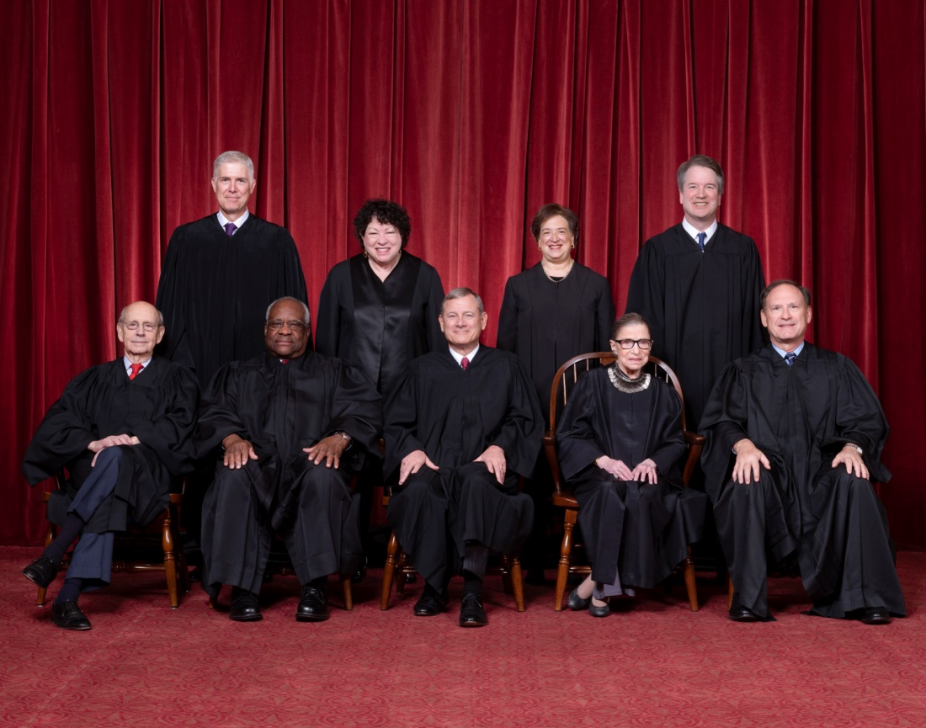
THE END

