Slide 1

Development of Healthcare Insurance Regulations among States
@nicolasterry
Hall Render Professor of Law & Executive Director of the Hall Center for Law and Health
Indiana University Robert H. McKinney School of Law

Slide 2


Background: Post mid-terms, an Existential Attack
Although “repeal and replace” now off the table until at least 2021…
Texas v. United States, 340 F.Supp.3d 579 (ND Tex. Dec. 14, 2018), Reed O'Connor, J.,
ACA's individual mandate, as amended by the Tax Cuts and Jobs Act, could not be fairly read as exercise of Congress’s constitutional tax power
Unconstitutional under the Commerce Clause and not severable from the remainder of the ACA.
Fifth Circuit
February 2019. Allows House of Representatives to intervene
Recall firestorm when DoJ elected not to defend ACA (June, 2108); March, 2019 in letter to appeals court,“is not urging that any portion of the district court’s judgment be reversed.” So has now abandoned severability
Oral arguments, July 8, 2019… 5th Cir. typically issues opinions 2 months later… so coming soon

Slide 3
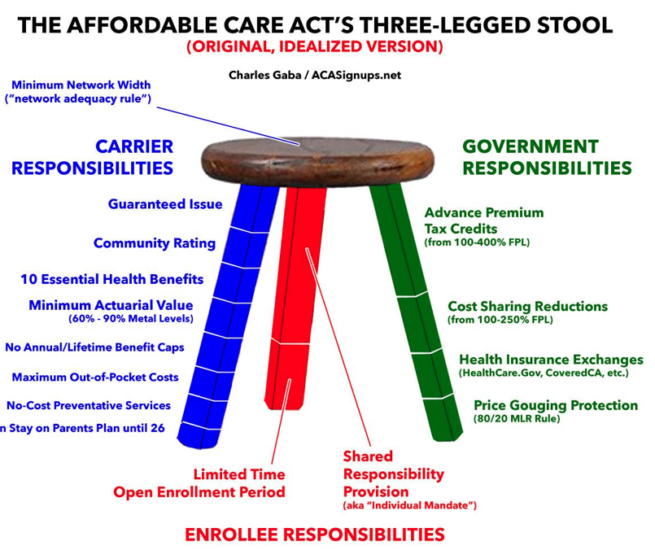
Notes:
At the core of the affordable care is a multi-faceted to approach to reforming the individual health insurance market. These reforms are sometimes visualized as a “three-legged stool,” primarily to emphasize their interdependence. Most of these reforms express as federal insurance rules prevent insurers from denying coverage or raising premiums based on preexisting conditions, and subsidies to make insurance affordable.
Major inroads have been to 2 legs…. enrollee responsibilities (the mandate) and the government’s subsidy and market stabilization responsibilities

Slide 4

The “Sabotage” or “Choice” Playbook
Destroy the Three-Legged Stool
(1) Individual Mandate (2) Subsidies/CSRs (3) Guaranteed Issue/Community Rating
Destabilize Risk Pools by Allowing Less Expensive, non-Essential Health Benefits (EHBs) Policies
Reduce Exchange Enrollment
2020 Final Payment Notice—increases premium adjustment percentage, reducing actuarial value and increasing required contribution from subsidy-eligible cohor
Chip Away at EHBs
“Process” Impediments to Exchange Sign-Ups
Reducing marketing, Deprecating outreach/navigators, Sunday maintenance (?) on federal web site, deprecation of ACA information on federal sites
Though let the record show… Democrat-controlled House almost unanimously voted to kill Cadillac Tax (7/17/2019)
Notes:
I am not going to litigate the ACA before you today—suffice it to say that there are many who view the administration’s approach to ACA health insurance regulation as sabotage, while many others view it as increasing choice for consumers who are frequently unable to afford coverage; whatever the motive, the playbook is essentially the same
https://sunlightfoundation.com/2019/05/15/new-report-shows-undermining-of-the-aca-through-web-censorship/
https://www.commonwealthfund.org/blog/2019/aca-marketplace-open-enrollment-numbers-reveal-impact during the 2019 open enrollment period, most state-based marketplaces invested significantly more than the federal government in advertising and outreach efforts. The majority of state marketplaces with larger budgets than the federal government performed better than the federal marketplace. Four of the five state marketplaces that budgeted the most per uninsured resident on advertising and navigator funding outperformed the federally facilitated marketplace, with two of the five, Rhode Island and New York, reporting plan selection growth greater than 4 percent.
https://www.healthaffairs.org/do/10.1377/hblog20190419.213173/full/
https://www.nytimes.com/2019/07/17/us/politics/obamacare-democrats-cadillac-tax.html?smid=nytcore-ios-share

Slide 5
Destabilizing Risk Pools (1)
Short-Term, Limited-Duration Insurance (Final Rule 8/01/2018)
ACA; was three months max
Now allowed to last as long as 364 days x 3 years
Lack EHB, can impose annual/lifetime, no guaranteed issue protections
Negative impact on individual and group market risk pools (likely would suck out young/healthy)
Notes:
“The resolution of disapproval will be introduced by Sen. Tammy Baldwin (D-Wis.). During a call with reporters Thursday, Senate Minority Leader Charles Schumer (D-N.Y.) said he thinks there will be unanimous support among Democrats once the resolution is introduced.” http://thehill.com/policy/healthcare/400102-senate-dems-to-force-a-vote-to-overturn-rules-on-non-obamacare-insurance?
Building out “alternative” plans that jeopardize individual and group market risk pools
https://www.kff.org/health-reform/issue-brief/understanding-short-term-limited-duration-health-insurance/
https://www.cms.gov/CCIIO/Resources/Files/Downloads/dwnlds/CMS-9924-F-STLDI-Final-Rule.pdf
https://s3.amazonaws.com/public-inspection.federalregister.gov/2018-03208.pdf
https://ag.ny.gov/sites/default/files/complaint_as-filed.pdf
https://www.vox.com/policy-and-politics/2018/7/20/17596392/voxcare-trump-association-health-plans
https://www.politifact.com/truth-o-meter/article/2018/jun/28/fact-checking-donald-trumps-rally-north-dakota/
http://www.smallbusinessmajority.org/press-release/association-health-plans-will-destabilize-small-group-market

Slide 6
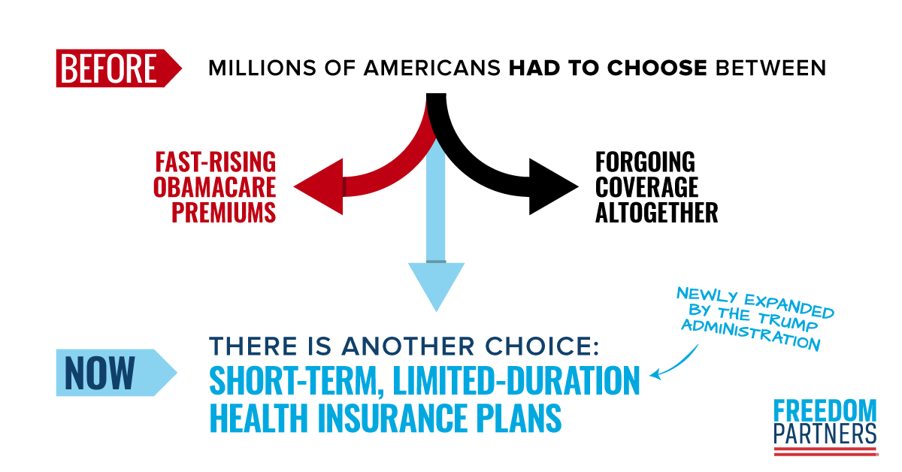
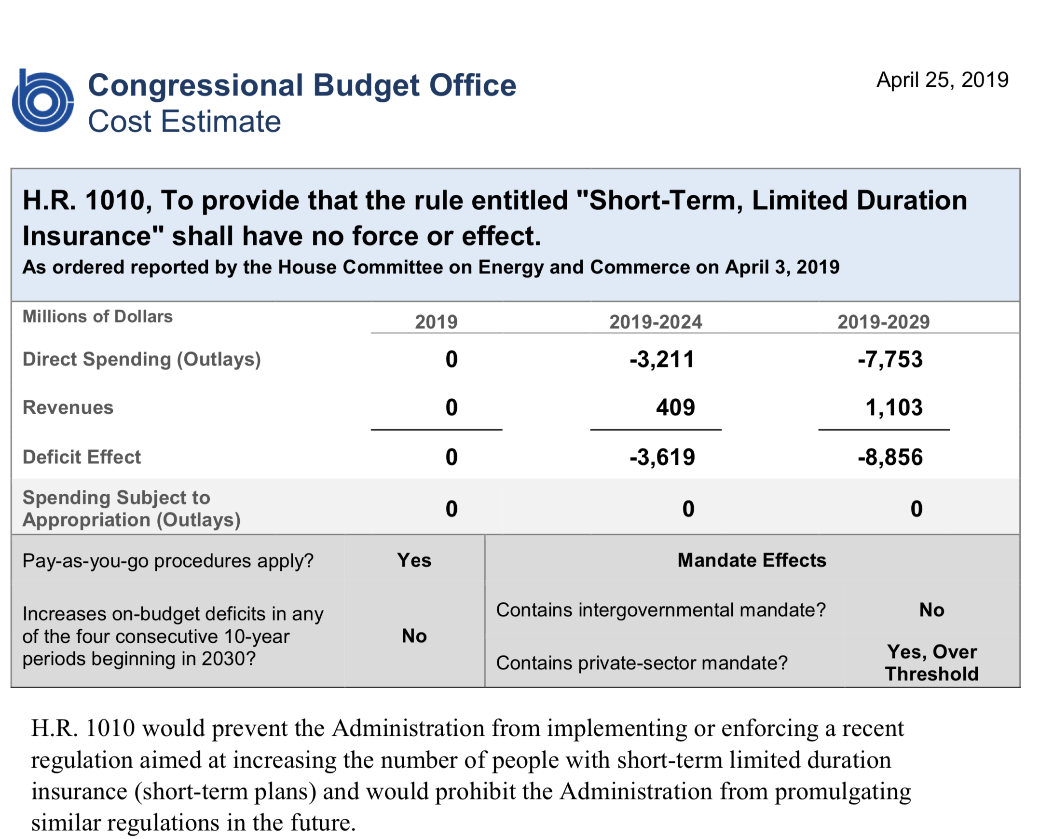
STLDs Challenged
Association for Community Affiliated Plans v. U.S. Dep’t of Treasury, (D. DC Sep 14, 2018).
364 days inconsistent with “short-term;” Renewals or extensions up to 36 months inconsistent with “Limited-duration” (ACA and HIPAA); Lack of transparency in rule-making violative of APA
Sabotage: “Like any law, the ACA can be repealed by act of Congress. But Congress has repeatedly rejected attempts to repeal the ACA. Now, with the issuance of the STLDI Rule, the Departments seek to do by executive fiat what could not be accomplished through the required constitutional process.”
Dismissed, 2019 U.S. Dist. LEXIS 120834 (7/19/2109) Chevron deference
House Democrats, H.R.1010 - To provide that the rule entitled "Short-Term, Limited Duration Insurance" shall have no force or effect.116th Congress (2019-2020)
Notes:
https://www.healthleadersmedia.com/strategy/association-health-plans-ruling-appealed-lawsuit-over-short-term-plans-proceeds
https://www.healthaffairs.org/do/10.1377/hblog20180917.479910/full/

Slide 7
Destabilizing Risk Pools (2)
Association Health Plans (AHPs) predated ACA with dubious history of fraud and regulatory avoidance because of federal-state gaps. ACA required compliance with insurance regulation (e.g., EHBs).
But, an ACA exception applied to small businesses with common interest that worked together as a virtual entity to buy health insurance. The Trump Administration Final Rule (6/19/2018) drove a truck through that exception and allows far more groups to join together to form associations (e.g., a chamber of commerce)
Negative impact on individual and group market risk pools
Because Final Rule changes ERISA definition of “employer” moves otherwise exchange and individual persons into employer-coverage legal space (where e.g., EHBs not applicable)
What’s the take-up rate? 30 to 35 plans? How many are actually new rather than holdovers?
Stabilization of ACA marketplaces suggests little impact
Notes:
https://www.commonwealthfund.org/blog/2019/past-future-association-health-plans (Jost)
Building out “alternative” plans that jeopardize individual and group market risk pools
https://www.kff.org/health-reform/issue-brief/understanding-short-term-limited-duration-health-insurance/
https://www.cms.gov/CCIIO/Resources/Files/Downloads/dwnlds/CMS-9924-F-STLDI-Final-Rule.pdf
https://s3.amazonaws.com/public-inspection.federalregister.gov/2018-03208.pdf
https://ag.ny.gov/sites/default/files/complaint_as-filed.pdf
https://www.vox.com/policy-and-politics/2018/7/20/17596392/voxcare-trump-association-health-plans
https://www.politifact.com/truth-o-meter/article/2018/jun/28/fact-checking-donald-trumps-rally-north-dakota/
http://www.smallbusinessmajority.org/press-release/association-health-plans-will-destabilize-small-group-market
https://www.modernhealthcare.com/insurance/association-health-plan-ruling-could-result-thousands-losing-coverage

Slide 8

AHPs Challenged; NY v. DoL
D. DC.,7/26/18.11 states and Washington, D.C., sue the Trump administration “Through that mechanism, the rule increases the risk of fraud and harm to consumers, requires States to redirect significant enforcement resources to curb those risks, and jeopardizes state efforts to protect their residents through stronger regulation. The rule is unlawful and should be vacated.”
March 2019, Judge Bates: held that the rule promulgated by the Department of Labor was unlawful.
Rule had unreasonably expanded the legal definition of "employer" and "employee."
The Department’s interpretation of the word “employer” is “clearly an end-run around the ACA.”
Thereafter a series of DoL guidances dealing with pre and post rule and pre and post Bate’s decision as to enrollment, enforcement, etc.
04/29/19 Administration files appeal to D.C. Circuit; 05/31/19, appeal argues within interpretation of federal law and agency had taken careful steps to ensure that wouldn’t be abused (Politico)
States are also using their existing insurance laws to disallow AHPs or highly regulate them
Notes:
Across 7 legal metrics…. Including “An association may provide for health care coverage for its members in Pennsylvania only if the association is properly formed as specified in Pennsylvania law, including, inter alia, that it is maintained in good faith for purposes other than that of obtaining insurance, and has been in active existence for at least two years.” https://www.insurance.pa.gov/Documents/Press%20and%20Communications/Testimonies,%20Remarks,%20Speeches/DOL%20HHS%20Letter%208.2.18.pdf
https://s3.amazonaws.com/public-inspection.federalregister.gov/2018-03208.pdf
https://ag.ny.gov/sites/default/files/complaint_as-filed.pdf
https://www.vox.com/policy-and-politics/2018/7/20/17596392/voxcare-trump-association-health-plans
https://www.politifact.com/truth-o-meter/article/2018/jun/28/fact-checking-donald-trumps-rally-north-dakota/

Slide 9

Next Up: HRAs
Cf. HSAs used to pay for health care; HRAs pay for health insurance
Cures Act 2016—allowed QSEHRAs for >50 employee firms
Health Reimbursement Arrangements and Other Account-Based Group Health Plans. Final Rule, 84 FR 28888
All firms can offer employees pretax dollars to buy ACA-compliant health insurance on individual market (so, at first sight, looks good for risk pool, though might begin to destabilize group pools)
But, if employer has high risk pool (cancer, women of child-bearing age, etc.) then likely to dump employee cohorts from group to individual causing individual market increases
More attractive in states with robust individual markets? Small firms?
Will employers increase payments at health insurance inflation rates?
Beginning of decoupling health insurance from employment?
P.S. the rules are quite complicated!!!
Notes:
QSEHRAs qualified small employer HRA
https://www.wsj.com/articles/your-employee-health-plan-could-soon-look-like-your-401-k-11561109401?
https://www.healthaffairs.org/do/10.1377/hblog20190614.388950/full/

Slide 10
States Playing Defense and Repairing the Stool
Notes:
So, this is the state playbook protecting, rebuilding the 3-legged stool
BTW, some of this is being replicated in environmental protections https://www.washingtonpost.com/national/health-science/states-arent-waiting-for-the-trump-administration-on-environmental-protections/2019/05/19/5dc853fc-7722-11e9-b3f5-5673edf2d127_story.html, everything from pesticides to vehicle emissions

Slide 11
Protect risk pools
Individual Mandate
Skimpy Plans
Protect Benefits
EHBs
Contraceptive Mandate
Notes:
Most of the state action is in the Blue Leg (to use Charles Gaba’s typology
http://acasignups.net/19/04/17/washington-gov-inslee-signs-bill-fully-locking-blue-leg-protections
Most states just cherry picking e.g., Nevada Assembly Bill 170—pre-existing condition protection
but Washington (6/8) and RI (7/8) and Maine and NICOLASPTERRY@GMAIL.COM locking in broader slate of protections

Slide 12

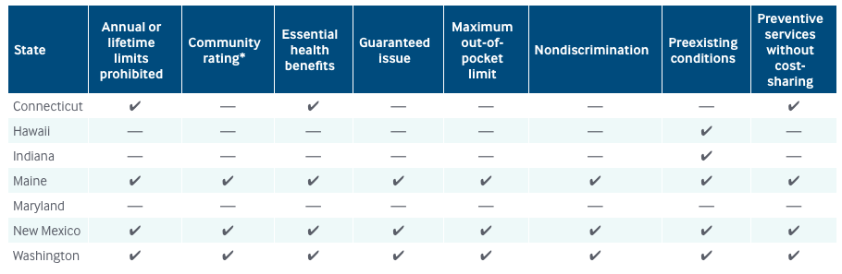
√
Nevada - - - - - - √ -
Notes:
Most states just cherry picking
but Washington (6/8) and RI (7/8) Maine and NM locking in broader slate of protections
https://www.commonwealthfund.org/blog/2019/can-states-fill-gap-preexisting-condition-protections
Updating Connecticut — https://patch.com/connecticut/guilford/rep-scanlon-health-care-bills-become-law Public Act 19-134 https://www.cga.ct.gov/2019/act/pa/pdf/2019PA-00134-R00HB-05521-PA.pdf protects those with preexisting conditions but I’m not convinced it outlaws Broader ACA medical underwriting provisions
Nevada Assembly Bill 170—pre-existing condition protection

Slide 13

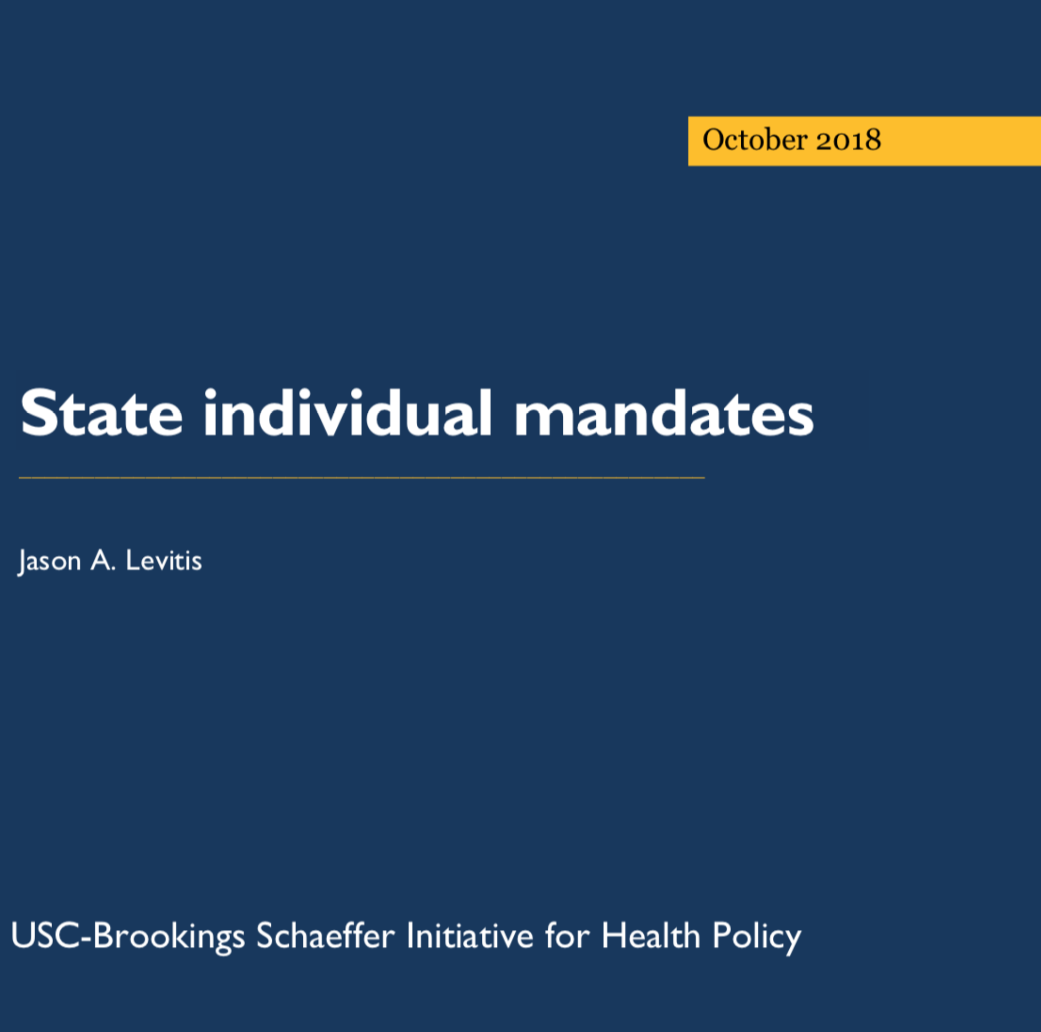
Individual Mandate
District of Columbia, New Jersey, and Vermont have passed mandates
Connecticut, Hawaii, Maryland, and Washington were considered likely to join them.
2019 Maryland health bill originally included mandate, but dropped during legislative process. Failed to pass in Hawaii. Withdrawn from Connecticut bill (which failed anyway). Washington and Vermont downgraded to feasibility studies.
California, 2 bills to create the mandate working their way through the Legislature. Gov. Newsom promoting them “California needs to stabilize a health insurance market that has suffered a “kneecapping” by the Trump administration.”
Note: mandate also gives state opportunity to declare which policies satisfy mandate creating another opportunity to deal with skimpy plans and facilitates targeted outreach to cohorts/locales with high rates of uninsured (Brookings, 2018)
How important is the IM now? Increases in cost and chances of death spiral both reduced so…
Notes:
https://www.latimes.com/politics/la-pol-ca-gavin-newsom-healthcare-subsidies-individua-mandate-20190514-story.html
https://www.brookings.edu/wp-content/uploads/2018/10/Levitis_State-Individual-Mandates_10.29.18.pdf

Slide 14
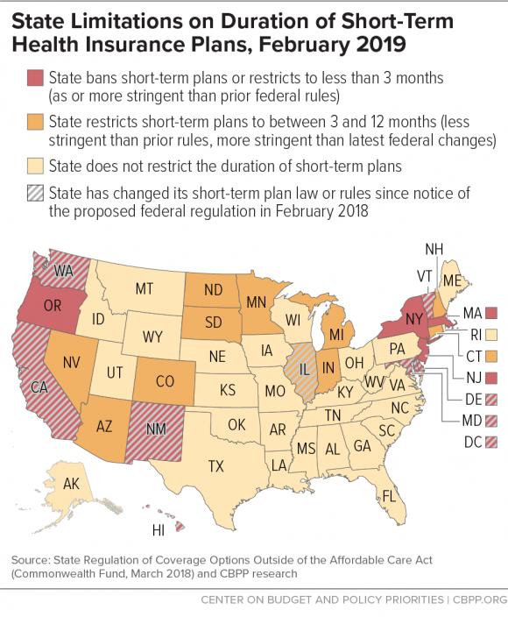
Prohibitions on Skimpy/STLDs Plans
Last Year
New Jersey (prohibited since 1993), D.C., California, Hawaii, Illinois, Oregon and Washington
Maryland clarified definition of “short-term limited duration insurance” by specifying that such insurance may not be extended or renewed and must apply the same underwriting standards to all applicants regardless of whether they have been previously covered by such insurance
Aug. 2 2018 letter from Pa Insurance Commissioner to DoL and HHS detailing “vigorous” oversight (translation-“when hell freezes over”)
This Year
DC: Health Insurance Marketplace Improvement Act Of 2018 (1/23/20198)
Colorado, Delaware, Washington & NM (by rule), Vermont (by statute) Defining short-term plans = nonrenewable & limited to 3 months
CA Senate Bill No. 1375, Approved by Governor September 22, 2018: Bars individuals from AHPs plans (bill author described plans as “junk insurance”)
Cf. Florida SB 322 (May 2019), specifically allows STLDs and AHPs
Notes:
https://www.cbpp.org/blog/more-states-protecting-residents-against-skimpy-short-term-health-plans
https://insuremekevin.com/california-wont-allow-trumps-small-group-association-plans-for-2019/#Lq1dSeOqqlXthD0W.99
https://www.commonwealthfund.org/publications/issue-briefs/2019/may/states-step-up-protect-markets-consumers-short-term-plans
https://www.rwjf.org/en/library/research/2019/01/the-marketing-of-short-term-health-plans.html

Slide 15
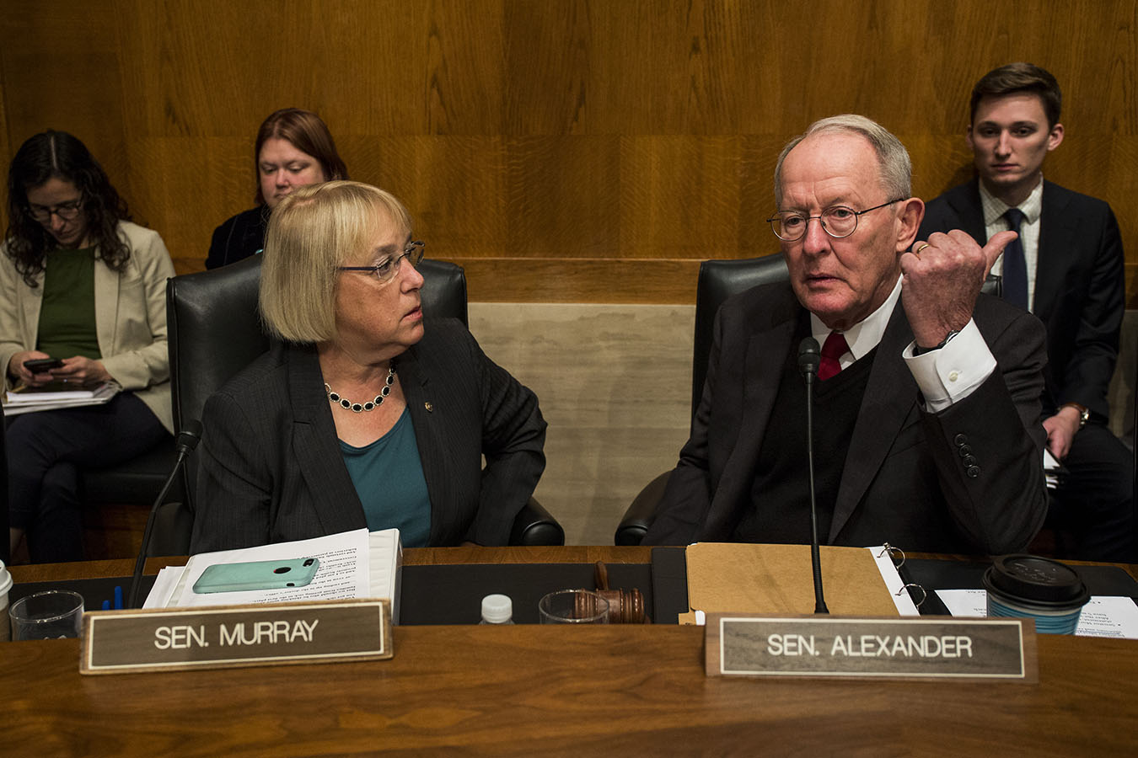


Market Stabilization
The 3 Rs: Reinsurance: No! Risk adjustment: Yes! Risk corridors (Maybe)
Maine Community Health Options v. U.S., 133 Fed.Cl. 1 (2017) ($12 billion breach of contract claim defended on basis that moneys not appropriated) (N), cert. granted 6/24/2019
Recall: Murray-Alexander plan to reintroduce reinsurance gains bipartisan support, but cannot survive toxicity after Graham-Cassidy repeal bill introduced and fails
Notes:
ACA included 3 measures to stabilize insurance markets—the 3 Rs, reinsurance, risk adjustment, and risk corridors. Reinsurance was always viewed as transitional and has sun-setted. Risk-adjustment deters insurance plans from cherry picking healthy enrollees or protects insurers with bad risk pools. For a while in 2018 it looked like Risk Adjustment was going away but it soon popped back. Risk corridors seek to minimize high risks by equalizing high returns with losses within some bands or corridors. Risk corridors have bene suspended by administration on basis that funds not appropriated but SCOTUS has granted cert on that issue
4/30/2109—“President Trump encouraged Democratic Sen. Patty Murray (Wash.) to resume efforts to find a bipartisan deal to shore up ObamaCare at a White House meeting on Tuesday.
Trump said that he did not understand why the bipartisan proposal that Murray worked on in 2017 and 2018 with Sen. Lamar Alexander (R-Tenn.) had been dropped, according to a Democratic source.
Murray replied that she had been told the White House would veto the measure. Trump replied that he never said that and encouraged Murray and Alexander to resume their efforts, a Democratic source said.”
https://thehill.com/policy/healthcare/441438-trump-urges-dem-senator-to-revive-bipartisan-obamacare-talks
https://www.modernhealthcare.com/article/20190117/NEWS/190119916/cms-wants-to-cut-aca-exchange-fees-end-silver-loading
https://khn.org/news/sen-alexander-releases-bipartisan-plan-to-lower-health-costs-end-surprise-bills/
https://www.politico.com/story/2019/06/03/obamacare-rate-hikes-appear-modest-for-2020-1497115
https://www.fiercehealthcare.com/payer/doj-asks-supreme-court-to-toss-payers-suits-seeking-12b-risk-corridor-payments
https://www.commonwealthfund.org/blog/2014/three-rs-health-insurance

Slide 16
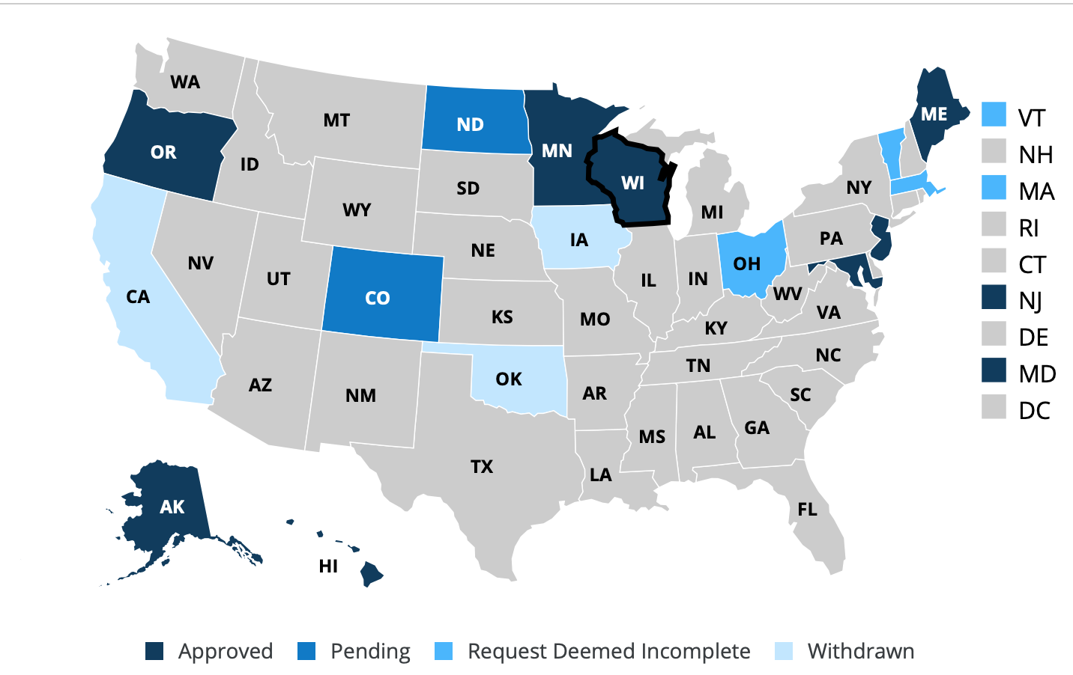
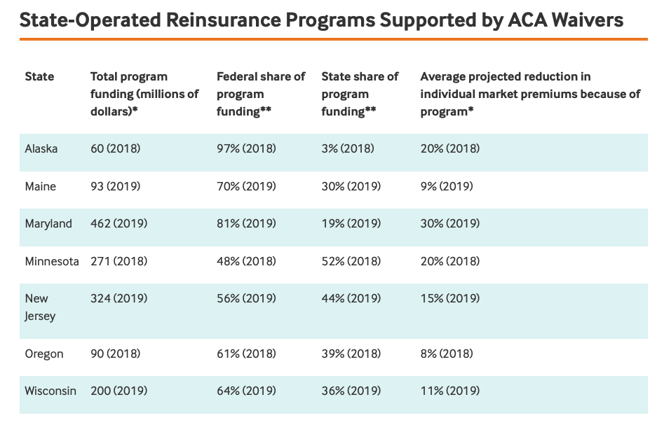
State Reinsurance Plans
Last year:
Alaska, Minnesota, Maryland, Wisconsin, Maine, New Hampshire, Oregon, New Jersey
This year:
Trend continues, e.g., Colorado and ND
Minnesota Premium Security Plan (reinsurance plan) renewed, no new appropriation required
Typically, (partially) funded through §1332 waiver—by which the state receives federal pass-through funding in the amount of the savings that would be generated from the resulting reduction in premium tax credits subsidies
Notes:
Waiver waives the single risk pool requirement in the individual market under ACA § 1312 (c)(1)
https://www.cms.gov/CCIIO/Programs-and-Initiatives/State-Innovation-Waivers/Downloads/Wisconsin-1332-Letter-final-and-signed.pdf
https://www.healthaffairs.org/do/10.1377/hblog20180803.450619/full/?
First is quote from Families USA summary
New Jersey approved https://www.healthaffairs.org/do/10.1377/hblog20180817.789199/full/?
https://www.commonwealthfund.org/blog/2019/administration-tried-make-it-easier-states-waive-aca-rules-will-any-take-plunge
https://www.kff.org/health-reform/fact-sheet/tracking-section-1332-state-innovation-waivers/
http://www.startribune.com/minnesota-extends-reinsurance-program/510776452/
https://www.kff.org/health-reform/fact-sheet/tracking-section-1332-state-innovation-waivers/

Slide 17
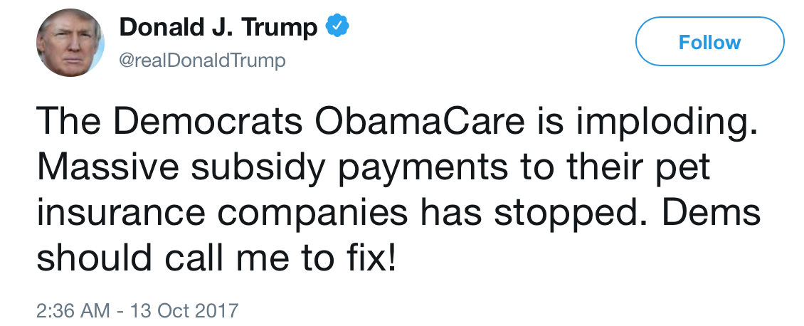

CSRs and Silver Loading
Recall House v. Price, etc., end of subsidy payments, etc.
CBO estimates that terminating CSR payments would increase premiums by 20% and increase the federal deficit, on net, by $194 billion from 2017 through 2026
However— tax credits increase in value along with the price of silver plan and if you qualify for a subsidy, you can never be asked to pay more than a set fraction of your income.
Insurers put all their increases into silver plans, essentially folding the CSR costs ($20b p.a.) back on the federal government.
Silver plans likely out of reach for >400 FPL (but better for low income persons, so progressives’ enthusiasm for CSR reinstatement not as strong)
CMS proposed Payment Notice for the 2020 allows loading for 2020 but suggests regulating them out if Congress doesn’t fix the subsidies
Insurers cases claiming CSRs continue before Court of Claims—and insurers are winning them. See e.g., Maine Community Health Options v. U.S., 142 Fed. Cl. 53 (Feb. 15, 2019) (Sweeney, CJ); Local Initiative Health Authority for L.A. County v. U.S., 142 Fed.Cl. 1 (Feb. 14, 2019) (Wheeler J.) (“The Government promised to make full and advanced CSR payments both in statute and through contract for which it is now liable. L.A. Care should not be left “holding the bag” for taking our Government at its word” at *21)
Notes:
The support process under the ACA for individual market plans is twofold—income-tied tax credits for purchase of a metallic plan, platinum, gold, silver or bronze and cost-sharing subsidies (CSRs) to reduce out-of-pocket costs for those with annual incomes below 250% of the federal poverty level. Administration decided to terminate CSR payments to insurers. But, insurers still under statutory duty to reduce costs…so ….got creative
Comments from Covered California https://www.coveredca.com/news/pdfs/CoveredCA_Consequences_of_Terminating_CSR.pdf
https://www.nytimes.com/2017/10/18/upshot/trumps-attack-on-insurer-gravy-train-could-actually-help-a-lot-of-consumers.html?
https://www.cms.gov/newsroom/press-releases/cms-issues-proposed-payment-notice-2020-coverage-year
https://www.healthleadersmedia.com/finance/end-silver-loading-question-queued-2021

Slide 18

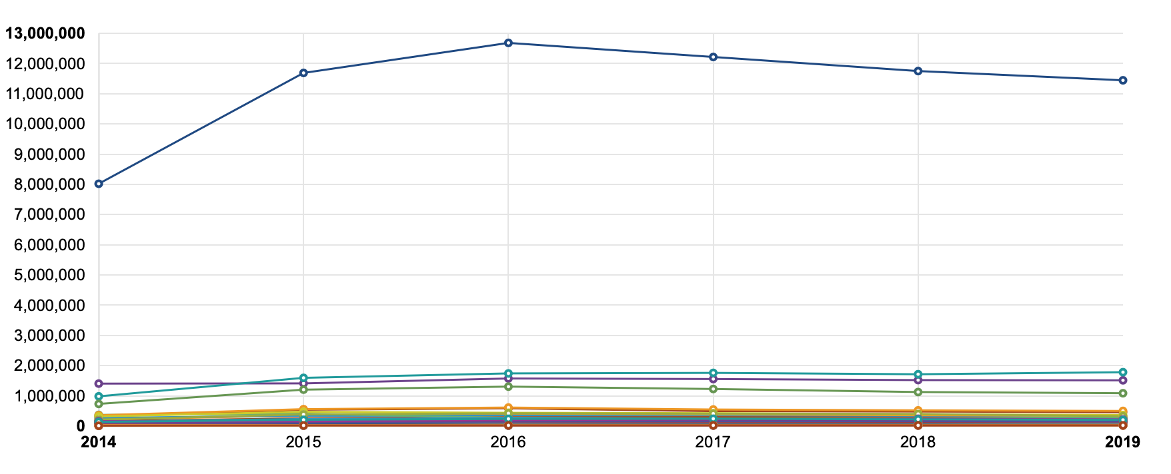
Notes:
CBO originally estimated that repeal of individual mandate would increase uninsured by 13m—that now revised to 7m, https://thehill.com/policy/healthcare/441888-cbo-repealing-mandate-penalty-increases-uninsured-by-7-million
Projected to rise by another 5 million by 2029
https://www.cbo.gov/system/files/2019-05/55085-Summary_0.pdf
Latest census figure last week—share of Americans without health insurance grew to 8.5 percent. https://www.washingtonpost.com/news/business/wp/2019/09/10/poverty-rate-fell-last-year-but-share-of-americans-without-health-insurance-rose-census-bureau-says/?wpisrc=al_news__alert-economy--alert-national&wpmk=1

Slide 19
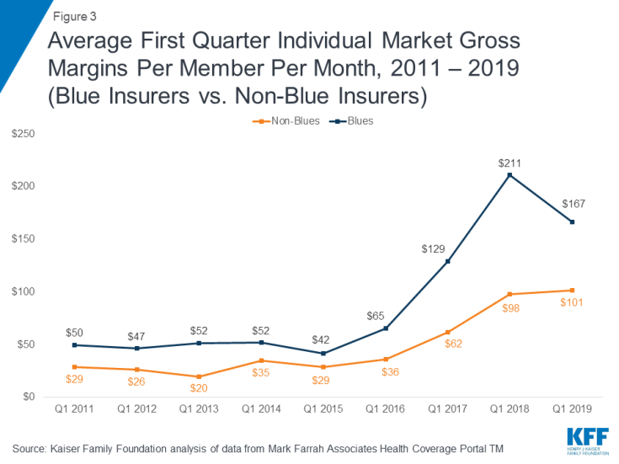
Markets Stable?
Markets may not need further stabilization as markets stabilize as insurers make money!
“For the first time since the marketplaces were established in 2014, premiums for the popular benchmark plans — which are used to establish subsidies — dipped by 1.5 percent in the 39 states relying on HealthCare.gov.” (Politico) likely because insurers had overpriced impact of loss of Individual Mandate and skimpy plans (KFF)
Gross margins increased in Q1 2019 (particularly for the Blues) (KFF)
Some proposed increases for 2020 very low (e.g., $.94 in Washington)
Note also, CMS proposed Payment Notice for the 2020 proposed reducing the exchange user fee that is charged to health insurers to fund the health insurance exchanges. That should help lower premiums in 2020
Notes:
4/30/2109—“President Trump encouraged Democratic Sen. Patty Murray (Wash.) to resume efforts to find a bipartisan deal to shore up ObamaCare at a White House meeting on Tuesday.
Trump said that he did not understand why the bipartisan proposal that Murray worked on in 2017 and 2018 with Sen. Lamar Alexander (R-Tenn.) had been dropped, according to a Democratic source.
Murray replied that she had been told the White House would veto the measure. Trump replied that he never said that and encouraged Murray and Alexander to resume their efforts, a Democratic source said.”
https://thehill.com/policy/healthcare/441438-trump-urges-dem-senator-to-revive-bipartisan-obamacare-talks
https://www.modernhealthcare.com/article/20190117/NEWS/190119916/cms-wants-to-cut-aca-exchange-fees-end-silver-loading
https://khn.org/news/sen-alexander-releases-bipartisan-plan-to-lower-health-costs-end-surprise-bills/
https://www.politico.com/story/2019/06/03/obamacare-rate-hikes-appear-modest-for-2020-1497115
https://www.fiercehealthcare.com/payer/doj-asks-supreme-court-to-toss-payers-suits-seeking-12b-risk-corridor-payments
https://www.kff.org/private-insurance/issue-brief/individual-insurance-market-performance-in-early-2019/?

Slide 20
Benefits

Slide 21
Essential Health Benefits; How We Got Here!
ACA Section 1302: 10 EHBs for individual (exchange) and small group plans (although in large part based on pre-ACA state EHBs). Exact coverages under each EHB “benchmarked” by employer-provided state plans
Threatened by “Repeal & Replace” (& now by Texas v. U.S.)
States moved to codify:
EHBs (Hawaii, New York, NJ), or
Benchmark process (Washington, California)
Notes:
Codifying EHBs—making the ACA’ 10 EHBs part of state law
Codifying Benchmark plan—While only Congress can remove one of the 10 EHBs from the ACA, the Secretary of Health & Human Services is required to periodically “update” the EHB and could re-write the rules to allow insurers to cover fewer treatments or services within the EHB categories (as happened in April).—this also gives opportunities to add more services e.g., pediatric dental
https://snjtoday.com/2019/06/03/governor-murphy-and-legislative-partners-announces-bill-package-to-protect-affordable-care-act-in-new-jersey/

Slide 22
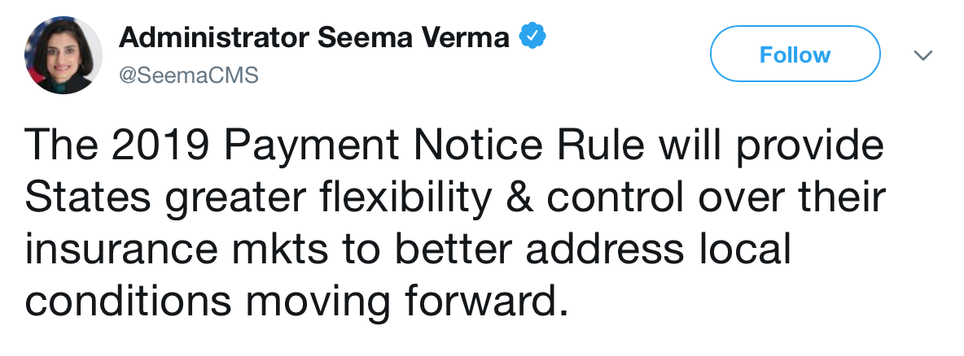
Essential Health Benefits-CMS Payment Notices
2019 Final Rule (83 FR 16930) & Payment Notice (April 9, 2018)
Beginning with 2020 plan year Options (1) Keep own benchmark, (2) Adopt a new one, (3) adopt another state’s benchmark, or (4) replace an EHB category with another state’s benchmark (Illinois only state to make change (opioids/pain)
Some concerns about a “race to the bottom,” “generosity” provision that stops states getting carried away, given that feds paying, and potential for states to discriminate against high-risk persons
2020 Final Rule (84 FR 17454) & Payment Notice (April 18, 2019)
Little change from prior rule/notice
Encourages coverage of MAT, anti-discriminatory warnings
Maximum annual OOP limit for 2020 is $8,150 for self-only, $16,300 for family coverage (3.16% over 2019)
Notes:
https://www.healthaffairs.org/do/10.1377/hblog20180410.631773/full/
https://www.healthaffairs.org/do/10.1377/hblog20190419.213173/full/
https://www.healthaffairs.org/do/10.1377/hblog20190420.666282/full/

Slide 23
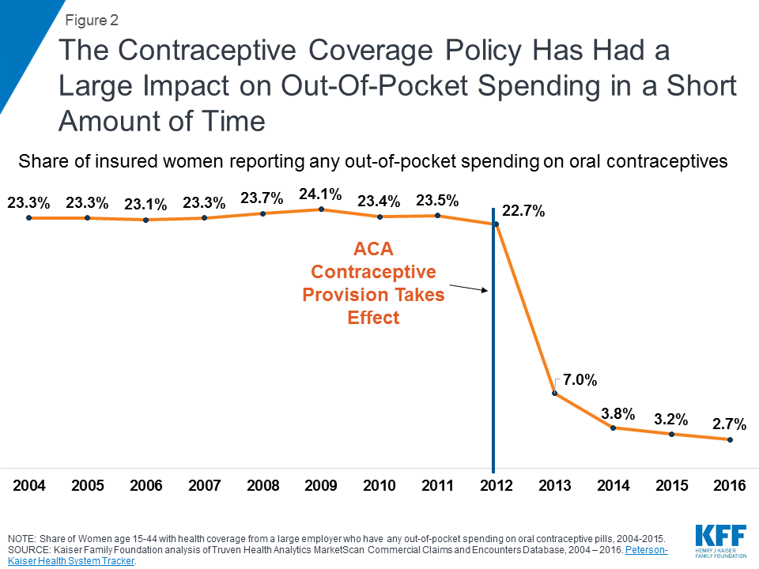
EHBs: Contraceptive Coverage
Continued fallout from Hobby Lobby, Wheaton College, and Zubik despite 77% of women and 64% of men reporting support for no-cost contraceptive coverage ($1.4b per year in OOP savings)
Evidence of a sharp spike in women seeking long-acting reversible contraception in the month after the 2016 election (Pace et al, JAMA)
Example of path dependent health insurance reliant on employers extended to sexual health
Interim Rules (October 2018) enjoined in multiple states
Impact of DeOtte v. Azar, 2019 WL 3786545 (N.D. Texas, July 29, 2019? Class action (“Every current and future employer in the United States that objects, based on its sincerely held religious beliefs) injunction against contraceptive mandate. U.S. decided not to defend, Nevada denied intervention — so permanent and unappealable!
Notes:
Most of what I have been talking to you about—the tale of the 3 legged (now 2 legged) stool is insurance law/regulation applicable only to individual insurance, marketplace plans—although EHBs are also part of Medicaid — however, this next section applies broadly to include group health
According to a JAMA article there is evidence of a sharp spike in women seeking long-acting reversible contraception in the month after the 2016 election
https://jamanetwork.com/journals/jamainternalmedicine/article-abstract/2723071?guestAccessKey=0784ba9e-1dd9-46a3-92d7-9849b434a0e2
https://www.kff.org/health-reform/issue-brief/new-regulations-broadening-employer-exemptions-to-contraceptive-coverage-impact-on-women/

Slide 24
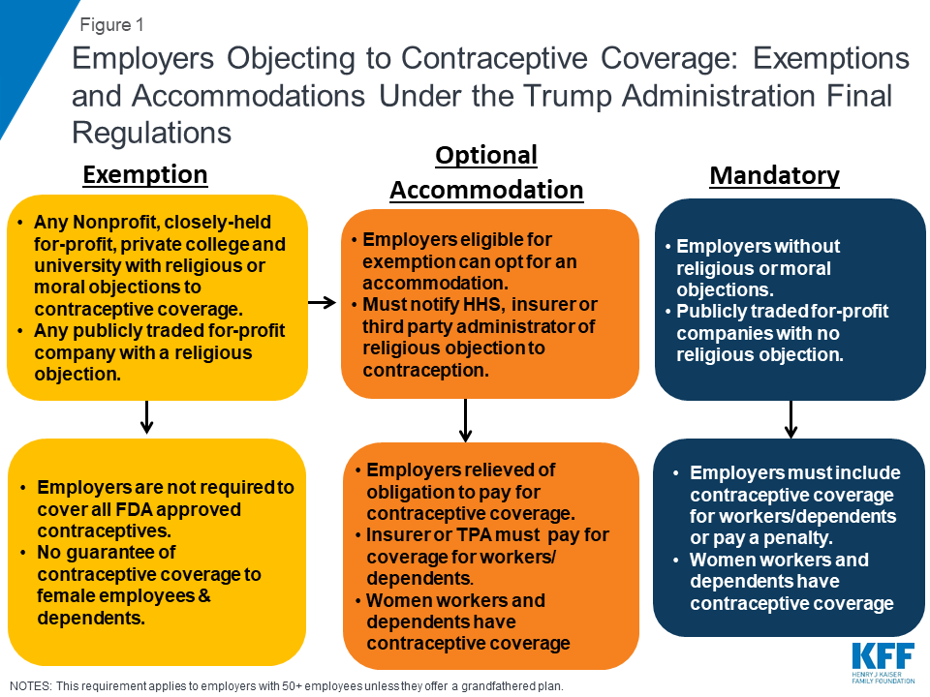
Final Rules on Religious (83 FR 57536) and Moral Objections (83 FR 57592) to Contraceptive Coverage
Religious Exemption significantly broadened the scope of the ACA religious exemption to encompass any non-profit or for-profit entity, whether closely held or publicly traded.
Moral Exemption made the exemption available to “additional entities”—including for-profit entities that are not publicly traded—that object based on “sincerely held moral convictions,” without any need for the objection to be grounded in a religious objection to contraception.
Enjoined (procedural (APA notice and comment) and substantive (exceed authority under ACA)
State of California v. HHS, (ND Ca., 01/13/19)
Cmlth of Pennsylvania v. Trump (ED Pa., 01/14/2019) , aff’d 2019 WL 3057657 (3d Cir, 07/12/2019)
Notes:
According to a JAMA article there is evidence of a sharp spike in women seeking long-acting reversible contraception in the month after the 2016 election
https://jamanetwork.com/journals/jamainternalmedicine/article-abstract/2723071?guestAccessKey=0784ba9e-1dd9-46a3-92d7-9849b434a0e2
https://www.kff.org/health-reform/issue-brief/new-regulations-broadening-employer-exemptions-to-contraceptive-coverage-impact-on-women/

Slide 25

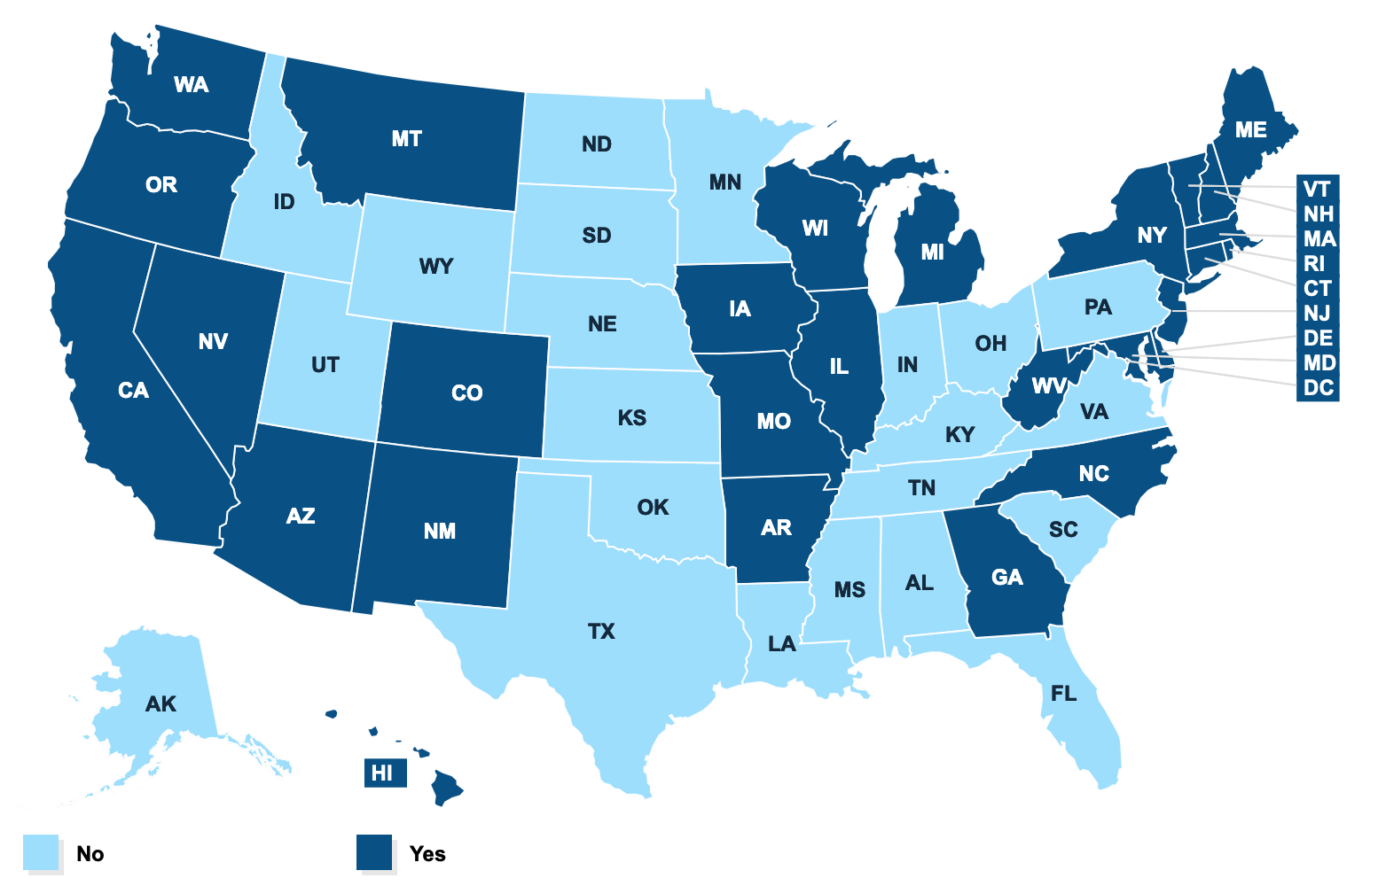
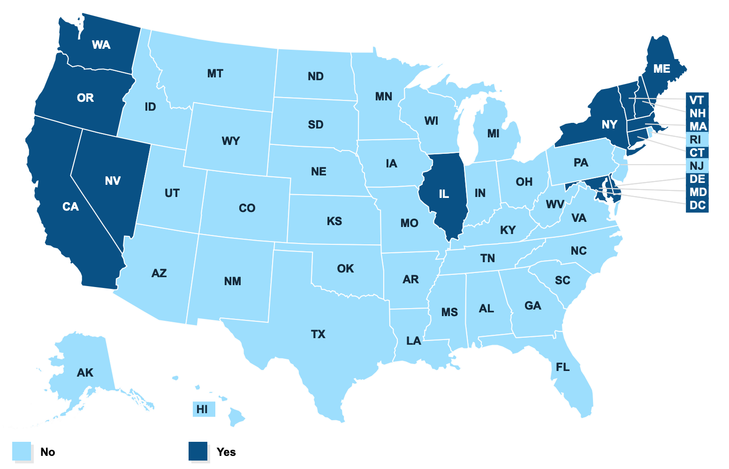
Notes:
Ten states and DC have strengthened and expanded the federal contraceptive coverage requirement (CA, IL, ME, MD, MA, NV, NY, OR, VT, WA). Soon NJ
Nationally this is what things look like — on the left the mandate (in 29 states) (tho’ there are some discrepancies between individual and group) and true “ACA” coverage that is free (14 states)
https://www.kff.org/other/state-indicator/state-requirements-for-insurance-coverage-of-contraceptives/?
BTW the lawsuit over Notre Dame’s contraceptive coverage filed in D. N.IN June 2018) is alive and I think has had oral arguments

Slide 26
States Moving to Offense
Notes:
To an extent these are both about state health insurance law and policy and canaries in the coal mine for broader national initiatives— The problems state Democratic lawmakers are confronting echo those the party would face at the national level if they sought a similar overhaul upon taking back Washington: How much to pay health care providers, how much to subsidize people's health care costs and how much of the private insurance market to preserve

Slide 27


Will California Lead the Way?
California Gov. Newsom committed to single-payer
However, initial priority given to shoring up/improving on ACA (“Healthcare for More”)
Individual mandate
Expanded subsidies
Coverage of undocumented persons up to age 26
Notes:
https://www.desertsun.com/story/news/2019/01/28/newsoms-move-not-yet-health-care-all-but-health-care-more/2706091002/

Slide 28
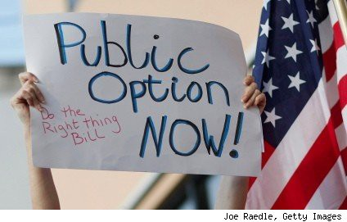
Public Option
Washington SB 5526 - 2019-20 (May, 2019) — “Cascade Care,” hybrid public-private system where the state will contract with private health insurers to administer the plans, but will control the terms to manage costs (but estimated at only 5-10% savings)
Colorado (2019) — legislation orders state agencies to undertake feasibility study
Connecticut (May 2019) — Legislation to establish government-subsidized health care ("Connecticut Option") abandoned reportedly following a threat by Cigna Corp. that the insurer would leave Connecticut if measure passed. Some signs of negotiations restarting (July 2019)
Notes:
https://www.courant.com/business/hc-biz-cigna-public-option-20190529-ys76asflezhgvismme6rtcaymi-story.html
https://familiesusa.org/sites/default/files/product_documents/NCCI_NCCI_MD-Easy-Enrollment-Health-Plan_Fact-Sheet_0.pdf
https://www.politico.com/story/2019/05/14/washington-public-health-plans-1431816?
Canary in the coal mine— The problems state Democratic lawmakers are confronting echo those the party would face at the national level if they sought a similar overhaul upon taking back Washington: How much to pay health care providers, how much to subsidize people's health care costs and how much of the private insurance market to preserve — if any. https://www.politico.com/story/2019/04/08/health-care-blue-states-1308730
https://coloradosun.com/2019/04/02/colorado-public-health-care-option-bill-2019/
https://www.middletownpress.com/middletown/article/Health-reform-talks-are-back-as-key-leaders-fight-14189266.php

Slide 29
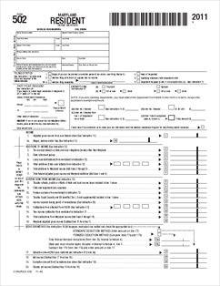
Insurance Access
Maryland, HB 814, SB 802 (March 2019) — an uninsured Marylander can start the enrollment process by simply checking a box on their state income tax return. That single step will let the state’s health care exchange determine eligibility for free or low-cost health insurance, based on information in the tax return. Those who qualify for Medicaid will be enrolled automatically. When people qualify for private coverage, the exchange will reach out and help them sign up for a plan that works for their family. (Families USA)
Notes:
https://www.courant.com/business/hc-biz-cigna-public-option-20190529-ys76asflezhgvismme6rtcaymi-story.html
https://familiesusa.org/sites/default/files/product_documents/NCCI_NCCI_MD-Easy-Enrollment-Health-Plan_Fact-Sheet_0.pdf
https://www.politico.com/story/2019/05/14/washington-public-health-plans-1431816?
Canary in the coal mine— The problems state Democratic lawmakers are confronting echo those the party would face at the national level if they sought a similar overhaul upon taking back Washington: How much to pay health care providers, how much to subsidize people's health care costs and how much of the private insurance market to preserve — if any. https://www.politico.com/story/2019/04/08/health-care-blue-states-1308730
https://coloradosun.com/2019/04/02/colorado-public-health-care-option-bill-2019/
https://www.middletownpress.com/middletown/article/Health-reform-talks-are-back-as-key-leaders-fight-14189266.php

Slide 30
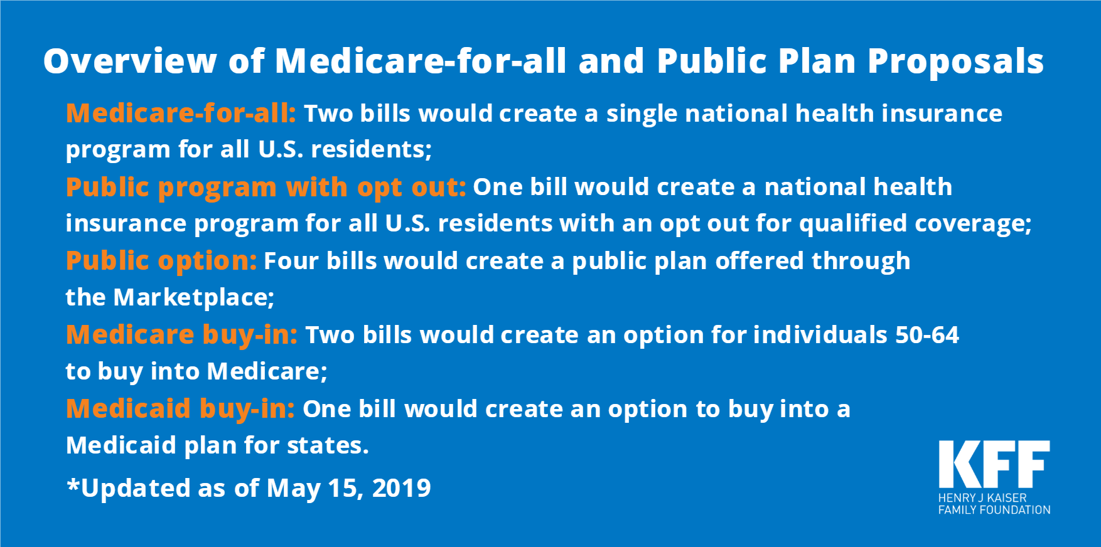

Concluding Thoughts
Existential threat is real and ongoing albeit in the courtroom (5th Circuit), not on the Hill
Congressional Kabuki theater continues but with script inverted—Symbolic House repeal bills that President Obama would veto now replaced by House ACA support bills that Senate won’t take up
Trump Administration continues, arguably at a reduced rate, to enable destabilizing of state health plans but frustrated by generally ACA-supportive litigation
Marketplace enrollments are in relatively slow decline, with the number of uninsured rising slightly faster (e.g., because those without premium assistance plans leaving individual market). Overall, declines in insurance create health problems not just for those uninsured because of the need for the “herd” to be healthy. Declines in insurance also adversely affect corporate and state revenues
State defensive legislation continues, but again at reduced rate
Very blue states move into offensive mode to improve healthcare financing and delivery above ACA baseline
If 5th Circuit upholds Texas decision SCOTUS oral arguments, etc. will likely take place in run-up to 2020 election! And …

Slide 31
Q & A
Mail: npterry@iupui.edu
Twitter: @nicolasterry
Nicolas Terry
Hall Render Professor of Law & Executive Director of the Hall Center for Law and Health
Indiana University Robert H. McKinney School of Law

