Slide 1
Ethics
Claire Szpara, Attorney and Ethics Officer, IDOI
Heidi Adair, Staff Attorney, OIG

Slide 2
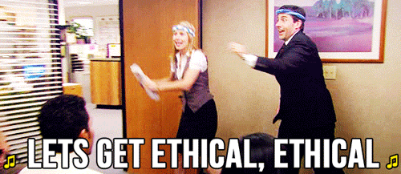
Let’s Get Ethical!

Slide 3
Introduction to the OIG & State Ethics Commission
Investigate Complaints
Adjudicate Complaints
Advice
Notes:
Sometimes there’s a bit of confusion as to whether the OIG and the State Ethics Commission are the same agency or completely separate, or what the deal is…
I’ll delve deeper into what each does, but in terms of how they intersect, this slide sums it up
Both are in the advisory game – issuing advisory opinions on how the Code of Ethics applies to different fact scenarios - but the OIG investigates allegations of ethics violations and files complaints with the State Ethics Commission, who then hold a full public administrative hearing and decide the case.

Slide 4
Establish Code of Ethics
Advise
Law Enforcement Agency
Educate
Investigate
WHO we are and WHAT we do:
Office of Inspector General

Slide 5
WHO we are and WHAT we do:
State Ethics Commission
Monthly Meetings
5 members
Advise
Adjudicate

Slide 6
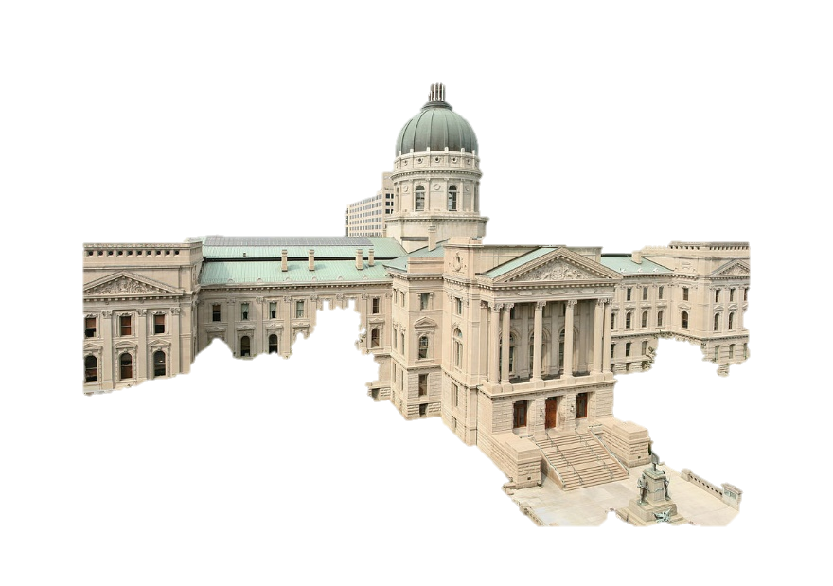
WHERE?
Executive
State Agencies
Boards & Commissions
Contractors

Slide 7
Hoosiers deserve to know that government decisions are being made in the public interest, not because of gifts, political contributions, or undue influence; . . . It is imperative that clear ethics guidelines be developed and rigorously enforced to ensure that all state employees meet the highest standards of conduct; - Executive Order 05-03
WHY was the Office of Inspector
General created?

Slide 8
Why focus on Executive Branch?
Majority are appointed
Executive Branch has by far the greatest number of employees and budgeted dollars of any of the three branches of government
Employees in the Executive Branch are entrusted to make many discretionary decisions affecting all levels of government operations
Notes:
The public does not get to vote on or hire these individuals – we all serve at the pleasure of the Governor
And there are a lot of unelected officials running the government, making decisions that impact the everyday lives of those who live and work in this State of Indiana –
And to do so effectively they need to have the highest level of integrity in order to earn and maintain the trust of the public

Slide 9
HOW?
Executive Order 05-03
Gov. Daniels’ vision
Serve as public watchdog
Root out fraud and ethical misconduct
Creation of OIG
Responsible for addressing fraud, abuse, and wrongdoing in agencies
IC 4-2-7
IC 4-2-6
Creation of State Ethics Commission
Ethics Statutes for Code of Ethics (42 IAC 1)

Slide 10
OIG Tools
OIG/SEC Tools
Law Enforcement Office with subpoena and arrest powers
Confidentiality for reporting parties and investigations
Protections against retaliation for reporting parties
Ability to prosecute cases if local prosecutor won’t accept
Informal Advisory Opinions
300 + per year
Formal Advisory Opinions
Educational offerings
voluntary and mandatory
Notes:
The confidentiality for reporting parties and investigations is very important
Because studies have shown that when employees feel confident there will be no retaliation, incidents are identified much more quickly, allowing organizations to resolve issues faster with less damage and expense
As are protections against retaliation for reporting parties
People need to have confidence that if they blow the whistle on another employee, maybe even their boss, that they won’t lose their job or otherwise be retaliated against

Slide 11
Indiana Code of Ethics
42 IAC 1-5-1 Gifts; Travel Expenses; Waivers 42 IAC 1-5-2 Donor Restrictions 42 IAC 1-5-3 Honoraria 42 IAC 1-5-4 Political Activity 42 IAC 1-5-5 Moonlighting 42 IAC 1-5-6 Conflicts Of Interests; Decisions And Voting 42 IAC 1-5-7 Conflicts Of Interests; Contracts 42 IAC 1-5-8 Additional Compensation 42 IAC 1-5-9 Bribery 42 IAC 1-5-10 Benefiting From Confidential Information 42 IAC 1-5-11 Divulging Confidential Information 42 IAC 1-5-12 Use Of State Property 42 IAC 1-5-13 Ghost Employment 42 IAC 1-5-14 Post-employment Restrictions 42 IAC 1-5-15 Nepotism
42 IAC 1-5-16 Communications by State Officers
Notes:
The public does not get to vote on or hire these individuals – we all serve at the pleasure of the Governor
And there are a lot of unelected officials running the government, making decisions that impact the everyday lives of those who live and work in this State of Indiana –
And to do so effectively they need to have the highest level of integrity in order to earn and maintain the trust of the public

Slide 12
Who does Ethics Code apply to?
State employees
State officers
Special state appointees
Persons who have a business relationship with the State
Notes:
The public does not get to vote on or hire these individuals – we all serve at the pleasure of the Governor
And there are a lot of unelected officials running the government, making decisions that impact the everyday lives of those who live and work in this State of Indiana –
And to do so effectively they need to have the highest level of integrity in order to earn and maintain the trust of the public

Slide 13
What does this mean to a regulated entity?
Executive branch lobbyists may not serve as special state appointees, except on advisory bodies.
If you have a business relationship with an agency, you are subject to the nepotism and gift rules.
If you profited by virtue of an employee, state official or special state appointee violation, the commission may revoke your license or permit, revoke the registration of a person registered as a lobbyist or bar you from obtaining a license, permit or lobbying activity with a state officer or agency.
Notes:
The public does not get to vote on or hire these individuals – we all serve at the pleasure of the Governor
And there are a lot of unelected officials running the government, making decisions that impact the everyday lives of those who live and work in this State of Indiana –
And to do so effectively they need to have the highest level of integrity in order to earn and maintain the trust of the public

Slide 14
Indiana Code of Ethics
Gifts
Post-employment
Conflict of interests
Nepotism
Notes:
The public does not get to vote on or hire these individuals – we all serve at the pleasure of the Governor
And there are a lot of unelected officials running the government, making decisions that impact the everyday lives of those who live and work in this State of Indiana –
And to do so effectively they need to have the highest level of integrity in order to earn and maintain the trust of the public

Slide 15
Gifts
• State workers:
Do not accept a gift from a person who has a business relationship with your agency (42 IAC 1-5-1)
• Those outside of state government:
Do not offer a gift to a state employee or special state appointee if you have a business relationship with the employee’s/special state appointee’s agency (42 IAC 1-5-2)
Notes:
The public does not get to vote on or hire these individuals – we all serve at the pleasure of the Governor
And there are a lot of unelected officials running the government, making decisions that impact the everyday lives of those who live and work in this State of Indiana –
And to do so effectively they need to have the highest level of integrity in order to earn and maintain the trust of the public

Slide 16
Business Relationship?
Definition:
Dealings of a person
Seeking, obtaining, establishing, maintaining or implementing
A pecuniary interest in a contract or purchase
A license or permit requiring the exercise of judgment or discretion
The relationship of a lobbyist, including an unregistered lobbyist
Notes:
The public does not get to vote on or hire these individuals – we all serve at the pleasure of the Governor
And there are a lot of unelected officials running the government, making decisions that impact the everyday lives of those who live and work in this State of Indiana –
And to do so effectively they need to have the highest level of integrity in order to earn and maintain the trust of the public

Slide 17
What does this mean to a regulated entity?
HAVE a business relationship
SEEK a business relationship
SEEK to influence an employee, state official or special state appointee in official capacity

Slide 18
What is a “gift”?
Gift
When is something not a “gift”?
Multiple exceptions
Favor
Service
Entertainment
Food/Drink
Travel expenses
Registration Fees
Nominal value
Reimbursement to Treasurer of State
Notes:
The public does not get to vote on or hire these individuals – we all serve at the pleasure of the Governor
And there are a lot of unelected officials running the government, making decisions that impact the everyday lives of those who live and work in this State of Indiana –
And to do so effectively they need to have the highest level of integrity in order to earn and maintain the trust of the public

Slide 19
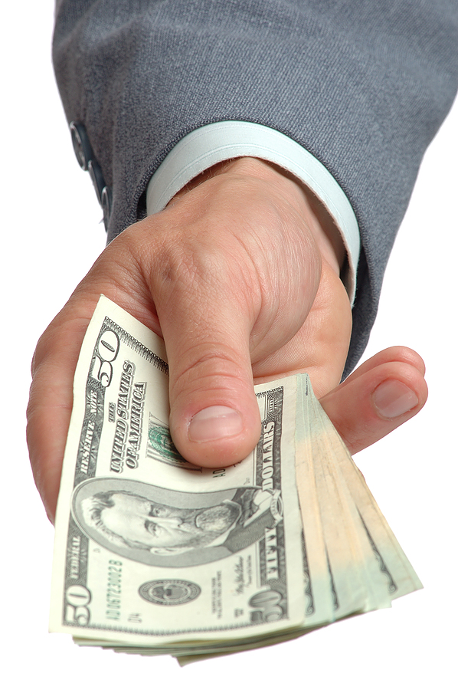
Additional Compensation
State workers cannot accept any additional compensation for doing their job.
This includes any money, thing of value, or financial benefit.
Notes:
The public does not get to vote on or hire these individuals – we all serve at the pleasure of the Governor
And there are a lot of unelected officials running the government, making decisions that impact the everyday lives of those who live and work in this State of Indiana –
And to do so effectively they need to have the highest level of integrity in order to earn and maintain the trust of the public

Slide 20
Conflicts of Interests
COI: Decisions and Votes – IC 4-2-6-9
COI: Contracts – IC 4-2-6-10.5
COI: Outside employment/moonlighting
– IC 4-2-6-5.5

Slide 21
Conflicts of Interests
State Workers:
• Do not participate in decisions/votes, or related matters, if you know that you, an immediate family member, a business organization you serve (as employee, director, officer, member, etc.), or any person/organization with whom you are negotiating employment has a financial interest in the outcome.
Notes:
The public does not get to vote on or hire these individuals – we all serve at the pleasure of the Governor
And there are a lot of unelected officials running the government, making decisions that impact the everyday lives of those who live and work in this State of Indiana –
And to do so effectively they need to have the highest level of integrity in order to earn and maintain the trust of the public

Slide 22
COI: Areas of Concern
• Relationships
• Boards and Commissions
• Employment Negotiations
• Outside employment/moonlighting
Notes:
The public does not get to vote on or hire these individuals – we all serve at the pleasure of the Governor
And there are a lot of unelected officials running the government, making decisions that impact the everyday lives of those who live and work in this State of Indiana –
And to do so effectively they need to have the highest level of integrity in order to earn and maintain the trust of the public

Slide 23
Outside employment
• State workers: do not take a second job that would conflict with your state job; do not use confidential information; do not use your state position for personal gain
• Regulated entities: though tempting to hire an expert in the field for contract work, consulting, etc. be careful that the state worker will not have any conflicts of interests

Slide 24
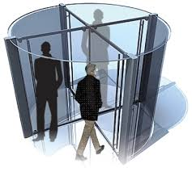
Post-employment
Cooling off requirement - IC 4-2-6-11(b)
• “revolving door”
• executive branch lobbying
• negotiation/administration of state contract
• regulatory/licensing decisions

Slide 25
Post-employment
Particular Matters IC 4-2-6-11(a)
(1) an application (8) a judicial proceeding
(2) a business transaction (9) a lawsuit
(3) a claim (10) a license
(4) a contract (11) an economic development project
(5) a determination (12) a public works project
(6) an enforcement proceeding
(7) an investigation
Notes:
Life of the matter (not limited to one-year)
Personal and substantial participation as state worker

Slide 26
Post-employment
Particular Matters Restriction - IC 4-2-6-11(c)
• Life of the matter (not limited to one-year)
• Personal and substantial participation as state worker
Notes:
Life of the matter (not limited to one-year)
Personal and substantial participation as state worker

Slide 27
Nepotism
Nepotism - IC 4-2-6-16
• Do not hire/supervise a relative
• Do not contract with a relative

Slide 28
Applied Ethics
Scenarios

Slide 29
Scenario
State agency with independent contactors
Independent contractor hosts paid luncheon for agency employees
Independent contractor sends $20 gift cards to agency employees
Is there an ethics violation?

Slide 30
Scenario
Employee of regulated entity is working closely with an IDOI attorney/employee on a project
Become friends
Invited to IDOI employee’s wedding
Attend the wedding and bring a gift
Is there an ethics violation?

Slide 31
Scenario
Agency employee applying for scholarship
Scholarship offered by an agency vendor
Agency employee would not receive direct payments from vendor
Is there an ethics violation?

Slide 32
Scenario
Agency employee very helpful on project
Want to maintain this relationship, let them know they did a really great job
Send thank you note and $20 gift card to the employee
Is there an ethics violation?

Slide 33
Scenario
Full-time agency employee looking for part-time position
Part-time employer has contract with agency
Part-time position has interaction with agency employees
Is there an ethics violation?

Slide 34
Scenario
Agency employee applied for outside position
Agency has regulatory authority over outside entity
Agency employee involved in pending investigation involving subsidiary of entity
Agency proposed screening procedure
Is there an ethics violation?

Slide 35
Scenario
Agency employee with consultant side job
Did not obtain approval for outside employment from supervisors
Agency employee created self-monitored screen and limited clients to those unrelated to agency position
Is there an ethics violation?

Slide 36
Scenario
Agency employee sells handmade items on Etsy
Tells you about this side business when at your place of business discussing a contract/claim
She leaves her card with you
Holidays roll around, you buy your significant other something from the state employee’s Etsy store
Is there an ethics violation?

Slide 37
Scenario
Family members are all insurance professionals
You just started a new job at an insurance firm and one of your first assignments is submitting a claim to IDOI
You find out your brother is in charge of the group at IDOI who will approve/deny the claim
Is there an ethics violation?

Slide 38
Scenario
Wife is chief of staff of state agency
Looking to contract with PR firm to deal with some bad publicity
Need to move very quickly, Husband is executive at PR firm
Wife hires this firm
Is there an ethics violation?

