Slide 1

Hot Topics in Enforcement
Indiana Department of Insurance
Consumer Protection Unit

Slide 2
Presentation Overview
Overview of the IDOI Consumer Protection Unit
Producer Licensing
Technology Advancements: Implications and Regulators
Notes:
My presentation is going to be broken up into three different sections. I am going to give you an overview of the Consumer Protection Unit which is comprised of four different areas:
Consumer Protection Division
Market Conduct Division
Title Division
Enforcement Division
… I am going to talk a little bit about investigations, what might trigger an investigation, and the role that the Enforcement Division plays in the approval or denial of new applications and application renewals … this would include insurance producers such as agents and bail agents ….
… and I want to briefly discuss advancements in technology, how technology is expected to impact the way business might be done in the insurance industry, and how these changes will impact regulators.

Slide 3

Consumer Protection Unit
Consumer Services Division
Market Conduct Division
Title Division
Enforcement Division
Notes:
The Consumer Protection Unit is comprised of Consumer Services Division, Market Conduct Division, The Title Division, and the Enforcement Division. I will not be talking about the Title Division because Jonathan just covered that particular area.
In general, the CPU interacts primarily with insurance agents, consumers, agencies, and companies, to resolve consumer complaints. Depending on our findings – the Consumer Protection Unit may be required to take disciplinary action against agents, agencies, or companies.
An administrative action might be initiated as a result of an agent who fails to disclose administrative action taken by another jurisdiction or failing to disclose criminal prosecution or conviction.
An administrative action might be taken against a company as a result of a market conduct examination where a broad range of consumer protection topics are addressed, such as violations concerning a company’s handling of claims, a pattern concerning complaints against agents, how complaints are handled or not handled, marketing and sales approaches, or underwriting.

Slide 4

Consumer Services Division
Resolution of Consumer Complaints
Improper Denial or Delay in Settling a Claim (IC 27-4-1-4.5)
Illegal Cancellation / Termination of a Policy
Matters not Resolved are Referred to Enforcement
Public Relations / Consumer Education
Notes:
Majority of complaints received by the Department are addressed by the Consumer Services Unit … and it goes without saying that most complaints are generated as a result of an issue with a claim or an issue with an agent or a broker.
I would like to point out that COMPLAINTS regarding AGENTS are typically forwarded to the Enforcement Division.
Not only do we investigate complaints made against agents, but we also MONITOR those complaints for PATTERNS among producers related to the same company.
Failure to Adjudicate Loss - (1) Refusing to pay claims without conducting a reasonable investigation based upon all available information, (2) Failing to affirm or deny coverage within a reasonable time period after insured has submitted proof of loss.
Before contacting DOI attempt to resolve issue with agent, broker, etc.
No satisfactory response – file a complaint with the Department.
DOI will not act as a legal rep for the consumer; will not intervene in a pending law suit;
Only addresses issues subject to insurance laws of the State if Indiana

Slide 5

Market Conduct
Identify Trends or Patterns Associated w/ Company Behavior
Consumer Complaints
Information or Complaints from other Divisions within IDOI
Articles or other Media Sources
Initiate a Targeted Market Conduct Examination –
When Directed
Recommendations in Resolving Market Issues
Work to Resolve Legal Issues or Inappropriate Market Behavior in lieu of Department Action.
Notes:
The Market Conduct Division performs examinations of companies and other licensed entities in order to ensure that they are in compliance with:
Contract Provisions
State Laws
Rules
Regulations
Performed to validate a suspected market conduct issue or to correct a problem.
Depending on the findings of a market conduct examination, and if the commissioner determine that regulatory action is warranted, the commissioner can initiate any proceeding or action authorized by law.

Slide 6
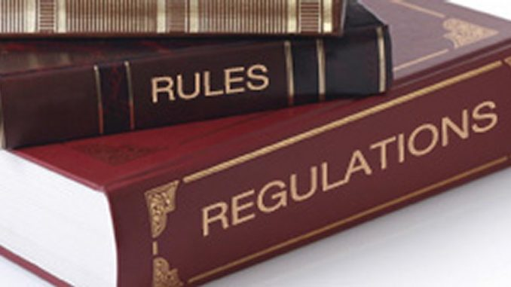
Enforcement Division
Entities Regulated by IDOI
Bail Bond / Recovery Agents
Real Estate Title Agents
Independent Adjusters
Public Adjusters (Represent the Insured)
Consultants
Independent and Captive Insurance
Producers
Company Insurance Producers
Third Party Administrators (TPA)
Managing General Agents (MGA)

Slide 7
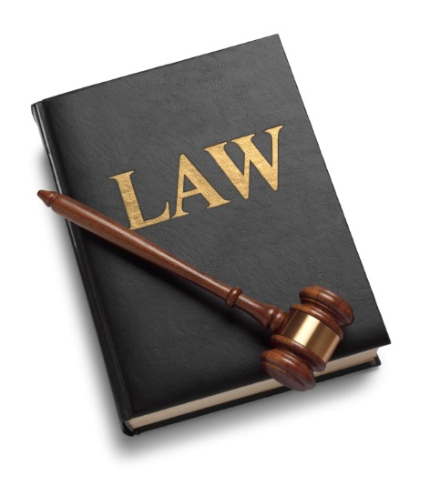
Enforcement Division
Entities Regulated by DOI
Professional Employer Organizations (PEO)
Health Maintenance Organizations (HMO)
Discount Medical Card Program Organizations
External Review Organizations (ERO)
Independent Review Organizations (IRO)
Preferred Provider Organizations (PPO)
Multiple Employer Welfare Organizations (MEWA)

Slide 8

Enforcement Division
Producer Licensing – Background Investigations
Producer Licensing – Renewals / New Applications
Producer Applications Adding a New Qualification
Criminal History
Administrative Actions in other States
FINRA (Financial Industry Regulation Authority)
Factors Barring an Applicant from Licensure (Disclosed)
Felony
Domestic Violence
Violent Misdemeanor
Theft, Embezzlement (Crimes of Dishonesty)
Notes:
WHAT MIGHT TRIGGER AN INVESTIGATION?
A. Producer Misconduct (e.g., Theft of a Premium, Falsifying Documentation, Deceptive Sales and Marketing practices (bait and switch), Public Adjuster Misconduct, Bail Agents.
B. New Applications (Disclosed / Undisclosed)
A felony or misdemeanor conviction involving a sexual crime, crimes against a child, domestic violence, battery on a law enforcement officer, or
Crimes of Dishonesty involving theft, fraud, forgery, embezzlement, or a violation of an insurance law.
C. Applications for a Renewal / Adding a Qualification
An undisclosed criminal conviction, criminal history, or administrative action taken against an individual by another jurisdiction; crime or action that has not been reported to the Department since a license was initially approved or previously renewed.

Slide 9

Enforcement Division
Factors Barring an Applicant from Licensure
Partial Disclosures / Non-Disclosures of Criminal Activity
Disciplinary Action from another Jurisdiction (Disclosed / Non-Disclosed)
Not more than 30 days after final disposition
“Termination for Cause”
FINRA
Notes:
A “Partial Disclosure” where an applicant who may have a number of misdemeanor or felony convictions will disclose a few with hopes that we will be satisfied with what has been disclosed – and look no further.”
New applicant submits application disclosing felony possession of a controlled substance; fails to mention that two months after that arrest, and in the next county over, they were arrested for felony distribution of a controlled substance.
Not reported: “Termination for Cause” – A company terminates an agent’s employment because they have reason to believe that the agent has violated an insurance law.
FINRA Termination or Disbarment: Prohibited from engaging in securities or investment banking activity.
FINRA example: International boiler room scheme that raised $44,2M from more than 1,400 foreign investors through sales of U.S. penny stocks. Permanent bar from the securities industry.

Slide 10
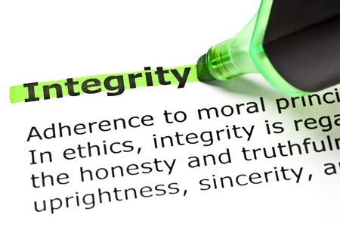
Enforcement Division
Regulatory Oversight of Licensed Producers and Companies
Improperly withholding, misappropriating, or converting monies or properties received in the course of doing insurance business.
Co-mingling a premium with personal funds
Intentional Misrepresentation
Coverage of a Policy (Actual or Proposed)
Criminal Prosecution (Not more than 30 days after Initial Pretrial Hearing Date)
Fraudulent, Coercive, Dishonest Practices, Incompetence, Financial Irresponsibility
License denial, suspension, or revocation in another jurisdiction

Slide 11
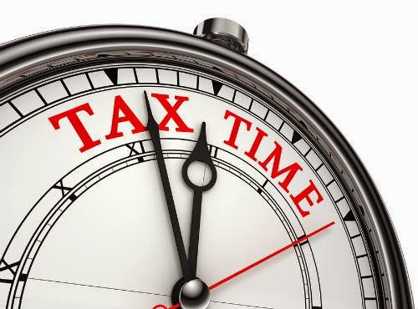
Enforcement Division
Regulatory Oversight of Licensed Producers or Companies
Failure to Pay State Income Tax
Failure to Comply w/ Court Ordered Child Support Obligation
Failing to Timely Inform the Commissioner of a Change in Legal Name or Address
Failure to Satisfy Continuing Education Requirements

Slide 12

Technology: A Catalyst for Regulatory Change Can Regulation Keep up with Innovation?
Insurance industry historically built on historical data analysis, promises of permanence, and risk control.
Change - Various Market Disruptors:
Changing Demographic Base w/ Increasingly
Sophisticated Consumers
Decrease in Brand Loyalty and Trust
Socio-economic Trends
Demand for Technological Convenience
Demand for a Faster, more Efficient, Customer-Friendly Experience
Industry Change Driven by “Insurtechs”
Notes:
Wave of recent change in the industry has been marked by SLOWER GROWTH, INCREASED COST, and REDUCED CUSTOMER SPENDING on insurance products.
In addition to change driven by economic factors, the insurance industry has had to face the prospect of REPLACING LEGACY SYSTEMS that can no longer adapt to changing MARKET CONDITIONS, an increase in more SOPHISTICATED FRAUD, and a more stringent REGULATORY ENVIRONMENT.
Tech convenience, speed, and change in BUYING HABITS are marked by Generation Y consumers becoming a predominant market force replacing the expectations and buying habits of BABY BOOMERS. Baby Boomers wanted someone to walk them through the buying process, whereas Gen Y consumers solicit peer recommendations and seem to prefer social media- type tools to TRADITIONAL SALES and MARKETING approaches.
Its also been observed that although ONLINE or mobile delivery distribution channels will dominate, traditional channels involving agents and brokers will not completely disappear.
The industry will need to find a way to support MULTICHANNEL DELIVERY.

Slide 13

Technology: A Catalyst for Regulatory Change Regulatory Implications
Insurtech: Where technological advancement transforms the business of insurance to create simpler products and streamlined customer service, while catering to a more tech-savvy generation of customers.
Insurance-on-Demand
Usage-based Insurance and Telematics
Smart Contracts
“Blockchains” / Distributed Ledger Technology
Customer-centric Products and Services
It is estimated that there are currently more than 1,500 Insurtech start-ups in more than 60 countries.
Notes:
Insurtech - refers to the use of TECHNOLOGY INNOVATIONS designed to squeeze out SAVINGS and EFFICENCY from the current Industry model and create COMPETITIVE PRICING.
Projected 41% growth annually between 2019 and 2023.
Insurtechs are looking to try and take advantage of different areas that large insurance firms have less incentive to exploit, such as offering ULTRA-CUSTOMIZED POLICIES, SOCIAL INSURANCE, and using NEW STREAMS OF DATA from INTERNET-ENABLED DEVICES to dynamically price premiums according to observed behavior.
1. Insurance is an old business.
2. Broad actuarial tables are used to assign policy seekers to a risk category. The group is then adjusted so enough people are lumped together to ensure that, overall, the policies are profitable for the company.
3. This traditional approach results in some people paying more than they should be based on the basic level of data used to group people.

Slide 14

Technology: A Catalyst for Regulatory Change Regulatory Implications
Insurtechs are active in all lines of business; appear to be primarily concentrated in the property and casualty sector.
Legacy companies acquiring technology from Insurtechs and are integrating that technology into their own corporate ecosystems
Insurtech concepts will fundamentally alter the business of insurance:
Industry Products
Data Collection
Distribution Channels
How Products will be Regulated
Notes:
4. The goal of Insurtechs is to collect and use data inputs from all kinds of devices from GPS tracking of cars to the activity trackers on peoples’ wrists, to build more finely delineated groupings of risk; thus allowing products to be priced more competitively.
5. Insurtechs are also testing deep-learned trained artificial intelligence to potentially handle the tasks of brokers in identifying the right mixes of policies to complete an individual’s coverage.
Insutechs are also developing different apps to create on-demand insurance for micro-events; such as borrowing a friend’s car.
BLOCKCHAIN = Digital pieces of information (THE BLOCK) stored in a public database (THE CHAIN).
SMART CONTRACTS =

Slide 15

Technology: A Catalyst for Regulatory Change Regulatory Implications
What must Regulators Consider in Terms of a Industry Change, Technological Advancement, and Consumer Protection?
Data Collection and Cybersecurity
How is it collected?
What are the data sets that will be collected?
How will it be used?
Who has access to it?
How will it be protected?

Slide 16
Technology: A Catalyst for Regulatory Change Regulatory Implications
Innovators and entrepreneurs behind initiatives not familiar with regulatory environment in the insurance industry.
U.S. based insurance industry is comprised of rules and regulations that may not be consistent from state-to-state.
Outdated regulations; effective in the past, but need to be modernized for growing technology.
Regulation viewed by the industry as an obstacle where technology is already outrunning regulation.

Slide 17

QUESTIONS

