Slide 1
Interstate Compact & Community Corrections
Tuesday, March 1, 2016
Les Alexander
Turran Blazier

Slide 2
Why do we have an Interstate compact?
The Interstate Commission oversees the day-to-day oversight of the compact between the states. The Commission promulgates rules to achieve the goals of the compact, ensures an opportunity for input and timely notice to victims and to jurisdictions where defined offenders are authorized to travel or to relocate across state lines and will establish a system of uniform data collection, provide access to information on active cases by authorized criminal justice officials, and coordinate regular reporting of Compact activities to heads of state councils, state executive, judicial, and legislative branches and criminal justice administrators. The Commission will also monitor compliance with the rules governing interstate movement of offenders and initiate interventions to address and correct noncompliance and will coordinate training and education regarding regulations of interstate movement of offenders for officials involved in such activity.

Slide 3
Interstate Compact in Indiana
Most states have Interstate Probation and Parole in the same office;
Indiana is a bifurcated state

Slide 4
Indiana Compact Staff
Jane Seigel
Commissioner/
Compact Administrator
Turran Blazier
Deputy Compact Administrator - Probation
Ronald Leffler;
Deputy Compact Administrator - Parole
Laura Hausladen
Nita Wright
Compact Specialists
Probation
Les Alexander
Compact Specialist
Parole

Slide 5
Compact Definitions
Substantial Compliance - sufficiently in compliance with the terms and conditions of his or her supervision so as not to result in initiation of revocation of supervision proceedings by the sending state.
Relocate - to remain in another state for more than 45 consecutive days in any 12 month period.

Slide 6
Resident - a person who—
(1) has continuously inhabited a state for at least 1 year prior to the commission of the offense for which the offender is under supervision; and
(2) intends that such state shall be the person’s principal place of residence; and
(3) has not, unless incarcerated or on active military deployment, remained in another state or states for a continuous period of 6 months or more with the intent to establish a new principal place of residence.

Slide 7
Resident Family - a parent, grandparent, aunt, uncle, adult child, adult sibling, spouse, legal guardian, or step-parent who–
(1) has resided in the receiving state for 180 calendar days or longer as of the date of the transfer request; and
(2) indicates willingness and ability to assist the offender as specified in the plan of supervision.

Slide 8
Retaking - the act of a sending state in physically removing an offender, or causing to have an offender removed, from a receiving state.
Significant Violation - an offender’s failure to comply with the terms or conditions of supervision that, if occurring in the receiving state, would result in a request for revocation of supervision.

Slide 9
Sex Offender - an adult placed under, or made subject to, supervision as the result of the commission of a criminal offense and released to the community under the jurisdiction of courts, paroling authorities, corrections, or other criminal justice agencies, and who is required to register as a sex offender either in the sending or receiving state and who is required to request transfer of supervision under the provisions of the Interstate Compact for Adult Offender Supervision.

Slide 10
Supervision - means the oversight exercised by authorities of a sending or receiving state over an offender for a period of time determined by a court or releasing authority, during which time the offender is required to report to or be monitored by supervising authorities, and to comply with regulations and conditions, other than monetary conditions, imposed on the offender at the time of the offender’s release to the community or during the period of supervision in the community

Slide 11
Warrant - written order of the court or authorities of a sending or receiving state or other body of competent jurisdiction which is made on behalf of the state, or United States, issued pursuant to statute and/or rule and which commands law enforcement to arrest an offender. The warrant shall be entered in the National Crime Information Center (NCIC) Wanted Person File with a nationwide pick-up radius with no bond amount set

Slide 12
Types of Eligible Supervision
Home Detention
Day Reporting
GPS
Alcohol Monitoring
Any other case that has conditions, under any type of community supervision
Work Release is not eligible.

Slide 13
Eligible Offenders Must Transfer to Relocate
Eligible Offenders | Non-eligible Offenders
All Felons Certain Misdemeanants (Rule 2.105) Next Slide | Certain Misdemeanants (Rule 2.105)
Deferred Sentences (Rule 2.106) Is there a finding of guilt? Has a plea been entered? Given up the right to trial? | Those on work-release (Rule 2.107) Or released under furlough Or on a pre-parole program Those on a Pre-Trial Intervention Programs
“Unsupervised” Offenders requiring monitoring Bench Probation | Offenders released on bail

Slide 14
Eligible Misdemeanants
Sentence = 1+ years of supervision AND
Instant Offense includes one or more:
Person incurred direct or threatened physical or psychological harm. | 2nd or subsequent offense of driving while impaired by drugs or alcohol
Use or possession of a firearm involved. | Sex offense requiring registration in the sending state
Rule 2.105

Slide 15
Eligibility for Transfer Part I: Nature of Offense
Physical Harm?
Firearm Offense?
Eligible for Transfer
Under ICAOS Depending
On Sentence (See Part II)
2nd Offense DUI?
Misdemeanor
Sex Offense?
Other Offenses
Infractions &
Civil Offenses
Offense not
Covered by
ICAOS
Type of Offense
Probation
Eligible for Transfer
Under ICAOS Depending
On Sentence (See Part II)
Felony
Parole
Not Subject to ICAOS Unless
Community
Supervision
Involved
Flat Time

Slide 16
Eligibility for Transfer Part II: Sentencing/Supervision Considerations
Sentence w/ Supervised
Probation or Other Community-Based
Supervision
Eligible for
Transfer
Under ICAOS
Sentencing
Outcome
Deferred Sentencing
(See Part III)
Sentence w/ no
Probation or Formal
Supervision
ICAOS Does Not
Apply

Slide 17
Eligibility for Transfer Part III Deferred Sentencing Considerations
Defendant Admits Guilt; Court Accepts Plea but Defers Sentence & Final Judgment in lieu of Supervised Probation, Treatment, or Community Corrections Program
Eligible for
Transfer Under
ICAOS
Court Enters Final Judgment Of Guilt but Suspends Execution of Sentence in lieu of Supervised
Probation, Treatment or
Community Corrections Program
Is it a
Deferred Sentence
Under ICAOS?
Court Defers Entry of Judgment
Or Execution of Sentence;
Offender not Subject to
Any Supervision Program
ICAOS Does Not
Apply

Slide 18
2 Types of Transfer
ALL transfers are solely at discretion of the Sending State
Mandatory Receiving State MUST accept supervision | Discretionary Receiving State has the discretion to accept or reject supervision
90+ days supervision remaining Valid ‘plan of supervision’ ‘Substantial compliance’ Qualifying reason Resident of receiving state Resident family in receiving state Other reasons per Rule 3.101-1 | Offenders not eligible for mandatory transfer Sending state must justify “WHY”
Rule 3.101

Slide 19
Acceptance of Transfer by Receiving State, Felony
Has Resident Family
Who Will Support
Supervision Plan?
Resident of
Receiving State?
No
No
Yes
Acceptance Not
Required; Discretionary
Transfer
Yes
Felony Offender with
Three Months or
More of Supervision
Remaining and in
Substantial Compliance
In the Sending State
Can Obtain Employment
Or has Means of
Support?
Acceptance
Required
No
Military Members Subject to Valid Orders of Deployment
Living with Family Military Members who are Subject to Valid Orders of Deployment
Yes
No
Employment Transfer of Family Member
Can Obtain Employment
Or has Means of Support?
Employment Transfer of Offender

Slide 20
Acceptance of Transfer by Receiving State, Misdemeanor
Has Resident Family
Who Will Support
Supervision Plan?
No
No
Resident of
Receiving State?
Acceptance Not
Required; Discretionary
Transfer
Yes
Yes
Misdemeanor
Offender Convicted
Of a Covered Offense
& Subject To 1 Year
or More of Supervision
Can Obtain Employment
Or has Visible Means of
Support?
No
Acceptance
Required
Military Members Subject to Valid Orders of Deployment
Yes
Living with Family Military Members who are Subject to Valid Orders of Deployment
Can Obtain Employment
Or has Means of
Support?
Employment Transfer of Family Member
No
Employment Transfer of Offender

Slide 21
Reporting Instructions
Reporting Instructions – allow an offender to return to the receiving state as long as he lived there at the time of sentencing
Mandatory
Discretionary
48 hours
Sex Offenders (5 days, can’t leave without approval)

Slide 22
Transfer Request
Must be completed within 15 days of approved reporting instructions
Fee
Court Approval
All non-eligible cases fall under discretionary
Compact Office approval required prior to collecting fee & submitting discretionary cases

Slide 23
“Retaking” vs. “Extradition”
Offender Application for Transfer (Waiver of Extradition)
MUST be signed PRIOR to leaving/transferring
States party to this compact waive all legal requirements to extradition of offenders who are fugitives from justice.
Rule 3.109
Retaking | Extradition
The only way an offender can be returned to the sending state under the Compact is if he originally left the sending state through an approved transfer or reporting instructions under the compact. | Fugitives are to be returned under the extradition clause of the constitution. (Article VI Section 2)

Slide 24
Discretionary Retaking
Sending State retains authority to retake at ANYTIME unless offender is charged with a new felony or violent crime in the receiving state.
Offender charged with a new criminal offense cannot be retaken:
until charges have been dismissed
sentence has been satisfied
offender released to supervision for new offense
sending and receiving state mutually agree to retake/return
Rule 5.101 & 5.101-1

Slide 25
Mandatory Retaking Rules 5.102, 5.103, 5.103-1
Receiving State requests retake &: | Mandatory Retake? | Sending State Action
Report of 1-2 significant violations | No | Respond with action/non-action to be taken
Report of 3rd significant violation | Yes | Issue warrant OR Order offender to return May ask for PC Hearing
Conviction of new felony | Yes | Issue warrant
Conviction of new violent crime | Yes | Issue warrant
“Absconder” apprehended in receiving state on sending state’s warrant | Yes | Warrant previously issued per Rule 4.109-2 May ask for PC Hearing

Slide 26
Retaking Responsibilities
Sending State | Receiving State
Cost of retaking | Cost of detaining
No bail or other release conditions allowed for offender | No bail or other release conditions allowed for offender
Retake within 30 calendar days | Conduct PC hearing if requested Morrisey vs. Brewer 408 U.S. 471 (1972) Gagnon vs. Scarpelli 411 U.S. 778 (1973) Offenders are entitled to a probable cause hearing: Close proximity to where the violations occurred An “administrative” hearing – not to determine guilt/innocence and level of due process is less than that of a revocation hearing Conducted by a “neutral and detached” person Mini Training Available
Establish authority of officers
Identify the offender Ensure no detainers against offender exist Ensure no extradition proceedings are pending
Rule 5.104, 5.105, 5.106, 5.107, 5.108, 5.110 & 5.111

Slide 27
Processing & Training
Community Corrections
Probation
2 Users
Create an account at www.interstatecompact.org
Complete On-Demand Trainings
ICAOS Course Library
ICOTS Course Library
Sign & Email User Agreement
(Email to Turran)
Review Compact Rules
Create an account at www.interstatecompact.org
Complete On-Demand Trainings
CC Staff ICAOS Course Library
Review Compact Rules
Must coordinate workflow with Probation

Slide 28
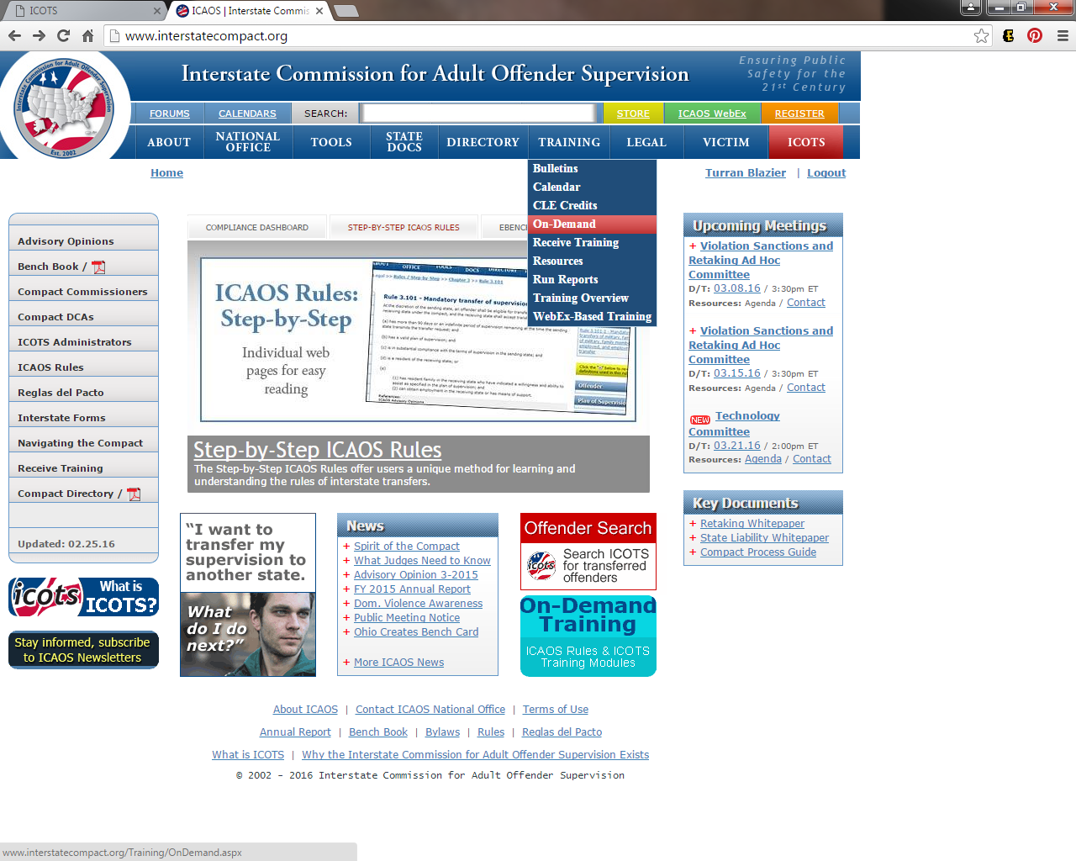

Slide 29
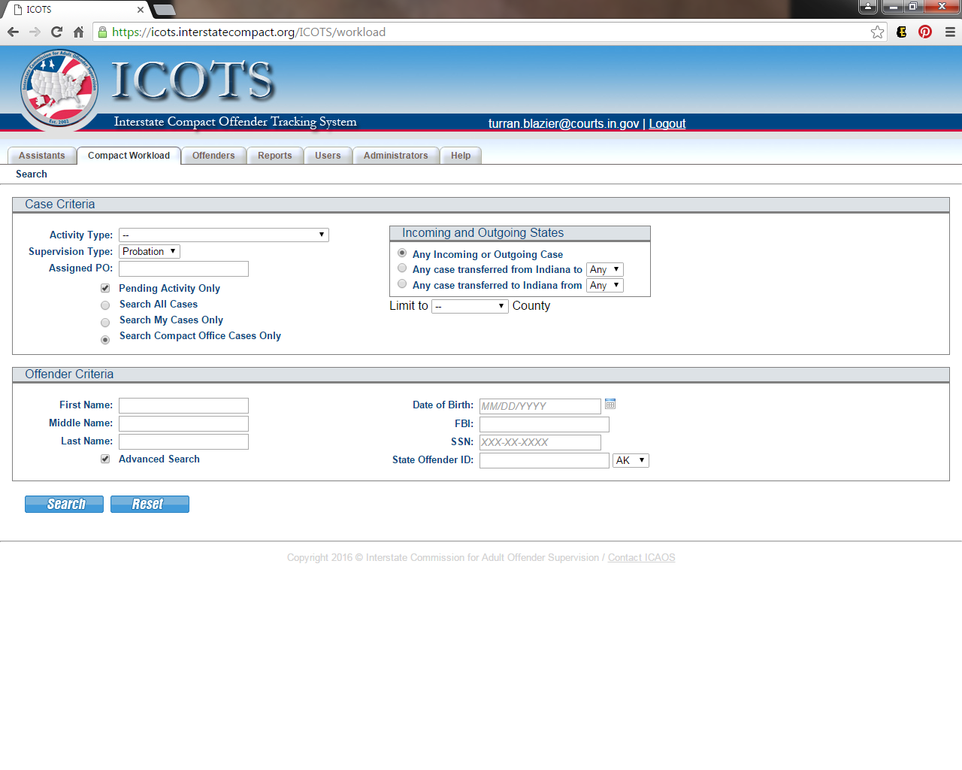

Slide 30
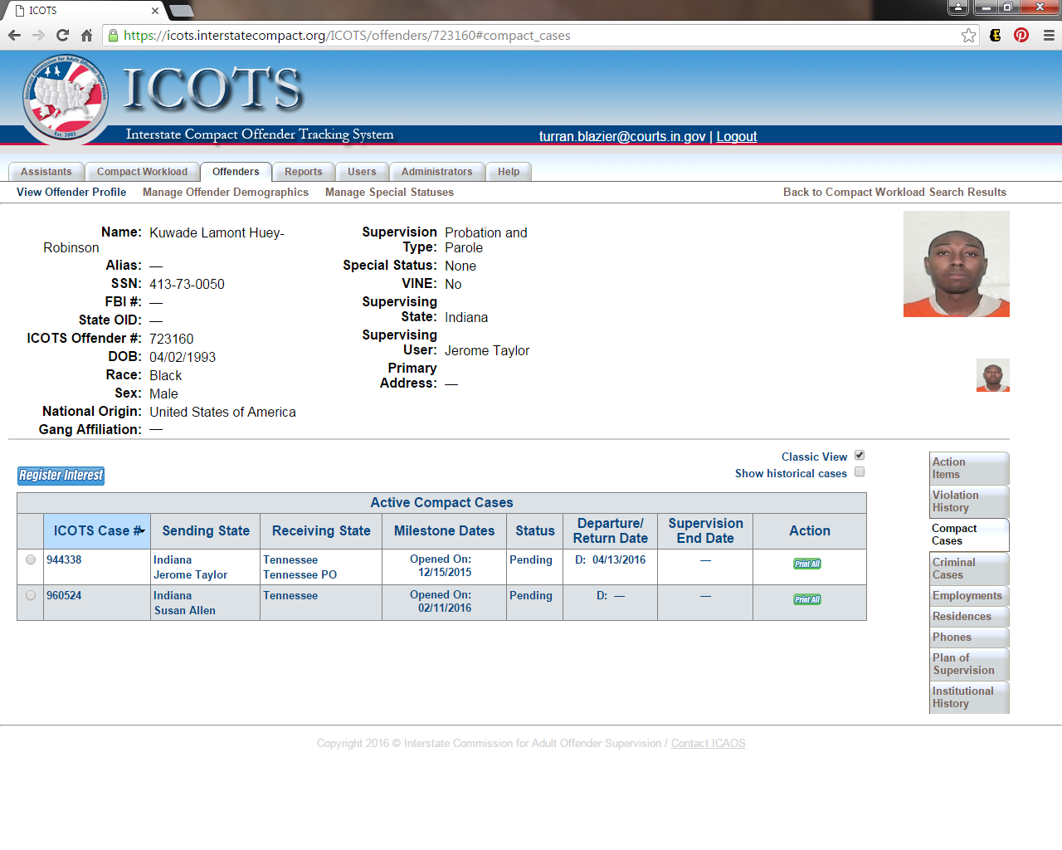

Slide 31
Contact Information
If after completing today’s training & online course libraries, you still have questions or require additional training, please contact:
Turran Blazier 317-234-3601
turran.blazier@courts.in.gov

