Slide 1

Indiana Department of Administration
On Behalf Of
Indiana Department of Education
Request for Service 19-083
Equitable Services
Pre-Proposal Conference
March 19th, 2019 @1 :30 PM
Teresa Deaton-Reese, IDOA Procurement
Indiana Department of Administration

Slide 2
Agenda
General Information
Purpose of RFP
Term of the Contract
Key Dates
Project Background
Scope of Work
Business Proposal, Technical Proposal, Cost Proposal
Proposal Preparation & Evaluation
Minority and Women’s Business Enterprises (M/WBE)
Additional Information
Question and Answer Session
Indiana Department of Administration

Slide 3
General Information
Sign-In Sheet for Attendees
Sign-In Sheet and PowerPoint will be posted on IDOA’s Solicitation Website
Hold questions until the end of the presentation
  Any verbal response is not considered binding; respondents are encouraged to submit any question formally in writing if it affects the proposal that will be submitted to the state.
Indiana Department of Administration

Slide 4
Purpose of the RFP
The purpose of this RFS is to select a vendor that can satisfy the State’s need for Equitable Services. It is the intent of IDOE to contract with a vendor that provides quality Equitable Services to eligible students enrolled in private school, and their respective educators and families, if the appropriate private school officials have (1) requested to SEA to provide such services directly and (2) demonstrated that the LEA involved has not met equitable services requirements in accordance with procedures. The State may make multiple award recommendations; however, there is no guarantee that if recommended for award that an SEA that receives an award letter will be chosen to provide equitable services and ultimately result in a contract
Indiana Department of Administration

Slide 5
Term of the Contract
Contract Term
  The term of the contract shall be for a period of two (2) years. There may be two (2) one-year renewals for a total of four (4) years at the State’s option.
Indiana Department of Administration

Slide 6
Key Dates
Activity | Date
Issue of RFP | March 6, 2019
Pre-Proposal Conference | March 19, 2019
Deadline to Submit Written Questions | March 21, 2019
Response to Written Questions/RFP Amendments | March 28, 2019
Submission of Proposals | April 11, 2019
The dates for the following activities are target dates only.
Proposal Evaluation | TBD
Proposal Discussions/Clarifications (if necessary) | TBD
Oral Presentations (if necessary) | TBD
Best and Final Offers (if necessary) | TBD
RFP Award Recommendation | TBD
Indiana Department of Administration

Slide 7
Scope of Work
Under ESEA sections 1117(b)(6)(C) (applicable to Title I equitable services) or 8501(c)(6)(C) (applicable to equitable services under Title VIII-covered programs, including Title I, Part C, Title II, Part A; Title III, Part A, Title IV Part A, and Title IV, Part B [21st Century CCLC]), a State Educational Agency (IDOE) must provide equitable services to eligible students enrolled in private schools, and their respective educators and families, if the appropriate private school officials have (1) requested the SEA to provide such services directly and (2) demonstrated that the LEA involved has not met equitable services requirements in accordance with procedures.
LEAs and private school officials must engage in a complaint process, and if the SEA determines that the LEA has substantially failed its duty to uphold equitable services requirements under the law, then the SEA may retain funds from an LEA’s allocation to provide services directly or through a contract. The retention of funds will include the funding to directly pay the vendor, and for the IDOE’s time and effort to oversee the program at the respective private schools.
This RFP requests proposals for vendors that can deliver equitable services to affected private schools. Successful proposals will exist on a list maintained by the IDOE, from which the appropriate private school officials may choose from, in order to receive equitable services when an LEA has substantially failed to deliver eligible services. Once selected by a private school official through consultation, the IDOE will engage the vendor to begin services and will pay the vendor directly. The vendor may bid upon providing services, either directly or through a contract, under any or all of the programs covered by Title I and Title VIII of ESSA.
Indiana Department of Administration

Slide 8
Business Proposal
(Attachment D)
Company Financial Information (Section 2.3.3)
  Confidential information must be kept separate from the proposal in the electronic copies. IDOA recommends sending a “public” file that has the confidential information redacted (may be in PDF format) and a “final” file that includes all required information (must be in format provided).
Contract Terms (Section 2.3.5)
  Respondent should review the sample State contract (Attachment B) and note exceptions to State non-mandatory clauses in Business Proposal. The Respondent should accept the mandatory clauses in the Business Proposal and Transmittal Letter.
References (2.3.6)
  The Respondent must include a list of at least three (3) clients for whom the Respondent has performed similar services.
Indiana Department of Administration

Slide 9
Technical Proposal
(Attachment E)
Please answer all questions in the Template we have provided for you. Your response should follow the structure listed in the Technical Proposal Instructions.
Where appropriate, supporting documentation (e.g. diagrams, certificates, graphics, or other exhibits) may be included as attachments to the proposal. Please include appropriate cross-references. However, when using cross-references, the body of the Technical Proposal should contain a meaningful summary of the referenced material.
Respondents are discouraged from simply repeating language from the RFP as evidence of an understanding or capability.
Indiana Department of Administration

Slide 10
Cost Proposal
(Attachment C)
Please complete the template provided for the Cost Proposal by populating ONLY the yellow shaded cells.
30 available points (plus 5 bonus pts available)
Cost scores will then be normalized to one another, based on the lowest cost proposal evaluated. The lowest cost proposal receives a total of 30 points. The normalization formula is as follows:
Respondent’s Cost Score = (Lowest Cost Proposal /Total Cost of Proposal) X 30
Indiana Department of Administration

Slide 11
Proposal Preparation
When submitting your response, please create a separate electronic folder for each component to which you are responding. This folder should contain all of the pertinent files for only that component, i.e., MWBE forms, Transmittal Letter, Business Proposal, etc.
Indiana Department of Administration

Slide 12
Proposal Preparation
Attachment C (Cost Proposal) must be returned in Excel
Use the templates provided for all answers
Do not alter templates
Submit all questions using template provided via email using the Q&A Template (Attachment F) to rfp@idoa.IN.gov
Indiana Department of Administration

Slide 13
Proposal Evaluation
Summary of Evaluation Criteria:
Criteria | Points
Adherence to Mandatory Requirements | Pass/Fail
Management Assessment/Quality (Business and Technical Proposal) | 60 available points
Cost (Cost Proposal) | 30 available points (5 bonus point available)
4. Minority Business Enterprise Subcontractor Commitment | 5 (1 bonus point is available, see Section 3.2.6)
5. Women Business Enterprise Subcontractor Commitment | 5 ( 1 bonus point is available, see Section 3.2.6)
Total | 100 (107 if bonus awarded)
Indiana Department of Administration

Slide 14
Minority and Women’s Business Enterprises
Mission/Vision
  Promote, monitor, and enforce the standards for certification of minority and women’s business enterprises.
  Provide equal opportunity to minority and women enterprises in the state’s procurement and contracting process.
Nondiscrimination and Antidiscrimination Laws
  Pursuant to Indiana Civil Rights Law, specifically IC §22-9-1-10, every state contract shall contain a provision requiring the contractor and subcontractors to not discriminate against any employee or applicant with respect to Protected Characteristics
Indiana Department of Administration

Slide 15
Minority and Women’s Business Enterprises
Contact Information
  Phone: 317-232-3061
  E-mail: mwbecompliance@idoa.in.gov
  Web: www.in.gov/idoa/mwbe
Complete Attachment A, MWBE Form
- Include sub-contractor letter of commitment
Goals for Proposal
- 8% Minority Business Enterprise
- 8% Women’s Business Enterprise
Indiana Department of Administration

Slide 16
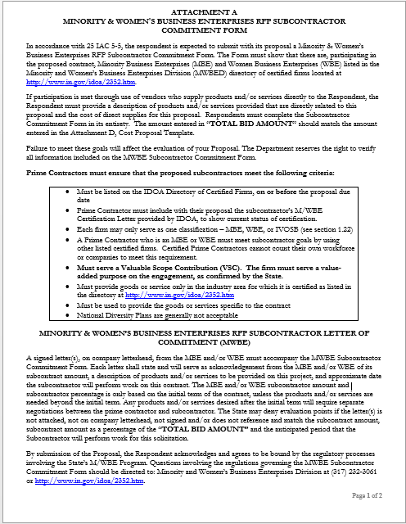
Indiana Department of Administration

Slide 17
Minority and Women’s Business Enterprises
Prime contractors must ensure that the proposed subcontractors meet the following criteria:
Are listed in the IDOA Directory of Certified Firms, on or before the proposal due date, national diversity plans are generally not accepted. The directory can be found here: http://www.in.gov/idoa/mwbe/2743.htm
Serve a Valuable Scope Contribution (VSC) on the engagement, as confirmed by the State.
Provide the goods or services specific to the contract and within the industry area for which it is certified
Indiana Department of Administration

Slide 18
Minority and Women’s Business Enterprises
Prime contractors should note the following:
Subcontractors’ MBE/WBE Certification Letter, provided by IDOA, must accompany the proposal to show current status of certification.
Each firm may only serve as one classification – MBE or WBE (see section 1.22)
Pursuant to 25 IAC 5-6-2(b)(d), a Prime Contractor who is a MBE or WBE must meet subcontractor goals by using other listed certified firms. Certified Prime Contractors cannot count their own workforce or companies to meet this requirement.
Indiana Department of Administration

Slide 19
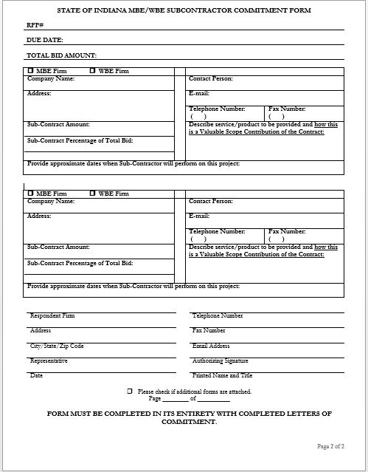
Indiana Department of Administration

Slide 20
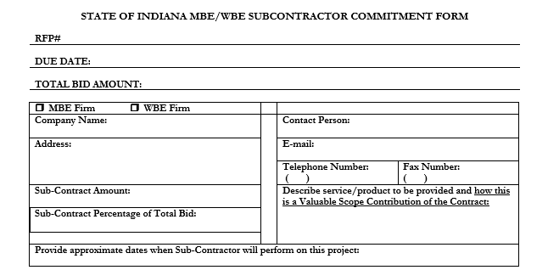
Minority and Women’s Business Enterprises
Indiana Department of Administration

Slide 21
Minority and Women’s Business Enterprises
Effective August, 2014, a new MWBE scoring methodology will be utilized for all RFP’s released
New Process - MWBE scoring is conducted based on 10 points plus a possible 2 bonus points scale
  MBE: Possible 5 points + 1 bonus point
  WBE: Possible 5 points + 1 bonus Point
Professional Services Scoring Methodology:
  The points will be awarded on the following schedule:
  Fractional percentages will be rounded up or down to the nearest whole percentage
  If the respondent’s commitment percentage is rounded down to 0% for MBE or WBE participation the respondent will receive 0 points.
  Submissions of 0% participation will result in a deduction of 1 point in each category
  The highest submission which exceeds the goal in each category will receive 6 points (5 points plus 1 bonus point). In case of a tie both firms will receive 6 points
% | 1% | 2% | 3% | 4% | 5% | 6% | 7% | 8%
Pts. | .625 | 1.25 | 1.875 | 2.5 | 3.125 | 3.75 | 4.375 | 5.0
Indiana Department of Administration

Slide 22
IDOA Subcontractor Scoring
RFP MWBE Scoring Example
Bidder | MBE % | Pts. | WBE % | Pts. | Total Pts.
Bidder 1 | 12.0% | 5.0 | 10.0% | 6.0 | 11.0
Bidder 2 | 6.0% | 3.75 | 4.0% | 2.5 | 6.25
Bidder 3 | 8.0% | 5.0 | 8.0% | 5.0 | 10.0
Bidder 4 | 16.0% | 6.0 | 0.2% | 0.0 | 6.0
Bidder 5 | 0.0% | -1.0 | 0.0% | -1.0 | -2.0
Indiana Department of Administration

Slide 23
Indiana Veteran Owned Small Business
In compliance of Federal Code 2CFR 200.319 - this RFS/Contract contains federal funds and this preference may not be considered or applied.
Indiana Department of Administration

Slide 24



Subcontractor Compliance
Pay Audit System
Tool utilized to monitor the state’s diversity spend for subcontractors
Selected primes and subcontractors are required to report payments submitted or received through this web-based tool
Based on contract terms payments should be reported monthly or quarterly
Questions? Contact Division of Supplier Diversity
  mwbecompliance@idoa.in.gov
  www.in.gov/idoa/mwbe/payaudit.htm
Prime
Submit subcontractor actual paid invoice amounts
Payment
Pay Audit System
Submit actual payments received
Subcontractor
Indiana Department of Administration

Slide 25
Additional Information
IDOA PROCUREMENT LINKS AND NUMBERS
http://www.in.gov/idoa/2354.htm
For Buy Indiana Questions/Registration
http://www.in.gov/idoa/2467.htm
A. Link to the developing for bidder registry with IDOA and Secretary of State.
http://www.in.gov/idoa/2464.htm
B. Secretary of State of Indiana:
Can be reached at (317) 232-6576 for registration assistance. www.in.gov/sos
C. See Vendor and Supplier Resource Center:
http://www.in.gov/idoa/3106.htm
Minority and Women Owned Business Enterprises:
Link to more information and full listing of IDOA Minority and Women Owned Businesses
http://www.in.gov/idoa/2352.htm
Indiana Veteran Owned Small Business Program:
Link to more information and full listing of Indiana Veteran Owned Small Businesses: http://www.in.gov/idoa/2862.htm. To search certified IVOSB’s: https//www.vip.vetbiz.gov
F. RFP posting and updates:
Go to http://www.in.gov/idoa/2354.htm (select “Current Opportunities” link)
Scroll through table until you find desired RFP number on left-hand side and click the link.
Indiana Department of Administration

Slide 26
Questions
    Any verbal response is not considered binding; respondents are encouraged to submit any question formally in writing if it affects the proposal that will be submitted to the state.
Indiana Department of Administration

Slide 27
Thank You
Teresa Deaton-Reese
tdeaton@idoa.IN.gov
Indiana Department of Administration

