Slide 1

Request for Proposal 20-011
OECOSL Quality Assurance (QA) System RFP
Indiana Department of Administration
On Behalf Of
The Indiana Family and Social Services Administration
Pre-Proposal Conference
June 6, 2019
Teresa Deaton
IDOA/Procurement Division
Indiana Department of Administration

Slide 2
Agenda
General Information
Purpose of RFP
Term of Contract
Key Dates
Background
Scope of Work
Business Proposal
Technical Proposal
Cost Proposal
Proposal Preparation
Evaluation Criteria
Minority and Women’s Business Enterprises (M/WBE)
Indiana Veteran Owned Small Business (IVOSB)
Additional Information
Question and Answer Session
Indiana Department of Administration
Notes:
Teresa

Slide 3
General Information
Sign-In Sheet for Attendees
Sign-In Sheet and PowerPoint will be posted on IDOA’s Solicitation Website
Hold questions until the end of the presentation
  Any verbal response is not considered binding; respondents are encouraged to submit any questions formally, in writing, if it affects the proposal that will be submitted to the state.
Indiana Department of Administration

Slide 4
Purpose of the RFP
The purpose of this RFP is to select a vendor to develop and implement a new Quality Assurance (QA) system to review data stored within the OECOSL systems and check the eligibility processes for OECOSL’s Child Care Development Fund (CCDF) and On My Way Pre-K programs, as well as maintain and operate the implemented system.
Indiana Department of Administration

Slide 5
Term of Contract
The term of the contract shall be for a period of four (4) years from the date of contract execution. There may be two (2) one-year renewals for a total of six (6) years at the State’s option.
Indiana Department of Administration

Slide 6
Key Dates
Activity | Date
Issue of RFP | May 28, 2019
Pre-Proposal Conference | June 6, 2019
Deadline to Submit Written Questions | June 7, 2019
Deadline to Submit Intent to Respond Form (optional) | June 7, 2019
Response to Written Questions/RFP Amendments | June 19, 2019
Submission of Proposals | July 10, 2019
The dates for the following activities are target dates only. These activities may be completed earlier or later than the date shown.
Proposal Evaluation | July/August 2019
Proposal Discussions/Clarifications (if necessary) | August 2019
Oral Presentations (if necessary) | August 2019
Best and Final Offers (if necessary) | August 2019
RFP Award Recommendation | September 2019
Indiana Department of Administration

Slide 7
Background
The mission of OECOSL is to provide parents with informed child care choices that will aid their children’s health, safety, and future success in school. Two of the ways that OECOSL accomplishes this is through the CCDF and On My Way Pre-K programs.
The CCDF program, which is part of a Federal partnership, helps low-income families obtain child care so that they may work or attend school. OECOSL is for the licensing, registration and CCDF certification of child care and early learning programs.
The On My Way Pre-K program awards grants to four (4) year old children from low-income families so that they may have access to a high-quality pre-K program the year before they begin kindergarten.
Indiana Department of Administration

Slide 8
Background (cont’d)
The CCDF program and the On My Way Pre-K program include Federal and/or State-mandated QA responsibilities that are carried out by OECOSL. The QA functionalities ensure that the data for each case is captured correctly, that ineligible families are not receiving payments, and that eligible families are receiving correct payments.
While a system currently exists within OECOSL to assist with these QA functionalities, the State is looking to upgrade to a new system that will comply with updated Federal and State, expedite the QA process, maintain accuracy in its QA functionalities, and interface with newly upgraded systems.
Indiana Department of Administration

Slide 9
Scope of Work
The Contractor will develop, design, and implement a solution to replace the current QA system. As part of the Design, Development, and Implementation (DDI) phase, the Contractor shall complete the following deliverables:
  Requirements Validation
  Design
  Development
  Data Conversion and Migration
  Testing
  Implementation
The system must maintain a strong level of accuracy in detecting errors in the data and the processes, reduce the number of people and steps involved in the QA process, and comply with all updated Federal and State guidelines.
Once the system has been implemented, the Contractor will also maintain and operate the system for the State. This includes general systems support, infrastructure management, application monitoring, incident management, access management, training, and enhancements.
Indiana Department of Administration

Slide 10
Business Proposal
(Attachment E)
Company Financial Information (Section 2.3.3)
  Confidential information must be kept separate from the proposal in the electronic copies. IDOA recommends sending a “public” file that has the confidential information redacted (may be in PDF format) and a “final” file that includes all required information (must be in format provided).
Contract Terms (Section 2.3.5)
  Respondents should review sample State contract and note exceptions to State mandatory and non-mandatory clauses in Business Proposal and Transmittal Letter.
References (2.3.6)
  Respondents must have at least three (3) references for whom the Respondent has provided products and/or services that are the same or similar to those products and/or services requested in this RFP. The Respondent is encouraged to contact all references prior to RFP submission to ensure that all contact information is current and accurate, and to confirm that references are willing and able to provide information to the State for the purposes of this RFP.
Indiana Department of Administration

Slide 11
Technical Proposal
(Attachment F)
Respondents should use Attachment F to complete their Technical Proposal. Use the yellow shaded fields to answer the questions in Attachment F.
  Yellow fields will expand to accommodate content.
  Make every attempt to preserve the original format of Attachment F.
Where appropriate, supporting documentation (e.g. diagrams, certificates, graphics, or other exhibits) may be submitted as an attachment and referenced within the relevant answer field.
Indiana Department of Administration

Slide 12
Cost Proposal
(Attachment D)
Please complete the template provided for the Cost Proposal by populating ONLY the yellow shaded cells.
Cost scores will then be normalized to one another, based on the cost proposal with the Lowest Total Four-Year NTE Base Contract Cost. The cost proposal with the Lowest Total Four-Year NTE Base Contract Cost receives a total of 25 points. The normalization formula is as follows:
Respondent’s Cost Score = (Lowest Cost Proposal /
Total Cost of Proposal) X 25
Indiana Department of Administration

Slide 13
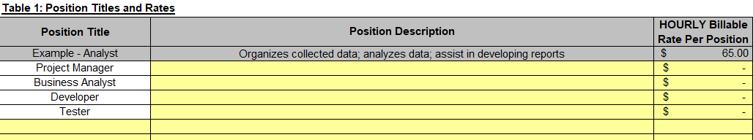
Cost Proposal (Cont.)
(Attachment D)
For the “Staffing Costs” tab, Respondents must fill in the yellow cells for each mandatory position listed, as well as for any additional positions the Respondent suggests. For each position listed, Respondents must fill in a description and the Hourly Billable Rate.
The Hourly Billable Rate should factor in all costs including the staff member's salary, benefits, and other such items necessary to complete all deliverables (such as but not limited to: travel, overhead, and supplies).
Indiana Department of Administration

Slide 14
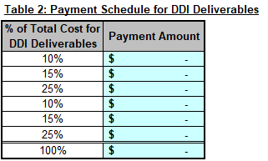
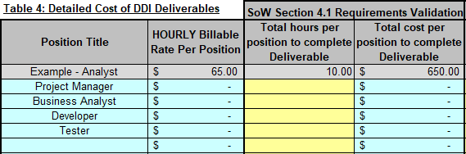
Cost Proposal (Cont.)
(Attachment D)
For the “DDI Deliverables” tab, in Table 4, fill in the total hours per position to complete the listed Deliverables. If a position is not required for a certain Deliverable, then you may enter "0" for the number of hours. All totals will be calculated automatically. Table 2 shows the payment amounts for each deliverable, regardless of how many hours were worked for each deliverable.
Indiana Department of Administration

Slide 15

Cost Proposal (Cont.)
(Attachment D)
The “DDI Deliverables” tab also contains Table 3, which calculates the maximum cost for “Change Requests” through the four base years.
The maximum cost for “Change Requests” shall be no greater than 10% of the total cost of all DDI Deliverables. For evaluation purposes only, the maximum cost for Change Requests shall be assumed to be during Contract Year 1 and will populate as such in the Cost Proposal Summary tab.
Indiana Department of Administration

Slide 16
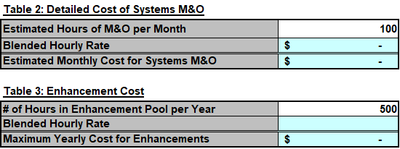
Cost Proposal (Cont.)
(Attachment D)
Respondents do not need to fill in any cells in the “Systems M&O” tab.
Table 2 calculates an estimated monthly cost for Systems M&O by multiplying the estimated hours of M&O the State expects to be used in a month by the "Blended Hourly Rate," which is calculated by taking the total cost for DDI Deliverables and dividing it by the total hours proposed. The estimated hours of M&O per month is for evaluation purposes only. The Contractor shall be paid for actual hours worked on M&O per month, capped at $25,000 per month.
Table 3 calculates the estimated maximum total cost for Enhancements by taking the number of hours in the enhancement pool per year, which is set at 500 hours, and multiplying it by the "Blended Hourly Rate.”
Indiana Department of Administration

Slide 17

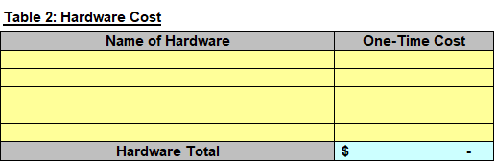
Cost Proposal (Cont.)
(Attachment D)
In the “Hardware and Hosting” tab, in Table 1, the Respondent shall propose all costs associated with a non-State hosted environment below.
In Table 2, the Respondent must also list all hardware requirements and its one-time costs needed to provide the services outlined in the Contract.
Indiana Department of Administration

Slide 18
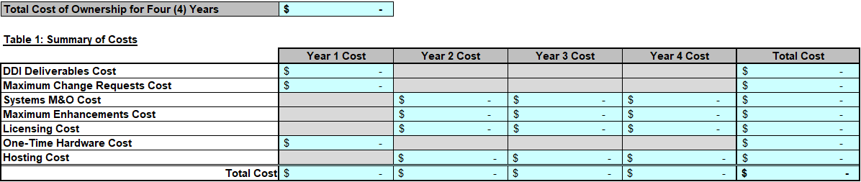
Cost Proposal (Cont.)
(Attachment D)
The “Cost Proposal Summary” tab will take into account the information in the other tabs to calculate a “Total Cost of Ownership for Four (4) Years.”
Table 1 summarizes your proposed cost by each of the four (4) base years of the Contract and sums them to get the “Total Cost of Ownership for Four (4) Years.”
Indiana Department of Administration

Slide 19
Proposal Preparation
Buy Indiana, Business Proposal (2.3.14)
  Respondent’s Buy Indiana status shall be finalized by proposal due date
  Five (5) definitions, details provided in the RFP Section 2.7
Indiana Economic Impact, Attachment C
  Definitions of FTE (Full-Time Equivalent)
  Example: If a Respondent has five (5) full time employees, is bidding on its 5th contract, and all contracts get an equal amount of commitment from the employees, then each employee commits 20% of his/her time to the new contract:
    0.2 x 5 employees – 1 FTE
Indiana Department of Administration

Slide 20
Proposal Preparation
When submitting your response, please create a separate electronic folder for each component to which you are responding. This folder should contain all of the pertinent files for only that component, i.e., MWBE forms, IVOSB forms, IEI form, Transmittal Letter, Business Proposal, etc. Your proposal may be deemed as non-responsive if these instructions are not followed.
Indiana Department of Administration

Slide 21
Proposal Preparation
Attachment D (Cost Proposal) must be returned in the original Excel format (No PDFs)
Use the templates provided for all responses
Do not alter any templates
Submit all questions via email using the Q&A Template (Attachment G)
Indiana Department of Administration

Slide 22
Evaluation Criteria
Criteria | Points
Adherence to Mandatory Requirements | Pass/Fail
Management Assessment/Quality (Business and Technical Proposal) | 50 points
Cost (Cost Proposal) | 25 points
Indiana Economic Impact | 5 points
Buy Indiana | 5 points
Minority Business Enterprise Subcontractor Commitment | 5 points (1 bonus point is available, see Section 3.2.6)
Women Business Enterprise Subcontractor Commitment | 5 points (1 bonus point is available, see Section 3.2.6)
Indiana Veteran Business Enterprise (IVOSB) Subcontractor Commitment | 5 points (1 bonus point is available, see Section 3.2.7)
Total | 100 (103 if bonus awarded)
Indiana Department of Administration

Slide 23
Minority and Women’s Business Enterprises
Mission/Vision
  Promote, monitor, and enforce the standards for certification of minority and women’s business enterprises.
  Provide equal opportunity to minority and women enterprises in the state’s procurement and contracting process.
Nondiscrimination and Antidiscrimination Laws
  Pursuant to Indiana Civil Rights Law, specifically IC §22-9-1-10, every state contract shall contain a provision requiring the contractor and subcontractors to not discriminate against any employee or applicant with respect to Protected Characteristics
Indiana Department of Administration

Slide 24
Minority and Women’s Business Enterprises
Contact Information
  Phone: 317-232-3061
  E-mail: mwbecompliance@idoa.in.gov
  Web: www.in.gov/idoa/mwbe
Complete Attachment A, MWBE Form
- Include sub-contractor letter of commitment
Goals for Proposal
- 8% Minority Business Enterprise
- 8% Women’s Business Enterprise
Indiana Department of Administration

Slide 25
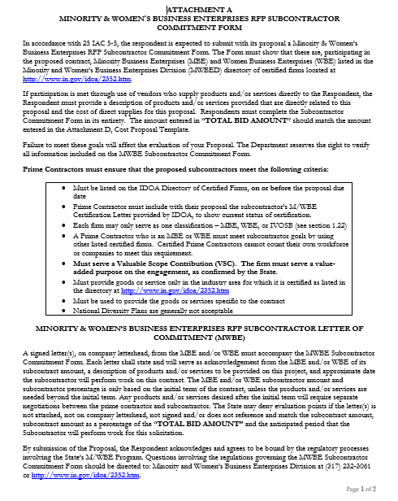
Indiana Department of Administration

Slide 26
Minority and Women’s Business Enterprises
Prime contractors must ensure that the proposed subcontractors meet the following criteria:
Are listed in the IDOA Directory of Certified Firms, on or before the proposal due date, national diversity plans are generally not accepted. The directory can be found here: http://www.in.gov/idoa/mwbe/2743.htm.
Serve a Valuable Scope Contribution (VSC) on the engagement, as confirmed by the State.
Provide the goods or services specific to the contract and within the industry area for which it is certified.
Indiana Department of Administration

Slide 27
Minority and Women’s Business Enterprises
Prime contractors should note the following:
Subcontractors’ MBE/WBE Certification Letter, provided by IDOA, must accompany the proposal to show current status of certification.
Each firm may only serve as one classification – MBE, WBE, or IVOSB (see section 1.22)
Pursuant to 25 IAC 5-6-2(b)(d), a Prime Contractor who is a MBE or WBE must meet subcontractor goals by using other listed certified firms. Certified Prime Contractors cannot count their own workforce or companies to meet this requirement.
Indiana Department of Administration

Slide 28
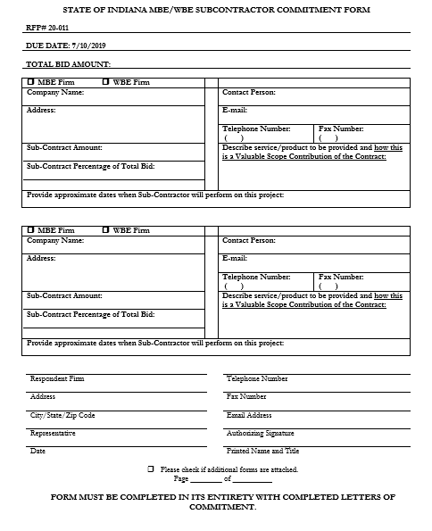
Indiana Department of Administration

Slide 29
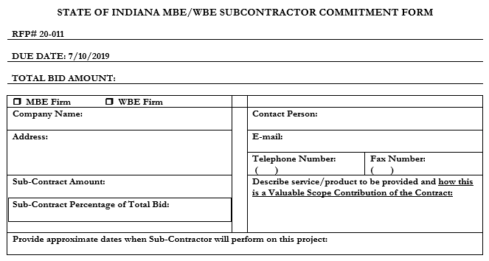
Minority and Women’s Business Enterprises
Indiana Department of Administration

Slide 30
Minority and Women’s Business Enterprises
Effective August, 2014, a new MWBE scoring methodology will be utilized for all RFP’s released
New Process - MWBE scoring is conducted based on 10 points plus a possible 2 bonus points scale
  MBE: Possible 5 points + 1 bonus point
  WBE: Possible 5 points + 1 bonus Point
Professional Services Scoring Methodology:
  The points will be awarded on the following schedule:
  Fractional percentages will be rounded up or down to the nearest whole percentage
  If the respondent’s commitment percentage is rounded down to 0% for MBE or WBE participation the respondent will receive 0 points.
  Submissions of 0% participation will result in a deduction of 1 point in each category
  The highest submission which exceeds the goal in each category will receive 6 points (5 points plus 1 bonus point). In case of a tie both firms will receive 6 points
% | 1% | 2% | 3% | 4% | 5% | 6% | 7% | 8%
Pts. | .625 | 1.25 | 1.875 | 2.5 | 3.125 | 3.75 | 4.375 | 5.0
Indiana Department of Administration

Slide 31
Indiana Veteran Owned Small Business
Contact Information
  Phone: 317-232-3061
  E-mail: Indianaveteranspreference@idoa.in.gov
  Web: www.in.gov/idoa/2862.htm
Complete Attachment A1, IVOSB Form
  Include sub-contractor letters of commitment
Goals for Proposal
  3% Veteran Business Enterprise
Indiana Department of Administration

Slide 32
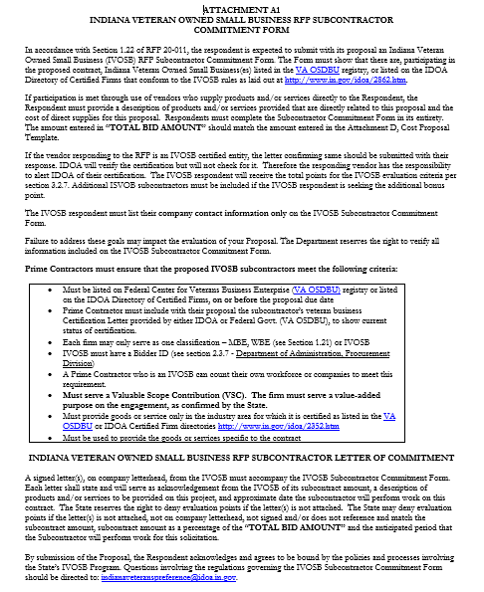
Indiana Department of Administration

Slide 33
Indiana Veteran Owned Small Business
Prime contractors should note the following:
Pursuant to 25 IAC 9-4-1(c), a Prime Contractor who is an IVOSB can use their own workforce to count toward the goal.
IVOSB must have a Bidder ID (see section 2.3.7 - Department of Administration, Procurement Division).
Prime contractor and/or subcontractors’ Certification Letter(s), provided by IDOA or Federal Center for Veterans Business Enterprise (VA OSDBU), must accompany the proposal to show current status of certification.
Each firm may only serve as one classification – MBE, WBE, or IVOSB (see section 1.22).
Indiana Department of Administration

Slide 34
Indiana Veteran Owned Small Business
Prime contractors must ensure that the proposed subcontractors meet the following criteria:
Must be listed on VA OSDBU registry or listed on the IDOA Directory of Certified Firms, on or before the proposal due date.
Serve a Valuable Scope Contribution (VSC) on the engagement, as confirmed by the State.
Provide the goods or services specific to the contract and within the industry area for which it is certified.
Indiana Department of Administration

Slide 35
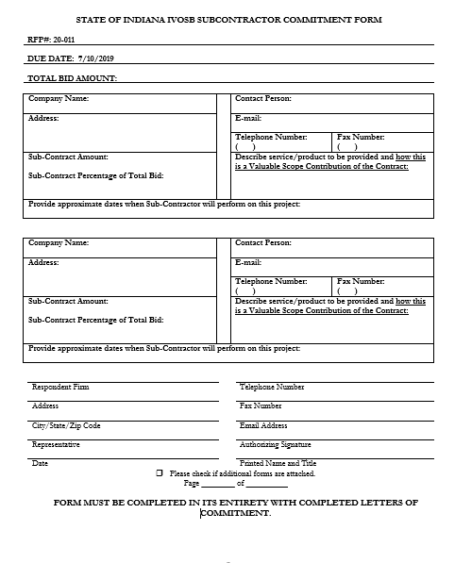
Indiana Department of Administration

Slide 36
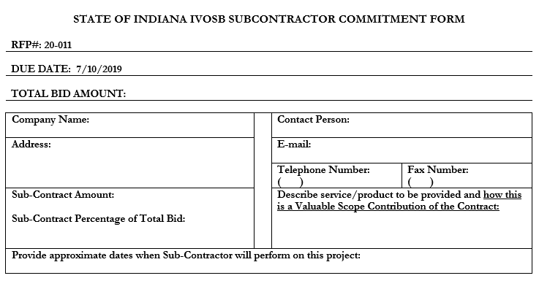
Indiana Veteran Business Enterprise
Indiana Department of Administration

Slide 37
Indiana Veteran Owned Small Business
New Process - IVOSB scoring is conducted based on 5 points plus a possible 1 bonus point scale
  - IVOSB: Possible 5 points + 1 bonus point
Professional Services Scoring Methodology:
  The points will be awarded on the following schedule:
  Fractional points will be awarded based upon a graduated scale between whole points. (e.g. a 0.3% commitment will receive .5 points and a 1.5% commitment will receive 2.5 points)
  Submissions of 0% participation will result in a deduction of 1 point in each category
  The highest submission which exceeds the goal in each category will receive 5 points (5 points plus 1 bonus point). In case of a tie both firms will receive 6 points.
% | 0% | 0.6% | 1.2% | 1.8% | 2.4% | 3%
Pts. | -1 | 1 | 2 | 3 | 4 | 5
Indiana Department of Administration

Slide 38
IDOA Subcontractor Scoring
RFP MBE/WBE/IVOSB Scoring Example
Bidder | MBE % | Pts. | WBE % | Pts. | IVOSB % | Pts. | Total Pts.
Bidder 1 | 12.0% | 5.0 | 10.0% | 6.0 | 3.5% | 6.0 | 17.00
Bidder 2 | 6.0% | 3.75 | 4.0% | 2.5 | 1.8% | 3.0 | 9.25
Bidder 3 | 8.0% | 5.0 | 8.0% | 5.0 | 3.0% | 5.0 | 15.00
Bidder 4 | 16.0% | 6.0 | 0.2% | 0.0 | 0.6% | 1.0 | 7.00
Bidder 5 | 0.0% | -1.0 | 0.0% | -1.0 | 0.0% | -1.0 | -3.00
Indiana Department of Administration

Slide 39



Subcontractor Compliance
Pay Audit System
Tool utilized to monitor the state’s diversity spend for subcontractors
Selected primes and subcontractors are required to report payments submitted or received through this web-based tool
Based on contract terms payments should be reported monthly or quarterly
Questions? Contact Division of Supplier Diversity
  mwbecompliance@idoa.in.gov
  www.in.gov/idoa/mwbe/payaudit.htm
Prime
Submit subcontractor actual paid invoice amounts
Payment
Pay Audit System
Submit actual payments received
Subcontractor
Indiana Department of Administration

Slide 40
Additional Information
IDOA PROCUREMENT LINKS AND NUMBERS
http://www.in.gov/idoa/2354.htm
For Buy Indiana Questions/Registration
http://www.in.gov/idoa/2467.htm
A. Link to the developing for bidder registry with IDOA and Secretary of State.
http://www.in.gov/idoa/2464.htm
B. Secretary of State of Indiana:
Can be reached at (317) 232-6576 for registration assistance. www.in.gov/sos
C. See Vendor and Supplier Resource Center:
http://www.in.gov/idoa/3106.htm
Minority and Women Owned Business Enterprises:
Link to more information and full listing of IDOA Minority and Women Owned Businesses
http://www.in.gov/idoa/2352.htm
Indiana Veteran Owned Small Business Program:
Link to more information and full listing of Indiana Veteran Owned Small Businesses: http://www.in.gov/idoa/2862.htm. To search certified IVOSB’s: https//www.vip.vetbiz.gov
F. RFP posting and updates:
Go to http://www.in.gov/idoa/2354.htm (select “Current Opportunities” link)
Scroll through table until you find desired RFP number on left-hand side and click the link.
Indiana Department of Administration

Slide 41
Questions
    Any verbal response is not considered binding; respondents are encouraged to submit any question formally in writing if it affects the proposal that will be submitted to the State.
Indiana Department of Administration

Slide 42
Thank You
Teresa Deaton
TDeaton@idoa.IN.gov
Indiana Department of Administration

