Slide 1

Indiana Department of Administration
On Behalf Of
Indiana State Police
Request for Proposal 19-109
Pre-Proposal Conference
May 14, 2019
1:30 PM
Teresa Deaton-Reese, IDOA Procurement
Indiana Department of Administration

Slide 2
Agenda
General Information
Purpose of RFP
Term of the Contract
Key Dates
Scope of Work
Business Proposal, Technical Proposal, Cost Proposal
Proposal Preparation & Evaluation
Minority and Women’s Business Enterprises (M/WBE)
Indiana Veteran Owned Small Business (IVOSB)
Additional Information
Question and Answer Session
Indiana Department of Administration

Slide 3
General Information
Sign-In Sheet for Attendees
Sign-In Sheet and PowerPoint will be posted on IDOA’s Solicitation Website
Hold questions until the end of the presentation
  Any verbal response is not considered binding; respondents are encouraged to submit any question formally in writing if it affects the proposal that will be submitted to the state.
Indiana Department of Administration

Slide 4
Purpose of the RFP
.
The purpose of this RFP is to select a vendor that can satisfy the State’s need for the analysis, reporting and if necessary testimony of controlled substance samples. It is the intent of ISP to contract with a vendor that provides quality assurance and professionalism in the examination of drug samples for ISP.
Indiana Department of Administration

Slide 5
Term of the Contract
Contract Term
  The term of the contract shall be for a period of two (2) years. There may be two (2) one-year renewals for a total of four (4) years at the State’s option.
Indiana Department of Administration

Slide 6
Key Dates
Activity | Date
Issue of RFP | April 26, 2019
Pre-Proposal Conference | May 14, 2019
Deadline to Submit Written Questions | May 15, 2019
Response to Written Questions/RFP Amendments | May 22, 2019
Submission of Proposals | June 6, 2019
The dates for the following activities are target dates only.
Proposal Evaluation | TBD
Proposal Discussions/Clarifications (if necessary) | TBD
Oral Presentations (if necessary) | TBD
Best and Final Offers (if necessary) | TBD
RFP Award Recommendation | TBD
Indiana Department of Administration

Slide 7
Scope of Work
Indiana State Police has not previously contracted for this project. The vendor shall test and report on the analysis of controlled substances/seized drug samples. The ISP will provide the vendor approximately 7000 samples over the course of approximately two years at a rate of approximately 400 samples/month. The vendor shall issue an individual report on each case tested and if necessary testify in support of their conclusions. The report is to be sent to each individual agency that submitted the controlled substances. See Attachment G for Scope of Work.
Indiana Department of Administration

Slide 8
Business Proposal
(Attachment E)
Company Financial Information (Section 2.3.3)
  Confidential information must be kept separate from the proposal in the electronic copies. IDOA recommends sending a “public” file that has the confidential information redacted (may be in PDF format) and a “final” file that includes all required information (must be in format provided).
Contract Terms (Section 2.3.5)
  Respondent should review the sample State contract (Attachment B) and note exceptions to State non-mandatory clauses in Business Proposal. The Respondent should accept the mandatory clauses in the Business Proposal and Transmittal Letter.
References (2.3.6)
  The Respondent must include a list of at least three (3) clients for whom the Respondent has performed similar services.
Indiana Department of Administration

Slide 9
Technical Proposal
(Attachment F)
Please answer all questions in the Template we have provided for you. Your response should follow the structure listed in the Technical Proposal Instructions.
Where appropriate, supporting documentation (e.g. diagrams, certificates, graphics, or other exhibits) may be included as attachments to the proposal. Please include appropriate cross-references. However, when using cross-references, the body of the Technical Proposal should contain a meaningful summary of the referenced material.
Respondents are discouraged from simply repeating language from the RFP as evidence of an understanding or capability.
Indiana Department of Administration

Slide 10
Cost Proposal
(Attachment D)
Please complete the template provided for the Cost Proposal by populating ONLY the yellow shaded cells.
Price
35 available points + 5 bonus points
Price will be measured against the State’s baseline cost for this scope of work. The cost that the State is currently paying or its best estimate will constitute the baseline cost. Cost scoring points will be assigned as follows:
Respondents who meet the State’s current baseline cost will receive zero (0) cost points.
Respondents who propose a decrease to the State’s current costs will receive positive points at the same rate as bid increasing cost.
Respondents who propose an increase to the State’s current cost will receive negative points at the same rate as bid lowering cost.
Respondents who propose a 10% decrease to the State’s current baseline cost will receive all of the available cost points.
If multiple Respondents decrease costs below 10% of the current baseline, an additional 5 points will be added to
Baseline for the term of this contract is $1,104,000.00.
Indiana Department of Administration

Slide 11
Proposal Preparation
Buy Indiana, Business Proposal (2.3.14)
  Buy Indiana Status shall be finalized by proposal due date
  There are 5 definitions, details provided in the RFP document
  Email confirmation included in proposal from buyindianainvest@idoa.in.gov (See section 2.7)
    This is required for any of the 5 criteria
Indiana Economic Impact, Attachment C
  The state defines FTE as a measurement of an employee's productivity on a specific project or contract. An FTE of 1 would mean that there is one worker fully engaged on a project.
  Example: If a Respondent has 5 full time employees and is bidding on its 5th contract, and all contracts get an equal amount of commitment from the employees then each employee commits 20% of his or her time to the new contract:
    0.2 x 5 employees= 1 FTE
Indiana Department of Administration

Slide 12
Proposal Preparation
When submitting your response, please create a separate electronic folder for each component to which you are responding. This folder should contain all of the pertinent files for only that component, i.e., MWBE forms, Transmittal Letter, Business Proposal, etc.
Indiana Department of Administration

Slide 13
Proposal Preparation
Attachment D (Cost Proposal) must be returned in Excel
Use the templates provided for all answers
Do not alter templates
Submit all questions using template provided via email using the Q&A Template (Attachment H) to rfp@idoa.IN.gov
Indiana Department of Administration

Slide 14
Proposal Evaluation
Summary of Evaluation Criteria:
Criteria | Points
Adherence to Mandatory Requirements | Pass/Fail
Management Assessment/Quality (Business and Technical Proposal) | 40 available points
Cost (Cost Proposal) | 35 available points (5 bonus points available)
Indiana Economic Impact | 5 points
Buy Indiana | 5 points
Minority Business Enterprise Subcontractor Commitment | 5 ( 1 bonus point is available, see Section 3.2.6)
Women Business Enterprise Subcontractor Commitment | 5 ( 1 bonus point is available, see Section 3.2.6)
Indiana Veteran Owned Small Business Subcontractor Commitment | 5 (1 bonus point is available, see Section 3.2.7)
Total | 100 (108 if bonus awarded)
Legend
Mandatory Requirements
MAQ and Cost Scores
Preference Scores
Indiana Department of Administration

Slide 15
Minority and Women’s Business Enterprises
Mission/Vision
  Promote, monitor, and enforce the standards for certification of minority and women’s business enterprises.
  Provide equal opportunity to minority and women enterprises in the state’s procurement and contracting process.
Nondiscrimination and Antidiscrimination Laws
  Pursuant to Indiana Civil Rights Law, specifically IC §22-9-1-10, every state contract shall contain a provision requiring the contractor and subcontractors to not discriminate against any employee or applicant with respect to Protected Characteristics
Indiana Department of Administration

Slide 16
Minority and Women’s Business Enterprises
Contact Information
  Phone: 317-232-3061
  E-mail: mwbecompliance@idoa.in.gov
  Web: www.in.gov/idoa/mwbe
Complete Attachment A, MWBE Form
- Include sub-contractor letter of commitment
Goals for Proposal
- 8% Minority Business Enterprise
- 8% Women’s Business Enterprise
Indiana Department of Administration

Slide 17
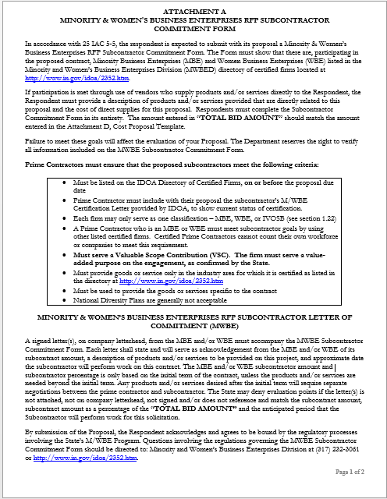
Indiana Department of Administration

Slide 18
Minority and Women’s Business Enterprises
Prime contractors must ensure that the proposed subcontractors meet the following criteria:
Are listed in the IDOA Directory of Certified Firms, on or before the proposal due date, national diversity plans are generally not accepted. The directory can be found here: http://www.in.gov/idoa/mwbe/2743.htm
Serve a Valuable Scope Contribution (VSC) on the engagement, as confirmed by the State.
Provide the goods or services specific to the contract and within the industry area for which it is certified
Indiana Department of Administration

Slide 19
Minority and Women’s Business Enterprises
Prime contractors should note the following:
Subcontractors’ MBE/WBE Certification Letter, provided by IDOA, must accompany the proposal to show current status of certification.
Each firm may only serve as one classification – MBE, WBE, or IVOSB (see section 1.22)
Pursuant to 25 IAC 5-6-2(b)(d), a Prime Contractor who is a MBE or WBE must meet subcontractor goals by using other listed certified firms. Certified Prime Contractors cannot count their own workforce or companies to meet this requirement.
Indiana Department of Administration

Slide 20
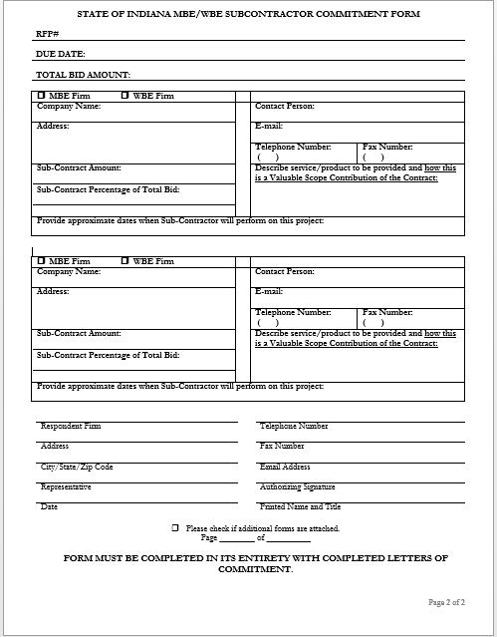
Indiana Department of Administration

Slide 21
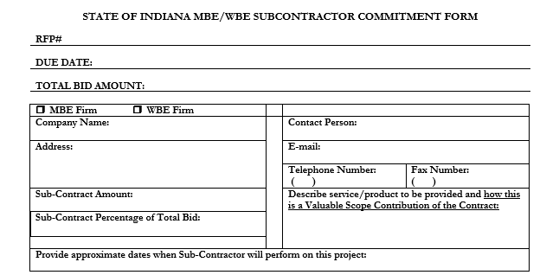
Minority and Women’s Business Enterprises
Indiana Department of Administration

Slide 22
Minority and Women’s Business Enterprises
Effective August, 2014, a new MWBE scoring methodology will be utilized for all RFP’s released
New Process - MWBE scoring is conducted based on 10 points plus a possible 2 bonus points scale
  MBE: Possible 5 points + 1 bonus point
  WBE: Possible 5 points + 1 bonus Point
Professional Services Scoring Methodology:
  The points will be awarded on the following schedule:
  Fractional percentages will be rounded up or down to the nearest whole percentage
  If the respondent’s commitment percentage is rounded down to 0% for MBE or WBE participation the respondent will receive 0 points.
  Submissions of 0% participation will result in a deduction of 1 point in each category
  The highest submission which exceeds the goal in each category will receive 6 points (5 points plus 1 bonus point). In case of a tie both firms will receive 6 points
% | 1% | 2% | 3% | 4% | 5% | 6% | 7% | 8%
Pts. | .625 | 1.25 | 1.875 | 2.5 | 3.125 | 3.75 | 4.375 | 5.0
Indiana Department of Administration

Slide 23
Indiana Veteran Owned Small Business
Contact Information
  Phone: 317-232-3061
  E-mail: Indianaveteranspreference@idoa.in.gov
  Web: www.in.gov/idoa/2862.htm
Complete Attachment A1, IVOSB Form
  Include sub-contractor letters of commitment
Goals for Proposal
  3% Veteran Business Enterprise
Indiana Department of Administration

Slide 24
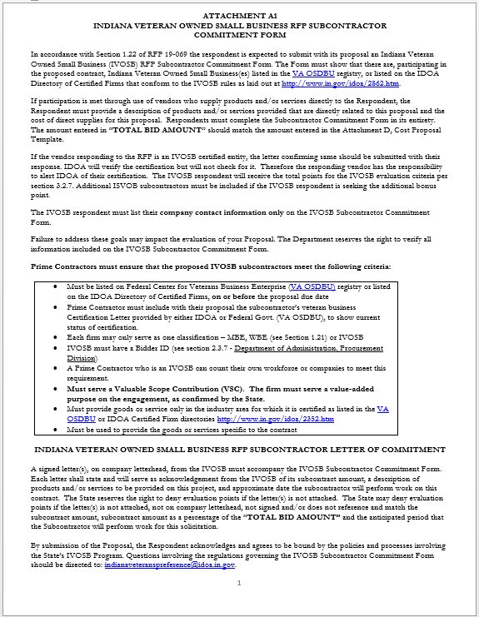

Slide 25
Indiana Veteran Owned Small Business
Prime contractors should note the following:
Pursuant to 25 IAC 9-4-1(c), a Prime Contractor who is an IVOSB can use their own workforce to count toward the goal.
Prime contractor and/or subcontractors’ Certification Letter(s), provided by IDOA or VA OSDBU, must accompany the proposal to show current status of certification.
Each firm may only serve as one classification – MBE, WBE, or IVOSB (see section 1.22).
Indiana Department of Administration

Slide 26
Indiana Veteran Owned Small Business
Prime contractors must ensure that the proposed subcontractors meet the following criteria:
Must be listed on Federal Center for Veterans Business Enterprise (VA OSDBU) registry or listed on the IDOA Directory of Certified Firms, on or before the proposal due date.
Serve a Valuable Scope Contribution (VSC) on the engagement, as confirmed by the State.
Provide the goods or services specific to the contract and within the industry area for which it is certified
Indiana Department of Administration

Slide 27
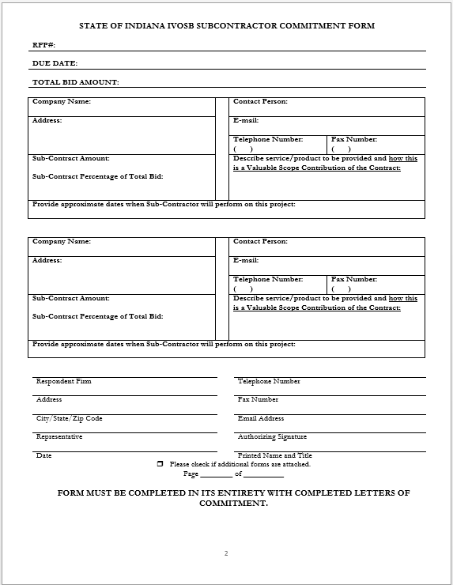
Indiana Department of Administration

Slide 28
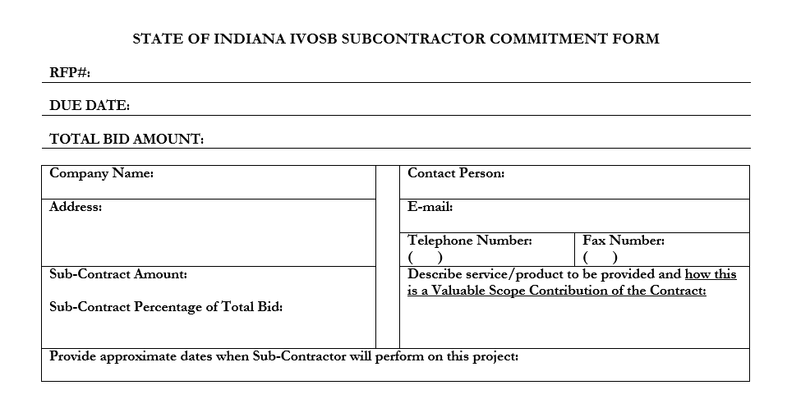
Indiana Veteran Owned Small Business
Indiana Department of Administration

Slide 29
Indiana Veteran Owned Small Business
New Process - IVOSB scoring is conducted based on 5 points plus a possible 1 bonus point scale
  - IVOSB: Possible 5 points + 1 bonus point
Professional Services Scoring Methodology:
  The points will be awarded on the following schedule:
  Fractional points will be awarded based upon a graduated scale between whole points. (e.g. a 0.3% commitment will receive .5 points and a 1.5% commitment will receive 2.5 points)
  Submissions of 0% participation will result in a deduction of 1 point in each category
  The highest submission which exceeds the goal in each category will receive 5 points (5 points plus 1 bonus point). In case of a tie both firms will receive 6 points.
% | 0% | 0.6% | 1.2% | 1.8% | 2.4% | 3%
Pts. | -1 | 1 | 2 | 3 | 4 | 5
Indiana Department of Administration

Slide 30
IDOA Subcontractor Scoring
RFP MBE/WBE/IVOSB Scoring Example
Bidder | MBE % | Pts. | WBE % | Pts. | IVOSB % | Pts. | Total Pts.
Bidder 1 | 12.0% | 5.0 | 10.0% | 6.0 | 3.50% | 6 | 17.00
Bidder 2 | 6.0% | 3.75 | 4.0% | 2.5 | 1.80% | 3 | 9.25
Bidder 3 | 8.0% | 5.0 | 8.0% | 5.0 | 3.00% | 5 | 15.00
Bidder 4 | 16.0% | 6.0 | 0.2% | 0.0 | 0.60% | 1 | 7.00
Bidder 5 | 0.0% | -1.0 | 0.0% | -1.0 | 0.00% | -1 | -3.00
Indiana Department of Administration

Slide 31



Subcontractor Compliance
Pay Audit System
Tool utilized to monitor the state’s diversity spend for subcontractors
Selected primes and subcontractors are required to report payments submitted or received through this web-based tool
Based on contract terms payments should be reported monthly or quarterly
Questions? Contact Division of Supplier Diversity
  mwbecompliance@idoa.in.gov
  www.in.gov/idoa/mwbe/payaudit.htm
Prime
Submit subcontractor actual paid invoice amounts
Payment
Pay Audit System
Submit actual payments received
Subcontractor
Indiana Department of Administration

Slide 32
Additional Information
IDOA PROCUREMENT LINKS AND NUMBERS
http://www.in.gov/idoa/2354.htm
For Buy Indiana Questions/Registration
http://www.in.gov/idoa/2467.htm
A. Link to the developing for bidder registry with IDOA and Secretary of State.
http://www.in.gov/idoa/2464.htm
B. Secretary of State of Indiana:
Can be reached at (317) 232-6576 for registration assistance. www.in.gov/sos
C. See Vendor and Supplier Resource Center:
http://www.in.gov/idoa/3106.htm
Minority and Women Owned Business Enterprises:
Link to more information and full listing of IDOA Minority and Women Owned Businesses
http://www.in.gov/idoa/2352.htm
Indiana Veteran Owned Small Business Program:
Link to more information and full listing of Indiana Veteran Owned Small Businesses: http://www.in.gov/idoa/2862.htm. To search certified IVOSB’s: https//www.vip.vetbiz.gov
F. RFP posting and updates:
Go to http://www.in.gov/idoa/2354.htm (select “Current Opportunities” link)
Scroll through table until you find desired RFP number on left-hand side and click the link.
Indiana Department of Administration

Slide 33
Questions
    Any verbal response is not considered binding; respondents are encouraged to submit any question formally in writing if it affects the proposal that will be submitted to the state.
Indiana Department of Administration

Slide 34
Thank You
Teresa Deaton-Reese
tdeaton@idoa.IN.gov
Indiana Department of Administration

