Slide 1

Request for Proposal 19-095
Long Term Care (LTC) Ombudsman Services
Indiana Department of Administration
On Behalf Of
The Indiana Family and Social Services Administration
Pre-Proposal Conference
March 27, 2019
Teresa Deaton Reese
IDOA/Procurement Division
Indiana Department of Administration

Slide 2
Agenda
General Information
Purpose of RFP
Term of Contract
Key Dates
Background
Scope of Work
Business Proposal
Technical Proposal
Technical Proposal Supplement
Proposal Preparation
Evaluation Criteria
Minority and Women’s Business Enterprises (M/WBE)
Indiana Veteran Owned Small Business (IVOSB)
Additional Information
Question and Answer Session
Indiana Department of Administration
Notes:
Teresa

Slide 3
General Information
Sign-In Sheet for Attendees
Sign-In Sheet and PowerPoint will be posted on IDOA’s Solicitation Website
Hold questions until the end of the presentation
  Any verbal response is not considered binding; respondents are encouraged to submit any questions formally, in writing, if it affects the proposal that will be submitted to the state.
Indiana Department of Administration

Slide 4
Purpose of the RFP
The purpose of this RFP is to select a single vendor that can provide Long Term Care (LTC) Ombudsman services for the State of Indiana.
It is the intent of FSSA to contract with a single vendor that will staff, organize, and supervise all local LTC Ombudsmen while ensuring accurate data reporting and high quality service provision for Indiana’s LTC Ombudsman Program.
Indiana Department of Administration

Slide 5
Term of Contract
The term of the contract shall be for a period of three (3) years from the date of contract execution. There may be two (2) one-year renewals for a total of five (5) years at the State’s option.
Indiana Department of Administration

Slide 6
Key Dates
Activity | Date
Issue of RFP | March 12, 2019
Pre-Proposal Conference | March 27, 2019 2:00 PM EST – Conference Center Room 14 Indiana Government Center - South Building
Deadline to Submit Written Questions | March 28, 2019
Deadline to Submit Intent to Respond Form (optional) | March 28, 2019
Response to Written Questions/RFP Amendments | April 5, 2019
Submission of Proposals | April 18, 2019
The dates for the following activities are target dates only. These activities may be completed earlier or later than the date shown.
Proposal Evaluation | April/May 2019
Proposal Discussions/Clarifications (if necessary) | May/June 2019
Oral Presentations (if necessary) | June 2019
Best and Final Offers (if necessary) | June 2019
RFP Award Recommendation | June 2019
Indiana Department of Administration

Slide 7
Background
The Indiana LTC Ombudsman Program is a federal and State funded program that provides advocacy and related services for residents of LTC facilities.
The mission of the LTC Ombudsman Program is to improve the quality of life and care for residents of LTC facilities.
Recently, the LTC Ombudsman Program has been dealing with two major challenges: growth in the number of residential care facilities and staffing concerns. As part of a solution to address these challenges, the LTC Ombudsman Program is undergoing a transition from provision of services by local Area Agencies on Aging (AAA) to a single Contractor. This Contractor will staff and manage all local LTC Ombudsmen in the state, while communicating with and adhering to the guidance of the State Long Term Care Ombudsman (SLTCO).
Please see Scope of Work (Attachment H) for additional information.
Indiana Department of Administration

Slide 8
Scope of Work
The chosen vendor will deliver LTC Ombudsman services as required, while also addressing the major concerns of the current program. The vendor’s responsibilities, at a high level, involve staffing, organizing, and supervising all local LTC Ombudsmen and ensuring each local LTC Ombudsman conducts their duties as required. The vendor will also be responsible for reporting all local LTC Ombudsman data into State approved software.
In order to be chosen as the State’s LTC Ombudsman Program Services vendor, a Respondent must meet the eligibility requirements listed in the Scope of Work, including, but not limited to, being a non-profit organization and having at least two (2) years of experience providing similar services to the State’s LTC Ombudsman Program’s target population.
Please see Scope of Work (Attachment H) for additional information.
Indiana Department of Administration

Slide 9
Business Proposal
(Attachment E)
Company Financial Information (Section 2.3.3)
  Confidential information must be kept separate from the proposal in the electronic copies. IDOA recommends sending a “public” file that has the confidential information redacted (may be in PDF format) and a “final” file that includes all required information (must be in format provided).
Contract Terms (Section 2.3.5)
  Respondents should review sample State contract and note exceptions to State mandatory and non-mandatory clauses in Business Proposal and Transmittal Letter.
References (2.3.6)
  Respondents must have at least three (3) references for whom the Respondent has provided products and/or services that are the same or similar to those products and/or services requested in this RFP. At least two (2) references must be from governmental clients for which the Respondent has provided LTC Ombudsman or similar resolution, advocacy, and care delivery services.
Indiana Department of Administration

Slide 10
Technical Proposal
(Attachment F)
Respondents should use Attachment F to complete their Technical Proposal. Use the yellow shaded fields to answer the questions in Attachment F.
  Yellow fields will expand to accommodate content.
  Make every attempt to preserve the original format of Attachment F.
Where appropriate, supporting documentation (e.g. diagrams, certificates, graphics, or other exhibits) may be submitted as an attachment and referenced within the relevant answer field.
Indiana Department of Administration

Slide 11
Technical Proposal Supplement
(Attachment G)
Please complete the template provided for the Technical Proposal Supplement by populating ONLY the yellow shaded cells.
The Technical Proposal Supplement asks Respondents to provide information on their proposal’s Staffing costs, Non-Staffing costs, and Additional Funding Sources. This information is not scored quantitatively but rather qualitatively to inform the services described in the Respondent’s Technical Proposal.
This attachment contains a maximum budget number that the Respondent may not exceed, however Respondents will not be scored based on lowest costs or have their proposed costs compared against each other.
Indiana Department of Administration

Slide 12
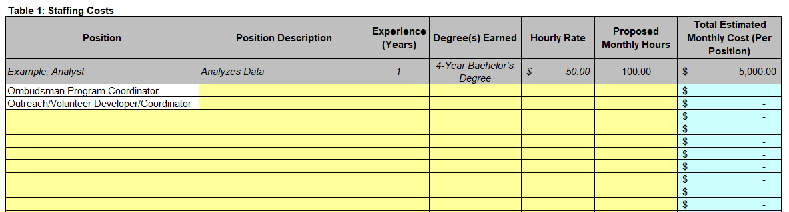
Technical Proposal Supplement (Cont.)
(Attachment G)
For the “Staffing Costs” tab, Respondents must fill in the yellow cells for each mandatory position listed, as well as for any additional positions the Respondent suggests. For each position listed, the Respondent must fill in a description, experience, degree(s) earned, hourly rate, and proposed monthly hours. The Hourly Rate must factor in all overhead costs.
Indiana Department of Administration

Slide 13
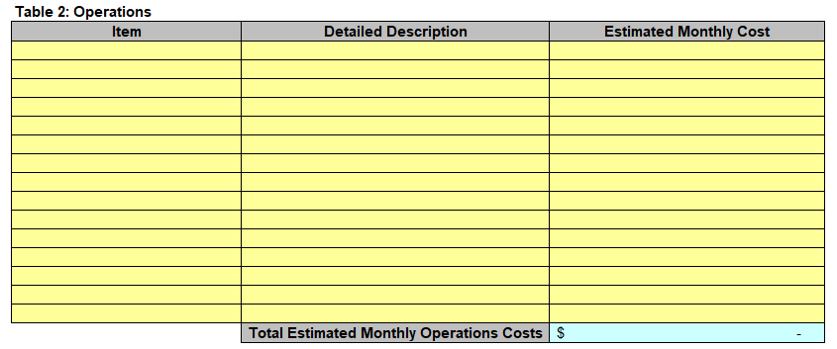

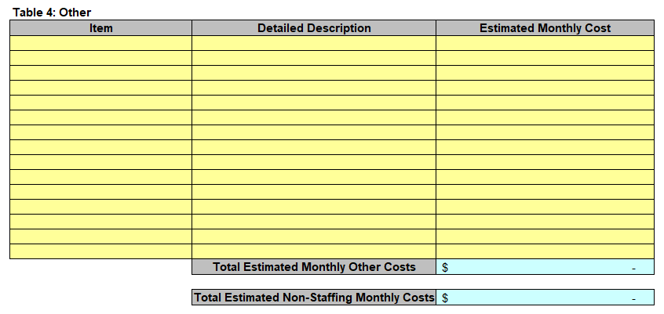
Technical Proposal Supplement (Cont.)
(Attachment G)
For the “Non-Staffing Costs” tab, Respondents must fill in the yellow cells for any operations, equipment, or other costs in the appropriate tables.
Indiana Department of Administration

Slide 14
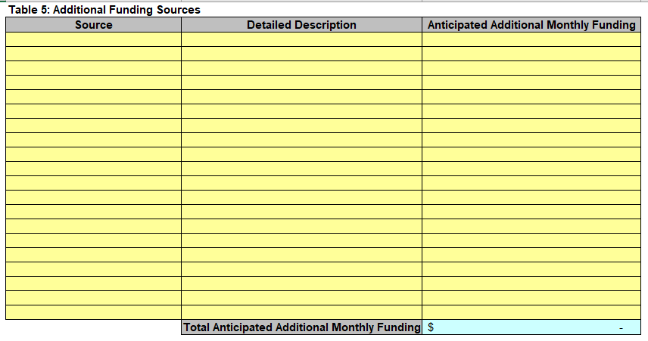
Technical Proposal Supplement (Cont.)
(Attachment G)
For the “Additional Funding Sources” tab, Respondents must fill in the yellow cells, if applicable, for any non-coercive solicitations of voluntary contributions that are expected from other funding sources.
Indiana Department of Administration

Slide 15
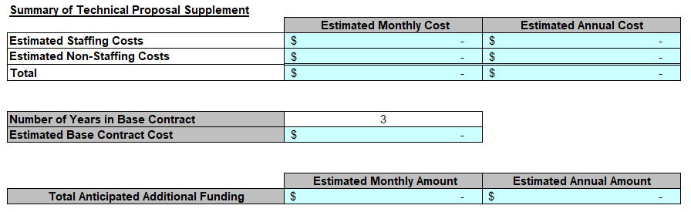
Technical Proposal Supplement (Cont.)
(Attachment G)
The “Summary” tab will pull Respondent’s information from the “Staffing Costs,” “Non-Staffing Costs,” and “Additional Funding Sources” tabs. Other than inserting the Respondent’s name, no response is necessary on this tab.
Indiana Department of Administration

Slide 16
Proposal Preparation
Buy Indiana, Business Proposal (2.3.14)
  Status shall be finalized by proposal due date
  Five (5) definitions, details provided in the RFP
Indiana Economic Impact, Attachment C
  Definitions of FTE (Full-Time Equivalent)
  Example: If a Respondent has five (5) full time employees, is bidding on its 5th contract, and all contracts get an equal amount of commitment from the employees, then each employee commits 20% of his/her time to the new contract:
    0.2 x 5 employees – 1 FTE
Indiana Department of Administration

Slide 17
Proposal Preparation
When submitting your response, please create a separate electronic folder for each component to which you are responding. This folder should contain all of the pertinent files for only that component, i.e., MWBE forms, IVOSB forms, IEI form, Transmittal Letter, Business Proposal, etc. Your proposal may be deemed as non-responsive if these instructions are not followed.
Indiana Department of Administration

Slide 18
Proposal Preparation
Attachment G (Technical Proposal Supplement) must be returned in the original Excel format (No PDFs)
Use the templates provided for all responses
Do not alter any templates
Submit all questions via email using the Q&A Template (Attachment D)
Indiana Department of Administration

Slide 19
Evaluation Criteria
Criteria | Points
Adherence to Mandatory Requirements | Pass/Fail
Management Assessment/Quality (Business Proposal, Technical Proposal, and Technical Proposal Supplement) | 75 points
Indiana Economic Impact | 5 points
Buy Indiana | 5 points
Minority Business Enterprise Subcontractor Commitment | 5 points (1 bonus point is available, see Section 3.2.6)
Women Business Enterprise Subcontractor Commitment | 5 points (1 bonus point is available, see Section 3.2.6)
Indiana Veteran Business Enterprise (IVOSB) Subcontractor Commitment | 5 points (1 bonus point is available, see Section 3.2.7)
Total | 100 (103 if bonus awarded)
Indiana Department of Administration

Slide 20
Minority and Women’s Business Enterprises
Mission/Vision
  Promote, monitor, and enforce the standards for certification of minority and women’s business enterprises.
  Provide equal opportunity to minority and women enterprises in the state’s procurement and contracting process.
Nondiscrimination and Antidiscrimination Laws
  Pursuant to Indiana Civil Rights Law, specifically IC §22-9-1-10, every state contract shall contain a provision requiring the contractor and subcontractors to not discriminate against any employee or applicant with respect to Protected Characteristics
Indiana Department of Administration

Slide 21
Minority and Women’s Business Enterprises
Contact Information
  Phone: 317-232-3061
  E-mail: mwbecompliance@idoa.in.gov
  Web: www.in.gov/idoa/mwbe
Complete Attachment A, MWBE Form
- Include sub-contractor letter of commitment
Goals for Proposal
- 8% Minority Business Enterprise
- 8% Women’s Business Enterprise
Indiana Department of Administration

Slide 22
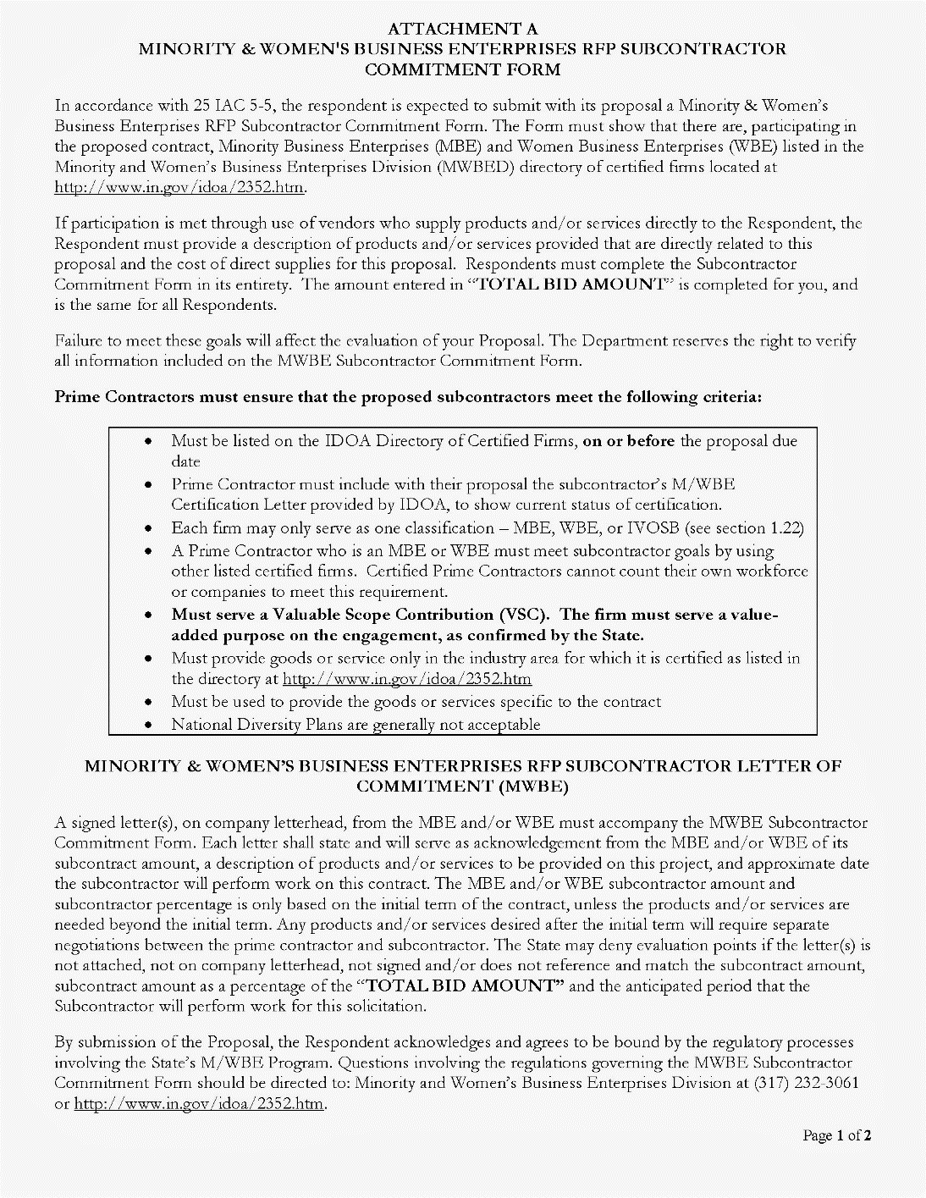
Indiana Department of Administration

Slide 23
Minority and Women’s Business Enterprises
Prime contractors must ensure that the proposed subcontractors meet the following criteria:
Are listed in the IDOA Directory of Certified Firms, on or before the proposal due date, national diversity plans are generally not accepted. The directory can be found here: http://www.in.gov/idoa/mwbe/2743.htm.
Serve a Valuable Scope Contribution (VSC) on the engagement, as confirmed by the State.
Provide the goods or services specific to the contract and within the industry area for which it is certified.
Indiana Department of Administration

Slide 24
Minority and Women’s Business Enterprises
Prime contractors should note the following:
Subcontractors’ MBE/WBE Certification Letter, provided by IDOA, must accompany the proposal to show current status of certification.
Each firm may only serve as one classification – MBE, WBE, or IVOSB (see section 1.22)
Pursuant to 25 IAC 5-6-2(b)(d), a Prime Contractor who is a MBE or WBE must meet subcontractor goals by using other listed certified firms. Certified Prime Contractors cannot count their own workforce or companies to meet this requirement.
Indiana Department of Administration

Slide 25
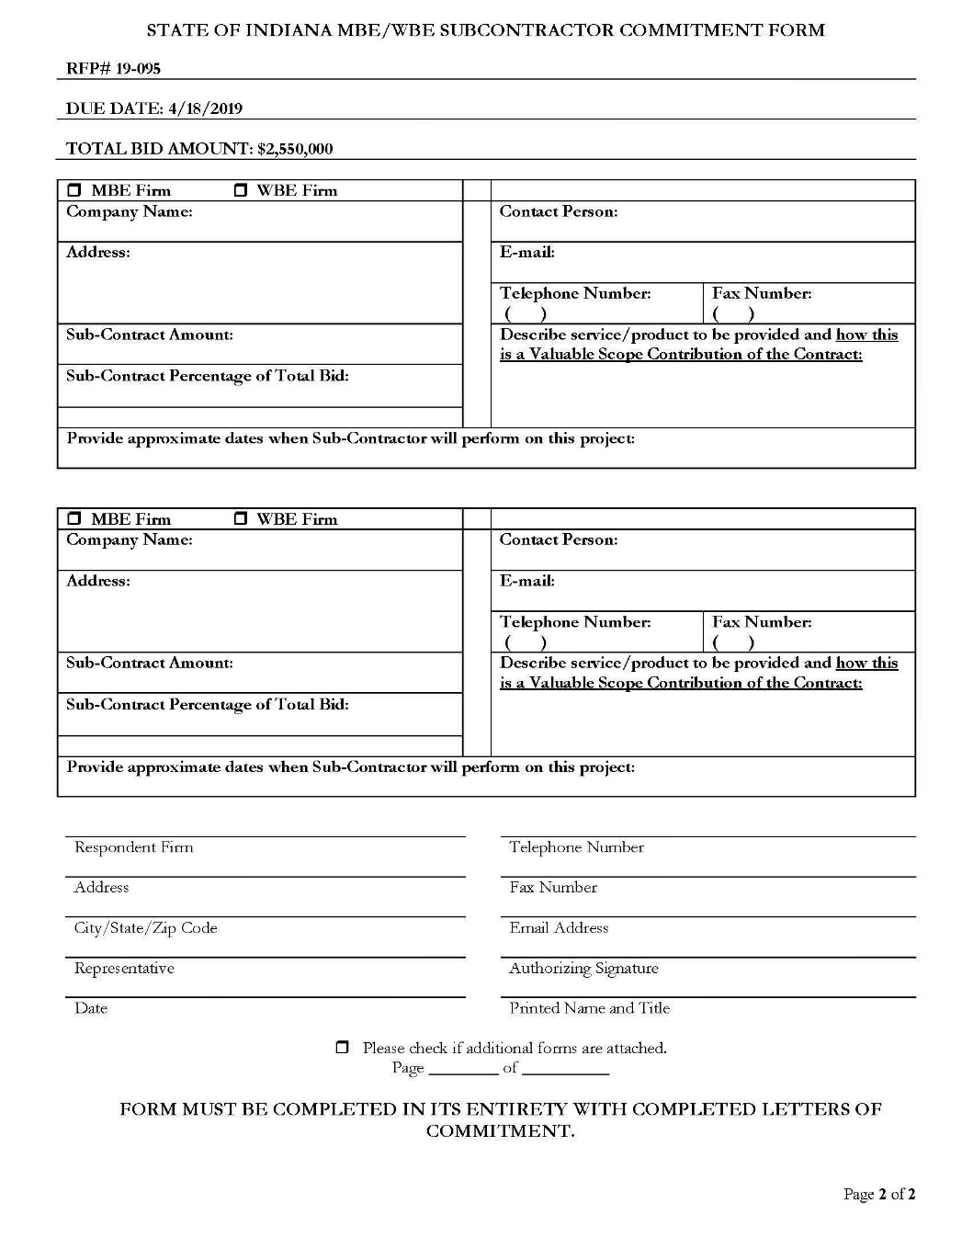
Indiana Department of Administration

Slide 26
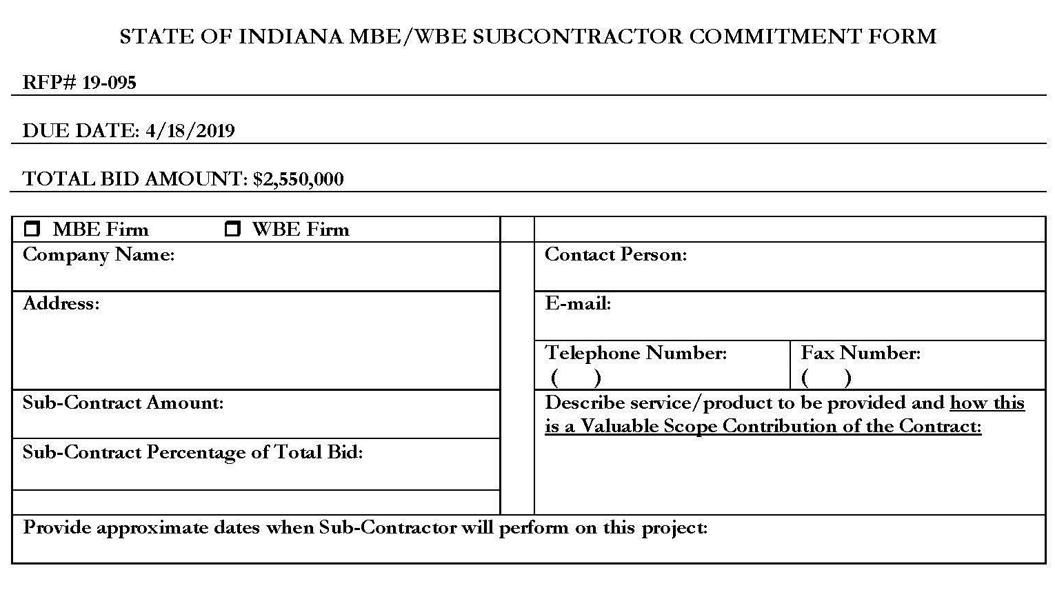
Minority and Women’s Business Enterprises
Indiana Department of Administration

Slide 27
Minority and Women’s Business Enterprises
Effective August 2014, a new MWBE scoring methodology will be utilized for all RFP’s released
New Process - MWBE scoring is conducted based on 10 points plus a possible 2 bonus points scale
  MBE: Possible 5 points + 1 bonus point
  WBE: Possible 5 points + 1 bonus Point
Professional Services Scoring Methodology:
  The points will be awarded on the following schedule:
  Fractional percentages will be rounded up or down to the nearest whole percentage
  If the respondent’s commitment percentage is rounded down to 0% for MBE or WBE participation the respondent will receive 0 points.
  Submissions of 0% participation will result in a deduction of 1 point in each category
  The highest submission which exceeds the goal in each category will receive 6 points (5 points plus 1 bonus point). In case of a tie both firms will receive 6 points
% | 1% | 2% | 3% | 4% | 5% | 6% | 7% | 8%
Pts. | .625 | 1.25 | 1.875 | 2.5 | 3.125 | 3.75 | 4.375 | 5.0
Indiana Department of Administration

Slide 28
Indiana Veteran Owned Small Business
Contact Information
  Phone: 317-232-3061
  E-mail: Indianaveteranspreference@idoa.in.gov
  Web: www.in.gov/idoa/2862.htm
Complete Attachment A1, IVOSB Form
  Include sub-contractor letters of commitment
Goals for Proposal
  3% Indiana Veteran Owned Small Business
Indiana Department of Administration

Slide 29
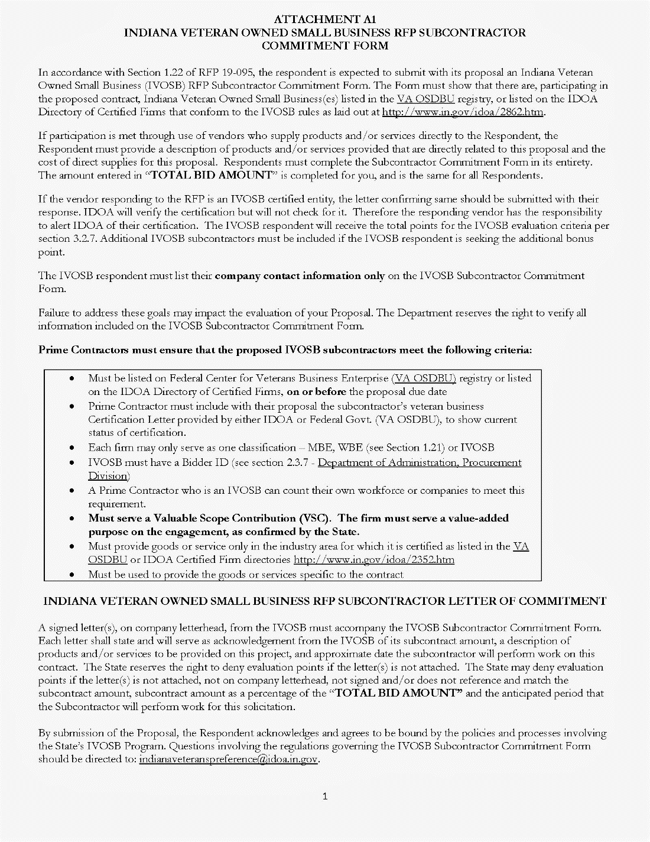
Indiana Department of Administration

Slide 30
Indiana Veteran Owned Small Business
Prime contractors should note the following:
Pursuant to 25 IAC 9-4-1(c), a Prime Contractor who is an IVOSB can use their own workforce to count toward the goal.
IVOSB must have a Bidder ID (see section 2.3.7 - Department of Administration, Procurement Division).
Prime contractor and/or subcontractors’ Certification Letter(s), provided by IDOA or Federal Center for Veterans Business Enterprise (VA OSDBU), must accompany the proposal to show current status of certification.
Each firm may only serve as one classification – MBE, WBE, or IVOSB (see section 1.22).
Indiana Department of Administration

Slide 31
Indiana Veteran Owned Small Business
Prime contractors must ensure that the proposed subcontractors meet the following criteria:
Must be listed on VA OSDBU registry or listed on the IDOA Directory of Certified Firms, on or before the proposal due date.
Serve a Valuable Scope Contribution (VSC) on the engagement, as confirmed by the State.
Provide the goods or services specific to the contract and within the industry area for which it is certified.
Indiana Department of Administration

Slide 32
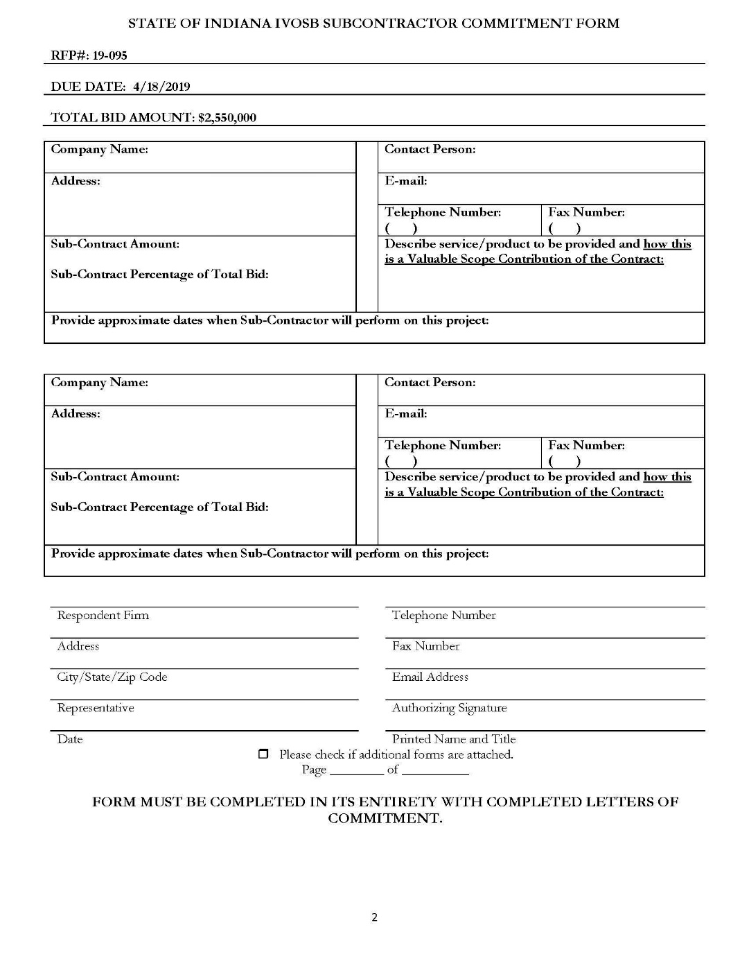
Indiana Department of Administration

Slide 33

Indiana Veteran Business Enterprise
Indiana Department of Administration

Slide 34
Indiana Veteran Owned Small Business
New Process - IVOSB scoring is conducted based on 5 points plus a possible 1 bonus point scale
  - IVOSB: Possible 5 points + 1 bonus point
Professional Services Scoring Methodology:
  The points will be awarded on the following schedule:
  Fractional points will be awarded based upon a graduated scale between whole points. (e.g. a 0.3% commitment will receive .5 points and a 1.5% commitment will receive 2.5 points)
  Submissions of 0% participation will result in a deduction of 1 point in each category
  The highest submission which exceeds the goal in each category will receive 5 points (5 points plus 1 bonus point). In case of a tie both firms will receive 6 points.
% | 0% | 0.6% | 1.2% | 1.8% | 2.4% | 3%
Pts. | -1 | 1 | 2 | 3 | 4 | 5
Indiana Department of Administration

Slide 35
IDOA Subcontractor Scoring
RFP MBE/WBE/IVOSB Scoring Example
Bidder | MBE % | Pts. | WBE % | Pts. | IVOSB % | Pts. | Total Pts.
Bidder 1 | 12.0% | 5.0 | 10.0% | 6.0 | 3.5% | 6.0 | 17.00
Bidder 2 | 6.0% | 3.75 | 4.0% | 2.5 | 1.8% | 3.0 | 9.25
Bidder 3 | 8.0% | 5.0 | 8.0% | 5.0 | 3.0% | 5.0 | 15.00
Bidder 4 | 16.0% | 6.0 | 0.2% | 0.0 | 0.6% | 1.0 | 7.00
Bidder 5 | 0.0% | -1.0 | 0.0% | -1.0 | 0.0% | -1.0 | -3.00
Indiana Department of Administration

Slide 36



Subcontractor Compliance
Pay Audit System
Tool utilized to monitor the state’s diversity spend for subcontractors
Selected primes and subcontractors are required to report payments submitted or received through this web-based tool
Based on contract terms payments should be reported monthly or quarterly
Questions? Contact Division of Supplier Diversity
  mwbecompliance@idoa.in.gov
  www.in.gov/idoa/mwbe/payaudit.htm
Prime
Submit subcontractor actual paid invoice amounts
Payment
Pay Audit System
Submit actual payments received
Subcontractor
Indiana Department of Administration

Slide 37
Additional Information
IDOA PROCUREMENT LINKS AND NUMBERS
http://www.in.gov/idoa/2354.htm
For Buy Indiana Questions/Registration
http://www.in.gov/idoa/2467.htm
A. Link to the developing for bidder registry with IDOA and Secretary of State.
http://www.in.gov/idoa/2464.htm
B. Secretary of State of Indiana:
Can be reached at (317) 232-6576 for registration assistance. www.in.gov/sos
C. See Vendor and Supplier Resource Center:
http://www.in.gov/idoa/3106.htm
Minority and Women Owned Business Enterprises:
Link to more information and full listing of IDOA Minority and Women Owned Businesses
http://www.in.gov/idoa/2352.htm
Indiana Veteran Owned Small Business Program:
Link to more information and full listing of Indiana Veteran Owned Small Businesses: http://www.in.gov/idoa/2862.htm. To search certified IVOSB’s: https//www.vip.vetbiz.gov
F. RFP posting and updates:
Go to http://www.in.gov/idoa/2354.htm (select “Current Opportunities” link)
Scroll through table until you find desired RFP number on left-hand side and click the link.
Indiana Department of Administration

Slide 38
Questions
    Any verbal response is not considered binding; respondents are encouraged to submit any question formally in writing if it affects the proposal that will be submitted to the State.
Indiana Department of Administration

Slide 39
Thank You
Teresa Deaton Reese
tdeaton@idoa.IN.gov
Indiana Department of Administration

