Slide 1

Indiana Department of Administration
On Behalf Of
Indiana Family and Social Services Administration and Indiana State Department of Health
Request for Proposal 19-088
Electronic Benefit Transfer (EBT) and Time and Attendance (T&A) System(s) RFP
Pre-Proposal Conference
February 26, 2019
10:00 AM
Teresa Deaton-Reese, IDOA Procurement
Indiana Department of Administration

Slide 2
Agenda
General Information
Purpose of RFP
Term of the Contract
Key Dates
Project Background
Scope of Work
Business Proposal, Technical Proposal, Cost Proposal, SNAP and TANF EBT System Requirements
Proposal Preparation & Evaluation
Minority and Women’s Business Enterprises (M/WBE)
Additional Information
Question and Answer Session
Indiana Department of Administration

Slide 3
General Information
Sign-In Sheet for Attendees
Sign-In Sheet and PowerPoint will be posted on IDOA’s Solicitation Website
Hold questions until the end of the presentation
  Any verbal response is not considered binding; respondents are encouraged to submit any question formally in writing if it affects the proposal that will be submitted to the state.
Indiana Department of Administration

Slide 4
Purpose of the RFP
The FSSA Division of Family Resources (DFR) and ISDH are seeking Contractor(s) to implement EBT system(s) and provide EBT card issuance and processing services for the Supplemental Nutrition Assistance Program (SNAP), Temporary Assistance for Needy Families (TANF) program, and the Special Supplemental Nutrition Program for Women, Infants, and Children (WIC).
The FSSA Office of Early Childhood Education and Out-of-School Learning (OECOSL) requires time and attendance (T&A) capturing and processing for the Central Reimbursement Office (CRO) for the Child Care Development Fund (CCDF) voucher and Pre-K programs.
Indiana Department of Administration

Slide 5
Term of the Contract
Contract Term
  The term of the contract shall be for a period of four (4) years. There may be three (3) one-year renewals for a total of seven (7) years at the State’s option.
  Year One of the contract shall be devoted to transition/implementation activities, and Year Two through Year Four shall be devoted to operations.
Indiana Department of Administration

Slide 6
Key Dates
Activity | Date
Issue of RFP | February 14, 2019
Pre-Proposal Conference | February 26, 2019
Deadline to Submit Written Questions | March 1, 2019, 3:00 pm ET
Intent to Respond Deadline | March 1, 2019, 3:00 pm ET
Response to Written Questions/RFP Amendments | March 15, 2019
Submission of Proposals | May 2, 2019
The dates for the following activities are target dates only.
Proposal Evaluation | May 3 to June 14, 2019
Proposal Discussions/Clarifications (if necessary) | May 3 to June 14, 2019
Oral Presentations (if necessary) | June 4 to June 6, 2019
Best and Final Offers (if necessary) | June 7 to June 14, 2019
RFP Award Recommendation | June 19, 2019
Indiana Department of Administration

Slide 7
Project Background
The State of Indiana has been delivering SNAP and TANF benefits via EBT since 2002. Clients must be able to access SNAP benefits for the purchase of eligible food items in authorized food retail locations.
Except in locations limited by Indiana law IC 12-13-14-4.5, TANF benefits may be accessed at Automated Teller Machines (ATMs) and Point-of-Sale (POS) devices, subject to retailer policies.
The WIC Program manages and authorizes benefits for eligible clients, who can apply their specific benefits toward approved products via EBT at authorized grocery retailers.
OECOSL’s Child Care CRO plays a critical role in the successful administration of the CCDF voucher program and Pre-K program by providing an automated, real time method for families to record the time that their children receive care and by making accurate, timely payments to providers for this care.
Indiana Department of Administration

Slide 8
Scope of Work
Attachment D
This RFP is divided into one common scope (Scope A) and three program-specific scopes: SNAP/TANF (Scope B), WIC (Scope C), and Child Care (Scope D).
Vendors may propose to provide services for an individual program-specific scope or any combination of program-specific scopes.
Currently, each program is administered independently, and each uses a separate and distinct mag-stripe card.
Indiana Department of Administration

Slide 9
Scope of Work – Scope A
Attachment D
The requirements, responsibilities, and activities included in Scope A shall apply equally to the provision of all individual, program-specific scopes.
Whether the a vendor chooses to respond to a single program-specific scope or multiple program-specific scopes, the vendor must submit a single response addressing the common content of Scope A, in addition to all applicable program-specific materials and response components.
Regardless of which program(s) vendors propose to fulfill, all vendors must respond to Scope A.
Indiana Department of Administration

Slide 10
Scope of Work – Scope B
Attachment D
Scope B covers SNAP and TANF EBT services.
Respondents proposing to fulfill Scope B must be able provide all services as outlined in RFP Attachment D, Section 5.
Please note that Scope B Respondents must also fill out Attachment G, “SNAP and TANF System Requirements,” in addition to the other standard proposal forms.
Indiana Department of Administration

Slide 11
Scope of Work – Scope C
Attachment D
Scope C covers WIC EBT services.
Respondents proposing to fulfill Scope C must be able provide all services as outlined in RFP Attachment D, Section 6.
Indiana Department of Administration

Slide 12
Scope of Work – Scope D
Attachment D
Scope D covers Child Care T&A services.
Respondents proposing to fulfill Scope D must be able provide all services as outlined in RFP Attachment D, Section 7.
While this service is currently handled via cards and remote devices, Respondents may propose an alternate method of capturing time and attendance as long as the proposed solution meets all requirements.
Indiana Department of Administration

Slide 13
Business Proposal
(Attachment E)
Company Financial Information (Section 2.3.3)
  Confidential information must be kept separate from the proposal in the electronic copies. IDOA recommends sending a “public” file that has the confidential information redacted (may be in PDF format) and a “final” file that includes all required information (must be in format provided).
Contract Terms (Section 2.3.5)
  Respondent should review the sample State contract (Attachment B) and note exceptions to State non-mandatory clauses in Business Proposal. The Respondent should accept the mandatory clauses in the Business Proposal and Transmittal Letter.
Indiana Department of Administration

Slide 14
Business Proposal (Cont.)
(Attachment E)
References (2.3.6)
  For each program-specific scope for which the Respondent proposes to fulfill, the Respondent must include a list of at least three (3) clients for whom the Respondent has performed similar services.
  The Respondent may list the same reference for multiple program-specific scopes only if the Respondent has provided applicable services in each program area for that reference.
  For example, if the Respondent proposes to fulfill Scope B and C, they must submit a total of at least six (6) client references (3 for each scope). If the Respondent has provided services similar to both Scope B and C for a single government client, the Respondent may list that client twice (once for Scope B and once for Scope C).
Indiana Department of Administration

Slide 15
Technical Proposal
(Attachment F)
Please answer all questions in the Template we have provided for you. Your response should follow the structure listed in the Technical Proposal Instructions.
Failure to complete the fields applicable to the program-specific scope(s) for which you propose to fulfill may impact your proposal’s responsiveness. Please note all Respondents must complete the fields associated with Scope A (Questions A.1 through A.10).
Where appropriate, supporting documentation (e.g. diagrams, certificates, graphics, or other exhibits) may be included as attachments to the proposal. Please include appropriate cross-references. However, when using cross-references, the body of the Technical Proposal should contain a meaningful summary of the referenced material.
Respondents are discouraged from simply repeating language from the RFP as evidence of an understanding or capability.
Indiana Department of Administration

Slide 16
Cost Proposal
(Attachment C)
Please complete the template provided for the Cost Proposal by populating ONLY the yellow shaded cells.
Cost will be evaluated against the State’s baseline cost for each program-specific scope of work. The cost that the State is currently paying or its best estimate will constitute the baseline cost. Cost scoring points will be assigned as follows:
  Respondents who meet the State’s current baseline cost will receive zero (0) cost points.
  Respondents who propose a decrease to the State’s current costs will receive positive points at the same rate as bid increasing cost.
  Respondents who propose an increase to the State’s current cost will receive negative points at the same rate as bid lowering cost.
  Respondents who propose a 10% decrease to the State’s current baseline cost will receive all of the available cost points.
  If multiple Respondents decrease costs below 10% of the current baseline, an additional 5 points will be added to the Respondent proposing the lowest cost.
Indiana Department of Administration

Slide 17
Cost Proposal (Cont.)
(Attachment C)
Respondents must fill out the tabs corresponding to the scope(s) of services they wish to provide.
Additionally, if a Respondent proposes to fulfill multiple scopes, please fill out the non-scored, non-evaluated "Multi-Scope Savings" tab, which allows Respondents to propose efficiency discounts in the event they are awarded multiple scopes under this RFP.
Do not make any entries on the "Cost Summary" tabs, as entries will be automatically calculated based on the entries on the other tabs.
Indiana Department of Administration

Slide 18
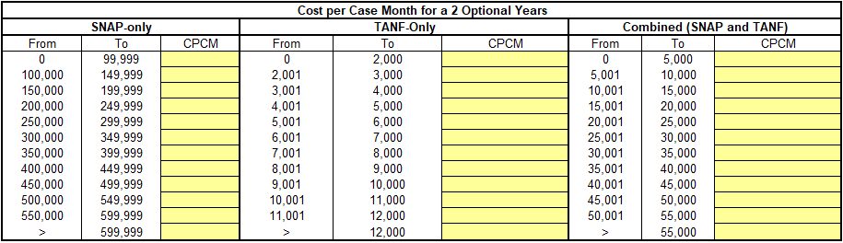
Cost Proposal (Cont.)
(Attachment C)
For each program-specific scope, Respondents will propose a the Cost per Case Month (CPCM) for each range of the program’s total active cases for both the base contract years and the optional years.
Example chart for gathering pricing for SNAP and TANF cases is provided below:
Indiana Department of Administration

Slide 19
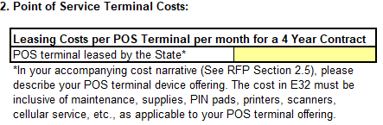
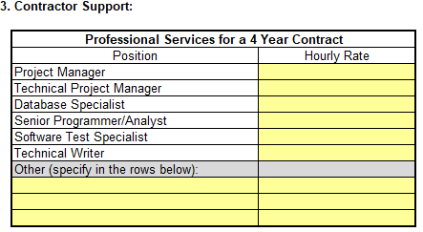
Cost Proposal (Cont.)
(Attachment D)
For each program-specific scope, Respondents will propose monthly leasing costs for required equipment, which varies across program-specific scopes.
Additionally, Respondents must provide hourly rates by staff role for support and enhancements for both the base and optional contract years. Please note that these hourly rates will only be used for work that exceeds the enhancement pool hours provided at no additional cost to the programs.
Indiana Department of Administration

Slide 20
Scope B – SNAP and TANF System Requirements
(Attachment G)
This form only applies if you propose to fulfill Scope B.
It contains a list of functionalities and obligations, which the Respondent’s proposed SNAP/TANF EBT solution is required to meet.
For each requirement, Respondents must indicate if the system/ solution meets the requirement “as is,” “with customization(s),” or “does not meet” the requirement.
For any “does not meet” response, the Respondent must provide an attached explanation on why the absence of that functionality does not diminish the State’s business processes. The State, in its sole discretion, may reject any proposal with a “Does not meet” selected if the State finds the proposed explanation insufficient.
Indiana Department of Administration

Slide 21
Proposal Preparation
When submitting your response, please create a separate electronic folder for each component to which you are responding. This folder should contain all of the pertinent files for only that component, i.e., MWBE forms, Transmittal Letter, Business Proposal, etc.
Indiana Department of Administration

Slide 22
Proposal Preparation
Attachment C (Cost Proposal) must be returned in Excel
Use the templates provided for all answers
Do not alter templates
Submit all questions using template provided via email using the Q&A Template (Attachment G) to rfp@idoa.IN.gov
Indiana Department of Administration

Slide 23
Proposal Evaluation
Summary of Evaluation Criteria:
Criteria | Points
Adherence to Mandatory Requirements | Pass/Fail
Management Assessment/Quality (Business and Technical Proposal) | 55 available points
Cost (Cost Proposal) | 35 available points (5 bonus points are available, see Section 3.2.3)
Minority Business Enterprise Subcontractor Commitment | 5 ( 1 bonus point is available, see Section 3.2.6)
Women Business Enterprise Subcontractor Commitment | 5 ( 1 bonus point is available, see Section 3.2.6)
Total | 100 (107 if bonus awarded)
Legend
Mandatory Requirements
MAQ and Cost Scores
Preference Scores
Indiana Department of Administration

Slide 24
Minority and Women’s Business Enterprises
Mission/Vision
  Promote, monitor, and enforce the standards for certification of minority and women’s business enterprises.
  Provide equal opportunity to minority and women enterprises in the state’s procurement and contracting process.
Nondiscrimination and Antidiscrimination Laws
  Pursuant to Indiana Civil Rights Law, specifically IC §22-9-1-10, every state contract shall contain a provision requiring the contractor and subcontractors to not discriminate against any employee or applicant with respect to Protected Characteristics
Indiana Department of Administration

Slide 25
Minority and Women’s Business Enterprises
Contact Information
  Phone: 317-232-3061
  E-mail: mwbecompliance@idoa.in.gov
  Web: www.in.gov/idoa/mwbe
Complete Attachment A, MWBE Form
- Include sub-contractor letter of commitment
Goals for Proposal
- 8% Minority Business Enterprise
- 8% Women’s Business Enterprise
Indiana Department of Administration

Slide 26
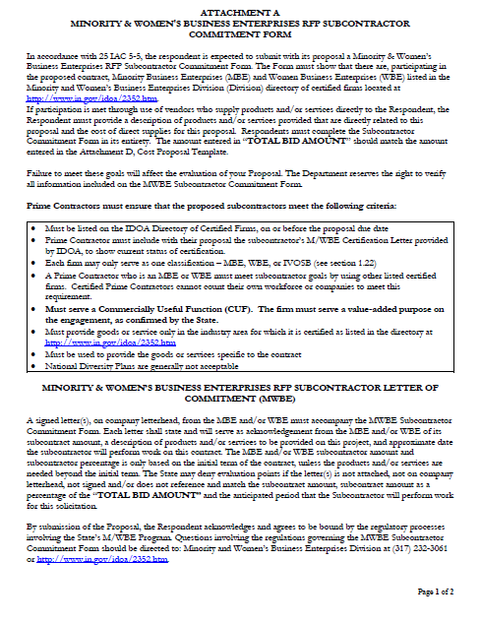
Indiana Department of Administration

Slide 27
Minority and Women’s Business Enterprises
Prime Contractors must ensure that the proposed subcontractors meet the following criteria:
Must be listed on the IDOA Directory of Certified Firms, on or before the proposal due date.
Prime Contractor must include with their proposal the subcontractor’s M/WBE Certification Letter provided by IDOA, to show current status of certification.
Each firm may only serve as one classification – MBE, WBE or IVOSB.
A Prime Contractor who is an MBE or WBE must meet subcontractor goals by using other listed certified firms. Certified Prime Contractors cannot count their own workforce or companies to meet this requirement.
Must serve a commercially useful function. The firm must serve a value-added purpose on the engagement.
Must provide goods or service only in the industry area for which it is certified as listed in the directory at http://www.in.gov/idoa/2352.htm
Must be used to provide the goods or services specific to the contract.
National Corporate Diversity Plans are generally not acceptable.
Indiana Department of Administration

Slide 28
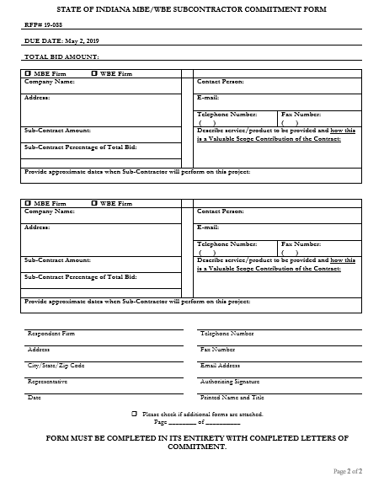
Indiana Department of Administration

Slide 29
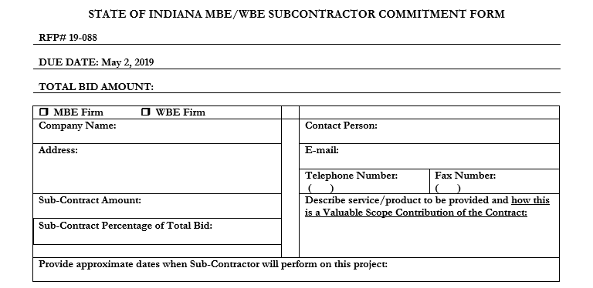
Minority and Women’s Business Enterprises
Indiana Department of Administration

Slide 30
Minority and Women’s Business Enterprises
Effective August, 2014, a new MWBE scoring methodology will be utilized for all RFP’s released
New Process - MWBE scoring is conducted based on 10 points plus a possible 2 bonus points scale
  MBE: Possible 5 points + 1 bonus point
  WBE: Possible 5 points + 1 bonus Point
Professional Services Scoring Methodology:
  The points will be awarded on the following schedule:
  Fractional percentages will be rounded up or down to the nearest whole percentage
  If the respondent’s commitment percentage is rounded down to 0% for MBE or WBE participation the respondent will receive 0 points.
  Submissions of 0% participation will result in a deduction of 1 point in each category
  The highest submission which exceeds the goal in each category will receive 6 points (5 points plus 1 bonus point). In case of a tie both firms will receive 6 points
% | 1% | 2% | 3% | 4% | 5% | 6% | 7% | 8%
Pts. | .625 | 1.25 | 1.875 | 2.5 | 3.125 | 3.75 | 4.375 | 5.0
Indiana Department of Administration

Slide 31
IDOA Subcontractor Scoring
RFP MBE/WBE/IVOSB Scoring Example
Bidder | MBE % | Pts. | WBE % | Pts. | IVOSB % | Pts. | Total Pts.
Bidder 1 | 12.0% | 5.0 | 10.0% | 6.0 | 3.50% | 6 | 17.00
Bidder 2 | 6.0% | 3.75 | 4.0% | 2.5 | 1.80% | 3 | 9.25
Bidder 3 | 8.0% | 5.0 | 8.0% | 5.0 | 3.00% | 5 | 15.00
Bidder 4 | 16.0% | 6.0 | 0.2% | 0.0 | 0.60% | 1 | 7.00
Bidder 5 | 0.0% | -1.0 | 0.0% | -1.0 | 0.00% | -1 | -3.00
*Please note that there is no IVOSB component on this RFP
Indiana Department of Administration

Slide 32



Subcontractor Compliance
Pay Audit System
Tool utilized to monitor the state’s diversity spend for subcontractors
Selected primes and subcontractors are required to report payments submitted or received through this web-based tool
Based on contract terms payments should be reported monthly or quarterly
Questions? Contact Division of Supplier Diversity
  mwbecompliance@idoa.in.gov
  www.in.gov/idoa/mwbe/payaudit.htm
Prime
Submit subcontractor actual paid invoice amounts
Payment
Pay Audit System
Submit actual payments received
Subcontractor
Indiana Department of Administration

Slide 33
Additional Information
IDOA PROCUREMENT LINKS AND NUMBERS
http://www.in.gov/idoa/2354.htm
1-877-77BUYIN (8946) For Vendor Registration Questions
http://www.in.gov/idoa/2464.htm
For Inquiries Regarding Substantial Indiana Economic Impact
http://www.in.gov/idoa/2467.htm
Link to the developing “one stop shop” for vendor registry with IDOA and Secretary of State.
B. Secretary of State of Indiana:
Can be reached at (317) 232-6576 for registration assistance. www.in.gov/sos
C. See Vendor Handbook:
Online version available at http://www.in.gov/idoa/files/vendor_handbook.doc
Minority and Women Owned Business Enterprises:
http://www.in.gov/idoa/files/Certification_List(48).xls for table of IDOA certified MBEs and WBEs. For more WBE’s information http://www.in.gov/idoa/2352.htm
Veteran Owned Small Business Program:
https://www.vip.vetbiz.gov/ for a search of certified IVOSB’s. For more IVOSB’s information http://www.in.gov/idoa/2862.htm
F. RFP posting and updates:
Go to http://www.in.gov/idoa/2354.htm (select “State of Indiana Opportunities” link)
Drag through table until you find desired RFP/RFI number on left-hand side and click the link.
Indiana Department of Administration

Slide 34
Questions
    Any verbal response is not considered binding; respondents are encouraged to submit any question formally in writing if it affects the proposal that will be submitted to the state.
Indiana Department of Administration

Slide 35
Thank You
Teresa Deaton-Reese
tdeaton@idoa.IN.gov
Indiana Department of Administration

