Slide 1

Request for Proposal 19-032 DDRS Home and Community Based Services (HCBS) Waiver Redesign Indiana Department of Administration On Behalf Of Indiana Family and Social Services Administration
Pre-Proposal Conference
September 26, 2018
Teresa Deaton-Reese, CPPB, CPPO Senior Account Manager
Indiana Department of Administration

Slide 2
Agenda
General Information
Purpose of RFP
Key Dates & Term of Contract
Project Background
Scope of Work
Business Proposal, Technical Proposal, Cost Proposal
Proposal Preparation & Evaluation Criteria
Minority and Women’s Business Enterprises (M/WBE)
Indiana Veteran Owned Small Businesses (IVOSB)
Additional Information
Question and Answer Session
Indiana Department of Administration
Notes:
Teresa

Slide 3
General Information
Sign-In Sheet for Attendees
Sign-In Sheet and PowerPoint will be posted on IDOA’s Solicitation Website
Hold questions until the end of the presentation
Any verbal response is not considered binding; Respondents are encouraged to submit any questions formally, in writing, if it affects the proposal that will be submitted to the State.
Indiana Department of Administration

Slide 4
Purpose of the RFP
The purpose of this RFP is to select a vendor that can satisfy the State’s need to develop new Home and Community Based Services (HCBS) waivers, which will not only comply with HCBS rules but also lead to improved services and supports encouraging fuller community integration for individuals in Indiana with intellectual and developmental disabilities (ID/DD).
The successful Respondent must ensure that the waivers:
Increase person-centered planning
Improve coordination of care
Increase community engagement
Enhance member experience
Maintain a level of qualified providers to adequately cater to the population
Comply with Home and Community Based Settings Rule
Utilize service models that promote efficiency and provide cost savings, where applicable
Indiana Department of Administration

Slide 5
Key Dates
Activity | Date
Issue of RFP | September 12, 2018
Pre-Proposal Conference | September 26, 2018
Deadline to Submit Intent to Respond (optional) and Written Questions | September 27, 2018
Response to Written Questions/RFP Amendments | October 4, 2018
Submission of Proposals | October 17, 2018
The dates for the following activities are target dates only. These activities may be completed earlier or later than the date shown.
Proposal Evaluation | November 2018
Proposal Discussions/Clarifications (if necessary) | November 2018
Oral Presentations (if necessary) | November 27, 2018
Best and Final Offers (if necessary) | November 28, 2018
RFP Award Recommendation | December 18, 2018
Indiana Department of Administration

Slide 6
Term of Contract
The State intends to sign a contract with one Respondent to fulfill the requirements in this RFP.
The initial term of the contract shall be for two (2) years from the date of contract execution.
Indiana Department of Administration

Slide 7
Project Background
The Bureau of Developmental Disabilities Services (BDDS) within the Division of Disability and Rehabilitative Services (DDRS) provides services for individuals with ID/DD that enable them to live as independently as possible in their communities.
Currently, the State supports 25,000 individuals through two waivers, with the number of waivers to increase in the future:
Community Integration and Habilitation Waiver (CIH)
Family Supports Waiver (FSW)
The State also joined the National Community of Practice for Supporting Families. Supporting Families through the LifeCourse is the framework for transformational change in Indiana and all HCBS waivers, supports, and services will support this framework.
Indiana Department of Administration

Slide 8
Scope of Work
The vendor will be responsible for redesigning and developing at most three waivers. For each, the vendor will produce the following deliverables:
Draft waiver design
Final waiver design
Draft waiver development
Final waiver development
The vendor will also be responsible for a transition plan and project management, including a project work plan, monthly progress reports, and comprehensive project documentation.
While the vendor will not be developing rates or rate methodologies, the vendor must have a strong understanding of rate activities in order to design the waivers to support an appropriate rate methodology and rate that will best serve the ID/DD population.
Indiana Department of Administration

Slide 9
Business Proposal (Attachment E)
Company Financial Information (Section 2.3.3)
Confidential information must be kept separate from the proposal in the electronic copies. IDOA recommends sending a “public” file that has the confidential information redacted (may be in PDF format) and a “final” file that includes all required information (must be in format provided).
Contract Terms (Section 2.3.5)
Respondent should review the sample State contract (Attachment B) and note exceptions to State non-mandatory clauses in Business Proposal. The Respondent should accept the mandatory clauses in the Business Proposal and Transmittal Letter.
References (2.3.6)
The Respondent must include a list of at least three (3) governmental clients for whom the Respondent has helped redesign and develop Medicaid HCBS waivers in the last five years. .
Indiana Department of Administration

Slide 10
Technical Proposal (Attachment F)
Respondents should use Attachment F to complete their Technical Proposal. Use the yellow shaded fields to answer the questions in Attachment F.
Yellow fields will expand to accommodate content.
Make every attempt to preserve the original format of Attachment F.
Where appropriate, supporting documentation (e.g. diagrams, certificates, graphics, or other exhibits) may be submitted as an attachment and referenced within the relevant answer field.
Indiana Department of Administration

Slide 11
Cost Proposal (Attachment D)
Please complete the template provided for the Cost Proposal by populating ONLY the yellow shaded cells.
Cost scores will then be calculated, based on the lowest cost proposal evaluated. The lowest cost proposal receives a total of 20 points. The normalization formula is as follows:
Respondent’s Cost Score = (Lowest Cost Proposal / Total Cost of Proposal) X 20
The Respondent’s Total Contract cost must not exceed the State’s budget of $900,000 or the Respondent will be disqualified.
Indiana Department of Administration

Slide 12
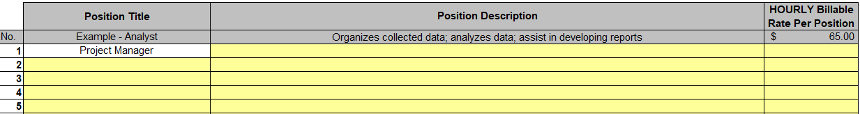
Cost Proposal (Cont.) (Attachment D)
For the “Staffing Rates” Tab, Respondents must fill in the yellow cells with the position title, description, and hourly billable rate for each staff member necessary to complete all activities listed in the Scope of Work.
Respondents must propose a description and hourly rate for the “Project Manager” position listed in the white-shaded cell.
The hourly billable rate must factor in all costs.
Indiana Department of Administration

Slide 13
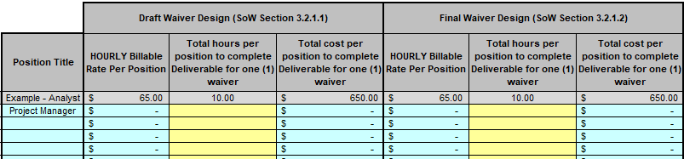
Cost Proposal (Cont.) (Attachment D)
For the “Deliverables” Tab, Respondents must fill in the total hours per position to complete each deliverable for one waiver. The “Deliverables” tab will automatically calculate the total cost to complete all the deliverables for one waiver.
If a position is not required for a certain deliverable, then the Respondent may enter “0” for hours required.
The Respondent shall include all potential costs for the scope of work in the hours proposed for the listed deliverables. This includes, but is not limited to, costs for the Transition Plan, the Project Work Plan, and the Monthly Progress Reports.
Indiana Department of Administration

Slide 14
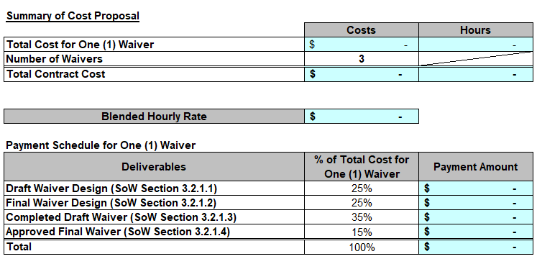
Cost Proposal (Cont.) (Attachment D)
The “Cost Proposal Summary” tab will pull the Respondent’s information from all the other tabs. Other than inserting the Respondent’s name, no response is necessary on this tab.
IMPORTANT: The “Total Contract Cost” must not exceed $900,000; otherwise, the Respondent’s proposal will be disqualified.
Indiana Department of Administration

Slide 15
Proposal Preparation
When submitting your response, please create a separate electronic folder for each component to which you are responding. This folder should contain all of the pertinent files for only that component, i.e., MWBE forms, Transmittal Letter, Business Proposal, etc. Your proposal may be deemed as non-responsive if these instructions are not followed.
Indiana Department of Administration

Slide 16
Proposal Preparation
Attachment D (Cost Proposal) must be returned in the original Excel format (No PDFs)
Use the templates provided for all responses
Do not alter any templates
Submit all questions via email using the Q&A Template (Attachment G) to rfp@idoa.IN.gov
Indiana Department of Administration

Slide 17
Evaluation Criteria
Criteria | Points
Adherence to Mandatory Requirements | Pass/Fail
Management Assessment/Quality (Business and Technical Proposal) | 55 points
Cost (Cost Proposal) | 20 points
Indiana Economic Impact | 5 points
Buy Indiana | 5 points
Minority Business Enterprise Subcontractor Commitment | 5 points (1 bonus point is available, see Section 3.2.6)
Women Business Enterprise Subcontractor Commitment | 5 points (1 bonus point is available, see Section 3.2.6)
Indiana Veteran Business Enterprise (IVOSB) Subcontractor Commitment | 5 points (1 bonus point is available, see Section 3.2.7)
Total | 100 (103 if bonus awarded)
Legend
Mandatory Requirements
MAQ and Cost Scores
Preference Scores
Indiana Department of Administration

Slide 18
Minority and Women’s Business Enterprises
Mission/Vision
Promote, monitor, and enforce the standards for certification of minority and women’s business enterprises.
Provide equal opportunity to minority and women enterprises in the state’s procurement and contracting process.
Nondiscrimination and Antidiscrimination Laws
Pursuant to Indiana Civil Rights Law, specifically IC §22-9-1-10, every state contract shall contain a provision requiring the contractor and subcontractors to not discriminate against any employee or applicant with respect to Protected Characteristics
Indiana Department of Administration

Slide 19
Minority and Women’s Business Enterprises
Contact Information
Phone: 317-232-3061
E-mail: mwbecompliance@idoa.in.gov
Web: www.in.gov/idoa/mwbe
Complete Attachment A, MWBE Form
- Include sub-contractor letter of commitment
Goals for Proposal
- 8% Minority Business Enterprise
- 8% Women’s Business Enterprise
Indiana Department of Administration

Slide 20
Minority and Women’s Business Enterprises
Prime contractors must ensure that the proposed subcontractors meet the following criteria:
Are listed in the IDOA Directory of Certified Firms, on or before the proposal due date, national diversity plans are generally not accepted. The directory can be found here: http://www.in.gov/idoa/mwbe/2743.htm
Serve a Commercially Useful Function (CUF) and value-added purpose on the engagement, as confirmed by the State.
Provide the goods or services specific to the contract and within the industry area for which it is certified
Indiana Department of Administration

Slide 21
Minority and Women’s Business Enterprises
Prime contractors should note the following:
Subcontractors’ MBE/WBE Certification Letter, provided by IDOA, must accompany the proposal to show current status of certification.
Each firm may only serve as one classification – MBE, WBE, or IVOSB (see section 1.22)
Pursuant to 25 IAC 5-6-2(b)(d), a Prime Contractor who is a MBE or WBE must meet subcontractor goals by using other listed certified firms. Certified Prime Contractors cannot count their own workforce or companies to meet this requirement.
Indiana Department of Administration

Slide 22
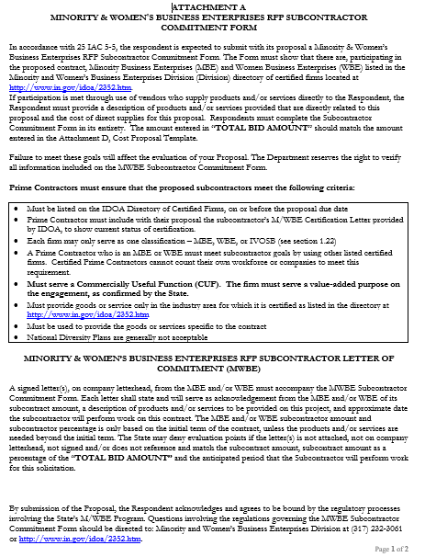
Indiana Department of Administration

Slide 23
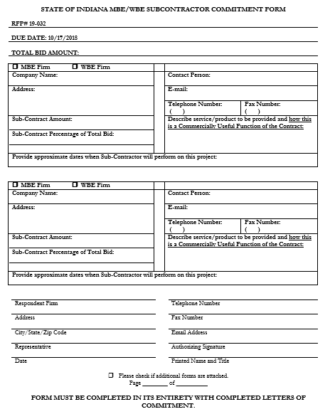
Indiana Department of Administration

Slide 24
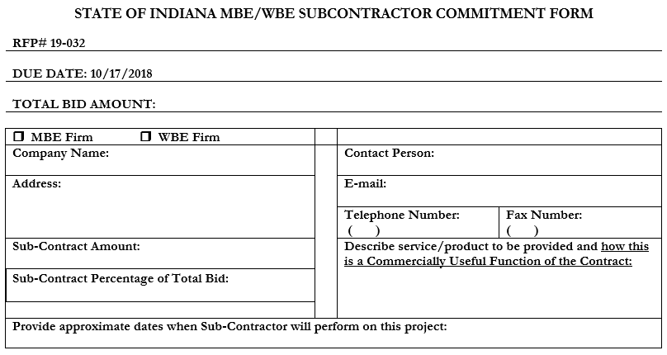
Minority and Women’s Business Enterprises
Indiana Department of Administration

Slide 25
Minority and Women’s Business Enterprises
New Process – Effective 2014, MWBE scoring is conducted based on 10 points plus a possible 2 bonus points scale
MBE: Possible 5 points + 1 bonus point
WBE: Possible 5 points + 1 bonus point
Professional Services Scoring Methodology:
The points will be awarded on the following schedule:
Fractional percentages will be rounded up or down to the nearest whole percentage
If the respondent’s commitment percentage is rounded down to 0% for MBE or WBE participation the respondent will receive 0 points.
Submissions of 0% participation will result in a deduction of 1 point in each category
The highest submission which exceeds the goal in each category will receive 6 points (5 points plus 1 bonus point). In case of a tie both firms will receive 6 points
% | 1% | 2% | 3% | 4% | 5% | 6% | 7% | 8%
Pts. | .625 | 1.25 | 1.875 | 2.5 | 3.125 | 3.75 | 4.375 | 5.0
Indiana Department of Administration

Slide 26
Minority and Women’s Business Enterprises
RFP MWBE Scoring Example
Bidder | MBE % | Pts. | WBE % | Pts. | Total Pts.
Bidder 1 | 12.0% | 5.0 | 10.0% | 6.0 | 11.0
Bidder 2 | 6.0% | 3.75 | 4.0% | 2.5 | 6.25
Bidder 3 | 8.0% | 5.0 | 8.0% | 5.0 | 10.0
Bidder 4 | 16.0% | 6.0 | 0.2% | 0.0 | 6.0
Bidder 5 | 0.0% | -1.0 | 0.0% | -1.0 | -2.0
Indiana Department of Administration

Slide 27



Minority and Women’s Business Enterprises
Pay Audit System
Tool utilized to monitor the state’s diversity spend for subcontractors
Selected primes and subcontractors are required to report payments submitted or received through this web-based tool
Based on contract terms payments should be reported monthly or quarterly
Questions? Contact MWBE Compliance
mwbecompliance@idoa.in.gov
www.in.gov/idoa/mwbe/payaudit.htm
Prime
Submit subcontractor actual paid invoice amounts
Payment
Pay Audit System
Submit actual payments received
Subcontractor
Indiana Department of Administration

Slide 28
Indiana Veteran Owned Small Businesses
Complete Attachment A1, IVOSB Form
Include sub-contractor letters of commitment
Goals for Proposal
3% Veteran Business Enterprise
Indiana Department of Administration

Slide 29
Indiana Veteran Owned Small Businesses
Prime Contractors must ensure that the proposed subcontractors meet the following criteria:
Must be listed on Federal Center for Veterans Business Enterprise (VA OSDBU) registry or be listed on the IDOA Directory of Certified Firms, on or before the proposal due date.
Prime Contractor must include with their proposal the subcontractor’s veteran business Certification Letter provided by either IDOA or Federal Govt. (VA OSDBU), to show current status of certification.
Each firm may only serve as one classification – MBE, WBE (see Section 1.21) or IVOSB
A Prime Contractor who is an IVOSB must meet subcontractor goals by using other listed certified firms. Certified Prime Contractors cannot count their own workforce or companies to meet this requirement.
Must serve a Commercially Useful Function (CUF). The firm must serve a value-added purpose on the engagement, as confirmed by the State.
Must provide goods or service only in the industry area for which it is certified as listed in the VA OSDBU or IDOA Certified Firm directories, https://www.in.gov/idoa/2862.htm
Must be used to provide the goods or services specific to the contract
Indiana Department of Administration

Slide 30
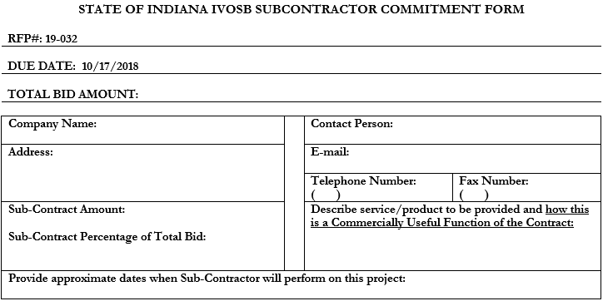
Indiana Veteran Owned Small Businesses
Indiana Department of Administration

Slide 31
Questions
Any verbal response is not considered binding; Respondents are encouraged to submit any question formally in writing if it affects the proposal that will be submitted to the State.
Indiana Department of Administration

Slide 32
Thank You
Tdeaton@idoa.IN.gov
Indiana Department of Administration

