Slide 1

Request for Proposal 18-051
Enterprise Data Warehouse Services
Indiana Department of Administration
On Behalf Of
All State Agencies
Pre-Proposal Conference
January 23, 2018
Teresa Deaton-Reese, CPPB, CPPO
Senior Account Manager
Indiana Department of Administration

Slide 2
Agenda
General Information
Purpose of RFP
Key Dates
Scope of Work
Proposal Preparation & Evaluation
Minority and Women’s Business Enterprises (M/WBE)
Question and Answer Session
Indiana Department of Administration
Notes:
Teresa

Slide 3
General Information
Sign-In Sheet for Attendees
Sign-In Sheet and PowerPoint will be posted on IDOA’s Solicitation Website
Hold questions until the end of the presentation
  Any verbal response is not considered binding; Respondents are encouraged to submit any questions formally, in writing, if it affects the proposal that will be submitted to the State.
Indiana Department of Administration

Slide 4
Purpose of the RFP
The State is seeking Respondent(s) to provide quality Maintenance, Operations, and Enhancement Services for FSSA’s Enterprise Data Warehouse Services
This solicitation may result in an award to either one vendor or two vendors.
Indiana Department of Administration

Slide 5
Key Dates
Activity | Date
Issue of RFP | January 12, 2018
Pre-Proposal Conference | January 23, 2018
Deadline to Submit Intent to Respond and Written Questions | February 2, 2018
Response to Written Questions/RFP Amendments | February 13, 2018
Submission of Proposals | March 13, 2018
The dates for the following activities are target dates only. These activities may be completed earlier or later than the date shown.
Proposal Evaluation | TBD
Proposal Discussions/Clarifications (if necessary) | TBD
Oral Presentations (if necessary) | TBD
Best and Final Offers (if necessary) | TBD
RFP Award Recommendation | April 16, 2018
Indiana Department of Administration

Slide 6
Term of Contract
The State intends to sign a contract with one Respondent or two Respondents to fulfill the requirements in this RFP.
The initial term of the contract shall be for four (4) years from the date of contract execution. There may be two (2) one-year renewals for a total of six (6) years at the State’s option.
Indiana Department of Administration

Slide 7
EDW Background
The Enterprise Data Warehouse (EDW) serves the data warehouse, decision support system, and business intelligence needs of FSSA.
Currently the State’s staff manages the EDW through the support of two vendors:
  The first vendor supports the EDW’s Teradata and Informatica ETL infrastructure and OMPP Data Warehouse (OMPP DW) healthcare-oriented data extraction and reporting
  The second vendor supports the Social Services Data Warehouse (SSDW), which is used by several program areas across FSSA (predominantly the Division of Family Resources), along with other groups such as the Department of Child Services (DCS) and the Child Support Bureau (CSB).
Both vendors have roles in enhancing the EDW in recent years with consolidated infrastructure, standard data warehouse-oriented tools, and migration of data and reports from the previous data warehouse.
Indiana Department of Administration

Slide 8
Scope of Work
Through this RFP, FSSA will contract for the following two sets of services:
Scope A | Maintenance and operations (M&O) and enhancement services for the EDW’s platform infrastructure M&O and enhancement services for the OMPP Data Warehouse
Scope B | M&O and enhancements support for the Social Services Data Warehouse (SSDW) Ad hoc support for EDW enhancements that impact the SSDW as needed, such as software testing
Respondents may propose for one or both scopes, but the State will evaluate the two scopes of work separately.
If one Respondent is awarded both scopes, they shall maintain distinct teams to handle each scope, with the exception of the Project Executive.
Indiana Department of Administration

Slide 9
Business Proposal
(Attachment H)
Company Financial Information (Section 2.3.3)
  Confidential information must be kept separate from the proposal in the electronic copies. IDOA recommends sending a “public” file that has the confidential information redacted (may be in PDF format) and a “final” file that includes all required information (must be in format provided).
Contract Terms (Section 2.3.5)
  Respondent should review the sample State contract (Attachment B) and note exceptions to State mandatory and non-mandatory clauses in Business Proposal and Transmittal Letter.
Indiana Department of Administration

Slide 10
Technical Proposal
(Attachment F - Scope A, Attachment G – Scope B)
Respondents may provide their responses in the format of their choosing but must organize their proposal in the exact order of questions provided in the Technical Proposal template followed by their answers.
Where appropriate, supporting documentation may be submitted as an attachment and referenced by a page and paragraph number.
Indiana Department of Administration

Slide 11
Cost Proposal
(Attachment D – Scope A, Attachment E – Scope B)
Please complete the template provided for the Cost Proposal by populating ONLY the yellow shaded cells.
Cost scores will then be normalized to one another, based on the lowest cost proposal evaluated. The lowest cost proposal receives a total of 30 points. The normalization formula is as follows:
Respondent’s Cost Score = (Lowest Cost Proposal / Total Cost of Proposal) X 30
Indiana Department of Administration

Slide 12
Cost Proposal (Cont.)
(Attachment D – Scope A, Attachment E – Scope B)
The “Summary” Tab will pull Respondent’s information from the “Start-Up Costs”, “Maintenance & Operations”, and “Enhancements” Tabs. Other than inserting the Respondent’s name, no response is necessary on this tab.
Indiana Department of Administration

Slide 13
Cost Proposal (Cont.)
(Attachment D – Scope A, Attachment E – Scope B)
For the “Start-Up Costs” Tab, Respondents should fill in the yellow cells with an start-up costs (if any), including a full description of the item (purpose, # of units, price, and total cost).
Indiana Department of Administration

Slide 14
Cost Proposal (Cont.)
(Attachment D – Scope A, Attachment E – Scope B)
On the “Staff Hourly Rates” Tab, Respondents should fill in the table with staff positions, role responsibilities, and the position’s hourly rate.
Snapshot from Attachment E (Attachment D will have slightly different positions):
Indiana Department of Administration

Slide 15
Cost Proposal (Cont.)
(Attachment D – Scope A, Attachment E – Scope B)
In Table 2 on the “Maintenance & Operations” Tab, Respondents should fill in the number of FTEs per position.
Snapshot from Attachment E (Attachment D will have slightly different positions):
Indiana Department of Administration

Slide 16
Cost Proposal (Cont.)
(Attachment D – Scope A, Attachment E – Scope B)
In Table 3 on the “Maintenance & Operations” Tab, Respondents should provide a full description of costs not related to staff (description, item number or SKU, price, number of units, etc.) and total yearly cost.
For Scope A only: In Table 4, Respondent should enter the unit price by year for each item/service listed in the table. The State expects the Contractor to provide the item/service without markup over the price paid by the Contractor. The State reserves the right to purchase any or none of these items during the life of the contract.
Indiana Department of Administration

Slide 17
Cost Proposal (Cont.)
(Attachment D – Scope A, Attachment E – Scope B)
On the “Enhancements” Tab, Respondents should provide enhancement Pool hourly rates in the yellow cells for work to be completed under the Enhancement Pool. The remainder of the Tab will populate automatically based on those inputs.
Snapshot from Attachment E (Attachment D will have a different monthly hours assumption):
Indiana Department of Administration

Slide 18
Cost Proposal (Cont.)
(Attachment D – Scope A, Attachment E – Scope B)
If your company is proposing to offer both Scope A and Scope B services, please fill in the “Scope A and B Synergy Savings” Tab with an explanation of the cost savings that the State can expect to receive as a result of the synergies between the two Scope of Works. Provide anticipated cost savings and the source of the cost savings, and the duration of the savings over the course of the contract.
Indiana Department of Administration

Slide 19
Proposal Preparation
When submitting your response, please create a separate electronic folder for each component to which you are responding. This folder should contain all of the pertinent files for only that component, i.e., MWBE forms, Transmittal Letter, Business Proposal, etc. Your proposal may be deemed as non-responsive if these instructions are not followed.
Indiana Department of Administration

Slide 20
Proposal Preparation
Attachment D and E (Cost Proposal) must be returned in the original Excel format (No PDFs)
Use the templates provided for all responses
Do not alter any templates
Submit all questions via email using the Q&A Template (Attachment I)
Indiana Department of Administration

Slide 21
Evaluation Criteria
Criteria | Points
Adherence to Mandatory Requirements | Pass/Fail
Management Assessment/Quality (Business and Technical Proposal) | 60 points
Cost (Cost Proposal) | 30 points
Minority Business Enterprise Subcontractor Commitment | 5 points (1 bonus point is available, see Section 3.2.6)
Women Business Enterprise Subcontractor Commitment | 5 points (1 bonus point is available, see Section 3.2.6)
Total | 100 (102 if bonus awarded)
Indiana Department of Administration

Slide 22
Minority and Women’s Business Enterprises
Complete Attachment A, MWBE Form
  Include sub-contractor letters of commitment
Goals for Proposal
  8% Minority Business Enterprise
  8% Women Business Enterprise
Indiana Department of Administration

Slide 23
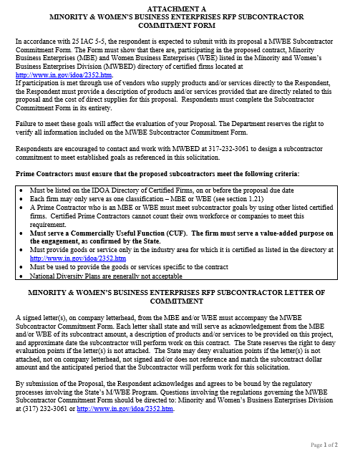
Indiana Department of Administration

Slide 24
Minority and Women’s Business Enterprises
Prime Contractors must ensure that the proposed subcontractors meet the following criteria:
Must be listed on the IDOA Directory of Certified Firms, on or before the proposal due date
Each firm may only serve as one classification – MBE or WBE
A Prime Contractor who is an MBE or WBE must meet subcontractor goals by using other listed certified firms. Certified Prime Contractors cannot count their own workforce or companies to meet this requirement.
Must serve a commercially useful function. The firm must serve a value-added purpose on the engagement.
Must provide goods or service only in the industry area for which it is certified as listed in the directory at http://www.in.gov/idoa/2352.htm
Must be used to provide the goods or services specific to the contract
National Corporate Diversity Plans are generally not acceptable
Indiana Department of Administration

Slide 25
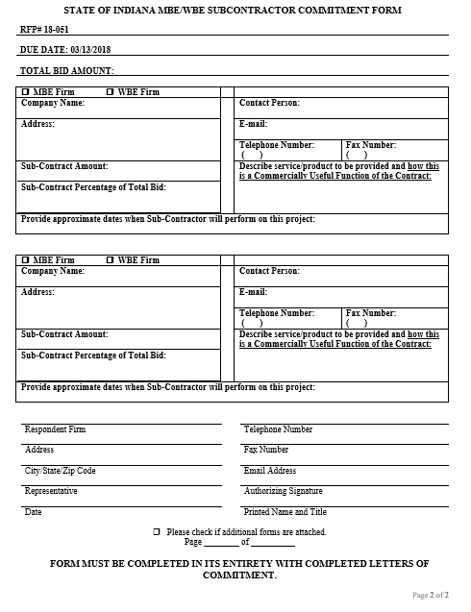
Indiana Department of Administration

Slide 26
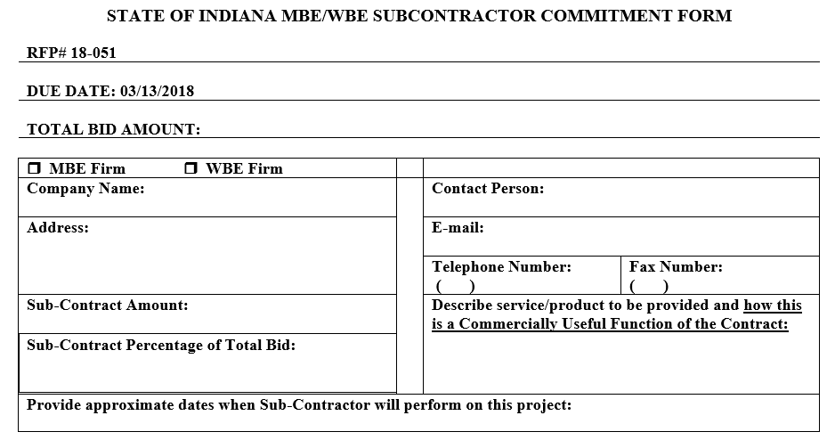
Minority and Women’s Business Enterprises
Indiana Department of Administration

Slide 27
Additional Information
IDOA PROCUREMENT LINKS AND NUMBERS
http://www.in.gov/idoa/2354.htm
1-877-77BUYIN (8946) For Vendor Registration Questions
http://www.in.gov/idoa/2467.htm
Link to the developing “one stop shop” for vendor registry with IDOA and Secretary of State. (Note: Buy Indiana preferences do not apply to this RFP)
B. Secretary of State of Indiana:
Can be reached at (317) 232-6576 for registration assistance. www.in.gov/sos
C. See Vendor Handbook:
Online version available at http://www.in.gov/idoa/files/VendorHandbook.pdf
Minority and Women Owned Business Enterprises: http://www.in.gov/idoa/mwbe/2743.htm
for table of IDOA certified MBEs and WBEs. For more WBE information http://www.in.gov/idoa/2352.htm
F. RFP posting and updates:
Go to http://www.in.gov/idoa/2354.htm (select “Current Opportunities” link)
Scroll through table until you find desired RFP/RFI number on left-hand side and click the link.
Indiana Department of Administration

Slide 28
Questions
    Any verbal response is not considered binding; Respondents are encouraged to submit any question formally in writing if it affects the proposal that will be submitted to the State.
Indiana Department of Administration

Slide 29
Thank You
Tdeaton@idoa.IN.gov
Indiana Department of Administration

