Slide 1

Request for Proposal 18-048 Indiana Department of Administration On Behalf Of Bureau of Motor Vehicles/Commission Solicitation For: Security Equipment and Support Pre-Proposal Conference
February 22, 2018
Teresa Deaton-Reese, CPPB, CPPO Strategic Sourcing Analyst
Indiana Department of Administration

Slide 2
Agenda
General Information
Purpose of RFP
Key Dates
Term of Contract
Scope of Work
Business Proposal
Technical Proposal
Cost Proposal
Proposal Preparation
Evaluation Criteria
Minority and Women’s Business Enterprises (M/WBE)
Indiana Veteran Owned Small Business (IVOSB)
Additional Information
Question and Answer Session
Indiana Department of Administration
Notes:
Teresa

Slide 3
General Information
Sign-In Sheet for Attendees
Sign-In Sheet and PowerPoint will be posted on IDOA’s Solicitation Website
Questions -Any verbal response is not considered binding; respondents are encouraged to submit any questions formally, in writing, if it affects the proposal that will be submitted to the state.
Indiana Department of Administration

Slide 4
Purpose of the RFP
The purpose of this RFP is to select a vendor that can satisfy the State’s need for Central Office and License Branch Security Equipment and Monitoring Services. Currently the security equipment utilized is owned by the BMV and of varying manufacturers and models. The State is interested in a full solution for equipment, equipment monitoring and maintenance for a monthly fee.
This RFP covers the need for security equipment, maintenance and support for approximately 130 License Branch locations throughout the State of Indiana and the Central Office location to be implemented in incremental phases. The awarded respondent will provide the following but is not limited to: camera equipment, panic alarms, motion detectors and door sensors. Support and Maintenance will include; installation of all necessary equipment, capturing and monitoring of video footage, maintenance of all equipment (including issue resolution) and reporting.
Indiana Department of Administration

Slide 5
Key Dates
Activity | Date
Issue of RFP | February 7, 2018
Pre-Proposal Conference | February 22, 2018
Deadline to Submit Written Questions | February 23, , 2018
Response to Written Questions/RFP Amendments | February 28, 2018
Submission of Proposals | March 14, 2018
The dates for the following activities are target dates only. These activities may be completed earlier or later than the date shown.
Proposal Evaluation | TBD
Proposal Discussions/Clarifications (if necessary) | TBD
Oral Presentations (if necessary) | TBD
Best and Final Offers (if necessary) | TBD
RFP Award Recommendation | April 18 2018
Indiana Department of Administration

Slide 6
Term of Contract
The term of the contract shall be for a period of four (4) years from the date of contract execution. There may be renewals at the State’s option.
Indiana Department of Administration

Slide 7
Scope of Work/Mandatory Requirement – Attachment F
Indiana Department of Administration

Slide 8
Business Proposal (Attachment E)
Company Financial Information (Section 2.3.3)
Confidential information must be kept separate from the proposal in the electronic copies. IDOA recommends sending a “public” file that has the confidential information redacted (may be in PDF format) and a “final” file that includes all required information (must be in format provided).
Contract Terms (Section 2.3.5)
Respondent should review sample State contract and note exceptions to State mandatory and non-mandatory clauses in Business Proposal and Transmittal Letter.
Indiana Department of Administration

Slide 9
Technical Proposal (Attachment G)
Please use the template provided for the Technical Proposal.
Where appropriate, supporting documentation may be submitted as an attachment and referenced by a page and paragraph number.
Please make separate folders for each section:
Example:
Business
Technical
Cost Proposal
Confidential
Indiana Department of Administration

Slide 10
Cost Proposal (Attachment D)
The Cost Proposal must be submitted in the original format. Any attempt to manipulate the format of the Cost Proposal document, attach caveats to pricing, or submit pricing that deviates from the current format will put your proposal at risk. Complete the yellow shaded field on the costs tab.
Cost Proposal Narrative: The Respondent should provide a brief narrative (not longer than two pages) in support of the cost proposal. The narrative should be focused on clarifying how the proposed prices correspond directly to the Respondent's Technical Proposal. For example, evaluators will expect detailed explanation of Maintenance and Support to correspond to Maintenance and Support items if described in the Technical Proposal
Cost Assumptions, Conditions and Constraints: The respondent should list and describe as part of its Cost Proposal any special cost assumptions, conditions, and/or constraints relative to, or which impact, the prices presented on the Cost Schedules. It is of particular importance to describe any assumptions made by the respondent in the development of the respondent's Technical Proposal that have a material impact on price. It is in the best interest of the respondent to make explicit the assumptions, conditions, and/or constraints that underlie the values presented on the Cost Schedules. Assumptions, conditions or constraints that conflict with the RFP requirements are not acceptable.
Indiana Department of Administration

Slide 11
Proposal Preparation
When submitting your response, please create a separate electronic folder for each component to which you are responding. This folder should contain all of the pertinent files for only that component, i.e., MWBE forms, IVOSB forms, IEI form, Transmittal Letter, Business Proposal, etc. Your proposal may be deemed as non-responsive if these instructions are not followed.
Indiana Department of Administration

Slide 12
Proposal Preparation
Buy Indiana, Business Proposal (2.3.13)
Status shall be finalized by proposal due date
Five (5) definitions, details provided in the RFP
Indiana Economic Impact, Attachment C
Definitions of FTE (Full-Time Equivalent)
Example: If a Respondent has five (5) full time employees, is bidding on its 5th contract, and all contracts get an equal amount of commitment from the employees, then each employee commits 20% of his/her time to the new contract:
0.2 x 5 employees – 1 FTE
Indiana Department of Administration

Slide 13
Proposal Preparation
Attachment E (Cost Proposal) must be returned in the original Excel format (No PDFs)
Use the templates provided for all responses
Do not alter any templates
Submit all questions via email using the Q&A Template (Attachment H)
Indiana Department of Administration

Slide 14
Evaluation Criteria
Criteria | Points
Adherence to Mandatory Requirements | Pass/Fail
Management Assessment/Quality (Business and Technical Proposal) | 50 points
Cost (Cost Proposal) | 25 points
Indiana Economic Impact | 5 points
Buy Indiana | 5 points
Minority Business Enterprise Subcontractor Commitment | 5 points (1 bonus point is available, see Section 3.2.6)
Women Business Enterprise Subcontractor Commitment | 5 points (1 bonus point is available, see Section 3.2.6)
Indiana Veteran Owned Small Business (IVOSB) Subcontractor Commitment | 5 points (1 bonus point is available, see Section 3.2.7)
Total | 100 (103 if bonus awarded)
Indiana Department of Administration

Slide 15
Minority and Women’s Business Enterprises
Complete Attachment A, MWBE Form
Include sub-contractor letters of commitment
Goals for Proposal
- 8% Minority Business Enterprise
- 8% Women’s Business Enterprise
Indiana Department of Administration

Slide 16
Minority and Women’s Business Enterprises
Prime Contractors must ensure that the proposed subcontractors meet the following criteria:
Must be listed on the IDOA Directory of Certified Firms, on or before the proposal due date
Prime Contractor must include with their proposal the subcontractor’s M/WBE Certification Letter provided by IDOA, to show current status of certification.
Each firm may only serve as one classification – MBE, WBE, or IVOSB (see section 1.22)
A Prime Contractor who is an MBE or WBE must meet subcontractor goals by using other listed certified firms. Certified Prime Contractors cannot count their own workforce or companies to meet this requirement.
Must serve a Commercially Useful Function (CUF). The firm must serve a value-added purpose on the engagement, as confirmed by the State.
Must provide goods or service only in the industry area for which it is certified as listed in the directory at http://www.in.gov/idoa/2352.htm
Must be used to provide the goods or services specific to the contract
National Diversity Plans are generally not acceptable
Indiana Department of Administration

Slide 17
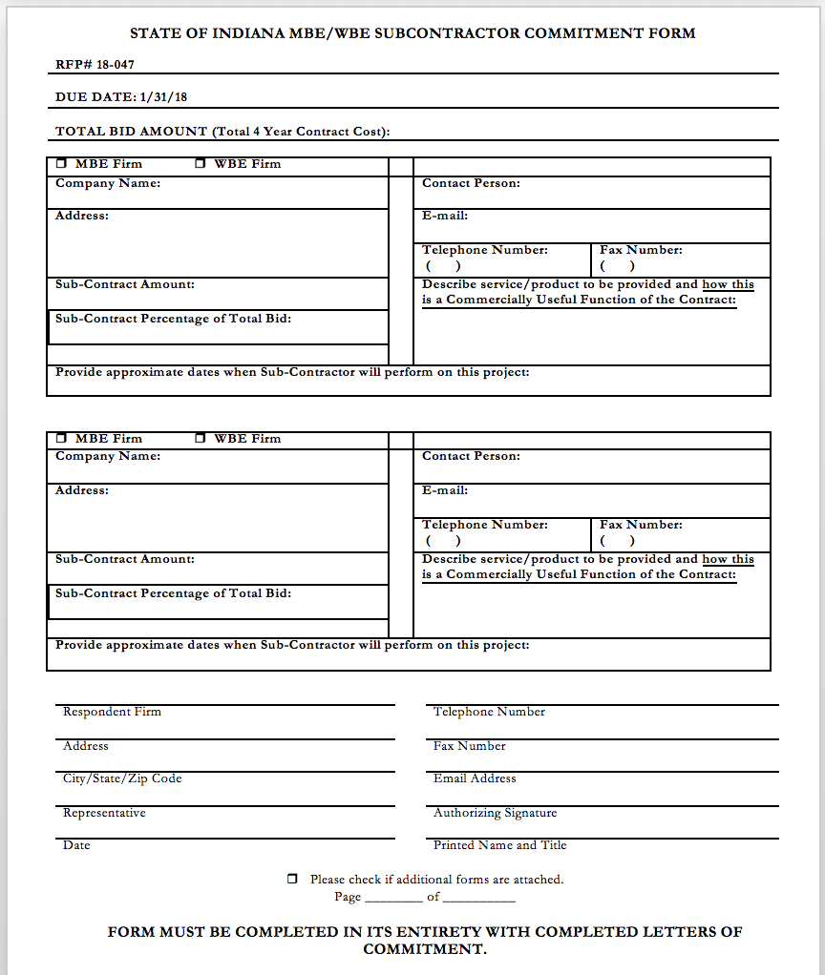
Indiana Department of Administration

Slide 18
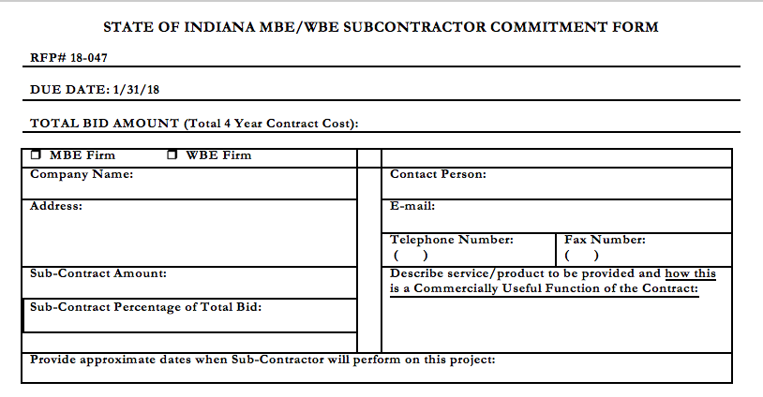
Minority and Women’s Business Enterprises
Indiana Department of Administration

Slide 19
Indiana Veteran Owned Small Business
Complete Attachment A1, IVOSB Form
Include sub-contractor letters of commitment
Goals for Proposal
- 3% Veteran Business Enterprise
Indiana Department of Administration

Slide 20
Indiana Veteran Owned Small Business
Prime Contractors must ensure that the proposed subcontractors meet the following criteria:
Must be listed on Federal Center for Veterans Business Enterprise (VA OSDBU) registry or listed on the IDOA Directory of Certified Firms, on or before the proposal due date
Prime Contractor must include with their proposal the subcontractor’s veteran business Certification Letter provided by either IDOA or Federal Govt. (VA OSDBU), to show current status of certification.
Each firm may only serve as one classification – MBE, WBE (see Section 1.21) or IVOSB
A Prime Contractor who is an IVOSB must meet subcontractor goals by using other listed certified firms. Certified Prime Contractors cannot count their own workforce or companies to meet this requirement.
Must serve a Commercially Useful Function (CUF). The firm must serve a value-added purpose on the engagement, as confirmed by the State.
Must provide goods or service only in the industry area for which it is certified as listed in the VA OSDBU or IDOA Certified Firm directories, http://www.in.gov/idoa/2352.htm
Must be used to provide the goods or services specific to the contract
Indiana Department of Administration

Slide 21
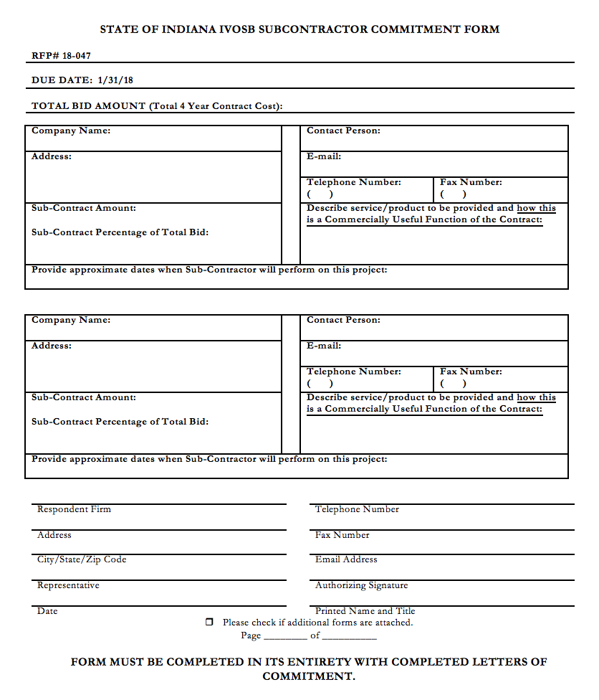
Indiana Department of Administration

Slide 22
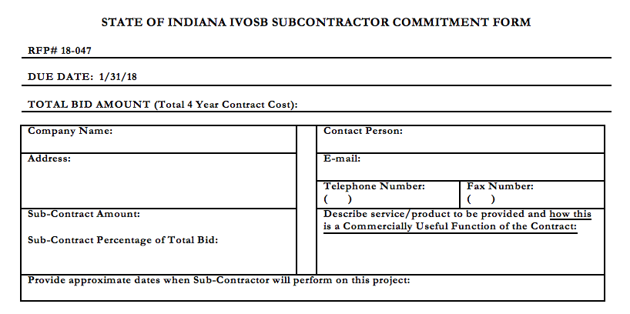
Indiana Veteran Business Enterprise
Indiana Department of Administration

Slide 23
Additional Information
IDOA PROCUREMENT LINKS AND NUMBERS
http://www.in.gov/idoa/2354.htm
1-877-77BUYIN (8946) For Vendor Registration Questions
http://www.in.gov/idoa/2464.htm
For Inquiries Regarding Substantial Indiana Economic Impact
http://www.in.gov/idoa/2467.htm
Link to the developing “one stop shop” for vendor registry with IDOA and Secretary of State.
B. Secretary of State of Indiana:
Can be reached at (317) 232-6576 for registration assistance. www.in.gov/sos
C. See Vendor Handbook:
Online version available at http://www.in.gov/idoa/files/vendor_handbook.doc
Minority and Women Owned Business Enterprises:
http://www.in.gov/idoa/files/Certification_List(48).xls for table of IDOA certified MBEs and WBEs. For more WBE’s information http://www.in.gov/idoa/2352.htm
Veteran’s Business Enterprise Program:
http://www.va.gov/osdbu/ for a search of certified IVOSB’s. For more IVOSB’s information http://www.in.gov/idoa/2352.htm
F. RFP posting and updates:
Go to http://www.in.gov/idoa/2354.htm (select “State of Indiana Opportunities” link)
Drag through table until you find desired RFP/RFI number on left-hand side and click the link.
Indiana Department of Administration

Slide 24
Questions
Any verbal response is not considered binding; respondents are encouraged to submit any question formally in writing if it affects the proposal that will be submitted to the State.
Indiana Department of Administration

Slide 25
Thank You
Teresa Deaton-Reese, CPPB, CPPO
tdeaton@idoa.in.gov
Indiana Department of Administration

