Slide 1

Indiana Department of Administration (IDOA) on behalf of All State Agencies Maintenance Repair and Operations (MRO) Products
Request for Proposal 18-038
Pre-Proposal Conference
April 24, 2018 10:00 AM EST
Patrick O’Connor, Senior Account Manager
Indiana Department of Administration

Slide 2
Agenda
General Information
Purpose of RFP
Contract Term and Award Strategy
Key Dates
Proposal Preparation & Evaluation
Minority and Women’s Business Enterprises (M/WBE)
Indiana Veteran Owned Small Business (IVOSB)
Question and Answer Session
Indiana Department of Administration

Slide 3
General Information
Sign-In Sheet for Attendees
Sign-In Sheet and PowerPoint will be posted on IDOA’s Solicitation Website
Hold questions until the end of the presentation
Any verbal response is not considered binding; respondents are encouraged to submit any question formally in writing if it affects the proposal that will be submitted to the state.
Indiana Department of Administration

Slide 4
Purpose of the RFP
The purpose of this RFP is to select a vendor that can satisfy the State, K12, and local entities’ need for Maintenance, Repair, and Operations products (MRO). It is the intent of the State to contract with a vendor or vendors that provide the State, K12, and local entities, who elect to purchase through the resulting contract, products and services as specified within this RFP at a competitive price.
The table, below, represents the approximate spend by product category in CY 2015 and 2016 for State and certain K12 and local entities who made purchases through the State’s current MRO contracts*
Commercial Cleaning and Janitorial | General Industrial | Lighting and Electrical | Paper Products and Dispensers | Plumbing Supplies | Safety Supplies | Total
$2,005,695 | $5,851,903 | $1,968,812 | $1,598,856 | $2,987,219 | $892,367 | $15,304,845
*These figures are only an estimate and are not to be construed as an amount to be offered under this RFP.
Indiana Department of Administration

Slide 5
Contract Term and Award Strategy
Contract Term: The term of the contract shall be for a period of two (2) years from the date of contract execution. There may be two (2) one-year renewals for a total of four (4) years at the State’s option.
Category Response Requirement: There are six product categories included in the Cost Proposal. A Respondent may respond to one, multiple, or all product categories.
Award in Best Interest of State: The State may award all or part of this RFP based on the best interests of the State. The State also reserves the right to award to multiple vendors.
Resulting Contracts: Categories will be evaluated and awarded separately. Respondents must indicate which product categories are included in their Response in the Transmittal Letter.
Separate Preference Forms by Category: Respondents must submit an individual and separate Attachment A, A1, and C for each responding product category. These forms must be aligned with the Respondent’s two year total amount for the corresponding product category as stated in Section 1.4.1 Current Purchasing Profile.
Indiana Department of Administration

Slide 6
Key Dates
Activity | Date
Issue of RFP | April 16, 2018
Pre-Proposal Conference | April 24, 2018, 10:00 AM EST
Deadline to Submit Questions regarding the Cost Proposal, including Market Basket Unit of Measures | May 1, 2018, 3:00 PM EST
Response to Questions regarding the Cost Proposal, including Market Basket Unit of Measures | May 8, 2018
Deadline to Submit all other Questions | May 15, 2018, 3:00 PM EST
Response to all other Questions | May 22, 2018
Submission of Proposals | June 12, 2018, 3:00 PM EST
The dates for the following activities are target dates only. These activities may be completed earlier or later than the date shown.
Proposal Evaluation | TBD
Proposal Discussions/Clarifications (if necessary) | TBD
Oral Presentations (if necessary) | TBD
Best and Final Offers (if necessary) | TBD
RFP Award Recommendation | Tentative: July 31, 2018
Indiana Department of Administration

Slide 7
Business Proposal (Attachment E)
Company Financial Information (Section 2.3.3)
Confidential information must be kept separate from the proposal in both hard and soft copy
Contract Terms (Section 2.3.5)
Respondent should review sample State contract and note exceptions to State mandatory and non-mandatory clauses in Transmittal Letter
Indiana Department of Administration

Slide 8
Technical Proposal (Attachment F)
Please use the Template we have provided for you.
Where appropriate, supporting documentation may be referenced by a page and paragraph number.
Indiana Department of Administration

Slide 9
Master Services Agreement (Attachment B)
Highlights from draft Master Services Agreement:
Overlapping Items: The resulting contract(s) will likely overlap or compete with other contracts. The State shall make the final determination for contract inclusion or exclusion of specific products within a specific category.
Catalog: Users shall have access to both hard copy and electronic catalogs (viewing only).
eProcurement: The Contractor agrees to provide an online catalog (punch-out) through the State’s PeopleSoft system –as well as the OneIndiana, K12Indiana and LibraryIndiana portals– that shall be used for pricing and ordering purposes.
Order Confirmation: An e-mail order confirmation shall be sent to the Ordering Agency’s buyer within one (1) hour of Contractor’s receipt of purchase order.
Indiana Department of Administration

Slide 10
Master Services Agreement (Attachment B)
Highlights from draft Master Services Agreement, continued:
Pricing: Every product sold under the resulting contract shall be sold at a price which is either:
1. Equal to or better than the Market Basket Price, or
2. The product’s List Price (at the time of sale) less a Non-Market Basket Discount.
Any product exceptions to a Market Basket Price or List Price less a Non-Market Basket Discount must be disclosed in the Respondent’s cost proposal in the designated section. The State will make the final determination of acceptable exceptions which will be memorialized in the resulting contract. Respondent shall provide a quarterly report of all products sold under the contract that did not receive a Market Basket Price or Non-Market Basket Discount.
Indiana Department of Administration

Slide 11
Master Services Agreement (Attachment B)
Highlights from draft Master Services Agreement, continued:
Price Hold: All item prices shall remain set and unchanged for the initial twelve (12) month after the Contract effective date.
Market Basket Changes: Market Basket composition and Non-Market Basket percentage off list price reviews will be conducted quarterly; any modification requires mutual agreement.
Fill Rate Guarantee: The Contractor shall maintain a 100% fill rate for delivery of Market Basket items within 48 hours.
Returns: The Contractor shall accept returns from an Ordering Agency within thirty (30) business days of receipt of product.
Indiana Department of Administration

Slide 12
Cost Proposal (Attachment D)
Please complete the template provided for the Cost Proposal by populating ONLY the yellow shaded cells.
Cost scores will then be normalized to one another, based on the lowest cost proposal evaluated. The lowest cost proposal receives a total of 45 points. The normalization formula is as follows:
Respondent’s Cost Score =
(Lowest Cost Proposal / Total Cost of Proposal) x 45
Indiana Department of Administration

Slide 13
Cost Proposal (Attachment D)
Please read the instructions carefully when completing the Cost Proposal Template.
Respondents are encouraged to provide pricing for all market basket (MB) items, and must provide pricing for at least 95.00% of the items on the market basket (MB) response sheets, and discount percentages for 100% of the items on the non market basket (Non-MB) to be considered complete and responsive.
The State will only accept items that are functionally equivalent to the items specified.
Pricing must include all delivery, shipping, service, restocking and administrative costs associated with the product.
Indiana Department of Administration

Slide 14
Cost Proposal (Attachment D)
The State recognizes that large purchases will be made outside of the market basket and expects Respondents to offer retrospective discounts (in the form of an administrative fee) for a number of these items each year. On a quarterly basis the State will identify the selected items in each category, as follows:
Commercial Cleaning and Janitorial Products - 7 items
General Industrial Supplies - 19 items
Lighting and Electrical Supplies - 6 items
Paper Products and Dispensers - 5 items
Plumbing Supplies - 10 items
Safety Supplies - 3 items
Respondents shall provide a retrospective discount percentage that will be applied to the total quarterly spend of highest number of items for each non-market basket product category.
Indiana Department of Administration

Slide 15
Proposal Preparation
Buy Indiana, Business Proposal (2.3.13)
Status shall be finalized by proposal due date
5 definitions, details provided in Business Proposal
Email confirmation included in proposal from buyindianainvest@idoa.in.gov (See section 2.7)
This is required for any of the 5 criteria
Indiana Economic Impact, Attachment C
Definition of FTE (Full-Time Equivalent)
Example: If a Respondent has 5 full time employees and is bidding on its 5th contract, and all contracts get an equal amount of commitment from the employees then each employee commits 20% of his or her time to the new contract:
0.2 x 5 employees= 1 FTE.
Indiana Department of Administration

Slide 16
Proposal Preparation
Attachment D (Cost Proposal) must be returned in Excel
Use the templates provided for all answers
Do not alter templates
Submit all questions using template provided
Separate Preference Forms by Category: Respondents must submit an individual and separate Attachment A, A1, and C for each responding product category.
Indiana Department of Administration

Slide 17
Proposal Evaluation
Summary of Evaluation Criteria:
Criteria | Points
Adherence to Mandatory Requirements | Pass/Fail
Management Assessment/Quality (Business and Technical Proposal) | 30 available points
Cost (Cost Proposal) | 45 available points
Indiana Economic Impact | 5 points
Buy Indiana | 5 points
Minority Business Enterprise Subcontractor Commitment | 5 ( 1 bonus point is available, see Section 3.2.6)
Women Business Enterprise Subcontractor Commitment | 5 ( 1 bonus point is available, see Section 3.2.6)
Indiana Veteran Owned Small Business Subcontractor Commitment | 5 (1 bonus point is available, see Section 3.2.7)
Total | 100 (103 if bonus awarded)
Indiana Department of Administration

Slide 18
Minority and Women’s Business Enterprises
Complete Attachment A, MWBE Form: one for each category Respondent is intending to respond to.
- Include sub-contractor letters of commitment
Goals for Proposal
- 8% Minority Business Enterprise
- 8% Women’s Business Enterprise
Respondents must complete this form in its entirety. The two year total amount entered in “TOTAL BID AMOUNT” should match the two year category total amount found in Section 1.4.1 (also seen below) Current Purchasing Profile.
Commercial Cleaning and Janitorial | General Industrial | Lighting and Electrical | Paper Products and Dispensers | Plumbing Supplies | Safety Supplies
$2,005,695 | $5,851,903 | $1,968,812 | $1,598,856 | $2,987,219 | $892,367
Indiana Department of Administration

Slide 19
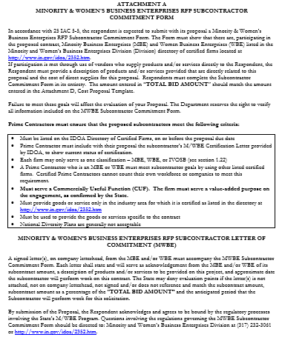
Indiana Department of Administration

Slide 20
Minority and Women’s Business Enterprises
Prime Contractors must ensure that the proposed subcontractors meet the following criteria:
Must be listed on the IDOA Directory of Certified Firms, on or before the proposal due date
Each firm may only serve as one classification – MBE, WBE or IVOSB
A Prime Contractor who is an MBE or WBE must meet subcontractor goals by using other listed certified firms. Certified Prime Contractors cannot count their own workforce or companies to meet this requirement.
Must serve a commercially useful function. The firm must serve a value-added purpose on the engagement.
Must provide goods or service only in the industry area for which it is certified as listed in the directory at http://www.in.gov/idoa/2352.htm
Must be used to provide the goods or services specific to the contract
National Corporate Diversity Plans are generally not acceptable
Indiana Department of Administration

Slide 21
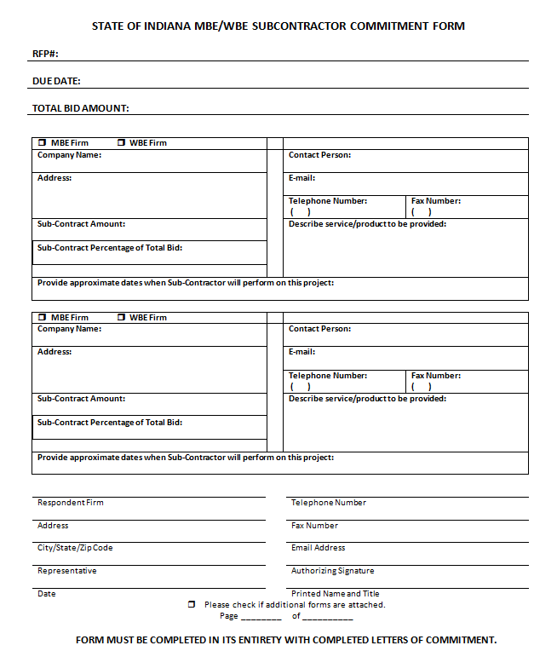
Indiana Department of Administration

Slide 22
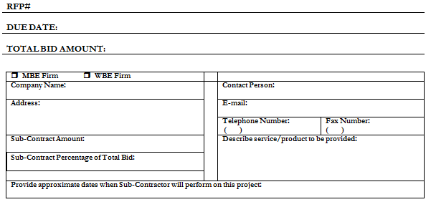
Minority and Women’s Business Enterprises
Indiana Department of Administration

Slide 23
Minority and Women’s Business Enterprises
Effective August, 2014, a new MWBE scoring methodology will be utilized for all RFP’s released
New Process – MWBE scoring is conducted based on 10 points plus a possible 2 bonus points scale
MBE: Possible 5 points + 1 bonus point
WBE: Possible 5 points + 1 bonus Point
Professional Services Scoring Methodology:
The points will be awarded on the following schedule:
Fractional percentages will be rounded up or down to the nearest whole percentage
If the respondent’s commitment percentage is rounded down to 0% for MBE or WBE participation the respondent will receive 0 points.
Submissions of 0% participation will result in a deduction of 1 point in each category
The highest submission which exceeds the goal in each category will receive 6 points (5 points plus 1 bonus point). In case of a tie both firms will receive 6 points
% | 1% | 2% | 3% | 4% | 5% | 6% | 7% | 8%
Pts. | .625 | 1.25 | 1.875 | 2.5 | 3.125 | 3.75 | 4.375 | 5.0
Indiana Department of Administration

Slide 24
Minority and Women’s Business Enterprises
RFP MWBE Scoring Example
Bidder | MBE % | Pts. | WBE % | Pts. | Total Pts.
Bidder 1 | 12.0% | 5.0 | 10.0% | 6.0 | 11.0
Bidder 2 | 6.0% | 3.75 | 4.0% | 2.5 | 6.25
Bidder 3 | 8.0% | 5.0 | 8.0% | 5.0 | 10.0
Bidder 4 | 16.0% | 6.0 | 0.2% | 0.0 | 6.0
Bidder 5 | 0.0% | -1.0 | 0.0% | -1.0 | -2.0
Indiana Department of Administration

Slide 25
Indiana Veteran Owned Small Business
Complete Attachment A1, IVOSB Form: one for each category Respondent is intending to respond to.
- Include sub-contractor letters of commitment
Goals for Proposal
- 3% Veteran Business Enterprise
Respondents must complete this form in its entirety. The two year total amount entered in “TOTAL BID AMOUNT” should match the two year category total amount found in Section 1.4.1 (also seen below) Current Purchasing Profile.
Commercial Cleaning and Janitorial | General Industrial | Lighting and Electrical | Paper Products and Dispensers | Plumbing Supplies | Safety Supplies
$2,005,695 | $5,851,903 | $1,968,812 | $1,598,856 | $2,987,219 | $892,367
Indiana Department of Administration

Slide 26
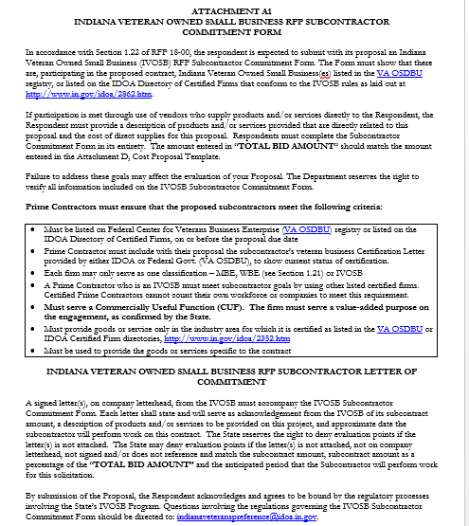

Slide 27
Indiana Veteran Owned Small Business
Prime Contractors must ensure that the proposed subcontractors meet the following criteria:
Must be listed on Federal Center for Veterans Business Enterprise (VA OSDBU) registry or listed on the IDOA Directory of Certified Firms, on or before the proposal due date
Prime Contractor must include with their proposal the subcontractor’s veteran business Certification Letter provided by either IDOA or Federal Govt. (VA OSDBU), to show current status of certification.
Each firm may only serve as one classification – MBE, WBE (see Section 1.21) or IVOSB
A Prime Contractor who is an IVOSB must meet subcontractor goals by using other listed certified firms. Certified Prime Contractors cannot count their own workforce or companies to meet this requirement.
Must serve a Commercially Useful Function (CUF). The firm must serve a value-added purpose on the engagement, as confirmed by the State.
Must provide goods or service only in the industry area for which it is certified as listed in the VA OSDBU or IDOA Certified Firm directories, http://www.in.gov/idoa/2352.htm
Must be used to provide the goods or services specific to the contract
Indiana Department of Administration

Slide 28
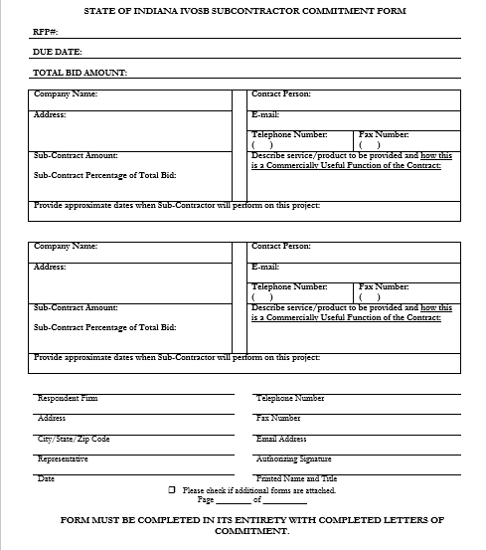
Indiana Department of Administration

Slide 29
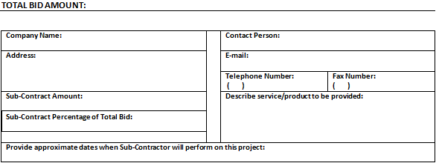
Indiana Veteran Owned Small Business
Indiana Department of Administration

Slide 30
Indiana Veteran Owned Small Business
New Process – IVOSB scoring is conducted based on 5 points plus a possible 1 bonus point scale
IVOSB: Possible 5 points + 1 bonus point
Professional Services Scoring Methodology:
The points will be awarded on the following schedule:
Fractional points will be awarded based upon a graduated scale between whole points. (e.g. a 0.3% commitment will receive .5 points and a 1.5% commitment will receive 2.5 points)
Submissions of 0% participation will result in a deduction of 1 point in each category
The highest submission which exceeds the goal in each category will receive 5 points (5 points plus 1 bonus point). In case of a tie both firms will receive 6 points.
% | 0% | 0.6% | 1.2% | 1.8% | 2.4% | 3%
Pts. | -1 | 1 | 2 | 3 | 4 | 5
Indiana Department of Administration

Slide 31
Additional Information
IDOA PROCUREMENT LINKS AND NUMBERS
http://www.in.gov/idoa/2354.htm
1-877-77BUYIN (8946) For Vendor Registration Questions
http://www.in.gov/idoa/2464.htm
For Inquiries Regarding Substantial Indiana Economic Impact
http://www.in.gov/idoa/2467.htm
Link to the developing “one stop shop” for vendor registry with IDOA and Secretary of State.
B. Secretary of State of Indiana:
Can be reached at (317) 232-6576 for registration assistance. www.in.gov/sos
C. See Vendor Handbook:
Online version available at http://www.in.gov/idoa/files/vendor_handbook.doc
Minority and Women Owned Business Enterprises:
http://www.in.gov/idoa/files/Certification_List(48).xls for table of IDOA certified MBEs and WBEs. For more WBE’s information http://www.in.gov/idoa/2352.htm
Veteran Owned Small Business Program:
https://www.vip.vetbiz.gov/ for a search of certified IVOSB’s. For more IVOSB’s information http://www.in.gov/idoa/2862.htm
F. RFP posting and updates:
Go to http://www.in.gov/idoa/2354.htm (select “State of Indiana Opportunities” link)
Drag through table until you find desired RFP/RFI number on left-hand side and click the link.
Indiana Department of Administration

Slide 32
Questions
Any verbal response is not considered binding; respondents are encouraged to submit any question formally in writing if it affects the proposal that will be submitted to the state.
Indiana Department of Administration

Slide 33
Thank You
Patrick O’Connor
poconnor1@idoa.in.gov
Indiana Department of Administration

