Slide 1

Pre-Proposal Conference Request for Proposals # 19-084, Consultant Services / Statistical Analysis of Utilization Indiana Department of Administration
Monday, March 11, 2019
10:00 AM ET
Conducted by Leslie Brothers, Sr. Account Manager
Indiana Department of Administration

Slide 2

Meeting Agenda
General RFP Information
Purpose of RFP
Upcoming RFP Activities and Key Dates
Proposal Structure, Preparation & Evaluation
Minority and Women’s Business Enterprises (M/WBE)
Indiana Veteran-Owned Small Business (IVOSB)
Question and Answer Session
Indiana Department of Administration

Slide 3
Meeting Information
Sign-In Sheet for Attendees
Sign-In Sheet and PowerPoint will be posted on IDOA’s Solicitation Website by EOD
Hold questions until the end of the presentation
Important reminder: Any verbal response is not considered binding; respondents are encouraged to submit any question formally in writing if it affects the proposal that will be submitted to the State.
Indiana Department of Administration

Slide 4
Purpose of the RFP
The purpose of RFP 19-084 is to select a vendor that can satisfy the State’s need for a qualified firm to provide statistical analysis of utilization.
The Statistical Analysis of Utilization Study aims to statistically analyze to what extent Minority Business Enterprises (MBEs) and Women Business Enterprises (WBEs) are used in the State of Indiana contracts.
The chosen vendor will assess the utilization of MBEs and WBEs that are qualified and ready, willing, and able to do business with each of the governmental units in the relevant market areas when compared to their availability as prime contractors and subcontractors in the specifically defined areas of construction, professional services, and goods and support services.
Indiana Department of Administration

Slide 5
Purpose (Continued)
The date range for the data to be analyzed from July 1, 2013 through June 30, 2018.
The recommendations of the Study will be used by the Governor’s MBE/WBE Commission to set the MBE/WBE goals in accordance with the IC 4-13-16.5-2(f).

Slide 6
Future Contract Term
The term of the contract shall be for a period of one (1) year from the date of contract execution. There may be one (1) one-year renewal for a total of two (2) years at the State’s option.
Indiana Department of Administration

Slide 7
RFP Activities & Key Dates
Activity | Date
Issue of RFP | March 4, 2019
Pre-Proposal Conference | March 11, 2019 at 10:00 AM EST
Deadline to Submit Written Questions | March 18, 2019 at 3:00 PM EST
Response to Written Questions/RFP Amendments | March 25, 2019
Submission of Proposals | April 15, 2019 by 3:00 PM EST
The dates for the following activities are target dates only. These activities may be completed earlier or later than the date shown.
Proposal Evaluation | April 29th – May 31st
Proposal Discussions/Clarifications (if necessary) | April 29th – May 31st
Oral Presentations (if necessary) | June 3rd – June 14th
Best and Final Offers (if necessary) | June 17th – June 28th
RFP Award Recommendation | July 19, 2019
Indiana Department of Administration

Slide 8
RFP Proposal Structure
Transmittal Letter
Business Proposal (Attachment E)
Technical Proposal (Attachment F)
Cost Proposal (Attachment D)
Indiana Economic Impact Form (Attachment C)
Subcontractor Commitment Forms
Minority and Women Business Enterprises (Attachment A)
Indiana Veteran-Owned Small Businesses (Attachment A1)
Other Supplemental Documents (as needed)
Indiana Department of Administration

Slide 9
Transmittal Letter
The Transmittal Letter serves as a cover letter to the proposal response. In this, it provides an introduction of the company responding to the RFP, highlighting interest, experience, and capabilities to provide the services sought. Specific items to be included in the Transmittal Letter, as referenced in Section 2.2 of the RFP document:
Acknowledgement of Understanding/Agreement with RFP Requirements & Conditions of Section 1
Summary of Ability & Desire
Signature of Authorized Representative
Identification of Company Contact
Confidential Information in Proposal
Other Information
Indiana Department of Administration

Slide 10
Business Proposal (Attachment E)
The Business Proposal provides general business information about the company responding to the RFP. Some specific information requested in this section includes the following, as referenced in Section 2.3 of the RFP:
Company Type & Organization Structure
Demonstration of Company Financial Stability
Agreement to State Contract Terms
Client References
Proposed Subcontractors
Experience Serving State Governments and Similar Clients
Indiana Preferences
Indiana Department of Administration

Slide 11
Technical Proposal (Attachment F)
The Technical Proposal outlines specific questions directly related to the scope of the services sought in the RFP. In this section, respondents will provide details about the proposed solutions and demonstrate capabilities. General examples of topics covered in the Technical Proposal include:
Technical Proposal Topics
Account Management and Reporting | Review / Evaluation
Statistical Analysis of Utilization Study | Expected Products
Indiana Department of Administration

Slide 12
Cost Proposal (Attachment D and Supplemental Narrative Response)
The Cost Proposal provides detailed information about all costs necessary to support the proposed solutions and associated resources. Respondents must detail proposed costs according to the following:
Identify each service provided and specify total cost for each
Identify staff roles, projected hours, and hourly rates
The following cost information is requested for informational purposes in the RFP but will not be evaluated:
Proposed costs of additional data reporting available
Other savings opportunities available
Indiana Department of Administration

Slide 13
Indiana Economic Impact (Attachment C)
The Indiana Economic Impact section provides information about how the resulting contract will impact the State of Indiana, under a respondent’s proposal. Impact is measured by the quantity of Indiana-based, full-time positions that will perform work under the contract.
IEI measures the FTE (Full-Time Equivalent)
Example: A Respondent plans to utilize 5 full-time employees for the State’s contract and is bidding on its 5th contract. If all contracts get an equal amount of commitment from the 5 employees then each employee commits 20% of his or her time to the new contract:
0.2 x 5 employees= 1 FTE.
Indiana Department of Administration

Slide 14
Proposal Preparation
Review all RFP documents thoroughly.
Identify any questions you may have and submit to State by Q&A due date. (March 18th at 3PM EST)
Begin working on the proposal response as soon as possible. Due dates and times are firm.
Make sure all proposal sections are completed and finalized in the proposal submission prior to the RFP due date/time. (April 15th at 3:00 PM EST)
(Example: Buy Indiana Status must be finalized beforehand, with email confirmation from buyindianainvest@idoa.in.gov. See Section 2.7 for details).
Indiana Department of Administration

Slide 15
Proposal Preparation
Use the templates provided for all sections of RFP. Please do not alter templates provided.
All templates provided in the RFP must be returned in the original format (examples: Word, Excel, etc.)
Proposals must be submitted on CD. Email submissions will not be accepted in place of CD.
Titles of electronic files on CD should be limited in length and number of characters. (example: Avoid file names such as “Company A – Technical Proposal, State of Indiana, RFP 19-084.” Instead, name the file something like “Technical Proposal.”
Indiana Department of Administration

Slide 16
Proposal Evaluation
Summary of Evaluation Criteria:
Criteria | Points
Adherence to Mandatory Requirements | Pass/Fail
Management Assessment/Quality (Business and Technical Proposal) | 45 available points
Cost (Cost Proposal) | 30 available points
Indiana Economic Impact | 5 available points
Buy Indiana | 5 available points
Minority Business Enterprise Subcontractor Commitment | 5 available points (1 bonus point is available, see Section 3.2.6)
Women Business Enterprise Subcontractor Commitment | 5 available points (1 bonus point is available, see Section 3.2.6)
Indiana Veteran Owned Small Business Subcontractor Commitment | 5 available points (1 bonus point is available, see Section 3.2.7)
Total | 100 (103 if bonus awarded)
Indiana Department of Administration

Slide 17
Minority and Women’s Business Enterprises
Mission/Vision
Promote, monitor, and enforce the standards for certification of minority and women’s business enterprises
Provide equal opportunity to minority and women enterprises in the state’s procurement and contracting process
Nondiscrimination and Antidiscrimination Laws
Pursuant to Indiana Civil Rights Law, specifically IC §22-9-1-10, every state contract shall contain a provision requiring the contractor and subcontractors to not discriminate against any employee or applicant with respect to Protected Characteristics
Indiana Department of Administration

Slide 18
Minority and Women’s Business Enterprises
Contact Information
Phone: 317-232-3061
E-mail: mwbecompliance@idoa.in.gov
Web: www.in.gov/idoa/mwbe
Complete Attachment A, MWBE Form
- Include sub-contractor letter of commitment
Goals for Proposal
- 8% Minority Business Enterprise
- 8% Women’s Business Enterprise
Indiana Department of Administration

Slide 19
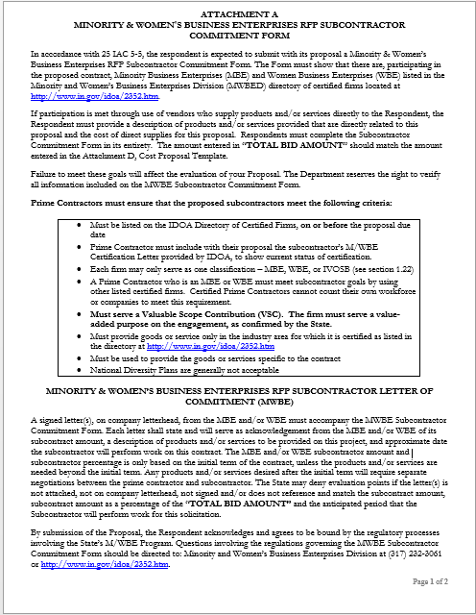
Indiana Department of Administration

Slide 20
Minority and Women’s Business Enterprises
Prime contractors must ensure that the proposed subcontractors meet the following criteria:
Are listed in the IDOA Directory of Certified Firms, on or before the proposal due date, national diversity plans are generally not accepted. The directory can be found here: http://www.in.gov/idoa/mwbe/2743.htm
Serve a Valuable Scope Contribution (VSC) on the engagement, as confirmed by the State.
Provide the goods or services specific to the contract and within the industry area for which it is certified
Indiana Department of Administration

Slide 21
Minority and Women’s Business Enterprises
Prime contractors should note the following:
Subcontractors’ MBE/WBE Certification Letter, provided by IDOA, must accompany the proposal to show current status of certification.
Each firm may only serve as one classification – MBE, WBE, or IVOSB (see section 1.22)
Pursuant to 25 IAC 5-6-2(b)(d), a Prime Contractor who is a MBE or WBE must meet subcontractor goals by using other listed certified firms. Certified Prime Contractors cannot count their own workforce or companies to meet this requirement.
Indiana Department of Administration

Slide 22
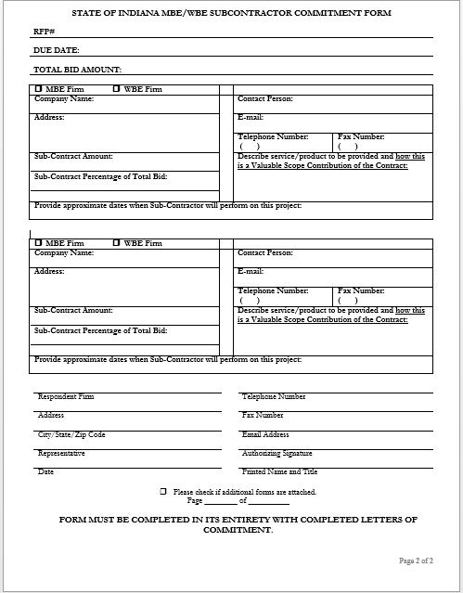
Indiana Department of Administration

Slide 23
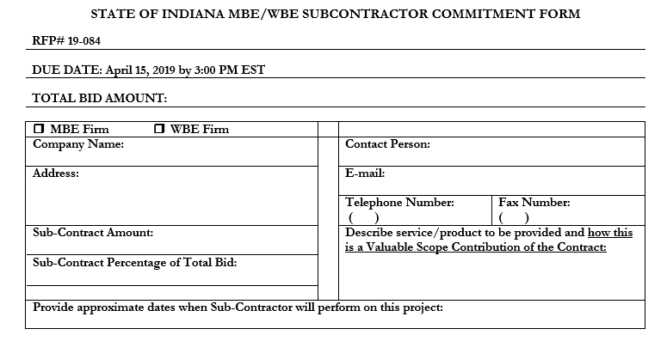
Minority and Women’s Business Enterprises
Indiana Department of Administration

Slide 24
Minority and Women’s Business Enterprises
New Process – Effective 2014, MWBE scoring is conducted based on 10 points plus a possible 2 bonus points scale
MBE: Possible 5 points + 1 bonus point
WBE: Possible 5 points + 1 bonus point
Professional Services Scoring Methodology:
The points will be awarded on the following schedule:
Fractional percentages will be rounded up or down to the nearest whole percentage
If the respondent’s commitment percentage is rounded down to 0% for MBE or WBE participation the respondent will receive 0 points.
Submissions of 0% participation will result in a deduction of 1 point in each category
The highest submission which exceeds the goal in each category will receive 6 points (5 points plus 1 bonus point). In case of a tie both firms will receive 6 points
% | 1% | 2% | 3% | 4% | 5% | 6% | 7% | 8%
Pts. | .625 | 1.25 | 1.875 | 2.5 | 3.125 | 3.75 | 4.375 | 5.0
Indiana Department of Administration

Slide 25
Indiana Veteran Owned Small Business
Contact Information
Phone: 317-232-3061
E-mail: Indianaveteranspreference@idoa.in.gov
Web: www.in.gov/idoa/2862.htm
Complete Attachment A1, IVOSB Form
Include sub-contractor letters of commitment
Goals for Proposal
3% Indiana Veteran Owned Small Business
Indiana Department of Administration

Slide 26
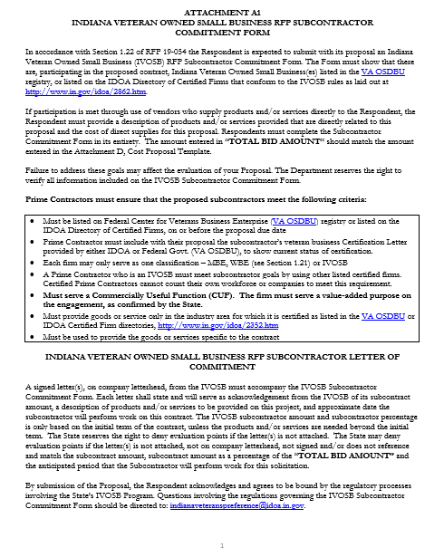

Slide 27
Indiana Veteran Owned Small Business
Prime contractors should note the following:
Pursuant to 25 IAC 9-4-1(c), a Prime Contractor who is an IVOSB can use their own workforce to count toward the goal.
Prime contractor and/or subcontractors’ Certification Letter(s), provided by IDOA or VA OSDBU, must accompany the proposal to show current status of certification.
Each firm may only serve as one classification – MBE, WBE, or IVOSB (see section 1.22).
Indiana Department of Administration

Slide 28
Indiana Veteran Owned Small Business
Prime contractors must ensure that the proposed subcontractors meet the following criteria:
Must be listed on Federal Center for Veterans Business Enterprise (VA OSDBU) registry or listed on the IDOA Directory of Certified Firms, on or before the proposal due date.
Serve a Valuable Scope Contribution (VSC) on the engagement, as confirmed by the State.
Provide the goods or services specific to the contract and within the industry area for which it is certified
Indiana Department of Administration

Slide 29
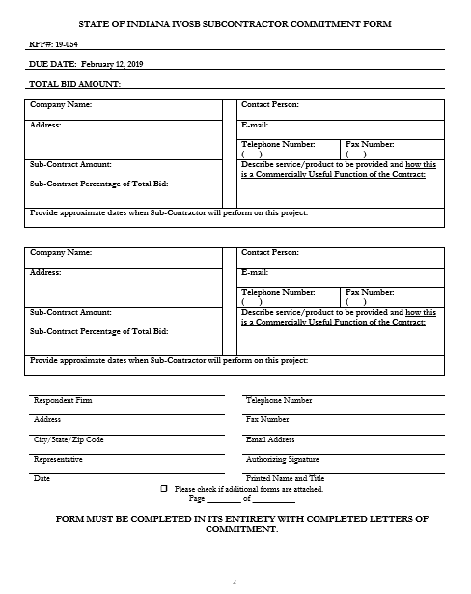
Indiana Department of Administration

Slide 30
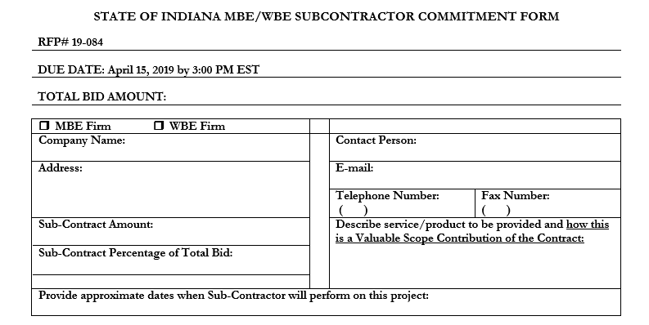
Indiana Veteran Owned Small Business
Indiana Department of Administration

Slide 31
Indiana Veteran Owned Small Business
New Process - IVOSB scoring is conducted based on 5 points plus a possible 1 bonus point scale
- IVOSB: Possible 5 points + 1 bonus point
Professional Services Scoring Methodology:
The points will be awarded on the following schedule:
Fractional points will be awarded based upon a graduated scale between whole points. (e.g. a 0.3% commitment will receive .5 points and a 1.5% commitment will receive 2.5 points)
Submissions of 0% participation will result in a deduction of 1 point in each category
The highest submission which exceeds the goal in each category will receive 5 points (5 points plus 1 bonus point). In case of a tie both firms will receive 6 points.
% | 0% | 0.6% | 1.2% | 1.8% | 2.4% | 3%
Pts. | -1 | 1 | 2 | 3 | 4 | 5
Indiana Department of Administration

Slide 32
IDOA Subcontractor Scoring
RFP MBE/WBE/IVOSB Scoring Example
Bidder | MBE % | Pts. | WBE % | Pts. | IVOSB % | Pts. | Total Pts.
Bidder 1 | 12.0% | 5.0 | 10.0% | 6.0 | 3.5% | 6.0 | 17.00
Bidder 2 | 6.0% | 3.75 | 4.0% | 2.5 | 1.8% | 3.0 | 9.25
Bidder 3 | 8.0% | 5.0 | 8.0% | 5.0 | 3.0% | 5.0 | 15.00
Bidder 4 | 16.0% | 6.0 | 0.2% | 0.0 | 0.6% | 1.0 | 7.00
Bidder 5 | 0.0% | -1.0 | 0.0% | -1.0 | 0.0% | -1.0 | -3.00
Indiana Department of Administration

Slide 33



Subcontractor Compliance
Pay Audit System
Tool utilized to monitor the state’s diversity spend for subcontractors
Selected primes and subcontractors are required to report payments submitted or received through this web-based tool
Based on contract terms payments should be reported monthly or quarterly
Questions? Contact Division of Supplier Diversity
mwbecompliance@idoa.in.gov
www.in.gov/idoa/mwbe/payaudit.htm
Prime
Submit subcontractor actual paid invoice amounts
Payment
Pay Audit System
Submit actual payments received
Subcontractor
Indiana Department of Administration

Slide 34
Additional Information
IDOA PROCUREMENT LINKS AND NUMBERS
http://www.in.gov/idoa/2354.htm
1-877-77BUYIN (8946) For Vendor Registration Questions
http://www.in.gov/idoa/2464.htm
For Inquiries Regarding Substantial Indiana Economic Impact
http://www.in.gov/idoa/2467.htm
Link to the developing “one stop shop” for vendor registry with IDOA and Secretary of State.
B. Secretary of State of Indiana:
Can be reached at (317) 232-6576 for registration assistance. www.in.gov/sos
C. See Vendor Handbook:
Online version available at http://www.in.gov/idoa/files/vendor_handbook.doc
Minority and Women Owned Business Enterprises:
http://www.in.gov/idoa/files/Certification_List(48).xls for table of IDOA certified MBEs and WBEs. For more WBE’s information http://www.in.gov/idoa/2352.htm
Veteran Owned Small Business Program:
https://www.vip.vetbiz.gov/ for a search of certified IVOSB’s. For more IVOSB’s information http://www.in.gov/idoa/2862.htm
F. RFP posting and updates:
Go to http://www.in.gov/idoa/2354.htm (select “State of Indiana Opportunities” link)
Drag through table until you find desired RFP/RFI number on left-hand side and click the link.
Indiana Department of Administration

Slide 35
Questions?
Any verbal response is not considered binding; respondents are encouraged to submit any question formally in writing if it affects the proposal that will be submitted to the state.
Indiana Department of Administration

Slide 36
Thank You!
Please reach out if there are any follow-up questions:
Leslie Brothers
LBrothers@idoa.IN.gov Office Phone: 317-234-4251
Indiana Department of Administration

