Slide 1
Request for Proposal 20-031
Cafeteria and coffee bar services for the Indiana Government Center
Indiana Department of Administration
On Behalf Of
The Department of Administration
Pre-Proposal Conference
October 17th, 2019
Austin Jones
IDOA/Procurement Division

Slide 2
Agenda
General Information
Purpose of RFP
Term of Contract
Key Dates
Scope of Work
Business Proposal
Technical Proposal
Cost Proposal
Proposal Preparation
Evaluation Criteria
Minority and Women’s Business Enterprises (M/WBE)
Indiana Veteran Owned Small Business (IVOSB)
Additional Information
Question and Answer Session

Slide 3
General Information
Sign-In Sheet for Attendees
Sign-In Sheet and PowerPoint will be posted on IDOA’s Solicitation Website
Hold questions until the end of the presentation
  Any verbal response is not considered binding; respondents are encouraged to submit any questions formally, in writing, if it affects the proposal that will be submitted to the state.

Slide 4
Purpose of the RFP
The purpose of this RFP is to select one or more respondents that can satisfy the State’s need for quality food and cafeteria services for the Indiana Government Center. It is the intent of the Department of Administration to contract with one or more respondents that provides quality food and cafeteria services for the Department of Administration and all state agencies.
  Two distinct components
    Operation of the North and South Cafeterias
    Operation of the North and South Coffee Bars
  May submit proposals for one or both components
  Attachment I – complete mandatory minimum requirements

Slide 5
Term of Contract
The term of the contract shall be for a period of six (6) years from the date of contract execution. There may be two (2) one-year renewals for a total of eight (8) years at the State’s option.

Slide 6
Key Dates
Activity | Date
Issue of RFP | October 08, 2019
Pre-Proposal Conference | October 17, 2019 at 12:30 PM EST Conference Room #19 Indiana Government Center South Cafeteria walk-through following the end of the presentation.
Deadline to Submit Written Questions | October 24, 2019 by 3:00 PM Eastern Time
Response to Written Questions/RFP Amendments | October 31, 2019
Submission of Proposals | November 22, 2019 by 3:00 PM Eastern Time
Submission of Reference Check Forms to State | December 10th, 2019
The dates for the following activities are target dates only. These activities may be completed earlier or later than the date shown.
Proposal Evaluation | TBD
Proposal Discussions/Clarifications (if necessary) | TBD
Oral Presentations (if necessary) | TBD
Best and Final Offers (if necessary) | TBD
RFP Award Recommendation | TBD

Slide 7
Scope of Work
It is the intent of the State to partner with a vendor(s) that can transform both the north and south cafeterias and coffee bars into inviting modernized spaces that feature superior service and food offerings. Competitive proposals will fully articulate how the Respondent plans to accomplish this.

Slide 8
Business Proposal (Attachment E)
Company Financial Information (Section 2.3.3)
  Respondents must provide documents to demonstrate financial stability including, for example, the most recent Dunn & Bradstreet Business Report (preferred) or audited financial statements for the two (2) most recently completed fiscal years. If neither of these can be provided, Respondents must explain why and include an income statement and balance sheet for each of the two (2) most recently completed fiscal years.
  If the documents are from a parent or holding company, Respondents must explain the business relationship between the entities and demonstrate the financial stability of the entity which is directly responding to this RFP.
Contract Terms (Section 2.3.5)
  Respondents should review sample State contract and note exceptions to State non-mandatory clauses in Business Proposal and Transmittal Letter. Mandatory clauses are non-negotiable.
References (Section 2.3.6)
  Respondents must have at least three (3) references for whom the Respondent has provided products and/or services that are the same or similar to those products and/or services requested in this RFP. Respondents must ask each reference to complete Attachment H Reference Check Form and mail or email it directly to IDOA (idoareferences@idoa.in.gov) by December 10, 2019 (10 business days after proposals are due).

Slide 9
Technical Proposal (Attachment F)
Respondents should use Attachment F and/or Attachment F1 to complete their Technical Proposal. Use the yellow shaded fields to answer the questions in Attachment F.
  Yellow fields will expand to accommodate content.
  Make every attempt to preserve the original format of Attachment F.
Where appropriate, supporting documentation (e.g. diagrams, certificates, graphics, or other exhibits) may be submitted as an attachment and referenced within the relevant answer field.

Slide 10
Cost Proposal (Attachment D and Attachment D1)
Please complete the template provided for the Cost Proposal by populating ONLY the yellow shaded cells.
Respondent’s Cost Score = (highest reinvestment percentage Cost Proposal / Vendor proposed reinvestment percentage Cost of Proposal) X 30

Slide 11
Proposal Preparation
Buy Indiana, Business Proposal (2.3.14)
  Respondent’s Buy Indiana status shall be finalized by proposal due date.
  Five (5) definitions, details provided in the RFP Section 2.7.
Indiana Economic Impact, Attachment C
  Respondents must submit this completed attachment, but it will not be used for evaluation purposes.
  Definitions of FTE (Full-Time Equivalent)
  Example: If a Respondent has five (5) full time employees, is bidding on its 5th contract, and all contracts get an equal amount of commitment from the employees, then each employee commits 20% of his/her time to the new contract:
    0.2 x 5 employees – 1 FTE

Slide 12
Proposal Preparation
Attachment D & D1 (Cost Proposal) must be returned in the original Excel format (No PDFs)
Use the templates provided for all responses
Do not alter any templates
Submit all questions via email using the Q&A Template (Attachment G)

Slide 13
Proposal Preparation
Confidential Information (Section 1.15)
  All materials contained in proposals are subject to the Access to Public Records Act (APRA) and can be accessed by any member of the public after contract award. The responses are deemed to be “public records” unless a specific provision of IC 5-14-3 protects it from disclosure.
  In order to request certain information be kept confidential, Respondents must claim a statutory exception to the APRA in their Transmittal Letter, including describing which specific provision applies to which specific part of their response.
  Confidential information must also be clearly marked and kept separate from the proposal in the electronic copies. IDOA recommends sending a “public” file that has the confidential information redacted (may be in PDF format) and a “final” file that includes all required information (must be in format provided).

Slide 14
Evaluation Criteria
Criteria | Points
Adherence to Mandatory Requirements | Pass/Fail
Management Assessment/Quality (Business and Technical Proposal) | 50 points
Cost (Cost Proposal) | 30 points
Buy Indiana | 5 points
Minority Business Enterprise Subcontractor Commitment | 5 points (1 bonus point is available, see Section 3.2.6)
Women Business Enterprise Subcontractor Commitment | 5 points (1 bonus point is available, see Section 3.2.6)
Indiana Veteran Owned Small Business Subcontractor Commitment | 5 points (1 bonus point is available, see Section 3.2.7)
Total | 100 (103 if bonus awarded)

Slide 15
Minority and Women’s Business Enterprises
Mission/Vision
  Promote, monitor, and enforce the standards for certification of minority and women’s business enterprises.
  Provide equal opportunity to minority and women enterprises in the state’s procurement and contracting process.
Nondiscrimination and Antidiscrimination Laws
  Pursuant to Indiana Civil Rights Law, specifically IC §22-9-1-10, every state contract shall contain a provision requiring the contractor and subcontractors to not discriminate against any employee or applicant with respect to Protected Characteristics

Slide 16
Minority and Women’s Business Enterprises
Contact Information
  Phone: 317-232-3061
  E-mail: mwbecompliance@idoa.in.gov
  Web: www.in.gov/idoa/mwbe
Complete Attachment A, MWBE Form
- Include sub-contractor letter of commitment
Goals for Proposal
- 8% Minority Business Enterprise
- 8% Women’s Business Enterprise

Slide 17
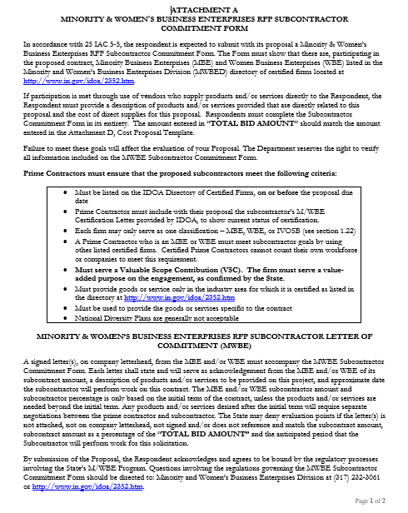

Slide 18
Minority and Women’s Business Enterprises
Prime contractors must ensure that the proposed subcontractors meet the following criteria:
Are listed in the IDOA Directory of Certified Firms, on or before the proposal due date, national diversity plans are generally not accepted. The directory can be found here: http://www.in.gov/idoa/mwbe/2743.htm.
Serve a Valuable Scope Contribution (VSC) on the engagement, as confirmed by the State.
Provide the goods or services specific to the contract and within the industry area for which it is certified.

Slide 19
Minority and Women’s Business Enterprises
Prime contractors should note the following:
Subcontractors’ MBE/WBE Certification Letter, provided by IDOA, must accompany the proposal to show current status of certification.
Each firm may only serve as one classification – MBE, WBE, or IVOSB (see section 1.22)
Pursuant to 25 IAC 5-6-2(b)(d), a Prime Contractor who is a MBE or WBE must meet subcontractor goals by using other listed certified firms. Certified Prime Contractors cannot count their own workforce or companies to meet this requirement.

Slide 20
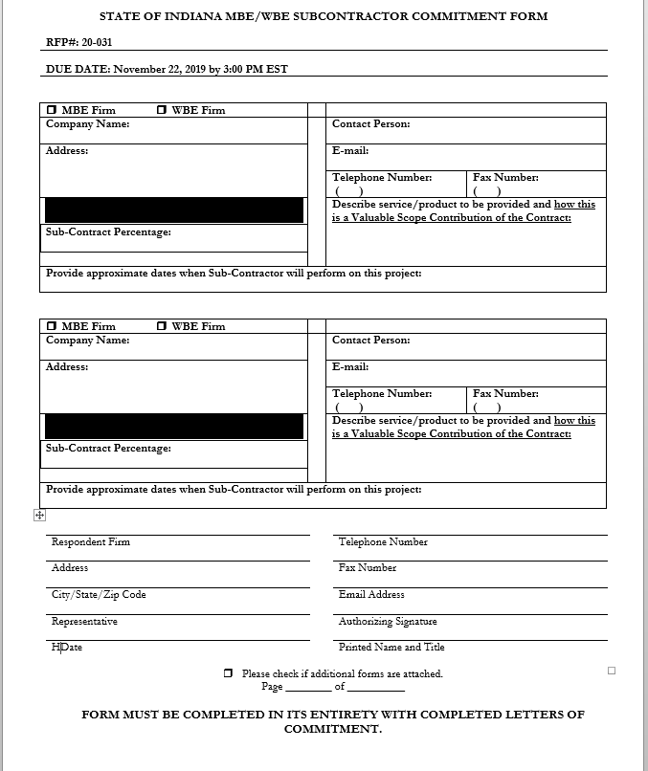

Slide 21
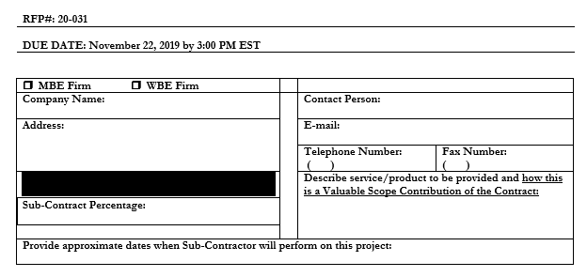
Minority and Women’s Business Enterprises

Slide 22
Minority and Women’s Business Enterprises
Effective August, 2014, a new MWBE scoring methodology will be utilized for all RFP’s released
New Process - MWBE scoring is conducted based on 10 points plus a possible 2 bonus points scale
  MBE: Possible 5 points + 1 bonus point
  WBE: Possible 5 points + 1 bonus Point
Professional Services Scoring Methodology:
  The points will be awarded on the following schedule:
  Fractional percentages will be rounded up or down to the nearest whole percentage
  If the respondent’s commitment percentage is rounded down to 0% for MBE or WBE participation the respondent will receive 0 points.
  Submissions of 0% participation will result in a deduction of 1 point in each category
  The highest submission which exceeds the goal (“exceeds” defined as a commitment percentage that is equal to or greater than 9% before rounding) in each category will receive 6
  points (5 points plus 1 bonus point). In case of a tie both firms will receive 6 points.
% | 1% | 2% | 3% | 4% | 5% | 6% | 7% | 8%
Pts. | .625 | 1.25 | 1.875 | 2.5 | 3.125 | 3.75 | 4.375 | 5.0

Slide 23
Indiana Veteran Owned Small Business
Contact Information
  Phone: 317-232-3061
  E-mail: Indianaveteranspreference@idoa.in.gov
  Web: www.in.gov/idoa/2862.htm
Complete Attachment A1, IVOSB Form
  Include sub-contractor letters of commitment
Goals for Proposal
  3% Veteran Owned Small Business

Slide 24
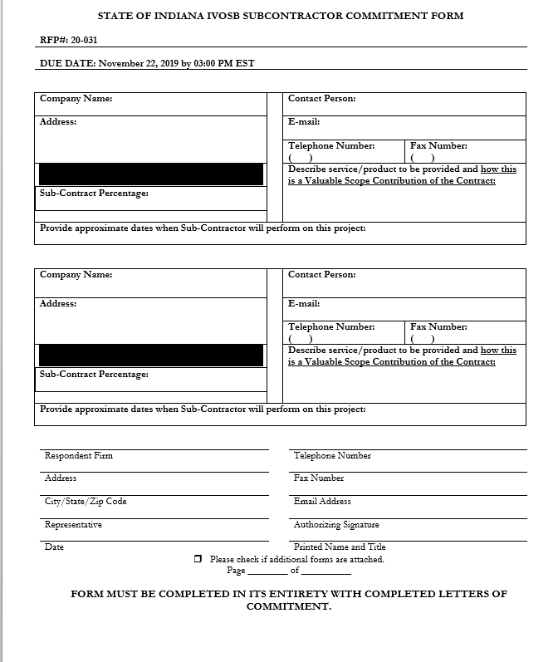

Slide 25
Indiana Veteran Owned Small Business
Prime contractors should note the following:
Pursuant to 25 IAC 9-4-1(c), a Prime Contractor who is an IVOSB can use their own workforce to count toward the goal.
IVOSB must have a Bidder ID (see section 2.3.7 - Department of Administration, Procurement Division).
Prime contractor and/or subcontractors’ Certification Letter(s), provided by IDOA or Federal Center for Veterans Business Enterprise (VA OSDBU), must accompany the proposal to show current status of certification.
Each firm may only serve as one classification – MBE, WBE, or IVOSB (see section 1.22).

Slide 26
Indiana Veteran Owned Small Business
Prime contractors must ensure that the proposed subcontractors meet the following criteria:
Must be listed on VA OSDBU registry or listed on the IDOA Directory of Certified Firms, on or before the proposal due date.
Serve a Valuable Scope Contribution (VSC) on the engagement, as confirmed by the State.
Provide the goods or services specific to the contract and within the industry area for which it is certified.

Slide 27
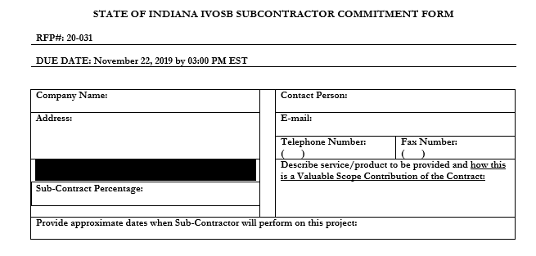
Indiana Veteran Owned Small Business

Slide 28
Indiana Veteran Owned Small Business
New Process - IVOSB scoring is conducted based on 5 points plus a possible 1 bonus point scale
  - IVOSB: Possible 5 points + 1 bonus point
Professional Services Scoring Methodology:
  The points will be awarded on the following schedule:
  Fractional points will be awarded based upon a graduated scale between whole points. (e.g. a 0.3% commitment will receive .5 points and a 1.5% commitment will receive 2.5 points)
  Submissions of 0% participation will result in a deduction of 1 point in each category
  The highest submission which exceeds the goal will receive 6 points (5 points plus 1 bonus point). In case of a tie both firms will receive 6 points.
% | 0% | 0.6% | 1.2% | 1.8% | 2.4% | 3%
Pts. | -1 | 1 | 2 | 3 | 4 | 5

Slide 29
IDOA Subcontractor Scoring
RFP MBE/WBE/IVOSB Scoring Example
Bidder | MBE % | Pts. | WBE % | Pts. | IVOSB % | Pts. | Total Pts.
Bidder 1 | 12.0% | 5.0 | 10.0% | 6.0 | 3.5% | 6.0 | 17.00
Bidder 2 | 6.0% | 3.75 | 4.0% | 2.5 | 1.8% | 3.0 | 9.25
Bidder 3 | 8.0% | 5.0 | 8.0% | 5.0 | 3.0% | 5.0 | 15.00
Bidder 4 | 16.0% | 6.0 | 0.2% | 0.0 | 0.6% | 1.0 | 7.00
Bidder 5 | 0.0% | -1.0 | 0.0% | -1.0 | 0.0% | -1.0 | -3.00

Slide 30



Subcontractor Compliance
Pay Audit System
Tool utilized to monitor the state’s diversity spend for subcontractors
Selected primes and subcontractors are required to report payments submitted or received through this web-based tool
Based on contract terms payments should be reported monthly or quarterly
Questions? Contact Division of Supplier Diversity
  mwbecompliance@idoa.in.gov
  www.in.gov/idoa/mwbe/payaudit.htm
Prime
Submit subcontractor actual paid invoice amounts
Payment
Pay Audit System
Submit actual payments received
Subcontractor

Slide 31
Additional Information
IDOA PROCUREMENT LINKS AND NUMBERS
http://www.in.gov/idoa/2354.htm
For Buy Indiana Questions/Registration
http://www.in.gov/idoa/2467.htm
A. Link to the developing for bidder registry with IDOA and Secretary of State.
http://www.in.gov/idoa/2464.htm
B. Secretary of State of Indiana:
Can be reached at (317) 232-6576 for registration assistance. www.in.gov/sos
C. See Vendor and Supplier Resource Center:
http://www.in.gov/idoa/3106.htm
Minority and Women Owned Business Enterprises:
Link to more information and full listing of IDOA Minority and Women Owned Businesses
http://www.in.gov/idoa/2352.htm
Indiana Veteran Owned Small Business Program:
Link to more information and full listing of Indiana Veteran Owned Small Businesses:
http://www.in.gov/idoa/2862.htm. To search certified IVOSB’s: https://www.vip.vetbiz.va.gov/
F. RFP posting and updates:
Go to http://www.in.gov/idoa/2354.htm (select “Current Opportunities” link)
Scroll through table until you find desired RFP number on left-hand side and click the link.

Slide 32
Questions
Any verbal response is not considered binding; respondents are encouraged to submit any question formally in writing if it affects the proposal that will be submitted to the State.

Slide 33
Thank You
Austin Jones aujones@idoa.in.gov

