Slide 1

Indiana Department of Administration
Online Personal Property Tax System
Request for Proposal 20-020
Pre-Proposal Conference
July 1, 2019
2:00 PM
Traci Davidson, Sr. Strategic Sourcing Analyst
Indiana Department of Administration

Slide 2
Agenda
General Information
Purpose of RFP
Key Dates
Proposal Preparation & Evaluation
Minority and Women’s Business Enterprises (M/WBE)
Indiana Veteran Owned Small Business (IVOSB)
Question and Answer Session
Indiana Department of Administration

Slide 3
General Information
Sign-In Sheet for Attendees
Sign-In Sheet and PowerPoint presentation will be posted on IDOA’s Solicitation Website
Hold questions until the end of the presentation
  Any verbal response given during this meeting is not considered binding; respondents are encouraged to submit any question formally in writing if it affects the proposal that will be submitted to the state.
Indiana Department of Administration

Slide 4
Purpose of the RFP
The State wishes to partner with a Contractor that design, develop, and implement a online database that Indiana residents will use to file their personal property tax's. As well as train County Assessors on proper utilization of the system.
Indiana Department of Administration

Slide 5
Term of RFP
Contract Term
  The term of the contract shall be for a period of two (2) years from the date of contract execution. There may be three (3) one-year renewals for a total of five (5) years at the discretion of IDOA.
  The State of Indiana does not currently have a contract for these services.
Indiana Department of Administration

Slide 6
Key Dates
Activity | Date
Issue of RFP | June 24, 2019
Pre-Proposal Conference | July 1, 2019 at 2:00 PM EST
Deadline to Submit Written Questions | July 9, 2019 by 3:00 PM EST
Response to Written Questions | July 16, 2019 by COB EST
Proposal Due | July 31, 2019 by 3:00 PM EST
Indiana Department of Administration

Slide 7
Business Proposal
(Attachment E)
This document allows this State gets to know your organization as a whole. It is a required submission & must be submitted in its original format. Key points in this section include
Company Financial Information (Section 2.3.3)
  Confidential information must be kept separate from the proposal
Contract Terms (Section 2.3.5)
  Respondent should review sample State contract (Attachment B) and note any exceptions to State mandatory and non-mandatory clauses in their Transmittal Letter
Indiana Department of Administration

Slide 8
Technical Proposal
(Attachment F)
This documents is where your will introduce your product / service to the State and explain how it will meet/exceeds the State’s expectations.
Must provide a response to each questions asked in the space provided. Responding “See Attachment” is not acceptable
Where appropriate, supporting documentation may be referenced by a page and paragraph number.
Please use the Template provided for you. Do Not Alter this documents in any way
Indiana Department of Administration

Slide 9
Cost Proposal
(Attachment D)
Please use the Template provided for you. Do Not Alter this documents in any way
Where appropriate, supporting documentation may be referenced by a page and paragraph number.
Indiana Department of Administration

Slide 10
Cost Proposal
(Attachment D)
The Cost Proposal is broken down into five (5) categories:
Implementation Fees
Hardware and Software Cost
Hosting and Application Mgt. Cost
Ongoing Operation Support
Other

Slide 11
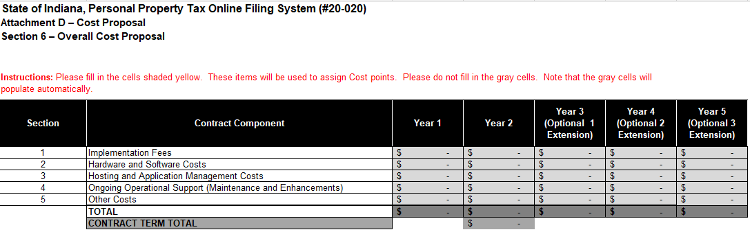
Cost Proposal
(Attachment D)
Tab 6 – Overall Cost Proposal
Cell E14 is the ‘Total Bid Amount’ used for forms A & A1

Slide 12
Proposal Preparation
Buy Indiana, Business Proposal (2.3.14)
  Status shall be finalized by proposal due date
  5 definitions, details provided in Business Proposal
  Email confirmation included in proposal from buyindianainvest@idoa.in.gov (See section 2.7)
    This is required for any of the 5 criteria
Indiana Economic Impact, Attachment C
  Definition of FTE (Full-Time Equivalent)
  Example: If a Respondent has 5 full time employees and is bidding on its 5th contract, and all contracts get an equal amount of commitment from the employees then each employee commits 20% of his or her time to the new contract:
    0.2 x 5 employees= 1 FTE.
Indiana Department of Administration

Slide 13
Proposal Evaluation
Summary of Evaluation Criteria:
Criteria | Points
Adherence to Mandatory Requirements | Pass/Fail
Management Assessment/Quality (Business and Technical Proposal) | 50 available points
Cost (Cost Proposal) | 30 available points
Buy Indiana | 5 points
Minority Business Enterprise Subcontractor Commitment | 5 ( 1 bonus point is available, see Section 3.2.6)
Women Business Enterprise Subcontractor Commitment | 5 ( 1 bonus point is available, see Section 3.2.6)
Indiana Veteran Owned Small Business Subcontractor Commitment | 5 (1 bonus point is available, see Section 3.2.7)
Total | 100 (103 if bonus awarded)
Indiana Department of Administration

Slide 14
Minority and Women’s Business Enterprises
Mission/Vision
  Promote, monitor, and enforce the standards for certification of minority and women’s business enterprises.
  Provide equal opportunity to minority and women enterprises in the state’s procurement and contracting process.
Nondiscrimination and Antidiscrimination Laws
  Pursuant to Indiana Civil Rights Law, specifically IC §22-9-1-10, every state contract shall contain a provision requiring the contractor and subcontractors to not discriminate against any employee or applicant with respect to Protected Characteristics
Indiana Department of Administration

Slide 15
Minority and Women’s Business Enterprises
Contact Information
  Phone: 317-232-3061
  E-mail: mwbecompliance@idoa.in.gov
  Web: www.in.gov/idoa/mwbe
Complete Attachment A, MWBE Form
- Include sub-contractor letter of commitment
Goals for Proposal
- 8% Minority Business Enterprise
- 8% Women’s Business Enterprise
Indiana Department of Administration

Slide 16
Minority and Women’s Business Enterprises
Prime contractors must ensure that the proposed subcontractors meet the following criteria:
Are listed in the IDOA Directory of Certified Firms, on or before the proposal due date, national diversity plans are generally not accepted. The directory can be found here: http://www.in.gov/idoa/mwbe/2743.htm
Serve a Valuable Scope Contribution (VSC) on the engagement, as confirmed by the State.
Provide the goods or services specific to the contract and within the industry area for which it is certified
Indiana Department of Administration

Slide 17
Minority and Women’s Business Enterprises
Prime contractors should note the following:
Subcontractors’ MBE/WBE Certification Letter, provided by IDOA, must accompany the proposal to show current status of certification.
Each firm may only serve as one classification – MBE, WBE, or IVOSB (see section 1.22)
Pursuant to 25 IAC 5-6-2(b)(d), a Prime Contractor who is a MBE or WBE must meet subcontractor goals by using other listed certified firms. Certified Prime Contractors cannot count their own workforce or companies to meet this requirement.
Indiana Department of Administration

Slide 18
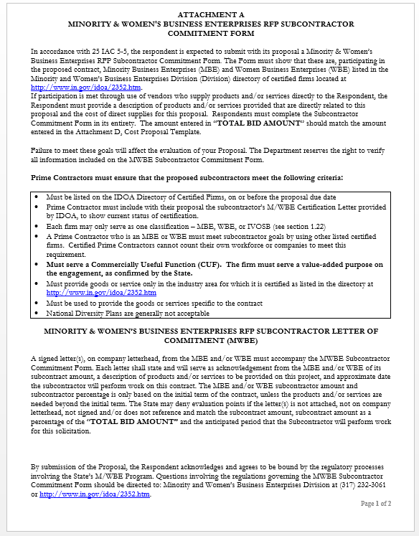
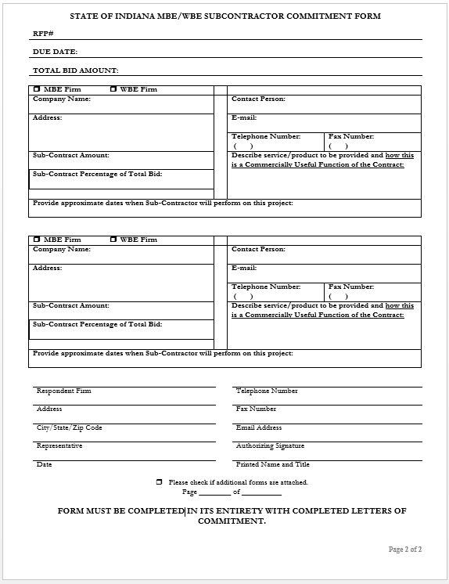
Indiana Department of Administration

Slide 19
Indiana Department of Administration

Slide 20
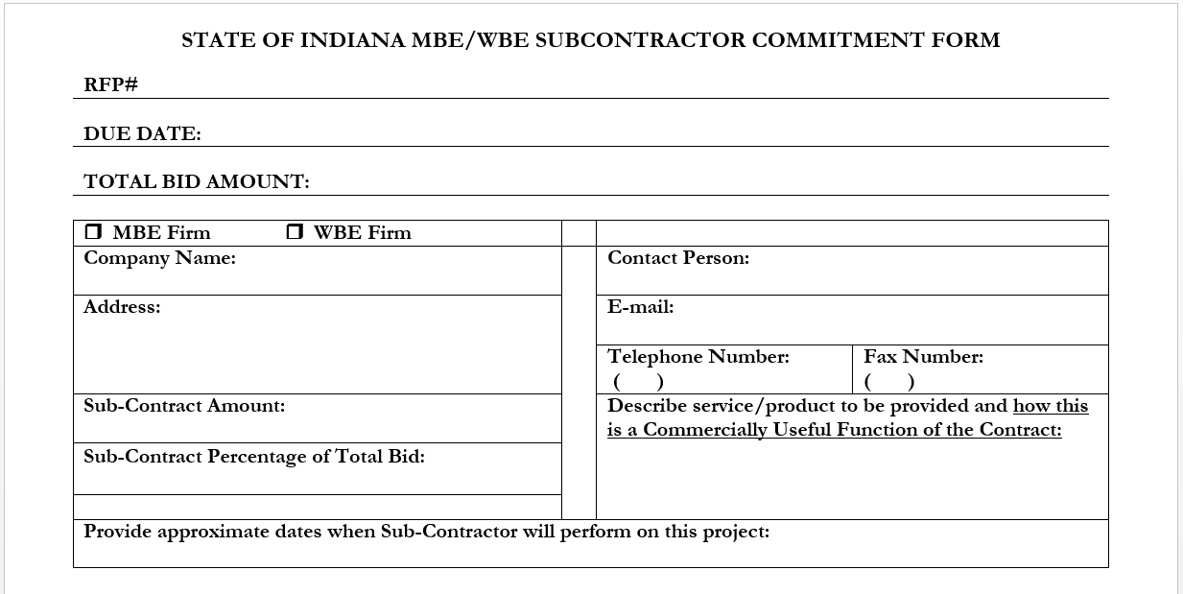
Minority and Women’s Business Enterprises
Must match cell E14 on Attachment D Cost Proposal
Indiana Department of Administration

Slide 21

Minority and Women’s Business Enterprises
New Process – Effective 2014, MWBE scoring is conducted based on 10 points plus a possible 2 bonus points scale
  MBE: Possible 5 points + 1 bonus point
  WBE: Possible 5 points + 1 bonus point
Professional Services Scoring Methodology:
  The points will be awarded on the following schedule:
  Fractional percentages will be rounded up or down to the nearest whole percentage
  If the respondent’s commitment percentage is rounded down to 0% for MBE or WBE participation the respondent will receive 0 points.
  Submissions of 0% participation will result in a deduction of 1 point in each category
  The highest submission which exceeds the goal in each category will receive 6 points (5 points plus 1 bonus point). In case of a tie both firms will receive 6 points
Indiana Department of Administration

Slide 22
Indiana Veteran Owned Business Enterprises
Contact Information
  Phone: 317-232-3061
  E-mail: Indianaveteranspreference@idoa.in.gov
  Web: www.in.gov/idoa/2862.htm
Complete Attachment A1, IVOSB Form
  Include sub-contractor letters of commitment
Goals for Proposal
  3% Veteran Business Enterprise
Indiana Department of Administration

Slide 23
Indiana Veteran Owned Small Business
Prime contractors should note the following:
Pursuant to 25 IAC 9-4-1(c), a Prime Contractor who is an IVOSB can use their own workforce to count toward the goal.
Prime contractor and/or subcontractors’ Certification Letter(s), provided by IDOA or VA OSDBU, must accompany the proposal to show current status of certification.
Each firm may only serve as one classification – MBE, WBE, or IVOSB (see section 1.22).
Indiana Department of Administration

Slide 24
Indiana Veteran Owned Small Business
Prime contractors must ensure that the proposed subcontractors meet the following criteria:
Must be listed on Federal Center for Veterans Business Enterprise (VA OSDBU) registry or listed on the IDOA Directory of Certified Firms, on or before the proposal due date.
Serve a Valuable Scope Contribution (VSC) on the engagement, as confirmed by the State.
Provide the goods or services specific to the contract and within the industry area for which it is certified

Slide 25
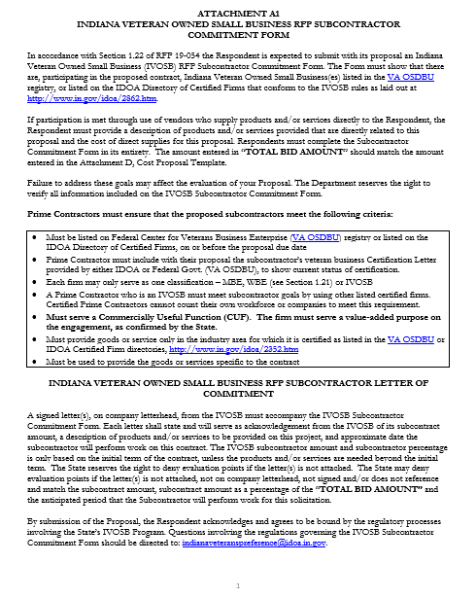
Indiana Department of Administration

Slide 26
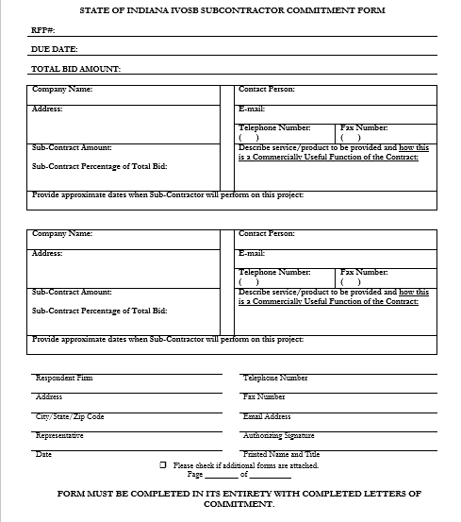
Indiana Department of Administration

Slide 27
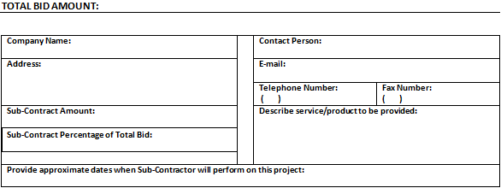
Indiana Veteran Owned Small Business
Must match cell E14 on Attachment D Cost Proposal
Indiana Department of Administration

Slide 28
Indiana Veteran Owned Small Business
New Process – IVOSB scoring is conducted based on 5 points plus a possible 1 bonus point scale
  IVOSB: Possible 5 points + 1 bonus point
Professional Services Scoring Methodology:
  The points will be awarded on the following schedule:
  Fractional points will be awarded based upon a graduated scale between whole points. (e.g. a 0.3% commitment will receive .5 points and a 1.5% commitment will receive 2.5 points)
  Submissions of 0% participation will result in a deduction of 1 point in each category
  The highest submission which exceeds the goal in each category will receive 5 points (5 points plus 1 bonus point). In case of a tie both firms will receive 6 points.
% | 0% | 0.6% | 1.2% | 1.8% | 2.4% | 3%
Pts. | -1 | 1 | 2 | 3 | 4 | 5
Indiana Department of Administration

Slide 29
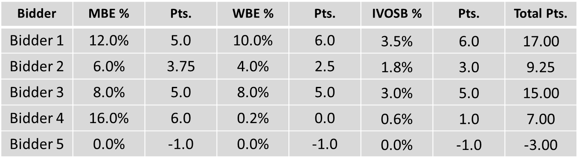
IDOA Subcontractor Scoring
RFP MBE/WBE/IVOSB Scoring Example

Slide 30



Subcontractor Compliance
Pay Audit System
Tool utilized to monitor the state’s diversity spend for subcontractors
Selected primes and subcontractors are required to report payments submitted or received through this web-based tool
Based on contract terms payments should be reported monthly or quarterly
Questions? Contact Division of Supplier Diversity
  mwbecompliance@idoa.in.gov
  www.in.gov/idoa/mwbe/payaudit.htm
~
Prime
Submit subcontractor actual paid invoice amounts
Payment
Pay Audit System
Submit actual payments received
Subcontractor

Slide 31
Required Forms / Documents
Transmittal Letter
Clearly identify a point of contact
Include any exceptions to Attachment B sample contract
Attachment A M/WBE Participation Plan
M/WBE Certification Letter from IDOA
Signed Commitment Letter from M/WBE
Attachment A1 Indiana Veterans’ Participation Plan
Certification Letter provided by IDOA or VA OSDBU
Signed Commitment Letter from IVOSB

Slide 32
Required Forms / Documents (cont’)
Attachment C Indiana Economic Impact
Attachment D Fee Proposal
Attachment E Business Proposal
Attachment F Technical Proposal
Attachment K Reference Check Form (3)
Buy Indiana email confirmation (if applicable)
Failure to submit any of the required forms/documents puts your proposal at risk of not being evaluated and/or loss of points.

Slide 33
Additional Information
IDOA PROCUREMENT LINKS AND NUMBERS
http://www.in.gov/idoa/2354.htm
1-877-77BUYIN (8946) For Vendor Registration Questions
http://www.in.gov/idoa/2464.htm
For Inquiries Regarding Substantial Indiana Economic Impact
http://www.in.gov/idoa/2467.htm
Link to the developing “one stop shop” for vendor registry with IDOA and Secretary of State.
B. Secretary of State of Indiana:
Can be reached at (317) 232-6576 for registration assistance. www.in.gov/sos
C. See Vendor Handbook:
Online version available at http://www.in.gov/idoa/files/vendor_handbook.doc
Minority and Women Owned Business Enterprises:
http://www.in.gov/idoa/files/Certification_List(48).xls for table of IDOA certified MBEs and WBEs. For more WBE’s information http://www.in.gov/idoa/2352.htm
Veteran Owned Small Business Program:
https://www.vip.vetbiz.gov/ for a search of certified IVOSB’s. For more IVOSB’s information http://www.in.gov/idoa/2862.htm
F. RFP posting and updates:
Go to http://www.in.gov/idoa/2354.htm (select “State of Indiana Opportunities” link)
Drag through table until you find desired RFP/RFI number on left-hand side and click the link.
Indiana Department of Administration

Slide 34
Questions
    Any verbal response given during this meeting is not considered binding; respondents are encouraged to submit all questions formally in writing on Attachment G to rfp@idoa.IN.gov .
Indiana Department of Administration

Slide 35
Thank You
Traci Davidson
tdavidson@idoa.IN.gov
Indiana Department of Administration

