Slide 1

Indiana Department of Education
Project AWARE
Request for Services 19-042
Pre-Proposal Conference
November 13, 2018
2:00 PM
Traci Davidson, Sr. Strategic Sourcing Analyst
Indiana Department of Administration

Slide 2
Agenda
General Information
Purpose of RFS
Key Dates
Proposal Preparation & Evaluation
Minority and Women’s Business Enterprises (M/WBE)
Question and Answer Session
Indiana Department of Administration

Slide 3
General Information
Sign-In Sheet for Attendees
Sign-In Sheet and PowerPoint will be posted on IDOA’s Solicitation Website
Hold questions until the end of the presentation
  Any verbal response is not considered binding; respondents are encouraged to submit any question formally in writing if it affects the proposal that will be submitted to the state.
Indiana Department of Administration

Slide 4
Purpose of the RFS
Selection of a data management platform to track sub-grantee performance measures and data regarding the delivery of student services and goals in accordance with the Project AWARE grant.
Indiana Department of Administration

Slide 5
Term of RFS
Contract Term
  The term of the contract shall be for a period of one (1) year from the date of contract execution. There may be up to four (4) one-year renewals for a total of five (5) years at the at the sole discretion of IDOE.
Indiana Department of Administration

Slide 6
Key Dates
Activity | Date
Issue of RFS | November 5, 2018
Pre-Proposal Conference | November 13, 2018 at 2:00 PM EST
Deadline to Submit Written Questions | November 20, 2018 by 3:00 PM EST
Response to Written Questions/RFS Amendments | November 30, 2018 by COB EST
Submission of Proposals | December 14, 2018 by 3:00 PM EST
Indiana Department of Administration

Slide 7
Business Proposal
(Attachment E)
Company Financial Information (Section 2.3.3)
  Confidential information must be kept separate from the proposal in both hard and soft copy
Contract Terms (Section 2.3.5)
  Respondent should review sample State contract and note exceptions to State mandatory and non-mandatory clauses in Transmittal Letter
Indiana Department of Administration

Slide 8
Technical Proposal
(Attachment F)
Please use the Template we have provided for you.
Where appropriate, supporting documentation may be referenced by a page and paragraph number.
Indiana Department of Administration

Slide 9
Cost Proposal
(Attachment D)
Please use the Template we have provided for you.
Where appropriate, supporting documentation may be referenced by a page and paragraph number.
Indiana Department of Administration

Slide 10
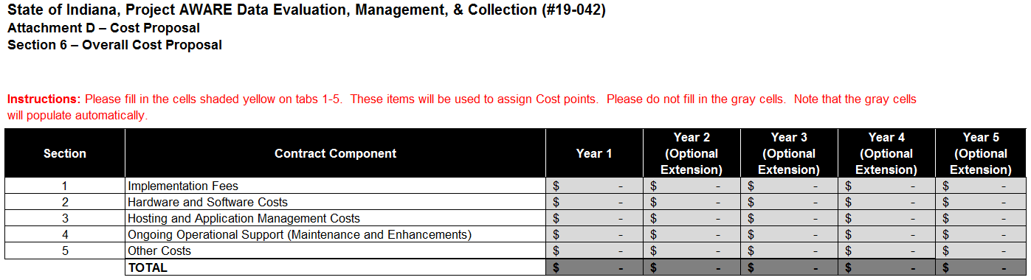
Cost Proposal
(Attachment D)
Cell D13 of Tab 6 is the total bid amount used for M/WBE calculations in Attachment A

Slide 11
Proposal Preparation
Buy Indiana, Business Proposal (2.3.14)
  Not Applicable
Indiana Economic Impact, Attachment C
While this form will not be used in scoring for this proposal the return of the form is required.
  Definition of FTE (Full-Time Equivalent)
  Example: If a Respondent has 5 full time employees and is bidding on its 5th contract, and all contracts get an equal amount of commitment from the employees then each employee commits 20% of his or her time to the new contract:
    0.2 x 5 employees= 1 FTE.
Indiana Department of Administration

Slide 12
Proposal Preparation
Use the templates provided for all answers
Do not alter templates
Submit all questions using template provided (Attachment G)
Indiana Department of Administration

Slide 13
Proposal Evaluation
Summary of Evaluation Criteria:
Criteria | Points
Adherence to Mandatory Requirements | Pass/Fail
Management Assessment/Quality (Business and Technical Proposal) | 55 available points
Cost (Cost Proposal) | 35 available points
Indiana Economic Impact | N/A
Buy Indiana | N/A
Minority Business Enterprise Subcontractor Commitment | 5 ( 1 bonus point is available, see Section 3.2.6)
Women Business Enterprise Subcontractor Commitment | 5 ( 1 bonus point is available, see Section 3.2.6)
Indiana Veteran Owned Small Business Subcontractor Commitment | N/A
Total | 100 (102 if bonus awarded)
Indiana Department of Administration

Slide 14
Minority and Women’s Business Enterprises
Contact Information
  Phone: 317-232-3061
  E-mail: mwbecompliance@idoa.in.gov
  Web: www.in.gov/idoa/mwbe
Complete Attachment A, MWBE Form
- Include sub-contractor letter of commitment
Goals for Proposal
- 8% Minority Business Enterprise
- 8% Women’s Business Enterprise
Indiana Department of Administration

Slide 15
Minority and Women’s Business Enterprises
Prime contractors must ensure that the proposed subcontractors meet the following criteria:
Are listed in the IDOA Directory of Certified Firms, on or before the proposal due date, national diversity plans are generally not accepted. The directory can be found here: http://www.in.gov/idoa/mwbe/2743.htm
Serve a Commercially Useful Function (CUF) and value-added purpose on the engagement, as confirmed by the State.
Provide the goods or services specific to the contract and within the industry area for which it is certified
Indiana Department of Administration

Slide 16
Minority and Women’s Business Enterprises
Prime contractors should note the following:
Subcontractors’ MBE/WBE Certification Letter, provided by IDOA, must accompany the proposal to show current status of certification.
Each firm may only serve as one classification – MBE, WBE, or IVOSB (see section 1.22)
Pursuant to 25 IAC 5-6-2(b)(d), a Prime Contractor who is a MBE or WBE must meet subcontractor goals by using other listed certified firms. Certified Prime Contractors cannot count their own workforce or companies to meet this requirement.
Indiana Department of Administration

Slide 17
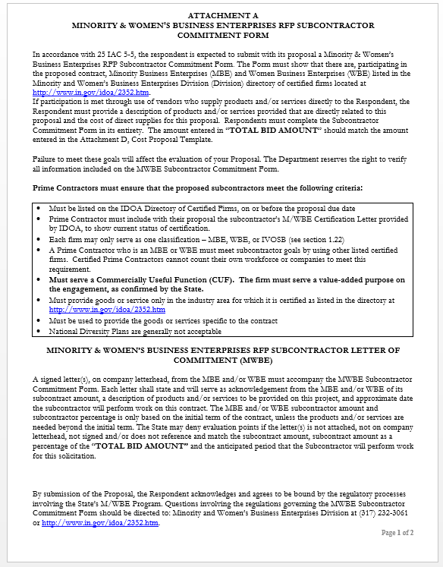
Indiana Department of Administration

Slide 18
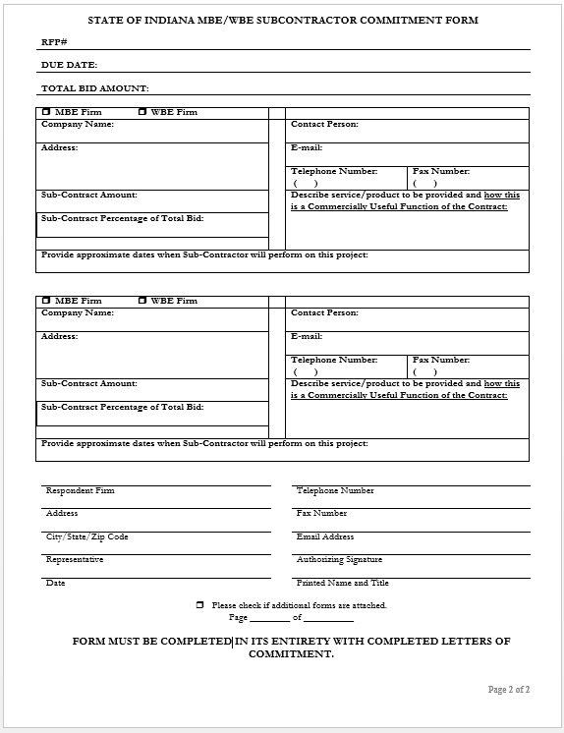
Indiana Department of Administration

Slide 19
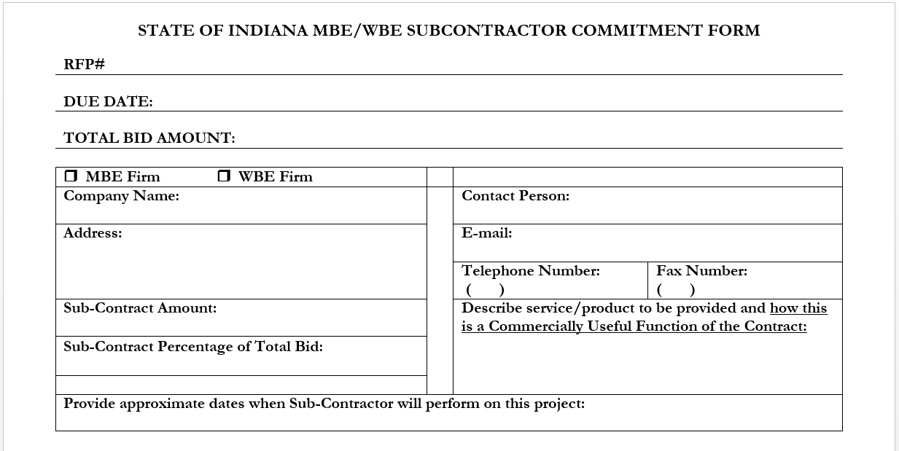
Minority and Women’s Business Enterprises
Indiana Department of Administration

Slide 20
Minority and Women’s Business Enterprises
New Process – Effective 2014, MWBE scoring is conducted based on 10 points plus a possible 2 bonus points scale
  MBE: Possible 5 points + 1 bonus point
  WBE: Possible 5 points + 1 bonus point
Professional Services Scoring Methodology:
  The points will be awarded on the following schedule:
  Fractional percentages will be rounded up or down to the nearest whole percentage
  If the respondent’s commitment percentage is rounded down to 0% for MBE or WBE participation the respondent will receive 0 points.
  Submissions of 0% participation will result in a deduction of 1 point in each category
  The highest submission which exceeds the goal in each category will receive 6 points (5 points plus 1 bonus point). In case of a tie both firms will receive 6 points
% | 1% | 2% | 3% | 4% | 5% | 6% | 7% | 8%
Pts. | .625 | 1.25 | 1.875 | 2.5 | 3.125 | 3.75 | 4.375 | 5.0
Indiana Department of Administration

Slide 21
Minority and Women’s Business Enterprises
RFS MWBE Scoring Example
Bidder | MBE % | Pts. | WBE % | Pts. | Total Pts.
Bidder 1 | 12.0% | 5.0 | 10.0% | 6.0 | 11.0
Bidder 2 | 6.0% | 3.75 | 4.0% | 2.5 | 6.25
Bidder 3 | 8.0% | 5.0 | 8.0% | 5.0 | 10.0
Bidder 4 | 16.0% | 6.0 | 0.2% | 0.0 | 6.0
Bidder 5 | 0.0% | -1.0 | 0.0% | -1.0 | -2.0
Indiana Department of Administration

Slide 22



Minority and Women’s Business Enterprises
Pay Audit System
Tool utilized to monitor the state’s diversity spend for subcontractors
Selected primes and subcontractors are required to report payments submitted or received through this web-based tool
Based on contract terms payments should be reported monthly or quarterly
Questions? Contact MWBE Compliance
  mwbecompliance@idoa.in.gov
  www.in.gov/idoa/mwbe/payaudit.htm
Prime
Submit subcontractor actual paid invoice amounts
Payment
Pay Audit System
Submit actual payments received
Subcontractor
Indiana Department of Administration

Slide 23
Additional Information
IDOA PROCUREMENT LINKS AND NUMBERS
http://www.in.gov/idoa/2354.htm
1-877-77BUYIN (8946) For Vendor Registration Questions
http://www.in.gov/idoa/2464.htm
For Inquiries Regarding Substantial Indiana Economic Impact
http://www.in.gov/idoa/2467.htm
Link to the developing “one stop shop” for vendor registry with IDOA and Secretary of State.
B. Secretary of State of Indiana:
Can be reached at (317) 232-6576 for registration assistance. www.in.gov/sos
C. See Vendor Handbook:
Online version available at http://www.in.gov/idoa/files/vendor_handbook.doc
Minority and Women Owned Business Enterprises:
http://www.in.gov/idoa/files/Certification_List(48).xls for table of IDOA certified MBEs and WBEs. For more WBE’s information http://www.in.gov/idoa/2352.htm
Veteran Owned Small Business Program:
https://www.vip.vetbiz.gov/ for a search of certified IVOSB’s. For more IVOSB’s information http://www.in.gov/idoa/2862.htm
F. RFS posting and updates:
Go to http://www.in.gov/idoa/2354.htm (select “State of Indiana Opportunities” link)
Drag through table until you find desired RFS/RFI number on left-hand side and click the link.
Indiana Department of Administration

Slide 24
Questions
    Any verbal response is not considered binding; respondents are encouraged to submit any question formally in writing if it affects the proposal that will be submitted to the state.
Indiana Department of Administration

Slide 25
Thank You
Traci Davidson
tdavidson@idoa.IN.gov
Indiana Department of Administration

