Slide 1

Division of Supplier Diversity 2019 Outreach Summary Report
1
11/22/2019

Slide 2

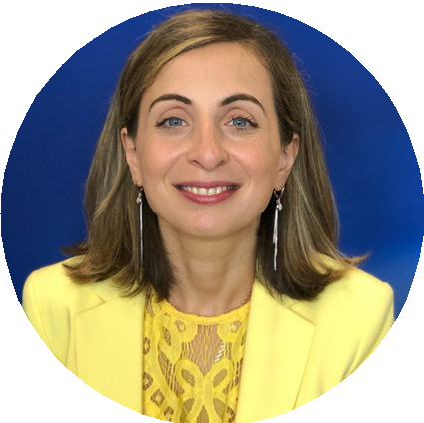
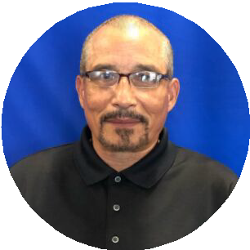
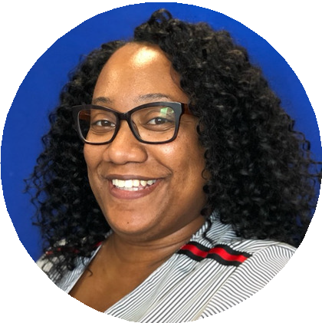
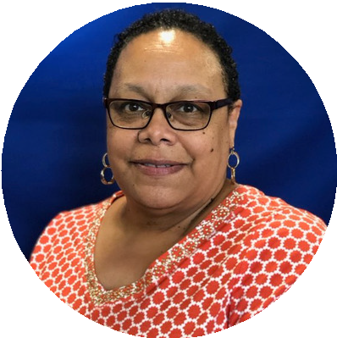
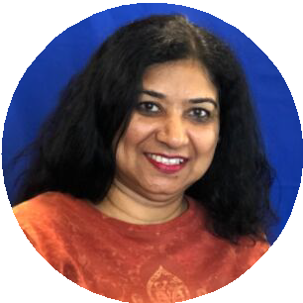
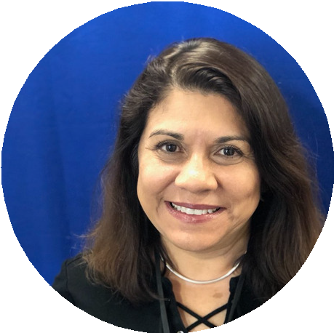

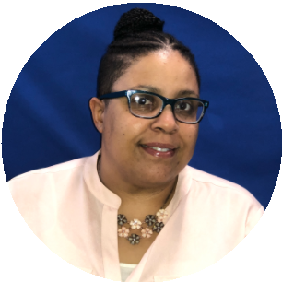
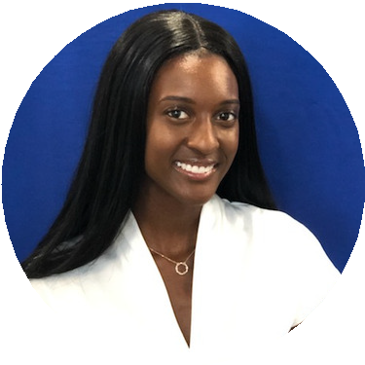
About Us
2
The Indiana Department of Administration (IDOA) Division of Supplier Diversity (DSD), acts on behalf of the State of Indiana to actively promote, monitor and enforce the standards for certification of minority and women’s business enterprises. The Division was established in 1983 by the State of Indiana when Indiana Code 4-13-16.5 became law.
Our Mission
Our mission is to provide equal opportunity in the state’s procurement and contracting process to Minority, Women and Veteran owned enterprises by way of certification, outreach and compliance.
Meet the Dream Team
DIVISION OF SUPPLIER DIVERSITY
Lesley Crane Commissioner
Maia Siprashvili-Lee Deputy Commissioner
Ralph Adams Contract Compliance Manager
Crystal Bell Certification Specialist
Vivian Cage Certification Specialist
Rashmi Fansler Office Administrator
Carmen Ledezma Certification Specialist
Corlisha Mitchell Contract Compliance Manager
Kesha Rich Deputy Director of Development and Compliance
Amber Sapenter Business Outreach Manager

Slide 3

Our Focus on Outreach
3
One of our primary functions is to actively promote the standards of certification for Minority, Women’s Business Enterprises and Indiana Veteran Owned Small Business Enterprises (MBE/WBE/IVOSB). In an effort to assist these enterprises gain access to state contracts, we go beyond the simple act of making our services open to the public.
We have redefined what it means to make our free resources more available and accessible by way of outreach programs, business conferences, online training, contract matchmaker events, and corporate partnerships that cover the State of Indiana.
Through outreach and business development, we actively engage and inform the Minority Business Enterprise (MBE), Women’s Business Enterprise (WBE) and Indiana Veteran Owned Small Business (IVOSB) community of the resources that are available by meeting them where they are whether it be through location, capacity or
need.
Our 2019 Outreach Initiatives
Through our business development, we continue to provide existing and potential vendors with unique opportunities to network and build relationships with our various stakeholders: government entities, private sector organizations, prime contractors, and other certified vendors.
To ensure that certified and potential certified businesses were provided with the tools they sought after to succeed in 2019, DSD planned and developed more targeted and in-depth educational program initiatives.
As we entered 2019, we looked to provide an outreach program that was reflective of our audience, one that is both resourceful and innovative. As a Division, we value the input of the businesses that attend our events. To better serve their needs, we listen to their suggestions and work diligently to include their ideas into our annual programming.
Based on the surveys and communications collected during our 2018 outreach events, our businesses find the most value in the following areas:
Certification Information
Knowledgeable Panelists
Educational Programming
Contract Opportunities
Networking Opportunities
These topics were strategically implemented in our 2019 regional business conference series: The Power of Now. In previous years, we provided our businesses with resources they could sew into their company in order to grow and prepare for a successful future. This conference season introduced tools and resources that MBE/ WBE/IVOSBs could implement immediately, so they may position themselves to be modern and successful in a highly competitive market. The workshops during this conference season shed light on industry knowledge and tips that can be valued by any business regardless of their sizes or level of development.

Slide 4




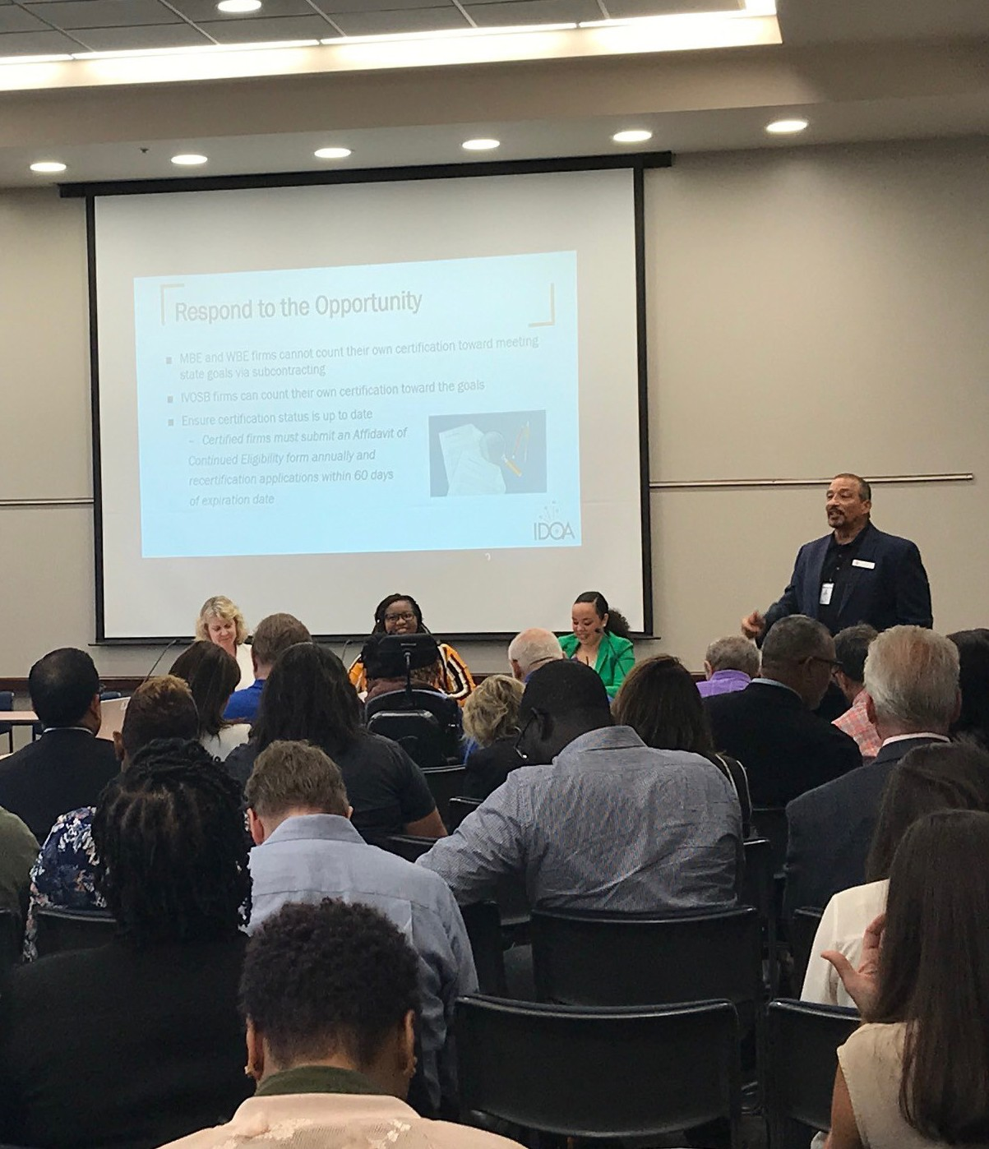
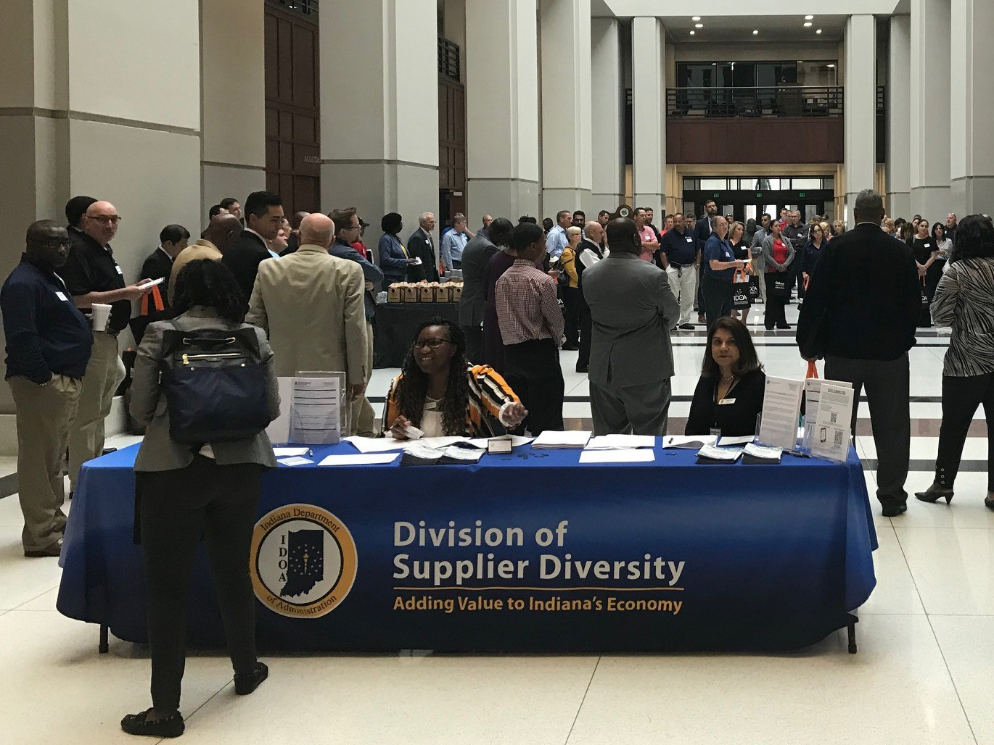
2019 “Presented by DSD”
4
Throughout the year the Division of Supplier Diversity participated in 73 different outreach based events, 22 of which were presented by DSD. The events that we hosted varied from webinars, to business conferences and workshops. By these efforts alone we have been able to connect with 475 attendees.
On the 3rd Wednesday of each month DSD host a certification webinar that walks attendees through the certification process. A certification specialist provides insightful information and highlights what common mistakes to avoid and tips for a smooth application process.
Each year, DSD hosts multiple business conferences across the State of Indiana. This year’s business conference theme – The Power of Now – focused on the opportunities and resources that business could take advantage of that would have an immediate impact on their businesses. The business conference was held in two cities this year, Hobart, IN and Indianapolis, IN. Combined, the conferences offered content at focused on the various areas of how to obtain area contracts and the importance of state certification. Each conference offered the opportunity to network and engage with the businesses that were in attendance.
This year, the Division hosted its inaugural Preparation Meeting Opportunity Workshop (PMO). This workshop is an unique initiative to help newly certified MBEs, WBEs and IVOSBs navigate through the State of Indiana contracting process. This program identified the fundamental information business owners need to know when actively pursuing a state contract as a contractor or subcontractor.
Financial Resources
Contracting Opportunities
MBE/WBE/IVOSB
Certification
Networking Opportunities

Slide 5
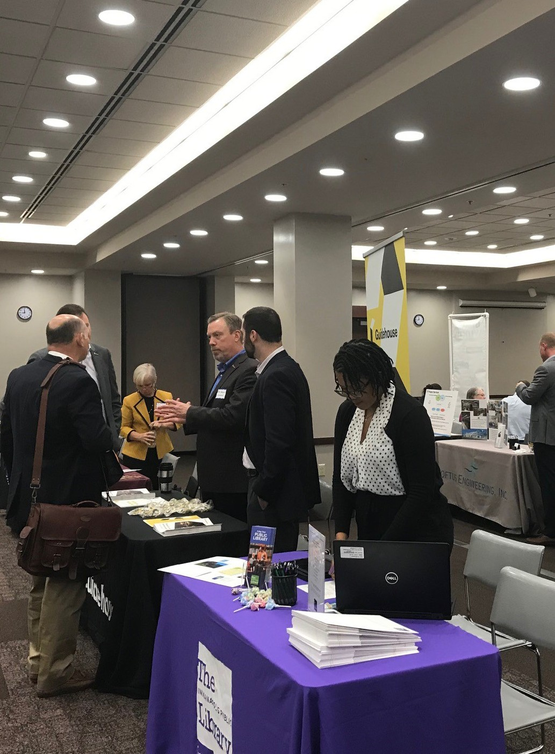
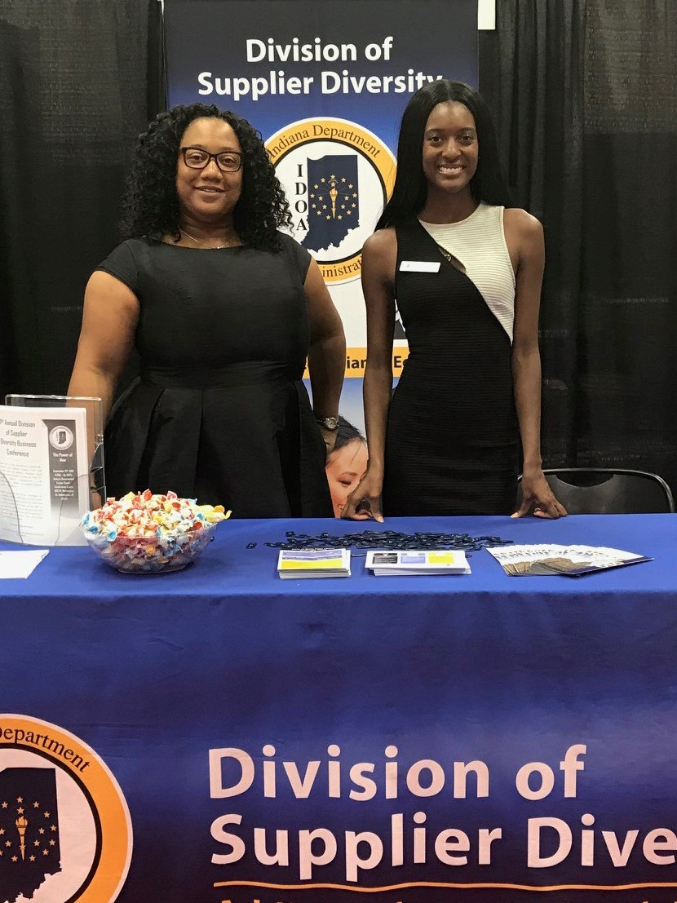
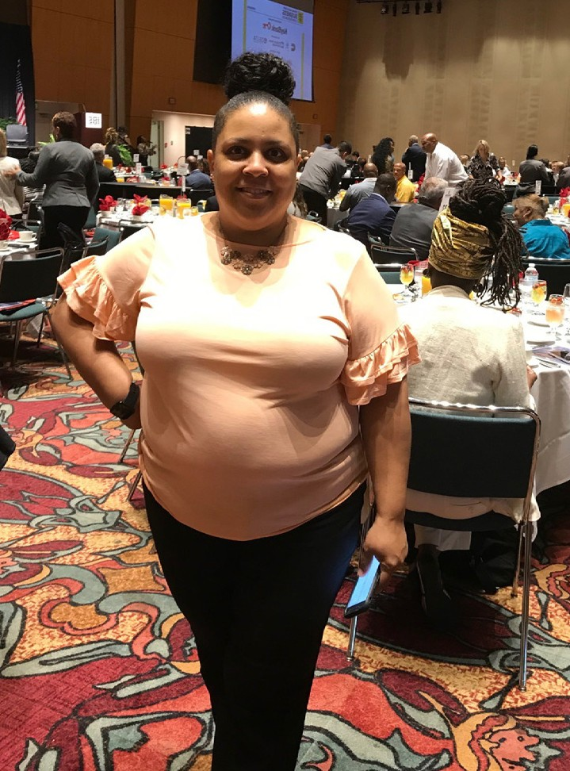
The Power of Partnerships
In order to magnify our outreach efforts, DSD partners with organizations and entities that have the same aspirations and share a similar goal to increase diversity and inclusion across Indiana.
5
Our corporate or community partnerships vary depending on each organization’s needs and/or event type. Over the years, the Division of Supplier Diversity has maintained existing and formed new partnerships with different organizations. Our partners support us through their sponsorship, collaborative planning on events, participation as a presenter, or as a vendor at our events. In return, we have been able to support them by participating in their events in various capacity.
Indiana Black Expo (IBE) Summer Celebration
In July, Indiana Department of Administration Division of Supplier Diversity participated in a series of events hosted by Indiana Black Expo for their Summer Celebration. Our participation included being a program sponsor for the IBE Mayor’s Breakfast and a table sponsor for the IBE Governor’s Reception. We also hosted the Business Opportunities with the State of Indiana workshop at the IBE State Day – Business Conference and took part in the three-day-long Indiana Black Expo Consumer Exhibition as a vendor.
Indiana Latino Expo (ILE)
Through the year, DSD had participated as a contributing sponsor to the community organization Indiana Latino Expo (ILE). ILE is a nonprofit statewide organization that represents a platform of opportunities for the Latino community. ILE supports various communities in creating awareness of their businesses, promoting economic development, cultural advancement, and educational opportunities. In 2019 DSD had been a sponsor and participant to their following events: ILE Mayor’s Breakfast, ILE Annual Expo, and the ILE Awards Gala. ILE is a pillar in the community for promoting diversity and inclusion and we are proud to call them our partners.
State Educational Institutions (SEI)
In 2018 the Governor’s Commission on Minority and Women Business Enterprises recommended that State Educational Institutes (SEIs) broaden their efforts to solicit MBE/WBE/IVOSB participation on their available contracts. As a result, members of the DSD team traveled to meet with all seven SEIs in order to individually address some of the challenges that they were facing and offer our support wherever possible. Of the seven, three SEIs – Ball State University, Indiana State University and Purdue University –reached out to include and partner with DSD on their outreach initiatives. DSD was able to participate as a vendor at each of their events.

Slide 6
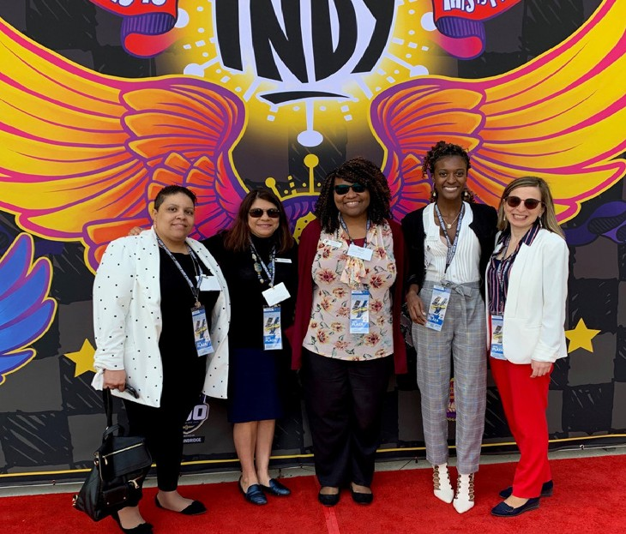
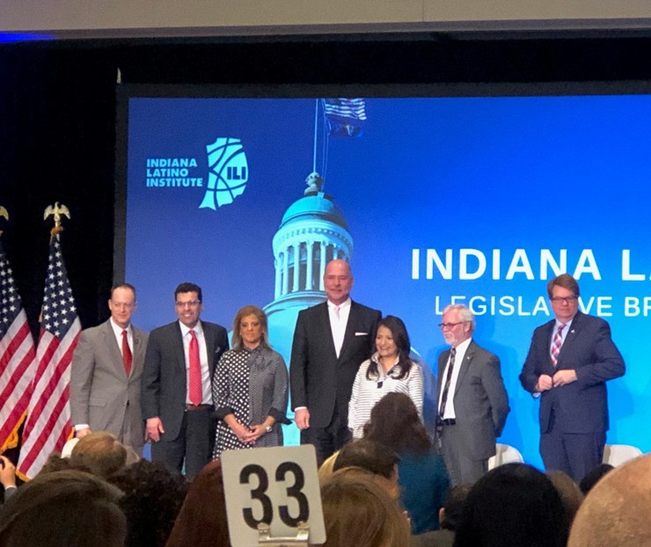
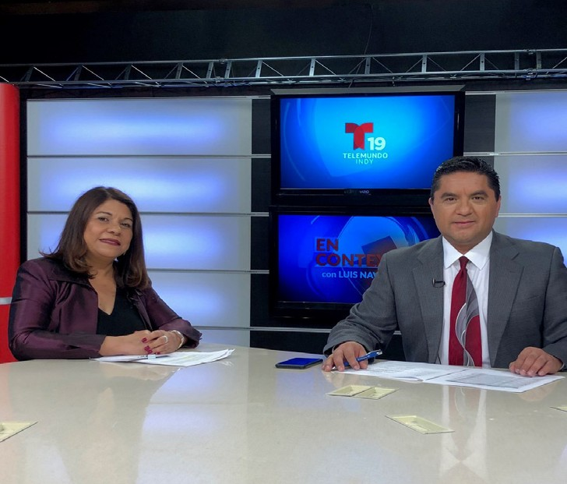
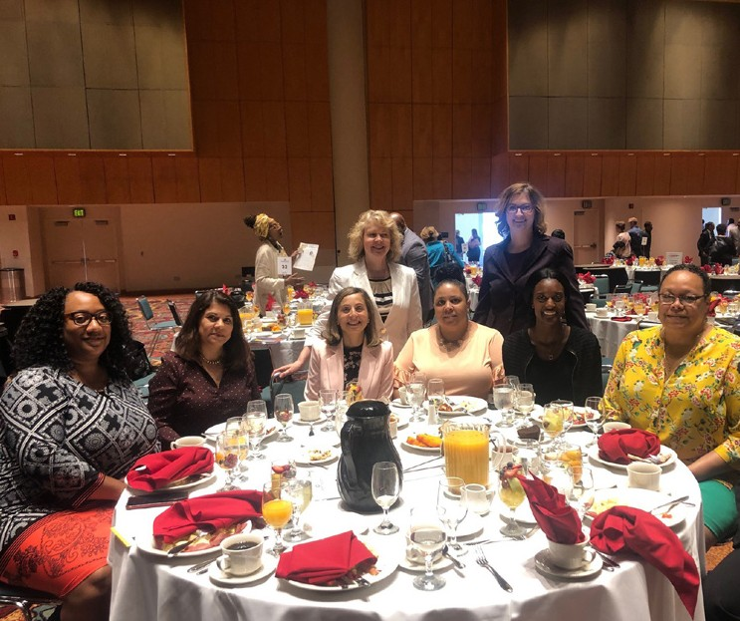
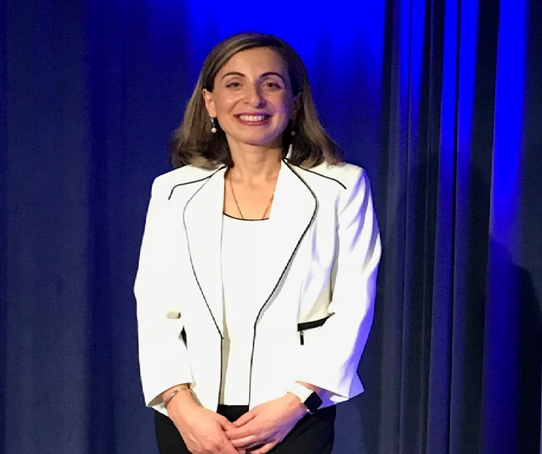
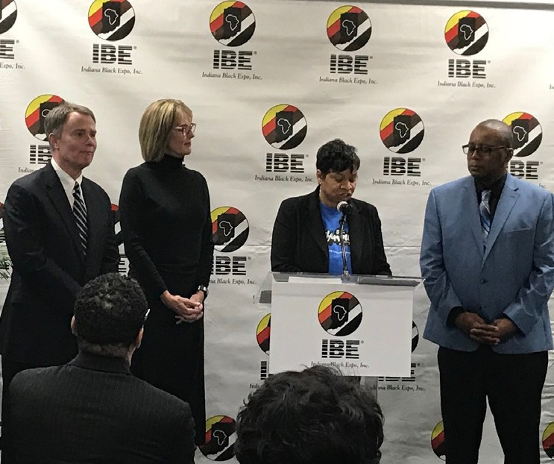
Out in the Field
6
Throughout 2019, DSD has participated in more than 51 external events across Indiana. Our involvement has been a presenter, panelist, exhibitor, sponsor or our support as an attendee.
Corporate and community partners whose events we have attended in 2019:
American Council of Engineering Companies (ACEC) Indiana
Asian American Alliance
Ball State University (BSU)
City of Indianapolis Office of Minority and Women Business Development (OMWBD)
Dak Foundation
Four Winds Casino
Great Lakes Women’s Business Council
Indiana American Water
Indiana Black Expo (IBE)
Indiana Civil Rights Commission (ICRC)
Indiana Latino Expo (ILE)
Indiana Latino Institute (ILI)
Indiana Small Business Development Center (ISBDC)
Indiana State Fair
Indiana State University (ISU)
Indianapolis Airport Authority (IAA)
Indianapolis Chamber
Indianapolis Urban League
IndyGo
Majestic Star Casino
National Association of Women Business Owners (NAWBO)
National Urban League
Purdue University (PU)
U.S. Small Business Administration (SBA)
Urban League of Northwest Indiana

Slide 7



Digital Developments
7
The Division of Supplier Diversity is inclusive in our measures to be as accessible as possible. Although we travel across the state to increase business engagement, we also have digital strategies and procedures in place for those who are still unable to attend our events. On our website, https://www.in.gov/idoa/mwbe, we are able to continue our outreach initiatives, to provide MBE/WBE/ IVOSBs with the resources needed to secure contracts, through the consistent and updated promotion of our services and events.
Our Business Opportunities page is updated weekly with new bid postings that are available from government agencies and other
external organizations. On our Events page, individuals can also access a list of our upcoming events, which include our business conferences and access to our monthly IDOA certification webinar.
As an additional measure, each week we send out emails to over 4,000 recipients and notify them of subcontracting and other contract opportunities with the State of Indiana and other organizations.
The Division of Supplier Diversity is also active on three popular social media platforms – Facebook, Instagram, and Twitter – where businesses are able to follow us and find out about our community involvement as it is happening.
Stay Connected. Follow Us on Facebook, Instagram, and Twitter!
@IDOA.MWBE
@Indiana_DSD
@Indiana_DSD

Slide 8







2020: Seeing the Big Picture
Division of Supplier Diversity 2020 Outreach Program
8
MBE WBE IVOSB
After reflecting on the engagement and opportunities that the Division of Supplier Diversity took to connect with diverse business owners, we found a few repetitive themes that remained most important: inclusion, connection and integrity. In 2020 we would like to take a step beyond what we have done in the past. Not only will we educate our market on the important technical components of supplier diversity but we will also incorporate the human components of business inclusion practices.
With the turn of the decade, we hope to change the perspective of our stakeholders, both direct and indirect, by taking a holistic approach to what it means to have valuable diversity practices. As an agency, we are responsible for monitoring the principals of supplier diversity through MBE/WBE/IVOSB certification and utilization. However, as a Division, we recognize that supplier diversity does not start, nor end, there. Through the function of outreach, we are able to help develop diverse businesses by being an advocate for inclusion and corporate integrity at all levels of a business. In 2020, we want to share the Big Picture of Diversity.
A Huge Thank You to the Division of Supplier Diversity 2019 Contributing Sponsors:
800.496.8101 WWW.SMILEPROMOTIONS.COM SMILESERVICE@SMILEPROMOTIONS.COM
If you would like to become a contributing sponsor, or learn more about how your business can directly support the Division of Supplier of Diversity, please email us at MWBE@idoa.in.gov or give us a call at 317-232-3061 for more information.

