Slide 1

A TRUSTED VOICE.
.
A TRUSTED VOICE.
Notes:
El Instituto Latino de Indiana, es una agencia sin fines de lucro dedicada pare servir la comunidad Latina en el estado de Indiana/The Indiana Latino Institute, Inc. (ILI), a 501(c)3 non-profit agency committed to serving Latino communities in the state of Indiana.

Slide 2
Agenda
Introduction of ILI
Federal Perspective
Obstacles for Indiana Latino Students
  Immigration Status
  Familial Barriers
  Lack of Financial Aid and Scholarship availability
  K-12 and Higher Education- lack of resources

Slide 3
ILI InTroductions

Slide 4

Our mission is to improve health and advance education for the Indiana Latino community through advocacy, research and innovative programs.
Notes:
The mission of the Indiana Latino Institute? Nuestra misión es mejorar la salud y avanzar la educación para la comunidad Latina en Indiana por medio de avocación, investigación, y programas innovadores.

Slide 5
Our Education Program
ILI Education Program
Make education a priority;
not an option
College Access
Case Management
Indiana Latino Education Summit
College Preparation Workshops
College Coaching
Women Reaching Higher
Peer to Peer Tutoring
Professional Development
Scholarships
Academic Scholarship
Community Service Scholarship
Paid Summer Internships
Internships
Job Fair
Resume Writing
For more information
Contact us at:(317) 472-1055 or ddavis@indianalatino.com

Slide 6
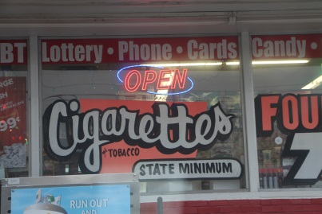

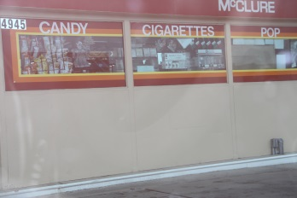

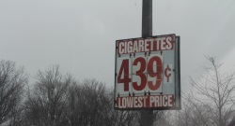
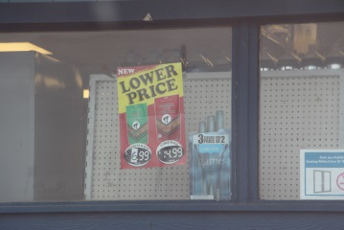
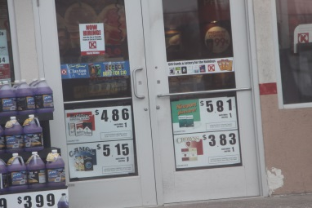

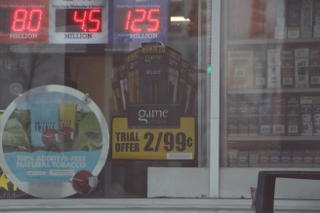
Tobacco Cessation and Prevention
Smoking rates in Latino middle students are nearly double that of African American and Caucasian youth
  High-schoolers have a higher rates of smoking
Why?

Slide 7
Federal Perspective

Slide 8
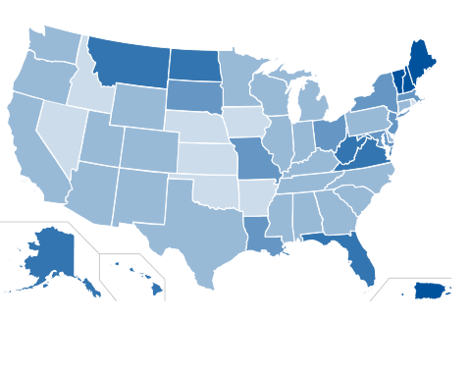
United States
K-12 Population: 22% is Latino
Total Population: 17% is Latino
Median Age: 27 for Latinos, compared to 42 for White non-Hispanics.
Degree Attainment
  20% of Latino adults (25 and older) had earned an associate degree or higher, compared to 36% of all adults.
Graduation Rate
  41% of Latino students graduated within 150% of program time for first-time, full-time freshmen, compared to 50% of all students.
Degree Attainment for Latino Students, 2011-2012:
  More than 30%
  26 to 30%
  21 to 25%
  16 to 20%
  15% or less
Source: based on Excellencia Education findings

Slide 9
Fast Facts: Latinos and Education in the U.S.
K-12
Hispanics are the largest minority group with the lowest degree attainment level in the U.S. public education system
Age
Latinos are much younger than the national and state populations
Median age- Latinos: 27 White: 42
Higher Education
20% of Latinos have a postsecondary degree compared to 36% of all U.S. adults
Latino youth represent 22% of the K-12 public school population
9% gap in degree attainment between Latino and White
Source: based on a press release from Excellencia Education

Slide 10
Obstacles for Indiana Latino Students in Higher Education
Immigration status
Familial barriers
Lack of scholarship and financial aid availability
K-12 and Higher Education- lack of resources

Slide 11
Immigration Status

Slide 12
Indiana Undocumented Immigrant Numbers are Decreasing
2009
100,000
2012
85,000
-15% Change
Decrease primarily due to US Recession
Students travel to states with more post-secondary education opportunities for immigration sensitive cases
Source: Pew Research Center estimates for 2009-2012 based on augmented American Community Service data . Key informant interviews-ILI

Slide 13
DACA (Deferred Action for Childhood Arrivals)
Under 31 by 06/15/12
Expanded DACA
Arrived to U.S. before age 16
Clean criminal record
DAPA (Deferred Action for Parental Accountability)
Parent of U.S. citizen or lawful permanent resident
Arrived to U.S. before age of 16
Continuously lived in U.S. since 06/15/12
Entered without inspection before 06/15/12
Currently in school, graduated or honorable discharge
Clean criminal record
Continuously lived in U.S. since 01/01/10
Present in the U.S. on 11/20/14 and since then
No current lawful immigration status
Currently in school or graduated
Pass background check
Application Fee: $465
Continuously lived in U.S. since 01/01/10
Present in U.S. on 11/20/14
No current lawful immigration status
Clean criminal record
Application Fee: $465
*uscis.gov

Slide 14
Number of DACA applicants
Total Applications
US- 465,509
Approved
US- 265,108
Ohio-
Approval Rate as of 03/22/13
US- 57.0%
Ohio-
Ohio-
IN- 6,041
IN- 2,350
IN- 38.9%
*Source: based on Brookings article

Slide 15
*Source: based on Brookings article

Slide 16
*Source: based on Brookings article

Slide 17
Familial Barriers

Slide 18
In 2012, 6.9% of U.S. K-12 students had at least one undocumented parent.
IN- 2.8% of K-12 students has at least one undocum
Excessive work commitments by undocumented parents
Cultural understanding of US education system
Low literacy rate (even in language of origin)
Dependence on children to translate.
Source: Pew Research Center estimates based on augmented American Community Service data

Slide 19
Financial aid and scholarships

Slide 20
State and Government Aid
U. S. citizens and eligible non-citizens
Private Scholarships
U.S. citizens, eligible non-citizens, DACA, Undocumented
In-State Tuition
U. S. citizens, eligible non-citizens, DACA(depends on university)

Slide 21
K-12 and Higher Education- lack of resources

Slide 22
Immigration
Bilingual/bicultural advocates
Cultural Competence

Slide 23
A TRUSTED VOICE.
Notes:
El Instituto Latino de Indiana, es una agencia sin fines de lucro dedicada pare servir la comunidad Latina en el estado de Indiana/The Indiana Latino Institute, Inc. (ILI), a 501(c)3 non-profit agency committed to serving Latino communities in the state of Indiana.

Slide 24
http://www.edexcelencia.org/sites/default/files/click_download/News%20Release-Latino%20College%20Completion%20in%2050%20States.pdf
http://www.uscis.gov/humanitarian/consideration-deferred-action-childhood-arrivals-process/ice-granted-daca-renewal-guidance
http://indianapublicmedia.org/news/unauthorized-immigrant-population-falls-indiana-74911/
http://www.pewhispanic.org/2014/11/18/unauthorized-immigrant-totals-rise-in-7-states-fall-in-14/ph_2014-11-18_unauthorized-immigration-02/
http://www.uscis.gov/humanitarian/consideration-deferred-action-childhood-arrivals-process.
http://www.nilc.org/dapa&daca.html
https://www.google.com/?gws_rd=ssl#q=what+is+an+itin+number

