Slide 1
Injury prevention advisory council (IPAC) & Indiana violent death reporting system (INVDRS) Meeting
05/06/2022

Slide 2
OUR MISSION:
To develop, implement and provide oversight of a statewide comprehensive trauma care system that:
Prevents injuries.
Saves lives.
Improves the care and outcomes of trauma patients
OUR VISION:
Prevent injuries in Indiana.

Slide 3
Round Robin and Introductions (in chat)
Name
Position
Organization/ Association
Updates
Current Projects and Programs
Upcoming events

Slide 4
Division Vacancies
  Drug Overdose Prevention Epidemiologist
  Community Outreach Coordinators - 2

Slide 5
Division Staff Updates
  Full-Time Staff
  Interns
  Naloxone Program Manager
    Laura Hollowell
  SUDORS Epidemiologist
    Sely-Ann Headley
  OD2A Program Coordinator
    Mariah Kirksey
  Trauma
    Sydney Plautz
    Alexis Stewart
  INVDRS
    Shannon Elliott

Slide 6
Grant Updates
  NVDRS 2022-2025 Application
    Requesting funds for another coroner minigrant cycle
  Expansion of Comprehensive Suicide
    Teaming with DMHA and Fatality Review Team
    The purpose is to implement and evaluate the comprehensive approach, with attention to one or more disproportionally affected populations, (e.g., veterans, rural communities, tribal populations, LGBTQ, homeless, other) that account for a significant proportion of the suicide burden and/or have suicide rates greater than the general population in a jurisdiction(s) (e.g., state, county, tribe).
  Naloxone – contact Laura Hollowell: LHollowell@health.in.gov
    FR CARA
    Local Health Department

Slide 7

Resource Guide App
Regularly Updated
Free download for iOS & Android
Phone & tablet capabilities
Available in Apple & Google Play stores

Slide 8
Upcoming Events
May
National Electrical Safety Month
National Water Safety Month
National Child Passenger Safety Technician Month
May 1: National Heatstroke Prevention Day
May 1-7: North American Occupational Safety and Health Week
June
National Safety Month
PTSD Awareness Month
June 3: National Gun Violence Awareness Day
July
Fireworks Safety Month
UV Safety Awareness Month
July 10-16: Operation Safe Driver Week

Slide 9
Mental health America Indiana
Kelby Gaw
Director of Communications and Marketing, Executive Assistant to the President

Slide 10
UNintentional injury data presentation:
Child passenger safety resources
Maria Cariaso
Injury Prevention Program Coordinator

Slide 11
What are injuries?
Injuries are NOT accidents
Accident: An unexpected occurrence, happening by chance
Injury:
  Definable & correctable event
  Specific risks for occurrence
    Examples: drinking and driving, biking without helmet, etc.

Slide 12
Car Crashes-The #1 Killer of Children
In the US:
  Motor vehicle injuries are a leading cause of death among children
  In 2019:
    608 children (12 years and younger) died as occupants in motor vehicle crashes, and more than 91,000 were injured
    Of children 12 years and younger, 38% were not buckled up

Slide 13
Child Passenger Safety (continued):
In 2019, 67% of fatally injured children riding with unbelted drivers were also unrestrained
Child restraint systems are often used incorrectly:
  Any where from 52% (AAA and National Safety Council) to 84% of child restraints show some sort of misuse

Slide 14
It is preventable
Keep child in backseat, rear-facing for as long as possible
Always check car seat owner’s manual
Always check vehicle owner’s manual
Height and weight requirements for each type of car seat varies per manufacturer (make, model, etc.) of car seat
Each car seat and vehicle are different

Slide 15
Resources in Indiana:
There are permanent fitting stations
Not “free” car seat clinic
  Must show financial need to qualify for seats
  Technicians will not let parent leave without proper seat
  Donations from parents
Car seat clinics, CPST classes, & booster bashes (all based within communities)

Slide 16
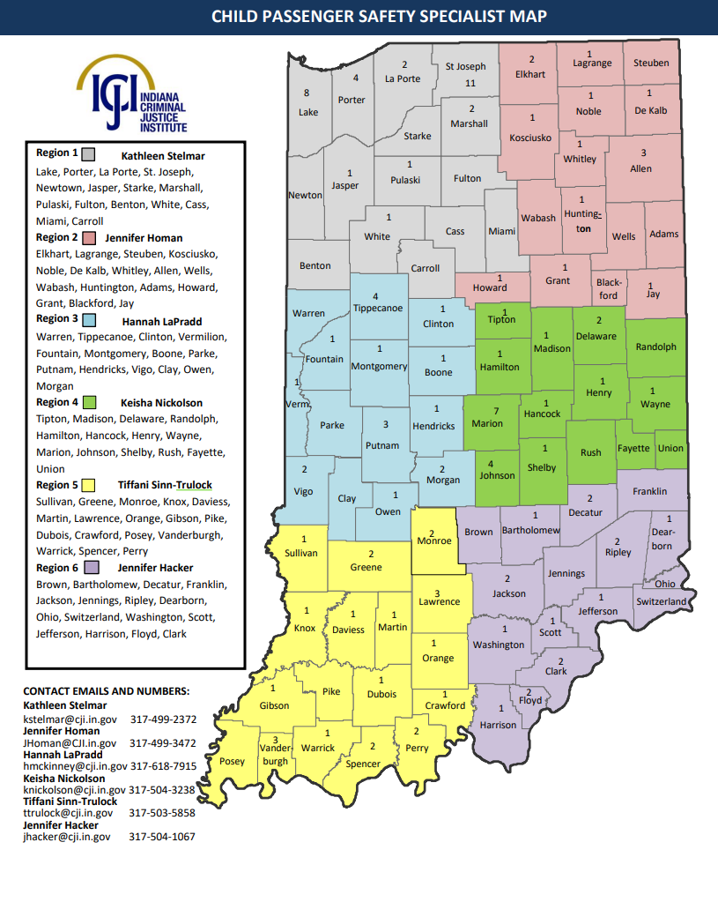

Slide 17
Additional Information:
How to become a fitting station:
    Indiana Criminal Justice Institute manages a network of child safety seat inspection stations
    Must be staffed by at least 1 CPST; Enter checks into the NDCF website
    Must provide replacement seats if necessary and report monthly activities to ICJI as well as provide a yearly expense report

Slide 18
Additional Information (Continued):
  Become a certified passenger safety technician:
  4-day course for a 2-year certification through Safe Kids Indiana.
  Fee of 95 dollars (scholarships available through Automotive Safety Program and IDOH)
    Courses all over Indiana
      http://cert.safekids.org/become-tech

Slide 19
National Child Passenger Safety Technician Month
Indiana Child Passenger Conference: May 04 and 05
Ivy Tech Community College (Indianapolis Zoo prior)
150-200 family attendees
All-day event

Slide 20
Websites to visit for helpful info:
Order free brochures on child passenger safety:
http://www.preventinjury.org/Brochures
More information on child passenger safety:
  https://www.safekids.org/child-passenger-safety
Find a technician:
  http://www.preventinjury.org/Child-Passenger-Safety/Child-Safety-Seat-Inspection-Stations/List-of-Child-Safety-Seat-Inspection-Stations
Check for recall:
  https://www.safercar.gov/parents/CarSeats/Car-Seat-Registration.htm?view=full

Slide 21
Unintentional injury data presentation:
Unintentional Injury Death in Indiana
Emma Heltzel
Injury Prevention Epidemiologist

Slide 22
Cause of Injury-Related Deaths in Indiana - 2020

Slide 23
Cause of Unintentional Injury-Related Deaths in Indiana - 2020

Slide 24
Rate of Unintentional Injury Deaths in Indiana by Age Group -2020

Slide 25
Unintentional Drug Poisoning Deaths in Indiana by Sex - 2020

Slide 26
Rate of Unintentional Drug Poisoning Deaths by Age Group in Indiana - 2020

Slide 27
Rate of Unintentional MVA Deaths in Indiana by Sex - 2020

Slide 28
Rate of Unintentional Fall Deaths by Sex - 2020

Slide 29
Rate of Unintentional Older Adult Fall Deaths in Indiana - 2020

Slide 30
Discussion
What do we, in Indiana, do well when it comes to the topics from today?
How can / where can we improve this?

Slide 31
2022 Meeting Dates
August 5
November 4

Slide 32
THANKS!
Presenter | Phone | Email
Morgan Sprecher | 812-929-3069 | msprecher@isdh.in.gov
Emma Heltzel | 317-234-3265 | eheltzel@isdh.in.gov

