Slide 1


Injury Prevention Advisory Council (IPAC) and Indiana Violent Death Reporting System (INVDRS) Meeting
Friday, July 17, 2020

Slide 2


Trauma and Injury Prevention Mission
To develop, implement and provide oversight of a statewide comprehensive trauma care system that:
Prevents injuries.
Saves lives.
Improves the care and outcomes of trauma patients.

Slide 3
Trauma and Injury Prevention Vision
Prevent injuries in Indiana.

Slide 4

Round Robin and Introductions
Name
Position
Organization/ Association
Updates
Current Projects and Programs
Upcoming events
@INDTrauma #SafetyIN
Notes:
Name
Organization/Association
Injury Prevention topic areas
IP events or programming with organization
Upcoming events hosted by organization
Remind that we are on twitter so please follow and connect with us!

Slide 5
Invite New Members
Please forward my contact information to colleagues interested in violence & injury prevention!

Slide 6

Resource Guide App
UPDATED!
Free download for iOS & Android
phone & tablet capabilities
Available in Apple & Google Play stores
Notes:
We’re updating!

Slide 7

ISDH Updates

Slide 8
Grant Activities
Students Teachers and Officers Preventing (STOP) School Violence
Submitted in June
Notes:
Stop= the Bureau of Justice Assistant’s STOP School Violence Grant Program is designed to improve school security by providing students and teachers with the tools they need to recognize, respond quickly to, and help prevent acts of violence

Slide 9
Upcoming Events
Online Suicide Prevention Summit
August 29-30
https://www.mentalhealthacademy.net/suicideprevention/aas

Slide 10
ISTCC/ITN Meeting Dates
Indiana State Trauma Care Committee, Indiana Government Center, 10 am EST
August 21st
October 16th
December 11th
Indiana Trauma Network, Indiana Government Center, 12:30 pm EST
August 21st
October 16th
December 11th

Slide 11
IPAC/INVDRS Meeting Dates
September 18th
November 20th

Slide 12
Unintentional Injury Program Spotlight: WARN Program
Jerry Richert, Indianapolis Fire Department, jerry.richert@indy.gov

Slide 13
Unintentional Injury Data Presentation: Drowning Fatalities in Indiana
Veronica Daye, Injury Prevention Epidemiologist
Trauma and Injury Prevention Division
Email questions to: Indianatrauma@isdh.in.gov

Slide 14
Drowning Deaths
Unintentional drowning is a leading cause of unintentional injury deaths for individuals under the age of 55
Indiana experiences over 65 drowning deaths per year

Slide 15
Drowning Deaths by Location (2016-2018)
238 deaths over the three years
District 5 had the highest amount of deaths
Marion County had the most deaths (41)
Counties with over 10 drowning deaths:
Allen Co. had the second highest deaths (15)
Hamilton Co. had 14 deaths
Lake Co. had 10 drowning deaths

Slide 16
Drowning Deaths by Month (2016-2018)
The summer months account for nearly half of all drowning deaths with July have the highest count

Slide 17
Demographic Variables (2018)

Slide 18
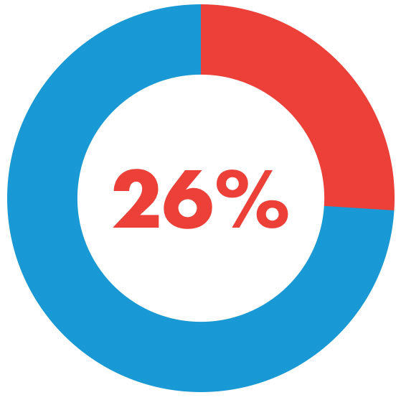

Drowning Deaths and Poisonings (2018)
For those over 18, 26% had a drug-related or alcohol-related poisoning as a contributing cause of death

Slide 19
Contact information
Veronica Daye
Injury Prevention Epidemiologist
Trauma and Injury Prevention Division
317.234.4943 (office)
vdaye@isdh.in.gov
Email questions to: Indianatrauma@isdh.in.gov

Slide 20

National Violent Death Reporting System (NVDRS) Overview
Division of Violence Prevention
Kameron Sheats, PhD
NVDRS Science Officer
INVDRS Advisory Committee Meeting
July 17, 2020
The findings and conclusions in this report are those of the authors and do not necessarily represent the official position of the Centers for Disease Control and Prevention.

Slide 21


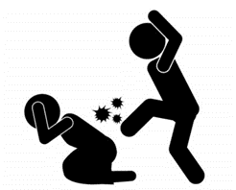



What Do We Know About Violence?
Number of violent deaths only tells part of story
Millions of people experience adverse physical, mental, and economic consequences
Violence erodes communities by reducing productivity, decreasing property values, and disrupting social services
Devastating impact on families, communities, and society
Violence is preventable
Information needed for prevention

Slide 22
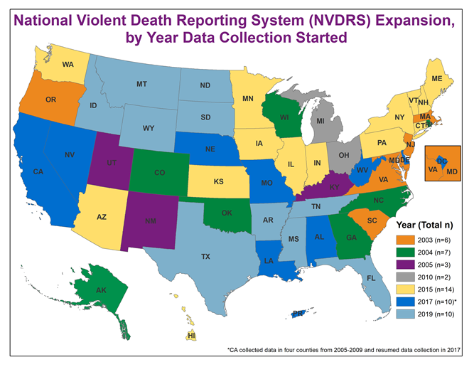
*Each VDRS program operates out of the state health department or through a bona fide agent

Slide 23

NVDRS
Data collected by states and territories through partnerships
No personally identifying information collected in system
Information collected using a web-based application
Trained abstractors enter data consistent with CDC guidance
Provides information for prevention

Slide 24

NVDRS Case Definition
Suicide
Homicide
Deaths of undetermined intent
Legal intervention (excluding executions)
Unintentional firearm deaths

Slide 25









Death Certificates
LE Reports
C/ME Reports
600+ variables
Injury characteristics Demographics Circumstances Mental Health Diagnoses Toxicology

Slide 26

NVDRS is Unique
It is a partnership between states, data providers and CDC
Tells the who, what, when, where, why, and how
Is comprehensive - includes all age groups
Combines sources to get full picture
Details about incident
Information about victims, suspects
Information about circumstances: events that preceded or were determined to be related to the violent death

Slide 27
Technical Assistance

Slide 28


Support to VDRS Recipients Through NVDRS Technical Assistance – A Team Effort!
CDC has a series of technical manuals (e.g., implementation Manual, coding manual, web-based system guide)
NVDRS abstractors receive training
Each VDRS program has a CDC Project Officer (PO) and Science Officer (SO)
Monthly calls with all states and CDC
Individual calls with PO/SO, ad-hoc calls, e-mails
Monitoring of project performance
Monthly coding workgroup calls with states
Help Desk (e-mail)
Reverse Site Visit Annual Meeting
NVDRS listserve
Monitoring of Data Quality

Slide 29
Data Dissemination Examples

Slide 30

Who uses NVDRS data?
Local, state, national violence prevention officials
Public health community
Healthcare providers
Vital Statistics programs
Law enforcement
Coroners/medical examiners
Schools of medicine, psychology, public health, sociology
Other stakeholder groups

Slide 31

NVDRS Journal Supplement
First NVDRS Supplement Second NVDRS Supplement
Published in December 2006 Published in October 2016

Slide 32

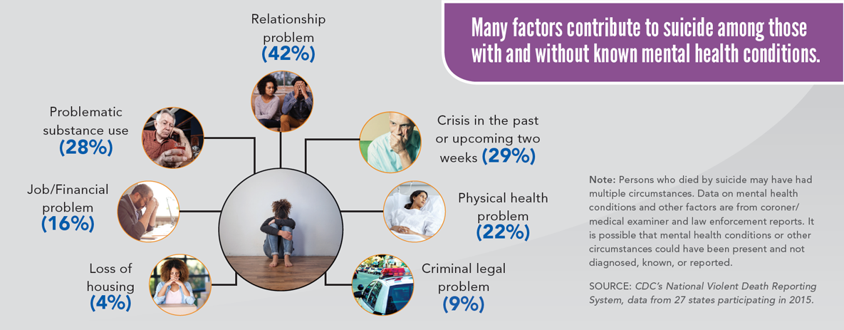
Factors Contributing to Suicide

Slide 33

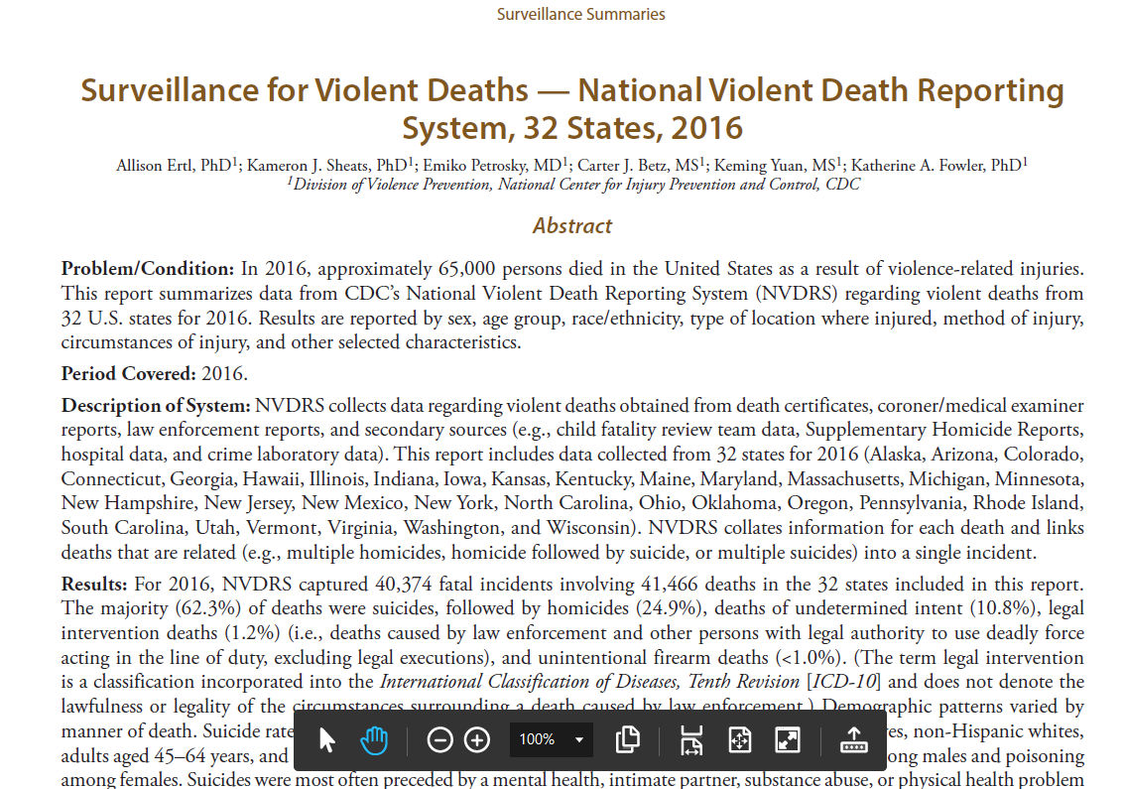
NVDRS MMWR Surveillance Summary

Slide 34



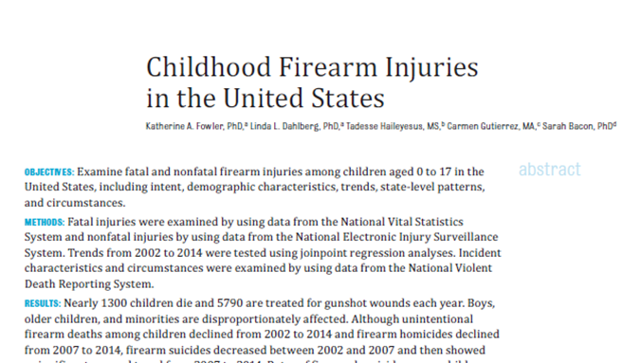





Childhood Firearm Injuries

Slide 35


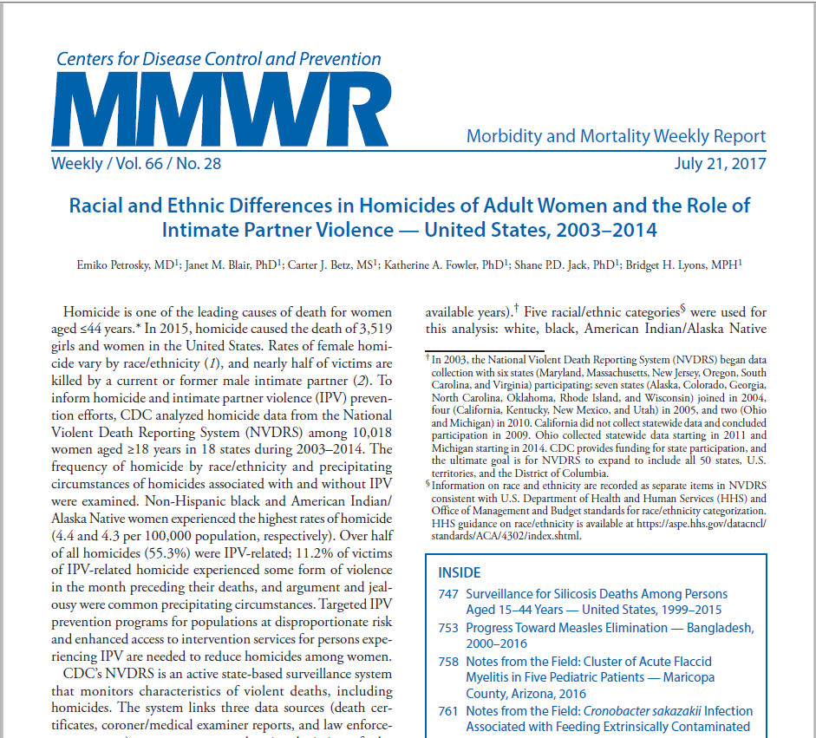

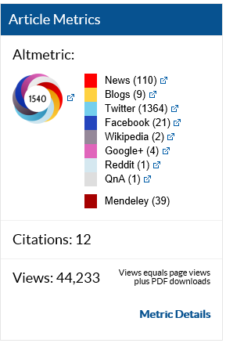

Homicides of Women MMWR (A Top 10 MMWR of 2017)

Slide 36
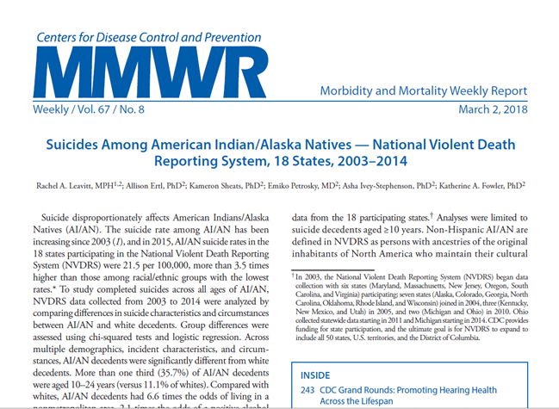
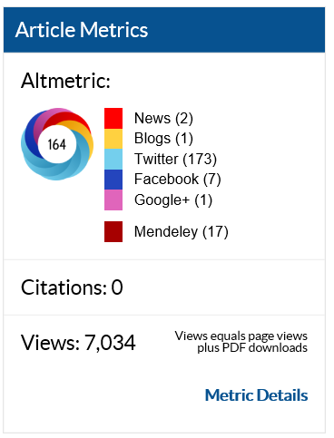
Suicides Among American Indian/Alaska Natives

Slide 37
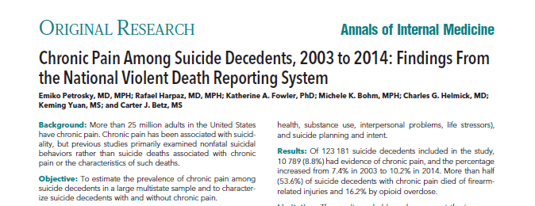
Chronic Pain and Suicide

Slide 38

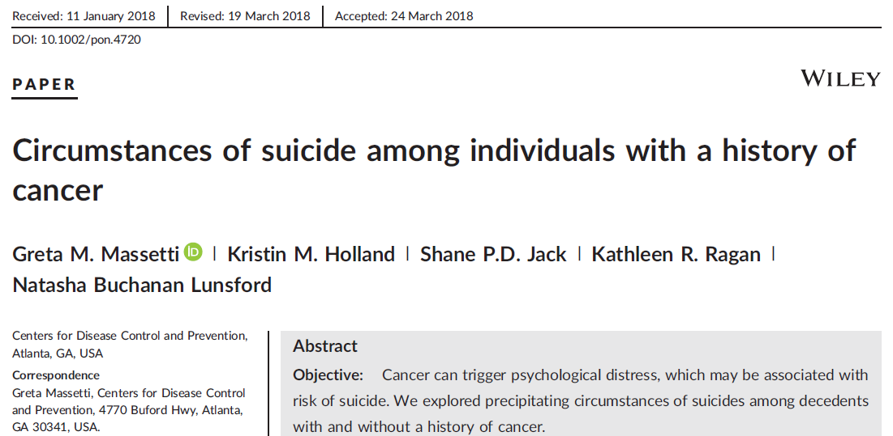
Cancer and Suicide

Slide 39
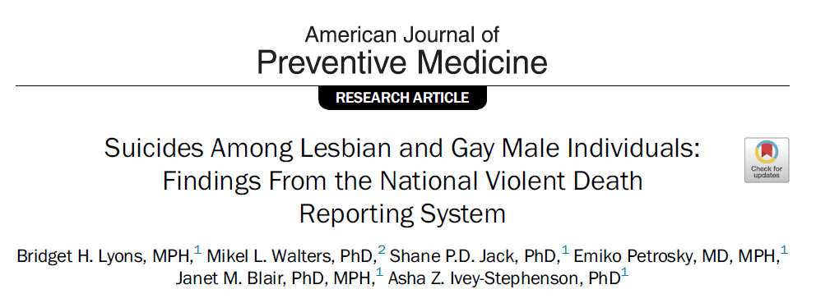
Suicides among Lesbian and Gay Individuals

Slide 40
Using VDRS Data for Prevention

Slide 41

How are NVDRS data used?
Inform communities
Document circumstances
Who, what, when, and where?
Insight as to why
Guide and target violence prevention programs, policies, and practices
Support planning and implementation of activities at the local, state, and federal levels
Monitor and evaluate prevention programs and strategies

Slide 42

Data Supports Suicide Prevention
Rhode Island
Data used to provide an overview of the epidemiology of youth suicide
Mental health issues often precipitated suicides
Information used to inform communities on signs and risks of suicide

Slide 43
Data Supports Suicide Prevention
Oregon
Data indicated need to target older adults
Developed state suicide prevention plan and targeted prevention efforts on older adults
Over 1/3 of decedents had visited a physician in the last 30 days of their life
Suggested that training physicians could be a promising approach

Slide 44
Suicides of Active Duty Military and Veterans
Alaska
Using VDRS data to identify veteran suicides and the circumstances involved
Working with the Alaska Veteran Affairs (VA) suicide prevention program
Information will be used to develop policies, intervention and prevention strategies

Slide 45
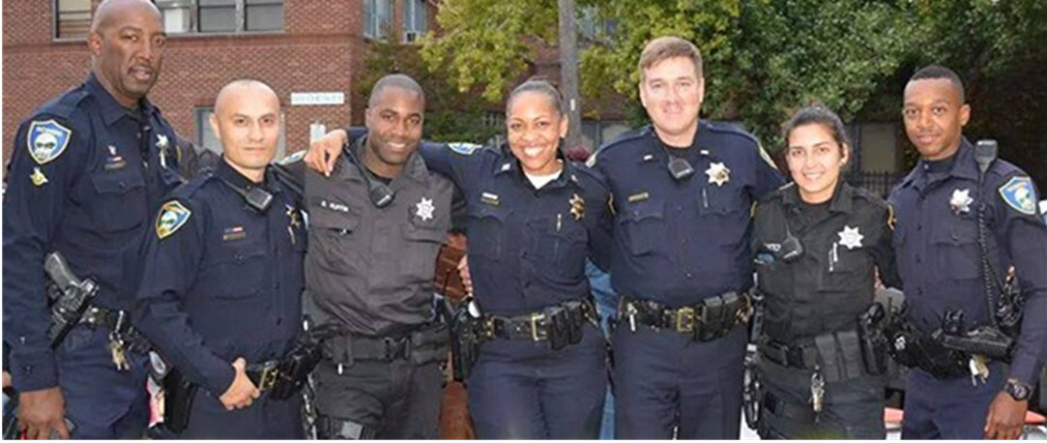
How can the system benefit Law Enforcement?

Slide 46
Law Enforcement-Related Analyses Using NVDRS
Published in the American Journal of Preventive Medicine
Occupational Homicides of Law Enforcement Officers, 2003-2013 (Blair JM, Fowler KA, Betz CJ, et al. )
Deaths Due to Use of Lethal Force by Law Enforcement, 17 States, 2009-2012 (DeGue S, Fowler KA, Calkins C.)
What these papers add:
NVDRS can address timely topics
Lethal force study first to examine characteristics using a multi-state system
Information for prevention and action

Slide 47
Using Mapping for Law Enforcement
Geographic analysis can help reveal patterns of violent death
More effective deployment of law enforcement
Better use of public safety resources
Stronger, targeted crime policies
Greater understanding of crime
Guide and target violence prevention efforts
Create healthier, safer communities

Slide 48
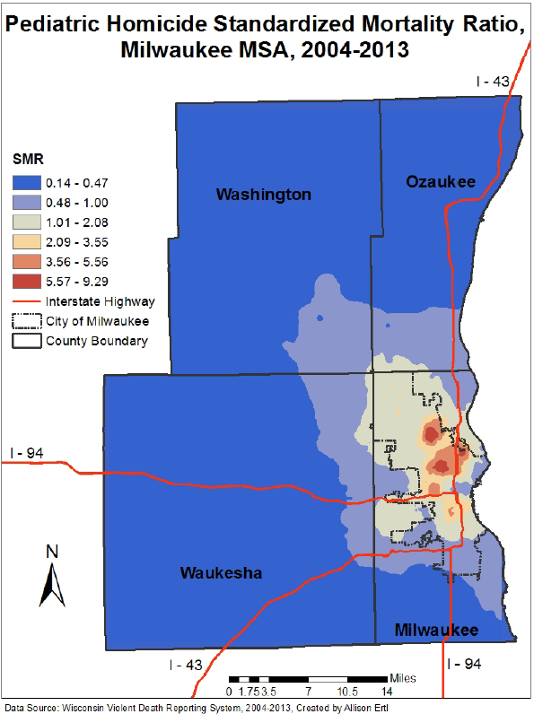
NVDRS in Action: Map from the WI Violent Death Reporting System

Slide 49
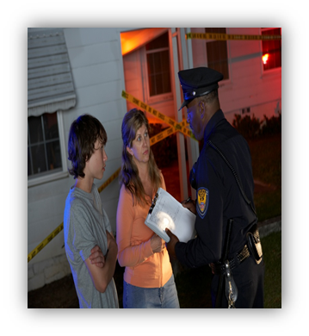
Data Supports Homicide Prevention
Oklahoma
Tested intervention for police officers responding to domestic violence calls
Data used to secure support for implementation and evaluation of the intervention
VDRS data on intimate partner homicides included in the final report of the National Institute of Justice, Police Departments' Use of the Lethality Assessment Program: A Quasi-Experimental Evaluation https://www.ncjrs.gov/pdffiles1/nij/grants/247456.pdf

Slide 50
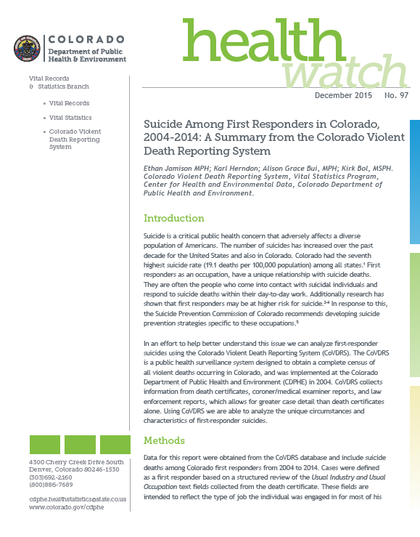
Suicides Among First Responders
Colorado
First responders (law enforcement, fire, EMS) more likely to have been a veteran than general population of suicide decedents
Raises issues about needs veterans may have as they transition from one high-stress position to another
Acknowledges needs of veterans continuing work as first responders
Prevention can focus on positive mental and physical health

Slide 51

NVDRS Brings Together Data Sources to Inform Law Enforcement and Public Health
Allows law enforcement to have a comprehensive view of violent deaths
CDC and VDRS programs have ongoing relationships with LE partner organizations and work with LE partners
Work with LE partners to enhance access and availability of quality data

Slide 52
Future Directions
NVDRS requires continued efforts to build and maintain relationships with stakeholders, including LE
LE officers have been helpful with NVDRS
Retired LE officers who provide expertise as abstractors
Serve as liaisons to help states get reports
Each VDRS program is required to have an Advisory Board
Talk to people in your state: we can help you identify partners
Collaboration can lead to the development of programs that can ultimately reduce violent deaths

Slide 53
Access to NVDRS Data

Slide 54

NVDRS WISQARS Data – Available to Public
Public access on the Web
http://wisqars.cdc.gov:8080/nvdrs/nvdrsDisplay.jsp
2017 NVDRS WISQARS data released Select variables to run your own reports
Manner of death
Victim/suspect relationship
Weapon type
Vulnerable populations
Circumstances

Slide 55

NVDRS Restricted Access Database (RAD)
For researchers who meet established criteria
Opportunity to conduct analyses using NVDRS data
Data available as a flat file to promote ease of use and analysis
More information available at the NVDRS RAD website:
https://www.cdc.gov/violenceprevention/nvdrs/rad.html

Slide 56
Acknowledgments
NVDRS Grantees
Vital Statistics, Coroner/Medical Examiner,
and Law Enforcement staff in NVDRS States
Surveillance Branch, Office of the Chief
Kathleen McDavid Harrison PhD MPH FACE,
Surveillance Branch Chief
Leroy Frazier Jr. MSPH CHES,
Surveillance Branch Deputy Chief
Mortality Surveillance Team/Surveillance Coordination Team
Apreal Bailey MPH, Project Officer
Jamar Barnes MPH, Project Officer
Carter Betz MS, Programmer/Analyst
Janet Blair PhD MPH, Team Lead
Craig Bryant, Computer Scientist
Scott VanHeest, IT Specialist
Jacqueline Crain, Public Health Advisor
Shane Davis Jack PhD, Science Officer
James Diggs MPH CHES, Public Health Advisor
Kristiana Dixon PhD, ORISE Fellow
Allison Ertl PhD Science Officer
Katherine Fowler PhD, Senior Scientist
Bernita Frazier PhD MPA, Public Health Advisor
Asha Ivey-Stephenson PhD, Science Officer
Rachel Leavitt MPH, ORISE Fellow
Colby Lokey MPH, Project Officer
Michele LaLand Project Officer
Bridget Lyons MPH, Science Officer
Emiko Petrosky MD, MPH, Science Officer
Lennisha Pinckney, MPH ORISE Fellow
Kameron Sheats PhD, Science Officer
Rebecca Wilson PhD, Science Officer
Keming Yuan MS, Mathematical Statistician

Slide 57
Thank you!

Slide 58
Intentional Injury Data Presentation: Finalized 2018 Data
Morgan Sprecher, INVDRS Epidemiologist

Slide 59
2018 Death Types
PDO: 1,123
Suicide: 1,079
Homicide: 497
Undetermined: 95

Slide 60
2018 PDO Demographics
Male
Frequency
Female

Slide 61
2018 PDO Toxicology
Notes:
Only 10% of these overdoses lead to a hospital admittance

Slide 62
2018 PDO Circumstances
Notes:
Only 10% of these overdoses lead to a hospital admittance

Slide 63
2018 Suicide Demographics
Frequency
Male
Female

Slide 64

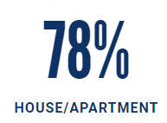
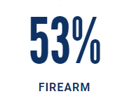

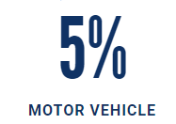
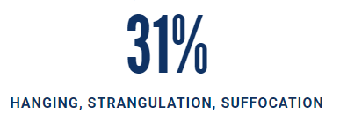
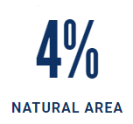
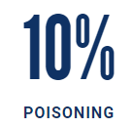
Location of Death
Type of Weapon

Slide 65
2018 Suicide Circumstances

Slide 66
Contact Information
Morgan Sprecher, INVDRS Epidemiologist
Trauma and Injury Prevention Division
317.233.9825 (office)
msprecher@isdh.in.gov
Email questions to: Indianatrauma@isd.in.gov

Slide 67
Thanks for joining!
Feel free to invite new attendees for the next meeting on September 18th!

