Slide 1
Indiana Violent Death Reporting System (INVDRS) Advisory Board Meeting July 20, 2018
Morgan Sprecher
INVDRS Epidemiologist
Division of Trauma and Injury Prevention
Email Questions: INVDRS@isdh.in.gov
Notes:
Welcome

Slide 2
INVDRS@isdh.in.gov
Email Questions: INVDRS@isdh.in.gov
Notes:
Please send your name, title, and organization to this email if you’re joining us via webcast.

Slide 3
Agenda
Introductions
Program Updates
INVDRS Updates
New hires
Toxicology Program Overview
Interpersonal Violence Prevention Tools & Programs
Coroner Case Management System demo
Additional Discussion
Email Questions: INVDRS@isdh.in.gov

Slide 4
Introductions
Email Questions: INVDRS@isdh.in.gov

Slide 5
Introductions & updates
Name
Title
Organization
Program Updates
Email Questions: INVDRS@isdh.in.gov
Notes:
We can start by going around the room and say your name, your title and organization

Slide 6
ISDH Updates
Email Questions: INVDRS@isdh.in.gov

Slide 7
New state health commissioner: Dr. Kris Box

Slide 8
New ISDH Staff
INVDRS Epidemiologist
Morgan Sprecher
Records Consultants
Welcome back Meghan!
DeAngela Hall
Carrie Bennett
Injury Prevention Epidemiologist
Jeremy Funk
Email Questions: INVDRS@isdh.in.gov

Slide 9
2018 meeting dates
1 p.m.-3 p.m. EST in Rice Auditorium
September 21st
Email Questions: INVDRS@isdh.in.gov
Notes:
For those of you who are on IPAC and INVDRS AB, the IPAC meetings will be on the same day from 10-12

Slide 10
Reports available at:
http://www.in.gov/isdh/25396.htm
Email Questions: INVDRS@isdh.in.gov
Notes:
The 2017 Suicide Report along with other resources are available here

Slide 11
Grant activities
NVDRS
Continuation application (year 5 of 5)
Prescription Drug Overdose: Prevention for States
Continuation application (year 3 of 3)
Enhanced State Surveillance of Opioids
Continuation application (year 2 of 2)
*NEW* Administration for Community Living – Traumatic Brain Injury State Partnership Program
Partnering with Dr. Lance Trexler at the Rehabilitation Hospital of Indiana
Email Questions: INVDRS@isdh.in.gov
Notes:
We’ve had quite a busy spring! Katie will explain these

Slide 12
2018 IPAC Meetings
Meetings: 1 p.m. – 3 p.m. EST
July 20 (webcast)
September 21
Midwest Injury Prevention Alliance (MIPA) Summit
November 29 & 30
Focusing on violence prevention
Email Questions: INVDRS@isdh.in.gov
Notes:
The 2018 dates for IPAC are as follows:
July 20, 2018 (webcast)
September 21, 2018
November 29 and 30, 2018

Slide 13
UNDERSTANDING OPIOID USE DISORDER
Outreach Presentation
Notes:
The Opioid Crisis has had a devastating impact on the entire state of Indiana.
Many people who struggle with opioid dependency face a wide range of stigmas that are preventing them from seeking treatment. We don’t want them to become an opioid overdose statistic.

Slide 14
#KnowTheOFacts
Notes:
It is important to understand that opioid use disorder is a disease
By increasing one’s understanding of opioid use disorder as a disease – it will help to limit bias and stigma associated with addiction.

Slide 15
#KnowTheOFacts
Notes:
By understanding and acknowledging the disease – the barriers to seeking and accessing treatment are reduced.
For example, when a person has diabetes, it is understood that this is a disease that can be treated.
In the same manner, a person with opioid use disorder can obtain treatment for this disease.
There is treatment for opioid use disorder and people need to be aware of this.

Slide 16
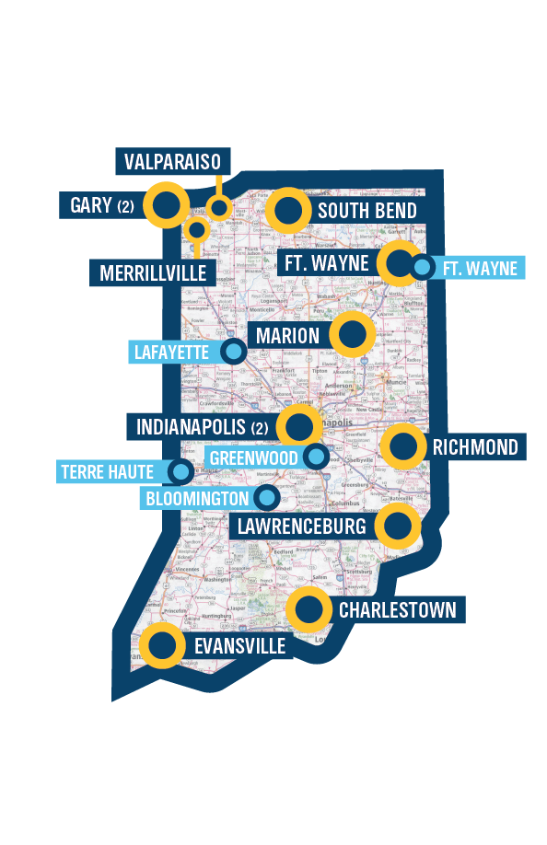
Opioid Treatment Programs in Indiana > Currently 13 > 5 more planned in 2018
#KnowTheOFacts
Notes:
Currently Indiana has 13 Opioid Treatment Programs (OTPs)
In 2018, 5 new OTPs are opening:
Fort Wayne / Allen County
Lafayette / Tippecanoe County
Terre Haute / Vigo County
Greenwood / Johnson County
Bloomington / Monroe County
Optional note as of 1/19/18: Proposed legislation would give Division of Mental Health and Addiction (DMHA) the authority to certify an additional 9 locations.

Slide 17
#KnowTheOFacts
Notes:
By understanding and acknowledging the disease – the barriers to seeking and
accessing treatment are reduced.
And with treatment comes the hope of recovery.
Hoosiers need to know that recovery is possible.

Slide 18
UNDERSTANDING OPIOID USE DISORDER
KnowTheOFacts.org
©2018

Slide 19
Upcoming Events
National Heatstroke Prevention Day, July 31
Back to School Safety Month, August
Safe + Sound Week, August 13-19
Drive Sober or Get Pulled Over, Aug. 17- Sept. 3
Infant Mortality Month, September
National TBI Awareness Month, September
Suicide Prevention Week, Sept. 9-15
Email Questions: INVDRS@isdh.in.gov

Slide 20
Upcoming Events
Child Passenger Safety Week, Sept. 23-29
Fall Prevention Week, Sept. 23-28
National Seat Check Saturday, Sept. 29
Teen Driver Safety Week, Oct. 21-27
Domestic Violence Awareness Month, October
International Survivors of Suicide Loss Day, Nov. 17
2018 Midwest Injury Prevention Alliance Summit, Nov. 29-30
Email Questions: INVDRS@isdh.in.gov

Slide 21
Data Provider Progress
Email Questions: INVDRS@isdh.in.gov

Slide 22
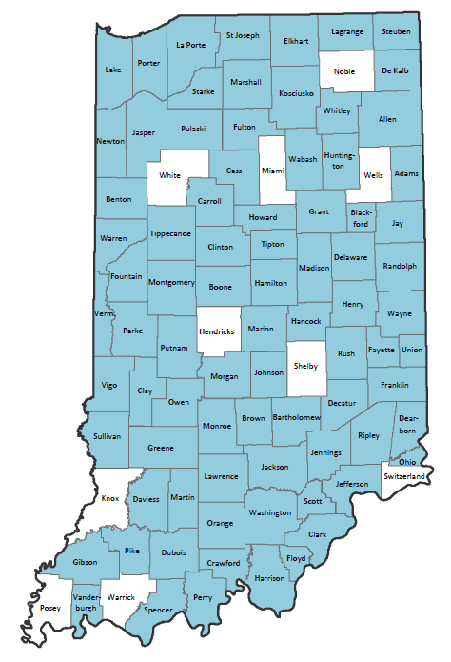
Coroners
82 signed data sharing agreements
Questions/Comments: Joboyle@isdh.in.gov
Notes:
We have added 7 counties since September 2017: Warren, Vigo, Sullivan, Vanderburgh, Jefferson, Jennings, and Owen

Slide 23
Coroners Not Participating
Hendricks
Knox
Miami
Noble
Shelby
Posey
Switzerland
Warrick
Wells
White
Please contact: JOboyle@isdh.in.gov
Email Questions: INVDRS@isdh.in.gov
Notes:
John is having difficulties getting in contact with the coroners from these counties. We are asking anyone in the AB who knows any of these individuals to please put them in contact with John.

Slide 24
Coroner Challenges
Coroners Signed DSA But Not Sending Reports
Brown - Carroll - Clinton
Dekalb - Floyd - Grant
Henry - Knox - Kosciusko
Madison - LaPorte - Marshall
Morgan - Orange - Parke
Pike - Pulaski - Randolph
Union - Wabash
Email Questions: INVDRS@isdh.in.gov
Notes:
White County Coroner, SD and Monticello PD are not participating

Slide 25
Law Enforcement Challenges
LE Agencies Not Participating in INVDRS
Monticello PD (15)
Elkhart County SD (58)
Goshen PD (30)
Cass County SD (9)
Gibson County SD (15)
Harrison County SD (38)
Decatur County SD (11)
Vevay PD (9)
Salem PD (21)
Wayne County SD (43)
Mishawaka PD (66)
Montgomery County SD (15)
New Albany PD (49)
Starke County SD (39)
Steuben County SD (19)
St. Joseph Cty SD (68)
Greencastle PD (8)
Email Questions: INVDRS@isdh.in.gov
Notes:
Number of Cases Needed for 2017-2018 Listed in Parenthesis

Slide 26
Successes
45 Coroner DSA’s in January 2017 to 82 today
Elkhart County Coroner is participating and we have already received their reports
Indiana State Police are participating and we have received some records
Email Questions: INVDRS@isdh.in.gov

Slide 27
Data Abstraction & Records Collection
Email Questions: INVDRS@isdh.in.gov

Slide 28
Data Availability and Deadlines
Data Year | Death Certificate Data | Complete INVDRS Data-CDC Deadline
2016 | Sept. 2017 (prelim), January 2018 (final) | June 2018
2017 | Sept. 2018 (prelim), January 2019 (final) | June 2019
Etc.
Email Questions: INVDRS@isdh.in.gov
Notes:
We successfully submitted 2016 data and working on 2017 currently.

Slide 29
2016 Records Collection
Coroner Reports Received: 90.8%
LE Reports Received: 95.2%
Coroner Reports Received: 97.6%
LE Reports Received: 89.8%
2015 Records Collection
Email Questions: INVDRS@isdh.in.gov
Notes:
Compared to 2015 (our pilot year), our 2016 coroner reports that we have received decreased; however, law enforcement reports received has increased.

Slide 30
Death Certificate Data for Violent Deaths
Email Questions: INVDRS@isdh.in.gov
Notes:
All data is final for years 2015 and 2016, but preliminary for 2017. All rates are per 100,000 population denoted at the bottom of the slide.

Slide 31
Email Questions: INVDRS@isdh.in.gov
Notes:
As recent studies from CDC has noted, suicide is increasing not only in the United States, but also in Indiana.

Slide 32
Email Questions: INVDRS@isdh.in.gov
Notes:
The 25-34 year old age category sees the largest count of homicides at 133 deaths, however, only denotes 34% of deaths for that age category because 54% of deaths are suicide. The largest percentage of homicide deaths actually belongs to those 18-24 years old. The largest number of suicide deaths fall in the age category of 45-54 year olds, but yet again is not the largest percentage. The largest percentage of suicide deaths belong to those over 65 years of age.

Slide 33
Email Questions: INVDRS@isdh.in.gov
Notes:
Like we saw in the 2015 data, 2016 shows the same scenario of 25-34 year olds experiencing the most homicide deaths and 45-54 year olds experiencing that most suicide deaths. 18-24 year olds still see the largest percentage of homicide deaths, but careful note should be taken of the 35-44 year olds who experienced a 10% increase from 2015-2016. Once again, the 65 and older age group saw the highest percentage of suicides.

Slide 34
Email Questions: INVDRS@isdh.in.gov
Notes:
For the third time we see homicide counts highest for those 25-34, but highest percentage of homicide deaths now belongs to those under 18. Not surprisingly, the most suicide counts are in 45-54 year olds with the highest percentage in 65 and older.

Slide 35
Email Questions: INVDRS@isdh.in.gov
Notes:
Its pretty obvious we see male deaths in staggering amounts across the board. While this is unfortunate, it helps us better understand our target audience for preventative measures.

Slide 36
Breakdown: Suicides
Email Questions: INVDRS@isdh.in.gov
Notes:
We’re going to dive into breaking down this data. We’ll start with suicide.

Slide 37
Mortality Dataset
Notes:
The following data will be from the mortality dataset presented by Jeremy Funk.

Slide 38
ICD-10 Code Used to Classify Suicide: 'X60 '-'X849','Y870'

Slide 39
ICD-10 Code Used to Classify Suicide: 'X60 '-'X849','Y870'

Slide 40
ICD-10 Code Used to Classify Suicide: 'X60 '-'X849','Y870'

Slide 41
ICD-10 Code Used to Classify Suicide: 'X60 '-'X849','Y870'

Slide 42
ICD-10 Code Used to Classify Suicide: 'X60 '-'X849','Y870'

Slide 43
INVDRS Data
Notes:
Now we’ll look at the INVDRS Data.

Slide 44
Counties with Most Resident Suicides: 2016 - 2017
Marion — 276
Lake — 133
Allen — 104
St. Joseph — 83
Hamilton, Vanderburgh — 73
7. Porter — 61
8. Monroe — 53
9. Elkhart — 51
10. Hendricks — 50
11. Madison — 48
12. Vigo — 47
13. Tippecanoe — 45
14. Wayne, Clark, Johnson — 35
Email Questions: INVDRS@isdh.in.gov
Notes:
These counties listed had the most suicides from 2016-2017. Significant changes from the previous year include the following: Vigo dropped down 5 spots, Porter moved up 2, Monroe moved up 4, and Wayne and Johnson were added to the list

Slide 45
Email Questions: INVDRS@isdh.in.gov
Notes:
Its interesting that no line is really the same, however 2016 and 2017 both show a slightly large increase during September.

Slide 46
Email Questions: INVDRS@isdh.in.gov
Notes:
From 2016 to 2017, suicide deaths are pretty comparable across every age category except 25-34 year olds.

Slide 47
Rates per 100,000.
Email Questions: INVDRS@isdh.in.gov
Notes:
Graph is pretty self explanatory - showing that 45-54 year olds have the highest rate of suicides.

Slide 48
Rates per 100,000.
Email Questions: INVDRS@isdh.in.gov
Notes:
We saw something similar to this earlier where the male population has the highest rate of suicide. This graph shows no one age category is influenced, but rather all age categories contribute to the large rates of male suicides. Special note should be taken of the 65 and older category demonstrating a 2x increased male rate compared to most other age categories.

Slide 49
Rates per 100,000.
Email Questions: INVDRS@isdh.in.gov
Notes:
Here we see the disparities between race and gender. How you would read this is “white males have a suicide rate of 25.9 per 100,000 people compared to African American males who have a suicide rate of 1.8 per 100,000 people.”

Slide 50
Email Questions: INVDRS@isdh.in.gov
Notes:
Here we have a breakdown of suicide decedents by marital status. The largest populations experiencing suicide is pretty split between married/civil union and never married.

Slide 51
Email Questions: INVDRS@isdh.in.gov
Notes:
Lastly, we have a breakdown of suicide decedents by education level. High school or GED education makes up the majority as you can see.

Slide 52
Breakdown: Homicides
Email Questions: INVDRS@isdh.in.gov
Notes:
No we’ll look at homicides

Slide 53
Counties with Most Homicides (2016-2017)
Marion — 366
Lake — 153
Allen — 93
St. Joseph — 43
Vanderburgh — 41
Elkhart — 28
Delaware — 21
8. Vigo — 14
9. Wayne — 11
10. Boone — 9
11. Howard — 9
12. Hendricks — 9
13. Carroll — 8
14. Madison — 8
15. Tippecanoe — 8
Email Questions: INVDRS@isdh.in.gov

Slide 54
Email Questions: INVDRS@isdh.in.gov
Notes:
Unlike the suicide counts by month, these lines fluctuate more. There seems to be no pattern between the years 2015, 2016, and 2017.

Slide 55
Email Questions: INVDRS@isdh.in.gov
Notes:
Both years are pretty comparable across all age groups.

Slide 56
Email Questions: INVDRS@isdh.in.gov
Notes:
Just like the suicide counts between gender and age, male homicide decedents are quite larger than female homicide decedents.

Slide 57
Rates per 100,000.
Email Questions: INVDRS@isdh.in.gov
Notes:
This graph is pretty self explanatory – 25-34 year olds have the highest homicide rate

Slide 58
Rates per 100,000.
Email Questions: INVDRS@isdh.in.gov
Notes:
Breaking down that homicide rate, we see again male homicide decedents are the highest just like male suicide decedents

Slide 59
2016 Homicide rates of White and African American Hoosiers: A look at the disparity.
Crude
Male
Female
Rates per 100,000.
Email Questions: INVDRS@isdh.in.gov
Notes:
Here we see the crude rate of homicide decedents. Males have the largest disparity. African American females have the lowest homicide rate.

Slide 60
Email Questions: INVDRS@isdh.in.gov
Notes:
A large majority of homicide decedents were never married. Following that, divorced or married individuals were homicide victims

Slide 61
Email Questions: INVDRS@isdh.in.gov
Notes:
Once again we see a high school or GED education accounting for nearly half of homicide victims.

Slide 62
Email Questions: INVDRS@isdh.in.gov
Notes:
Here is a graph now comparing education level between suicide and homicide victims. Like I said earlier, HS/GED accounts for the majority. Homicide in 9th-12th grade level and 8th grade level nearly doubled compared to suicide. Suicide in individuals with a bachelors, masters or doctorate nearly doubled compared to homicide.

Slide 63
Child Section
Email Questions: INVDRS@isdh.in.gov

Slide 64
Email Questions: INVDRS@isdh.in.gov
Notes:
Homicide and suicide counts for children (or those under 18 years old) were pretty consistent through 2015 to 2017. However, our “accident” category seems to be rising.

Slide 65
Email Questions: INVDRS@isdh.in.gov
Notes:
Even for the 18 and younger category we see a high count of male homicide and suicide victims

Slide 66
Email Questions: INVDRS@isdh.in.gov
Notes:
15-18 year olds experience the highest counts in homicide and suicide deaths.. Nearly triple that of 10-15 year olds

Slide 67
Rates per 100,000.
Email Questions: INVDRS@isdh.in.gov
Notes:
Children less than 10 years of age had no suicide events so where left off this graph. This is showing the rate instead of counts like the previous slide

Slide 68
Rates per 100,000.
Email Questions: INVDRS@isdh.in.gov
Notes:
Children less than 10 years of age experience the highest homicide rate

Slide 69
Suicide Circumstances
Email Questions: INVDRS@isdh.in.gov
Notes:
It is important we look at the circumstances surrounding a death by suicide to understand where prevention efforts should be focused and who is most at risk. All data is from the completed abstracted cases from 2016.

Slide 70
*H/S/S = Hanging, strangulation, suffocation
Email Questions: INVDRS@isdh.in.gov
Notes:
The most commonly used weapon type for suicide decedents were firearms. When comparing this to individual counties, the trend was the same.

Slide 71
Email Questions: INVDRS@isdh.in.gov
Notes:
When specifically looking at mental health and substance abuse, depressed mood accounted for a large percentage of suicide decedents.

Slide 72
2016
Mental Health Diagnoses-76
53 Depression
3 Bipolar
2 Schizophrenia
1 PTSD
Email Questions: INVDRS@isdh.in.gov
Notes:
In 2016 alone there were 76 mental health diagnoses for suicide decedents. The following are the breakdown of the most common diagnoses.

Slide 73
Email Questions: INVDRS@isdh.in.gov
Notes:
It is important to look at life events surrounding the time of a death by suicide. The highest event was an intimate partner violence problem – whether the decedent was a victim, we do not know. The next highest life stressors were physical health problem (like cancer or diabetes) followed by an argument which we will look at closer.

Slide 74
Email Questions: INVDRS@isdh.in.gov
Notes:
Over 75% of suicide decedents had an argument within 24 hours of their death. Rarely did it occur during the argument.

Slide 75
Notes:
Specific to the suicide event – the most common circumstance was a history of suicidal thoughts followed closely by leaving a note and disclosing to someone the intent to die by suicide in which we will look at closer.

Slide 76
Email Questions: INVDRS@isdh.in.gov
Notes:
The most common group of people who were disclosed suicide intent to were previous or current intimate partner, family members, or friends and colleagues. Rarely was intent expressed to healthcare workers or others.

Slide 77
Homicide Circumstances
Email Questions: INVDRS@isdh.in.gov
Notes:
It is important we also look at circumstances surrounding homicide so we can better understand which populations or groups of people are most at risk. Again, all data are from the abstracted 2016 cases.

Slide 78
*H/S/S = Hanging, strangulation, suffocation
Email Questions: INVDRS@isdh.in.gov
Notes:
Nearly three quarters of homicide decedents were killed by a firearm. The next leader is a sharp instrument.

Slide 79
Email Questions: INVDRS@isdh.in.gov
Notes:
Arguments account for the highest percentage of homicide circumstances followed closely by precipitated by other crime, which we will look at closer.

Slide 80
Precipitated by Other Crime Breakdown
Robbery = 14 homicides
Burglary = 6 homicides
Motor Vehicle Theft = 4 homicides
Drug Trade= 1 homicides
Email Questions: INVDRS@isdh.in.gov
Notes:
Of the homicides precipitated by other crime, robbery is the leading crime.

Slide 81
You asked…
… we listened!
Email Questions: INVDRS@isdh.in.gov
Notes:
From the September 2017 meeting you all had idea about what you wanted to see with the data. Here are some other infographics we were able to provide

Slide 82
*H/S/S = Hanging, strangulation, suffocation
Email Questions: INVDRS@isdh.in.gov
Notes:
Firearm deaths steadily increase with increasing age group
H/S/S highest in 24-34 yr olds
Poisoning highest in 45-54 yr olds
Sharp instrument highest in 45-54 yr olds

Slide 83
Notes:
Homes and apartments saw the largest suicide deaths followed by natural area such as woods and forests then with parking garages and streets

Slide 84
Notes:
Shifting to homicide, homes and apartments still saw the largest homicide deaths, but not nearly as much. Streets and alleys follow second with motor vehicles following that. Again, we see parking garages and natural areas still as a top contender

Slide 85
What else would you like to see?
Activity!
Email Questions: indianatrauma@isdh.in.gov
Email Questions: INVDRS@isdh.in.gov
Notes:
What other break down of the Death Certificates would you like?

Slide 86
Toxicology Program Overview
Jeremy Funk, Trauma & Injury Epidemiologist
Division of Trauma and Injury Prevention
Email Questions: INVDRS@isdh.in.gov
Notes:
Again, here is Jeremy Funk

Slide 87
Traditional Toxicology
As a part of the legal process, Coroners are required to verify suspected drug-related fatalities by testing urine, blood, vitreous samples.
Standard panels identify ~50 commonly prescribed medications and illicit drugs.
Each specimen cost $250.
Notes:
One of the many tasks asked of coroners to establish the medio-legal cause of death in suspected drug overdose cases. In order to do this, MEs collect blood, urine, or vitreous samples from decedents and test them across around 50 commonly abused prescription and illicit drugs. Each of these panels cost the coroner $250 and can be burdensome in counties that are heavily effected by the opioid epidemic.

Slide 88
Toxicology Timeline
Collection
Analysis
NMS receive the fluid samples and process them using the traditional panel. NMS then produces a finalized report identifying the positive metabolites found.
Dispersal
NMS publishes final reports to coroners.
Medical Examiners (ME) identify suspected drug-related fatalities. MEs collect urine, blood, vitreous samples. Coroners then mail samples to NMS.
ISDH Vital Records then abstracts mortality data and distributes data to Epidemiologist.
County records finalizes the death certificate and submits to ISDH Vital Records.
ME abstracts tox data and completes coroner report. Coroner then signs death certificate and submits records to county.
Expected Timeline
Collection: 2 – 5 days
Analysis: 3 – 6 weeks
Dispersal: 6 – 9 Months
Total 7 – 11 Months

Slide 89
Traditional Toxicology Panels
The Problems:
Weak sensitivity and specificity of the test and fails to establish definitive medico-legal cause of death (COD) for opioids.
Limited Coroner funding.
Failure in timely data analysis.
Notes:
While this process has been sufficient for a long time, there are several problems that lend this process to be outdated.
With an increased interest in opioid fatalities….

Slide 90
Project Description
Objective:
Develop a timely, economically feasible, & standardized toxicology surveillance system for verification of suspected drug intoxications.
Goals:
1. Establish a web-based database for Coroners to upload toxicology results.
2. Expedite surveillance and response to mortality trends across Indiana Jurisdictions.
3. Elicit legislative funding for statewide implementation.
4. Gain further insight on epidemic trends.

Slide 91
Establishing Medico-Legal COD
Enhanced panels identify ~200 prescribed medications and illicit drugs.
Additional Panel Capability:
Over-the-counter drugs
Detection of opioid co-mixing
Fentanyl analog testing **
Each specimen cost $450

Slide 92
Traditional Toxicology Panels
The Problems:
Weak sensitivity and specificity of the test and fails to establish definitive medico-legal cause of death (COD) for opioids.
Limited Coroner funding.
Failure in timely data analysis.

Slide 93
Providing Financial Support
In 2017, the CDC funded this initiative through the Supplement Grant of the Enhanced State Surveillance of Opioids (ESOS) Grant.
Starting in November 2017, ISDH funded the use of enhanced panels in five reporting counties.
Deemed overwhelmingly successful and expanded to eight additional counties in January 2018.

Slide 94
Traditional Toxicology Panels
The Problems:
Weak sensitivity and specificity of the test and fails to establish definitive medico-legal cause of death (COD) for opioids.
Limited Coroner funding.
Failure in timely data analysis.

Slide 95
Expediting Toxicology Timeline
Collection
Analysis
NMS receives the fluid samples and process them using the traditional panel. NMS then produces a finalized report identifying the positive metabolites found.
Dispersal
NMS publishes final reports to the coroners.
Medical Examiners (ME) identify suspected drug-related fatalities. MEs collect urine, blood, vitreous samples. Coroners then mail samples to NMS.
ME abstracts reports. Coroner, Signs death certificate, and submits records to county.
County records finalizes the death certificate and submits to ISDH Vital Records.
ISDH Vital Records then abstracts mortality data and distributes data to Epidemiologist.
Expected Timeline
Collection: 2 – 5 days
Analysis: 3 – 6 weeks
Dispersal: 6 – 9 Months
Total 7 – 11 Months

Slide 96
Expediting Toxicology Timeline
Collection
Analysis
NMS receives the fluid samples and process them using the traditional panel. NMS then produces a finalized report identifying the positive metabolites found.
Dispersal
NMS publishes final reports to coroners.
Medical Examiners (ME) identify suspected drug-related fatalities. MEs collect urine, blood, vitreous samples. Coroners then mail samples to NMS.
ISDH Vital Records then abstracts mortality data and distributes data to Epidemiologist.
County records finalizes the death certificate and submits to ISDH Vital Records.
ME abstracts reports and completes coroner report. Coroner then Signs death certificate and submits records to county.
Lag Point
Bypassing this step would allow ISDH to monitor mortality data 6 to 9 months earlier

Slide 97
Updated Toxicology Timeline
Collection
Analysis
NMS receives the fluid samples and process them using the enhanced panel. NMS then produces a finalized report identifying the positive metabolites found.
Dispersal
NMS publishes final reports within the centralized database established by ISDH.
Medical Examiners (ME) identify suspected drug-related fatalities. MEs collect urine, blood, vitreous samples. Coroners then mail samples to NMS.
ISDH abstracts toxicology data and develops monthly surveillance reports.
Coroners abstract reports and complete coroner reports necessary for death certificate.
Expected Timeline
Collection: 2 – 5 days
Analysis: 3 – 6 weeks
Dispersal: Immediate
Total 4 – 6 Weeks

Slide 98
Traditional Toxicology Panels
The Problems:
Weak sensitivity and specificity of the test and fails to establish definitive medico-legal cause of death (COD) for opioids.
Limited Coroner funding.
Failure in timely data analysis.

Slide 99
Senate Enrolled Act (SEA) 139
IC 36-2-14-6(b) If the coroner reasonably suspects the cause of the person's death to be accidental or intentional overdose of a controlled substance (as defined by IC 35-48-1-9), the coroner shall do the following:
Obtain any relevant information about the decedent maintained by the INSPECT program established by IC 25-1-13-4.
Extract one (1) or more of the following bodily fluids from the decedent:
Blood.
Vitreous.
Urine.
Notes:
- Effective July 1

Slide 100
SEA 139 continued
The coroner shall do the following:
Test a bodily fluid extracted under subdivision (2) to determine whether the bodily fluid contained any amount, including a trace amount, of a controlled substance at the time of the decedent’s death.
Report the results of the test conducted under this subsection to the ISDH after completing the medical investigation of the cause of the decedent’s death.
Provide the ISDH notice of the decedent’s death, including any information related to the controlled substances involved, if any.

Slide 101
ISDH role
ISDH contracts with a third party for testing services.
Request for Proposal process, per Indiana Department of Administration (IDOA), requirements.
Testing is FREE.
Email questions to: indianatrauma@isdh.in.gov
Notes:
ISDH has a Centers for Disease Control and Prevention (CDC) grant that is funding the testing services because CDC wants the DE identified results.
Illicit vs. prescription drug abuse.

Slide 102
Reporting
You are still required to report the results of the mandatory toxicology test(s) conducted to the ISDH, even if you decide not to participate in the free ISDH toxicology program.
This will require additional effort on your part to transmit through a secure transfer method (i.e. secure email, secure fax, registered mail, etc.).
Notes:
ISDH has a Centers for Disease Control and Prevention (CDC) grant that is funding the testing services because CDC wants the DE identified results.
Illicit vs. prescription drug abuse.
We are getting reports back from NMS in ~14 business days.

Slide 103
Pilot Expansion
Starting July 2018, the State will fully fund all 92 county coroners.
The Division of Trauma and Injury Prevention (DTIP) will provide funds for all 92 county coroners to use enhanced panel through the NMS program until July 2019.
To date, 79 county coroners are enrolled or in the process of being enrolled into the NMS system.
13 county coroners have yet to enroll.

Slide 104
How has ISDH used this surveillance tool to fight the opioid epidemic?

Slide 105
Provides New Insights
County-specific trends of drug usage in poisoning-related deaths.
Concentrations allow for the identification of drugs ingested beyond therapeutic range.
This opens the door for a tool with increased sensitivity and specificity on determining the agent responsible for the fatality
Monthly Multi-Drug Reports.

Slide 106
Monthly Multi-Drug Report
A monthly report that provides the demographic data on the collected toxicology results.
Originally was exclusively distributed to the Governor's Office, but now is freely available to the public.

Slide 107
Monthly Multi-Drug Report
Total Toxicology Reports in Database
Date of Death January 2017 – June 2018 | County | Count
 | Clark | 4
 | Dearborn | 1
 | Delaware | 21
 | Floyd | 3
 | Grant | 3
 | Henry | 8
 | Howard | 13
 | Madison | 4
 | Marion | 82
 | Monroe | 2
 | Scott | 11
 | Vanderburgh | 5
 | Wayne | 36
 | Total | 193
Sex
Male | 125
Female | 68
Total | 193
Multi-drug Use: Total number of Drugs Found in Post-Mortem Toxicology
Num. of Drugs | Frequency
1 | 33
2 | 59
3 | 50
4+ | 45
Total | 187
Age Group
Unspecified | 11
<20 | 5
20 - 29 | 24
30 - 39 | 38
40 - 49 | 36
50 - 59 | 31
60+ | 13
Avg. | 42
Total | 161

Slide 114
Toxicology program conclusions
ISDH has built a surveillance system that dramatically increases timeliness of verifying drug-related mortality data.
The use of enhanced toxicology has been signed into Indiana Law and will go into effect July 1, 2018.
ISDH is continuing to develop new ways to use this data to fight the opioid epidemic.

Slide 115
Contact information
Jeremy Funk, MPH
Injury Prevention Epidemiologist
JFunk1@isdh.IN.gov
317-234-4943

Slide 116
Interpersonal Violence Tools & Programs
Email Questions: INVDRS@isdh.in.gov
Notes:
Go around the room and say your name, your title and organization

Slide 117
Interpersonal Violence Prevention Repository
Katie Hokanson, Director of Trauma and Injury Prevention
Indiana State Department of Health

Slide 118
Interpersonal Violence
Interpersonal violence (IPV) involves intentional injury directed from one person to another
This can encompasses many forms of violence, including: physical abuse, sexual assault, domestic violence, bullying, and homicide

Slide 119
Indiana IPV Statistics
The rate for Assault-related ED visits for Ages 5-14 was 16.4 for 2007-2010
In Indiana the 2008-2012 rate for Homicide/Assault deaths for Ages 0-9 was 2.45
The rate for Homicide/Assault deaths for Ages 10-19 was 1.82 for 2008-2012

Slide 120
IPV Prevention in Health Care Settings
Many cases of IPV will came in contact with hospitals, emergency departments, and other health care facilities
This is a key location that interpersonal violence identification and prevention can take place
The goal was to create a repository of evidence based prevention and screening programs and tools

Slide 121
Repository Categories
Child physical abuse
Adult sexual assault
Child sexual abuse
Domestic violence
Bullying
Homicide
Traumatic stress
Elder abuse

Slide 122
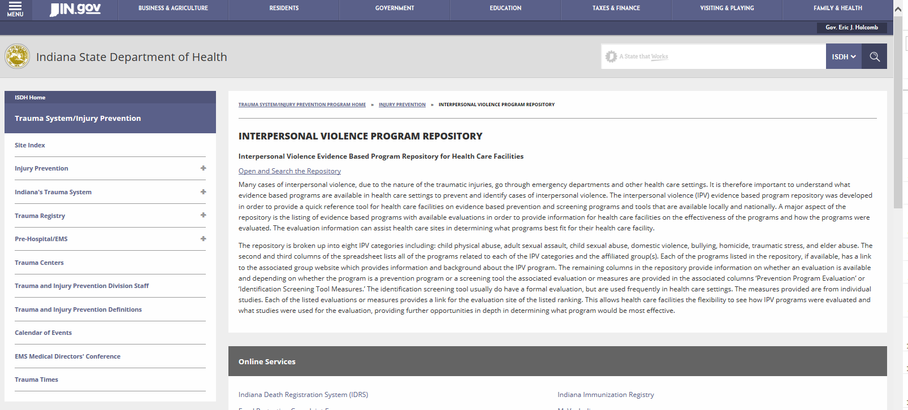
Repository
Notes:
https://secure.in.gov/isdh/27783.htm

Slide 123
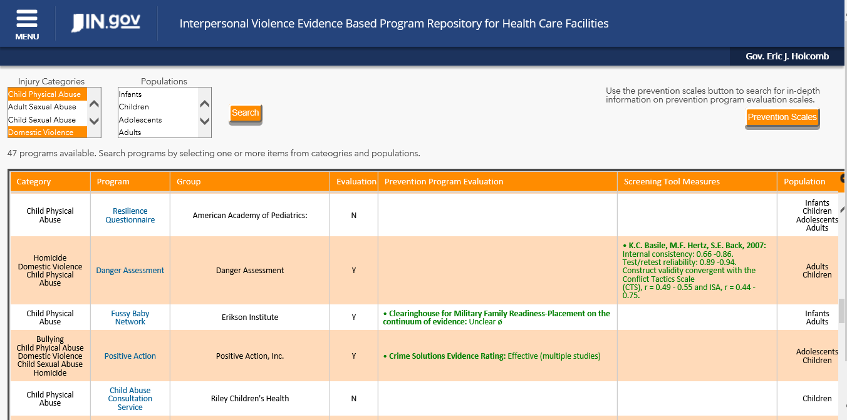
Repository
Notes:
https://secure.in.gov/isdh/27783.htm

Slide 124
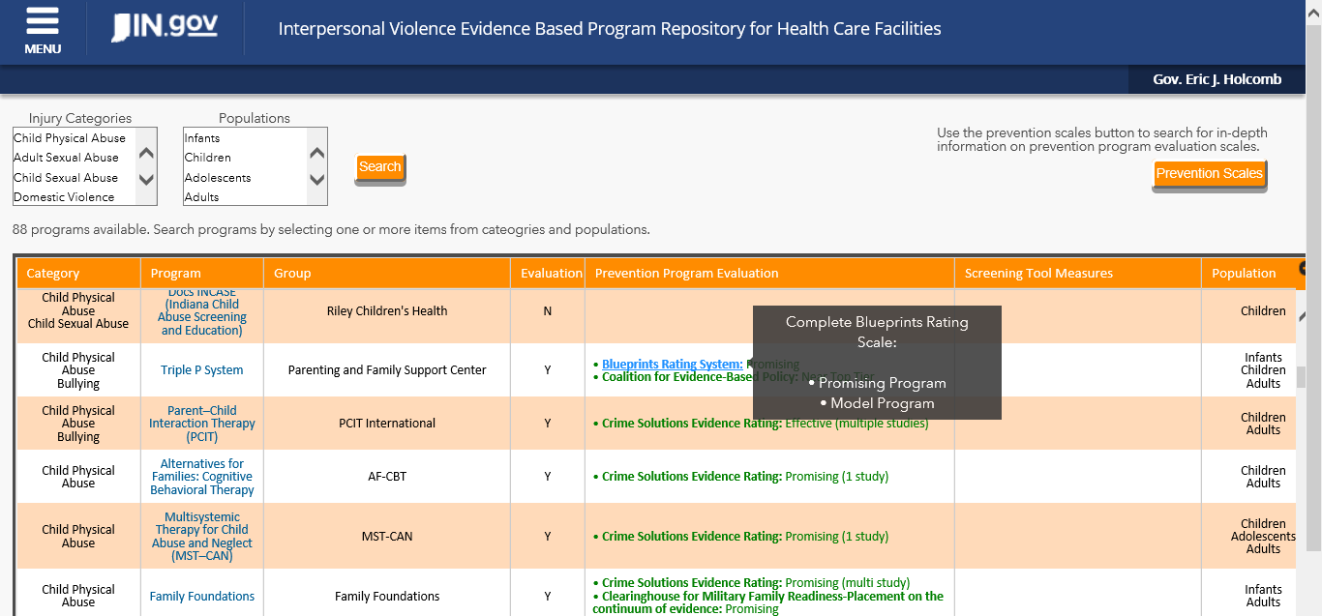
Repository
Notes:
https://secure.in.gov/isdh/27783.htm

Slide 125
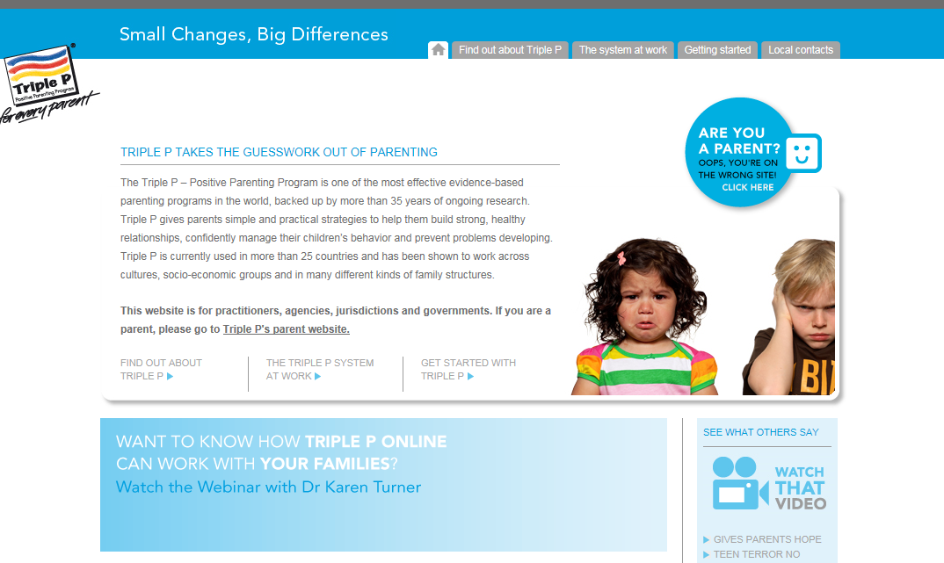

Slide 126
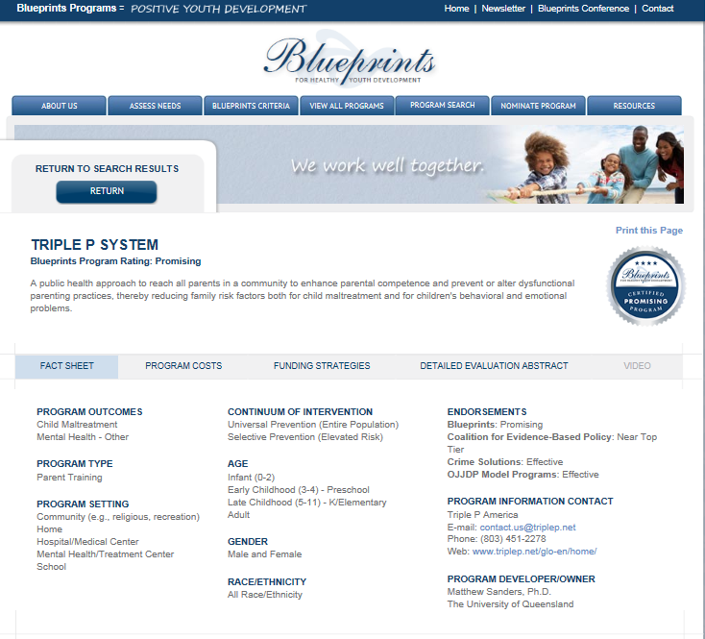

Slide 127
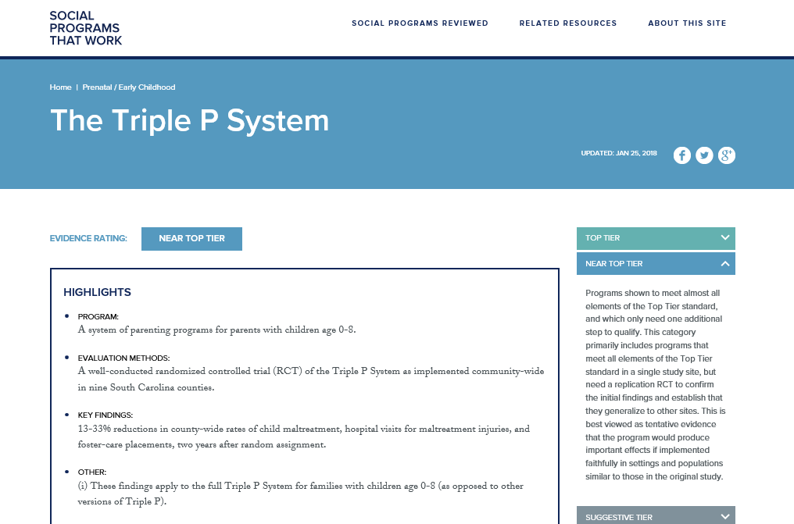

Slide 128
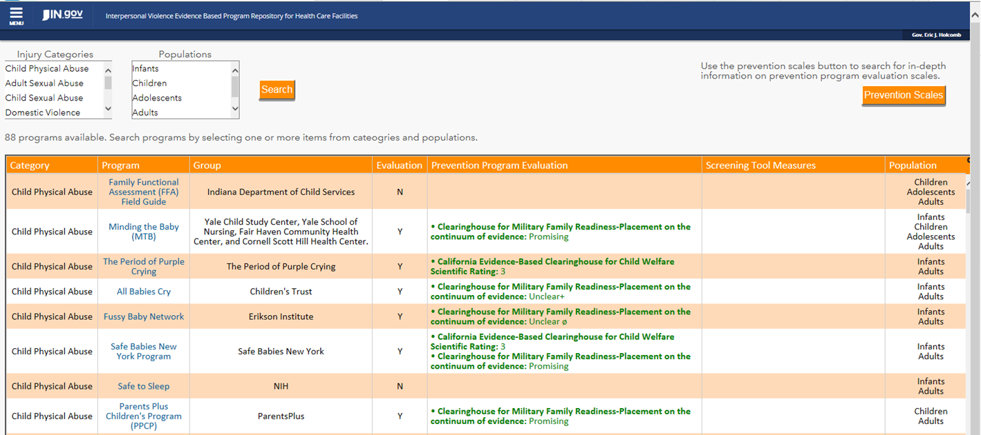

Slide 130
Conclusion
The Interpersonal Violence Prevention Repository will provide a quick reference for health care facilities on evidence based prevention and screening programs and tools
The IPV program repository can be accessed from the link below
https://secure.in.gov/isdh/27783.htm

Slide 131
Next Steps
Incorporation of the repository into the Injuries in Indiana: Resource Guide mobile app

Slide 132
Questions?

Slide 133
Indiana Coroner Case Management System (INCCMS) Overview
Ramzi Nimry, Statewide Trauma System Development and Training Manager
Division of Trauma and Injury Prevention
Email Questions: INVDRS@isdh.in.gov
Notes:
Go around the room and say your name, your title and organization

Slide 134
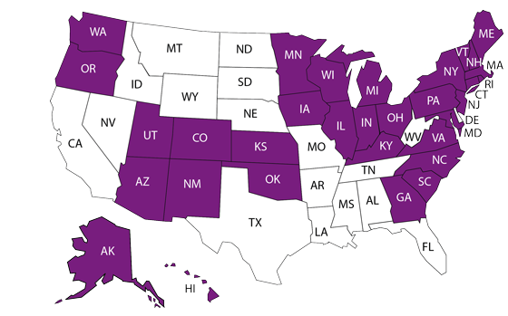
32 States Funded in 2014
Notes:
The $7.5 million in funding will expand the National Violent Death Reporting System from 18 to 32 participating states, which will enable greater collection of critical data on violent deaths over the next five years. Amount of funding granted was based on the number of violent deaths in 2010. Indiana was above the national average rate for violent deaths.
The 32 states participating in NVDRS include Alaska, Arizona*, Colorado, Connecticut*, Georgia, Hawaii*, Iowa*, Illinois*, Indiana*, Kansas*, Kentucky, Massachusetts, Maryland, Maine*, Michigan, Minnesota*, North Carolina, New Hampshire*, New Jersey, New Mexico, New York*, Ohio, Oklahoma, Oregon, Pennsylvania*, Rhode Island, South Carolina, Utah, Virginia, Vermont*, Washington*, and Wisconsin. * - New states
Midwest and East Coast very well represented.

Slide 135
National Violent Death Reporting System (NVDRS)
National, ongoing, state-based surveillance system
Data collected by states through partnerships
Data for informing prevention efforts
Comprehensive information on violent deaths in participating states ― incident-based system
@INDTrauma
Notes:
The ISDH was successful in applying to the Centers for Disease Control and Prevention, Collecting Violent Death Information Using the National Violent Death Reporting System funding opportunity.
In 1999, the Institute of Medicine report cited the need for a national fatal intentional injury surveillance system.
The National Violent Injury Statistics System was piloted in 12 sites in 2000, the same year that the CDC began planning for a publicly funded system. In 2002, Congress first appropriated funds for the National Violent Death Reporting System, and the data collection began in six states in 2003.
The National Violent Death Reporting System is a national, ongoing, state-based surveillance system. The System currently has data from 18 states, but has been expanded to 32 states. The data within the National Violent Death Reporting System registry is collected by participating states in the partnership. It includes comprehensive information from various sources on violent deaths from an incident-based system.

Slide 136
Four Primary Objectives
Create and update a plan to implement INVDRS in Indiana
Collect and abstract comprehensive data on violent deaths
Explore innovative methods of collecting, reporting, and sharing data
Disseminate aggregate INVDRS data to stakeholders, the public, and CDC’s multi-state database (examples on the next slide)
Notes:
The division will look at utilizing trauma registry data once we start inputting information into the system.

Slide 137
What is the Indiana Coroner Case Management System (INCCMS)?
Comprehensive case management system for Indiana coroners.
Provided FREE by Indiana State Department of Health (ISDH)
Features include:
Web-based
Report Writer allows you to create ad hoc reports
External documents can be uploaded and attached to cases
Optimized for tables and smartphones, usable with Wi-Fi in the field

Slide 138
What is the Indiana Coroner Case Management System (INCCMS)?
Secure and confidential stored on ISDH servers with unlimited storage
Violent death and overdose cases are sent to ISDH via manually entry

Slide 139
Indiana Coroner Case Management System (INCCMS) statistics
Counties using this full-time for 2018 cases: DeKalb, Hancock, Harrison, Howard, Lake, Newton, St. Joseph, Steuben
Counties that have entered at least one case: Fountain, Franklin, Jackson, Marshall, Scott, Starke, Tipton, Washington
Counties trained to date: 31

Slide 140
So what does the Indiana Coroner Case Management System (INCCMS) look like?
Ramzi Nimry, Statewide Trauma System Development and Training Manager
317-234-7321
RNimry@isdh.IN.gov

Slide 141
Additional Discussion
Email Questions: INVDRS@isdh.in.gov

Slide 142
2018 meeting dates
1 p.m.-3 p.m. EST in Rice Auditorium
September 21st
Email Questions: INVDRS@isdh.in.gov
Notes:
For those of you who are on IPAC and INVDRS AB, the IPAC meetings will be on the same day from 10-12

Slide 143
Call to Action
Send interested parties to ISDH Division of Trauma and Injury Prevention
INVDRS@isdh.in.gov
INVDRS PI & Epidemiologist
Morgan Sprecher
msprecher@isdh.in.gov
Notes:
If you know anyone interested in joining us please send them my info or vice versa ☺

