Slide 1

Indiana Injury Prevention
Advisory Council
Webcast to begin in 10 minutes

Slide 2
Indiana Injury Prevention
Advisory Council
Webcast to begin in 9 minutes

Slide 3
Indiana Injury Prevention
Advisory Council
Webcast to begin in 8 minutes

Slide 4
Indiana Injury Prevention
Advisory Council
Webcast to begin in 7 minutes

Slide 5
Indiana Injury Prevention
Advisory Council
Webcast to begin in 6 minutes

Slide 6
Indiana Injury Prevention
Advisory Council
Webcast to begin in 5 minutes

Slide 7
Indiana Injury Prevention
Advisory Council
Webcast to begin in 4 minutes

Slide 8
Indiana Injury Prevention
Advisory Council
Webcast to begin in 3 minutes

Slide 9
Indiana Injury Prevention
Advisory Council
Webcast to begin in 2 minutes

Slide 10
Indiana Injury Prevention
Advisory Council
Webcast to begin in 1 minute

Slide 11
Indiana Injury Prevention
Advisory Council
Webcast to begin momentarily…

Slide 12

Indiana Injury Prevention
Advisory Council
January 19th, 2018
Submit your questions to:
indianatrauma@isdh.in.gov

Slide 13
Outline
Welcome!
ISDH Updates
  Staff changes & introductions
  Grant and funding updates
  Prescription Drug Overdose (PDO) updates
Submit your questions to:
indianatrauma@isdh.in.gov

Slide 14
Outline
ISDH Injury Prevention updates
  Special Emphasis Reports
  Violence Prevention Repository
  IPAC Updates
    Strategic planning, annual conference, meeting times\schedule, and IPAC survey
  Child Passenger Safety Activities: Booster Bashes & CPS Tech Reimbursement
  STEADI Update

Slide 15
Outline
Kayleigh Allen, University of Indianapolis, Center for Aging and Community:
  Giving a program overview as well as discussing collaboration with ISDH to expand Stepping On in Indiana
Kate Kunk, CICOA Aging & In-Home Solutions:
  Educating participants on the Seniors and Balance Workshop as well as the CICOA Safe at Home Program

Slide 16
Outline
Preston Harness, Indiana State Department of Health:
  Training participants on the Stopping Elderly Accidents, Deaths, and Injuries (STEADI) algorithm and how to use the toolkit
Teresa Williams, IU Health Arnett:
  Presenting on implementing STEADI into senior wellness clinic and how high-risk patients are referred to other specialists and the Stepping On program

Slide 17
Outline
Michaela Graham, IU Health Methodist:
  Giving an overview of Indiana Falls Prevention Coalition (INFPC)
  Training attendees to use AARP Home Safety Checklist
  Giving a program overview of IU Health Methodist’s inpatient and emergency department fall prevention efforts

Slide 18
ISDH Updates

Slide 19

Staff Changes
Jeremy Funk, Injury Prevention Epidemiologist
Audrey Rehberg, Naloxone Program Manager
Tyler Gannon, Prescription Drug Overdose Community Outreach Coordinator
@INDTrauma #SafetyIN

Slide 20
Welcome Jeremy Funk!
@INDTrauma #SafetyIN

Slide 21
Contact Information
Jeremy Funk, MPH
Injury Prevention Epidemiologist
JFunk1@isdh.IN.gov
(317) 234-4943
@INDTrauma #SafetyIN

Slide 22
Welcome Audrey Rehberg!
@INDTrauma #SafetyIN

Slide 23
Grant and Funding Updates
Awarded:
  National Violent Death Reporting System (NVDRS)
  Prescription Drug Overdose: Prevention for States (base and supplement)
  Enhanced State Surveillance of Opioids
  First Responder Comprehensive Addiction and Recovery Act (FR-CARA)
@INDTrauma #SafetyIN

Slide 24
FR-CARA Updates
93 first responder agencies applied
  37 law enforcement
  41 fire departments
  15 EMS services
3,301 kits were requested
@INDTrauma #SafetyIN

Slide 25
Questions?

Slide 26
Contact Information
Audrey Rehberg, MPH
Naloxone Program Manager
ARehberg@isdh.IN.gov
(317) 234-0848
@INDTrauma #SafetyIN

Slide 27
Welcome Tyler!
@INDTrauma #SafetyIN

Slide 28
PDO Team Update
Community Outreach Coordinators
  Sending PDO community coordinators to listen to community needs through local health departments (LHD) and local coordinating councils (LCC).
  Provide technical assistance to counties.

Slide 29
Community interventions – technical assistance
PDO community outreach coordinators visit counties.
Listening to community member concerns.
Assessing needs.
Learning about pre-existing community strategies.
Sharing relevant information and handouts.

Slide 30
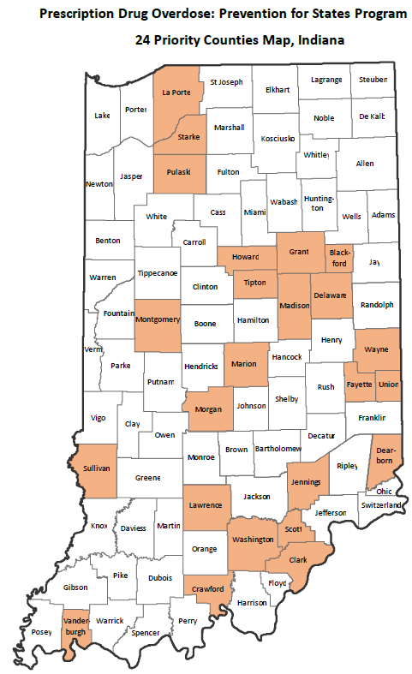

Slide 31
Highlights of work
Attended 316 meetings
Provided 387 hours of technical assistance
Reached 5,342 people
PDO team has held a prescription drug overdose booth at 25 recorded fairs/conferences/meetings
Connected with Butler professors to help develop curriculum on opioids/INSPECT for pharmacy students
Received positive feedback from partners on information provided

Slide 32
Highlights of work
PDO weekly email with 679 subscribers
ISDH Drug Overdose Prevention Website
Stats Explorer
Created monthly opioid-related webcasts for 2018, that features subject matter experts on topics such as:
  Prescribing guidelines
  Drug take-back events
  Fighting against stigma
  Successes and challenges of naloxone distribution

Slide 33


Slide 34
Questions?

Slide 35
Contact Information:
Tyler Gannon, MPH
PDO Community Outreach Coordinator
TGannon@isdh.IN.gov
(317) 233-1243
@INDTrauma #SafetyIN

Slide 36
ISDH injury prevention updates

Slide 37
ISDH Injury Prevention Updates
New Special Emphasis Reports and other documents:
  2017 Child Injuries Report 0-5 Years
  2017 Child Injuries Report 6-11 Years
  2017 Child Injuries Report 12-18 Years
  2017 Fireworks Injury Report
  Violence Prevention Repository
  Injury Prevention Observances Calendar

Slide 38
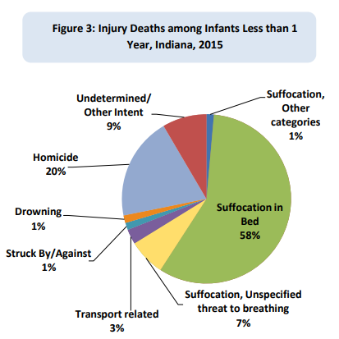
  2017 Child Injuries Report 0-5 Years
n=71

Slide 39
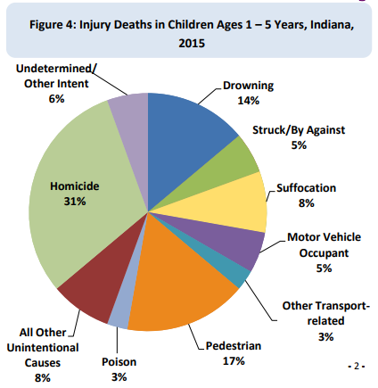
  2017 Child Injuries Report 0-5 Years
n=36

Slide 40
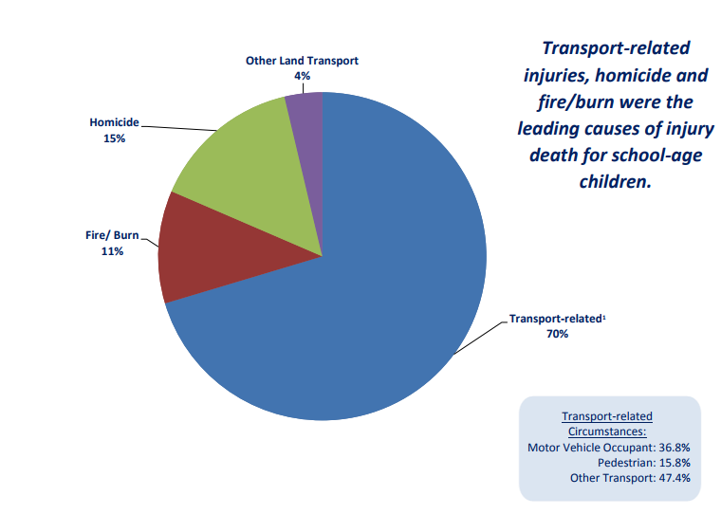
  2017 Child Injuries Report 6-11 Years
n=27

Slide 41
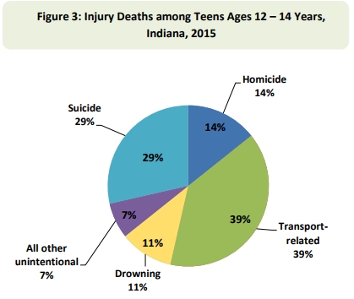
  2017 Child Injuries Report 12-18 Years
n=28

Slide 42
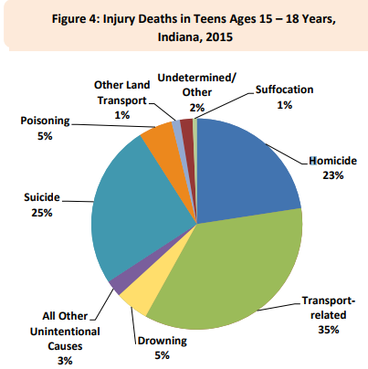
  2017 Child Injuries Report 12-18 Years
n=155

Slide 43
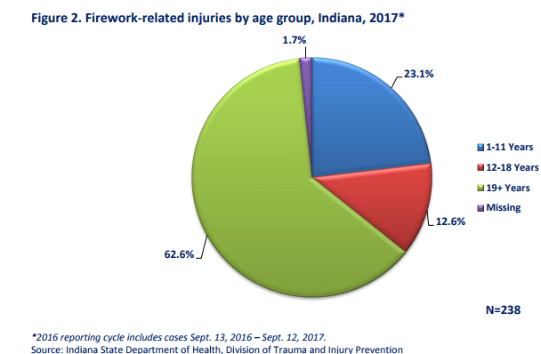
  2017 Firework-related Injuries Report

Slide 44
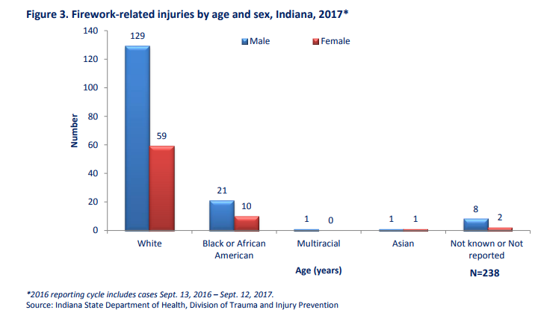
  2017 Firework-related Injuries Report

Slide 45
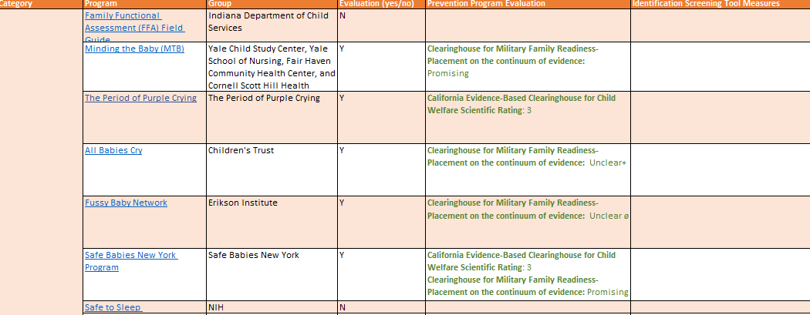
Interpersonal Violence Prevention Repository

Slide 46
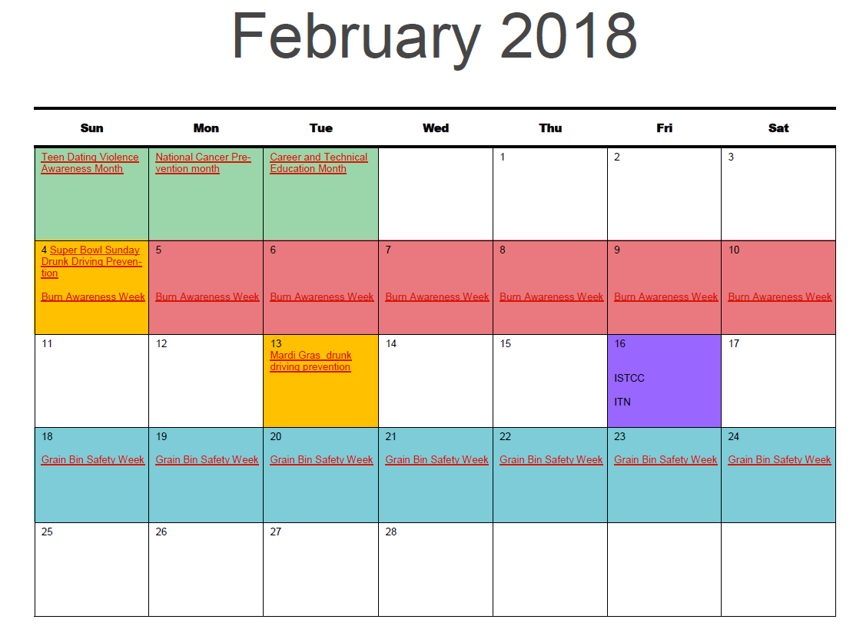
Injury Prevention Observances Calendar

Slide 47
List of ISDH Injury Prevention Documents and Reports
  2017 Suicide in Indiana
  Preventing Injuries in Indiana: A Resource Guide
  Special Emphasis Reports:
    Drug overdose
    Traumatic brain injuries
    Older adult falls
  http://in.gov/isdh/25396.htm

Slide 48
IPAC Updates

Slide 49
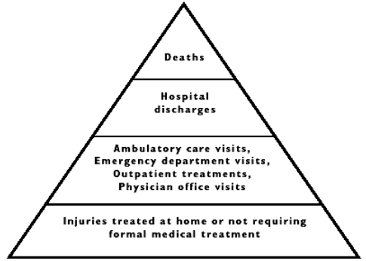
Strategic Plan
2016-2918 ISDH, Division of Trauma and Injury Prevention Strategic Plan:
  http://www.in.gov/isdh/files/Katie_Hokanson_-_2016_to_2018_Strategic_Plan_February_19_2016.pdf
Will discuss updating in March 2018 IPAC meeting

Slide 50
Strategic Plan
Objectives:
  Identify opportunities to reduce or prevent injuries within the state of Indiana.
  Enhance the skills, knowledge, and resources of injury prevention workforce.
      Injury Prevention Advisory Council (IPAC) Injury Prevention Conference
      Injury Prevention Advisory Council membership

Slide 51
Strategic Plan
Objectives:
  Establish a sustainable and relevant infrastructure that provides leadership, funding, data, policy and evaluation for injury prevention.
  Provide access and technical assistance for best practice and evidence-based injury prevention strategies.
      Preventing Injury in Indiana: A Resource Guide
      Injury Prevention Resource Guide Application

Slide 52
Strategic Plan:
1.Establish a sustainable and relevant infrastructure that provides leadership, funding, data, policy and evaluation for injury prevention
2. Collaborative injury prevention efforts in:
  •Traffic Safety
  •Poisoning
  •Traumatic Brain Injury

Slide 53
Strategic Plan:
Statewide direction and focus for older adult (age 65+) falls prevention
Statewide direction and focus for child injuries
  • Safe sleep
  •Child passenger safety
  • Bullying

Slide 54
Strategic Plan:
5. Statewide direction and focus for violence prevention
  • Indiana Violent Death Reporting System
  • Focus on homicides, suicides, and other violence
6. Enhance the skills, knowledge, & resources of injury prevention workforce
  • Resource Guide
  • IPAC membership
  • IPAC conference

Slide 55
Annual IPAC Conference
We will not host an annual IPAC conference this year:
  Midwest Injury Prevention Alliance (MIPA) has requested that they host the 2018 MIPA conference in the fall of 2018.
  More information will come soon!

Slide 56
Regular IPAC Meetings
Upcoming Meetings (all from 10-12PM):
  March 16th, 2018
  May 18th, 2018
  July 20th, 2018
  September 21st, 2018
  November 16th, 2018

Slide 57
IPAC Survey Results
Topics chosen most in survey:
  Older adult falls, childhood injuries\child fatality review, traffic safety\motor vehicles collisions, rural health, prescription drug overdose, best practices (case studies, evidence based programs, etc.), and collaboration opportunities.

Slide 58
IPAC Survey Results
Topics chosen most in survey regarding meeting logistics:
  Regional experts\speakers, more online meetings, and more guest speakers in general.

Slide 59
Child Passenger Safety & Booster Bash Collaborations

Slide 60
Booster Bash
2017 wrap up:
  915 booster seats have been handed out to communities and parents
  Data was collected via Automotive Safety Program Check-up Form during each appointment
  Data on child passenger\booster seats usage is being gathered and calculated
    Forms are coming in on rolling basis

Slide 61


Slide 62
Child Passenger Safety Technician Reimbursement Program:
CPST Reimbursement Program:
  ISDH can reimburse future technicians $250.
Goal is to increase the number of active technicians in trauma centers and community organizations throughout the state.
So far, program has contributed to 47 new CPSTs in Indiana!

Slide 63
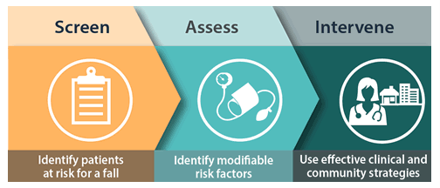
Stopping Elderly Accidents, Deaths, and Injuries (STEADI) Older Adult Fall Screening:
Trained 4 new organizations on toolkit since October:
  Community hospital, fire\EMS, and local health departments.
Preston is available for trainings for your organization\brochures are available.

Slide 64
Questions?

Slide 65
Welcome Kayleigh!
Kayleigh Allen, MS, PAPHS
Project Coordinator
allenkk@uindy.edu
(317) 791-5934

Slide 66


Slide 67
Mission
The University of Indianapolis Center for Aging & Community collaborates, educates and conducts research to enhance the quality of life for all people as they age.

Slide 68
Vision
The University of Indianapolis Center for Aging & Community is a catalyst for change that leads to a world in which all people age with dignity & optimal health.

Slide 69
Consulting Services
Since 2001, the University of Indianapolis Center for Aging & Community has offered a broad range of consulting services to organizations working with, on behalf of, or marketing to older adults. We tailor our services to meet each
Organizational and community needs assessment
Project management
Program evaluation
Education and training
Coordination of community collaborations
Research on business and social issues related to aging

Slide 70
Our Team
The staff at CAC comprise an interdisciplinary team of experienced professionals who make it their business to help serve our clients’ business needs. Our team has expertise in:
Project Management & Evaluation
Gerontology
Research Design & Implementation
Public Health
Healthy Aging & Aging in Place
Community Planning

Slide 71
Who We Serve
In this era of a rapidly aging world population, there are few businesses and organizations that do not find them-selves working with or on behalf of older adults. These organizations and some of our past clients include:
Government Agencies
Human Services Organizations
Trade Associations
Community and Charitable Foundations
Faith-based Organizations
For-profit Businesses

Slide 72
Current Projects
Advanced Education in Long Term Care (Phase 2)
Expressive Arts in Long Term Care
OPTIMISTIC
Regional Quality Improvement Collaborative (Phase 2)
Stepping On

Slide 73
Clients & Partners
Central Indiana Senior Fund
Hendricks Community Hospital Corp.
Indiana Association of Adult Day Services
Indiana Division of Aging
Indiana Governor’s Council for People with Disabilities Indiana Health Care Association
Indiana State Department of Health
Indiana University
Regenstrief Institute
WFYI Public Media

Slide 74
For more information
Ellen W. Miller, PhD, PT
Executive Director
emiller@uindy.edu
(317) 791-5930

Slide 75
Welcome Kate!
Kate Kunk, RN, CIRS-A/D
Caregiver Options Counselor
CICOA Aging & In-Home Solutions
kkunk@cicoa.org
(317) 803-6002

Slide 76
Fall Prevention Programs at CICOA
Keeping People SAFE
(317) 803-6131

Slide 77
What's an Area Agency on Aging?
The Older Americans Act mandated the creation of an agency for everyone in the U.S.
Not-for-profit (largely funded by your state and federal tax dollars)
Information, referral and specific services that can mean the difference between independence in the community and requiring institutional care in a nursing home
CICOA Aging & In-Home Solutions is the AAA for Central Indiana (Area 8)
Notes:
CICOA is Central Indiana’s front door to
information and referral
specific services
that can mean the difference between independence in the community—and requiring residence in a nursing facility.

Slide 78


Combined efforts within CICOA
Two departments at CICOA specifically address home safety, including fall prevention:

Slide 79
The Safe at Home goal:
To increase accessibility and ease of use of difficult areas of the home, and to prevent future falls through these modifications.
NOTE: This department is wholly dedicated to home modifications
in the interest of home safety and the potential for
improved quality of life.

Slide 80
Is both year-round...
Last year, 268 home accessibility modifications were completed:
  Bathroom renovations with grab bars, ADA toilets, barrier-free showers
  Installation of banisters
  Lighting improvements
  Widening of doorways
  Replacing faucets with single levers
  Ramp construction

Slide 81
AND an annual half-day event
Special annual community outreach:
High-impact half-day of service to low-income homeowners over 60 yrs
Helps make homes and yards safe and accessible for daily living
Labor provided by CICOA employees and community volunteers
Each year the focus is in a selected Central Indiana community
Has served more than 170 households with the help of about 1300 volunteers since Safe at Home event was begun in 2010

Slide 82
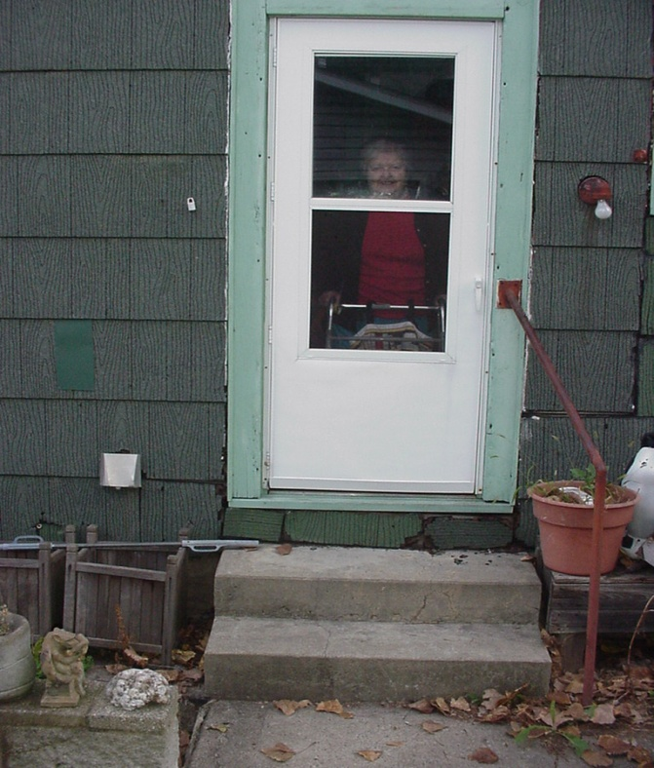
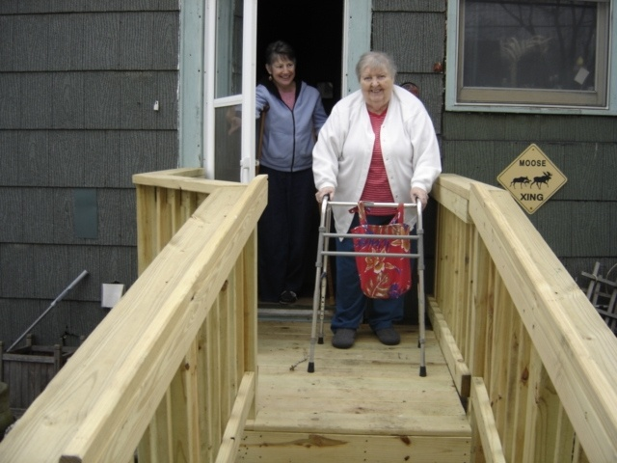
Before
After

Slide 83
CICOA's many-faceted response to the needs
of Central Indiana's family caregivers
COUNSELING AND WORKSHOPS FOR EVERYONE!

Slide 84


Slide 85
Contacts
Dan Amonett, MA, MIS
Certified Aging in Place Specialist (CAPS)
Director Safe at Home
damonett@cicoa.org
Kate Kunk, RN, CIRS-A/D
Facilitator
Seniors & Balance Workshop
Caregiver Options Counselor
kkunk@cicoa.org
CICOA Aging & In-Home Solutions
Indiana Association of Area Agencies on Aging

Slide 86
THANK YOU!
For information on matters regarding aging, disability, or caregiving, call
CICOA Aging & In-Home Solutions
(317) 803-6131

Slide 87
Kate Kunk, RN, CIRS-A/D
Caregiver Options Counselor
CICOA Aging & In-Home Solutions
kkunk@cicoa.org
(317) 803-6002

Slide 88
Welcome Preston!

Slide 89
Stopping Elderly Accidents, Deaths, and Injuries Toolkit
Preston Harness, MPH
Injury Prevention Program Coordinator
Indiana State Department of Health
Pharness@isdh.IN.gov
(317) 232-3121

Slide 90
Stopping Elderly Accidents, Deaths, and Injuries (STEADI) Toolkit:
STEADI Toolkit:
  Simple but comprehensive approach for fall risk assessment and effective fall prevention for older adults
  Developed by the CDC:
    Anyone who serves older adults can screen for falling

Slide 91
STEADI:
STEADI:
  Designed for community-dwelling, independently ambulatory older adults ages 65+
  Not intended for institutionalized or hospitalized patients
  Designed to screen all patients 65+

Slide 92
STEADI:
Why does this apply to my organization?
  Fall risks need to be identified.
  Offering and referring to evidence-based fall prevention programs (EBP’s) is critical.
  Brings opportunities for other collaborations in the community (e.g., Stepping On, home visitation\screening programs, Matter of Balance, T’ai Chi, other evidence-based programs).

Slide 93
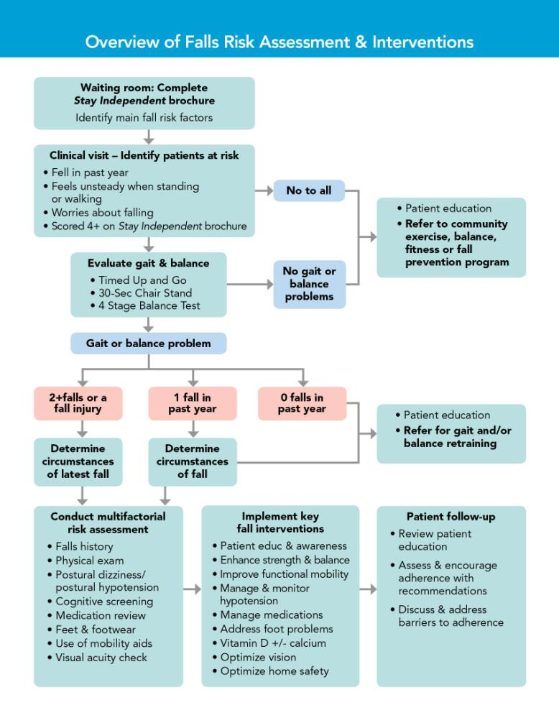

Slide 94

STEADI:
3 essential parts:
  1.) Provider Resources
  2.) Training Materials
  3.) Patient Education Brochures

Slide 95

STEADI:
Provider Resources

Slide 96
STEADI:
Provider Resources:
  3.5” 5.5” pocket guide
  Wall chart- Integrating Falls Assessment & Interventions into Practice
  Assessment tools
  Management tools

Slide 97
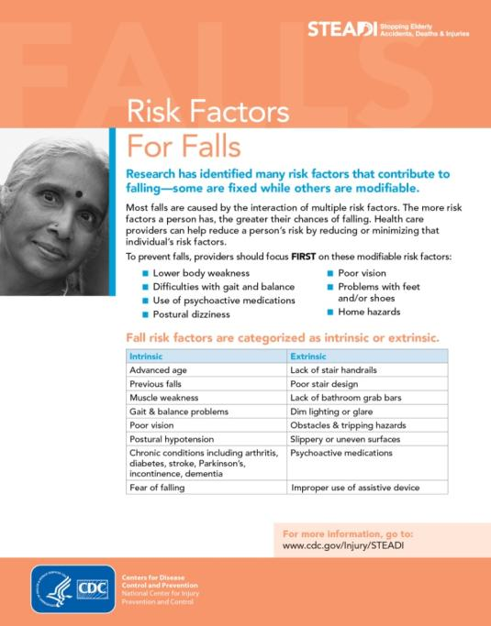
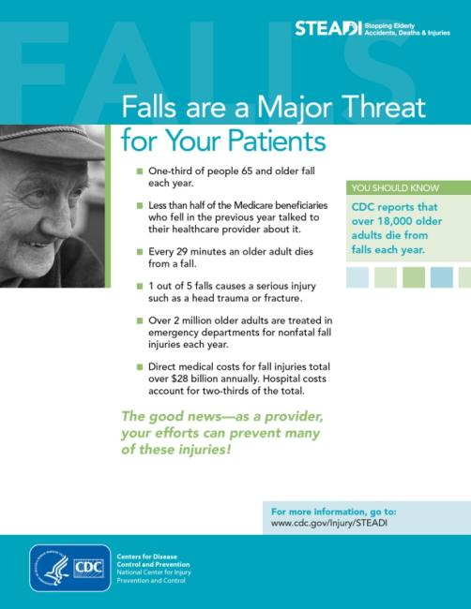
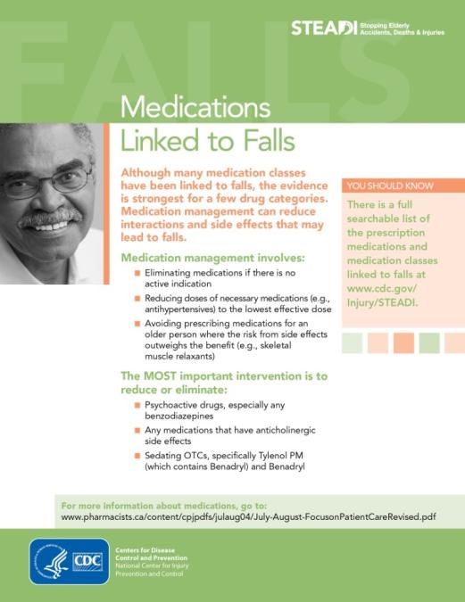
Resources: Fact Sheets

Slide 98
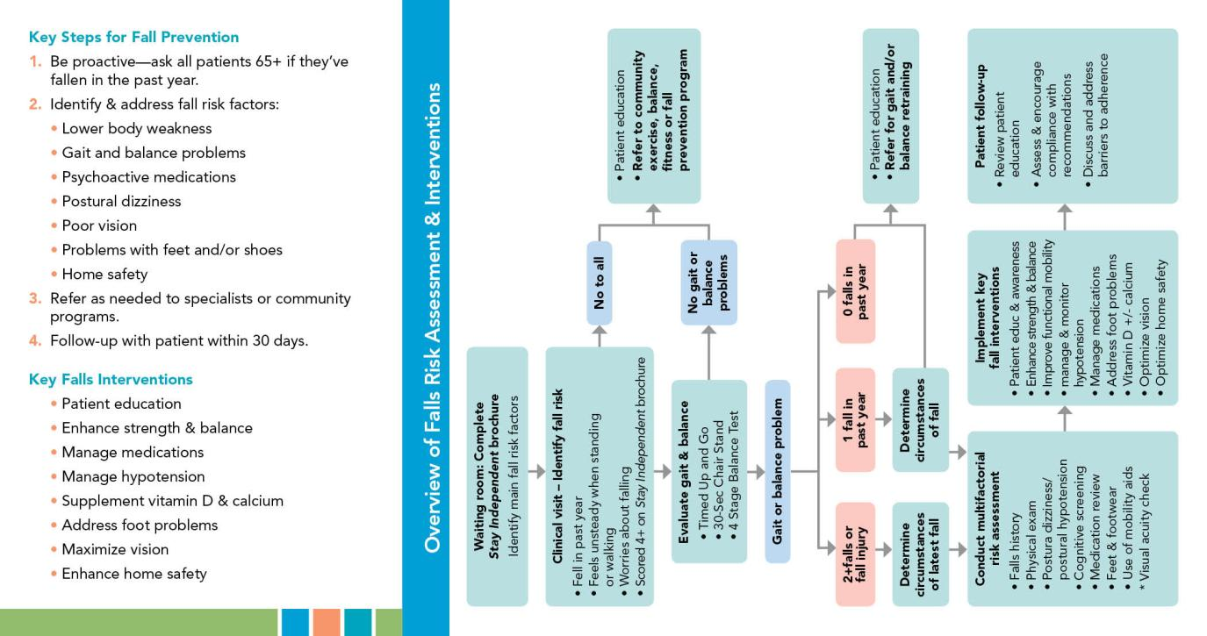
Resources: Pocket Guide

Slide 99
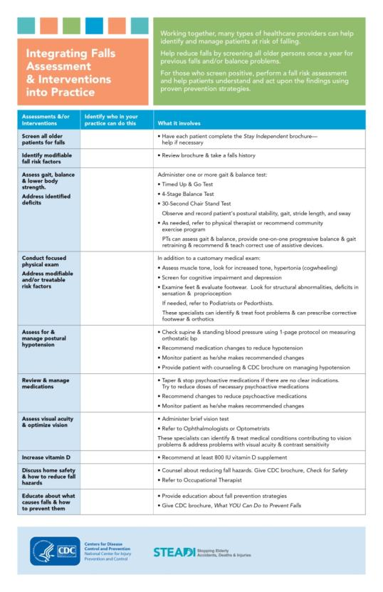
Resources: Integrating Fall Prevention into Practice:
Organize your program so fall risk assessment and management occurs routinely:
  How does the organization use all members to manage fall risk and prevention?
  Can the receptionist be useful?
  Where\when should the patient complete the questionnaire?
  Who should perform balance tests?

Slide 100
Assessment Tools:
Stay Independent Brochure:
  Self-risk assessment
Instructions for:
  3 standardized gait and balance tests
  Orthostatic blood pressure measurement
Fall Risk Checklist for summarizing risk assessment findings

Slide 101
Assessment:

Slide 102

Assessment: Stay Independent Brochure

Slide 103
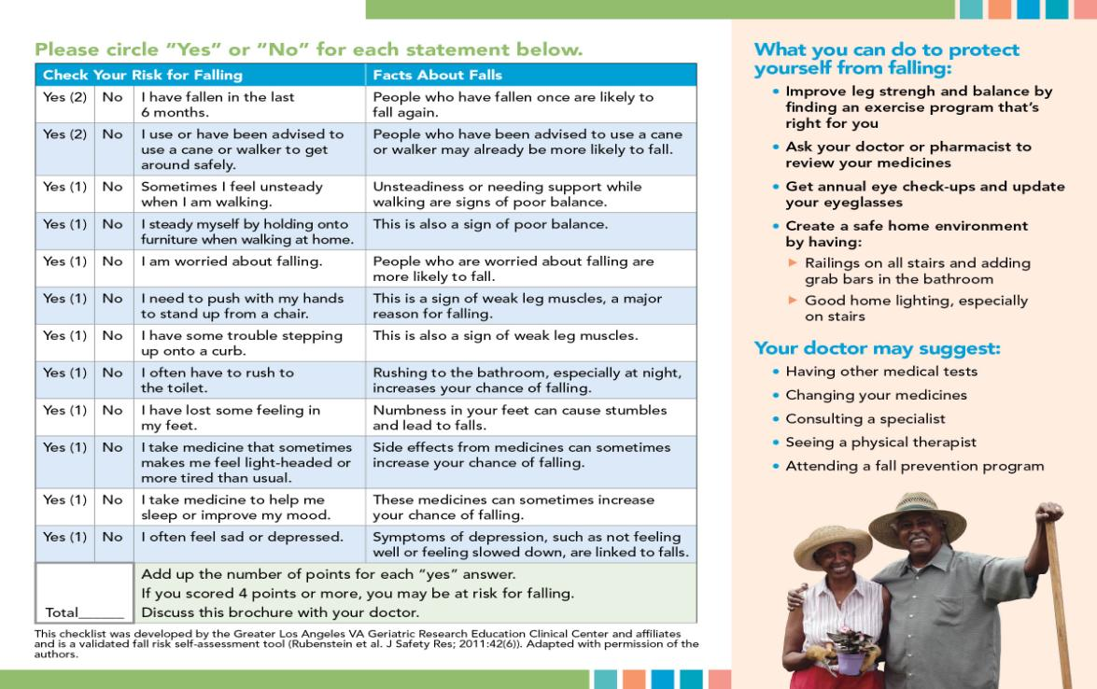
Assessment: Stay Independent Brochure

Slide 104

Assessment: Gait and Balance Test Instructions

Slide 105
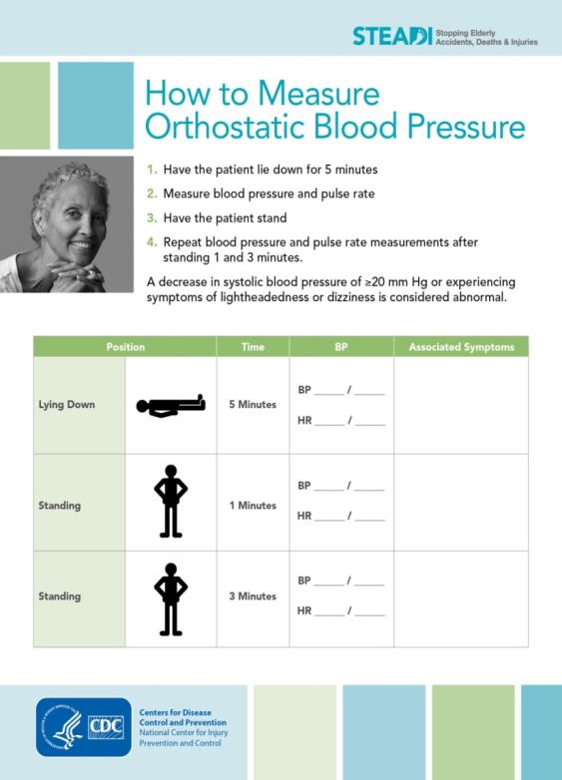
Assessment: Orthostatic Hypotension (OH)

Slide 106
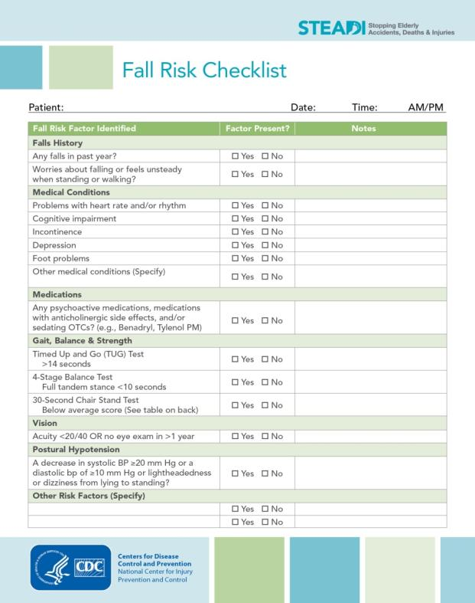
Assessment: Fall Risk Checklist
This checklist is intended to “put it all together”
Findings from the patient’s assessment can all be summarized and easily reviewed.

Slide 107
Assessment:
Management:

Slide 108
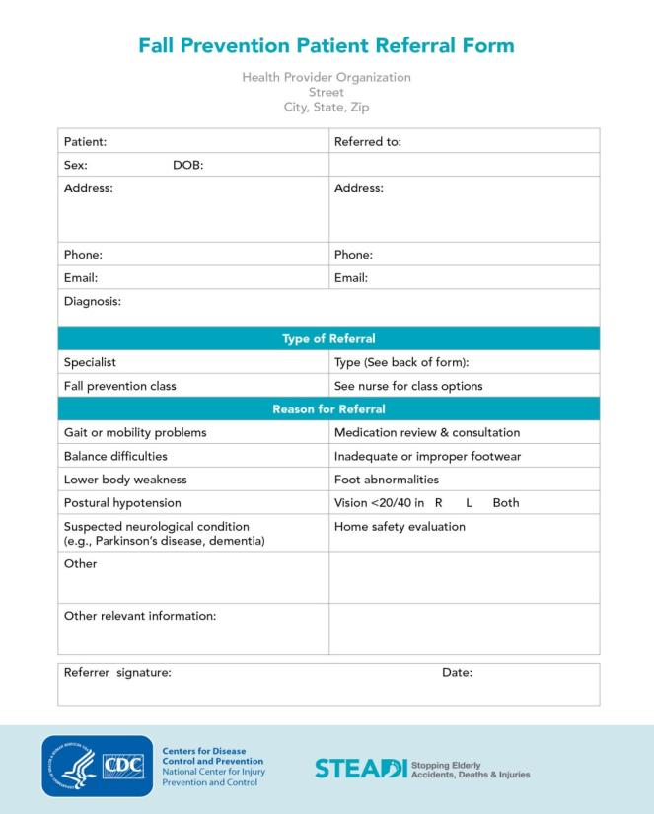
Management: Fall Prevention Referral Forms
Way to refer patient to PT, OT, Podiatry, Optometry, home safety assessments, or other specialist or physician.

Slide 109
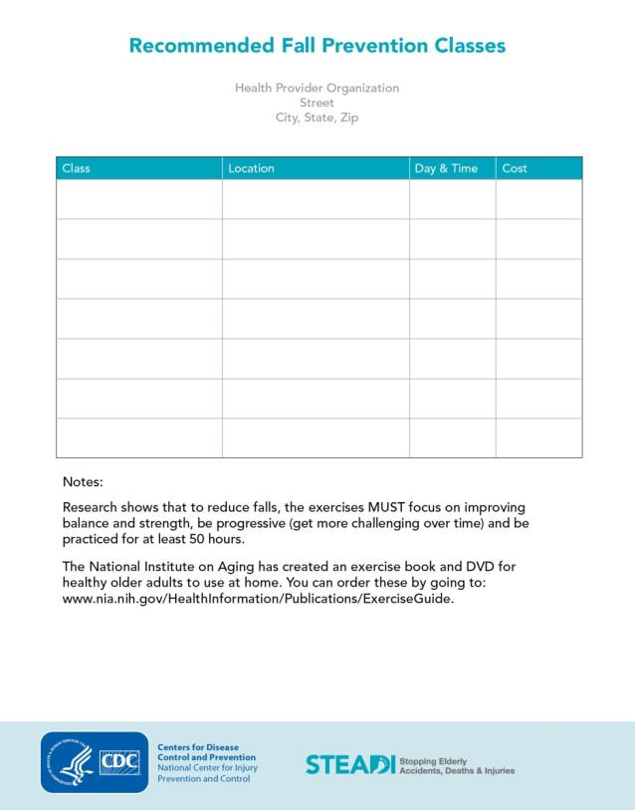
Management: Recommendation to Fall Prevention Classes
Worksheet for listing evidence-based fall prevention programs in the community.

Slide 110
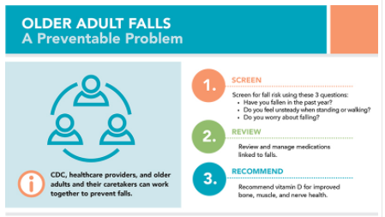
STEADI:
Training Resources

Slide 111
Training Materials:
Screen, review, and recommending.
Case Studies illustrating 3 levels of fall risk:
  Practice patient intervention with the toolkit
Talking about Fall Prevention with Your Patients:
  Are they ready to change?
  Stages of Change model

Slide 112
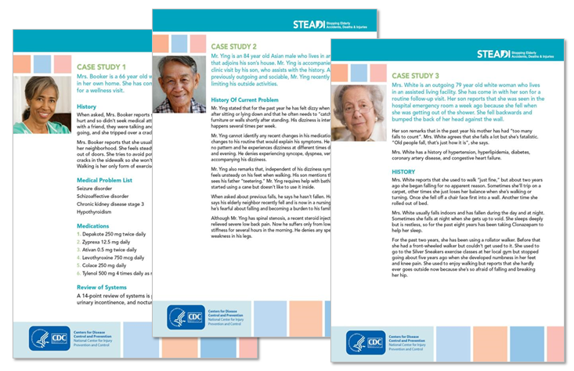
Case Studies:

Slide 113
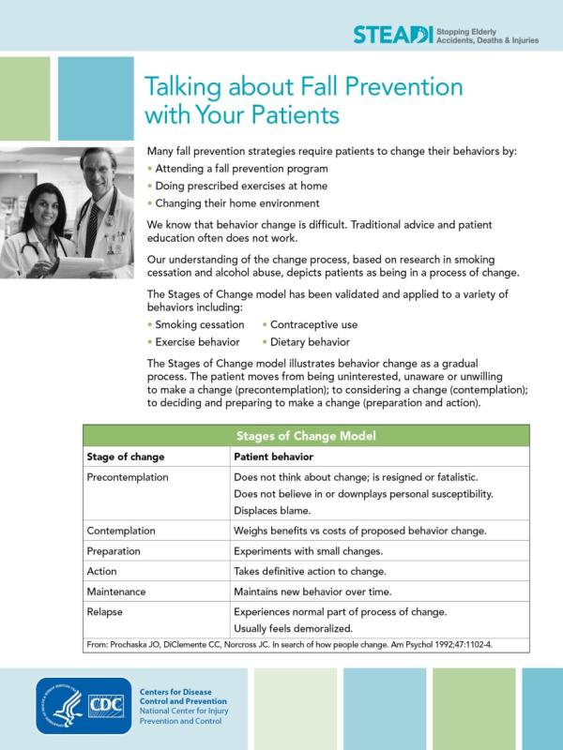
Talking with Patients:

Slide 114

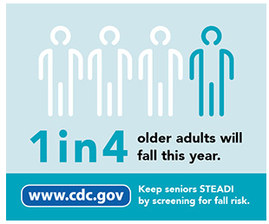
STEADI:
Patient Education Materials

Slide 115
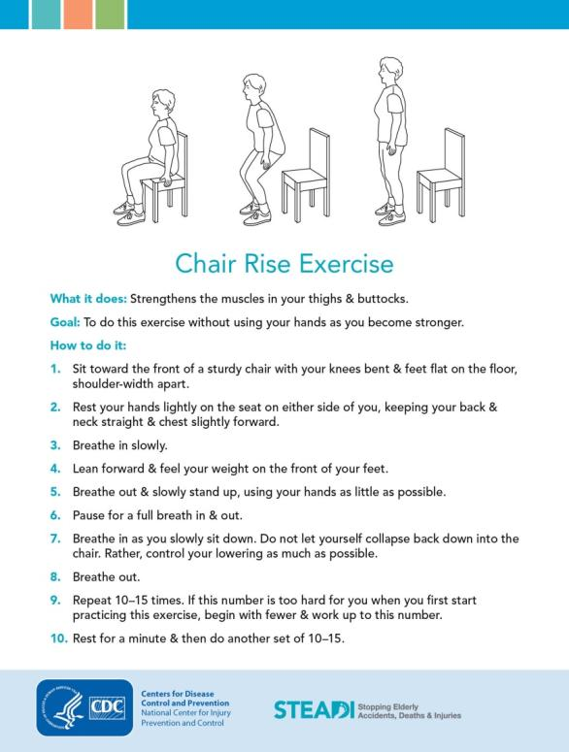
Patient Education:
3 CDC Brochures:
  What YOU Can do to Prevent Falls
  Check for Safety
  Postural Hypotension

Slide 116
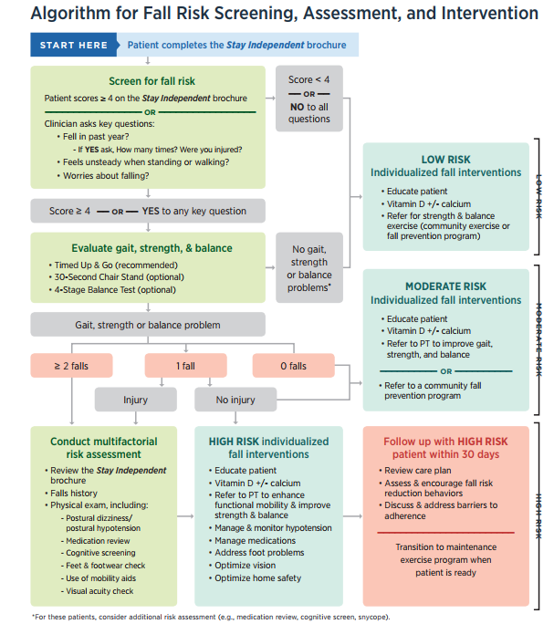

Recommend (based on risk):
Screen
Review

Slide 117
Wrapping Up:
What is your role?
  Ask that older adults initiate conversations with their doctors.
  Hand out Stay Independent brochures.
  Educated practitioners in your community about STEADI.
  Offer trainings and support for fall prevention in your area.
  Consider what partners in your area can utilize STEADI.

Slide 118
Wrapping Up (cont.):
What is your role?
  Use EBFPs such as Stepping On, Matter of Balance, T’ai chi, etc., to support your mission.
  Spread the word about STEADI because it is FREE!
  Introduce health systems with community programs, classes, and groups.

Slide 119
Thank you!
Preston Harness, MPH, CPST
Injury Prevention Program Coordinator
Indiana State Department of Health
Division of Injury & Trauma Prevention
PHarness@isdh.IN.gov
(317) 232- 3121
http://www.in.gov/isdh/19537.htm

Slide 120
Welcome Teresa!
Teresa S. Williams RN, BSN
Trauma Registrar/Outreach Coordinator
IU Health Arnett Level III Trauma Center
Phone: 765-838-5119
email:twilli24@iuhealth.org

Slide 121
TRAUMA SERVICES
Fall Prevention Outreach Programs
SLIP, STEADI, STEPPING ON
Amanda Rardon RN
Trauma Program Director
Teresa Williams RN, BSN
Trauma Outreach Coordinator

Slide 122
Senior Lifestyle & Injury Prevention (SLIP):

Slide 123
Senior Lifestyle & Injury Prevention (SLIP):
Implemented 2014 at IU Health Arnett
Society of Trauma Nurses
Program for Assisted Living, Senior Groups, etc.
Quick one hour presentation
Ability to encourage participants to attend Stepping On

Slide 124
Senior Lifestyle & Injury Prevention (SLIP):
Our percentage of elderly falls was 63% of our trauma related injuries per year.
After implementing the SLIP program we were able to obtain data from a local Assisted Living Facility showing that when we presented the SLIP program, same level falls decreased substantially.
Data obtained from the assisted living facilities showed that when SLIP was provided, fall rates dropped over 80% after the presentation.
Data also showed that approximately 3 months later they began to rise again. We were able to revisit these communities and repeat the presentation.

Slide 125
Stopping Elderly Accidents, Deaths, & Injuries (STEADI)

Slide 126
STEADI:
This program was developed by the CDC.
We implemented this in July 2016 with our outpatient “Ageing Population” group.
Unlicensed healthcare providers were going to homes to visit patients who were part of a senior outpatient group prone to falls and in need of other assistance.
These providers are in the home and use STEADI to perform evaluations for fall risk and home safety.
On Fridays, a multidisciplinary team met to discuss those at risk for fall. These patients are referred to PT, local community programs and are also referred to Stepping On if appropriate.

Slide 127
Stepping On

Slide 128
Stepping On:
This is a evidence based, multi-faceted, facilitated group program with a follow-up visit or phone call and a 3 month booster session to support strategies covered in the 7 week course that meets once a week for 2 hours.
Expert guest speakers cover balance and strength exercises, pharmacology related to falls, community safety and vision.
IU Health Arnett Trauma Services just finished the 3rd workshop and in February and March 2018 will start workshop number 4 & 5.

Slide 129
How do these programs reach the senior population?
In using SLIP we reach out to those seniors who reside in Assisted Living communities, and those in Senior retirement areas. During SLIP presentations in the independent retirement areas we can also refer them on to Stepping On if needed.
In using STEADI in our new Medicare Wellness Clinic we can evaluate the need for referral to physical therapy, rehab, Community Programs, or Stepping On.

Slide 130
And to tie it all together!
In using Stepping On we are reaching out to those seniors who are independent but are at risk of falling. In reaching out to these seniors we are attempting to educate them with ways to obtain better balance and strength. In doing this, they can continue to live independent lives free from falls.

Slide 131
How do we obtain participants?
Senior Wellness Clinic (STEADI)
Physical Therapy Department
SLIP presentations feed participants to Stepping On
Networking
Social Media
Outpatient physician visits

Slide 132
Contact Information:
Teresa S. Williams RN, BSN
Trauma Registrar/Outreach Coordinator
IU Health Arnett Level III Trauma Center
Phone: 765-838-5119
email:twilli24@iuhealth.org

Slide 133
Welcome Michaela!
Michaela Graham, MPH
Injury Prevention Coordinator
IU Health Methodist Trauma Services
mgraham@iuhealth.org
(317) 962-8150

Slide 134
Indiana Fall Prevention Coalition
Michaela Graham, MPH
IU Health Methodist Trauma Services

Slide 135
Mission
Our mission is to improve the well-being of older adults and at risk individuals in Indiana by raising awareness of fall prevention, reducing fall related injuries and effecting policy change through leadership, advocacy and education.

Slide 136
Who we are
Collaborative Effort
Improve the wellbeing of older adults & at-risk individuals
How?
  Awareness of fall prevention
  Reducing fall related injuries
  Effecting policy change through leadership, advocacy & education
  Promoting evidence-based programs and interventions

Slide 137
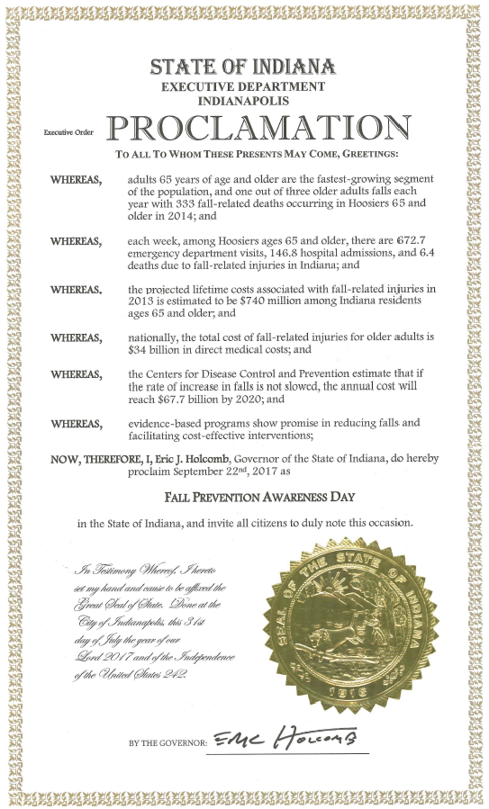
What’s up?
Meetings
Quarterly
Next: February 21,2018
Website
www.INFallPrevention.org
Coalition information
Resources
Coming: Provider Information
Events
State Fair
Safe at Home event
Fall Prevention Awareness Day

Slide 138






Where do I fit in?
Join us!
Coalition better with participation
All entities with any interest/affiliation with fall prevention
Quarterly Meetings
Contact Linda Sinclair (lisincla@iu.edu)
Events
Partnering
Raise awareness
Resources
Spread the Word
Refer friends from across the state
Those that would benefit from resources

Slide 139

AARP Home Fit Guide
Transform home into “Lifelong Home”
  Suitable for all inhabitants
  Do-it-yourself fixes to skilled tasks
28 pages of Lessons, suggestions & Solutions
Available through www.INFallPrevention.org
  Directly at: https://docs.wixstatic.com/ugd/e3d4a3_c21985a1349e449590750d45b666da8a.pdf
Printable

Slide 140


Rebuilding Together’s Safe at Home Checklist
Specific to geriatric home adjustments
  An area-by-area checklist of questions
  An area-by-area checklist of suggestions
1 page front & back
Available through www.INFallPrevention.org
  Directly at: https://docs.wixstaRetic.com/ugd/e3d4a3_3feb882806e54a729ac1405fc493f4af.pdf
Printable

Slide 141
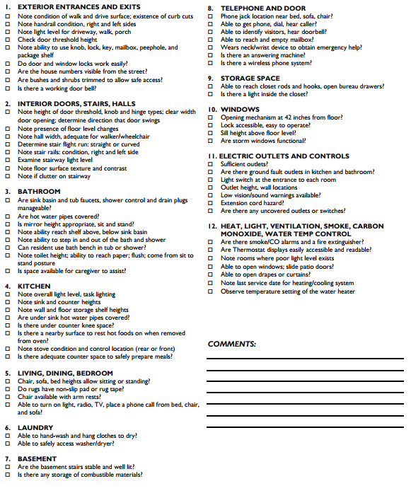
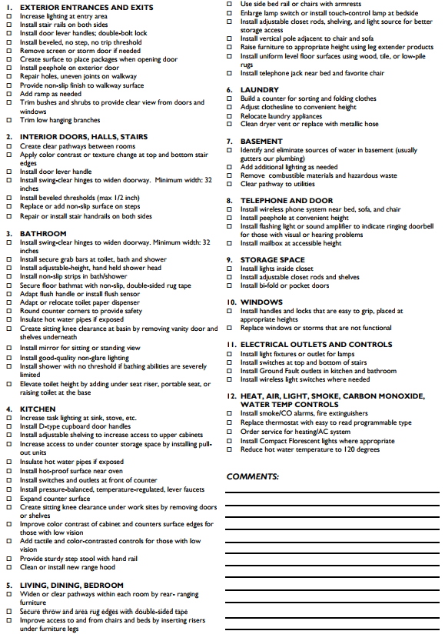

Slide 142
AAHC Inpatient Fall Prevention Team
Michaela Graham, MPH
IU Health Methodist Trauma Services

Slide 143

2017 Refresh
Team Retreat
Half-day retreat
TeamSTEPPS Training
Incident Review
Set 1-3 top strategies to focus on:
  Patient/Family Collaboration
  Prevention of Mobility Regression
  Prevention of Acute Confusion Onset
Monthly meetings after that

Slide 144
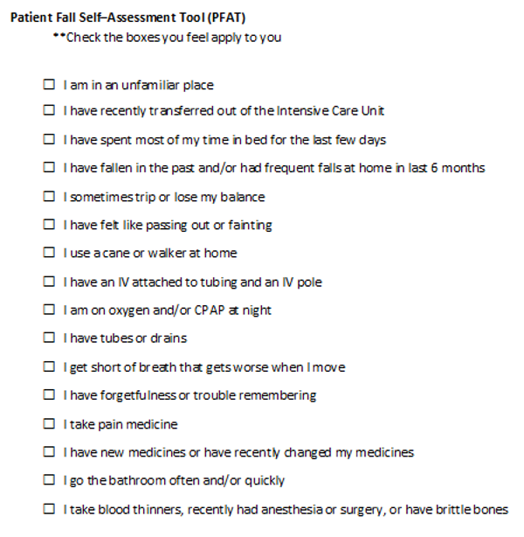
Patient/Family Collaboration
Patient Partnership Pilot
  Negotiation/Communication = key
  Self-assessment
    Leads to fall precaution discussion
  Minimal pushback
Literature Review
  Listening, empathy, negotiation

Slide 145

Prevention of Mobility Regression
Patient/Family involvement
Interprofessional Involvement
  Mobility Protocol?
Prevention of Acute Confusion Onset
Interprofessional involvement
  Protocol?
Delerium/Fall prevention Order Set
  Needs to be data driven

Slide 146

Post-Fall Reviews
Fall Champions on each unit conduct
Additional info to the incident form
Risk Factors
  Fall History
  Urgency
  Patient Care Equipment
  Mobility
  Cognition
  Dizzyness/orthostasis
  Seizure/ETOH
  Deviations in standards of care

Slide 147
Please Contact:
Michaela Graham, MPH
Injury Prevention Coordinator
IU Health Methodist Trauma Services mgraham4@iuhealth.org
317.962.8150

Slide 148
Upcoming Events

Slide 149


Slide 150


Slide 151


Slide 152
February Events
Teen Dating Violence Awareness Month
Super Bowl Sunday Drunk Driving Prevention: Feb. 4th
Burn Awareness Week, Feb. 5-10th
Mardi Gras Drunk Driving Prevention, Feb. 13th
Indiana State Trauma Care Committee (ISTCC) and Indiana Trauma Network Meetings: Feb. 16th
Grain Bin Safety Week: Feb. 18-24th

Slide 153
March Events
Brain Injury Awareness Month
Workplace Eye Wellness Month
National Sleep Foundation Sleep Awareness Week: March 2-9th
Patient Safety Week: March 11-16th
St. Patrick’s Day Impaired Driving Prevention: March 17th
National Poison Prevention Week: March 18-24th

Slide 154
Thank you for your attention!
Preston Harness, MPH, CPST
Injury Prevention Program Coordinator
Indiana State Department of Health
Division of Injury & Trauma Prevention
PHarness@isdh.IN.gov
(317) 232- 3121
http://www.in.gov/isdh/19537.htm

