Slide 1
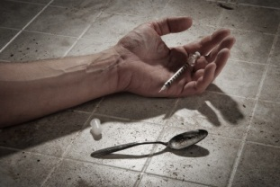
Reducing Opioid Overdose Deaths with Naloxone

Slide 2
Learning Objectives
Describe SEA 227 and SEA 406
List common opioid drug names
Recognize the signs and symptoms of an opioid overdose
Explain how to use naloxone
Recognize possible responses to naloxone
Describe how to provide continued support to the opioid overdose victim
Practice preparing and administering naloxone

Slide 3
The Problem
Opioid abuse and overdose deaths are an EPIDEMIC
Indiana ranked 16th nationally for drug overdose deaths in 2013
Epidemic is growing at an alarming rate
Use – Indiana doctors wrote more opioid prescriptions per person than 41 other states
Abuse – 21% of Indiana high school students and 11.2% of college students reported use of controlled substances for non-medical reasons
Overdose Deaths – Indiana saw a 500% increase in drug overdose deaths between 1999 and 2009
Heroin – Deaths from heroin overdose have increased from 16 in 2007 to 170* in 2014
*2014 data is provisional and subject to change

Slide 4
The Facts
Americans make up 4.4% of the world’s population and consume 80% of the world’s opioids
Enough prescription painkillers were prescribed in 2010 to medicate every American adult 24/7 for a month
4 out of 5 new heroin users said they had used prescription painkillers
Someone dies every 19 minutes from a drug overdose in the U.S.
Notes:
In the US, we consume 79,700 kilograms of hydrocodone which translates to 99.3% of the world consumption.
We consume 60% of oxycodone worldwide
***Since December 2013, there has been an 11% ↓ in the amount of opiates prescribed in Indiana.

Slide 5
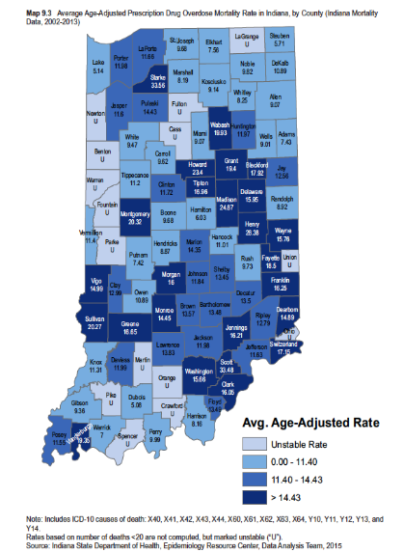
Average Age-Adjusted Prescription Drug Overdose Mortality Rate in Indiana, by County (2002-2013)
( Rates per 100,000)
Notes:
Indiana Center for Health Policy
If the unintentional poisoning death rate stays the same as it was in 2007, about as many Americans will die from unintentional drug poisoning deaths over the next decade as live in cities the size of Newark, New Jersey; Anchorage, Alaska; or St. Paul, Minnesota.”
Dr. Len Paulozzi, National Center for Injury Prevention and Control,
Centers for Disease Control and Prevention
280,000 people, roughly

Slide 6
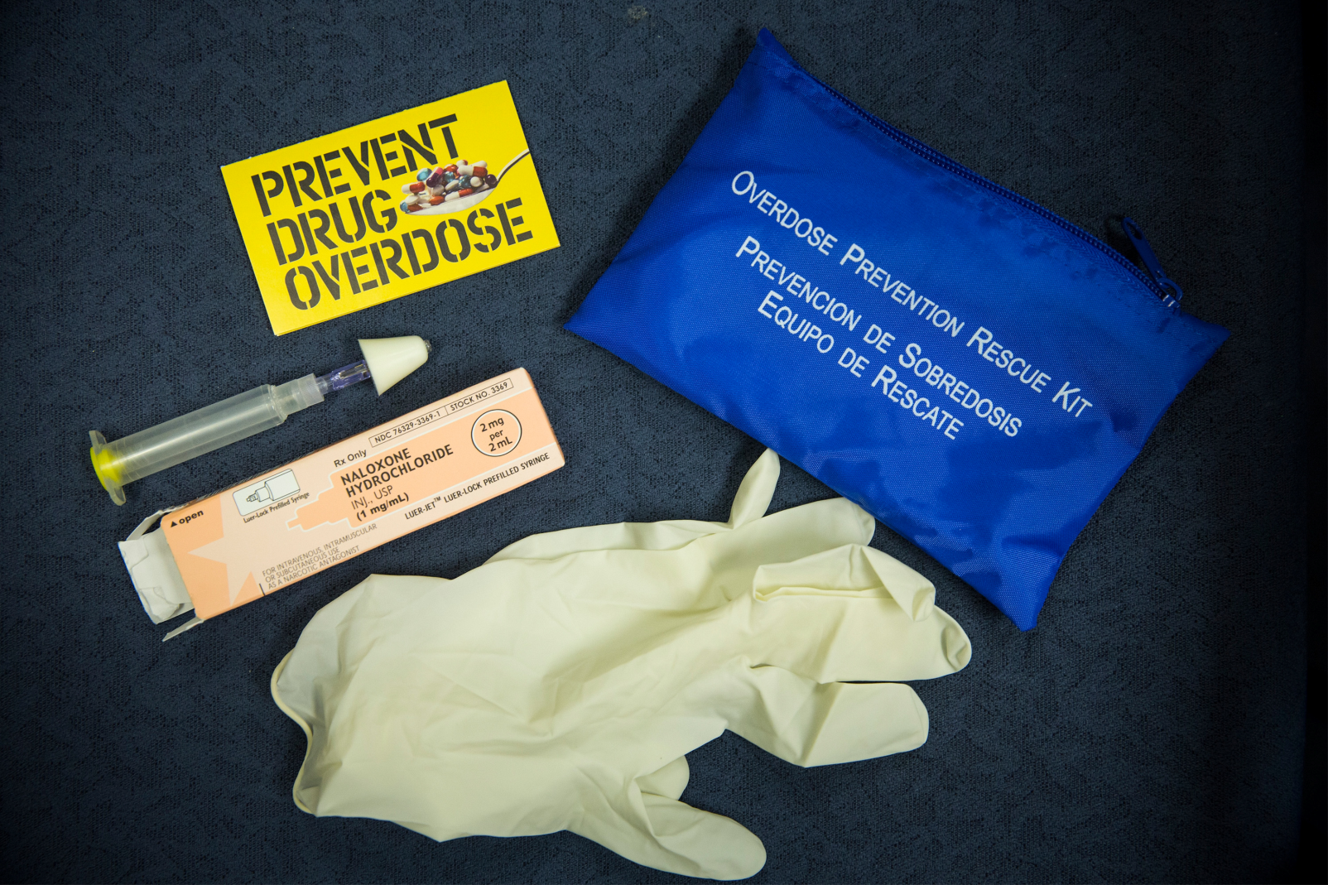
We Must STOP the Bleeding!

Slide 7
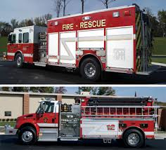
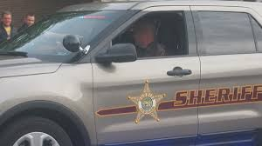
Senate Enrolled Act 227 (IC 16-31-3-23.5)
Any First Responder (EMT, Advanced EMT, emergency medical responder, paramedic, firefighter, volunteer firefighter, or law enforcement officer) can administer an overdose prevention drug [naloxone (Narcan™) or similar drug] to a person with an overdose
Any first responder administering naloxone is immune from civil liability when administering the drug except for an act of gross negligence or willful misconduct
Notes:
Allows certain health care providers to prescribe, and a pharmacist to dispense, an overdose prevention drug to any of these professionals

Slide 8
Senate Enrolled Act 406 (IC 16-42-27-2)
Lay responders also now have the authority to administer naloxone, and include:
a person at risk
a family member
a friend or
any other individual or entity in a position to assist
They must call 911 either immediately before or after administering naloxone

Slide 9
Senate Enrolled Act 406- Reporting Requirements
EMS must report to the Indiana State Department of Health (ISDH):
The number of times an overdose intervention drug is administered before, during, and after EMS arrives on the scene
By any first responder, including Police, Fire, or other Lay responder

Slide 10
How to Report to ISDH
Report through the EMS registry
Police and Fire report their use or any pre-response use to the Transport EMS
All run sheets now have sections for reporting naloxone administration in the field
ISDH is permitted by Indiana Department of Homeland Security (IDHS) to access run sheet data monthly
ISDH will pull the information required for reporting

Slide 11
Questions on Reporting to ISDH?
If you have any questions regarding reporting requirements, contact:
Murray Lawry
Trauma and Injury Prevention Division
317-233-7695
mlawry@isdh.in.gov

Slide 12
Opioids versus Opiates
Opioids – natural and synthetic substances with morphine-like activity
Opiates – subclass of opioids including drugs extracted from opioid (poppy) plant
Opiates and opioids act exactly the same way in the brain!
Notes:
Opiates are morphine, codeine, and heroin and all are derived from opium poppies.

Slide 13
Opioids
Decrease the feeling of and reaction to pain
Depress the nervous system (which can depress breathing)
Provide comfort and may cause euphoria
Are used to treat acute and chronic pain and as anesthesia during surgeries or painful procedures
Medical and illicit opioid use can result in addiction, overdose, and death
Notes:
So, what is an opioid? An opioid is a synthetic or semi-synthetic alkaloid that acts on the central nervous system to decrease perception of and reaction to pain. They are also used to increase pain tolerance. They are prescribed for acute, debilitating, and chronic pain, or palliative care.

Slide 14
Opioids Include
Heroin
Buprenorphine (Suboxone)
Butorphanol (Stadol)
Codeine
Fentanyl (Duragesic patch)
Hydrocodone (Vicodin, Norco)
Hydromorphone (Dilaudid)
Meperidine (Demerol)
Morphine
Nalbuphine (Nubain)
Oxycodone (Percocet/Percodan)
Oxymorphone
Pentazocine (Talwin)
Paregoric
Propoxyphene (Darvon)
Notes:
As you can see, there are many brand and generic names for opioids and opiates.

Slide 15
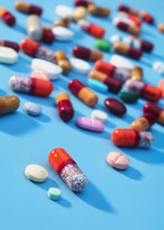
Opioid Effects
Tolerance develops after prolonged use
Person needs increasing amounts to achieve same effects
Common side effects
Nausea and vomiting
Drowsiness
Lethargy
Itching & flushing
Dry mouth
Small pupils
Constipation/difficulty having bowel movements
Notes:
Long term usage of opioids and opiates is known for creating tolerance and/or addiction that requires increasing doses to maintain the same effect. There are many common side effects, but miosis is one that you should be using during your differential diagnosis.

Slide 16
Heroin
Opioid that may be inhaled, snorted, smoked, injected, or swallowed
“Snorting, sniffing, shooting up, mainlining, skin-popping, or muscling”
Street names
Smack, H, Tar, Chiba
Junk, Brown Sugar, Skag, Mud
Dragon, Dope
White, China White, White Nurse/Lady/Horse/Girl/Stuff/Boy
Boy, He
Black, Black Tar, Black Pearl, Black Stuff, Black Eagle
Brown, Brown Crystal, Brown Tape, Brown Rhine
Mexican Brown, Mexican Mud, Mexican Horse
Snow, Snowball
Scat, Sack, Skunk
Number 3, Number 4, Number 8

Slide 17
Opioid Addiction & Treatment
Methadone
commonly prescribed in addiction treatment (liquid)
also used as a pain reliever (pill)
Suboxone and Subutex (Buprenorphine)
commonly prescribed in addiction treatment
also can be used as a pain reliever
Both are long-acting
reduces the craving for opioids for days
can cause prolonged respiratory depression

Slide 18
What Is NOT an Opioid?
Naloxone - reverses opioid overdose
Common street/prescription drugs:
Cocaine, LSD, ecstasy (Molly), sedatives/tranquilizers, marijuana
Benzos, downers, nerve pills, tranks
Valley girl (Valium), barbs
BUT…Overdose deaths typically involve multiple substances, including opioids

Slide 19
Who’s at Risk for Overdose?
People who get opioids from multiple providers
People who use opioids for non-medical reasons
People who use drugs prescribed for others
People who inject drugs
Former users recently released from prison or abstinence-based drug treatment programs
Notes:
Who is at a high risk for an opioid or opiate overdose? As you can see by the list, there are many risk groups.

Slide 20
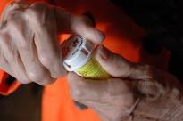
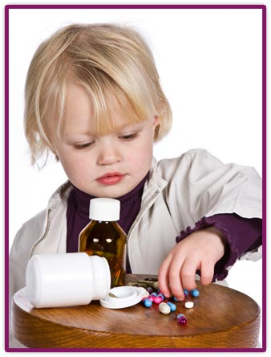
Who Else is at Risk?
Elderly people using opioids for pain
Anyone on high doses of opioids, even if taking medications correctly
People using pain-relieving patches incorrectly
People taking multiple respiratory depressants
People with chronic lung disease or sleep apnea taking opioids
Children who accidentally take pain-killers
Notes:
In addition the elderly, children, and people using pain relieving patches are also at risk for an opioid or opiate overdose.

Slide 21
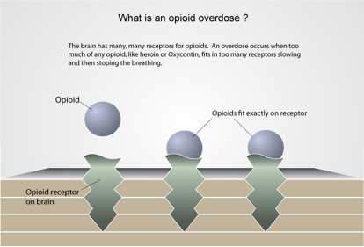
What Is an Opioid Overdose?
Graphics: Maya Doe-Simkins

Slide 22
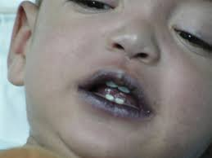
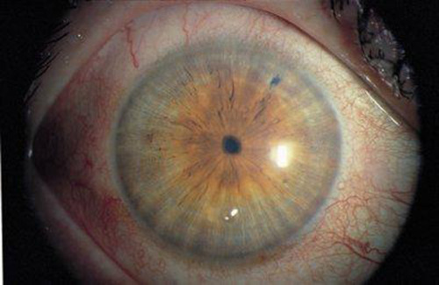
What Does Opioid Overdose Look Like?
No response to stimuli (shaking, sternal rub)
Infrequent or NO breathing
Deep snoring or gurgling (death rattle)
Pale, clammy skin
Blue lips and/or fingertips
Small pupils
Slow pulse
Ultimately, opioids kill by suppressing the drive to breathe!

Slide 23
How Does Naloxone Work?
Opioids slow breathing decreased oxygen flow to the brain brain injury and death
Naloxone
blocks opioid effects
restores breathing
increases oxygen to the brain
Reversing the overdose quickly saves lives
Notes:
Naloxone is NOT effective against respiratory depression due to non-opioid drugs (or other causes)

Slide 24
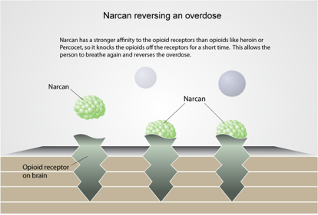
How Does Naloxone Work?
Graphics: Maya Doe-Simkins

Slide 25
Overview of Naloxone Use
Determine that the person is unresponsive and that drug overdose is possible
Contact EMS (Dispatch/911)
Provide rescue breathing to the limit of your skills/comfort level
Administer Naloxone to reverse the cause of failed breathing

Slide 26
When Do you Use Naloxone?
If a person is not responding, and
Bystanders report drug use, or
Drug bottles, needles, cookers or other paraphernalia are found at the scene, or
Signs of injection of drugs are found on the skin (“track marks”), or
The person has a history of opioid use, licit or illicit, or
The person has symptoms of overdose
Notes:
What are the indications of an opioid or opiate overdose? 1. Respiratory arrest or hypoventilation with evidence of use by bystander report, drug paraphernalia, prescription bottles, or track marks – and/or 2. recognition of the opiate/opioid toxidrome.

Slide 27
If Other Drugs are Found
Other drug (non-opioid) overdoses won’t respond to naloxone, but….
People who overdose have often taken multiple drugs, including opioids, so give naloxone!
Hypersensitivity or allergy to the drug is extremely rare, but overdose death is not

Slide 28
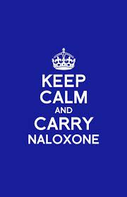
Naloxone Administration
Intranasal (IN) spray
Injection
Auto-injector
IV injection
IM injection

Slide 29
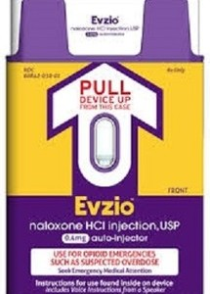
Naloxone Auto-Injector
EZVIO (naloxone) is a take home auto-injector
FDA approved 4/2014
Each dose contains 0.4 mg naloxone/0.4 ml
Comes in a box of two single dose auto-injectors plus a training injector

Slide 30
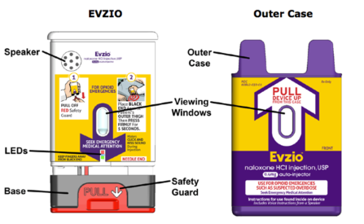
EVZIO
Pull naloxone auto-injector from case
Device will now provide voice-prompt guidance
Grasp firmly and pull off red safety guard
Notes:
Instructions are specific to EVZIO naloxone autoinjector. Minor variations may be required for other devices (such as time held against thigh or location of safety guard)
If battery fails or voice prompts are not delivered, auto-injector should still function.
After injection is complete and autoinjector removed from patient, device should shield needle.

Slide 31
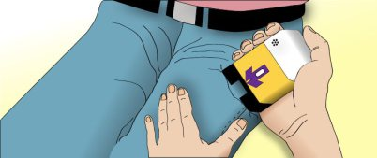
EVZIO
Place black end against patient’s outer thigh
Press firmly against patient’s outer thigh and hold in place for five seconds
Remove auto-injector and dispose in sharps container
Continue to support patient’s breathing within your abilities

Slide 32
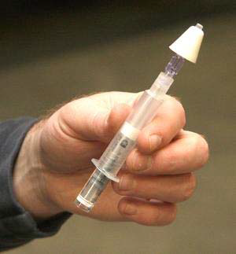
Intranasal Naloxone
Very low risk of exposure to blood (no exposed needle)
Can be administered quickly and with little training
Rapid onset of action
Very effective when used properly
Notes:
There are many positive reasons for bystanders to administer intranasal naloxone. It minimizes the risk for blood borne pathogen exposure. It can be rapidly administered and naloxone has a 3-5 minute onset with peak effect in 12-20 minutes.

Slide 33
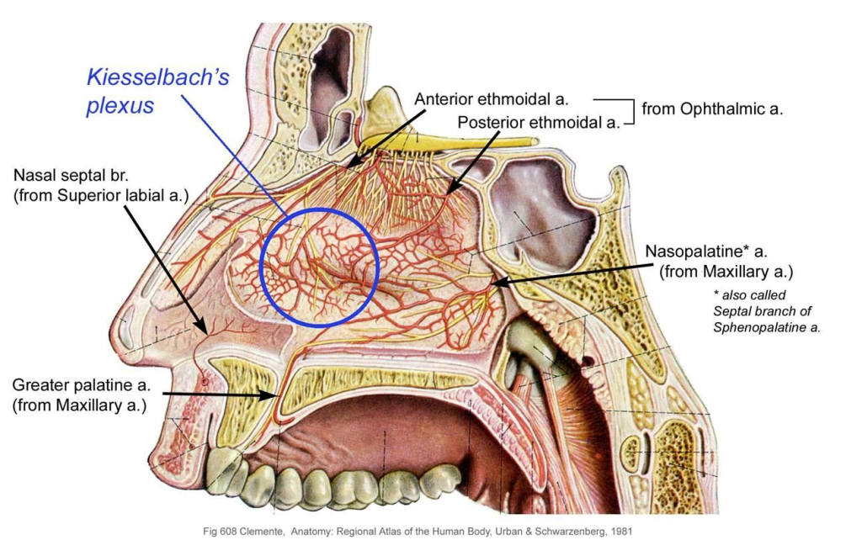
Intranasal Naloxone
Nose is lined with lots of tiny blood vessels which quickly absorb naloxone into the blood stream
Notes:
Intranasal administration allows bystanders to administer naloxone almost as quickly as the intravenous route. The nasal mucosa is highly vascularized and absorbs drugs directly into the blood stream.

Slide 34
Why Use an Atomizer?
Atomizer turns the liquid into a fine mist
Squirting the drug as mist covers more surface area inside the nose
More surface = more blood vessels = more naloxone into the bloodstream
Notes:
Briskly compressing the syringe converts the liquid naloxone into a fine atomized mist. This results in broader mucosal coverage and better chance of absorption into the blood stream than drops that can run straight back into the throat.

Slide 35
Nasal Atomizer Use

Slide 36
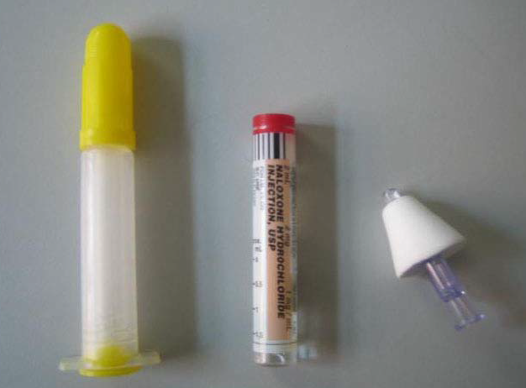
Preparation: Step 1
Notes:
For equipment, you will need one luer-jet needle free syringe, one vial of naloxone, and one atomizer.

Slide 37
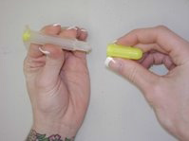
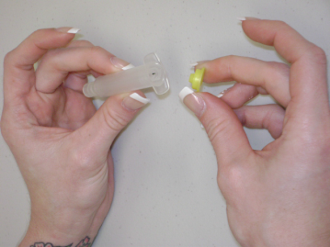
Preparation: Step 2
Notes:
Remove the caps from both ends of the luer-jet needle free syringe.

Slide 38
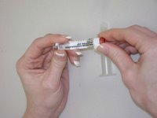
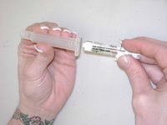
Preparation: Step 3
Notes:
Remove the red cap from the naloxone vial. Screw the now open end of the vial into the syringe. It will become difficult to turn when it is threaded enough.

Slide 39
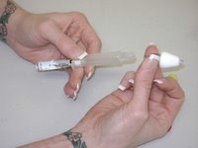
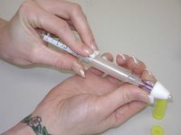
Preparation: Step 4
Notes:
Attach the nasal atomizer to the opposite end.

Slide 40
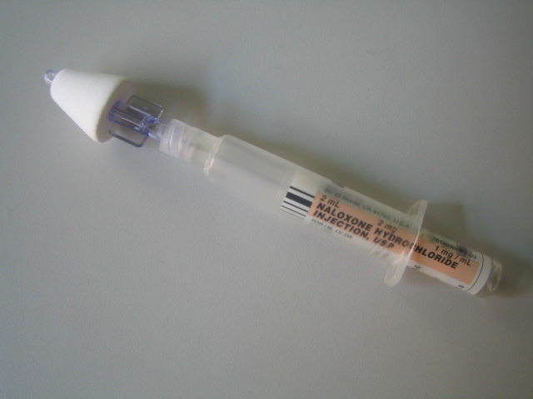
One Luer Attached Atomizer
Notes:
This is what your final product should look like!

Slide 41
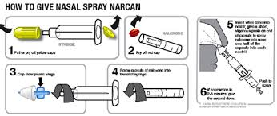
Using Intranasal Naloxone
Do rescue breathing if you know how
See if nose is free of blood or mucous
Assemble kit
Notes:
The administration will take some choreographing of your team members. Continue to ventilate your patient, assess the nares and suction as needed. Control your patient’s head and place the atomizer in one nare while carefully occluding the opposite nostril.

Slide 42
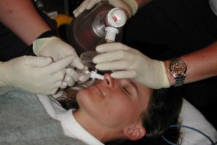
Using Intranasal Naloxone
Gently, but firmly, place the atomizer in one nostril and spray half the medication
Repeat on the other side
If only one nostril is available, spray all medication on that side
Notes:
The administration will take some choreographing of your team members. Continue to ventilate your patient, assess the nares and suction as needed. Control your patient’s head and place the atomizer in one nare while carefully occluding the opposite nostril.

Slide 43
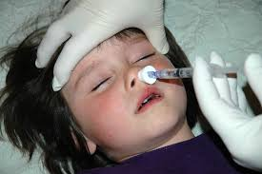
Using Intranasal Naloxone in Infants or Small Children
Use less of the liquid (one quarter dose in each nostril)
Repeat as needed in five minutes if the ambulance has not arrived and the child is still unresponsive
Notes:
Pediatric patients are less likely to be suffering from an overdose caused by intentional use, but children can still be victims of an opioid overdose, usually inadvertently from ingestion of non-secured medications. Treatment doses for pediatric patients are as follows:
Infant: 0.5mg per nostril (total 1mg)
Child: 1mg per nostril (total 2mg)

Slide 44
What Am I Going to See?
Respiratory rate increases
No Breathing → Breathing
Color improves
Blue → “Normal” color
Level of consciousness improves

Slide 45
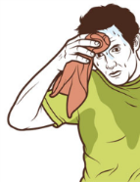
What Am I Going to See?
Intranasal naloxone can cause opioid withdrawal:
Runny nose & sweating
Nausea & vomiting
Fast heart rate
Shakes
Agitation, irritability, restlessness, confusion
Fear of causing withdrawal should not prevent use when the person is unresponsive
Withdrawal is NOT life-threatening--overdose IS
Notes:
Rapid opioid or opiate withdrawal may also cause the above signs and symptoms. This is more common in the chronic opioid or opiate user who has been administered naloxone. Nevertheless, if a patient is in respiratory arrest secondary to an opioid or opiate overdose, the administration of naloxone is a life-saving time-critical action.

Slide 46
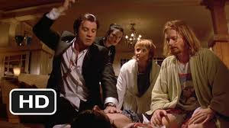
What about Combativeness?
Usually not seen with intranasal naloxone
Recent study showed #1 effect is confusion
<3% became violent/combative
Goal: Take person from dead to not dead
Goal: Safe transfer to EMS providers

Slide 47
What If It’s NOT Working?
Give second dose of naloxone
Some opioids (long-acting, large doses) require more
It may NOT work if
Person has been out for too long
Person has used other substances (EtOH, Benzos) without opioids
But it won’t hurt, so GIVE naloxone

Slide 48
Naloxone Duration
Naloxone wears off in 20-90 minutes
Some opioids (buprenorphine and methadone) can last for 24-36 hours
Monitor patient carefully
Transport patient to ED ASAP
Repeat dose if it wears off

Slide 49
Key Points to Remember
Support patient breathing, if you know how
Spray naloxone 2.0 mg (half in each nostril – less for infants and small children)
Continue to provide breathing support
Transport patient to ED
Be prepared to readminister naloxone if first dose didn’t work or wears off
Report ANY naloxone administration in the field to ISDH via the EMS Run Sheet
Notes:
For an adult, the dose is 2mg of naloxone. For intranasal administration, this is 1mg of Naloxone per nostril. Remember, the onset for naloxone is 3-5 minutes, so you may need to continue ventilating the patient. Also, consider contacting poison control or local medical control if poly-substance use is suspected.

Slide 50
Skills Practice
Given a scenario
Prepare an intranasal naloxone atomizer using the required equipment
Demonstrate administration of intranasal naloxone on an adult intubation head
Demonstrate use of the EZVIO auto-injector using the training device (if available)
Demonstrate as well as explain how you would provide continued support
Always request EMS (Dispatch/911)
Notes:
You will need to practice drawing up the correct dosage and administering intranasal naloxone. Your practice of the 6 drug rights and of intranasal narcan administration will occur at your squad.

Slide 51
Course Summary
What we learned
Drug overdose deaths are epidemic nationally and in Indiana
First responders can legally administer naloxone to overdose victims
Naloxone is a safe and effective way to reverse opioid overdoses
The risk factors for opioid overdose
What an opioid overdose looks like
When to use naloxone
How to prepare an intranasal atomizer
How and when to use the intranasal atomizer
How to utilize the EZVIO auto-injector (if available)

Slide 52
Credit and Acknowledgements
VT EMS/VDH/DPS
Central MA EMS Corp.
Northwestern Medical Center
VT Department of Health
VT Department of Public Safety
Indianapolis EMS
Indiana State Department of Health

Slide 53
References
Indiana State Department of Health
Indiana Department of Homeland Security
Centers for Disease Control and Prevention
Drugs.com
Food and Drug Administration
MDPH Bureau of Substance Abuse Services
N.O.M.A.D. (Not One More Anonymous Death Overdose Prevention Project)
Overdoselifeline.org

