Slide 1
Injury prevention advisory council (IPAC) & Indiana violent death reporting system (INVDRS) Meeting
08/05/2022

Slide 2
OUR MISSION:
To develop, implement and provide oversight of a statewide comprehensive trauma care system that:
Prevents injuries.
Saves lives.
Improves the care and outcomes of trauma patients
OUR VISION:
Prevent injuries in Indiana.

Slide 3
Round Robin and Introductions (in chat)
Name
Position
Organization/ Association
Updates
Current Projects and Programs
Upcoming events

Slide 4
Division Vacancies
Community Outreach Coordinators - 2

Slide 5
Division Staff Updates
Full-Time Staff
Interns
Drug Overdose Prevention Epidemiologist
Allison Lake, MPH
Fall internships now open!
INVDRS – contact Morgan
Trauma – contact Emma

Slide 6
Grant Updates
NVDRS 2022-2025 Application - Pending
Coroner Minigrant
Awarded $25,000 to date
Open for 1 more month – Sept 1.
Naloxone – contact Laura Hollowell: LHollowell@health.in.gov
FR CARA
Local Health Department

Slide 7

Resource Guide App
Currently undergoing a much-needed overhaul
Content and design will be updated
Relaunching the app in the future

Slide 8
Upcoming Events
August
Children’s Eye Health and Safety Month
August 31st – Overdose Awareness Day
September
Sept 4-10 – National Suicide Prevention Week
Sept 19-23 – National Farm Safety and Health Week
National Suicide Prevention Month
October
Domestic Violence Awareness Month
National Substance Abuse Awareness Month
Oct 16-22 – National Teen Driver Safety Week
Oct 23-30 – Red Ribbon Week
November
Winter Safety Awareness Month

Slide 9
Indiana 988 Implementation Update
Kara Biro
Director of Behavioral Health Crisis Care
kara.biro2@fssa.in.gov

Slide 10
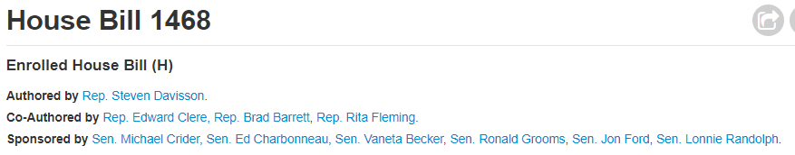
What is 9-8-8 in Indiana?
“Specifies that the division of mental health and addiction (division) has primary oversight over suicide prevention and crisis services activities and coordination and designation of the 9-8-8 crisis hotline centers. Sets forth requirements to be designated as a 9-8-8 crisis hotline center. Establishes the statewide 9-8-8 trust fund.”
“Not later than July 1, 2022, the division may designate at least one (1) 9-8-8 crisis hotline center in Indiana to coordinate crisis intervention services and crisis care coordination to individuals accessing the 9-8-8 suicide prevention and behavioral health crisis hotline (9-8-8 crisis hotline) from anywhere in Indiana twenty-four (24) hours a day, seven (7) days a week.”
Per the bill, DMHA will have oversight over
9-8-8 crisis hotline center(s)
Crisis receiving and stabilization services
Mobile crisis teams
Notes:
(c) In order to be designated by the division under subsection (b), a 9-8-8 crisis hotline must meet the following:
(1) Have an active agreement with the administrator of the national suicide prevention lifeline for participation within the network.
(2) Comply with the national suicide prevention lifeline requirements and best practice guidelines for operational and clinical standards.
(3) Use technology, including chat and texting that is interoperable between and across crisis and emergency response systems used throughout Indiana to ensure cohesive and coordinated crisis care.
Sec. 7. The division shall adopt rules under IC 4-22-2 to allow appropriate information sharing and communication between and across crisis and emergency response systems for the purpose of real time crisis care coordination, including deployment of crisis and outgoing services and linked, flexible services specific to crisis response.
Sec. 8. (a) A designated 9-8-8 crisis hotline center may deploy crisis and outgoing services, including mobile crisis teams, and coordinate access to crisis receiving and stabilization services or other appropriate local sources in accordance with guidelines by the national suicide prevention lifeline.
(b) A designated 9-8-8 crisis hotline shall coordinate access to crisis receiving and stabilization services for individuals accessing the 9-8-8 suicide prevention and behavioral health crisis hotline through appropriate information sharing concerning availability of services.
(c) A designated 9-8-8 crisis hotline center shall meet the requirements set forth by the national suicide prevention lifeline for serving high risk and specialized populations, including individuals with co-occurring mental health and substance use disorders and other relevant and culturally sensitive special populations, as identified by the federal Substance Abuse and Mental Health Services Administration, including training requirements and policies for transferring callers to an appropriate specialized center or subnetwork.
(d) A designated 9-8-8 crisis hotline center must provide follow-up services to individuals accessing the 9-8-8 crisis hotline consistent with guidelines and policies established by the national suicide prevention lifeline.
Sec. 9. Before March 1 of each year, a designated 9-8-8 crisis hotline center shall submit a written report to the division concerning the 9-8-8 crisis hotline's usage and the services provided by the center.
Sec. 10. (a) The division shall coordinate: (1) available onsite response services of crisis calls using state and locally funded mobile crisis teams; and (2) crisis receiving and stabilization services resulting from a 9-8-8 call.

Slide 11
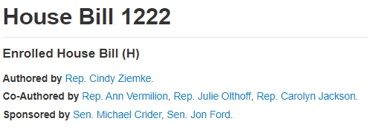
What is 9-8-8 in Indiana?
The mobile crisis teams must include a peer certified by the division and at least one of the following:
A behavioral health professional licensed under
An other behavioral health professional (OBHP) as defined in 440 IAC 11-1-12.
Emergency medical services personnel licensed under IC 16-31.
Law enforcement based co-responder behavioral health teams.
Crisis response services provided by a mobile crisis team must be provided under the supervision of:
a behavioral health professional licensed under IC 25-23.6
a licensed physician or a licensed advance practice nurse or clinical nurse specialist.
The supervision required under this subsection may be performed remotely.

Slide 12
The 988 Centers function as Care Traffic Control Centers
Someone to Contact
Statewide 988 Center(s)
Someone to Respond
Mobile Crisis Response and Stabilization Teams
A Safe Place for Help
Short-term Crisis Stabilization Centers
Status Disposition for Intensive Referrals
Shared Bed Inventory Tracking
High-tech, GPS-enabled Mobile Crisis Dispatch
24/7 Outpatient Scheduling
Real-time Performance Outcomes Dashboards
Notes:
This is a chance to transform Crisis Care
A system capable of serving anyone, anytime, anywhere

Slide 13
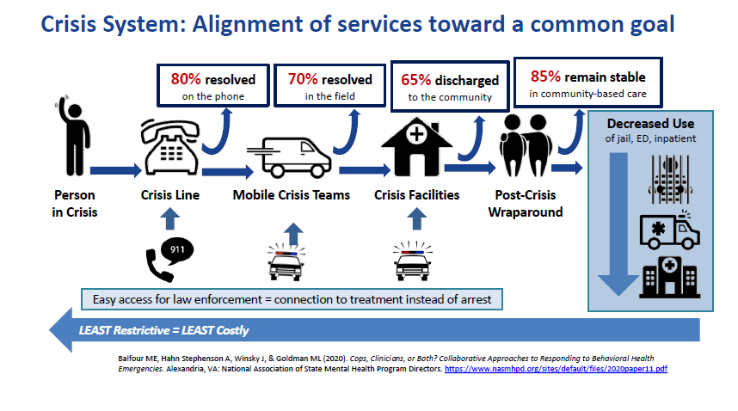

A Crisis System that Works
The above image is a reproduced slide from the April 2, 2021
Congressional Briefing: Mental Health is Not a Crime:
How 988 and Crisis Services will Transform Care

Slide 14
Vision and Mission Statements for 9-8-8 (Indiana)
Vision
Mission
Applying a recovery orientation that includes:
Providing quick, competent, and nation-leading crisis response services for every Indiana resident
Creating a sustainable infrastructure that will fully coordinate crisis care for mental health, substance use, and suicidal crises
significant use of peer staff,
collaboration with law enforcement,
and a commitment to Zero suicide/suicide safer care and the safety of consumers and staff
trauma-informed care,
person and family centered focus,
Notes:
This vision sets person-centered care as the primary goal of the 988 system
This is important because “Systems have a tendency to produce exactly and only what you ask them to produce.”

Slide 15
Peers are the Key that unlocks the Potential of Crisis Care
Common Themes in Elevated Stress Response | Potential Ways to De-Stress Crisis Response
Threat of Social Evaluation (e.g., public speaking) | Safety, Trustworthiness, Dignity and Respect
Lack of Control over Outcomes | Collaboration, Empowerment, and Peer Support
Unpredictability | Information Sharing and Peer Support
Perception of Things Getting Worse | Trustworthiness and Peer Support
No Frustration Outlets (e.g., hobby, exercise, etc.) | Peers Connecting to Local Support Systems
Low Social Support (e.g., rejection) | Peers Connecting to Local Support Systems

Slide 16
988 Committees: Answering Questions for the Infrastructure of the Indiana 988 Crisis Line
Notes:
Each committee's overall goal is to help realize the State of Indiana's vision for 988 which is to provide quick, competent, and nation-leading crisis response services for every Indiana resident.

Slide 17
988 Planning Committees
Operations and Training
Equity
Ensuring that people in crisis are treated justly according to their circumstances
Marketing and Education
Improving public understanding and awareness of 988 services
Resources, Referrals, and Linkages
Ensuring 988 centers have up-to-date resources and linkage information
Developing standardized operational standards and training for Indiana's 988 Centers
Notes:
We currently have 58 members spread throughout four 988 planning committees which I will dive into more about later in the presentation.
Who is at the table:
NSPL Center Representatives
First Responder Representatives
Crisis and Suicide Intervention Representatives
Intellectual and Developmental Disability Representatives
Medicaid Representatives
Community Mental Health Center (CMHC) Representatives
NAMI Representatives
Crisis Intervention Team Representatives
Those with Lived Experiences
Those with Extensive Knowledge of Local/State Resources
Those with a Passion for Equitable and Accessible Mental Health Services and Criminal Justice Diversion

Slide 18
911 and 988 Working Together to Serve All Indiana Residents

Slide 19
Forming Relationships and Understanding One Another
121 Public Safety Answering Points (PSAPs) in Indiana
December 2021 all were invited to join a committee to look at interoperability
Goal was to have representation from all 4 quadrants of the state, as well as central Indiana
All 4 quadrants and Central Indiana represented
Representatives from State 911 Board
Notes:
First meeting was held in January; Over 30 counties represented – over 40 members
Bridging language barriers between PSAPs and 988 -Codes, signals, and behavioral health language
Data Collection – different platforms within law enforcement
Training – what is currently offered, when, and how vs. what do we want for the future
What calls for service is 911 comfortable diverting to 988
Understanding the role and training of 988 crisis specialists at our National Suicide Prevention Lifeline Centers (NSPLs)

Slide 20
UNintentional injury presentation: Stepping On: Older Adult Fall Prevention
Maria Cariaso
Injury Prevention Program Coordinator

Slide 21

Stepping On
Stepping On is a high-level, evidence-based program proven to reduce falls and build confidence in older adults.
a 7-week (one 2-hour session per week) falls prevention program
The program has demonstrated a 31% reduction in falls.

Slide 22
Stepping On Cont.
Group members set short term goals each week - goals that focus on life activities that are most important to them
Physical therapists, pharmacists and other experts help the group adapt fall prevention practices for individual needs and levels

Slide 23
Stepping On Cont.
It is a discussion-based program
Two trained facilitators lead the discussion
Who can become a facilitator?
First responders
Injury prevention coordinators
Community leaders
Hospital staff

Slide 24
Stepping On Cont.
Guest experts are brought in to discuss topics such as:
Exercising and moving about safely- Physical Therapist
Proper use of canes and walkers- Physical Therapist
Vision and Falls- Optometrist
Medication Management- Pharmacist
Getting Out and About- EMS

Slide 25
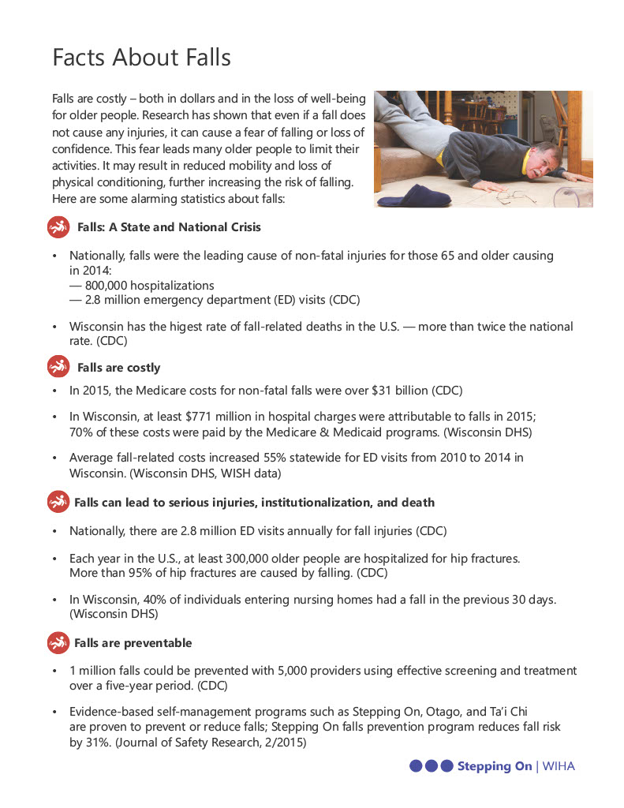
Facts from WIHA

Slide 26
Upcoming workshops
First Indianapolis workshop
Fridays from September 9 – October 21, 2022
University of Indianapolis Health Pavilion
9:30 – 11:30 a.m.
FREE REGISTRATION * FREE PARKING

Slide 27
Thank you!
For more information please contact:
Maria Cariaso
Injury Prevention Program Coordinator
mcariaso@health.in.gov
3172344943

Slide 28
intentional injury presentation: racial disparities in violent deaths
Morgan Sprecher
Indiana Violent Death Reporting System Epidemiologist

Slide 29
Violent Deaths Race Breakdown, 2016-2020

Slide 30
Homicide Death Rate
Black
White
Asian

Slide 31
Legal Intervention Death Rate
Black
White
Asian

Slide 32
Suicide or Self-Harm Death Rate
White
Black
Asian

Slide 33
Undetermined Death Rate
Black
White
Asian

Slide 34
Unintentional Poisoning Death Rate
Black
White
Asian

Slide 35
Weapon Type by Race
Black - 2,903 Deaths
White – 12,884 Deaths

Slide 36
Substances Present at Death, 2016-2020
Black
White

Slide 37
Suicide Circumstances, 2016-2020
Black
White
~33% reporting
~50% reporting

Slide 38
Holly’s House
Crystal Simmons
Curriculum Development Specialist
Holly’s House

Slide 39
Discussion
What do we, in Indiana, do well when it comes to the topics from today?
How can / where can we improve this?

Slide 40
2022 Meeting Dates
November 4

Slide 41
THANKS!
Presenter | Phone | Email
Morgan Sprecher | 317-234-9825 | msprecher@isdh.in.gov
Emma Heltzel | 317-234-3265 | eheltzel@isdh.in.gov
Maria Cariaso | 317-234-4943 | mcariaso@health.in.gov
Kara Biro | 317-903-7361 | Kara.biro2@fssa.in.gov
Crystal Simmons | 812-437-7233 | scission@hollyshouse.org

