Slide 1
What is Brain Injury?
Flora McConnell Hammond, MD
Professor & Chair, Physical Medicine & Rehabilitation
Indiana University School of Medicine
Chief of Medical Affairs, Rehabilitation Hospital of Indiana

Slide 2
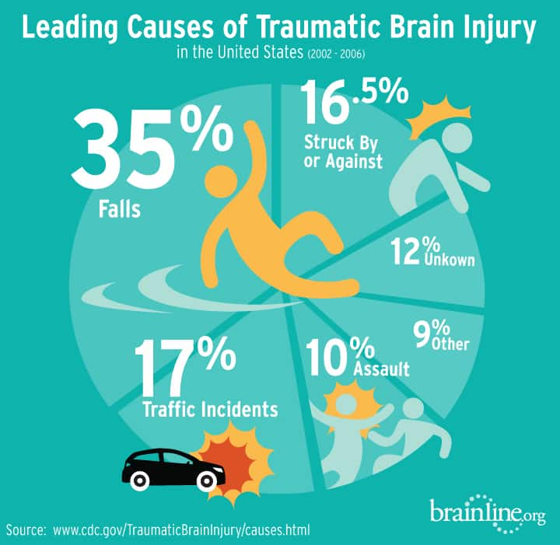
What is Brain Injury?
Traumatic brain injury (TBI) = an external force to head that causes altered consciousness.
Dazed/confused for seconds or minutes to unconsciousness (coma) for minutes to days.
e.g., fall, motor vehicle crash, sports, flying object
Anoxic brain injury = due to lack of oxygen.
e.g., cardiac arrest, drug overdose, respiratory failure.

Slide 3

Who does brain injury affect?: Anyone, Anytime, Anywhere …
Notes:
Anyone…
Young (late teens – 20’s) due to MVC and sports.
Elderly due to falls.
Traumatic BI: Most commonly due to falls & MVC.
Anoxic brain injury: Most commonly due to cardiac arrest & drug overdose.
TBI causes altered consciousness: Dazed/confused for seconds or minutes to unconsciousness (coma) for minutes to days.

Slide 4
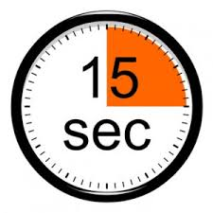

Brain Injury is Common
2.5 million TBIs annually in US (1% US population)
  Most are “mild” TBIs
    Many don’t seek medical attention
  88% seen in ED and released
  11% hospitalized
  3% die
  6% live with long-term disability
  Common to not be told that a brain injury occurred
  May struggle and not know why
Notes:
Extremely common: 1 every 15 seconds.
Most walk away with no treatment needed.
Many other need treatment.
11% hospitalized
only 6% go on to live with longterm disability
Many not diagnosed or never told that they had a brain injury.

Slide 5
Mild TBI is AKA:
Concussion
Mild head injury
Minimal head injury
Benign head Injury
Trivial head injury
Low risk
Grade I, Class I
Dinged
Bell Rung
Acquired brain injury
Complicated vs. uncomplicated
Commotio cerebri
Concussion
=
Mild TBI
Notes:
Concussion is a brain injury,… a mild TBI.
Lots of terms for mild TBI.
“Mild” --- misleading
-just what it looks like in the first 24 hours; does not have to do with outcome/consequences

Slide 6
Mild Traumatic Brain Injury
Definition of Mild TBI
  An applied force that causes:
    Altered mental state at the time of the incident; or
    Loss of consciousness <30 minutes; or
    Loss of memory of the event immediately before or after (PTA) <24 hours
Loss of consciousness is not related to symptom development
Brain injury diagnosis is not based on not imaging
  CT scan imaging is normal in most mild TBI (80-90%) & some moderate-to-severe TBI
  Diffuse axonal injury (due to shearing forces) not always seen on CT scan
Notes:
MILD TBI: What is it: dazed, confused, +/- LOC (less than 30 minutes)
LOC not required & does not determine presence of longterm effects
CT SCAN is usually normal; Occasionally have findings on CT scan (10-20%).
Brain injury diagnosis is not based on imaging.

Slide 7
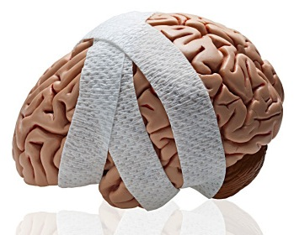
Potential Consequences of Mild Traumatic Brain Injury
Life Threatening
  Intracranial hemorrhages
  Second Impact Syndrome
Immediate effects (1-2 weeks)
  Somatic, cognitive, emotional & behavioral changes
Longer term effects
  Persisting symptoms: postconcussive syndrome
  Risks of re-injury & cumulative effects of reinjury
    Impulsivity, impaired balance, altered attention, substance use
Notes:
Risks:
-Intracranial bleeding in hours after the injury (elderly, on anticoagulants)
-2nd impact syndrome: Repeat injury soon after → second impact syndrome [Severe brain swelling resulting from suffering a 2nd TBI before recovering from a 1st TBI] Catastrophic (50% die). Refractory to treatment. Swelling → brain herniation → severe damage/death. (Younger population (< 21 y.o.) at high risk due to higher water volume & less space within the skull to accommodate for swelling.)
-
Outcomes:
- Generally completely resolve (mostly within 2 weeks).
- Some don’t improve readily. May effect ability to work or complete routine activities.
- Majority asymptomatic at 1 year.

Slide 8
Post-Concussive Syndrome:
A constellation of symptoms resulting from mild TBI
Physical Symptoms
Headaches
Dizziness / vertigo
Nausea & vomiting
Fatigue
Sleep disturbance
Tinnitus
Incoordination
Balance impairment
Vision disturbance
Light & noise sensitivity
Loss of smell and taste
Cognitive Symptoms
Short-term memory impairment
Poor attention
Slowed information processing
Organization
Problem solving
Initiation
Affective Symptoms
Depression
Anxiety
Irritability
Impatience
Anger control
Aggression
Disinhibition
Lability
Need to recognize, reassure, educate, & treat
Outcomes: Generally completely resolve (mostly within 2 weeks). Some don’t improve readily. May effect ability to work or complete routine activities. Majority asymptomatic at 1 year.

Slide 9
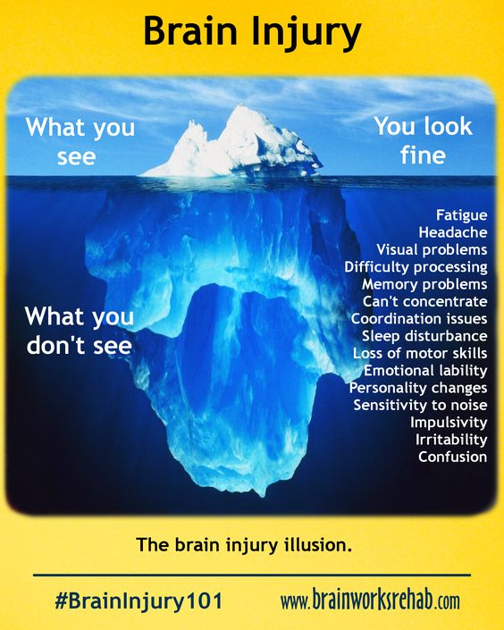
Living with mild, moderate, severe brain injury
A Silent Epidemic
Dizziness
Imbalance
Depression
Spasticity
Pain
Notes:
.

Slide 10
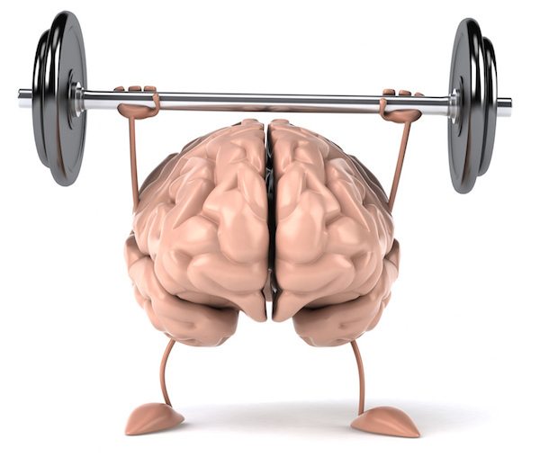
Pain & Brain Injury
Fractures, and later possible osteoarthritis
Complex regional pain syndrome
Peripheral nerve injury
Headaches
Management of pain after brain injury has unique considerations
Important to know if one has history of brain injury

