Slide 1
Education and Resources for Individuals with TBI

Slide 2
Professionals Who Work with Individuals with Brain Injury

Slide 3
Professionals who work with individuals with brain injury: Clinical Neuropsychologist
A Clinical Neuropsychologist specializes in the clinical evaluation of brain functions and other psychological conditions for purposes of:
Diagnosis, or possible diagnosis that may be associated with cognitive and/or behavioral impairments.
Differentiate between possible causes of cognitive and/or behavioral impairments (e.g., traumatic brain injury versus anxiety, dementia versus depression).
Determining needed and appropriate treatments (e.g., psychotherapy, rehabilitation therapies, referral to a specific type of physician (e.g., psychiatrist, physical medicine and rehabilitation).
Clinical Neuropsychologists provide:
Patient and family education about the effects of brain injury.
Both individual and group therapy to promote adjustment to brain injury.
Cognitive rehabilitation for people with brain injury.

Slide 4
Professionals who work with individuals with brain injury: Rehabilitation Psychologist
A Rehabilitation Psychologist specializes in the clinical evaluation of adjustment to disability and the development of psychological or rehabilitation treatment plan for the purpose of:
Determining needed and appropriate treatments (e.g., psychotherapy, rehabilitation therapies, referral to a specific type of physician (e.g., psychiatrist, physical medical and rehabilitation).
Rehabilitation Psychologists provide:
Patient and family education about the effects of brain injury.
Both individual and group therapy to promote adjustment to brain injury.

Slide 5
Professionals who work with individuals with brain injury: Physiatrists
Physiatrists are Physical Medicine and Rehabilitation (PM&R) physicians, who treat a wide variety of medical conditions affecting the brain, spinal cord, nerves, bones, joints, ligaments, muscles, and tendons. They are medical doctors who have completed training in the specialty PM&R, and may be subspecialty certified in Brain Injury Medicine, Hospice and Palliative Medicine, Neuromuscular Medicine, Pain Medicine, Pediatric Rehabilitation Medicine, Spinal Cord Injury Medicine, and/or Sports Medicine.
A Physiatrist, who has subspecialty of Brain Injury Medicine, provides:
Evaluation and treatment of the impact of brain injury on the functioning of the patient’s body (e.g., posture, balance, mobility) in addition to the cognitive and behavioral consequences of the injury.
Management and coordination of an interdisciplinary brain injury team. This can include some if not all of the professionals mentioned in this presentation.

Slide 6
Professionals who work with individuals with brain injury: Neuro-opthamologist & Case Management
A Neuro-opthamologist is a medical specialist who treats vision problems, monitors changes in visual acuity, and other problems that may develop as a result of damage to the brain.
A Brain Injury Resource Facilitator, Case Manager, or Care Coordinator are professionals who are typically responsible for the identification, navigation and facilitation of community reintegration for individual with brain injury. Because these rolls vary across programs, so does their the title of the position. All, however, guide and advocate for their patient or client by:
Contact with the individual and family.
Contact various community and social service providers.
Contact with rehabilitation providers to advocate and assist as well as provide assistance throughout brain injury continuum.

Slide 7
Professionals who work with individuals with brain injury: Therapists
Inpatient and Outpatient Therapy includes the following types of therapists:
Physical Therapist (PT) who focuses on improving physical function by addressing muscle strength, flexibility, endurance, balance, and coordination.
Occupational Therapist (OT)who use purposeful activities as a means of preventing, reducing, or overcoming physical, cognitive and emotional challenges to ensure the highest level of independent functioning in meaningful daily living.
Speech Therapist (SLP) who evaluates an individual’s ability to comprehend what is seen or heard, as well as express oneself through speech, writing, or other forms of communication. Also, some speech therapists are trained in cognitive rehabilitation
Certified Driving Rehabilitation Specialist (CDRS): are professionals who have completed additional training and education in the field of driver rehabilitation

Slide 8
Types of Brain Injury Rehabilitation

Slide 9
Types of Brain Injury Rehabilitation: Post-acute Rehabilitation
Post- Acute Rehabilitation:
Goal of post-acute rehabilitation is to help the person become as independent as possible.
This type of comprehensive rehabilitation in a post-acute facility is considered the gold standard for care and treatment following brain injury.
Post-acute care settings include long-term care hospitals (LTCHs or LTACs), inpatient rehabilitation facilities (IRFs), skilled nursing facilities (SNFs) and home health agencies.
Notes:
Acute Rehabilitation Setting: As early as possible in the recovery process, individuals should begin this.
Activities of daily living include dressing, eating, using the bathroom, walking, and speaking.
Post-Acute Rehabilitation: When patients are well enough to participate in more intensive therapy,

Slide 10
Brain Injury Rehabilitation: Types of Post-acute Rehabilitation
Inpatient Rehabilitation Facilities- Acute Rehabilitation:
The treatment is provided in a special unit of a trauma hospital, a rehabilitation hospital, or another inpatient setting.
During acute rehabilitation, a team of health professionals with experience and training in brain injury work with the patient to regain as many activities of daily living at the highest level of functioning possible.
Sub-acute Rehabilitation:
Designed for persons with brain injury who need less-intensive rehabilitation services over a longer period of time or those who have made progress in an acute rehabilitation setting (and are still progressing) but are not making rapid functional gains. May be provided in a variety of settings, such as a skilled nursing facility or nursing home.
Long-Term Acute Care:
Facilities designed to provide extended medical and rehabilitative care for patients who are clinically complex and have multiple acute or chronic conditions (Liu et al., 2001).
Home Health Care:
Includes, but is not limited to: skilled nursing care, physical therapy, occupational therapy, speech therapy, and care by home health aide.
Notes:
Sub-acute: Patients who cannot tolerate intensive therapies may be transferred to a sub-acute rehabilitation facility.
Liu, K., Baseggio, C., Wissoker, D., Maxwell, S., Haley, J., & Long, S. (2001). Long-term care hospitals under Medicare: Facility-level characteristics. Health Care Financing Review, 23(2), 1-18.
https://www.cms.gov/Medicare/Medicare-Fee-for-Service-Payment/LongTermCareHospitalPPS/Downloads/ltchurban.pdf

Slide 11
Types of Brain Injury Rehabilitation: Outpatient
Outpatient Rehabilitation (speech, occupational, physical, vision):
Therapies to maintain and enhance recovery of Individuals whose injuries were not severe enough to require hospitalization or who were not initially diagnosed with a brain injury when the incident occurred may attend outpatient therapies to address problem areas as a result of their brain injury.
Outpatient Day Program:
Day treatment provides rehabilitation in a structured group setting during the day and allows the person with a brain injury to return home at night.
May include various therapies (ST, PT, OT)throughout the day as well as groups, brain injury psychotherapy, activities like grocery shopping, accessing transportation, dining out at local restaurants, and pre-vocational and vocational assessment and counseling to help patients make a smooth transition to their communities, school or work.
Notes:
Sub-acute: Patients who cannot tolerate intensive therapies may be transferred to a sub-acute rehabilitation facility.

Slide 12
Types of Brain Injury Rehabilitation: Cognitive Rehabilitation
Cognitive Rehabilitation is evidence-based rehabilitation strategies for impairments of:
Attention and concentration
Memory
Executive functions
Language and social communication
Visuospatial skills
The primary goal of these strategies are to ameliorate injury-related cognitive and behavioral deficits in order to maximize safety, daily functioning, independence, and quality of life.
Haskins, E., Cicerone, K., Dams-O’Conner, K., Eberle, R., Langenbaun, D., Shapiro-Rosenbaum, A., (2012). Cognitive Rehabilitation Manual. American Congress of Rehabilitation Medicine. BI-ISIG. L. Trexler (Ed.).

Slide 13
TBI-related Accreditations and Certifications

Slide 14
TBI-related Accreditation & Certifications: ACBIS
The Academy of Certified Brain Injury Specialists (ACBIS) has a mission is to provide education, training, certification, and ongoing resources for specialists in the brain injury community.
There are four certification options representing distinct levels of experience and supervisory skills:
Certified Brain Injury Specialist (CBIS) which Credentials for individuals who assist persons with brain injury to restore, maintain, and promote optimal health.
Certified Brain Injury Specialist Trainer (CBIST) credentials an approved trainer who can provide official ACBIS training to CBIS candidates.
Provisional Certified Brain Injury Specialist (PCBIS) credentials students enrolled in an accredited University program.
Brain Injury Fundamentals Certificate trains those who care for or encounter individuals with brain injury. This includes non-licensed direct care staff persons, facility staff, family members and friends, first responders, and others in the community.
Visit www.acbis.pro for more information
Notes:
CBIS: Credential for individuals who assist persons with brain injury to restore, maintain, and promote optimal health. CBIS is the next step in professional development and has been widely recognized and respected for many years in the field of brain injury. The requirement for this certification includes having a high school diploma equivalency and 500 hours of verifiable direct contact experience with individuals with brain injury.
CBIST: Approved to provide official ACBIS training to CBIS candidates. They must have received a minimum of a bachelors degree from an accredited four-year institution. They are required to demonstrate a minimum of five years' experience in the field of brain injury and present advanced skills in brain injury (i.e., developing guidelines or protocols for brain injury programs, conducting brain injury related trainings, publishing articles on brain injury rehabilitation) by providing documentation that those professional skills are being maintained through continuing education.
PCBIS: For students enrolled in an accredited University program to join the expanding group of professionals seeking to offer optimal care for individuals with a brain injury. Candidates who go on to complete 500-hours of verified clinical employment and/or supervised academic internship experience* working with individuals who have a brain injury within a 3-year period from the date of original PCBIS certification will receive their full certification.
Brain Injury Fundamentals Certificate: Developed by experienced clinicians and rehabilitation professionals, Brain Injury Fundamentals is an all-new training and certificate program designed to address the unique needs and challenges of those who care for or encounter individuals with brain injury. This includes non-licensed direct care staff persons, facility staff, family members and friends, first responders, and others in the community. The mandatory trainingcourse covers essential topics such as:
Cognition
Guidelines for interacting and building rapport
Brain injury and behavior
Medical complications
Safe medication management
Families coping with brain injury
The course is grounded in adult learning principles, maximizing participant engagement and application through an interactive workbook. Using real-life scenarios to anchor the course concepts, participants learn about the challenges people face following brain injury and the types of support they need. This essential program will help candidates understand different types of behavior, manage medication safely, and provide support to families and friends.

Slide 15
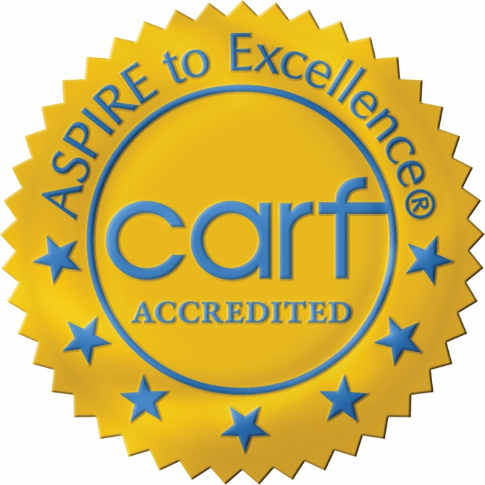
TBI-related Accreditation & Certifications: CARF
Commission on Accreditation of Rehabilitation Facilities (CARF):
Accreditor of choice for brain injury rehabilitation programs.
Has specific standards for brain injury programs developed by both consumers and the field.
Programs deliver services that focus on the unique medical, physical, cognitive, communication, psychosocial, behavioral, vocational, educational, accessibility, and leisure/recreational needs of persons with acquired brain injury.
A program seeking accreditation as a Brain Injury Specialty Program must include in the survey application and the site survey all portions of the program that the organization provides and that meet the program descriptions.
Visit www.carf.org for more information
Notes:
These accredited programs are typically within a hospital, outpatient clinic, LTAC, residential services, etc.
A Brain Injury Specialty Program delivers services that focus on the unique medical, physical, cognitive, communication, psychosocial, behavioral, vocational, educational, accessibility, and leisure/recreational needs of persons with acquired brain injury. The program integrates services to:
— Minimize the impact of impairments and secondary complications.
— Reduce activity limitations.
— Maximize participation, including wellness, quality of life, and inclusion in the community.
— Decrease environmental barriers.
— Promote self-advocacy.
A Brain Injury Specialty Program recognizes the individuality, preferences, strengths, and needs of the persons served and their families/support systems. It provides access to information, services, and resources available to enhance the lives of the persons served within their families/support systems, communities, and life roles and supports their efforts to promote personal health and wellness and improve quality of life throughout their life span.
The program demonstrates the commitment, capabilities, and resources to maintain itself as a specialized program for persons with acquired brain injury. A Brain Injury Specialty Program utilizes current research and evidence to provide effective rehabilitation and supports future improvements by advocating for or participating in brain injury research.
A Brain Injury Specialty Program partners with the persons served, families/support systems, and providers from emergency through community-based services to foster an integrated system of services that optimizes recovery, adjustment, inclusion, participation, and prevention. A Brain Injury Specialty Program engages and partners with providers within and outside of rehabilitation to increase access to services by advocating for persons who have sustained a brain injury to regulators, legislators, educational institutions, research funding organizations, payers, and the community at large.
(Comprehensive Integrated Inpatient Rehabilitation Program, Outpatient Medical Rehabilitation Program, Home and Community Services, Residential Rehabilitation Program, and Vocational Services)

Slide 16
Acquired Brain Injury (ABI) Screening & Accommodations

Slide 17
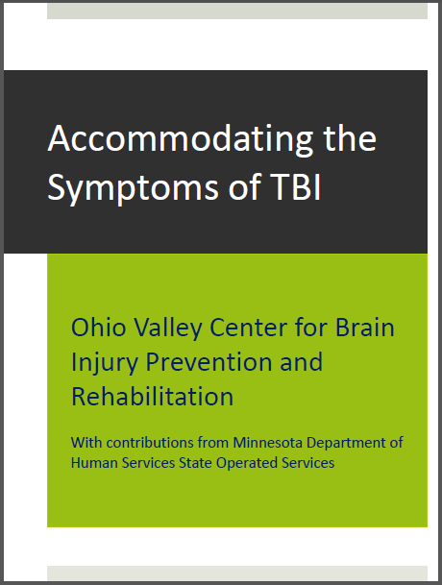
Screening & Accommodations: The Ohio Valley Center for Brain Injury Prevention & Rehabilitation
The Ohio Valley Center for Brain Injury Prevention & Rehabilitation conducts research, provides education and develops programs to improve the quality of life of persons who experience traumatic brain injury (TBI).
Downloadable Publication: Accommodating the Symptoms of TBI
Web-base Training Modules: Screening & Accommodations
OSU TBI Identification Method (OSU-TBI-ID) https://tbi.osu.edu/modules/7
The Ohio State University Traumatic Brain Injury Identification Method (OSU TBI-ID) is a standardized procedure for eliciting a person’s lifetime history of TBI via a 3-5 minute structured interview.
Accommodating the Symptoms of TBI https://tbi.osu.edu/modules/6
Learn to recognize the common symptoms of TBI and how to incorporate compensatory strategies into your treatment practices. These simple, yet effective accommodations you can make in your professional practice with patients who have been impacted by TBI will help you increase the odds of treatment success.
Notes:
The Ohio State University (OSU) Traumatic Brain Injury (TBI) Identification Method (OSU TBI-ID) is a standardized procedure for eliciting a person’s lifetime history of TBI via a 3-5 minute structured interview.
Originally published in 2007 by John Corrigan, PhD
A standardized procedure for eliciting lifetime exposure to TBI via a structured interview
Strong psychometric properties
See here for more info:
Corrigan, J.D., Bogner, J.A. (2007). Initial reliability and validity of the OSU TBI Identification Method. J Head Trauma Rehabil, 22(6):318-329.
https://heller.brandeis.edu/ibh/pdfs/accommodating-tbi-booklet-1-14.pdf

Slide 18
Brain Injury Websites & Fact Sheets

Slide 19
National Brain Injury Websites:
The following list of websites offer exceptional resources for those who have experienced a brain injury and for those who wish to know more about brain injury, the resources available along with education and current research.
Brain Injury Association of America: www.biausa.org
Advance awareness, research, treatment, and education and to improve the quality of life for all people affected by brain injury.
United States Brain Injury Alliance: http://usbia.org
Engages the community in preventing brain injury and improving lives.

Slide 20
National Brain Injury Websites cont.
The Model Systems Knowledge Translation Center (MSKTC): https://msktc.org/tbi
The MSKTC works with researchers in 16 Traumatic Brain Injury (TBI) Model Systems, including Rehabilitation Hospital of Indiana and IU School of Medicine’s model systems, to develop resources for people living with traumatic brain injuries and their supporters.
Resources and educational material include:
Evidence-based materials available in a variety of formats such as printable PDF documents, videos, and slideshows.
Brain Injury Fact Sheets: MSKTC collaborates with TBI Model Systems to produce evidence-based and consumer-friendly fact sheets.
Centers for Disease Control & Prevention (CDC): Brain Injury & Concussion www.cdc.gov/traumaticbraininjury
Resource and education materials include:
Basic information on Traumatic Brain Injury including signs, symptoms, response, recovery, prevention
Provider Resources: Online Training and Tools for Healthcare Providers
Publications, Reports and Fact Sheets
Data and Statistics: Rates of TBI-related deaths, ER visits, hospitalizations
HEADS Up: Educational materials to support concussion efforts
And more…

Slide 21
Community Agencies & Organizations

Slide 22
Brain Injury Support Groups: In Indiana & the U.S.
Brain Injury Support Groups provide support systems for individuals and their families who have experienced a brain injury. They can be joint groups of these individuals and their caregivers or they may be separate groups.
Whichever the group, involvement in a brain injury support group helps to:
Become more educated.
Feel less isolated.
Have the opportunity to help others.
Involvement can positively impact:
Both the individual with TBI and their caregiver with unmet emotional and social supports.
Positive peer interaction and model behavior, etc.
Lessening the feeling of isolation.
Caregiver distress.
How to find a Brain Injury Support
Nationally, the Brain Injury Association of America can connect you to individual states and their brain injury resources, as well as available support groups. www.biausa.org/find-bia
In Indiana, go to https://biaindiana.org/ and click on “Find A Support Group.”
The U.S. Brain Injury Alliance also offers brain injury resources and support groups for the states who are members of their alliance. Go to https://usbia.org to access their site.

Slide 23
Community Agencies & Organizations
Office of Vocational Rehabilitation (VR): www.csavr.org/stateagencydirectory
Federal programs that can provide a series of services that are designed to facilitate the entrance into or return to work by people with disabilities or by people who have recently acquired an injury or disability.
Services may include vocational assessment and evaluation, training, upgrading of general skills, refresher courses, on-the-job training, career counseling, employment searches, and consulting with potential or existing employers for job accommodations and modification.
Independent Living Centers: www.ilru.org/projects/cil-net/cil-center-and-association-directory
Community-based, cross-disability, non-profit organizations that are designed and operated by people with disabilities. CILs are unique in that they operate according to a strict philosophy of consumer control, wherein people with all types of disabilities directly govern and staff the organization.
May provide: Peer Support, Information and Referral, Individual and Systems Advocacy, Independent Living Skills Training, etc.

Slide 24
Community Agencies & Organizations
State Medicaid Waivers: https://www.cms.gov
Program that allows states to provide different services that allow those who need care to receive services in their homes or communities.
Part of a state's Medicaid program, but they provide a special group of services to a certain population.
Usually require medical and financial eligibility, but state waiver eligibility requirements may not be exactly the same as state Medicaid eligibility.

Slide 25
Special Populations

Slide 26
Special Populations: Pediatrics & Military
Pediatrics:
www.biausa.org/brain-injury/about-brain-injury/children-what-to-expect
www.brainline.org/children-tbi
Military:
www.polytrauma.va.gov/understanding-tbi/index.asp
www.brainline.org/military-veterans

