Slide 1

Screening for Lifetime History of Traumatic Brain Injury
John D. Corrigan, PhD
Professor
Department of Physical Medicine
and Rehabilitation
Director
Ohio Brain Injury Program

Slide 2
Financial Disclosure
I have no financial relationships to disclose relevant to this presentation.

Slide 3
How can you determine if a person has a problematic history of TBI?
Objective:

Slide 4
Issues Assessing a Lifetime
History of TBI
Capture from medical encounters
  medical treatment often may not be sought
  lifetime records not available
  mild TBI often missed in Emergency Departments
Biomarkers
  imaging, neuropsych assessment specific but not sensitive
  proteomics very acute only and sensitive but not specific
Retrospective self-report
  cannot self-diagnose
  not aware of injury (“telescoping,” poor memory, too young)
Gold
Standard

Slide 5
Challenges Eliciting
Self-reports
Public’s limited or inaccurate knowledge
Need to stimulate recall
Injuries before age 5
Concurrent sources of altered consciousness
Periods of multiple blows to the head

Slide 6
Selected Methods of
Eliciting Self-report
TBI-TAC identified 20 different tools being used
DVBIC Brief TBI Screen (BTBIS; Schwab et al.)
TBI Questionnaire (TBIQ; Diamond et al.)
Brain Injury Screening Questionnaire (BISQ; Gordon et al.)
OSU TBI Identification Method (OSU TBI-ID; Corrigan & Bogner)
Boston Assessment of Traumatic Brain Injury Lifetime (BAT-L; Fortier et al.)

Slide 7
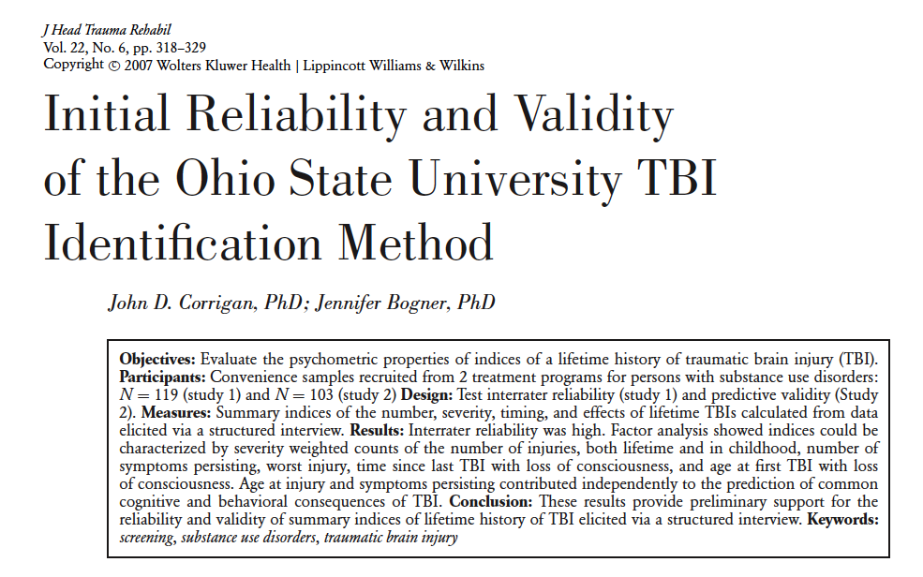
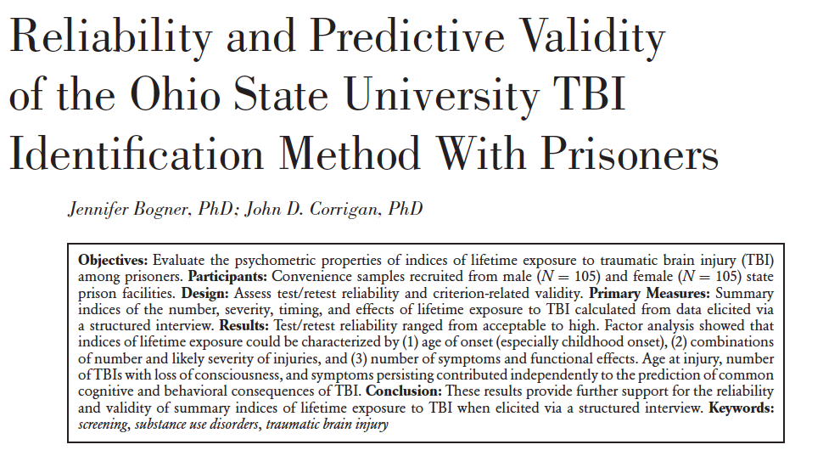
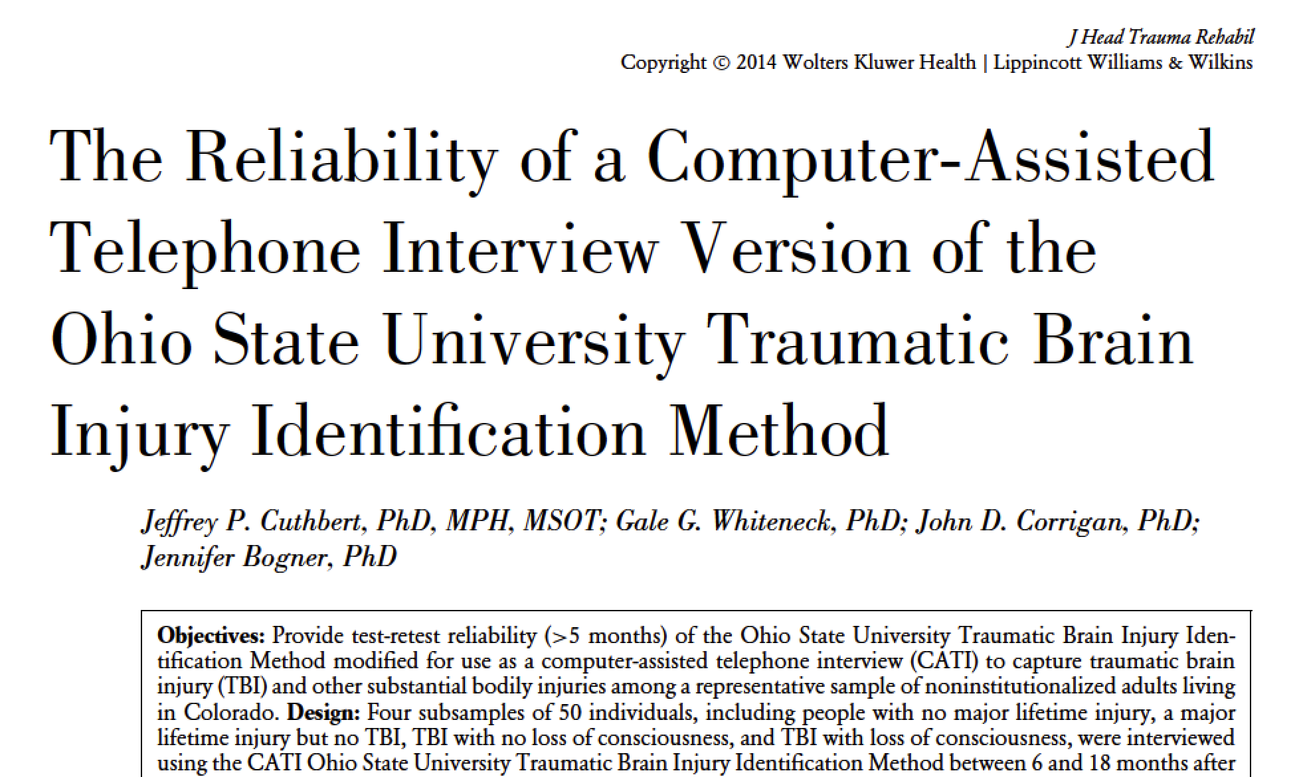

Slide 8
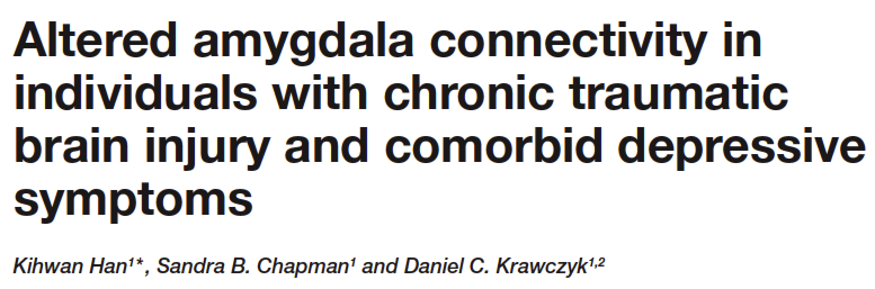
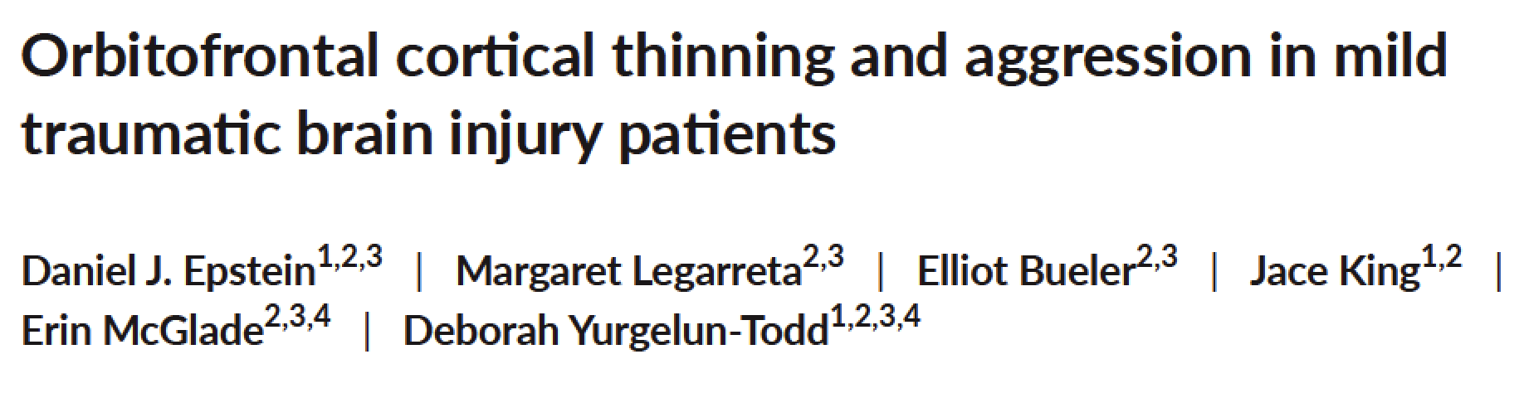
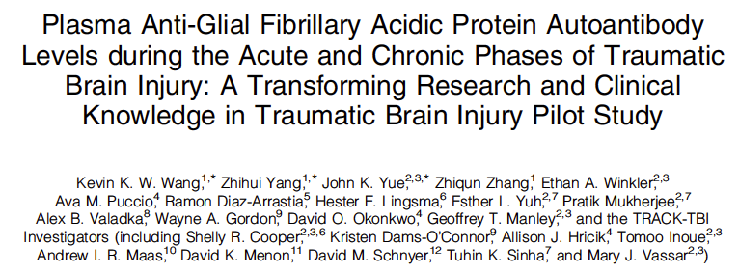
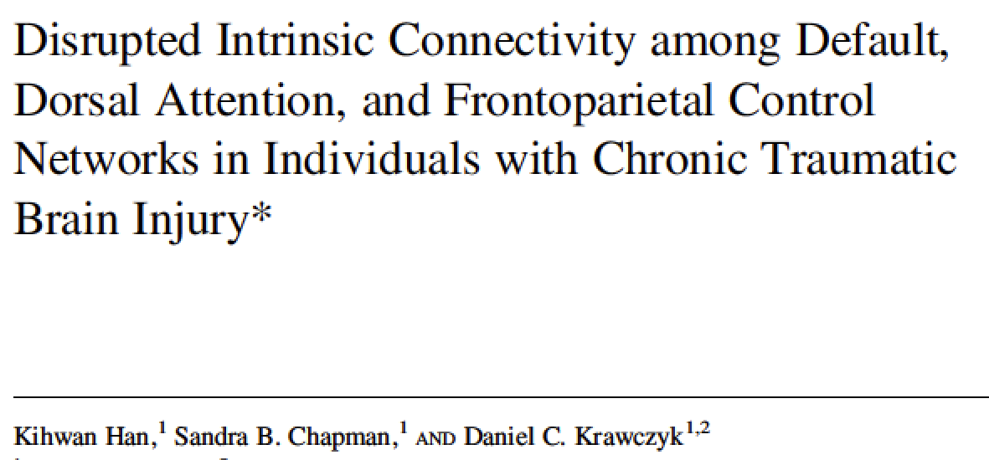
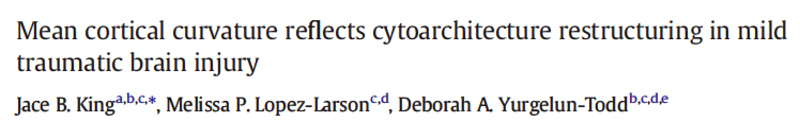
Neurological correlates of lifetime history of TBI from the OSU TBI-ID

Slide 9
OSU TBI
Identification Method
Structured interview designed to elicit lifetime history of TBI.
Avoids misunderstanding about what a TBI is by eliciting injuries, then determining if altered consciousness occurred.
Provides more information than simple “yes/no”

Slide 10
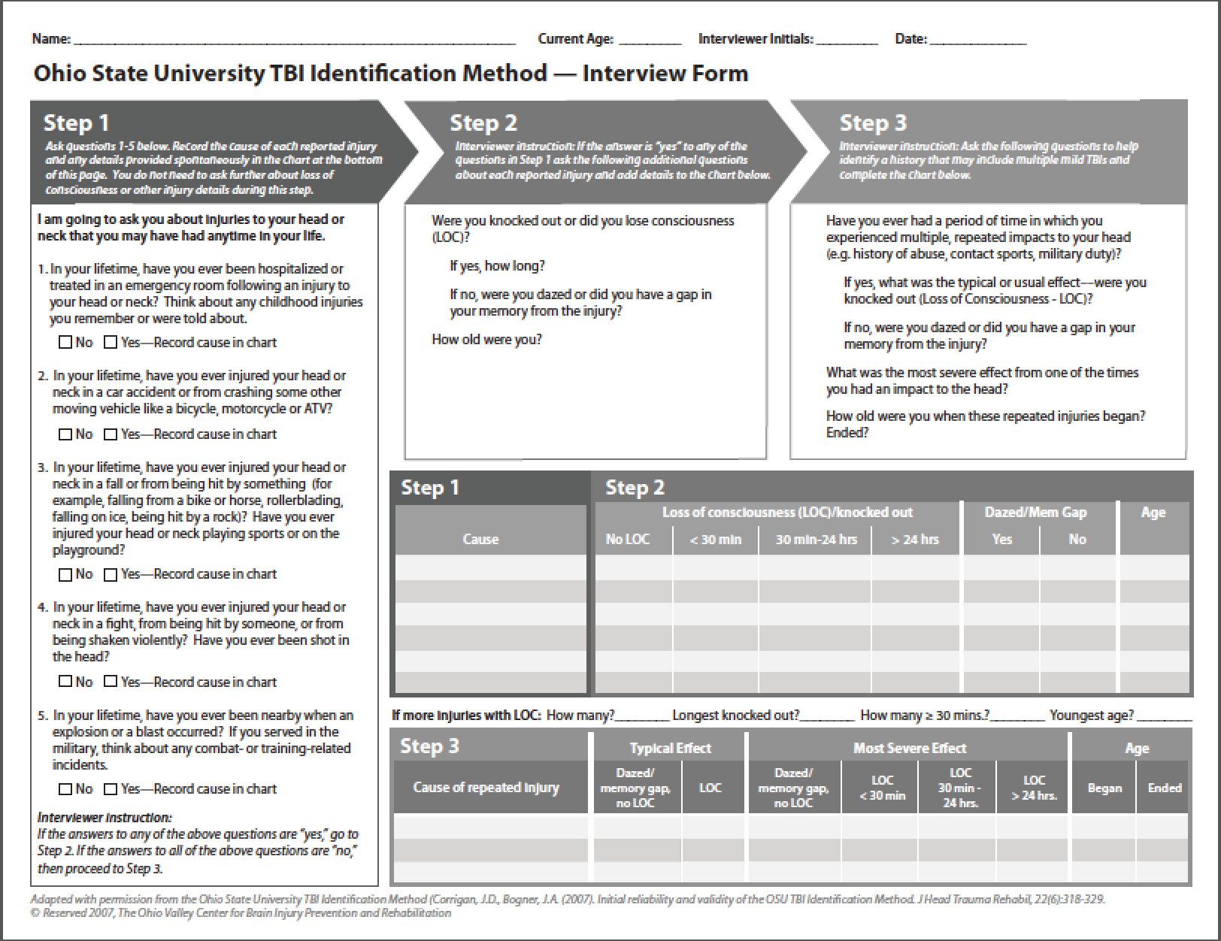

Slide 11
OSU TBI-ID: Step 1
5 Questions:
The goal of these questions is to help recall injuries to the head or neck by reminding the respondent about hospital visits and probing for common causes of TBI.
Do not be concerned about whether a TBI occurred, only if it was possible.
Notes:
Please refer to the document: Ohio State University TBI Identification Method Short Form.
Many people incur multiple injuries in a traumatic event; injuries to the head may be overlooked if there is a more life threatening or obvious injury. Listen for reports of a blow to the head, the head having impact with another object (e.g., the ground, a windshield) or substantial shaking without impact. “Concussion” literally means shaking. Events involving high velocity forces, such as experienced during a moving vehicle crash or an explosion, may result in a brain injury even if the head is not hit. Listen for injuries that received, or should have received medical attention.

Slide 13
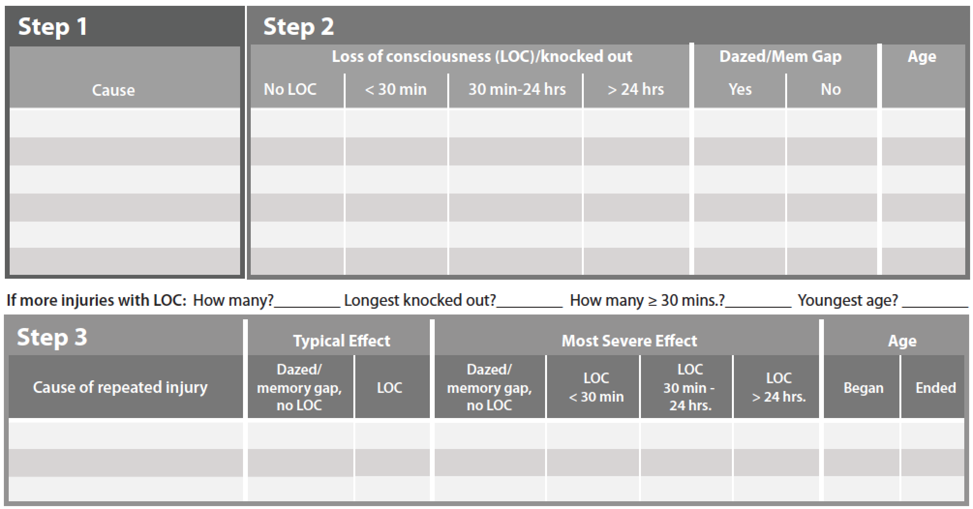
fell off of bike--ER
car crash
1st husband hit me

Slide 14
OSU TBI-ID: Step 2
Determine if a TBI occurred
Were you knocked out or did you lose consciousness (LOC)?
If yes, how long?
If no, were you dazed or did you have a gap in your memory from the injury?
How old were you?
Notes:
Please refer to the document: Ohio State University TBI Identification Method Short Form.
Many people incur multiple injuries in a traumatic event; injuries to the head may be overlooked if there is a more life threatening or obvious injury. Listen for reports of a blow to the head, the head having impact with another object (e.g., the ground, a windshield) or substantial shaking without impact. “Concussion” literally means shaking. Events involving high velocity forces, such as experienced during a moving vehicle crash or an explosion, may result in a brain injury even if the head is not hit. Listen for injuries that received, or should have received medical attention.

Slide 15
fell off of bike--ER
X
X
9
car crash
X
14
1st husband hit me
X
early 20’s

Slide 16
OSU TBI-ID: Step 3
Determine if there were any periods
with repeated blows to the head
Have you ever had a period of time in which you experienced multiple, repeated impacts to your head (e.g., history of abuse, contact sports, military duty)?
If yes, what was the typical or usual effect––were you knocked out (Loss of Consciousness–LOC
If no, were you dazed or did you have a gap in your memory from the injury?
What was the most severe effect?
How old were you?
Notes:
Please refer to the document: Ohio State University TBI Identification Method Short Form.
Many people incur multiple injuries in a traumatic event; injuries to the head may be overlooked if there is a more life threatening or obvious injury. Listen for reports of a blow to the head, the head having impact with another object (e.g., the ground, a windshield) or substantial shaking without impact. “Concussion” literally means shaking. Events involving high velocity forces, such as experienced during a moving vehicle crash or an explosion, may result in a brain injury even if the head is not hit. Listen for injuries that received, or should have received medical attention.

Slide 17
fell off of bike--ER
X
X
9
car crash
X
14
1st husband hit me
X
early 20’s
1st husband hit me
X
X
21
23

Slide 18
Problematic History of TBI
Worst lifetime TBI was moderate or severe
First TBI with loss of consciousness occurred in childhood
Had 2 or more TBIs close together or a period of time when they experienced multiple blows to the head.
A mild TBI in recent weeks or a more severe TBI in recent months.
Any history of TBI when combined with one or more other sources of compromised brain function.

Slide 19
Worst was a moderate TBI
First with loss of consciousness in childhood
Had a period of multiple blows to the head
fell off of bike--ER
X
X
9
car crash
X
14
1st husband hit me
X
early 20’s
1st husband hit me
X
X
21
23

Slide 20
Problematic History of TBI
Due to cognitive and/or behavioral weaknesses that result from damage to the frontal areas of the brain, person with a problematic history of TBI may have difficulty:
  knowing what problems they have;
  changing their behavior;
  accessing services; and/or
  remaining engaged in services.
Notes:
Just knowing that a person has a history of at least one TBI provides you with limited information. However, this information should lead you to suspect that there may also be a history of difficulties with accessing services.

Slide 21
THANK YOU
Additional information and training at: www.ohiovalley.org

