Slide 1
Sexually Transmitted Disease
Surveillance 2020
Gonorrhea
Notes:
This slide set was prepared by the Division of STD Prevention, National Center for HIV/AIDS, Viral Hepatitis, STD, and TB Prevention (NCHHSTP), Centers for Disease Control and Prevention (CDC). These slides display trends for STDs in the United States through 2019. Data presented include case reports provided to CDC through the National Notifiable Diseases Surveillance System (NNDSS) and data collected through projects and programs that monitor STDs in various settings, including the STD Surveillance Network (SSuN), and the Gonococcal Isolate Surveillance Project (GISP).
For more information on data sources, data collection and reporting practices, and case definitions, please see the Technical Note, available at https://www.cdc.gov/std/statistics/2020/technical-notes.htm
All data points for figures presented in these slides are available at https://www.cdc.gov/std/statistics/2020/data.zip
NOTE: This slide set is in the public domain. You may reproduce these slides without permission; however, citation as to source is appreciated.
Centers for Disease Control and Prevention. Sexually Transmitted Disease Surveillance 2020. Atlanta: U.S. Department of Health and Human Services; 2022.
You are also free to adapt and revise these slides; however, you must remove the CDC name and logo if changes are made.

Slide 2
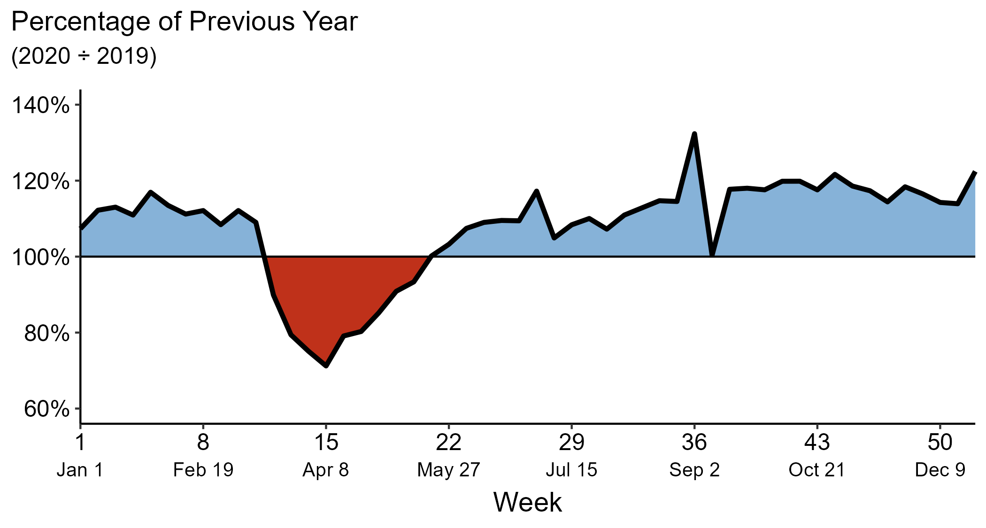
Gonorrhea — Reported 2020 Cases as a Percentage of 2019 by MMWR Week, United States
NOTE: The MMWR week is the week of the epidemiologic year for which the case is assigned by the reporting local or state health department.
Adapted from Pagaoa et al, Sexually Transmitted Diseases, 2021
Notes:
To quantify the COVID-19 pandemic’s potential impact on reported STDs, the number of 2020 cases reported for a given MMWR week was compared to the number of cases reported in the same week in 2019. The comparison is expressed in terms of the percentage of the previous year’s cases that were reported. Percentages lower than 100% denote when 2020 numbers were less than 2019 numbers, while percentages higher than 100% indicate when 2020 numbers were higher than 2019 numbers.
From MMWR weeks 1–11 (December 29, 2019–March 14, 2020), the 2020 cumulative total of reported gonorrhea cases (135,769 cases) was higher than the 2019 cumulative total for the same number of weeks (121,625 cases). In week 12 (week of March 15–21, 2020; the first full week of the emergency declaration for the COVID-19 pandemic), the weekly number of 2020 gonorrhea cases was 89.9% of 2019 cases. Following week 12, the difference between 2020 cases compared to 2019 cases increased, reaching its greatest point at week 15 (71.2%; week of April 5–11, 2020). The final number of reported cases of gonorrhea for 2020 was 110.0% of the 2019 total (677,769 and 616,392 respectively).
The COVID-19 pandemic has introduced uncertainty and difficulty in interpreting 2020 case data. See Impact of COVID-19 on STDs (https://www.cdc.gov/std/statistics/2020/impact.htm) for more information.
See Technical Notes (https://www.cdc.gov/std/statistics/2020/technical-notes.htm) for information on gonorrhea case reporting.
Data points are available at: https://www.cdc.gov/std/statistics/2020/data.zip

Slide 3
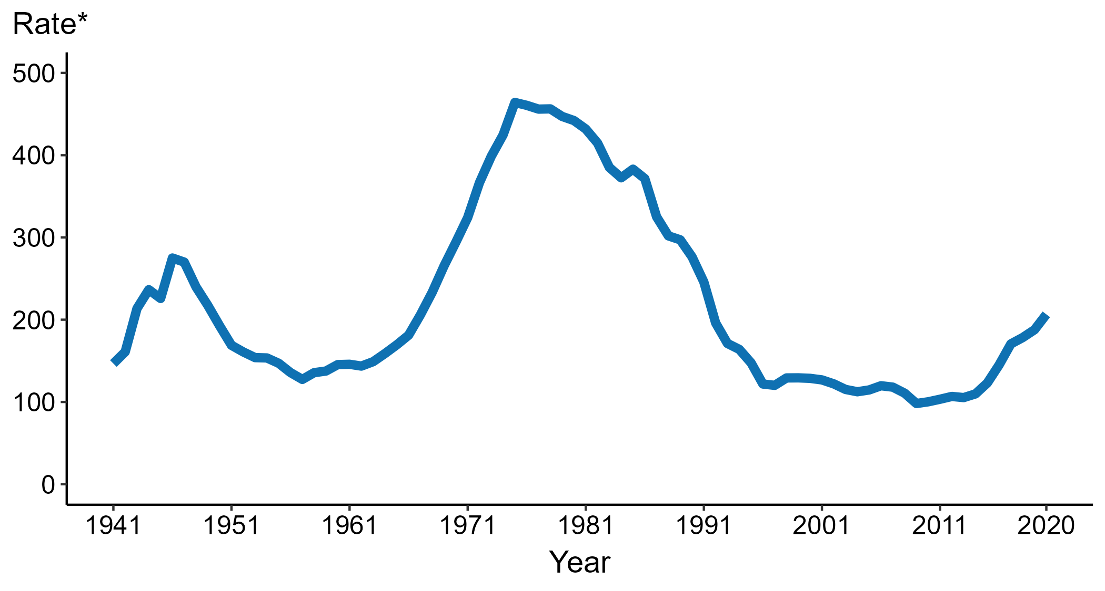
Gonorrhea — Rates of Reported Cases by Year, United States, 1941–2020
* Per 100,000
Notes:
Data collection for gonorrhea began in 1941 and gonorrhea was made a nationally notifiable condition in 1944. Steep declines in cases rates in the 1940s and 1950s likely reflect expanded use of penicillin to treat infection.
In 2020, 677,769 total cases of gonorrhea were reported in the United States. During 2019 to 2020, the rate of reported gonorrhea increased 10.0% (from 187.8 to 206.5 per 100,000).
The COVID-19 pandemic has introduced uncertainty and difficulty in interpreting 2020 case data. See Impact of COVID-19 on STDs (https://www.cdc.gov/std/statistics/2020/impact.htm) for more information.
See Technical Notes (https://www.cdc.gov/std/statistics/2020/technical-notes.htm) for information on gonorrhea case reporting.
Data points are available at: https://www.cdc.gov/std/statistics/2020/data.zip

Slide 4
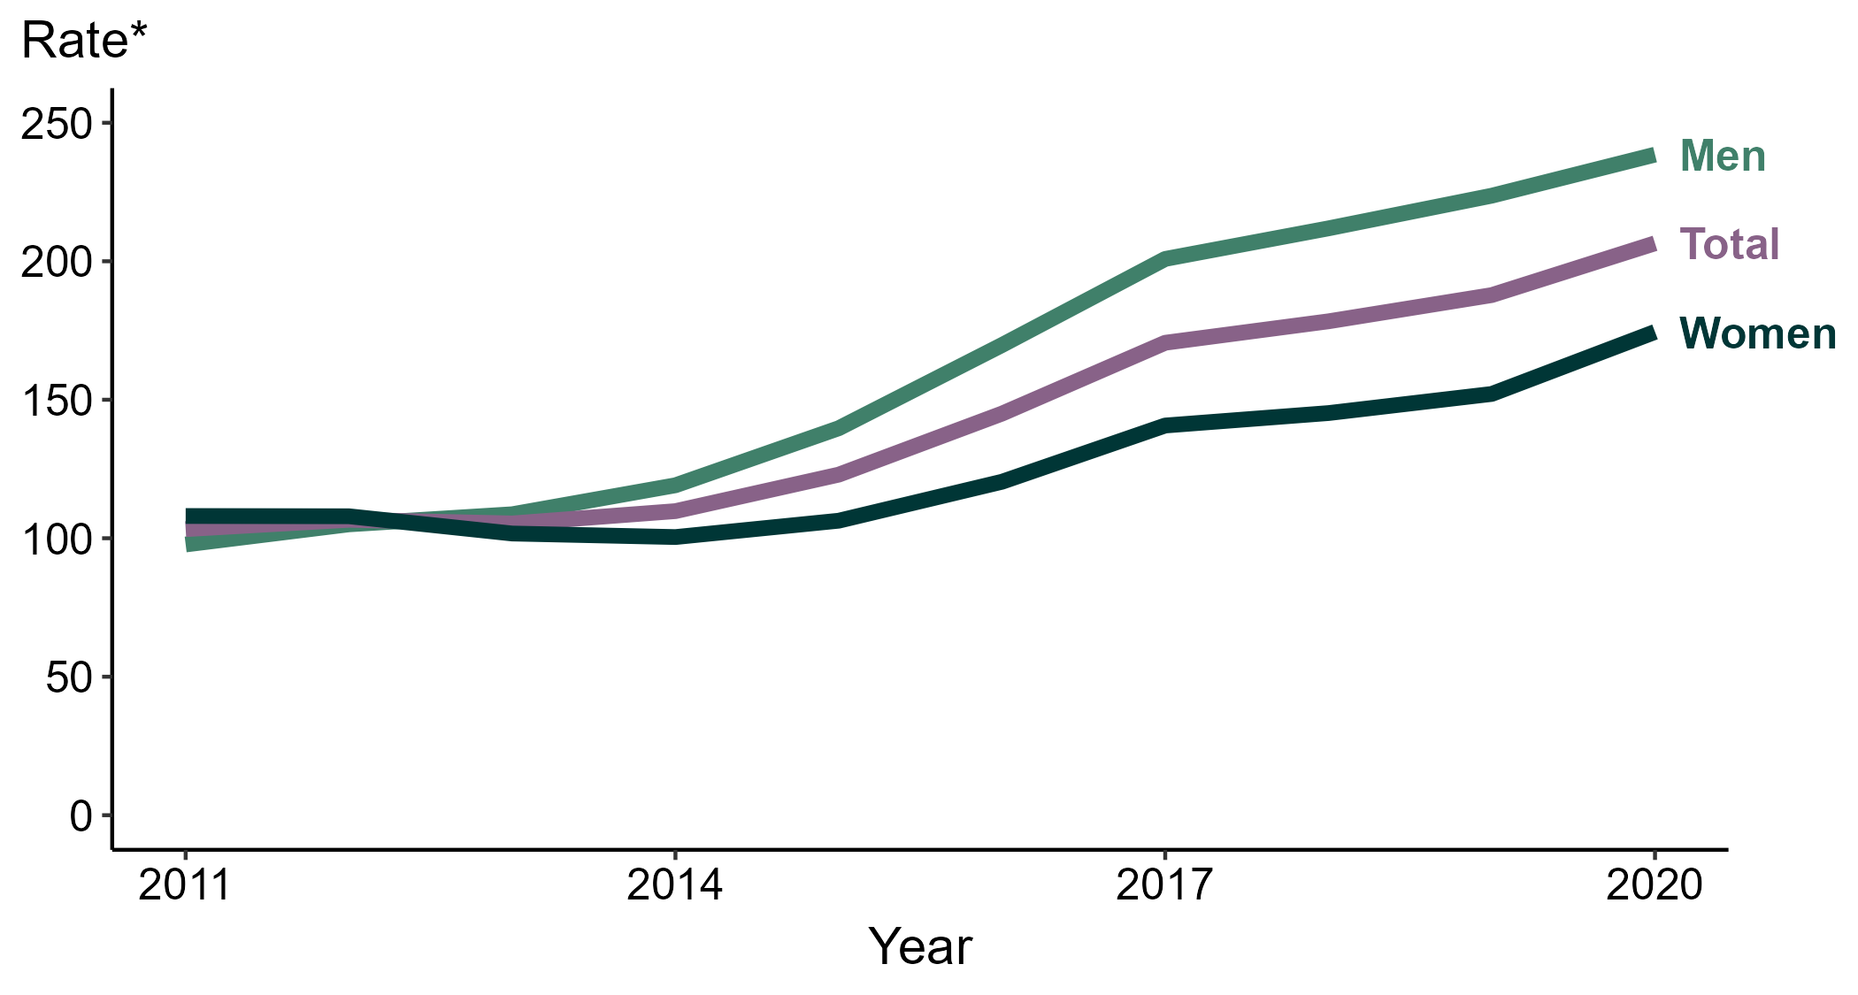
Gonorrhea — Rates of Reported Cases by Sex, United States, 2011–2020
* Per 100,000
Notes:
During 2019 to 2020, the gonorrhea rate among women increased 14.7% (from 152.1 to 174.5 per 100,000) and the rate among men increased 6.6% (from 223.7 to 238.5 per 100,000).
Over the last 5 years, the gonorrhea rate among women increased 44.9% (from 120.4 to 174.5 per 100,000) and the rate among men increased 40.5% (from 169.7 to 238.5 per 100,000). Over the last 10 years, the gonorrhea rate among men increased 144.1% (from 97.7 to 238.5 per 100,000) and the rate among women increased 61.6% (from 108.0 to 174.5 per 100,000).
The COVID-19 pandemic has introduced uncertainty and difficulty in interpreting 2020 case data. See Impact of COVID-19 on STDs (https://www.cdc.gov/std/statistics/2020/impact.htm) for more information.
See Technical Notes (https://www.cdc.gov/std/statistics/2020/technical-notes.htm) for information on gonorrhea case reporting.
Data points are available at: https://www.cdc.gov/std/statistics/2020/data.zip

Slide 5
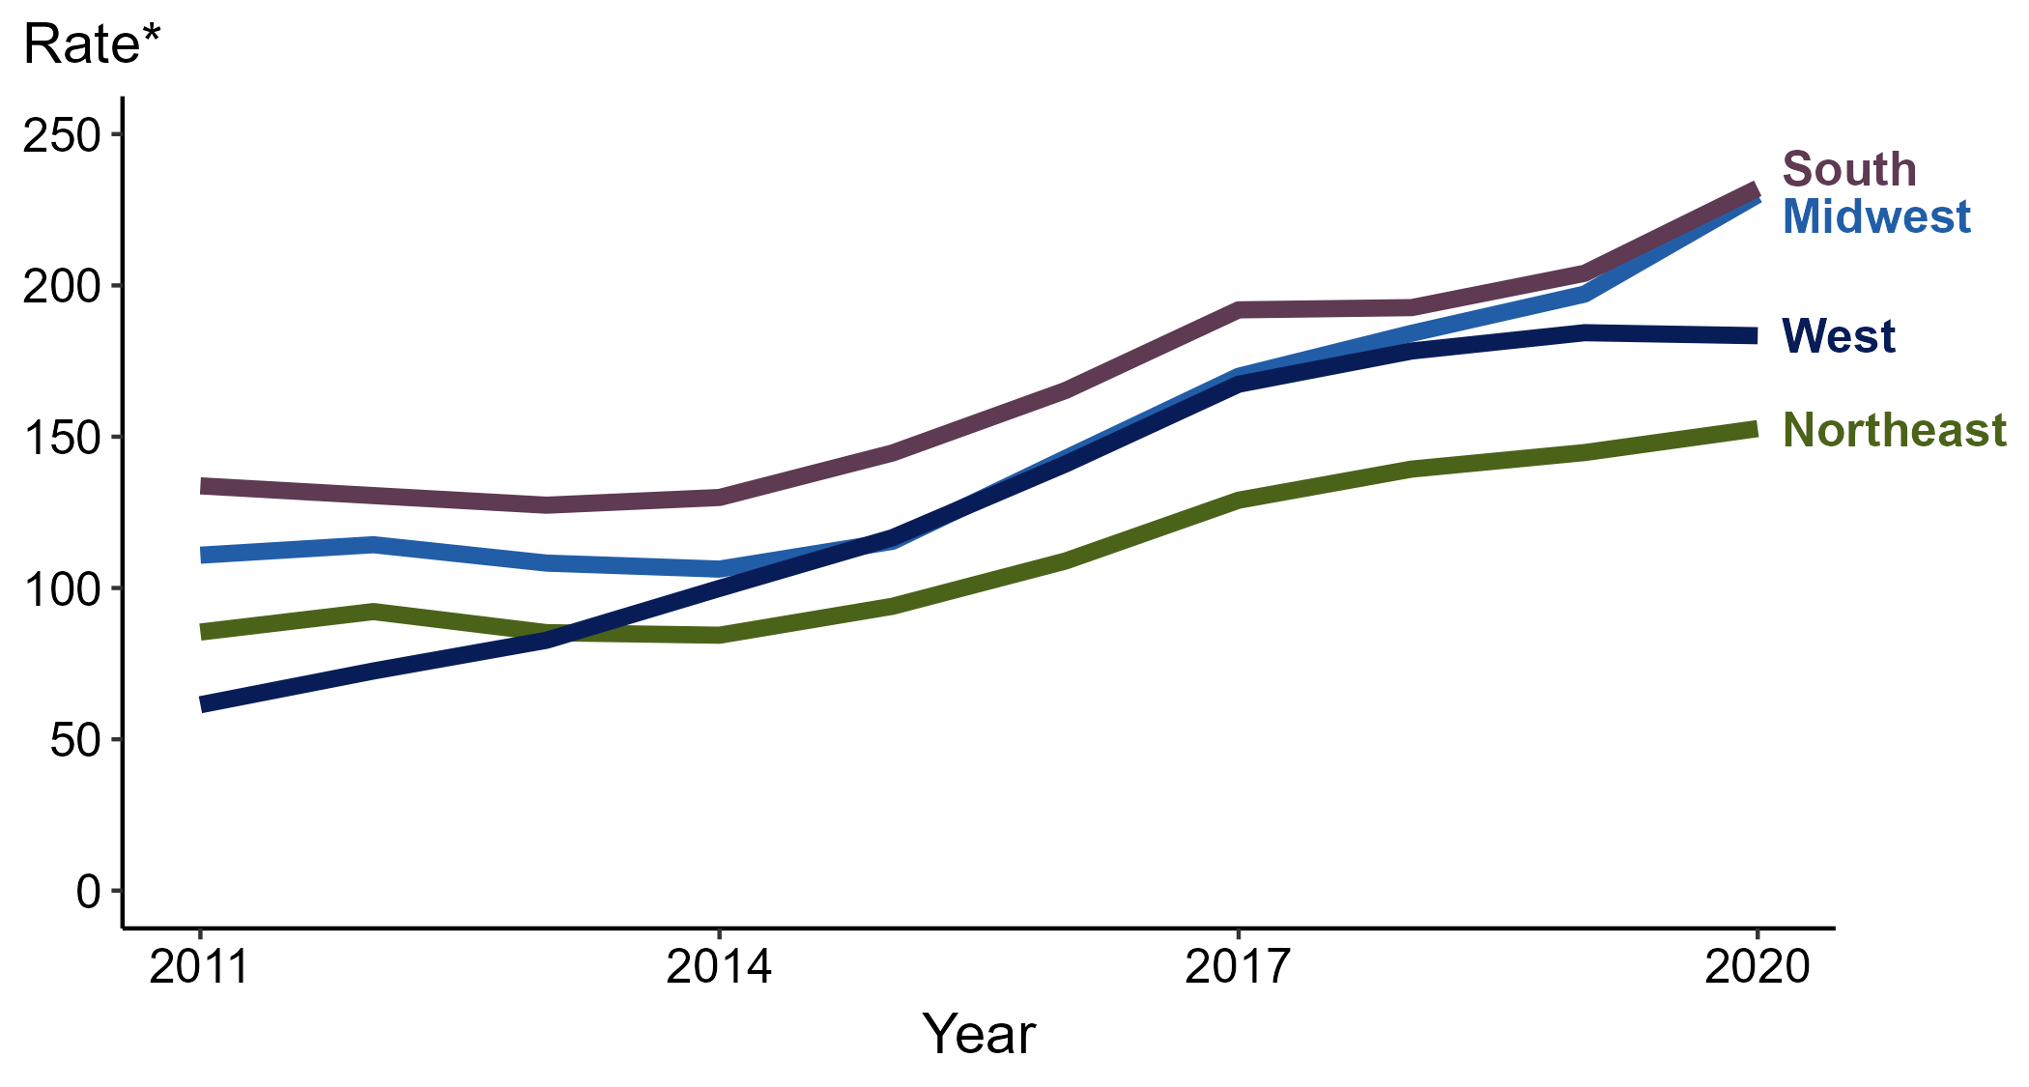
Gonorrhea — Rates of Reported Cases by Region, United States, 2011–2020
* Per 100,000
Notes:
In 2020, the South had the highest rate of reported gonorrhea (232.1 cases per 100,000; 13.8% increase from 2019), followed by the Midwest (230.0 cases per 100,000; 16.7% increase from 2019), the West (183.4 cases per 100,000; 0.5% decrease from 2019), and the Northeast (152.7 cases per 100,000; 5.5% increase from 2019).
The Midwest had the greatest 5-year increase in rates of reported cases of gonorrhea (142.8 to 230.0 per 100,000; 61.1% increase from 2016). The West had the greatest 10-year increase in rates of reported cases of gonorrhea (61.4 to 183.4 per 100,000; 198.7% increase from 2011).
The COVID-19 pandemic has introduced uncertainty and difficulty in interpreting 2020 case data. See Impact of COVID-19 on STDs (https://www.cdc.gov/std/statistics/2020/impact.htm) for more information.
See Technical Notes (https://www.cdc.gov/std/statistics/2020/technical-notes.htm) for information on gonorrhea case reporting.
Data points are available at: https://www.cdc.gov/std/statistics/2020/data.zip

Slide 6
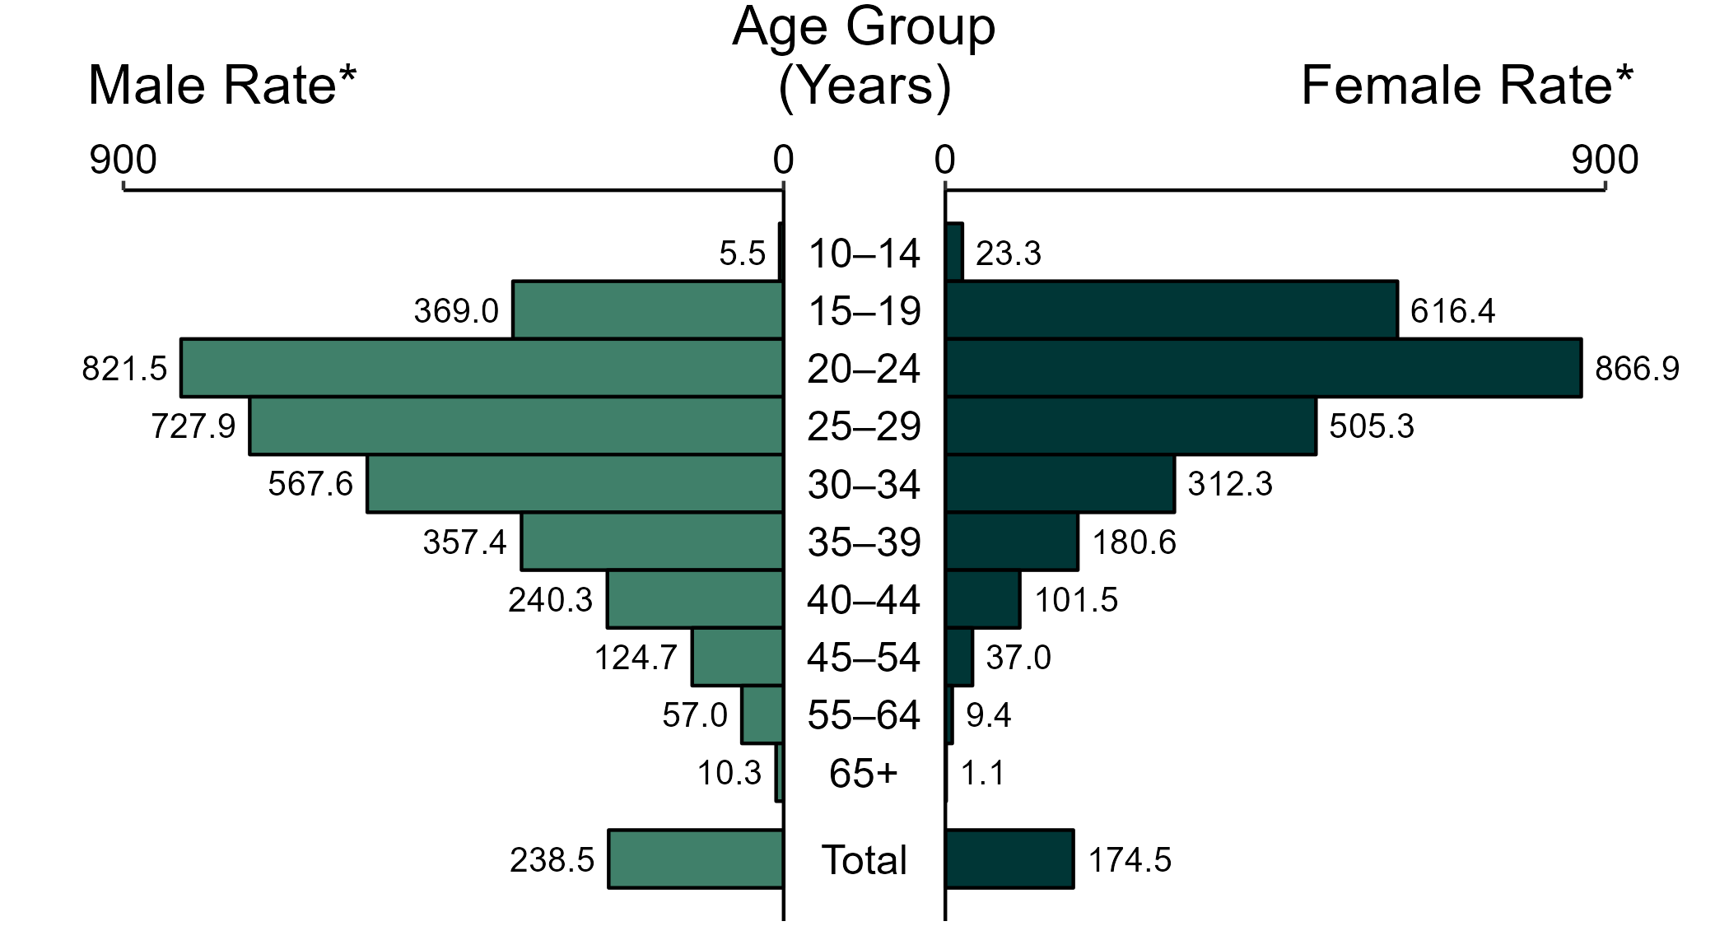
Gonorrhea — Rates of Reported Cases by Age Group and Sex, United States, 2020
* Per 100,000
NOTE: Total includes all ages.
Notes:
In 2020, women aged 20 to 24 years had the highest rate of reported cases of gonorrhea (866.9 per 100,000), followed by those aged 15 to 19 years (616.4 per 100,000) and 25 to 29 years (505.3 per 100,000). Among men, those aged 20 to 24 years had the highest rate of reported cases of gonorrhea (821.5 per 100,000), followed by those aged 25 to 29 years (727.9 per 100,000) and 30 to 34 years (567.6 per 100,000).
The COVID-19 pandemic has introduced uncertainty and difficulty in interpreting 2020 case data. See Impact of COVID-19 on STDs (https://www.cdc.gov/std/statistics/2020/impact.htm) for more information.
See Technical Notes (https://www.cdc.gov/std/statistics/2020/technical-notes.htm) for information on gonorrhea case reporting.
Data points are available at: https://www.cdc.gov/std/statistics/2020/data.zip

Slide 7
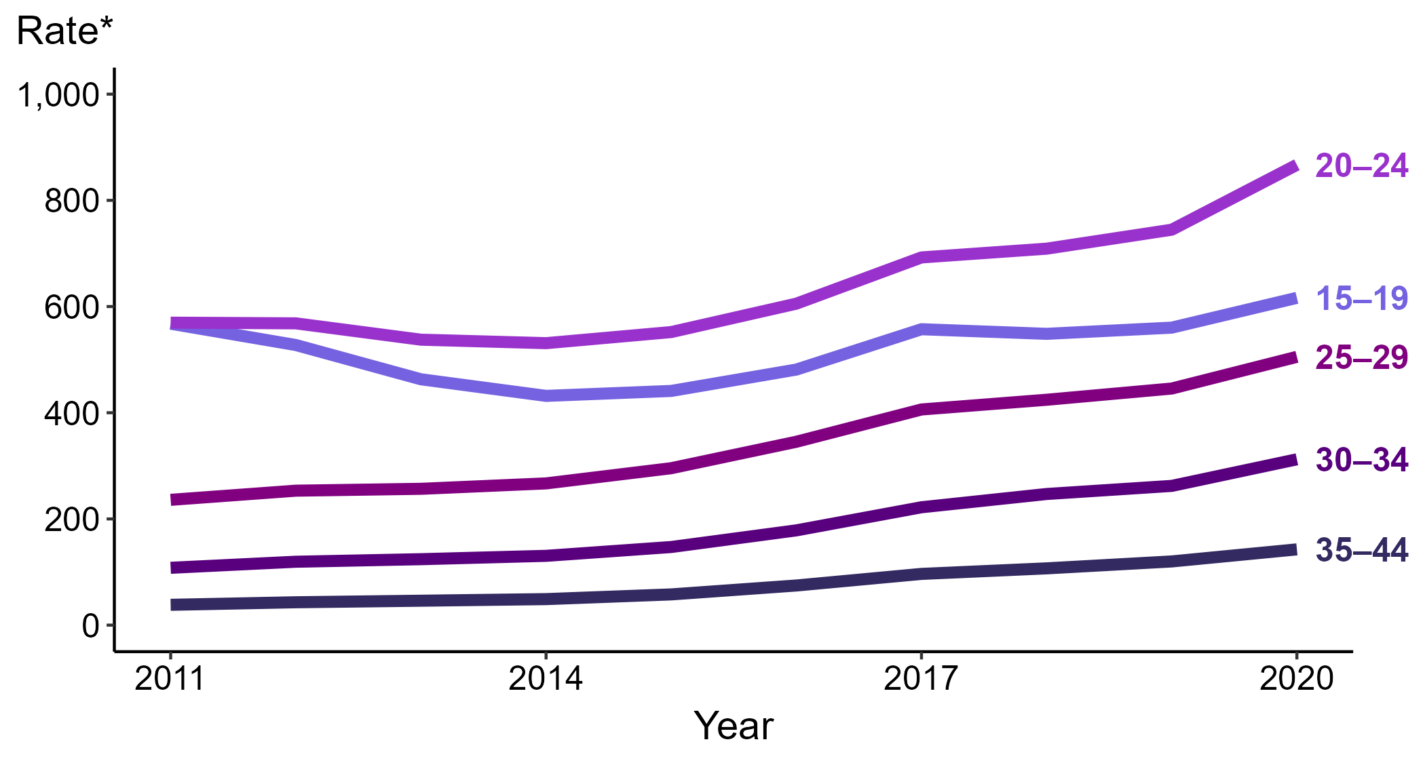
Gonorrhea — Rates of Reported Cases Among Women Aged 15–44 Years by Age Group, United States, 2011–2020
* Per 100,000
Notes:
In 2020, women aged 20 to 24 years had the highest rate of reported cases of gonorrhea among women (866.9 cases per 100,000; 16.4% increase from 2019), followed by those aged 15 to 19 years (616.4 cases per 100,000; 10.0% increase from 2019), those aged 25 to 29 years (505.3 cases per 100,000; 13.4% increase from 2019), those aged 30 to 34 years (312.3 cases per 100,000; 19.1% increase from 2019), and those aged 35 to 44 years (142.7 cases per 100,000; 18.9% increase from 2019).
The COVID-19 pandemic has introduced uncertainty and difficulty in interpreting 2020 case data. See Impact of COVID-19 on STDs (https://www.cdc.gov/std/statistics/2020/impact.htm) for more information.
See Technical Notes (https://www.cdc.gov/std/statistics/2020/technical-notes.htm) for information on gonorrhea case reporting.
Data points are available at: https://www.cdc.gov/std/statistics/2020/data.zip

Slide 8
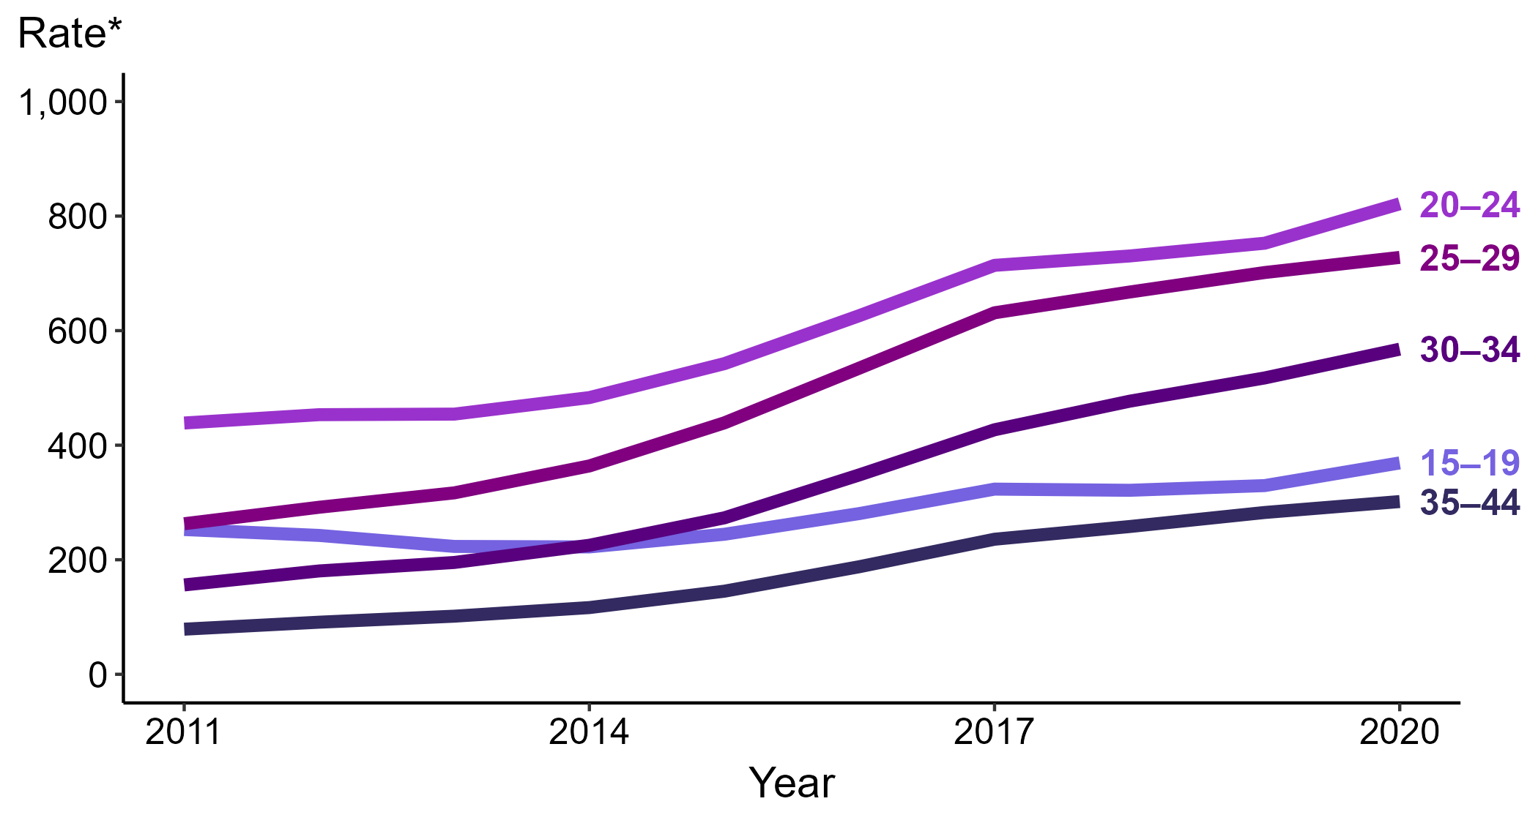
Gonorrhea — Rates of Reported Cases Among Men Aged 15–44 Years by Age Group, United States, 2011–2020
* Per 100,000
Notes:
In 2020, men aged 20 to 24 years had the highest rate of reported cases of gonorrhea among men (821.5 cases per 100,000; 9.2% increase from 2019), followed by those aged 25 to 29 years (727.9 cases per 100,000; 3.8% increase from 2019), those aged 30 to 34 years (567.6 cases per 100,000; 9.7% increase from 2019), those aged 15 to 19 years (369.0 cases per 100,000; 12.0% increase from 2019), and those aged 35 to 44 years (301.6 cases per 100,000; 6.8% increase from 2019).
The COVID-19 pandemic has introduced uncertainty and difficulty in interpreting 2020 case data. See Impact of COVID-19 on STDs (https://www.cdc.gov/std/statistics/2020/impact.htm) for more information.
See Technical Notes (https://www.cdc.gov/std/statistics/2020/technical-notes.htm) for information on gonorrhea case reporting.
Data points are available at: https://www.cdc.gov/std/statistics/2020/data.zip

Slide 9
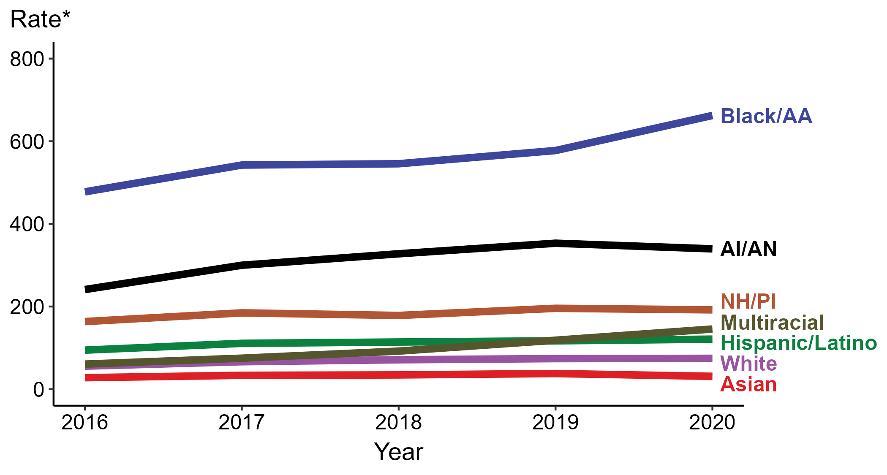
Gonorrhea — Rates of Reported Cases by Race/Hispanic Ethnicity, United States, 2016–2020
* Per 100,000
ACRONYMS: AI/AN = American Indian/Alaska Native; Black/AA = Black or African American; NH/PI = Native Hawaiian/Pacific Islander
Notes:
In 2020, the highest rate of reported cases of gonorrhea was among non-Hispanic Black or African American persons (662.4 cases per 100,000; 14.7% increase from 2019), followed by non-Hispanic American Indian or Alaska Native persons (339.6 cases per 100,000; 3.9% decrease from 2019), non-Hispanic Native Hawaiian or other Pacific Islander persons (192.0 cases per 100,000; 1.9% decrease from 2019), non-Hispanic persons of multiple races (145.5 cases per 100,000; 22.9% increase from 2019), Hispanic or Latino persons of any race (121.0 cases per 100,000; 3.4% increase from 2019), non-Hispanic White persons (74.6 cases per 100,000; 0.8% increase from 2019), and non-Hispanic Asian persons (31.1 cases per 100,000; 17.7% decrease from 2019). Non-Hispanic persons of multiple races had the greatest 5-year increase in rates of reported cases of gonorrhea (60.7 to 145.5 per 100,000; 139.7% increase from 2016).
For this figure, race/Hispanic ethnicity is categorized first by reported Hispanic ethnicity, then by reported race. Therefore, cases categorized as Hispanic/Latino can be of any race; cases categorized into a race group include both non-Hispanic persons and persons of unknown Hispanic ethnicity. Not all US jurisdictions reported cases in Office of Management and Budget compliant race categories during 2016 to 2020. This may minimally under- or overestimate rates for Asian, Native Hawaiian or other Pacific Islander, or multiracial individuals. No population data exist for unknown or other race; therefore, rates are not calculated. For completeness, data in this figure include cases reported from all jurisdictions.
The COVID-19 pandemic has introduced uncertainty and difficulty in interpreting 2020 case data. See Impact of COVID-19 on STDs (https://www.cdc.gov/std/statistics/2020/impact.htm) for more information.
See Technical Notes (https://www.cdc.gov/std/statistics/2020/technical-notes.htm) for information on gonorrhea case reporting and reporting of race/Hispanic ethnicity for STD cases.
Data points are available at: https://www.cdc.gov/std/statistics/2020/data.zip

Slide 10
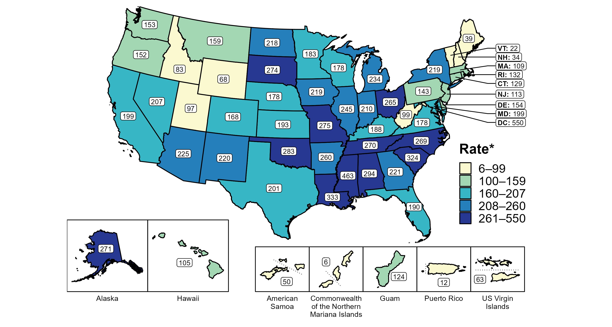
Gonorrhea — Rates of Reported Cases by State, United States and Territories, 2020
* Per 100,000
Notes:
In 2020, rates of reported gonorrhea ranged by state from 22 cases per 100,000 population in Vermont to 463 cases per 100,000 population in Mississippi. The rate of reported gonorrhea in the District of Columbia was 550 per 100,000 population.
Among US territories, rates of reported gonorrhea ranged from 6 cases per 100,000 population in the Commonwealth of the Northern Mariana Islands to 124 cases per 100,000 population in Guam.
The COVID-19 pandemic has introduced uncertainty and difficulty in interpreting 2020 case data. See Impact of COVID-19 on STDs (https://www.cdc.gov/std/statistics/2020/impact.htm) for more information.
See Technical Notes (https://www.cdc.gov/std/statistics/2020/technical-notes.htm) for information on gonorrhea case reporting and on interpreting reported rates in US territories.
Data points are available at: https://www.cdc.gov/std/statistics/2020/data.zip

Slide 11
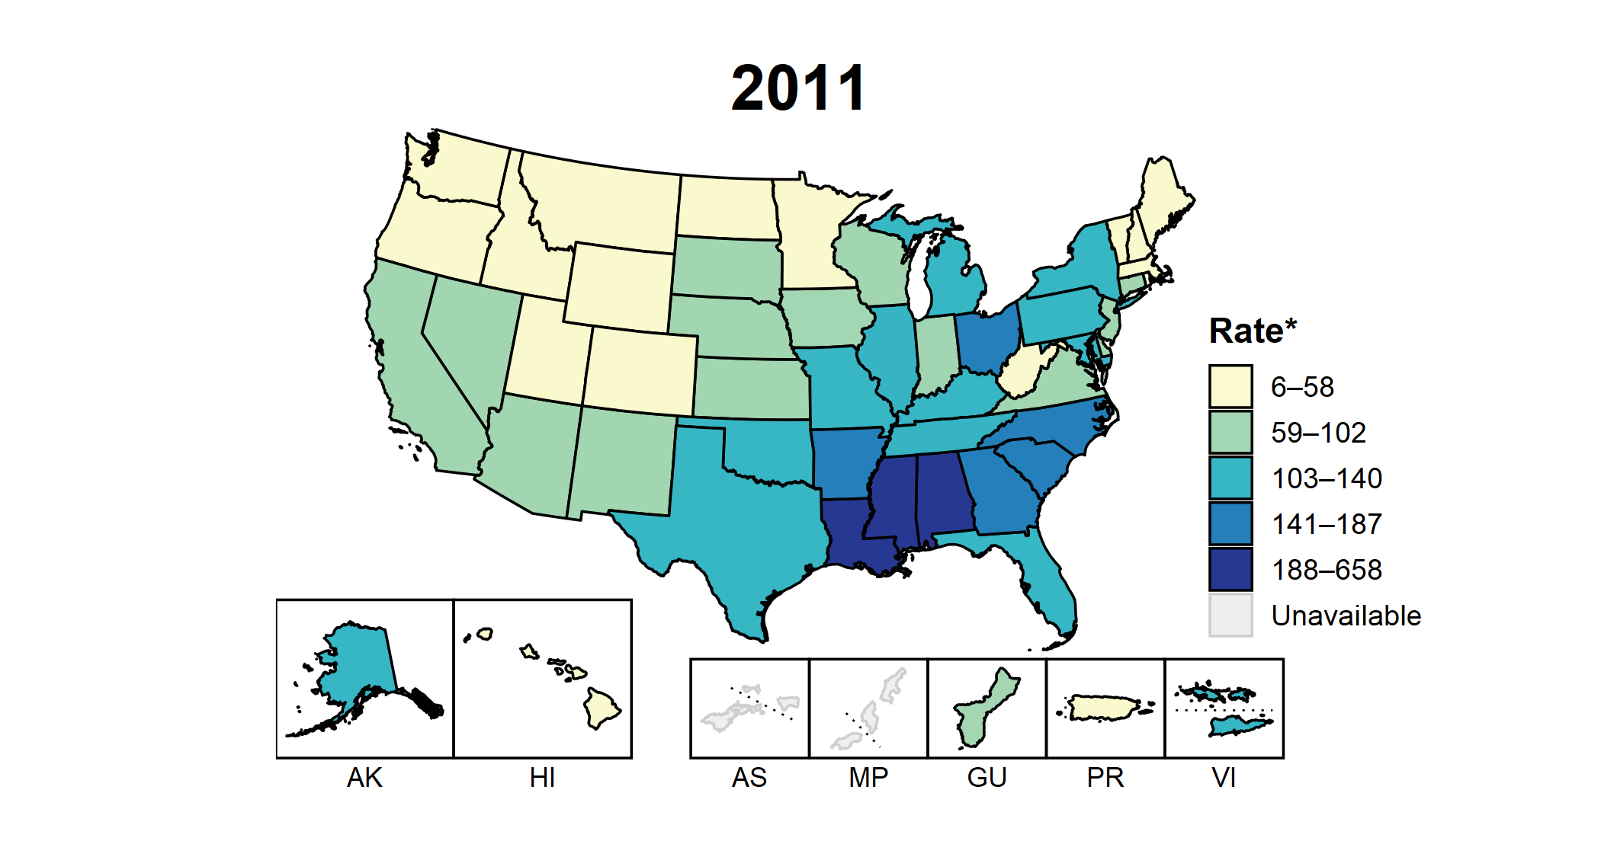
Gonorrhea — Rates of Reported Cases by State, United States and Territories, 2011–2020
* Per 100,000
Notes:
This slide contains an animated figure that will play when the slide is in presentation mode. A static version of the figure that displays maps from the first and last years of the range is available as a separate slide.
In 2011, eight states and the District of Columbia (DC; 16.1% of available areas) had a rate of reported gonorrhea greater than or equal to 141 cases per 100,000 population. This increased to 38 states and DC (69.6% of available areas) in 2020. During 2019 to 2020, rates of reported gonorrhea increased in 36 states and two territories.
American Samoa and the Commonwealth of the Northern Mariana Islands began reporting data on gonorrhea cases to CDC in 2018; data are not available for those areas prior to that year. In addition, data on reported gonorrhea cases in 2018 are not available for the US Virgin Islands.
The COVID-19 pandemic has introduced uncertainty and difficulty in interpreting 2020 case data. See Impact of COVID-19 on STDs (https://www.cdc.gov/std/statistics/2020/impact.htm) for more information.
See Technical Notes (https://www.cdc.gov/std/statistics/2020/technical-notes.htm) for information on gonorrhea case reporting and on interpreting reported rates in US territories.
Data points are available at: https://www.cdc.gov/std/statistics/2020/data.zip

Slide 12
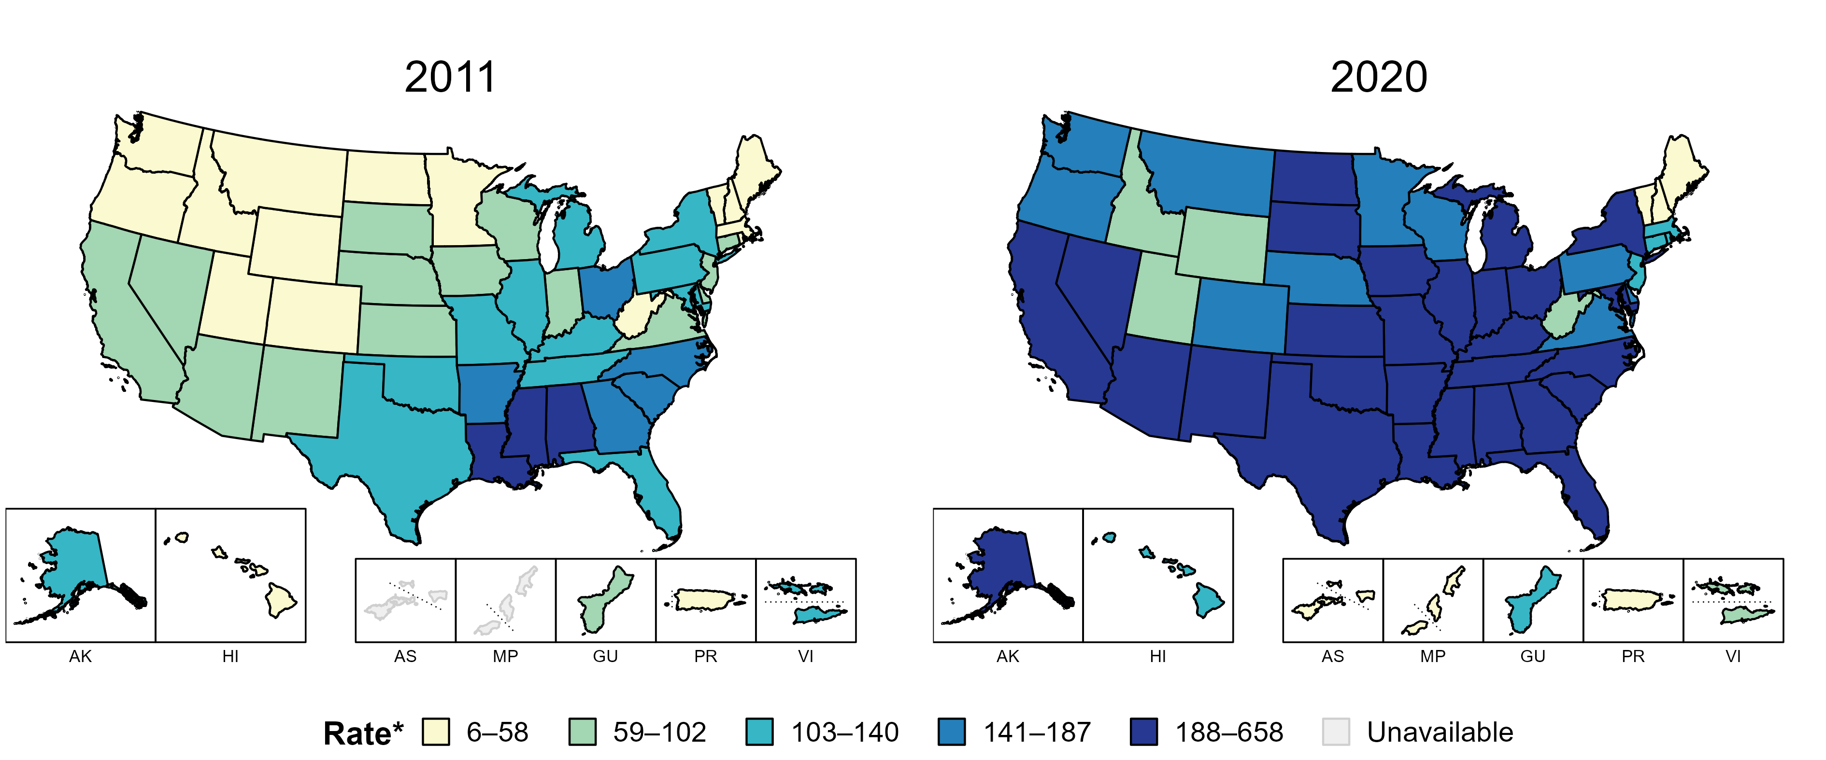
Gonorrhea — Rates of Reported Cases by State, United States and Territories, 2011 and 2020
* Per 100,000
Notes:
In 2011, eight states and the District of Columbia (DC; 16.1% of available areas) had a rate of reported gonorrhea greater than or equal to 141 cases per 100,000 population. This increased to 38 states and DC (69.6% of available areas) in 2020.
American Samoa and the Commonwealth of the Northern Mariana Islands began reporting data on gonorrhea cases to CDC in 2018; data are not available for those areas prior to that year.
The COVID-19 pandemic has introduced uncertainty and difficulty in interpreting 2020 case data. See Impact of COVID-19 on STDs (https://www.cdc.gov/std/statistics/2020/impact.htm) for more information.
See Technical Notes (https://www.cdc.gov/std/statistics/2020/technical-notes.htm) for information on gonorrhea case reporting and on interpreting reported rates in US territories.
Data points are available at: https://www.cdc.gov/std/statistics/2020/data.zip

Slide 13
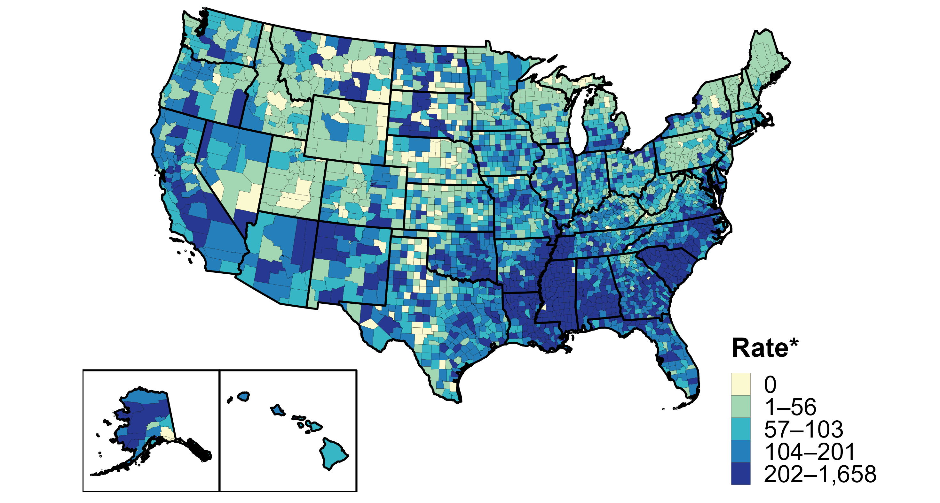
Gonorrhea — Rates of Reported Cases by County, United States, 2020
* Per 100,000
Notes:
In 2020, 94% of all counties and county equivalents in the United States reported at least one case of gonorrhea. Out of 3,143 counties and county equivalents, 78 (2%) reported over half of all cases of gonorrhea.
The COVID-19 pandemic has introduced uncertainty and difficulty in interpreting 2020 case data. See Impact of COVID-19 on STDs (https://www.cdc.gov/std/statistics/2020/impact.htm) for more information.
See Technical Notes (https://www.cdc.gov/std/statistics/2020/technical-notes.htm) for information on gonorrhea case reporting.
Data points are available at: https://www.cdc.gov/std/statistics/2020/data.zip

Slide 14
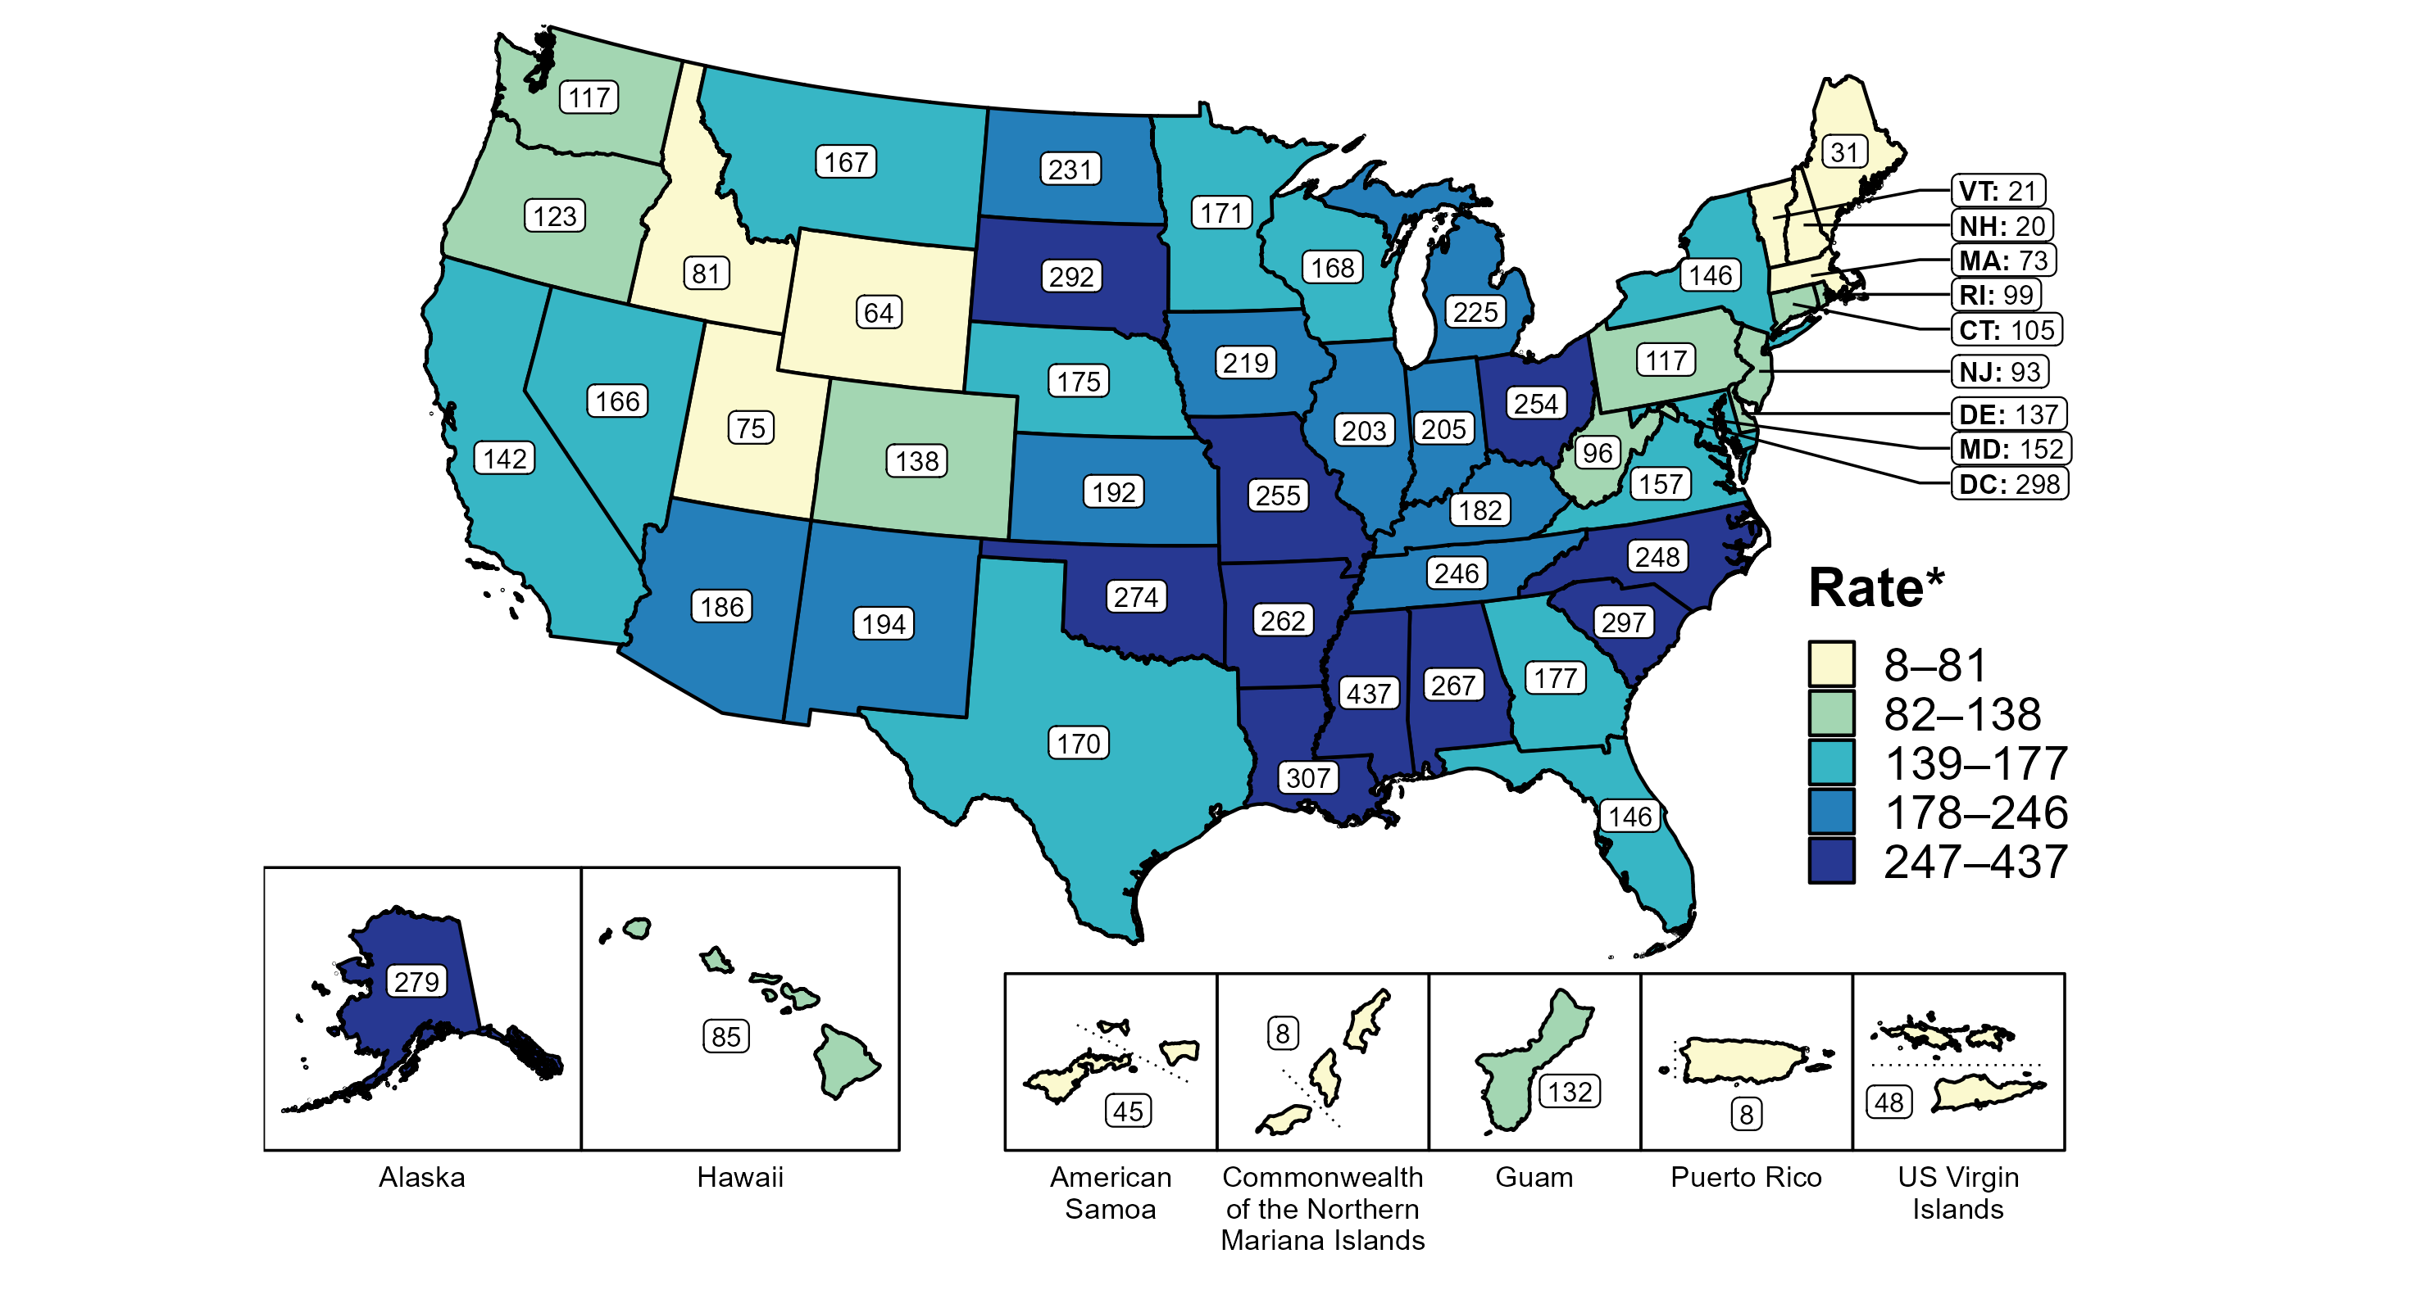
Gonorrhea — Rates of Reported Cases Among Women by State, United States and Territories, 2020
* Per 100,000
Notes:
In 2020, rates of reported gonorrhea ranged by state from 20 cases per 100,000 women in New Hampshire to 437 cases per 100,000 women in Mississippi. The rate of reported gonorrhea in the District of Columbia was 298 per 100,000 women.
Among US territories, rates of reported gonorrhea ranged from 8 cases per 100,000 women in the Commonwealth of the Northern Mariana Islands and Puerto Rico to 132 cases per 100,000 women in Guam.
The COVID-19 pandemic has introduced uncertainty and difficulty in interpreting 2020 case data. See Impact of COVID-19 on STDs (https://www.cdc.gov/std/statistics/2020/impact.htm) for more information.
See Technical Notes (https://www.cdc.gov/std/statistics/2020/technical-notes.htm) for information on gonorrhea case reporting and on interpreting reported rates in US territories.
Data points are available at: https://www.cdc.gov/std/statistics/2020/data.zip

Slide 15
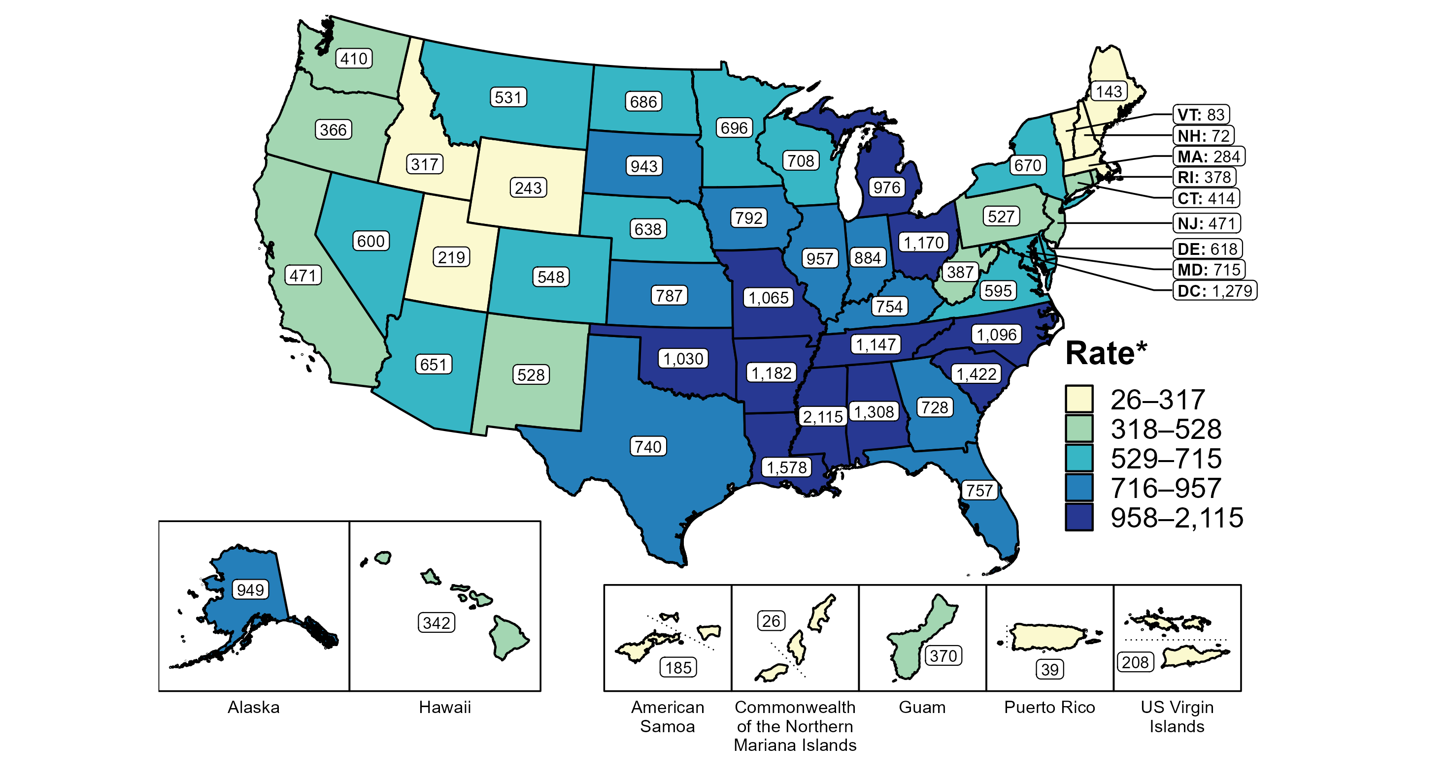
Gonorrhea — Rates of Reported Cases Among Women Aged 15–24 Years by State, United States and Territories, 2020
* Per 100,000
Notes:
In 2020, rates of reported gonorrhea ranged by state from 72 cases per 100,000 women aged 15 to 24 years in New Hampshire to 2,115 cases per 100,000 women aged 15 to 24 years in Mississippi. The rate of reported gonorrhea in the District of Columbia was 1,279 per 100,000 women aged 15 to 24 years.
Among US territories, rates of reported gonorrhea ranged from 26 cases per 100,000 women aged 15 to 24 years in the Commonwealth of the Northern Mariana Islands to 370 cases per 100,000 women aged 15 to 24 years in Guam.
The COVID-19 pandemic has introduced uncertainty and difficulty in interpreting 2020 case data. See Impact of COVID-19 on STDs (https://www.cdc.gov/std/statistics/2020/impact.htm) for more information.
See Technical Notes (https://www.cdc.gov/std/statistics/2020/technical-notes.htm) for information on gonorrhea case reporting and on interpreting reported rates in US territories.
Data points are available at: https://www.cdc.gov/std/statistics/2020/data.zip

Slide 16
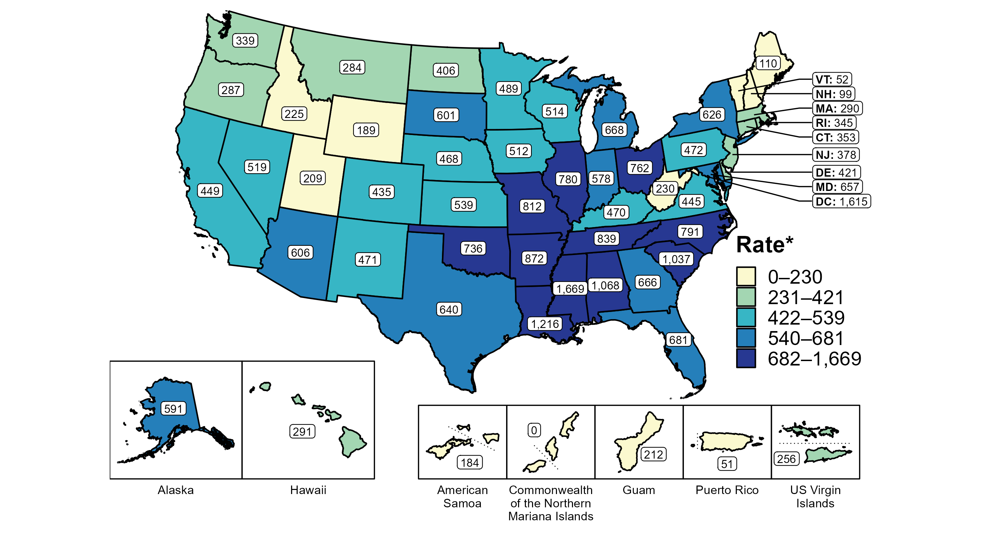
Gonorrhea — Rates of Reported Cases Among Men Aged 15–24 Years by State, United States and Territories, 2020
* Per 100,000
Notes:
In 2020, rates of reported gonorrhea ranged by state from 52 cases per 100,000 men aged 15 to 24 years in Vermont to 1,669 cases per 100,000 men aged 15 to 24 years in Mississippi. The rate of reported gonorrhea in the District of Columbia was 1,615 per 100,000 men aged 15 to 24 years.
Among US territories, rates of reported gonorrhea ranged from 0 cases per 100,000 men aged 15 to 24 years in the Commonwealth of the Northern Mariana Islands to 256 cases per 100,000 men aged 15 to 24 years in the US Virgin Islands.
The COVID-19 pandemic has introduced uncertainty and difficulty in interpreting 2020 case data. See Impact of COVID-19 on STDs (https://www.cdc.gov/std/statistics/2020/impact.htm) for more information.
See Technical Notes (https://www.cdc.gov/std/statistics/2020/technical-notes.htm) for information on gonorrhea case reporting and on interpreting reported rates in US territories.
Data points are available at: https://www.cdc.gov/std/statistics/2020/data.zip

Slide 17
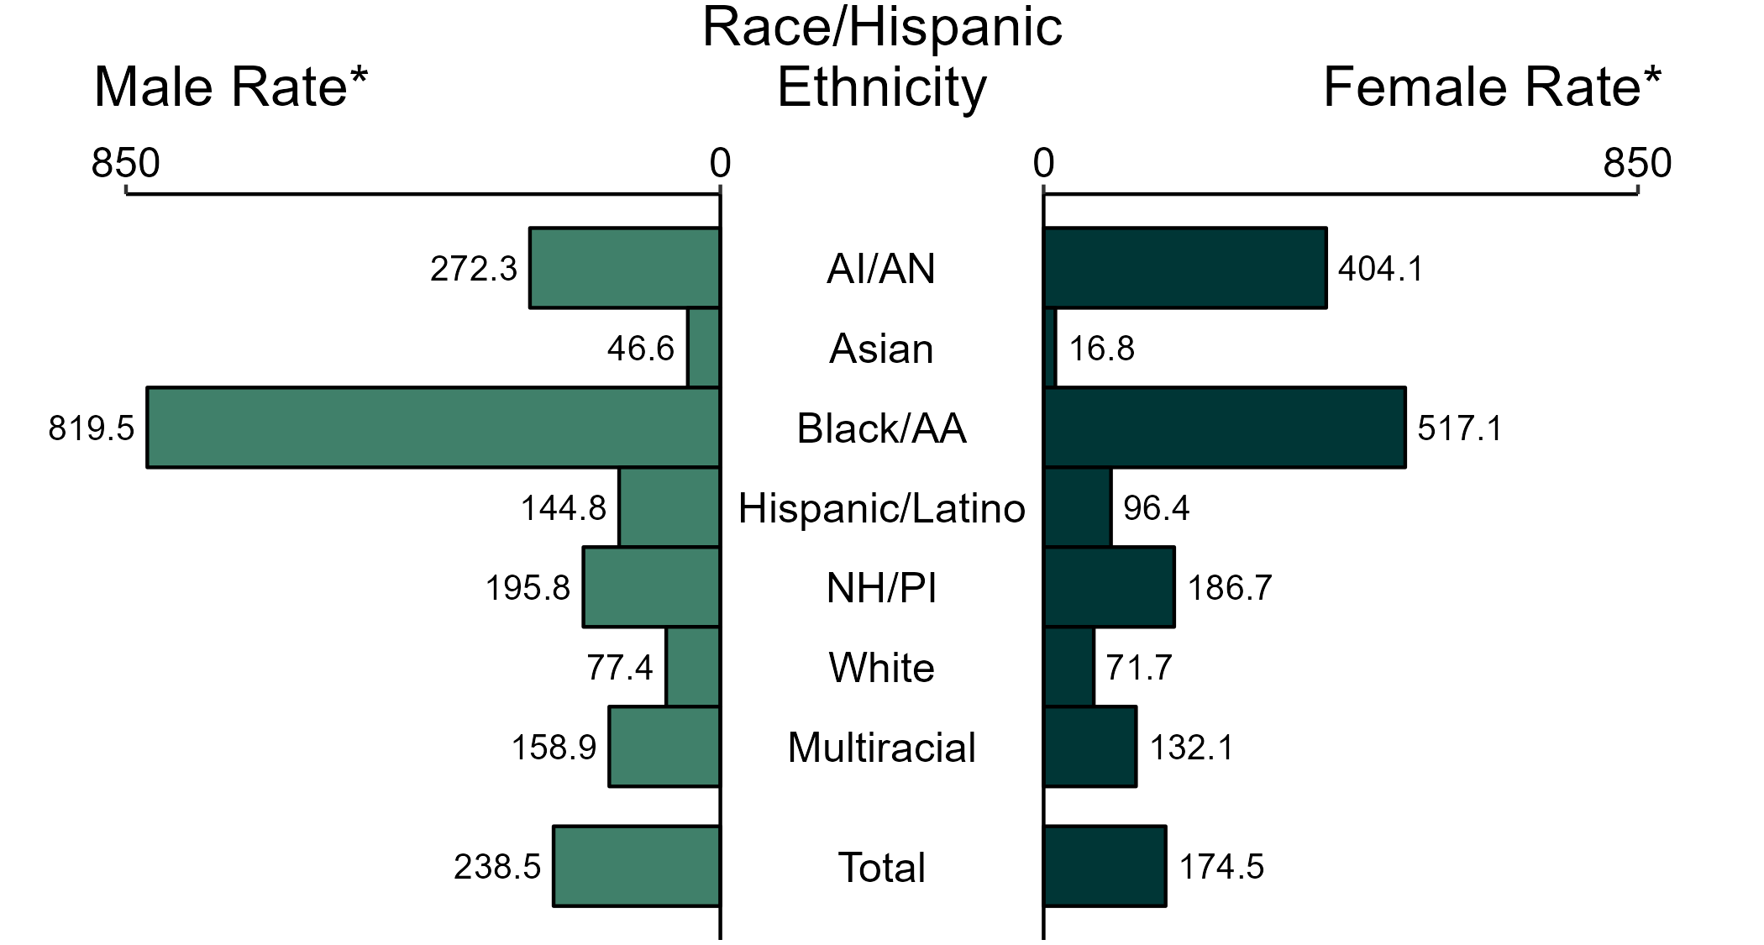
Gonorrhea — Rate of Reported Cases by Race/Hispanic Ethnicity and Sex, United States, 2020
* Per 100,000
ACRONYMS: AI/AN = American Indian/Alaska Native; Black/AA = Black or African American; NH/PI = Native Hawaiian/Pacific Islander
NOTE: Total includes all cases including those with unknown race/Hispanic ethnicity.
Notes:
In 2020, non-Hispanic Black or African American men had the highest rate of reported cases of gonorrhea (819.5 per 100,000), followed by non-Hispanic American Indian or Alaska Native men (272.3 per 100,000) and non-Hispanic Native Hawaiian or other Pacific Islander men (195.8 per 100,000). Among women, non-Hispanic Black or African American women also had the highest rate of reported cases of gonorrhea (517.1 per 100,000), followed by non-Hispanic American Indian or Alaska Native women (404.1 per 100,000) and non-Hispanic Native Hawaiian or other Pacific Islander women (186.7 per 100,000).
Using non-Hispanic White persons as the reference category, the greatest racial disparity in rates of reported gonorrhea was observed among non-Hispanic Black or African American men, with a rate ratio of 10.6. Among women, the greatest disparity was observed among non-Hispanic Black or African American women as well, with a rate 7.2 times that of non-Hispanic White women.
For this figure, race/Hispanic ethnicity is categorized first by reported Hispanic ethnicity, then by reported race. Therefore, cases categorized as Hispanic/Latino can be of any race; cases categorized into a race group include both non-Hispanic persons and persons of unknown Hispanic ethnicity. Not all US jurisdictions reported cases in Office of Management and Budget compliant race categories in 2020. This may minimally under- or overestimate rates for Asian, Native Hawaiian or other Pacific Islander, or multiracial individuals. No population data exist for unknown or other race; therefore, rates are not calculated. For completeness, data in this figure include cases reported from all jurisdictions.
The COVID-19 pandemic has introduced uncertainty and difficulty in interpreting 2020 case data. See Impact of COVID-19 on STDs (https://www.cdc.gov/std/statistics/2020/impact.htm) for more information.
See Technical Notes (https://www.cdc.gov/std/statistics/2020/technical-notes.htm) for information on gonorrhea case reporting and reporting of race/Hispanic ethnicity for STD cases.
Data points are available at: https://www.cdc.gov/std/statistics/2020/data.zip

Slide 18
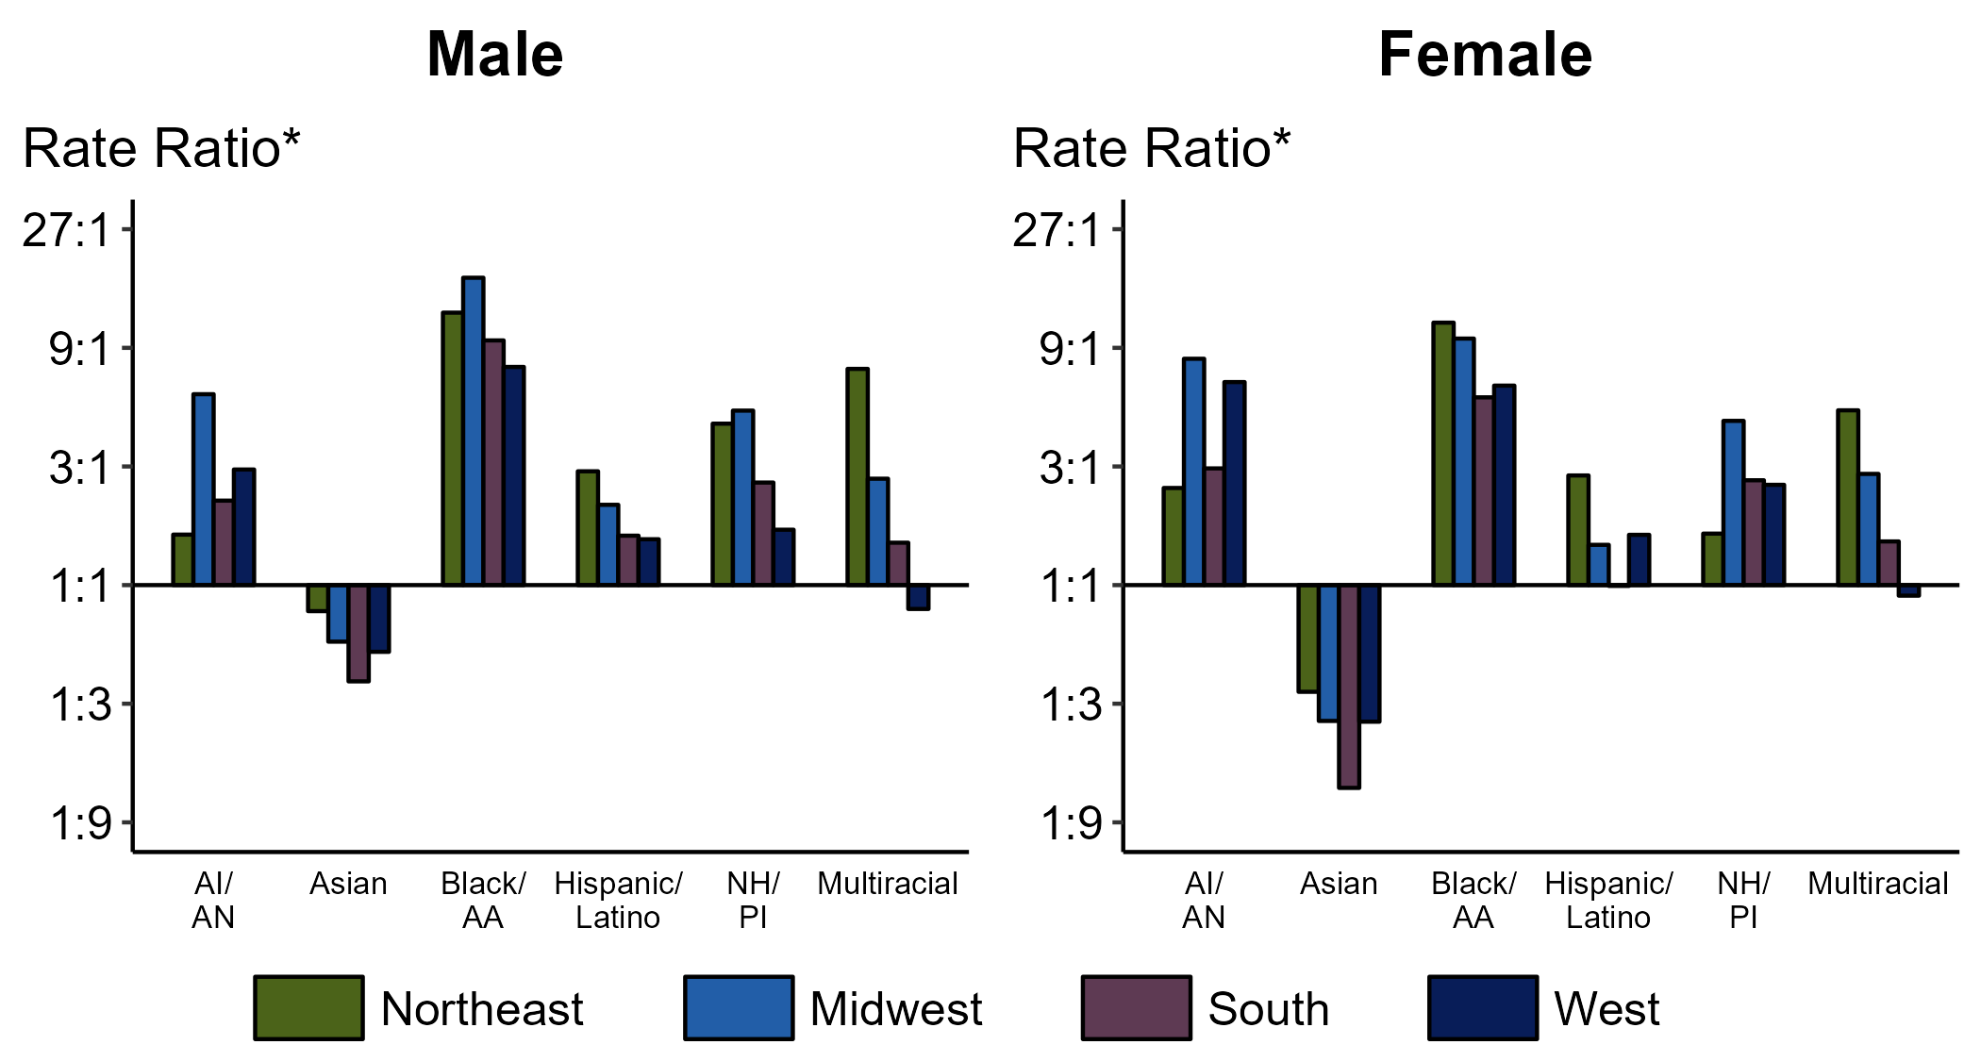
Gonorrhea — Rate Ratios by Sex, Race/Hispanic Ethnicity, and Region, United States, 2020
* For the rate ratios, non-Hispanic White persons are the reference population. Y-axis is log scale.
ACRONYMS: AI/AN = American Indian/Alaska Native; Black/AA = Black or African American; NH/PI = Native Hawaiian/Pacific Islander
Notes:
Among males and females, rate ratios of rates of reported gonorrhea by race/Hispanic ethnicity (using non-Hispanic White persons as the reference population) varied by region in 2020. Among males, the greatest rate ratio was in the Midwest where the rate of gonorrhea among non-Hispanic Black males was 17.2 times the rate among non-Hispanic White males. Among females, the greatest rate ratio was in the Northeast where the rate of gonorrhea among non-Hispanic Black females was 11.4 times the rate among non-Hispanic White females.
For this figure, race/Hispanic ethnicity is categorized first by reported Hispanic ethnicity, then by reported race. Therefore, cases categorized as Hispanic/Latino can be of any race; cases categorized into a race group include both non-Hispanic persons and persons of unknown Hispanic ethnicity. Not all US jurisdictions reported cases in Office of Management and Budget compliant race categories in 2020. This may minimally under- or overestimate rates for Asian, Native Hawaiian or other Pacific Islander, or multiracial individuals. No population data exist for unknown or other race; therefore, rates and rate ratios are not calculated. For completeness, data in this figure include cases reported from all jurisdictions.
The COVID-19 pandemic has introduced uncertainty and difficulty in interpreting 2020 case data. See Impact of COVID-19 on STDs (https://www.cdc.gov/std/statistics/2020/impact.htm) for more information.
See Technical Notes (https://www.cdc.gov/std/statistics/2020/technical-notes.htm) for information on gonorrhea case reporting and reporting of race/Hispanic ethnicity for STD cases.
Data points are available at: https://www.cdc.gov/std/statistics/2020/data.zip

Slide 19
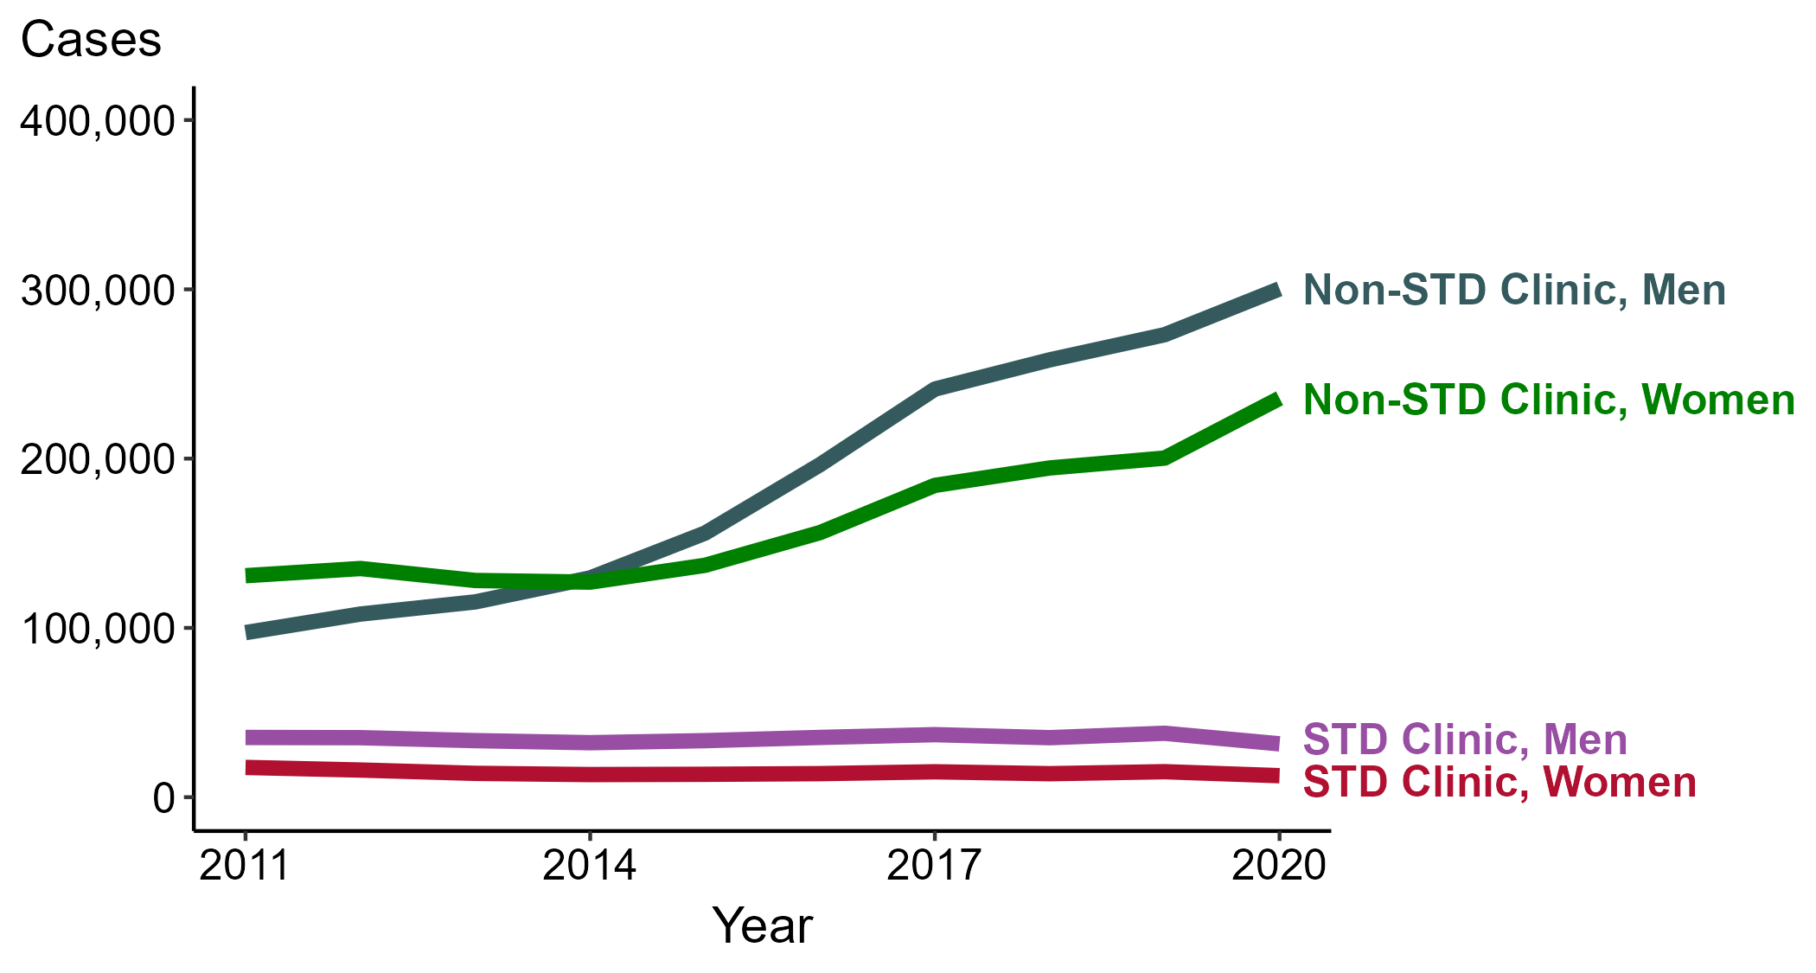
Gonorrhea — Reported Cases by Reporting Source and Sex, United States, 2011–2020
NOTE: During 2011 to 2020, the proportion of all cases with unknown reporting source was 13.7%, from a low of 11.9% in 2012 to a high of 14.4% in 2019.
Notes:
During 2011 to 2020, the number of gonorrhea cases reported from STD clinics decreased 10.7% among men (35,274 to 31,511 cases) and decreased 27.8% among women (17,577 to 12,693 cases), while the number of cases reported from non-STD clinics increased 208.9% among men (97,215 to 300,286 cases) and increased 80.1% among women (130,837 to 235,623 cases).
The COVID-19 pandemic has introduced uncertainty and difficulty in interpreting 2020 case data. See Impact of COVID-19 on STDs (https://www.cdc.gov/std/statistics/2020/impact.htm) for more information.
See Technical Notes (https://www.cdc.gov/std/statistics/2020/technical-notes.htm) for information on gonorrhea case reporting.
Data points are available at: https://www.cdc.gov/std/statistics/2020/data.zip

Slide 20
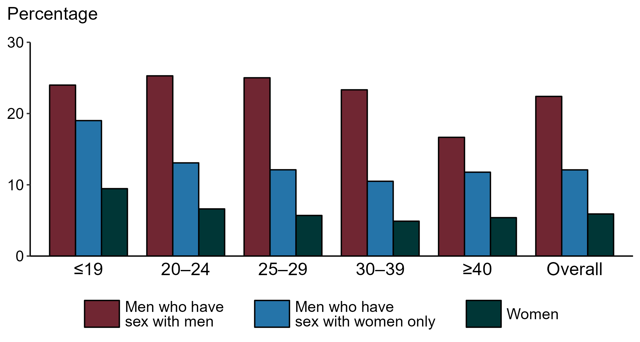
Gonorrhea — Proportion of STD Clinic Patients Testing Positive by Age Group, Sex, and Sex of Sex Partners, STD Surveillance Network (SSuN), 2020
NOTE: Results are based on data obtained from unique patients in eight participating sites (Baltimore, Florida, Indiana, Multnomah County, New York City, Philadelphia, San Francisco, and Washington) with known sex of sex partners attending SSuN STD clinics who were tested ≥1 times for gonorrhea in 2020 (n=33,367).
Notes:
Among patients accessing care in participating STD clinics in the STD Surveillance Network (SSuN) who were tested for gonorrhea in 2020, 22.4% of men who have sex with men, 12.1% of men who have sex with women only, and 5.9% of women were positive. The proportion of STD clinic patients who tested positive for gonorrhea varied by sex and sex of sex partners, as well as by age group. Men who have sex with men were noted to have higher proportions of testing positive in all age groups when compared to women and men who have sex with women only.
The COVID-19 pandemic has introduced uncertainty and difficulty in interpreting data collected in 2020. See Impact of COVID-19 on STDs (https://www.cdc.gov/std/statistics/2020/impact.htm) for more information.
See Technical Notes (https://www.cdc.gov/std/statistics/2020/technical-notes.htm) for information on SSuN methodology.
Data points are available at: https://www.cdc.gov/std/statistics/2020/data.zip

Slide 21
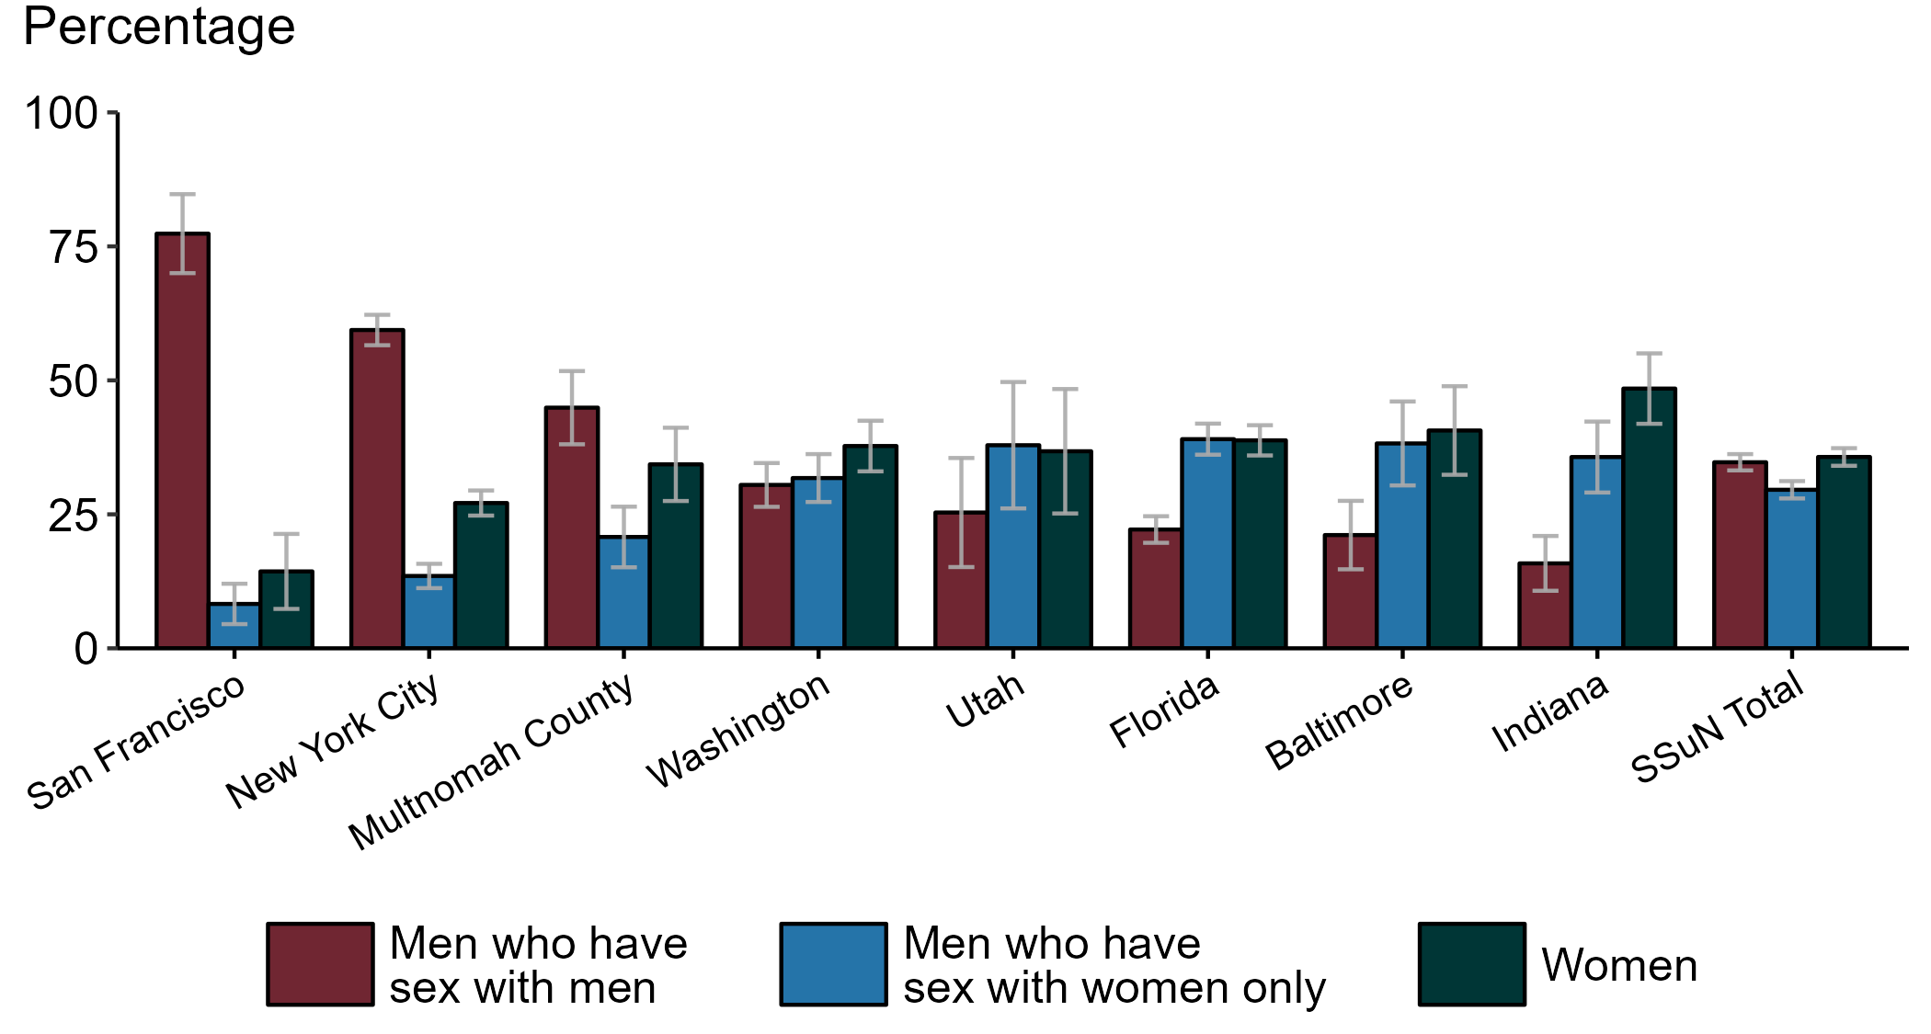
Estimated Proportion of Gonorrhea Cases by Sex and Sex of Sex Partners and Jurisdiction, STD Surveillance Network (SSuN), 2020
NOTE: Estimate based on weighted analysis of data on sex of sex partners obtained from interviews (n=4,244) conducted among a random sample of gonorrhea cases reported January to December 2020. Includes eight SSuN sites reporting completed case investigations in 2020 for at least 2% of all reported cases.
Notes:
In 2020, San Francisco had the highest proportion of gonorrhea cases reported among men who have sex with men, Indiana had the highest proportion of gonorrhea case reported among women and Washington state had the highest proportion of gonorrhea cases reported among men who have sex with women only. Overall, the proportion of gonorrhea estimated to be attributed to men who have sex with men in 2020 was 34.7%.
The COVID-19 pandemic has introduced uncertainty and difficulty in interpreting data collected in 2020. See Impact of COVID-19 on STDs (https://www.cdc.gov/std/statistics/2020/impact.htm) for more information.
See Technical Notes (https://www.cdc.gov/std/statistics/2020/technical-notes.htm) for information on SSuN methodology.
Data points are available at: https://www.cdc.gov/std/statistics/2020/data.zip

Slide 22
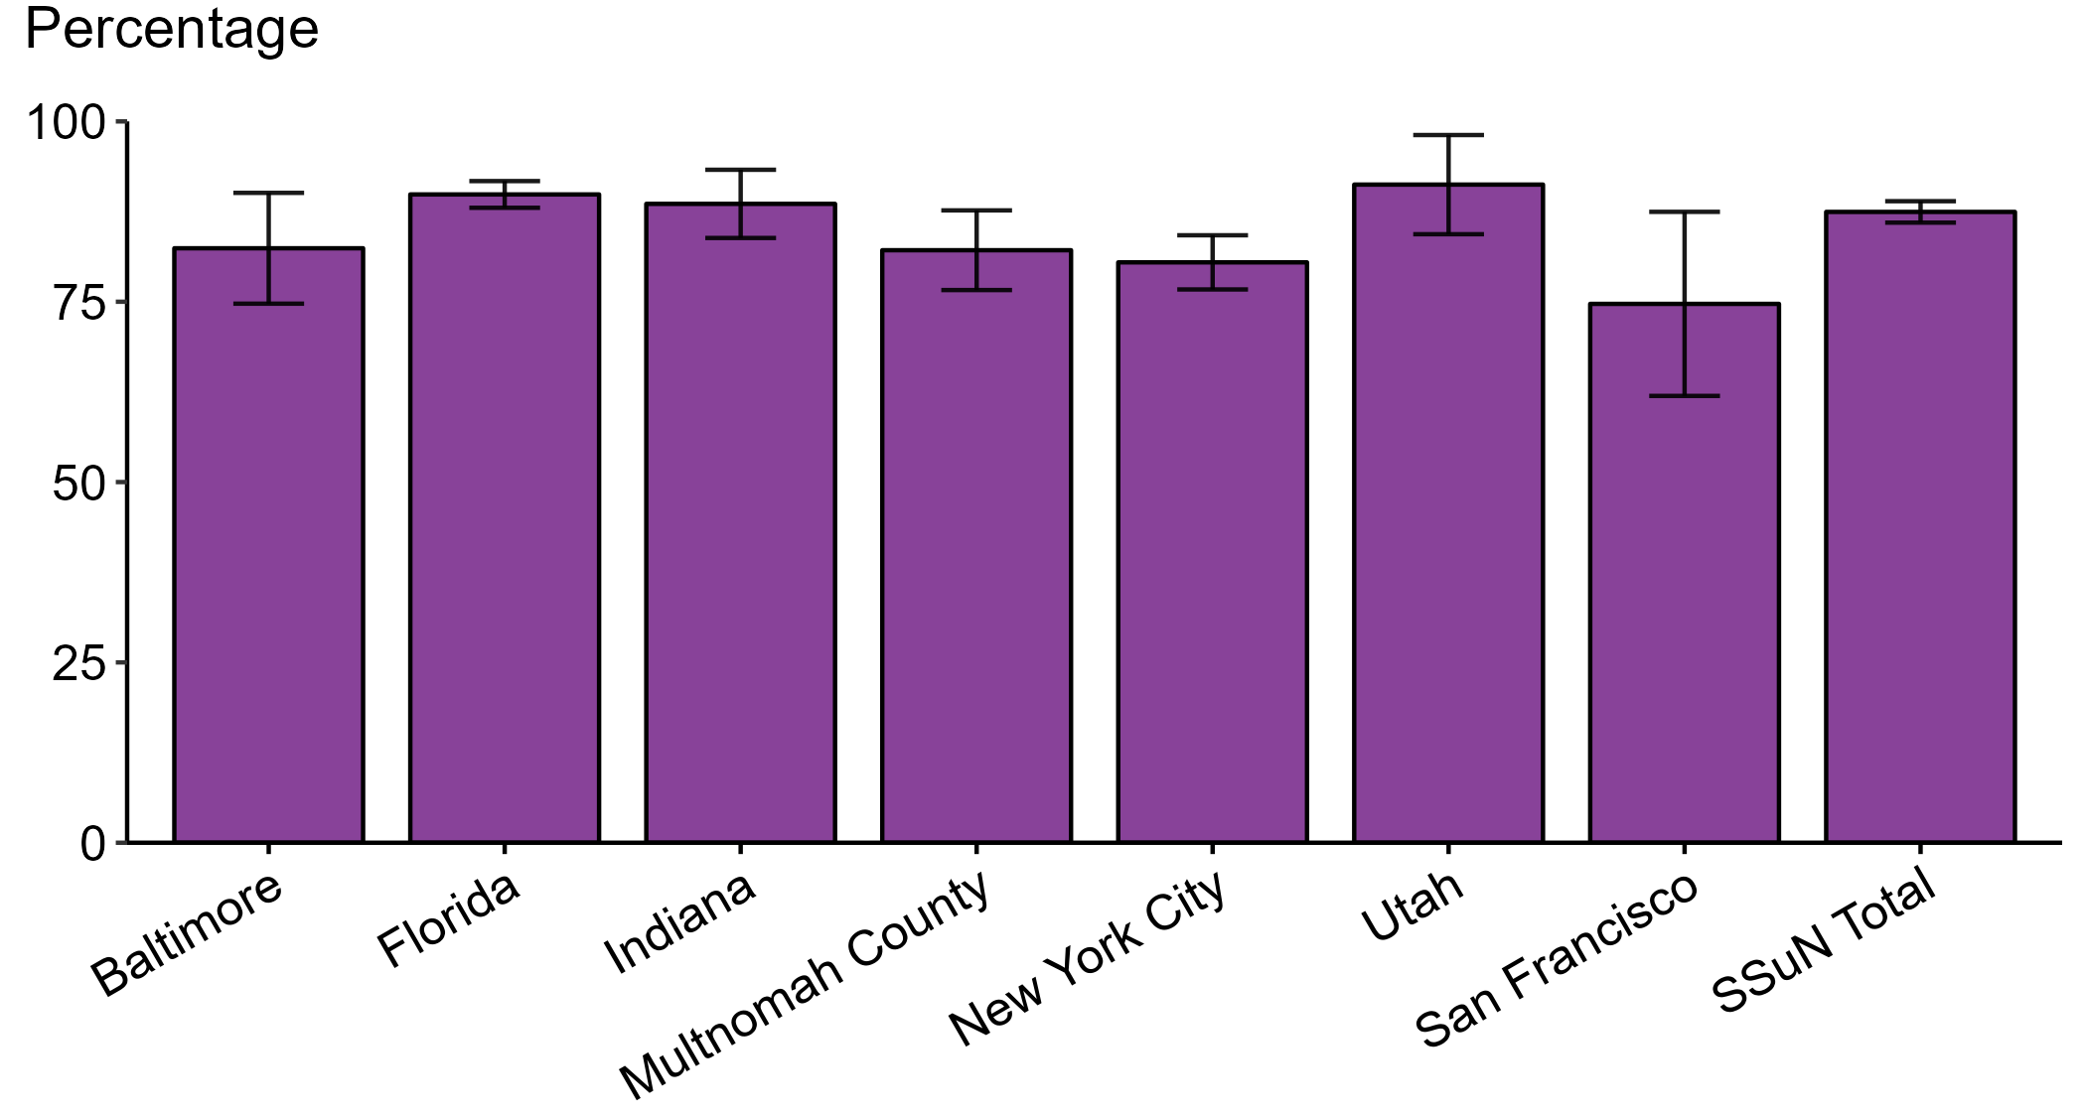
Gonorrhea – Estimated Proportion of Cases Treated with Recommended Regimen by Jurisdiction, STD Surveillance Network (SSuN), 2020
NOTE: Includes SSuN jurisdictions with treatment and dosage data ascertained for at least 80% of sampled, investigated cases. In 2020, the recommended treatment for uncomplicated gonorrhea was ceftriaxone 250 mg intramuscular plus azithromycin 1 gm orally. In December 2020, gonorrhea treatment recommendations were updated to recommend only a single 500 mg intramuscular dose of ceftriaxone. Data in this figure reflect the previous treatment recommendations only.
Notes:
In 2020, Utah reported the highest proportion of gonorrhea cases treated with the recommended regimen and San Francisco reported the lowest proportion of cases treated with the recommended regimen. The overall proportion of cases treated with the recommended regimen was 87.5% in 2020.
The COVID-19 pandemic has introduced uncertainty and difficulty in interpreting data collected in 2020. See Impact of COVID-19 on STDs (https://www.cdc.gov/std/statistics/2020/impact.htm) for more information.
See Technical Notes (https://www.cdc.gov/std/statistics/2020/technical-notes.htm) for information on SSuN methodology.
Data points are available at: https://www.cdc.gov/std/statistics/2020/data.zip

Slide 23
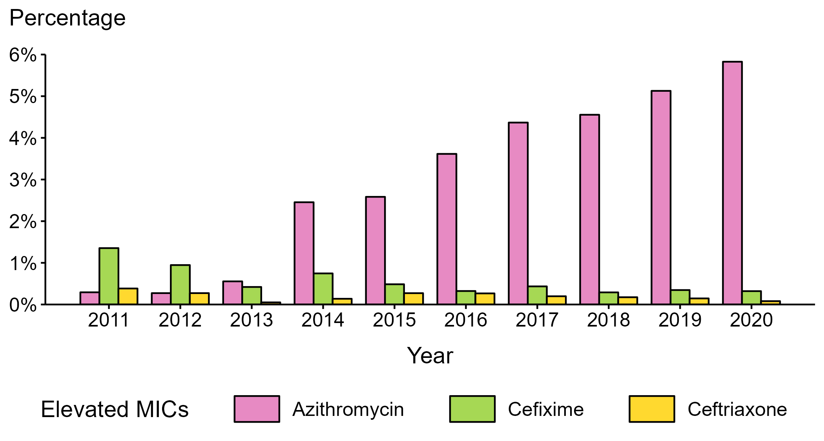
Neisseria gonorrhoeae — Percentage of Isolates with Elevated Minimum Inhibitory Concentrations (MICs) to Azithromycin, Cefixime, and Ceftriaxone, Gonococcal Isolate Surveillance Project (GISP), 2011–2020
NOTE: Elevated MICs = Azithromycin: ≥ 2.0 µg/mL; Cefixime: ≥ 0.25 µg/mL; Ceftriaxone: ≥ 0.125 µg/mL
Notes:
During 2011–2020, the percentage of Neisseria gonorrhoeae isolates that exhibited elevated ceftriaxone minimum inhibitory concentrations, defined as ≥ 0.125 µg/mL, fluctuated between 0.1% and 0.4%. In 2020, 0.1% of isolates had elevated ceftriaxone minimum inhibitory concentrations. The percentage of isolates with elevated cefixime minimum inhibitory concentrations (≥ 0.25 µg/mL) declined from 1.4% in 2011 to 0.3% in 2020. During 2012–2014, the percentage of isolates with elevated azithromycin minimum inhibitory concentrations (≥ 2 µg/mL) ranged from 0.3% to 2.5% with a sharp increase during 2013–2014 (0.6% to 2.5%); during 2014–2020, the percentage increased from 2.5% to 5.8%.
The COVID-19 pandemic has introduced uncertainty and difficulty in interpreting data collected in 2020. See Impact of COVID-19 on STDs (https://www.cdc.gov/std/statistics/2020/impact.htm) for more information.
See Technical Notes (https://www.cdc.gov/std/statistics/2020/technical-notes.htm) for information on GISP methodology.
Data points are available at: https://www.cdc.gov/std/statistics/2020/data.zip

Slide 24
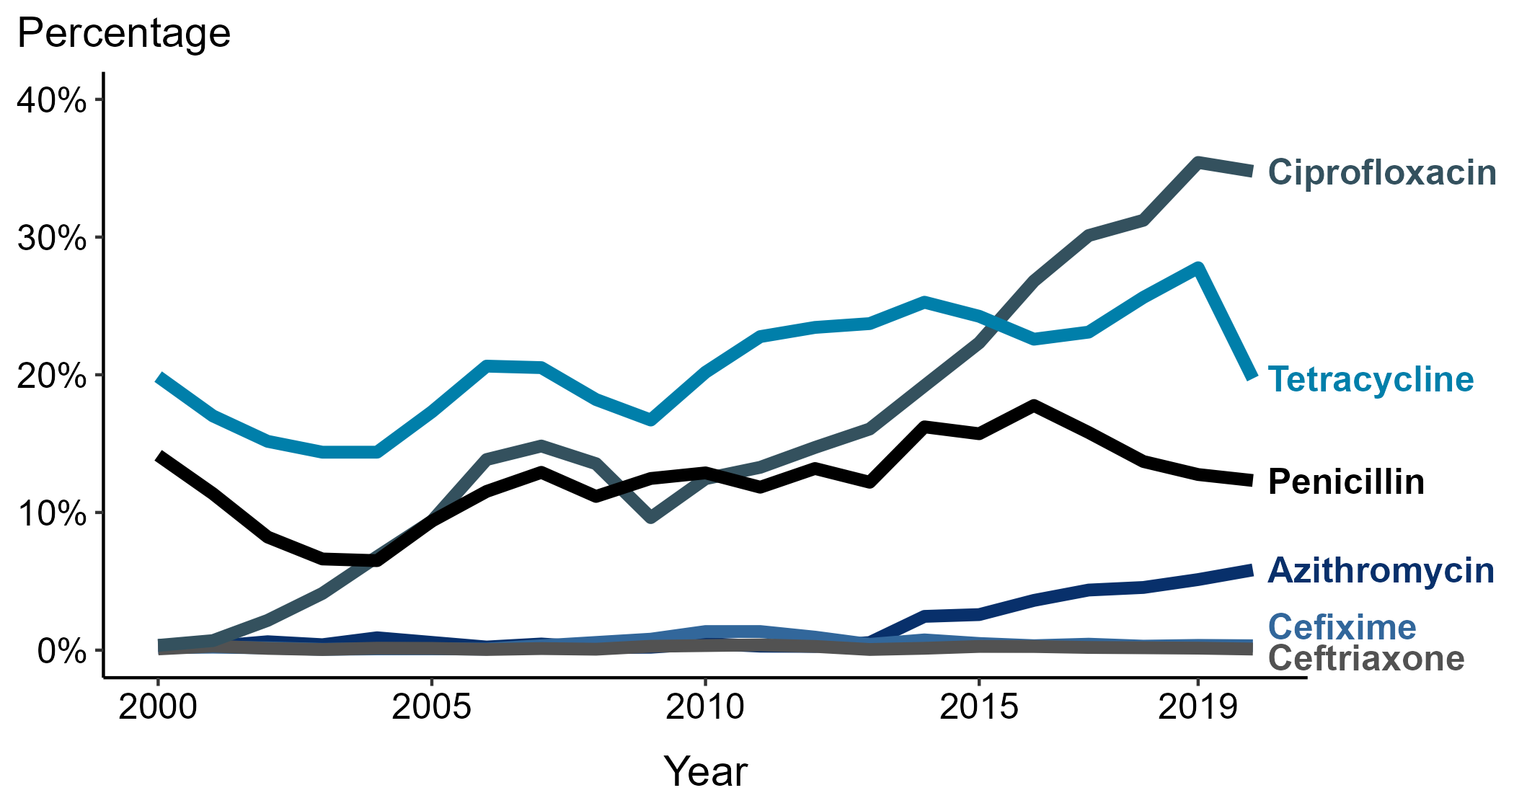
Neisseria gonorrhoeae — Prevalence of Tetracycline, Penicillin, or Ciprofloxacin Resistance* or Elevated Cefixime, Ceftriaxone, or Azithromycin Minimum Inhibitory Concentrations (MICs)†, by Year — Gonococcal Isolate Surveillance Project (GISP), 2000–2020
* Resistance: Ciprofloxacin: MIC ≥ 1.0 µg/mL; Penicillin: MIC ≥ 2.0 µg/mL or Beta-lactamase positive; Tetracycline: MIC ≥ 2.0 µg/mL
† Elevated MICs: Azithromycin: MIC ≥ 1.0 µg/mL 29 (2000–2004); ≥ 2.0 µg/mL (2005–2020); Ceftriaxone: MIC ≥ 0.125 µg/mL; Cefixime: MIC ≥ 0.25 µg/mL
NOTE: Cefixime susceptibility was not tested in 2007 and 2008.
Notes:
In 2020, 34.8% of Neisseria gonorrhoeae isolates collected from GISP sites were resistant to ciprofloxacin, 19.7% to tetracycline, and 12.3% to penicillin.
The COVID-19 pandemic has introduced uncertainty and difficulty in interpreting data collected in 2020. See Impact of COVID-19 on STDs (https://www.cdc.gov/std/statistics/2020/impact.htm) for more information.
See Technical Notes (https://www.cdc.gov/std/statistics/2020/technical-notes.htm) for information on GISP methodology.
Data points are available at: https://www.cdc.gov/std/statistics/2020/data.zip

Slide 25
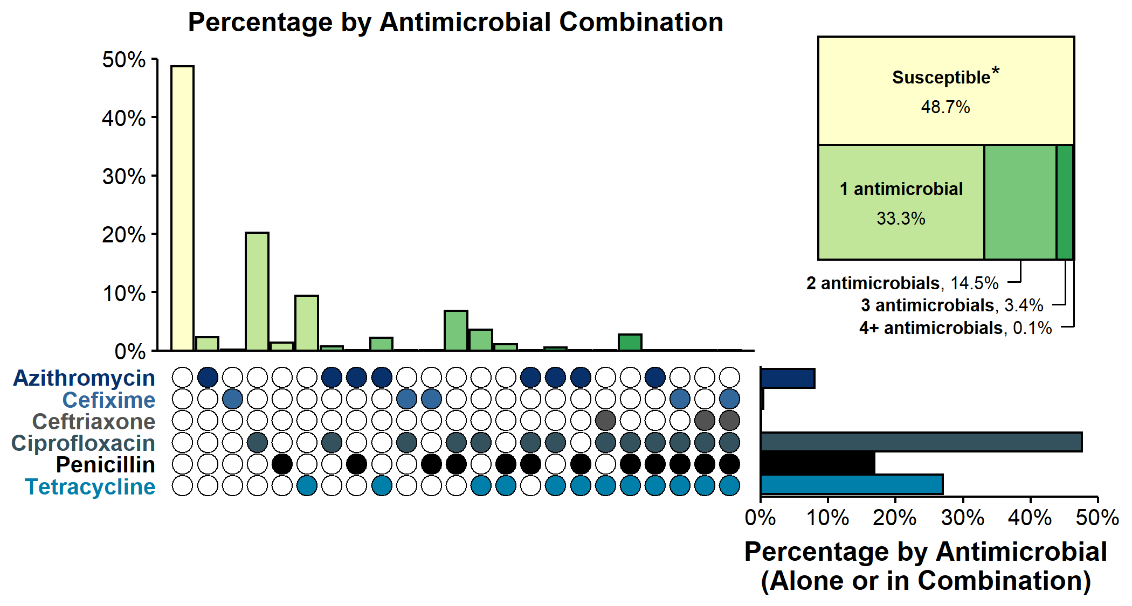
Resistance or Elevated Minimum Inhibitory Concentration (MIC) Patterns of Neisseria gonorrhoeae Isolates to Antimicrobials, Gonococcal Isolate Surveillance Project (GISP), 2020
* Susceptible category includes isolates with penicillin (or Beta-lactamase negative), tetracycline, and ciprofloxacin MIC values that are not considered resistant (i.e., susceptible and intermediate resistant) based on Clinical & Laboratory Standards Institute criteria and isolates with ceftriaxone, cefixime, and azithromycin MIC values that are not considered elevated based on GISP “alert” values.
NOTE: Elevated MIC = Ceftriaxone: MIC ≥ 0.125 µg/mL; Cefixime: MIC ≥ 0.25 µg/mL; Azithromycin: MIC ≥ 2.0 µg/mL. Resistance = Tetracycline: MIC ≥ 2.0 µg/mL; Ciprofloxacin: MIC ≥ 1.0 µg/mL; Penicillin: MIC ≥ 2.0 µg/mL or Beta-lactamase positive. In the figure, a filled circle reflects resistance or elevated MIC to a specific antimicrobial; only antimicrobial combinations with non-zero percentages are shown.
Notes:
In 2020, 48.7% of Neisseria gonorrhoeae isolates collected through GISP were susceptible to the six antimicrobials tested. Less than half (49%) were resistant to at least one of three antimicrobials (tetracycline, penicillin, or ciprofloxacin). An additional 2.4% of isolates were susceptible to those antimicrobials, but had elevated minimum inhibitory concentrations to ceftriaxone, cefixime, or azithromycin. Overall, 14.5% of isolates demonstrated resistance or elevated minimum inhibitory concentrations to two antimicrobials tested; 3.4% demonstrated resistance or elevated minimum inhibitory concentrations to three antimicrobials tested. No isolates with elevated azithromycin minimum inhibitory concentrations also had elevated ceftriaxone minimum inhibitory concentrations.
The COVID-19 pandemic has introduced uncertainty and difficulty in interpreting data collected in 2020. See Impact of COVID-19 on STDs (https://www.cdc.gov/std/statistics/2020/impact.htm) for more information.
See Technical Notes (https://www.cdc.gov/std/statistics/2020/technical-notes.htm) for information on GISP methodology.
Data points are available at: https://www.cdc.gov/std/statistics/2020/data.zip

Slide 26
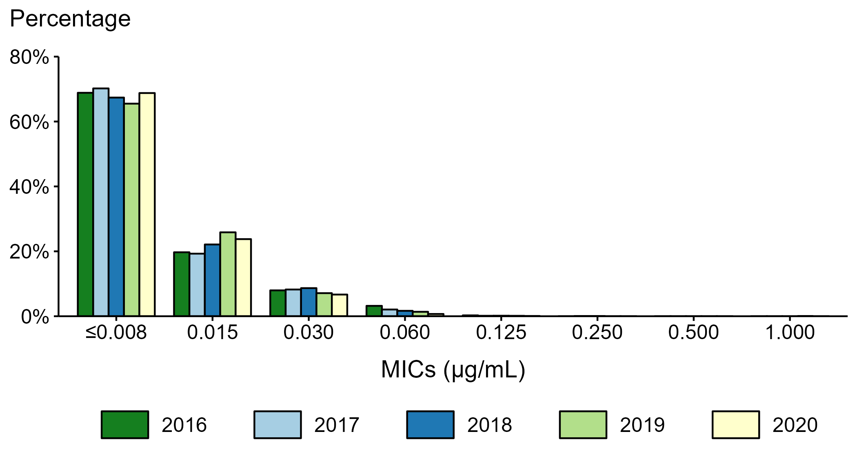
Neisseria gonorrhoeae — Distribution of Ceftriaxone Minimum Inhibitory Concentrations (MICs) by Year, Gonococcal Isolate Surveillance Project (GISP), 2016–2020
Notes:
During 2016 to 2020, 65.5–70.2% of all tested Neisseria gonorrhoeae isolates had a ceftriaxone minimum inhibitory concentration value ≤0.008 µg/mL and 99.7–99.9% had a minimum inhibitory concentration value <0.125 µg/mL.
The COVID-19 pandemic has introduced uncertainty and difficulty in interpreting data collected in 2020. See Impact of COVID-19 on STDs (https://www.cdc.gov/std/statistics/2020/impact.htm) for more information.
See Technical Notes (https://www.cdc.gov/std/statistics/2020/technical-notes.htm) for information on GISP methodology.
Data points are available at: https://www.cdc.gov/std/statistics/2020/data.zip

Slide 27
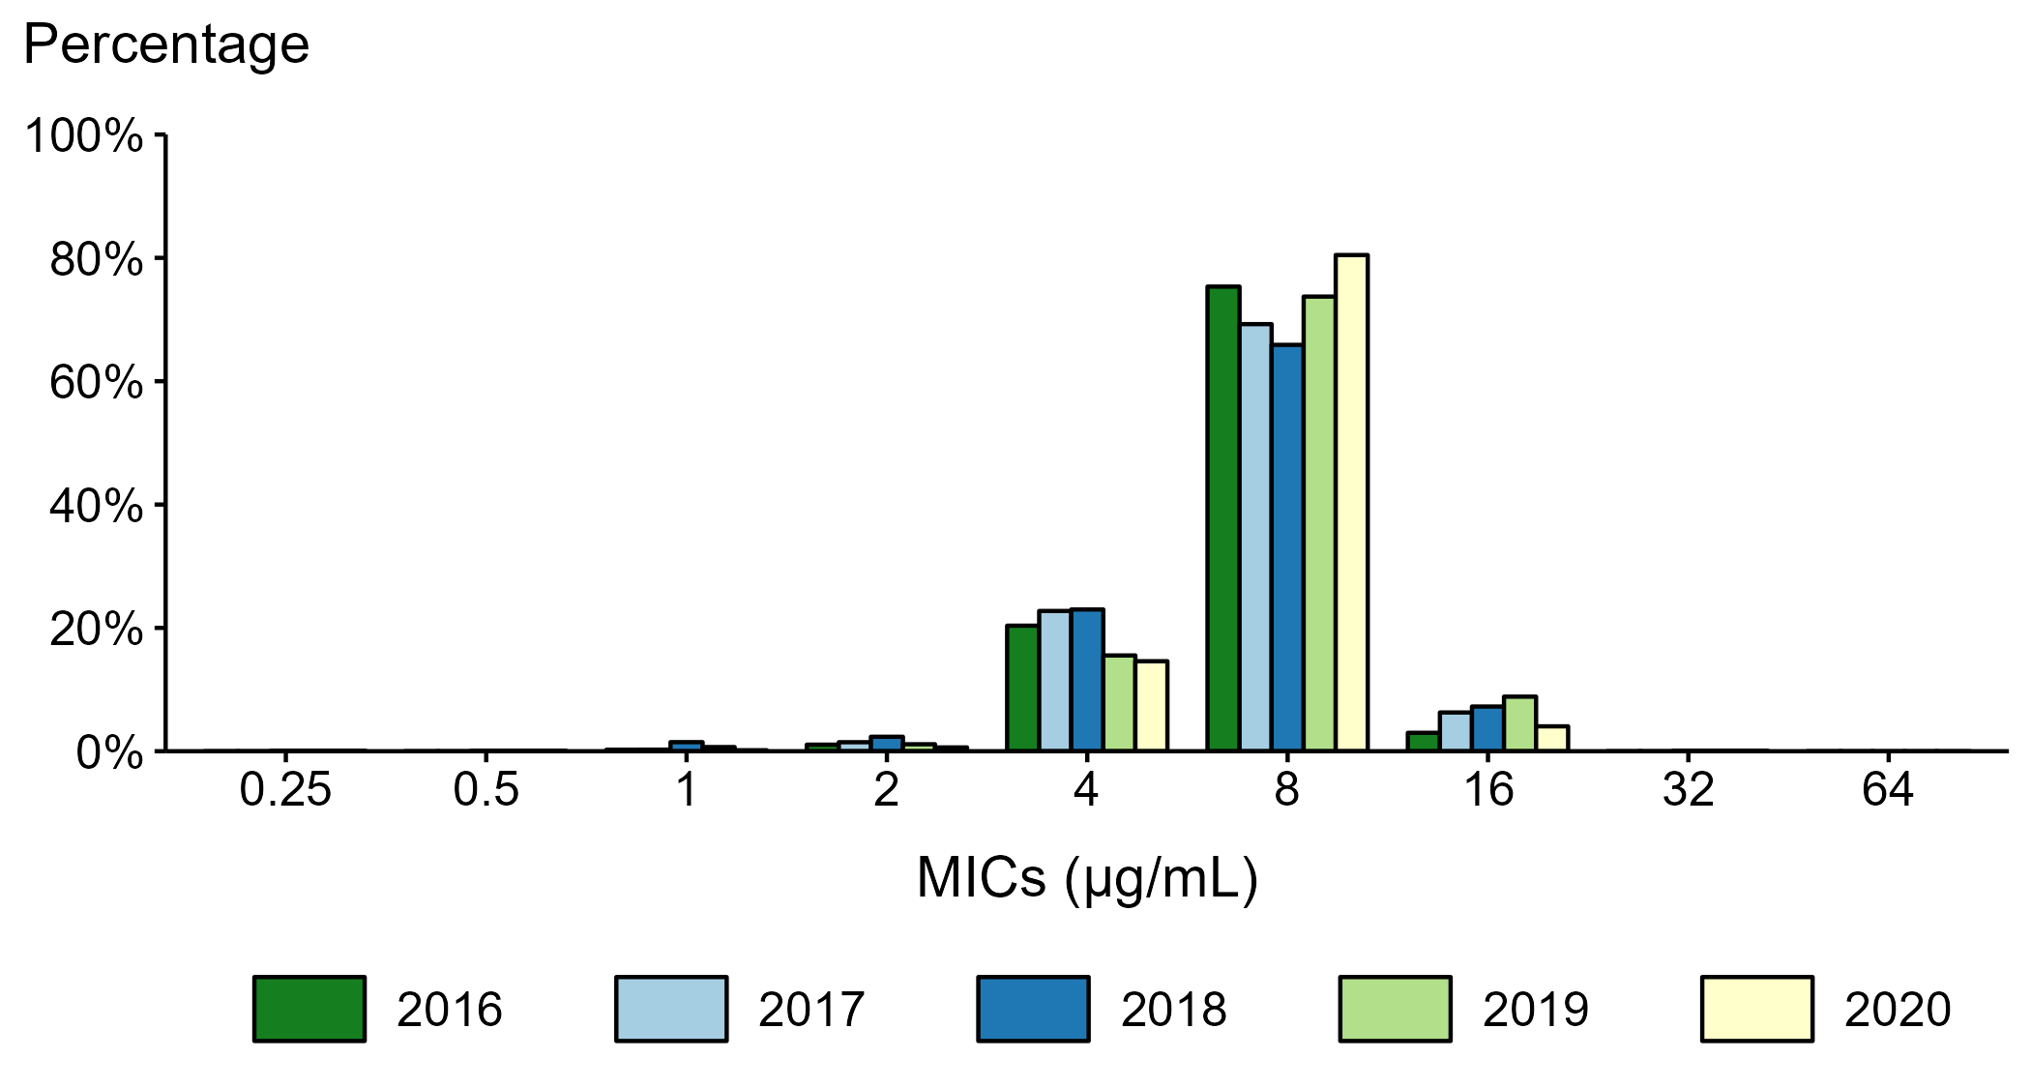
Neisseria gonorrhoeae — Distribution of Gentamicin Minimum Inhibitory Concentrations (MICs) by Year, Gonococcal Isolate Surveillance Project (GISP), 2016–2020
NOTE: Beginning in 2018, the antibiotic susceptibility testing range for gentamicin was expanded from MICs of 1 µg/mL–32 µg/mL in previous years to 0.25 µg/mL–64 µg/mL.
Notes:
During 2016 to 2020, 65.9–80.5% of all tested Neisseria gonorrhoeae isolates had a gentamicin minimum inhibitory concentration value of 8 µg/mL. In 2020, 0.03% of all tested Neisseria gonorrhoeae isolates had a gentamicin minimum inhibitory concentration above 16 µg/mL.
The COVID-19 pandemic has introduced uncertainty and difficulty in interpreting data collected in 2020. See Impact of COVID-19 on STDs (https://www.cdc.gov/std/statistics/2020/impact.htm) for more information.
See Technical Notes (https://www.cdc.gov/std/statistics/2020/technical-notes.htm) for information on GISP methodology.
Data points are available at: https://www.cdc.gov/std/statistics/2020/data.zip

Slide 28
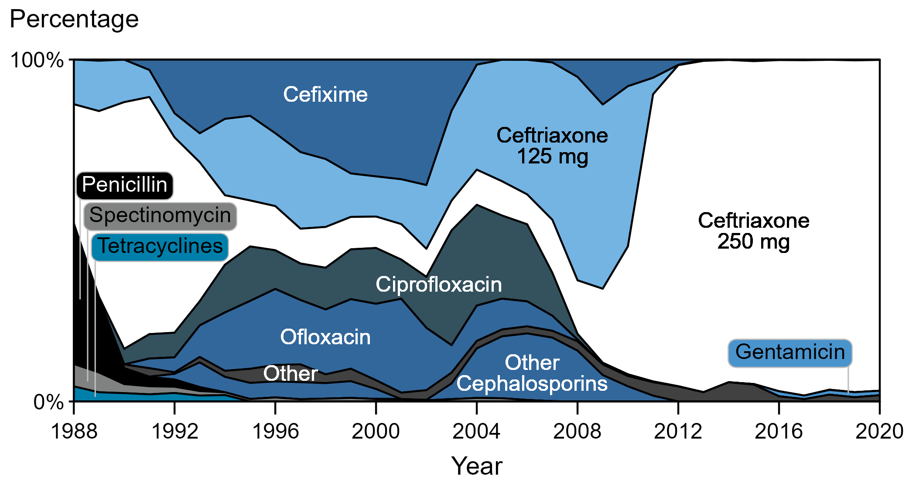
Distribution of Primary Antimicrobial Drugs Used to Treat Gonorrhea Among Participants, Gonococcal Isolate Surveillance Project (GISP), 1988–2020
Notes:
In 2020, 96.8% of GISP participants were treated with ceftriaxone 250 mg. Participants treated with gentamicin 240 mg increased from 0.2% in 2015 to 1.3% in 2020.
The COVID-19 pandemic has introduced uncertainty and difficulty in interpreting data collected in 2020. See Impact of COVID-19 on STDs (https://www.cdc.gov/std/statistics/2020/impact.htm) for more information.
See Technical Notes (https://www.cdc.gov/std/statistics/2020/technical-notes.htm) for information on GISP methodology.
Data points are available at: https://www.cdc.gov/std/statistics/2020/data.zip

Slide 29
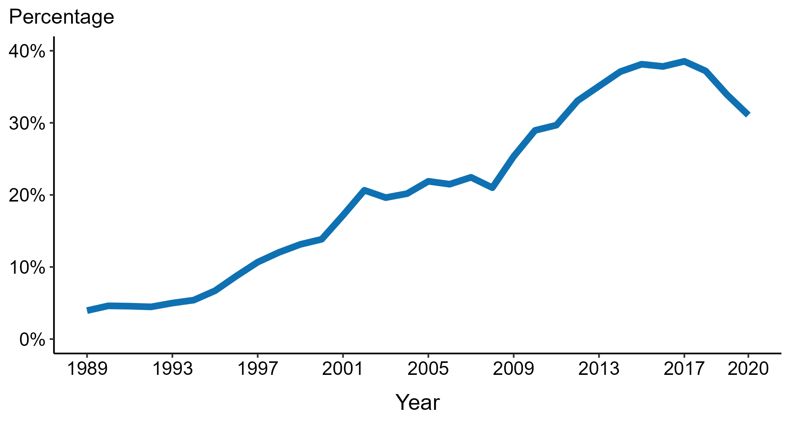
Neisseria gonorrhoeae — Percentage of Urethral Isolates Obtained from MSM Attending STD Clinics, Gonococcal Isolate Surveillance Project (GISP), 1989–2020
ACRONYMS: MSM = Gay, bisexual, and other men who have sex with men
Notes:
Overall, the proportion of Neisseria gonorrhoeae isolates collected in selected STD clinics participating in GISP that were from men who have sex with men increased steadily from 3.9% in 1989 to a high of 38.5% in 2017. In 2020, this proportion was 31.1%.
The COVID-19 pandemic has introduced uncertainty and difficulty in interpreting data collected in 2020. See Impact of COVID-19 on STDs (https://www.cdc.gov/std/statistics/2020/impact.htm) for more information.
See Technical Notes (https://www.cdc.gov/std/statistics/2020/technical-notes.htm) for information on GISP methodology.
Data points are available at: https://www.cdc.gov/std/statistics/2020/data.zip

Slide 30
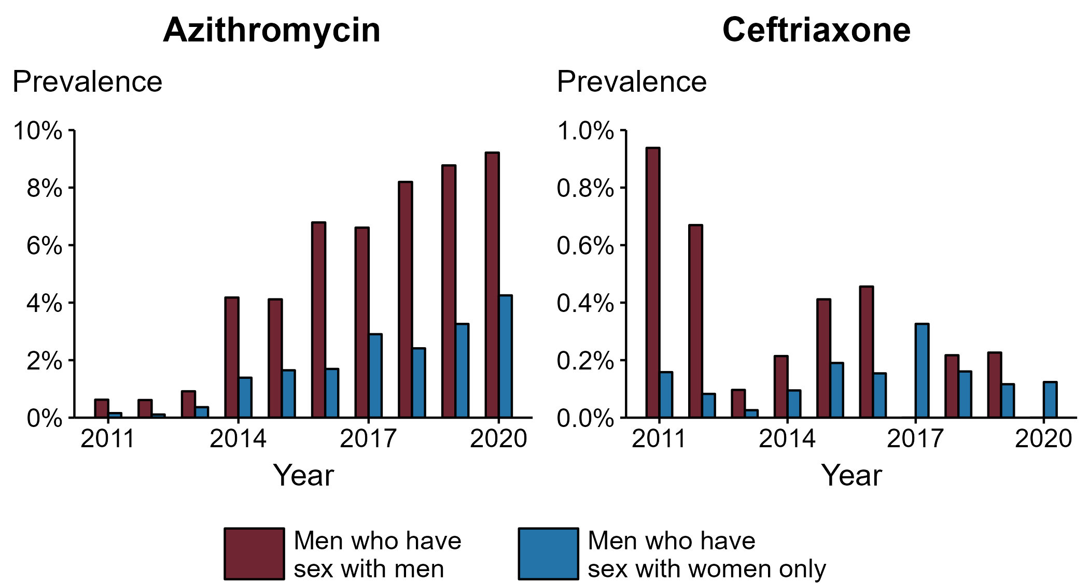
Neisseria gonorrhoeae — Percentage of Urethral Isolates with Elevated Minimum Inhibitory Concentrations (MICs) to Azithromycin* and Ceftriaxone† by Sex and Sex of Sex Partners, Gonococcal Isolate Surveillance Project (GISP), 2011–2020
* Elevated Azithromycin MIC: ≥ 2.0 µg/mL
† Elevated Ceftriaxone MIC: ≥ 0.125 µg/mL
Notes:
In 2020, the proportion of Neisseria gonorrhoeae isolates with elevated azithromycin minimum inhibitory concentrations (≥ 2.0 µg/mL) was higher in isolates from men who have sex with men than from men who have sex with women only. For azithromycin, 9.2% of isolates from men who have sex with men had elevated minimum inhibitory concentrations compared to 4.3% in men who have sex with women only. For ceftriaxone, the proportion of isolates with elevated ceftriaxone minimum inhibitory concentrations (≥ 0.125 µg/mL) was higher at 0.1% in men who have sex with women only compared to 0% in men who have sex with men.
The COVID-19 pandemic has introduced uncertainty and difficulty in interpreting data collected in 2020. See Impact of COVID-19 on STDs (https://www.cdc.gov/std/statistics/2020/impact.htm) for more information.
See Technical Notes (https://www.cdc.gov/std/statistics/2020/technical-notes.htm) for information on GISP methodology.
Data points are available at: https://www.cdc.gov/std/statistics/2020/data.zip

Slide 31
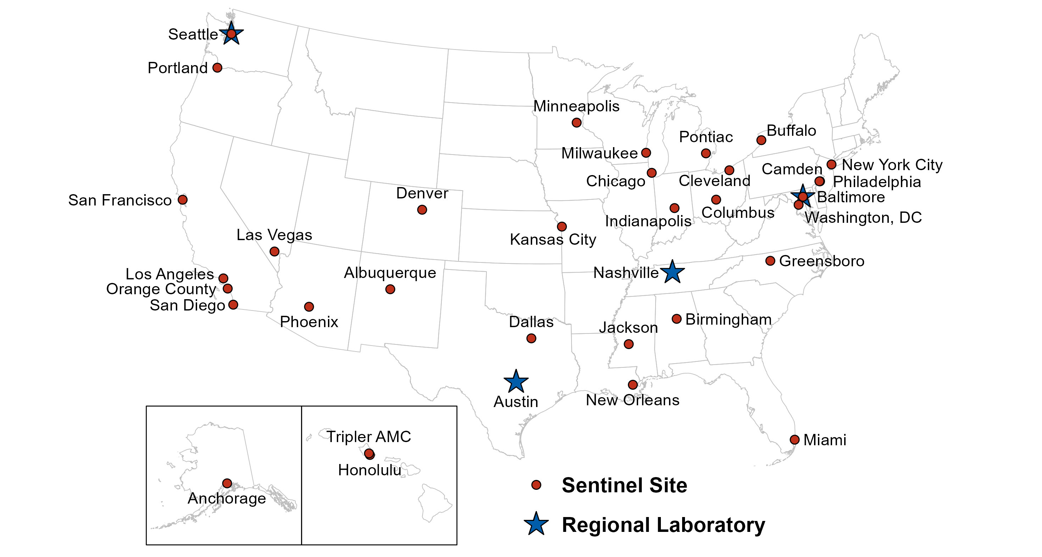
Location of Participating Sentinel Sites and Regional Laboratories, Gonococcal Isolate Surveillance Project (GISP), 2020
NOTE: Baltimore and Seattle are both sentinel sites and regional laboratories.
Notes:
See Technical Notes (https://www.cdc.gov/std/statistics/2020/technical-notes.htm) for information on GISP methodology.

Slide 32
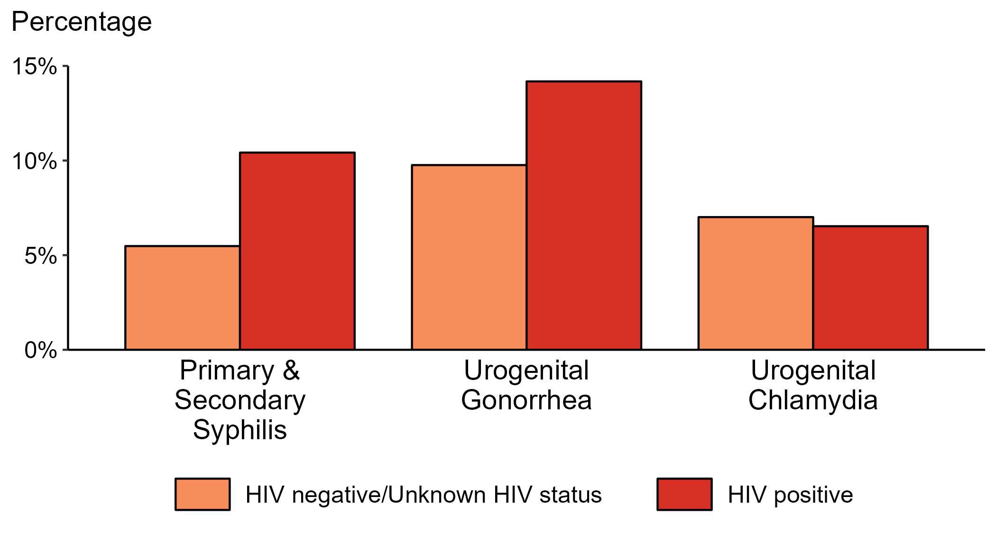
Proportion of MSM with Primary and Secondary Syphilis, Urogenital Gonorrhea, or Urogenital Chlamydia by HIV Status, STD Surveillance Network (SSuN), 2020
NOTE: Results are based on data obtained from patients in eight participating sites (Baltimore, Florida, Indiana, Multnomah County, New York City, Philadelphia, San Francisco, and Washington).
ACRONYMS: MSM = Gay, bisexual, and other men who have sex with men
Notes:
Among gay, bisexual and other men who have sex with men (referred to as MSM) attending participating STD clinics in the STD Surveillance Network, the portion diagnosed with primary and secondary syphilis was higher for those that were HIV positive compared with those not known to be HIV positive (10.4% versus 5.5%). The pattern was similar for urogential gonorrhea, with the proportion of testing positive higher among HIV-positive MSM compared with MSM not known to be HIV positive (14.2% versus 9.8%); however, the proportion testing positive for urogential chlamydia was similar (7.0% among HIV-positive MSM and 6.5% among MSM not known to be HIV positive).
For this figure, HIV status is categorized using documented in the clinic records (based on self-report or most recent HIV test result) or matched information documented in the jurisdiction’s HIV registry.
The COVID-19 pandemic has introduced uncertainty and difficulty in interpreting data collected in 2020. See Impact of COVID-19 on STDs (https://www.cdc.gov/std/statistics/2020/impact.htm) for more information.
See Technical Notes (https://www.cdc.gov/std/statistics/2020/technical-notes.htm) for information on SSuN methodology.
Data points are available at: https://www.cdc.gov/std/statistics/2020/data.zip

Slide 33
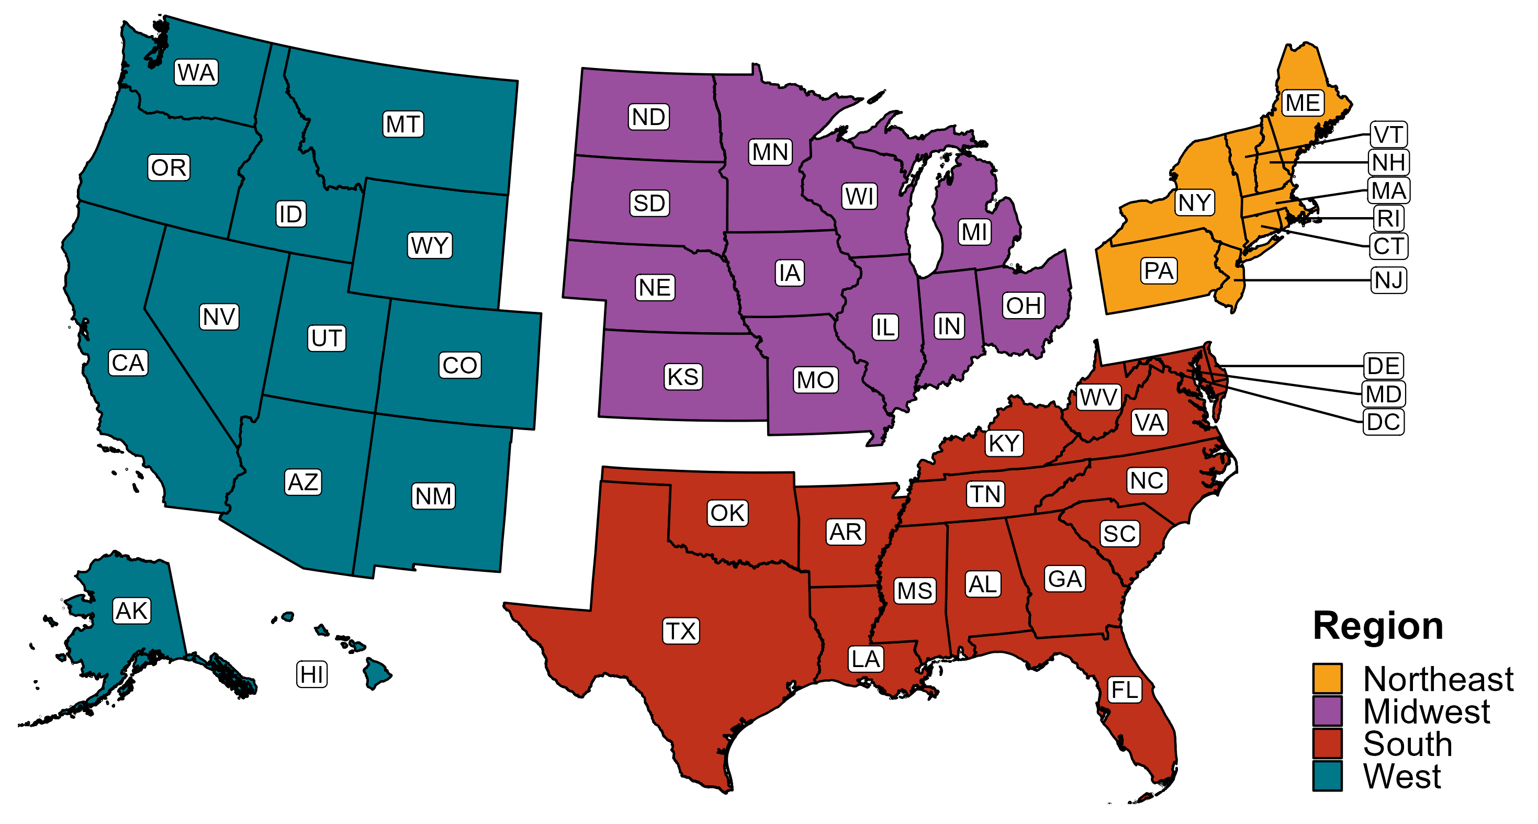
Reference Map of US Census Regions

