Slide 1
Orchestrating the Arts:
A Success Story Supporting Clinical Outcomes

Slide 2
Objectives…
Identify program characteristics to enhance resident engagement
Understand the role of the Arts on clinical outcomes
List the resident, staff and facility benefits of implementing Art programs
Discuss the types of evidenced based Art programs affecting quality of care at The Cedars
Operating for financial sustainability

Slide 3
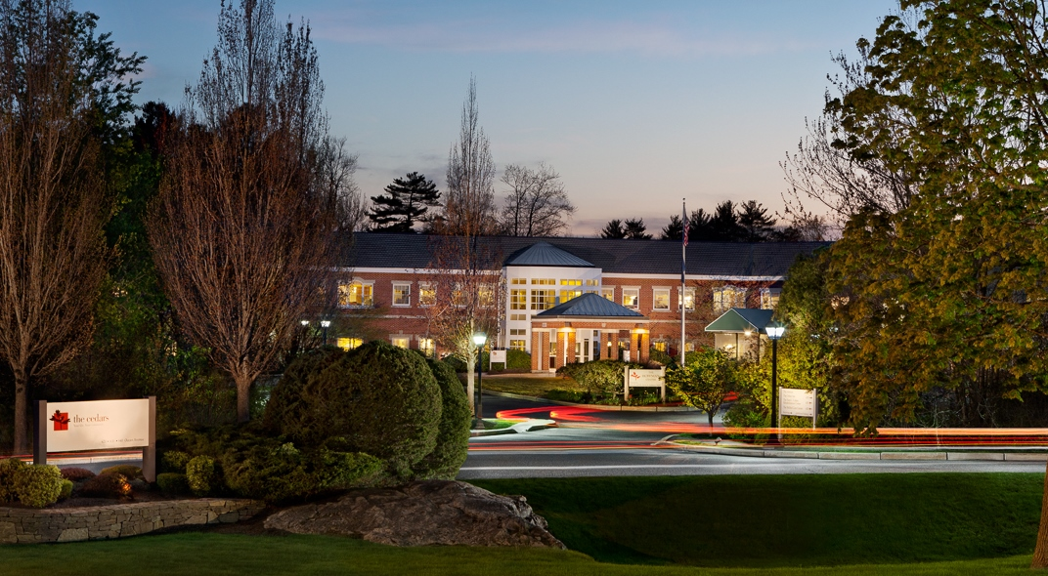
The Cedars: Who We Are…
The Cedars, a non-profit senior living community in Portland since 1929, offers independent living, assisted living, in-patient and out-patient rehabilitation, and skilled care.

Slide 4
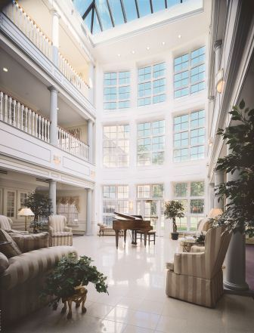
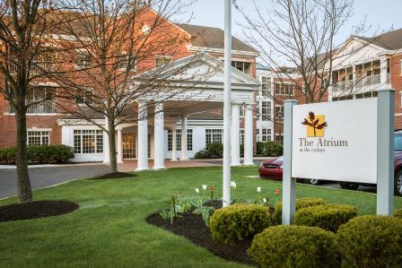
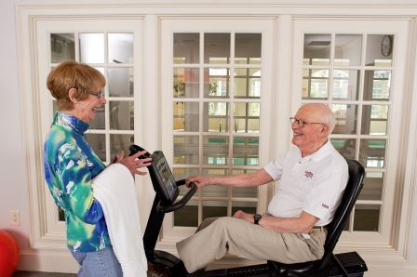
Senior Living Options: The Atrium…
Independent Living at The Atrium
  61 spacious apartments
  Wellness-focused amenities
  Priority access to healthcare services

Slide 5
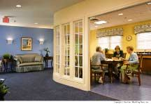
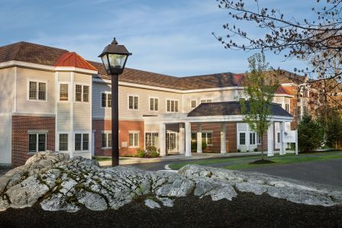
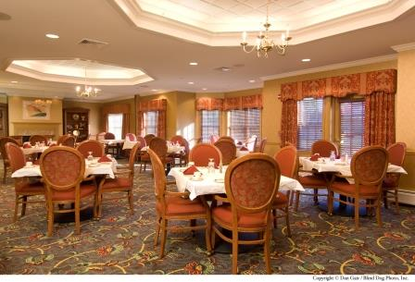
Senior Living Options: The Osher Inn…
Assisted Living at The Osher Inn
  30 private apartments
  Personalized assisted services
  24/7 personal support

Slide 6
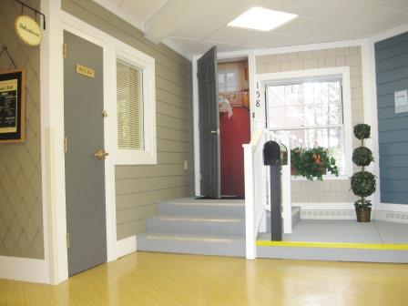
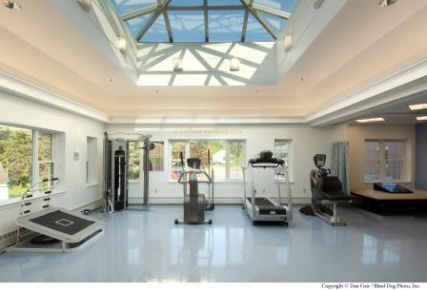
Rehabilitation at The Cedars…
State-of-the-Art Healing
820 Admissions
75% Community DC
Average LOS 15-21 Days

Slide 7
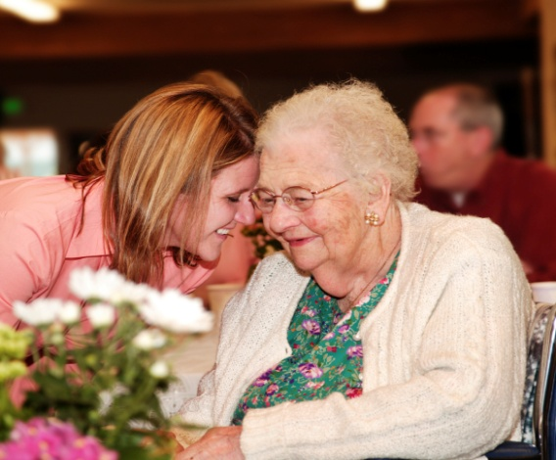
The Skilled Care Center: LTC…
Cherish your health
Stimulate your mind
Nurture our body
Cultivate your spirit

Slide 8
Drilling Down….
LTC:
  56% Census
  40.6% Dementia/Alzheimer’s Diagnosis
  38% Behavior Symptoms
  We Needed to Engage Residents with Behavioral Symptoms to Improve Clinical Outcomes

Slide 9
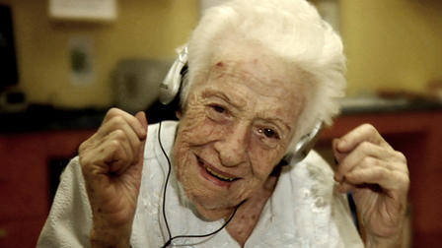
Our story begins…

Slide 10
It is The Cedars Belief….
Our values
  Person-Centered Approach to Care
    Choice
    Dignity
    Individuality: Sense of Self

Slide 11
Our Foundation….
Life stories
Spontaneous activities
  Individual and Small Group
Scheduled activities
Large group
Use of volunteers
Educational Institutions

Slide 12
Clinical Outcomes…
Antipsychotics: National, Regional, State Averages…
National: 22.8%
Regional: 23%
State Averages: 19.8%
The Cedars
8.8%

Slide 13
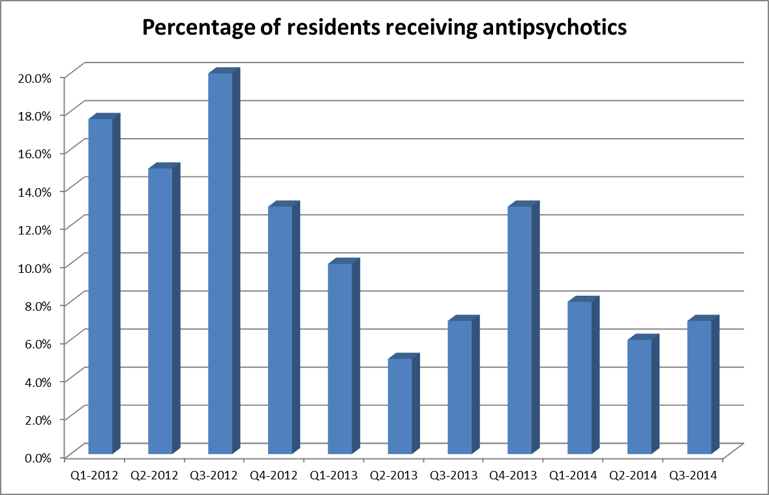
Our Journey….

Slide 14
2015 Percent Falls…

Slide 15
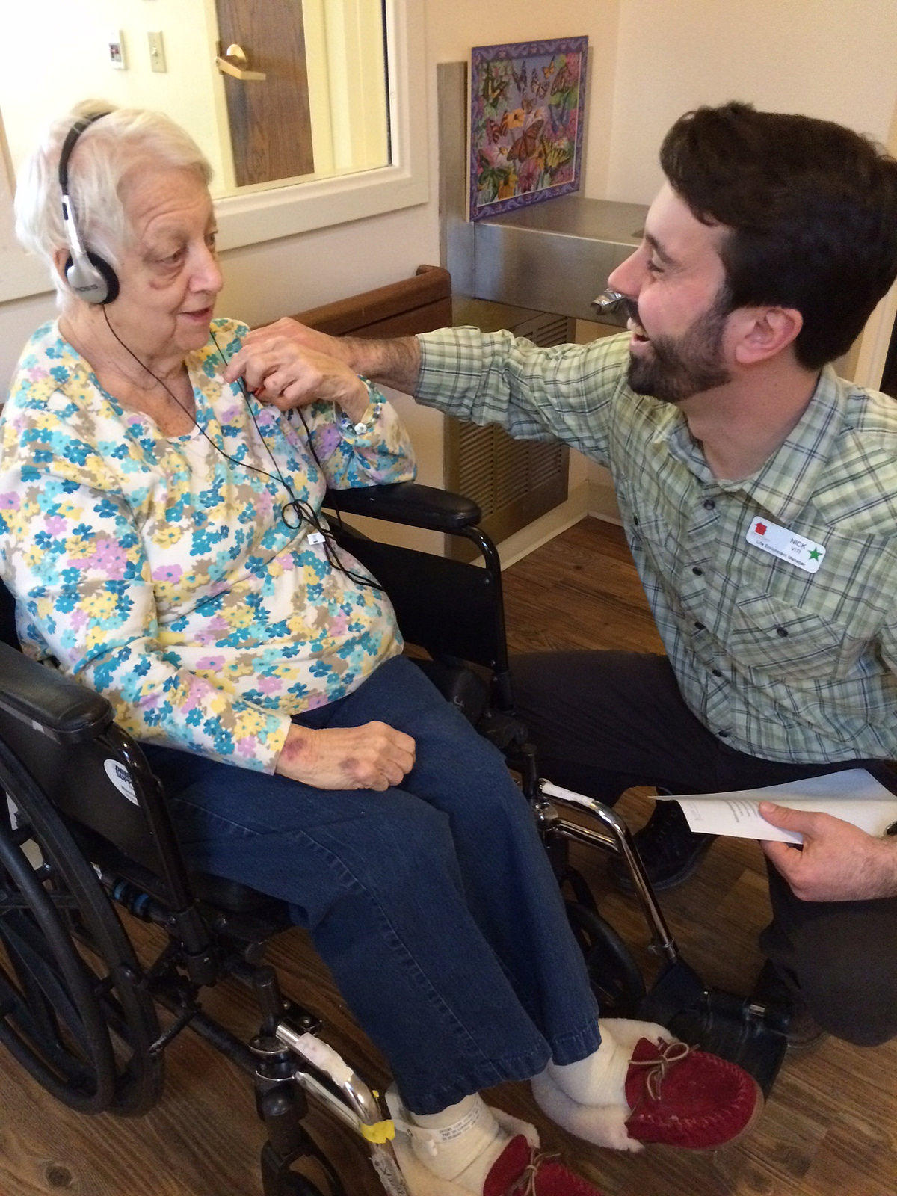
Engagement of the Arts…
Visual
Music
Movement Based
Writing
Drawing
Painting
All Have Positive
Clinical Outcomes….

Slide 16
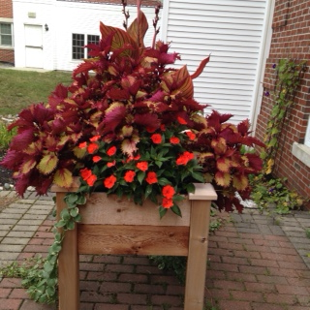
Supporting Resident Engagement
Unique Programing…
Flower program
  Very popular program
  Performed weekly
  Overseen by a florist
  Supported by activities fund
  Easy implementation
  Individual, small and large group settings

Slide 17
Arts & Technology….
Music and Memory Program
  Certification needed
  24/7 program
  Personalized music program using iShuffles
  Evidenced based program
  Easy to implement
  Relatively low cost: depends profit /not-for-profit
  http://musicandmemory.org/

Slide 18
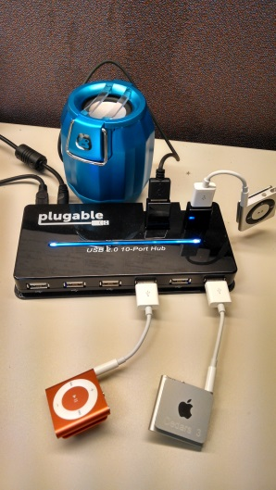
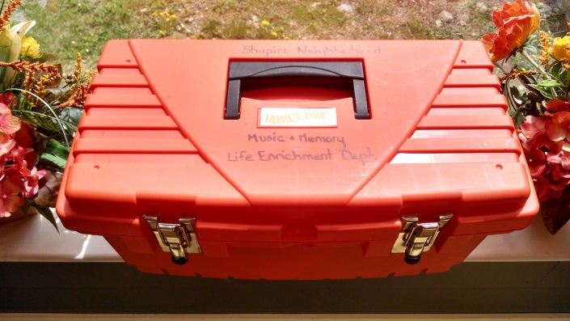

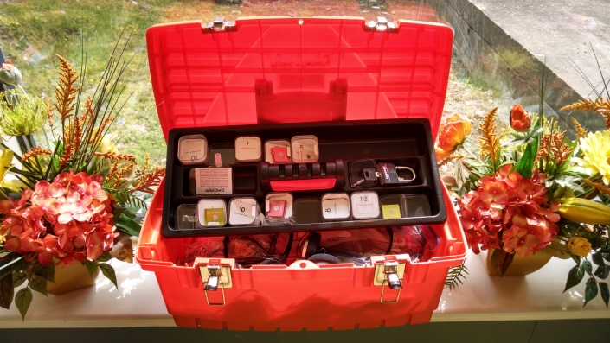
Equipment ….

Slide 19
Arts &Technology…
It’s Never 2 Late
  Makes technology and the internet accessible to all
  Adaptive hardware, software and content
  Easy to implement
  24/7 program
  Cost: $2,500/yearly
  Start-up cost: $10,000.00
  Can be used by Rehabilitation Therapy Department
  My page, social, cognitive, spiritual, physical
  http://www.in2l.com/

Slide 20
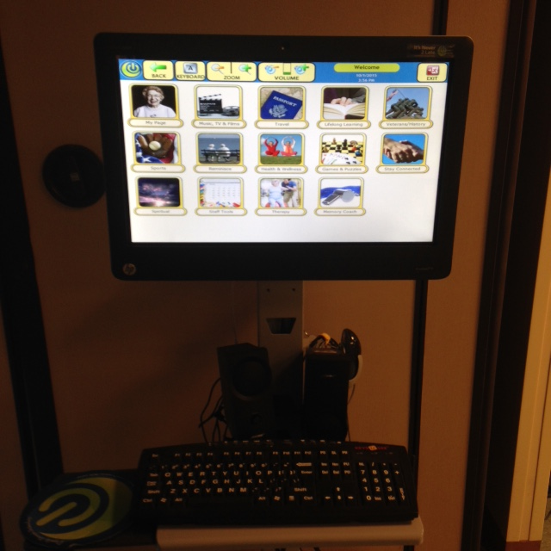
It’s Never 2 Late…

Slide 21
The Arts…
Opening Minds through Art
  Evidenced-based intergenerational program
  Certification needed : $500.00
  Visual art program: abstract art
  Developed by Scripps Gerontology Center at Miami University, Ohio
  Benefits: Expression, engagement, socialization
  Cost: Instructor $1,200.00, supplies $2,000.00
  Harder to implement
  http://www.scrippsoma.org/

Slide 22
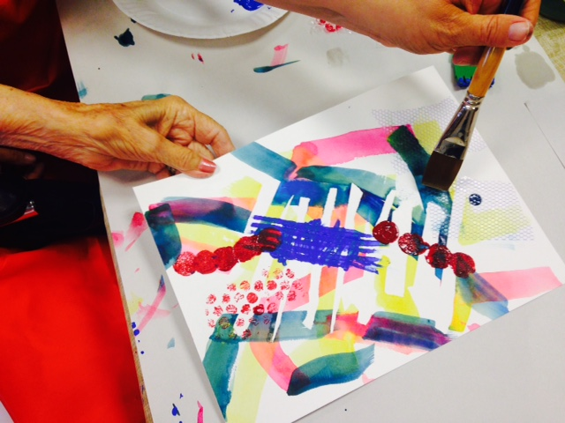
Opening Minds through Arts…

Slide 23
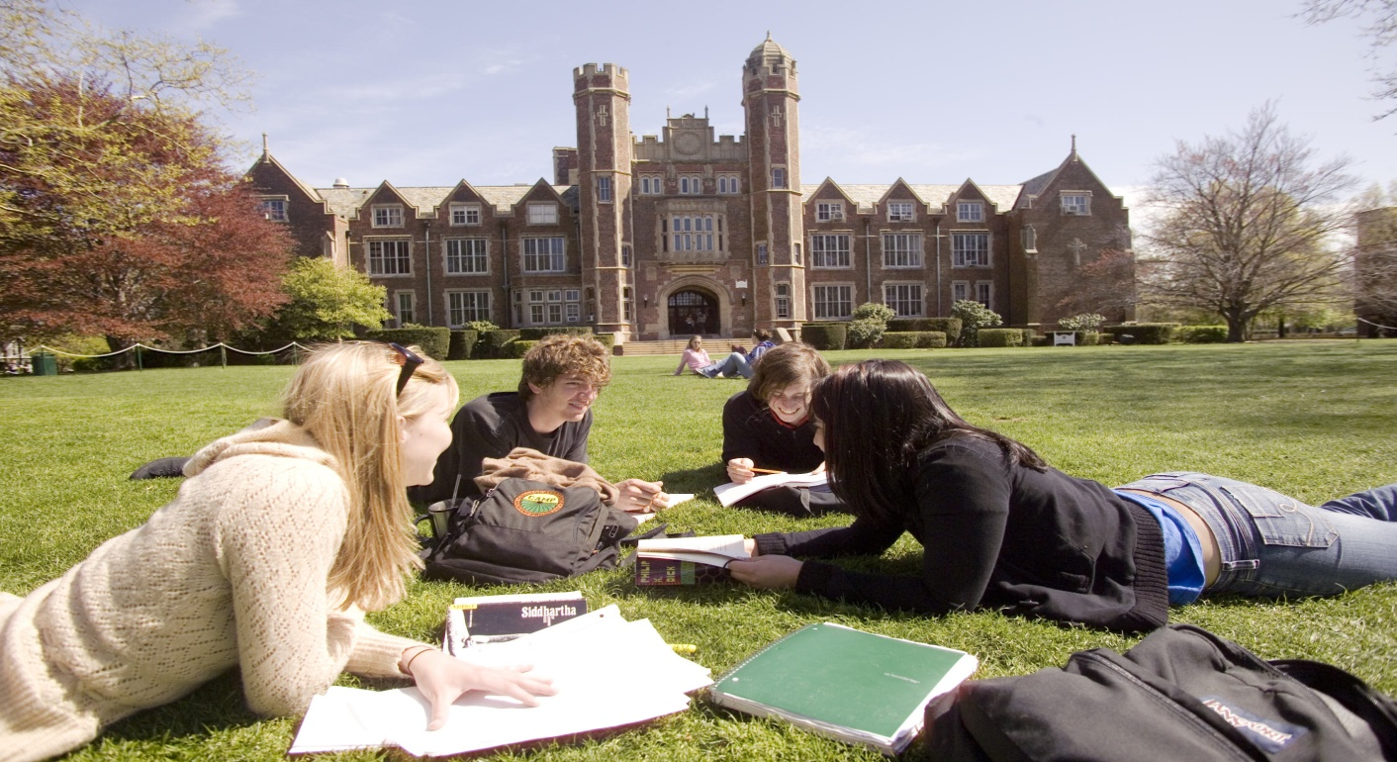
A Unique Partnership: University Support…
The Cedars will provide students a unique opportunity to spend time with other disciplines, preform a life history and medical record review, learn about geriatrics in an IL/AL/LTC setting, establish a relationship with an elder teacher and participate in The Cedars Opening Minds to the Arts program. The combination of classroom and experiential learning will provide the student with real life application and experience in the field of geriatrics. A three credit course.

Slide 24
Technology with the Arts…
Memory Lane TV
  Multi-sensory & interactive film collection
  Video, music, photography, recorded sounds and aromas
  Stimulate recollection, enhances socialization
  Easy to implementation
  24/7 intervention
  Requires some training
  Cost: $180 memory stick, sent boxes $300.00, plus TV
  ? Monthly subscription
  http://memory-lane.tv/

Slide 25

Memory Lane TV…

Slide 26
Resident Benefits: Improved Quality of Life…
Mood
  Decrease anxiety, agitation, depressive statements
Alertness
  Decreased somnolence
  Increased eye contact, ability to attend to task
  Engagement
    Decreased restlessness
    Singing, smiling
  Socialization
Conversation
  Reminiscence
  Positive Redirection
Activity
  Therapeutic exercise
  Self-feeding
Diversion
  Stable mood during increased activity in environment
  Bereavement
Identity
  Person-centeredness

Slide 27
Staff & Facility Benefits…
Staff
  Supportive environment
  Anticipating needs
  More efficient
  Strong relationships
Clinical
  Quality of Care: Antipsychotics/Falls
Facility
  Increase referrals
  Increase retention
  Better quality outcomes

Slide 28
Covering Costs…
Activities Fund
Art Show
Community Outreach Activities
  High Schools; ishuffles
Fund Raising Activities
  Auxiliary Support
  Individual Interest
University Support

Slide 29
Contact….
Angela Hunt, PT,MS
Chief Operating Officer/Administrator
ahunt@thecedarsportland.org
Questions

