Slide 1
Comprehensive School Physical Activity Program
Module 3: Communicating Success
Penelope Friday, MPH, CHES

Slide 3
Objectives
Describe the Whole School, Whole Community, Whole Child (WSCC) model and Comprehensive School Physical Activity Program (CSPAP) framework.
Articulate the connections between WSCC, CSPAP, national guidance and strategies and CSPAP plans.
Describe data points for and perceptions of CSPAP.
Showcase examples between current grantees of implementations

Slide 4
Reflection Activity
If CSPAP plans are conducted at the school level, what are ways that district-level staff and administrators can support schools to create such plans?
What are your current physical activity strengths and weaknesses as a corporation?
What are three things currently being done to connect CSPAP and WSCC models into the school environment?
After completing CSPAP Part One, what highlights were brought to your attention?
Notes:
***Recap CSPAP Part 1

Slide 5
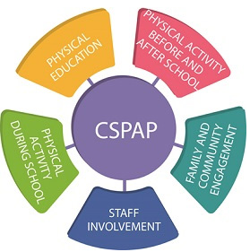
Healthy School Grantees
Fort Wayne: Virtual movement courses, PE requirement, built in movement breaks for elementary students
Huntington: Anyone Can Run program, 4H Wheels Club, active transportation
Hammond: Wellness coalition at each school, Playworks training for all recess supervisors

Slide 6
Healthy School Grantees
Invent Learning Hub: After school dance and sports clubs, Kids Dance Outreach and mindful movement for teachers
MSD of Warren: Physical activity is built into all staff meetings to increase active minutes, GoNoodle Plus

Slide 7

Physical Activity Without Funds
Playworks SEL Game Guide
School wellness coalitions
Wellness policy additions
Moving recess before lunch
“Active appreciation” opportunities for staff
Physical activity rewards for students
Movement before exams
Project based learning with physical activity

Slide 8
School Health Profiles
At the state and priority district level, data from the School Health Profiles can be used to assess the implementation of the process of CSPAP and the five components of CSPAP in schools. This data is collected every even year.

Slide 9
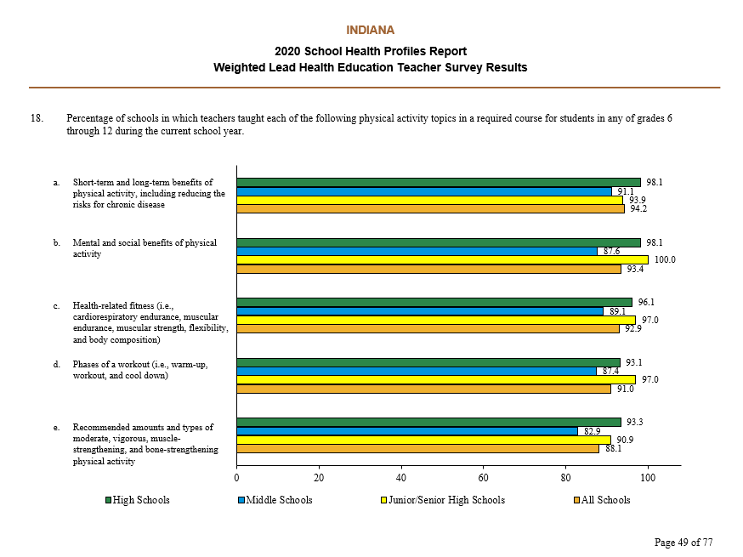

Slide 10
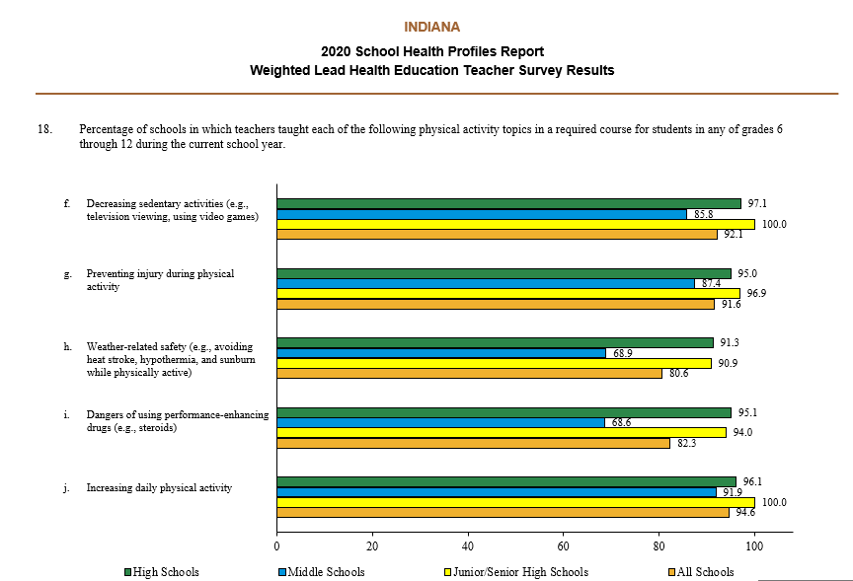


Slide 11
Assessment
High influence
Low interest
High influence
High interest
Low influence
Low interest
Low influence
High interest
Increasing active minutes
Professional development on physical activity in classroom
Training for recess supervisors

Slide 12
CSPAP Process
The CSPAP Process: Schools can use the following three-step process for CSPAP, which includes: development of a CSPAP, implementation of a CSPAP, and evaluation of a CSPAP.
1. Development of a CSPAP. This includes:
a. Establishing a team/committee and designate a PAL
b. Conducting a needs assessment (i.e., School Health Index)
c. Creating a vision, goals, objectives
d. Identifying intended outcomes
e. Developing a CSPAP plan (activities, grade level, scheduled time, location, facilitator, # students, cost, funding source, timeline)
2. Implementation of a CSPAP. Schools implement their CSPAP plan they developed in phase 1, which should align with and address the five components of a CSPAP.
3. Evaluation of a CSPAP. Schools evaluate the impact (process and outcomes) of their CSPAP plan they developed in phase 1.

Slide 13
CSPAP Development
Is there one or more than one group (e.g., a school health council, committee, or team) at your school that offers guidance on the development of policies or coordinates activities on health topics? Assessed the availability of physical activity opportunities for students*
Has your school ever used the School Health Index or other self-assessment tool to assess your school’s policies, activities, and programs in the following areas?
During the past year, has any school health council, committee, or team at your school done any of the following activities? Developed a written plan for implementing a Comprehensive School Physical Activity Program (a multi-component approach that provides opportunities for students to be physically active before, during, and after school)

Slide 14
Debrief the Data
How can this data help to tell a compelling story for you?
Are there pieces still missing from this data story?
With whom would this information resonate?

Slide 15
Policy and Structure Support
Two ways to garner support for CSPAP implementation at the school level is through policy and structural supports at the school, district, and state level.
CSPAP in their school improvement plans: In addition, states and districts can create structural supports for CSPAP by ensuring they have leadership (e.g., PE coordinator) for physical education and physical activity at these levels and by providing professional develop and technical assistance on these topics to schools.
Local school wellness policies can help guide schools on the practices they should implement to address physical education and physical activity.
Notes:
Two ways to garner support for CSPAP implementation at the school level is through policy and structural supports at the school, district, and state level.
In terms of policy, CSPAP or components of CSPAP can be included in the local school wellness policy. This policy can help guide schools on the practices they should implement to address physical education and physical activity.
As for structural supports, schools can include CSPAP or components of CSPAP in their school improvement plans. There are two questions on the School Health Profiles that address school improvements plans for physical education and physical activity [Question 2b-c. The Elementary and Secondary Education Act requires certain schools to have a written School Improvement Plan (SIP). Many states and school districts also require schools to have a written SIP. Does your school’s written SIP include health-related objectives on any of the following topics? (b) Physical education and (c) Physical Activity]. In addition, states and districts can create structural supports for CSPAP by ensuring they have leadership (e.g., PE coordinator) for physical education and physical activity at these levels and by providing professional develop and technical assistance on these topics to schools.

Slide 16
Batesville Case Study
“Physical Activity at the forefront of everything we do.”
Diversify activities so access and interest was never an issue
TEAM BATESVILLE running club to promote family and community engagement
Biggest barrier that continues to exist is the requirement of active minutes
Utilize your Physical Education Instructors to lead not just their classes, but ALL physical activity initiatives for school
Notes:
Tried to spend time with resources, money and
Student wellness involves many things like SEL
Nutriton and physical and are a constant through those 17 years
Key saying: PA is at the forefront of everything we
Good property, resources, equipment, at least ¼ mile track
Build in fundriasers instead o selling things (candy, bake sale, converted into walkathons)
JUMP rope for ropee
How to get families involved with family fitness night
Climbing walls, diversify and access was never a problem and approach
Recess: moved around recess, have it before lunch
Never taken away
Find ways to manage behavior
Families: create TEAM BATRESVILLE born from girls on the run, run a 5K over 9 weeks
Got whole community involved
Barriers were the start, enroll everyone as a curtiousy “:”Derby fest” , registration paperwork, took school buses from start to finish
LICENSED PE Instructors, institutionalize the effort, PE lead on wellness for student and staff, with them regular, sense of authority and
Barrier: walking buddies, walking school bus to address parent fears, distant might not be far, to get
Gap that will always exist: requirement of active minutes, we did not have enough PE time K-12, one time a week to one semester
Focused on how could we get to 150 minutes, get teachers trained to move during class, structured physical activity during
Put policy together

Slide 17
Presentation Tips
Use pictures
Highlight success stories + data
Customize it: colors, logos
Use other formats – video, Camtasia, webinar, etc.
Add quotes from superintendents, administrators
Add short video(s) within the PowerPoint
Add WSCC model and/or video from ASCD explaining model
Bring manipulatives (brain booster handout, etc.)

Slide 18
Resources
Physical Activity in the Classroom: https://www.cdc.gov/healthyschools/physicalactivity/pdf/17_278143-A_PE-PA-Framework_508.pdf
Every Kid Healthy Week: http://everykidhealthyweek.org/
Playworks Game Library: https://www.playworks.org/game-library/
Creating a wellness committee: https://www.cdc.gov/physicalactivity/worksite-pa/pdf/steps2wellness_employee_physical_activity_needs.pdf
Take a Break Guide: http://www.coloradoedinitiative.org/wp-content/uploads/2014/08/CEI-Take-a-Break-Teacher-Toolbox.pdf
Division of Nutrition and Physical Activity: https://www.in.gov/health/dnpa/
CDC CSPAP: https://www.cdc.gov/healthyschools/professional_development/e-learning/cspap.html
CDC CSPAP Guide: https://www.cdc.gov/healthyschools/physicalactivity/pdf/13_242620-A_CSPAP_SchoolPhysActivityPrograms_Final_508_12192013.pdf
CSPAP Presentation One: https://www.youtube.com/watch?v=CIK6mFPB_CA

Slide 19
Contact Information
Emma Smythe
Youth Physical Activity Coordinator
esmythe@isdh.in.gov
Lindsey Bouza
Division of Nutrition and Physical Activity Director
lbouza@isdh.in.gov

