Slide 1
Comprehensive School Physical Activity Program ​
Module 2: Classroom Physical Activity
​
Emma Smythe
Youth Physical Activity Coordinator

Slide 2
OUR MISSION:
To promote, protect, and improve the health and safety of all Hoosiers.
OUR VISION:
Every Hoosier reaches optimal health regardless of where they live, learn, work, or play.

Slide 3
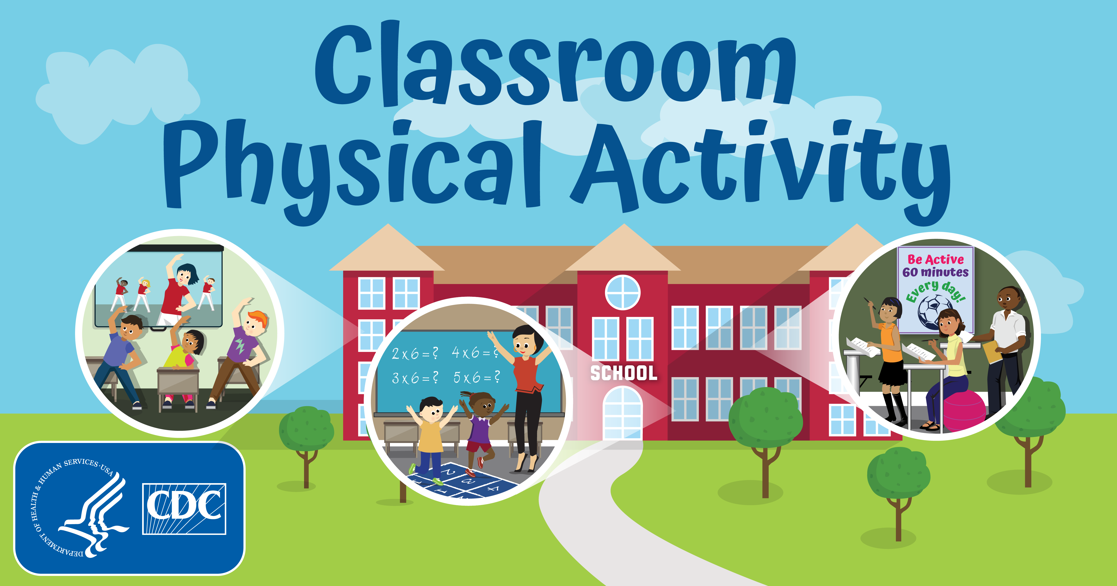
Objectives
Key Takeaways from CSPAP Part 1
Module Introduction
Classroom Physical Activity: Definitions
and Policies
Strategies for Classroom Physical Activity
Classroom Physical Activity Examples
What can you do?
Resources
Closing thoughts

Slide 4
Key Takeaways from CSPAP Part 1
Physical Activity (PA) is not just “one more thing” to do; it is proven to be an asset to the learning environment.
Utilize your community partners, other school staff, and health and physical educators to formulate what increasing PA minutes would look like in each building, before during, and after the school day.
Wellness policies are an opportunity to rebuild the language to align with health and wellness priorities and hold schools accountable for progress.
Schools can impact the overall health and wellness and behaviors in their students – at all ages, that will transcend into their adult lives.
To listen to the full one-hour CSPAP Part 1 presentation, click here: https://www.youtube.com/watch?v=CIK6mFPB_CA

Slide 5
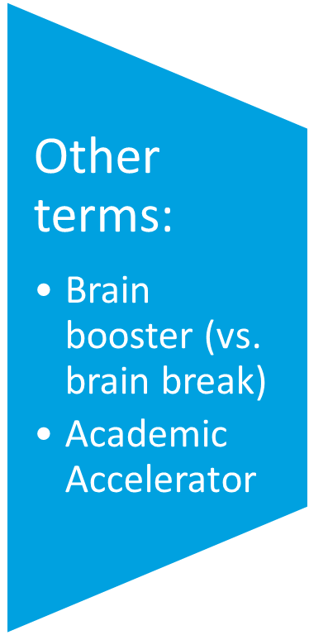


Definition of Classroom Physical Activity
Classroom PA includes any physical activity done in the classroom during the school day.
It includes:
    Activity during academic classroom instruction
    Breaks from instruction specifically designed for physical activity

Slide 6




Benefits of Classroom Physical Activity
As part of planned academic lessons:
  Improves academic achievement, attention-to-task behaviors, attentiveness
As part of physical activity breaks:
  Allows for mental/physical breaks from school tasks
  Brain can consolidate information → better retention and retrieval
  *When school staff model healthy behaviors, students are more likely to engage in healthy behaviors.
Notes:
Opportunities for physical activity should not be limited to the school’s gymnasium. Classroom activity breaks activate the brain, improve behavior and leave students more focused and ready to return to their academic activities. Classroom teachers should consider incorporating short physical activities into their lessons. Classroom energizers can be used as an opportunity to move or can link lesson content to the movement. The classroom layout can also be altered to add equipment that promotes physical activity while students learn, such as standing at their desk, using stability balls to sit on or having “walk and talk” school assignments or discussions.

Slide 7
National Guidance on Classroom PA (Proposed)
This guidance encourages schools to:
Develop a CSPAP that includes classroom PA
Use classroom PA as opportunities to reinforce skills taught during physical education
Incorporate physical activity into lesson plans and/or as breaks from academic subjects
Provide appropriate time for physical activity breaks (physical activity breaks can last up to 30 minutes, but are typically between 5-15 minutes long)
Ensure that barriers to performing classroom physical activity such as equipment and available space are minimized
Involve other teachers in the planning, development and/or selection of classroom physical activity materials and procedures
Notes:
National Guidance on Classroom PA document:

Slide 8

Considerations for Classroom PA
Classroom PA is implemented at the classroom level and depends on the support that teachers receive from school administrators, as well as their own buy-in and comfort level. Each classroom is unique, and one prescribed plan for classroom physical activity will not work in all classrooms.
Approaches will likely vary depending on factors such as the following:
Culture and context of the classroom and school
Goals of individual classes or courses
Preferences and comfort level of individual teachers
Enjoyment level and preferences of students
Resources, time, and spaces available
*Source: CDC, Strategies for Classroom Physical Activity in Schools

Slide 9





Draft Strategies for Classroom PA
Make leadership decisions
Communicate & enforce behavioral & safety expectations
Create a classroom environment supportive of PA
Engage the school community to support classroom PA
Gather information on classroom PA
Notes:
Now that we know the proposed recommended policies for classroom physical activity, we need to explore how to turn these recommendations into practice.
• CDC has proposed a set of evidence-based strategies for planning and providing classroom physical activity in schools.
• These 17 strategies are organized into 5 categories
o Make leadership decisions
o Communicate and enforce behavioral and safety expectations
o Create a classroom environment supportive of physical activity
o Engage the school community to support classroom physical activity
o Gather information on classroom physical activity
• These strategies are an integral part of classroom physical activity planning and should result in increased physical activity and improved behavior and engagement in the classroom.
• These strategies are still in draft form as part of an environmental scan on classroom PA from CDC.
• Although they are still in draft form, you can see that they are very similar to those strategies identified for recess.
• These strategies will eventually be finalized and included in a suite of resources similar to the ones CDC and SHAPE America created for recess

Slide 10
Strategy Questions
What resources have you or other partners used to address these strategies?
What successes have you experienced around implementing these strategies?
What challenges have you experienced around implementing these strategies?
What types of questions should school staff consider when addressing these strategies?
*Strategies are an integral part of classroom PA planning and should result in an increase in PA and improve student behavior and engagement.
Notes:
Before you execute strategies for Classroom PA, there are a few questions you, as apart of the school staff need to ask yourself

Slide 11
Elementary & Intermediate Levels
Short, three-to-five minute lessons incorporating learning and physical activity with no extra equipment needed.
Short, age-appropriate activities integrated into the classroom called Energizers. Examples are listed below:
    Sitting on exercise balls at their desks
    Starting the day with a dance party
    Creating a hallway obstacle course to complement a lesson plan
    Encouraging functional fitness such as running in place before a quiz
    Implementing a ‘yoga pose of the day’ after lunch
Resources:
    https://www.healthiergeneration.org/_asset/590hh0/10-1819_SecondaryClassroomPA.pdf
    https://wvde.state.wv.us/healthyschools/documents/resource_guide_interactiveFinal.pdf

Slide 12
Middle & Secondary Levels
Start slowly and have patience, but be persistent about encouraging movement in class
Ask for student input on what they would like to do for physical activity (PA) breaks; ask students to lead the classroom PA breaks
Use appropriate music that appeals to teens to encourage movement
Dance breaks; mindfulness & yoga
Create voluntary PA programs during lunch periods that could include capture the flag, walking the track, sports charades, obstacle courses, etc.
Integrate movement into your class content and subject areas – you could do any PA in any classroom environment
Resources:
  https://wvde.state.wv.us/healthyschools/documents/resource_guide_interactiveFinal.pdf
  http://www.coloradoedinitiative.org/wp-content/uploads/2014/08/CEI-Take-a-Break-Teacher-Toolbox.pdf

Slide 13
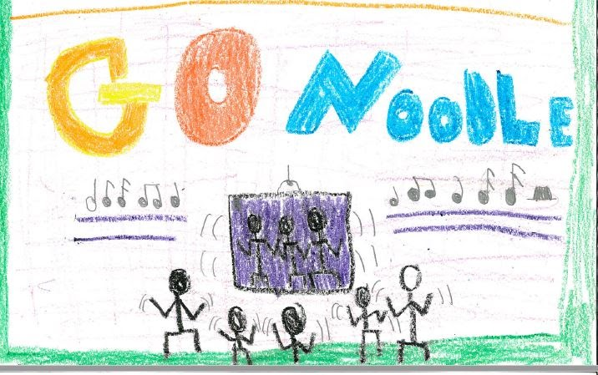
Success Story – GoNoodle Plus
“Indiana Department of Health,
First, when my class does GoNoodle, we get so energized. One time our class had to stay inside for recess all week, so we used GoNoodle to help get our wiggles out. Second, not everyone participates in GoNoodle, but we still have fun with those who do play. Last, we also like to do (GoNoodle) after or during an assignment and not just have to sit all the time. This is why me and my classmates love doing GoNoodle and getting our wiggles out.”
-Third Grade Indiana Student, Creekside Elementary School, Franklin Community School Corporation, Franklin, IN

Slide 14
What Can Teachers Do?
Encourage physical activity by joining students on the playground or in the gym
Talk about physical activities you like to do outside of school
Send home activity ideas that families can do together
Do not use or take away physical activity as a form of punishment
Use opportunities for physical activity as a reward
Notes:
Safety considerations are integral to the planning and implementation of daily physical activity
for students. Create a schedule/calendar to stay on track and committed to incorporating PA during classroom time

Slide 15
What Can Teachers Do Cont…
Take short physical activity breaks in between classroom lessons
Incorporate more active time during physical education class
Educate students about the benefits of lifelong physical activity
Incorporate age-appropriate opportunities for physical activity into core subject matter courses such as nature walks for science class and jumping activities for math class
Design a classroom that encourages more physical activity

Slide 16
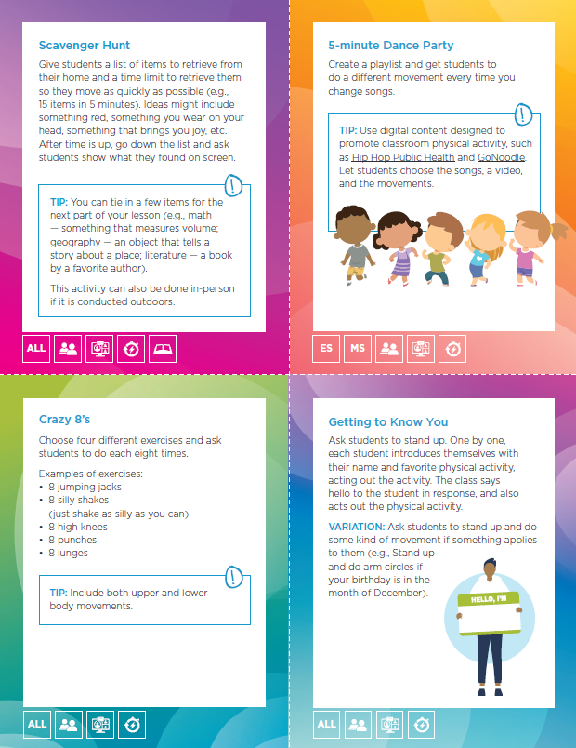
Classroom PA Videos
Crazy 8’s Energizer – Springboard to Active Schools Video (1 min. 39 sec.):
https://www.youtube.com/watch?v=QKhEcFKuNmw
Up Down, Stop, Go - Springboard to Active Schools Video (1 min. 30 sec.):
Energizer: Up, Down, Stop, Go (Opposites) - YouTube

Slide 17
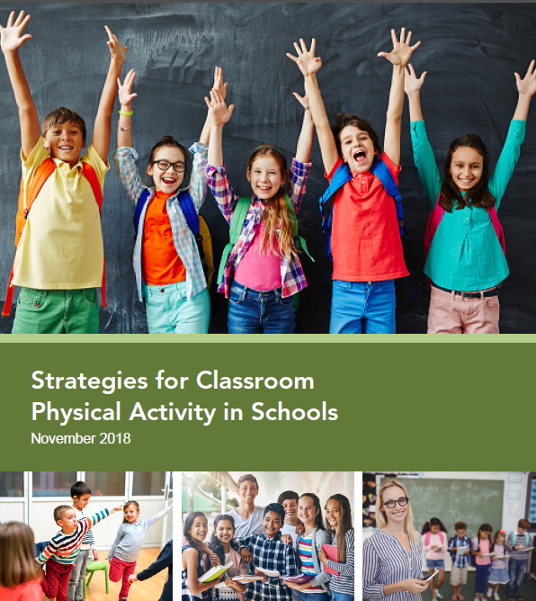
Classroom PA Webinar Recordings
Integrating Movement into Your Math Lesson Webinar Recording (1/2 hour): https://schoolspringboard.org/resources/webinar-integrating-movement-into-your-math-lessons/
Integrating Movement into Your Language Arts, Science, and Social Studies Lessons Webinar Recording (1/2 hour): https://schoolspringboard.org/resources/webinar-integrating-movement-into-your-language-arts-science-and-social-studies-lessons/

Slide 18
Resources
Strategies for Classroom Activity in Schools: This CDC document describes 10 evidence-based strategies for promoting and planning for classroom physical activity. https://www.cdc.gov/healthyschools/physicalactivity/pdf/2019_04_25_Strategies-for-CPA_508tagged.pdf
Playworks SEL Game Guide: This game guide will teach kids social and emotional skills to practice in a classroom, gym, or outside. The skills chosen were developed by well-known SEL frameworks and the on-the-ground impact seen across schools around the country. Sel-game-guide-download
Exploring Empathy Through Physical Activity: Tips on supporting better communication and conflict resolution and building relationships rooted in trust. https://www.actionforhealthykids.org/activity/exploring-empathy-with-physical-activity/
Classroom Physical Activity Ideas & Tips: Tips for teachers on how to effectively engage students in active learning and printable sheets of easy-to-use and adaptable activity/energizer cards for different grade levels and learning settings (in-person vs. virtual).
Classroom Physical Activity Ideas & Tips https://schoolspringboard.org/resources/classroom-physical-activity-ideas-and-tips/
http://www.coloradoedinitiative.org/wp-content/uploads/2014/08/CEI-Take-a-Break-Teacher-Toolbox.pdf
Erika’s Lighthouse: A suite of programs designed to allow educators to empower teens with an introduction to mental health, depression-literacy, help-seeking and what it takes to promote good mental health. Focused on grades 4-12. https://www.erikaslighthouse.org/

Slide 19
Closing Thoughts
What do you want your “classroom climate” to look like?
What do you want your students to learn from classroom PA?
Not every student will not want to participate – be flexible, adapt, provide options, and encourage
Safe environment, empowerment, self-confidence, calmness, focus, and retention
Real life application
Notes:
In closing, you have the resources, guidance, and ideas – now go apply it!

Slide 20
Contact Information
If you or your school has any questions or comments, please contact the Division of Nutrition and Physical Activity:
Emma Smythe
Youth Physical Activity Coordinator
ESmythe@isdh.in.gov
Lindsey Bouza
Director
LBouza@isdh.in.gov

