Slide 1
Comprehensive School Physical Activity Program (CSPAP)
Communicating Success
10/1/2020

Slide 2
OUR MISSION:
To promote, protect, and improve the health and safety of all Hoosiers.
OUR VISION:
Every Hoosier reaches optimal health regardless of where they live, learn, work, or play.

Slide 3
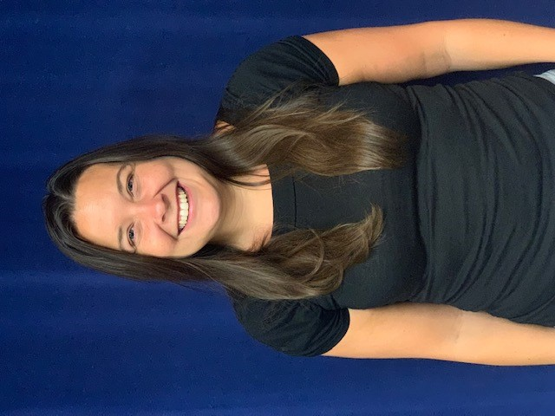
Introduction
Emma Smythe Penelope Friday
Youth Physical Activity Coordinator Childhood Obesity Prevention Coordinator
Division of Nutrition and Physical Activity

Slide 4
Comprehensive School Physical Activity Program
Action item planning for the strengths and weaknesses around movement during the school day
Learning forum about best practice implementation for physical activities
Key stakeholder engagement session designed to self-assess current gaps in activity levels
Opportunity to utilize movement as a complement to learning by constructing a sustainability proposal
Notes:
-Purpose of training
-History of CSPAP
-Overview
***Give details and credit to Shape America/CDC for being leaders in CSPAP development
PF

Slide 5
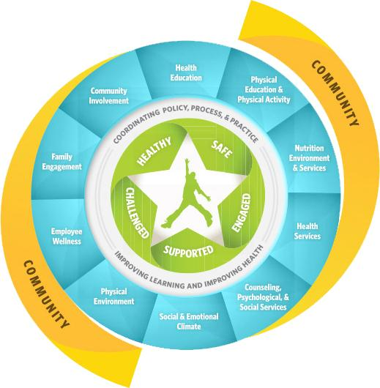
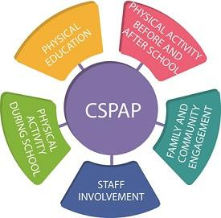
WSCC and CSPAP Models
Notes:
Schools play a vital role in ensuring children and adolescents get the nationally recommended 60 minutes of physical activity each day. Through the Whole School, Whole Community, Whole Child (WSCC) model, schools can provide many opportunities for students to be physically active. The WSCC model includes physical education and physical activity and the Comprehensive School Physical Activity Program (CSPAP) is a framework for planning and organizing activities this component.
Five Youth Tenants: Health, Safe, Engaged, Supported, Challenged
PF
PA=physical activity

Slide 6
Seven Steps to Develop a CSPAP
Establish a team and designate a Physical Activity Leader
Conduct a needs assessment
Create a vision, goals and objectives
Identify intended outcomes
Develop your CSPAP plan
Implement
Evaluate
Notes:
PF

Slide 7
How physically active are Indiana’s youth?
According to 2015 Youth Risk Behavior Survey (YRBS) data (Indiana did not receive weighted data in 2017 or 2019):
Only 25.3% are physically active for the recommended 60 minutes/day
Only 28% of adolescents attend daily physical education classes in an average week
29% of adolescents watched television three or more hours per day on an average school day (screen time should be <2 hours per day)
Notes:
The Youth Risk Behavior Surveillance System (YRBSS) monitors six categories of health-related behaviors that contribute to the leading causes of death and disability among youth and adults, including—
Behaviors that contribute to unintentional injuries and violence
Sexual behaviors related to unintended pregnancy and sexually transmitted diseases, including HIV infection
Alcohol and other drug use
Tobacco use
Unhealthy dietary behaviors
Inadequate physical activity
YRBSS also measures the prevalence of obesity and asthma and other health-related behaviors plus sexual identity and general sexual behaviors.
***plug for 2020-2021 year
ES

Slide 8
Childhood Obesity in Indiana
1 in 3 Hoosier children ages 10-17 are overweight or obese (33.9%)
Indiana is ranked 9th in the nation for childhood overweight and obesity
In comparison to all neighboring states, Indiana has the highest rate
CDC released new data:
Indiana’s adult obesity rate increased from 33.6% to 34.1%
Notes:
An essential component of a healthy lifestyle
Plays a crucial role in preventing chronic diseases
Builds strong bones and muscles
Increases physical fitness
Promotes positive mental health
Improve engagement and academic achievement
Power of Play!
Health equity and inclusion
ES

Slide 9
Benefits of Quality Physical Education During School
Gives students the knowledge and skills to participate in a lifetime of PA
Teach, mentor, and support youth to become physically active at an early age
Teaches skill development - needed for safe and fun play/movement
Provides a wide range of developmentally appropriate activities
Supports other school subject areas - learning retention
Provides a foundation to help children socialize successfully and the opportunity to learn positive people skills
Develops a sense of self-worth, confidence, and independence
Gives the opportunity to set and reach goals
Notes:
An essential component of a healthy lifestyle
Plays a powerful role in preventing chronic diseases
Builds strong bones and muscles
Increases physical fitness
Promotes positive mental health
Improve engagement and academic achievement
ES

Slide 10
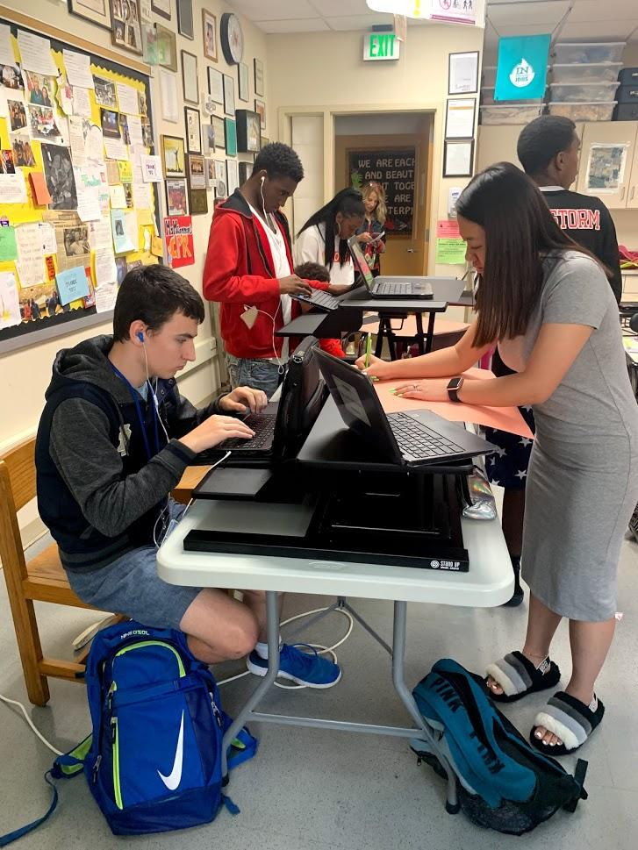
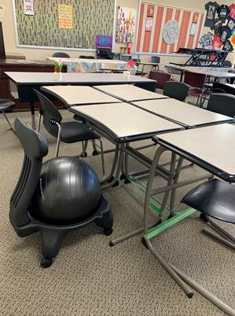
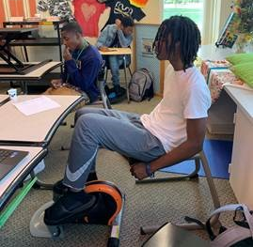
Warren Central High School Testimonial
Having physical activity equipment in the classroom has been a lifesaver! The stand up desks, under desk peddlers, ellipticals, and fidget desk bands were in high demand once we purchased them. The equipment also served as an outlet for our students. When other teachers in our building saw the movement classrooms in action, they wanted a piece of the action! The value and benefits of having physical activity in the classroom was witnessed from other teachers and our administration.”
-Candy Handy-Ogle, Physical Education/Department Chair, Warren Central High School, Indianapolis, IN (WCHS received funding from the Greater Indianapolis YMCA, Indiana State Department of Health, Division of Nutrition and Physical Activity’s 2018 Youth Adolescent Physical Activity Grant to purchase kinesthetic equipment for their behavioral risk classrooms)
Notes:
ES

Slide 11
Stages of Play
Unoccupied Play (Birth-3 Months): At this stage baby is just making a lot of movements with their arms, legs, hands, feet, etc. They are learning about and discovering how their body moves.
Solitary Play (Birth-2 Years): This is the stage when a child plays alone. They are not interested in playing with others quite yet.
Spectator/Onlooker Behavior (2 Years): During this stage a child begins to watch other children playing but does not play with them.
Parallel Play (2+ Years)
When a child plays alongside or near others but does not play with them this stage is referred to as parallel play.
Notes:
Play is serious learning
How enter K and then we expect sitting which actually alters the synapses
Link article
PF

Slide 12
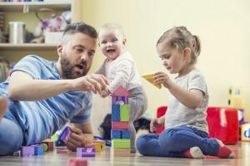
Stages of Play
Associate Play (3-4 Years)
When a child starts to interact with others during play, but there is not a large amount of interaction at this stage. A child might be doing an activity related to the kids around him, but might not actually be interacting with another child. For example, kids might all be playing on the same piece of playground equipment but all doing different things like climbing, swinging, etc.
Cooperative Play (4+ years)
When a child plays together with others and has interest in both the
activity and other children involved in playing they are participating
in cooperative play.
Notes:
When do you ever enjoy sitting for long periods of time?
DNPA: practice what we preach, educators don’t have luxury of this.
PF

Slide 13
Recess Guidance
Provide all students in kindergarten through 12th grade with at least 20 minutes of recess daily (or a similar daily period of physical activity).
Prohibit the replacement of physical education with recess or the use of recess to meet time requirements for physical education policies.
Provide schools and students with adequate spaces, facilities, equipment, and supplies for recess.
Ensure that spaces and facilities for recess meet or exceed recommended safety standards.
Notes:
Manipulative play: fine motor control
Large muscle: skip, jump, hop, pedal
https://www.cdc.gov/healthyschools/physicalactivity/pdf/Recess_Data_Brief_CDC_Logo_FINAL_191106.pdf
https://www.cdc.gov/healthyschools/physicalactivity/recess.htm
Recess planning template
Big body play
PF
NOT MANDATED

Slide 14
Recess Guidance Cont…
Prohibit the exclusion of students from recess for disciplinary reasons or academic performance in the classroom.
Prohibit the use of physical activity during recess as punishment.
Provide recess before lunch.
Provide staff members who lead or supervise recess with ongoing professional development.
Notes:
PF

Slide 15
Building a School Recess Plan
A school recess plan identifies the strategies a school will use to organize and implement recess at a school.
Helps with accountability, tracking physical activity during recess, and documenting the impact of recess
Can be shared with all school staff, students, and parents.
For more information, visit:
https://www.cdc.gov/healthyschools/physicalactivity/pdf/2016_12_16_CustomizableRecessPlanningTemplate.docx
Notes:
Youth spend only 20% of their waking hours in school
How they invest the other 80% transforms their lives, especially for youth living in under-resourced communities
Afterschool programs, otherwise known as out-of-school time (OST) programs offer a wide range of hands-on learning and enrichment opportunities beyond school hours that prepare children and youth for success in school, work, college and life
PF
Assessment/evaluation of PEPA
https://www.cdc.gov/healthyschools/physicalactivity/recess.htm
Assessment/evaluation - recess planning template and r

Slide 16
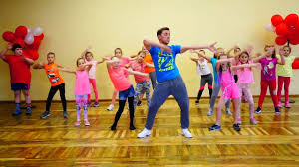
In-School Examples
Morning dance party or Zumba for elementary students where students earn the role of “party starter”
Explorers club that merges creativity with walking for middle schoolers
Reward high school students with physical activity opportunities such as capture the flag or walking the track
Notes:
PF

Slide 17
Physical Activity Before and After School
The hours leading up to the start of the school day and after school are an opportune time to get kids moving and showcases the importance of living a healthy lifestyle in different ways other than participating in sports (all ages and grades)
Examples:
Walking laps in the gymnasium or school hallways
Instructor-led group movement activities - yoga and mindfulness, Zumba; encourage walking/biking to school - safe routes to school
Free play in the school gymnasium or on the playground
Notes:
According to the Center for Disease Control (CDC), 61.5 percent of children ages 9-13 do not participate in any organized physical activity outside of school hours and 22.6 percent do not engage in any type of physical activity during free time (Afterschool Alliance). ES
Less behavior Issues and less students tend to “act out”
Releases stress, anxiety, depression they may experience at their home environment/living situation (outside of school hours)
Students come to class more enthusiastic, attentive, and ready to learn

Slide 18
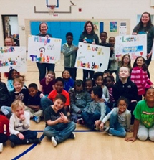
Afterschool Program Success Story – G.O..A.L.
Get on Board Active Living (G.O.A.L.) Program:
Afterschool program geared towards elementary aged youth focusing on increasing physical activity minutes and learning nutrition and healthy eating habits
YAPA grantee for the past five years
Program’s current reach is ~1,500 elementary age students per school year
50 college students each school year are trained to teach the program at each site
Expanded program to Lafayette, Bloomington, Indianapolis & surrounding communities
Testimonial: “The college student leaders did an amazing job keeping things fun and interactive for students. The curriculum they used was amazing in the sense that it was not always “sit down and listen”; it was a good balance of both sitting and being up and active. All my students were so excited to go to Get On Board Active Living (GOAL) each week. I could tell the kids were learning new information because they were teaching it to me!” - Get On Board Active Living (G.O.A.L.) After School Program Coordinator, Indianapolis, IN
Notes:
The GOAL initiative was developed 10 years ago by IU Health Bloomington Hospital with the goal of providing health education to local youth and families and equipping them with the knowledge, skills, and confidence to build healthy and active lifestyles. They have been able to triple the number of elementary age students that participate in the after-school program each year and quadruple the number of college students who engage as leaders in this program!
ES

Slide 19
Afterschool Fights Crime
Notes:
In Indiana, juvenile crime peaks from 10 p.m. to 2 a.m. with 30 percent of school-day incidences recorded at that time. About 17 percent of all juvenile crime on school days falls during the hours following the last school bell from 2 to 6 p.m.
The crime peaks not occurring from 2 to 6 p.m. are largely due to much of law enforcement in those states recording youth criminal activity as having all occurred at only one hour during the day, often noon or midnight. This would artificially inflate the crime rate for that time period.
*Source: Council for a Strong America 2019 data
ES

Slide 20
Brainstorm Session
Are you maximizing partnerships?
What does this look like with physical activity?
How are you encouraging families to incorporate physical activity at home?
What are the challenges? What has been successful for you - personally and professionally?
Notes:
Community:
What are some organizations that you know of that cater to youth? How have you leveraged this resource in your own work? Using their information or resources, collaborating on events, training, etc.
Jump IN, Playworks, Lifesmart Youth, Indy Youth Sports
Family:
How are you encouraging families to incorporate physical activity at home?
Eat dinner together
Modeling good lifestyle choices
Limiting technology usage, especially during meals, family time, outdoor play
Get active together! Dance, workout videos, clean the house, go for walks, garden, go to the park
Cook healthy meals together!
Turning challenges into successes
PF

Slide 21
Staff Involvement
Critical role of modeling physical activity and kinesthetic teaching
Improves work culture by promoting movement and awareness of each other’s wellness journey
Provide staff with access to physical activities through staff wellness plans
Intentional habit building for educators such as walking meetings or indoor walking trail
Celebrate physical well-being, rather than utilizing language and behaviors physical activity seem like punishment
Utilize physical activity as a coping and self-regulation strategy
Notes:
Do you want to include anything in relation to your healthy school grant goal/focus/etc to have the participants follow and be more engaged? Make them understand WHY they need this training and why was it required? Perhaps this could be at the beginning of the presentation
-culture versus climate
Discussion: What policies/programs/initiatives exist in your school that may not be fully utilized to is potential to improve staff overall health and wellness?
PF

Slide 22
Non-Food Rewards
Rewarding kids with food, even healthy food, encourages kids to eat when they may not be hungry and can lead to poor eating habits.
Younger students:
Be “Super Kid of the Day”
Dance to favorite music
Lead group activities
Share a favorite object or photo
Receive a trophy or ribbon
Older students:
Win tickets to events
Receive free gear (t-shirt, frisbee, wristbands, etc.)
Gift cards
Receive a positive note from the program staff or director
For more information, visit Maine Health’s Toolkit pg. 95-104
Notes:
Why should schools provide physical activity programs?
• Children who are physically active receive physical and mental health benefits.
• Comprehensive school-based physical activity programs can help children meet most of their physical activity needs by encouraging physical activity in a multitude of settings and in a variety of ways.
• School-based physical activity programs benefit communities as well as students and schools.
Any teacher can do to promote and advocate for PA (examples)-before/after school
ES

Slide 23
Wellness Policy Opportunities
Expand community partnerships to link out-of-school programs that promote physical activity
Establish social norms such as morning movement over the intercom
Encourage collaboration between health services, health educators and physical education instructors with other staff members
Assess, inspect and maintain areas where physical activity occurs
Provide educational resources on movement in all languages utilized by families
Quantify active minutes during the school day and work towards 30
Notes:
Pull notes and key phrases from Edu. Wellness Toolkit
Alignment of policy and practices around dimensions of wellness
Team effort and not just on the shoulders of the Food Service Director
PE Silo, when in fact they are creative people who can “spice” up lesson plans with movement
SMART Goals for increasing PE/PA
https://www.cdc.gov/healthyschools/wscc/infographics/SHB-WSCC-Integrating-PE-PA_th-508.pdf
DNPA review and consult on your current policy
PF

Slide 24
Resources
Educator Wellness Toolkit -coming soon!
CDC guidelines for PA/PE
The Council for a Strong America: https://www.strongnation.org/articles/938-the-prime-time-for-juvenile-crime-in-indiana
Indiana Afterschool Network: https://www.indianaafterschool.org/
DNPA website: https://www.in.gov/isdh/20060.htm
COVID-19/virtual resources? TBD
Youth Adolescent Physical Activity Grant (YAPA) information -https://www.in.gov/isdh/28327.htm
Healthy Schools Toolkit 2nd Edition: https://www.in.gov/isdh/files/2018%20Healthy%20Schools%20Toolkit.pdf
Healthy Schools Newsletter - sign up here: https://www.surveymonkey.com/r/B5HWT3F
CDC Step by Step Guide: steps.aspx
CDC One Pager: https://www.cdc.gov/healthyschools/wscc/infographics/SHB-WSCC-Integrating-PE-PA_th-508.pdf
Notes:
ES

Slide 25
Big 5 Takeaways:
PA is not just “one more thing” to do. It is proven to be an asset to the learning environment.
Altering systems in place around movement will take time. Utilize your community partners, health and physical educators to formulate what increasing active minutes would look like each building
PA is a component of the WSCC Model and is an all-encompassing practice for social-emotional learning
Wellness policies are an opportunity to rebuild the language to align with health and wellness priorities, and hold schools accountable for progress
Schools are in a position to impact the health behaviors of children that transcend into their adult lives
Notes:
PF

Slide 26
Completion Survey
Please confirm your attendance by completing this 5-minute survey! Thanks for joining us!
https://www.surveymonkey.com/r/F2TP8N3
Contact Information:
Penelope Friday at Pfriday@isdh.in.gov
Emma Smythe at ESmythe@isdh.in.gov
Notes:
ES

